Slide 1
Recent activities of OCR-VC
Committee on Earth Observation Satellites
François Montagner (EUMETSAT) on behalf of
OCR-VC: Ewa Kwiatkowska (EUMETSAT), Paul DiGiacomo (NOAA), Craig Donlon (ESA)
CEOS WGCV-44
EUMETSAT, Darmstadt, Germany
28 – 31 August 2018

Slide 2
Ocean Color Radiometry-
Virtual Constellation

Slide 3
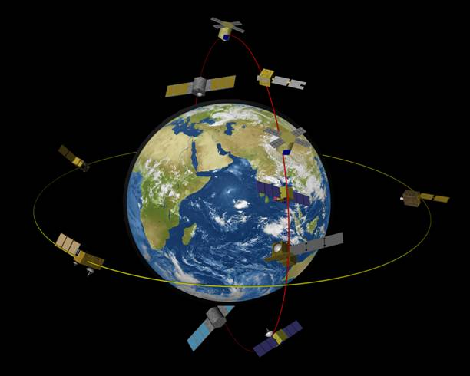
Ocean Colour Radiometry
Virtual Constellation (OCR-VC)
Established by IOCCG through CEOS to provide a long time series of calibrated ocean colour radiances from measurements obtained from multiple satellites
Goals of the OCR-VC
To ensure the continuity of the ocean colour time series for (i) Climate, (ii) Operational services, and (iii) Marine ecosystem health
To provide high quality data sets through a concerted inter‐agency effort organized by the OCR-Implementation Team and based on the White Paper “International Network for Sensor Inter-comparison and Uncertainty Assessment” (INSITU-OCR)
Data harmonization for CDRs, Operational services, Marine ecosystem health
Facilitate timely and easy access to data
Capacity building and outreach
All space agencies on the IOCCG Committee contribute
to the OCR-VC

Slide 4
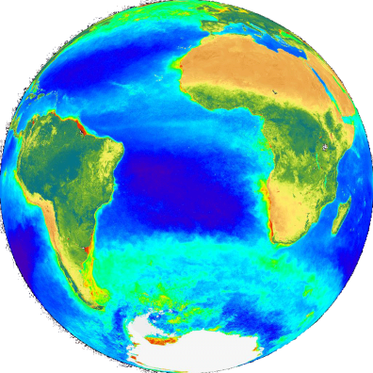
INSITU-OCR White Paper
INSITU-OCR White Paper
White Paper recommendations
space sensor radiometric calibration, characterization and temporal stability
development and assessment of satellite products
in situ data / FRMs measurements
information management and support
 | Recommendations
Space Sensor Radiometric Calibration, Characterization and Temporal Stability | R1.1 Comprehensive pre-launch instrument calibration/characterization
 | R1.2 Open access to calibration and characterization data
 | R1.3 Permanent working group on satellite sensor calibration
 | R1.4 Vicarious calibration
 | R1.5 Support for calibration teams
 | R1.6 Assess and correct for instrument degradation
Development and Assessment of Satellite Products | R2.1 Distribution of calibrated and uncalibrated data
 | R2.2 Permanent working groups on algorithm topics
 | R2.3 Product uncertainties
 | R2.4 Regional bio-optical algorithms
 | R2.5 Open access to source codes for processing algorithms
 | R2.6 Long-term field measurement programs
 | R2.7 Validation protocols
 | R2.8 Level-3 data products generation
 | R2.9 Ancillary data
 | Recommendations
In Situ Data / Fiducial Reference Measurements | R3.1 Improving traceability of in situ measurements
 | R3.2 Continuous consolidation and update of measurement protocols
 | R3.3 Uncertainty budgets
 | R3.4 Quality Assurance of in situ data
 | R3.5 Archival of in situ data
 | R3.6 Community processor for in situ data
 | R3.7 Priority for variables to be collected
 | R3.8 General coordination of field campaigns
Information Management and Support | R4.1 Accessibility and distribution of large volumes of data
 | R4.2 Processing capabilities for calibration and validation activities
 | R4.3 Accessibility to documentation
 | R4.4 Data formats
 | R4.5 Support for open source data processing and visualization

Slide 5
OCR on-going CalVal activities
System Vicarious Calibration
Coordinated cross-agency activities:
NASA – completing 3-year/US$8M investment in first phase of SVC development, 3 projects (UV-SWIR)
ESA – FRM4SOC SVC workshop in Feb 2017
ESA – FRM4SOC radiometry protocols under IOCCG review, final workshop 4-5 October 2018
NOAA – continuous operations of MOBY
NOAA – MOBY Technology Refreshment on-going
JRC – peer-review publications in support of OC-SVC requirements
EUMETSAT – “Requirements for Copernicus OC-SVC Infrastructure” under IOCCG review
EUMETSAT – “Preliminary design of Copernicus OC-SVC Infrastructure” to be started soon
R1.4
Task Force on Satellite Sensor Calibration
Collaboration on space instrument accuracy and stability to maximize the quality of OCR data records
regular coordination at IOCS meetings
interest in WGCV/GSICS lunar model development activities
R1.3, 1.1, 1.5, 1.6

Slide 6
Further OCR on-going activities
Coordination of In Situ Measurement Protocols
Coordination, revision and development of in situ measurement protocols
R3.1, 3.2, 3.3, 3.4
Geostationary OCR capabilities
Support and promotion of geostationary activities:
KIOST-GOCI –first demonstration geoOCR benefits
Early geoOCR activities at various agencies
Looking for coordination with other VCs for mission requirements and science harmonization
R2.2, 2.4
Exploration of measurements beyond the passive radiometry
R2.2, 2.4
Coordinated cross-agency activities on examining advantages of other measurements for aquatic biological, biogeochemical, and ecological retrievals
White Papers in preparation:
Lidar
Polarimetry
Looking for coordination with other VCs for observational/mission requirements and science harmonization
e.g. atmospheric communities (aerosols and clouds)

Slide 7
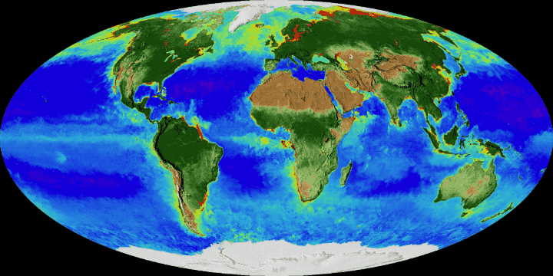
OCR-VC Questions?

