Slide 1
Linkage with recent AC-VC activities
CEOS WGCV Plenary # 44
EUMETSAT, Darmstadt, DE
August 28-31, 2018

Slide 2
AC-VC Linkage
Recent interaction with CEOS AC-VC
Participation in AC-VC-13 in 2017/06 at CNES (Paris)
Participation in AC-VC-14 in 2018/05 at NOAA (College Park)
ACSG members contribute validation support to cross-agencies harmonization efforts in all AC-VC key topics
Contribution to protocols facing new data validation challenges:
AC-VC/WGCV formulation of Geophysical Validation Needs for the GEO-AQ Constellation (Lead B. Veihelmann)
Interaction on new AQ validation challenges
Contribution to white paper on GHG constellation (Lead D. Crisp)
Advances in error assessment of ozone trend estimates in SPARC LOTUS and WMO O3 Assessment 2018

Slide 3
AC-VC Meeting May 2018

Slide 6
AC-VC Linkage
SPARC activities (www.sparc-climate.org)
LOTUS, OCTAV-UTLS and TUNER follow-on SPARC/IO3C/IGACO-WMO/NDACC (SI2N) on changes in ozone profile trends
ACSG related:
Harmonization of retrievals, data reporting, calibration issues
Calculation and expression of uncertainties
Issues of data comparisons and merging
Feedback on reference measurement networks (FRM)
Uncertainties on trend assessments (single-/multi-mission, L2/L3…)
Validation of L3 and higher level products (C3S relevance)

Slide 7
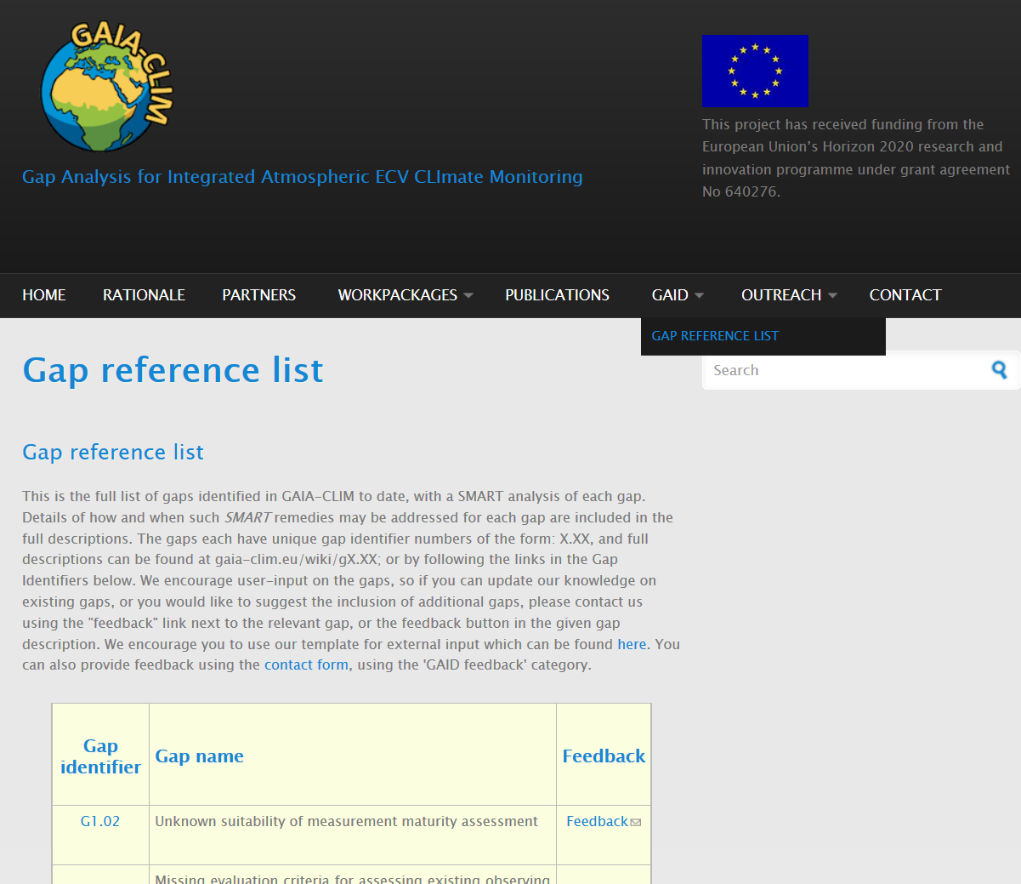
AC-VC Linkage
GAIA-CLIM Gap Analysis and Impact Document (GAID)
Collaborative project (H2020, 2015-2018): GCOS AC ECV related networks + space agencies + coordinating bodies GCOS, WMO…
SMART analysis of gaps in satellite validation capabilities
Proposes remedies for key stakeholders
Presented to AC-VC plenary for feedback and new gaps
http://www.gaia-clim.eu

Slide 8
AC-VC Linkage
http://www.gaia-clim.eu

