Slide 1
GSICS/WGCV Linkages
K. Thome
NASA
WGCV Plenary # 44
EUMETSAT, Darmstadt, Germany
August 28-31, 2018

Slide 2
Recent GSICS contributions to WGCV activities
Have been numerous examples but point to two activities here that were part of the CEOS Work Plan
CV-15: L1 top-of-atmosphere interoperability | Q4 2017 | Develop an initial recommendation of a community reference in collaboration with GSICS. | Topic is part of CEOS efforts toward interoperability of analysis ready data products
CV-16: Report on outcomes from GSICS/CEOS reference Solar Spectrum evaluation | Q2 2018 | Cooperation through a series of Web Meetings to evaluate recent advances to recommend a solar spectra for GSICS and CEOS to ensure interoperability. | Will be officially completed when updated spectrum is posted to WGCV website

Slide 3
Past efforts highlighted in 2014 by Hewison
Glossary of calibration terminology from WGCV-38
Best Practice Guidelines
e.g. Traceability,
Calibration Uncertainty
Definition of Standards from WGCV-37
Specific interactions with WGCV Sub-Groups: IVOS, MWSG, ACC - Need for coordination
# | Action Item | Lead | Due Date | Status
WGCV-39-08 | Draft GSICS/WGCV collaborations based on WGCV-39 Sub-Group presentations provided to GSICS, WGCV, and Sub-Group chairs for comments | Vice Chair / Chair | 31 July 2015 | Discussion at WGCV-44 should allow closure

Slide 4
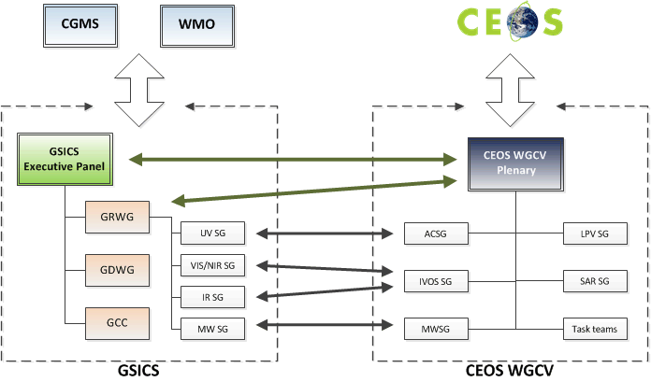

Slide 5
Past efforts
Geolocation/navigation/rectification methodology & metrics
Inter-comparison Campaigns – aircraft, ground-based support, etc.
Data exchange/analysis,
Offer to review campaign plans
Intra-System Comparisons

Slide 6
Moving forward
Interactions seem strong amongst the various subgroups
Overlaps in personnel
Joint meetings and telecons
Is the current status quo good enough or are there other opportunities that should be encouraged?

