Slide 1
Cal/Val at EUMETSAT: An Overview
Remote Sensing and Products Division
User Service and Climate Division
EUMETSAT

Slide 2
Outline
Definitions
Objectives
Tasks
Phases
Process
Examples
- Commissioning
- Operations
Outlook

Slide 3
Definitions
Calibration:
The process of quantitatively defining the instrument response to known, controlled signal inputs
=> Instrument response: Measurement view counts
=> Known, controlled signal inputs:
      Deep space radiance
      Deep space reflectivity
      On-board calibration target radiance
      Vicarious calibration target radiance
      Vicarious calibration target reflectivity

Slide 4
Definitions
Validation:
The process of assessing by independent means the quality of the products derived from the instrument output
=> Products derived from the instrument output:
      L1: calibrated, geolocated Earth view radiances and reflectances, spectra, bending angles
      L2: surface properties and temperature, trace gases and aerosols, land use and forest fires, temperature and humidity profiles, cloud fraction and cloud properties, winds, stability indices

Slide 5
Objectives
Compare in orbit instrument performance with pre-launch calibration and characterisation
Validate L1 and L2 operational products to meet the end-user requirements or even exceed the specifications
Assure that the products are compliant with the end-user requirements or even exceed the specifications during the lifetime of the respective mission

Slide 6
Tasks
In-depth analysis of consistency between operational processor outputs and reference datasets generated by e.g. a fully validated prototype
Collection of suitable independent validation data sets, i.e. measurements from ground based, airborne, and other satellites
Provision of environmental data to characterise a reference status of the Earth/Atmosphere system (e.g. ECMWF re-analysis)
Development/adaption and use of appropriate Cal/Val software (radiative transfer models, collocation tools, comparison statistics incl. random error and bias estimation)
Maintenance and extension of product processing facilities through updated algorithms and auxiliary data sets
In case of need, iterative validation (e.g. re-run of validation after processor update) and re-processing to obtain products of improved quality
Continuous monitoring of product quality

Slide 7
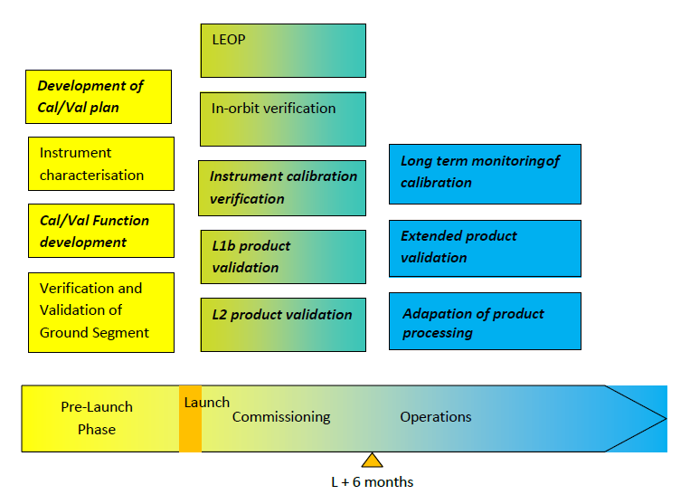
Phases

Slide 8
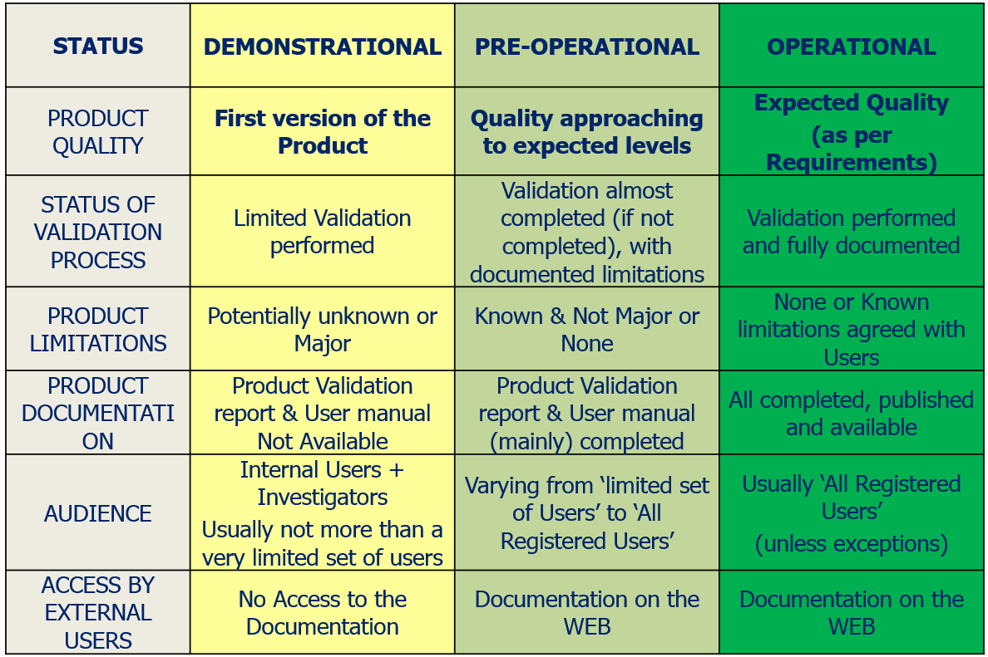
Process
A product validation review board gives a recommendation concerning the declaration of the product status:
(Holmlund, 2016)

Slide 9
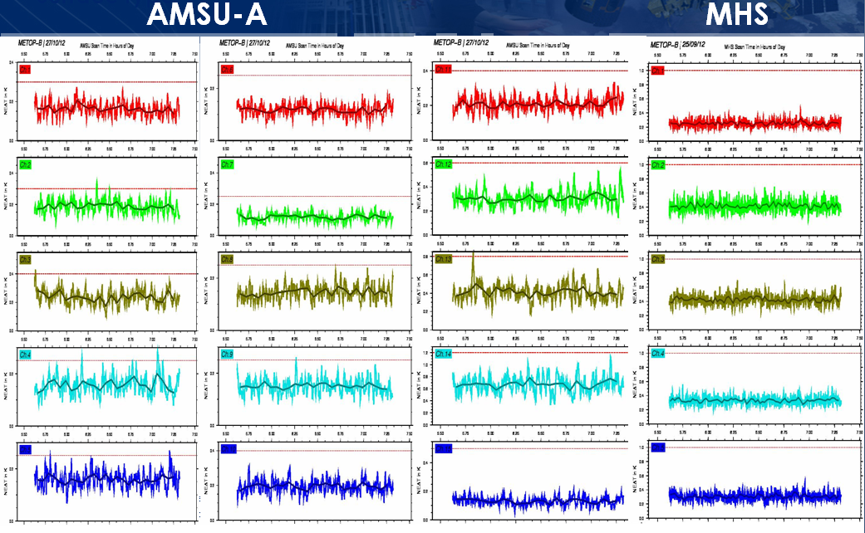
Example: Metop-B In-Orbit AMSU-A and MHS Radiometric Performance (NEΔT) at Begin of Lifetime

Slide 10
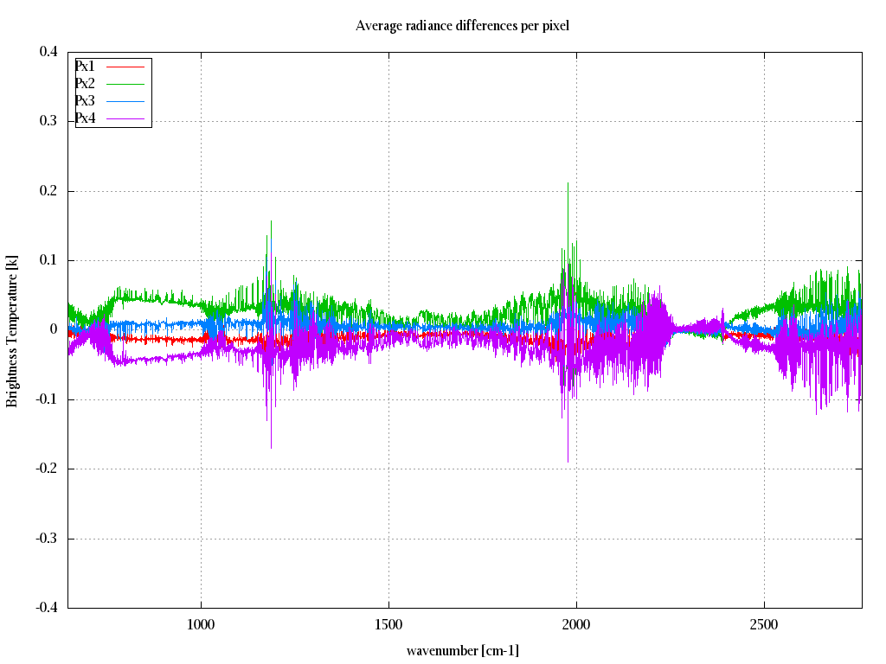
Example: IASI L1 Calibration through Inter-Pixel Radiance Comparisons Using Double Differences
Interpixel radiances consistency check
Using OBS-CALC methodology, by night, over sea
Requirement being within 0.1K, except inter-bands areas
(Coppens, 2015)

Slide 11
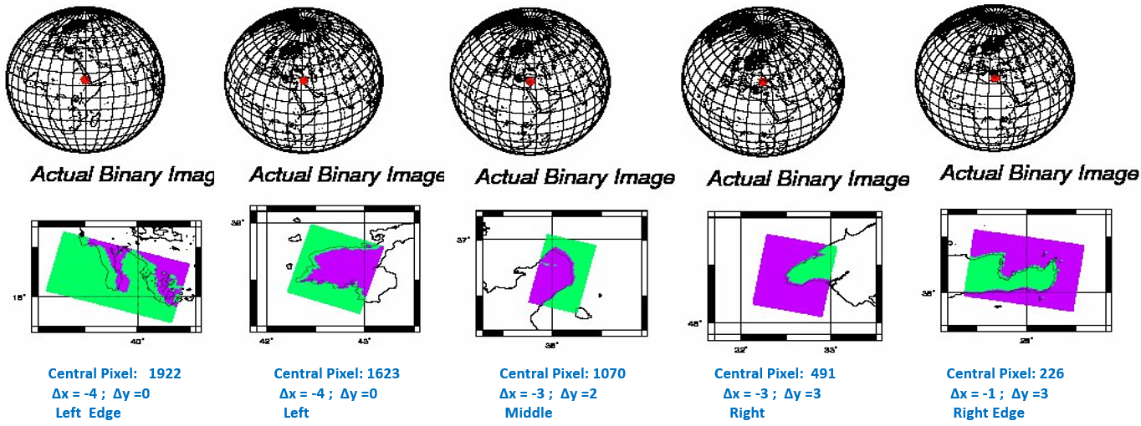
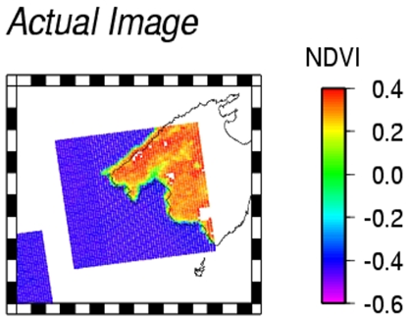
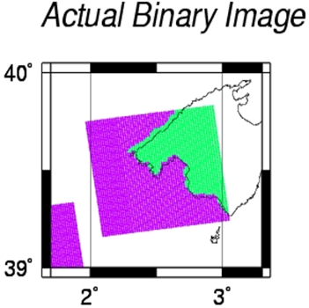
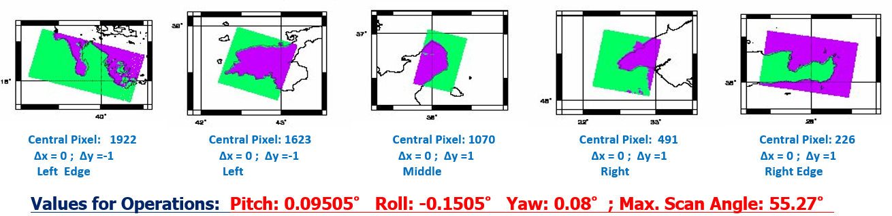
Example: Geolocation Assessment of Metop-A AVHRR/3 Using Landmarks

Slide 12
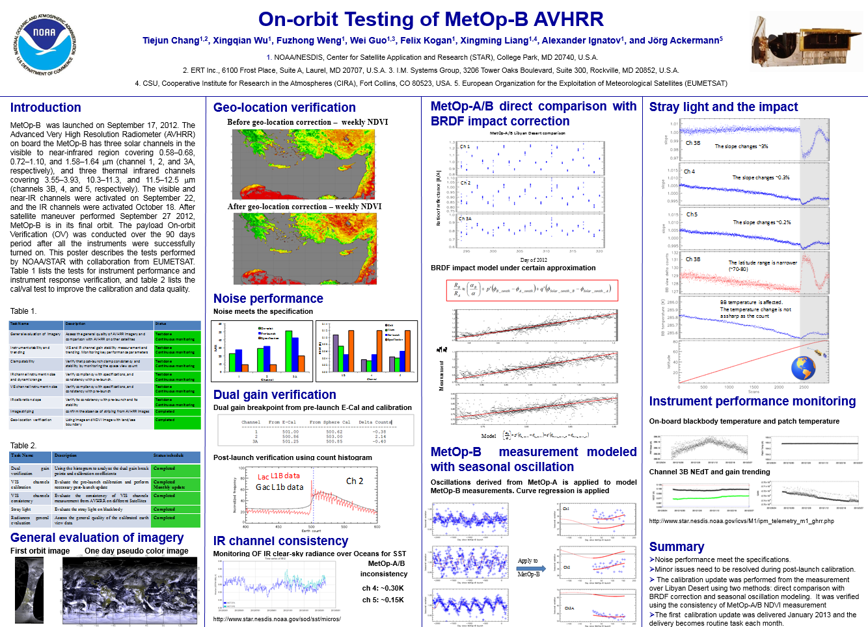
Example: Co-operation with NOAA during Metop-B Commissioning
Poster presented during the NOAA Satellite Conference 2013 (http://satelliteconferences.noaa.gov/2013/Poster_List_Final.html):

Slide 13
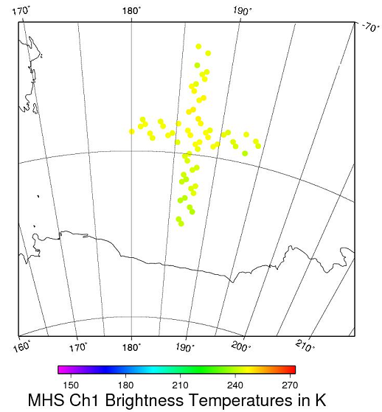
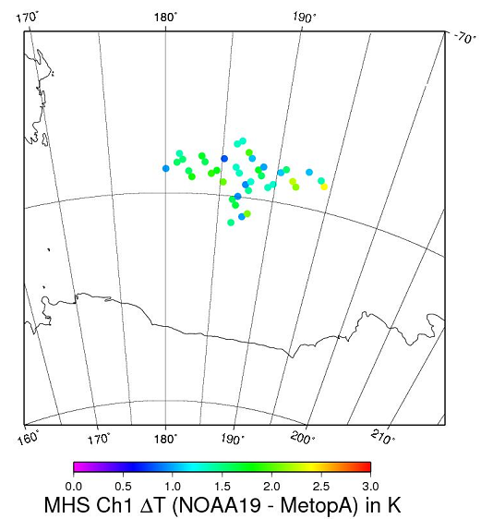
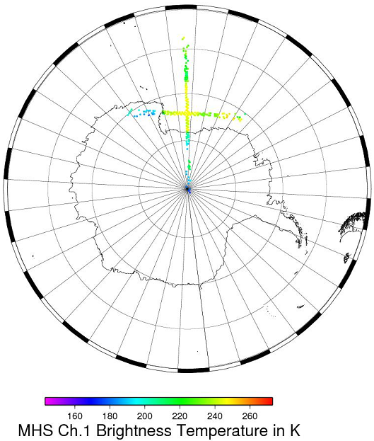
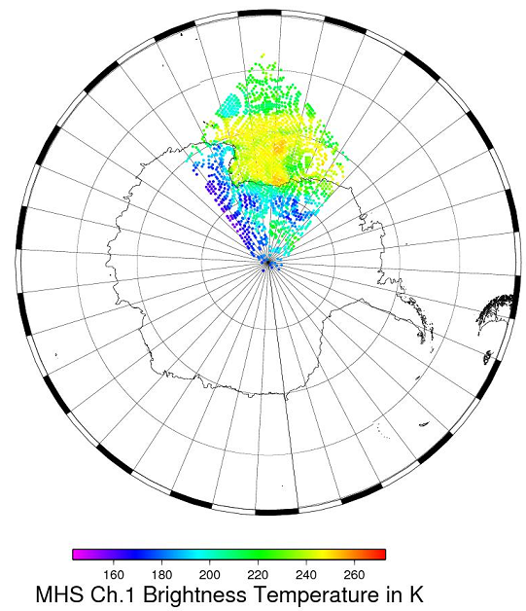
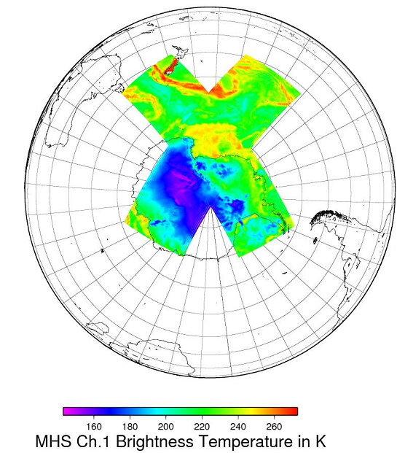
Example: Use of Simultaneous Nadir Overpasses (SNO’s)
Metop-A
Metop-A N-19 SNO on 4. April 2009, 11:16:04 UTC
Restriction to co-located pixels (less than 10km distance)
=> 2260 pixels left
2. Restriction to similar viewing angles (less than 3 pixels with the same scanning angles)
=>245 pixels left
NOAA-19
3. Restriction to co-located near nadir views (pixels 35 to 56 only)
=> 62 pixels left
4. Restriction to coincident near nadir views (maximum time difference of 30 seconds)
40 pixels left
Computation of BT Differences

Slide 14
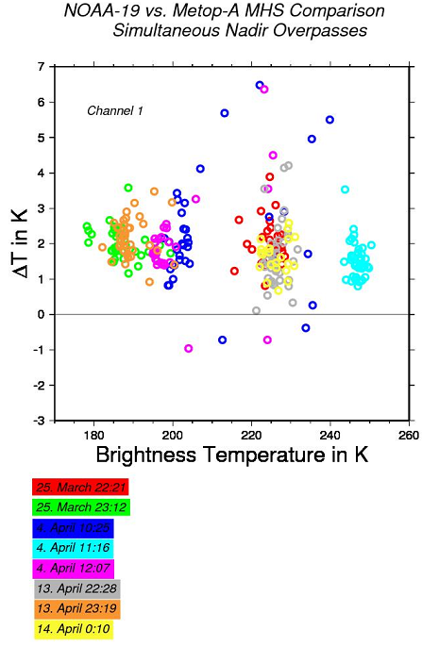
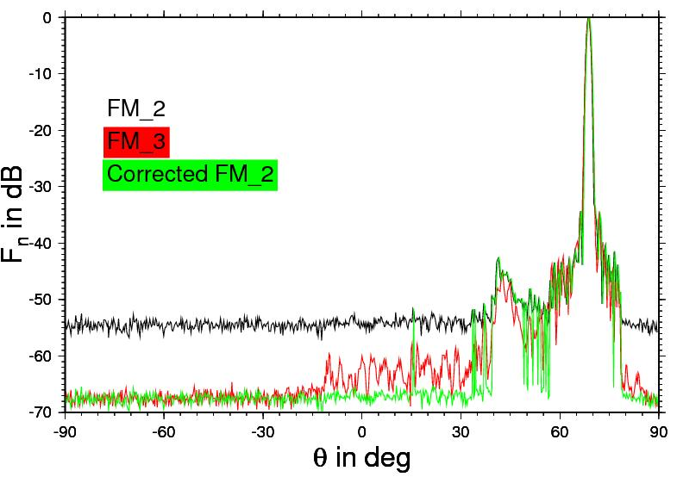
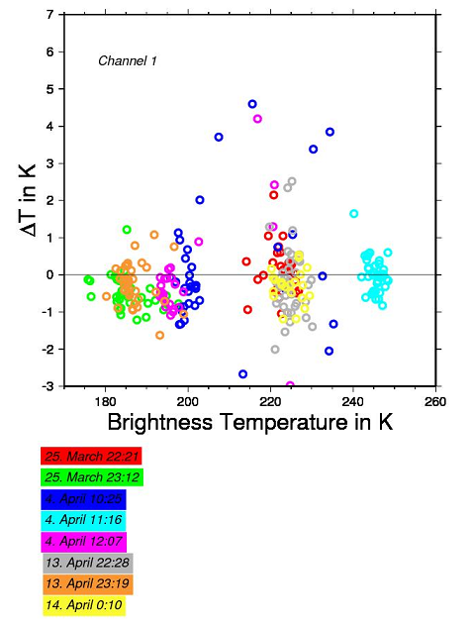
Example: NOAA-19 MHS L1 Product Validation Using SNO Results
=> Significant Bias due to high space view correction factors
=> High space view correction factors due to wrong noise floor of antenna pattern in the pre-launch data
=> Re-run of the Level 1 processing with updated space view correction factors
=> Repetition of the SNO analysis
=> Correction of the antenna pattern
=> Re-calculation of the space view correction

Slide 15
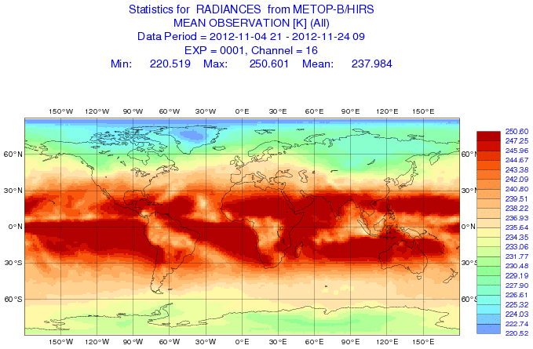
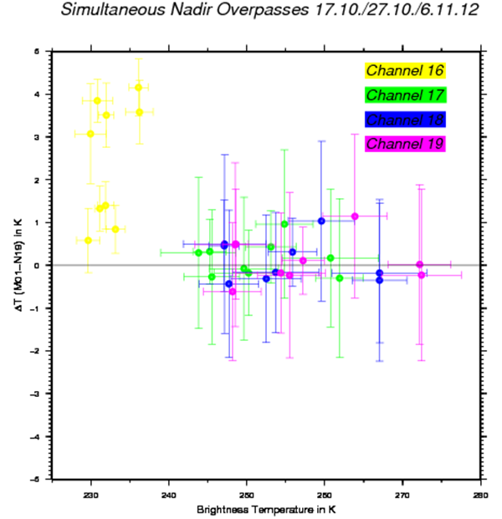
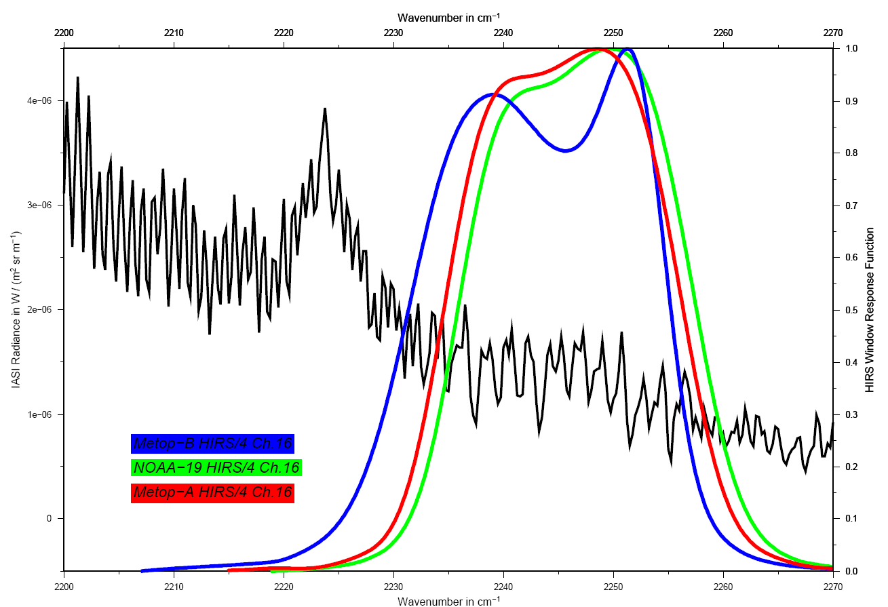
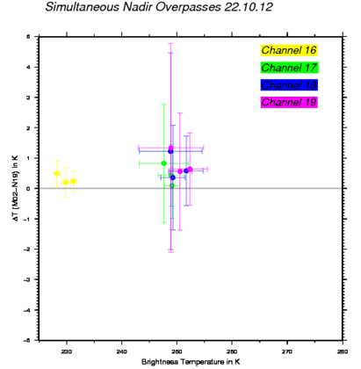
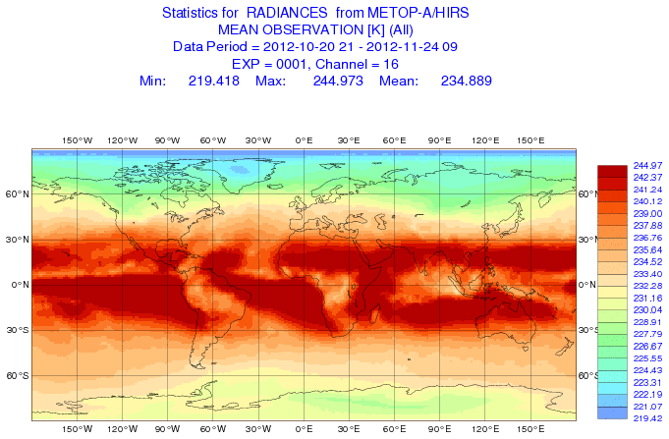
Example: Evaluation of Metop-A/B HIRS/4 (Chs. 16 to 19) using SNO’s
Metop-B vs. NOAA-19
Metop-A vs. NOAA-19
Notes:
Setting occultation = blue, rising occultation = red

Slide 16
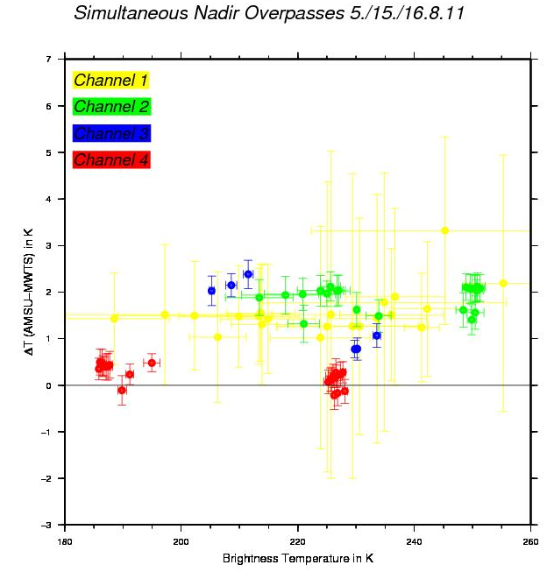
Example: FY-3A MWTS vs. Metop-A and NOAA-19 AMSU-A Measurements
Method: Evaluation of SNO’s between FY-3A MWTS and AMSU-A onboard Metop-A and NOAA-19
Results:
MWTS channel 1 brightness temperatures are about 1.5 K colder, when compared with AMSU channel 3.
MWTS channel 2 brightness temperatures are about 2.0 K colder, when compared with AMSU channel 5. In addition, this bias depends slightly on the target temperature.
MWTS channel 3 brightness temperatures are about 1.0 K to 2.0 K colder, when compared with AMSU channel 7. This temperature dependent bias is larger for lower target temperatures.
MWTS channel 4 brightness temperatures coincide well with AMSU channel 9 measurements.
=> A possible cause for the observed cold biases is a frequency shift of affected MWTS channels by 40 to 80 MHz

Slide 17
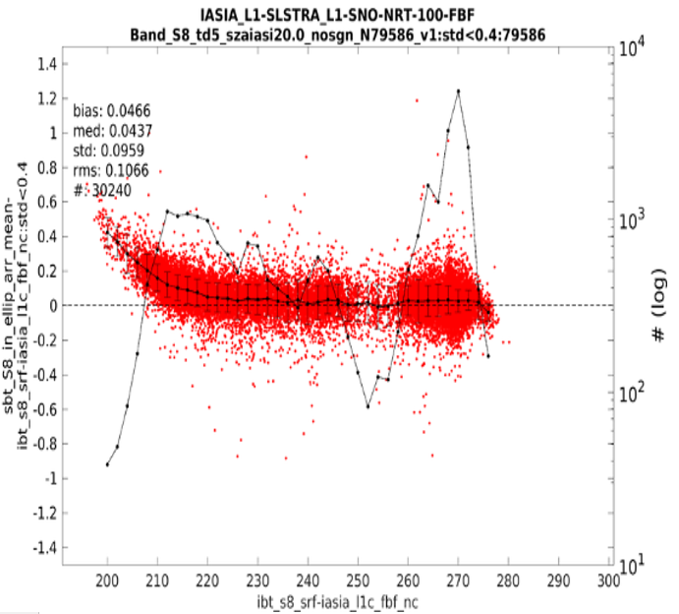
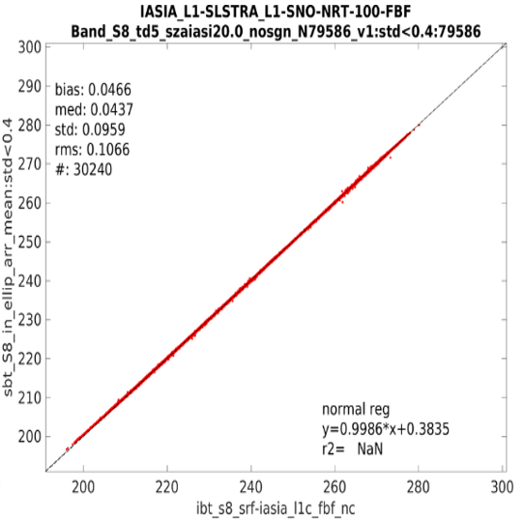
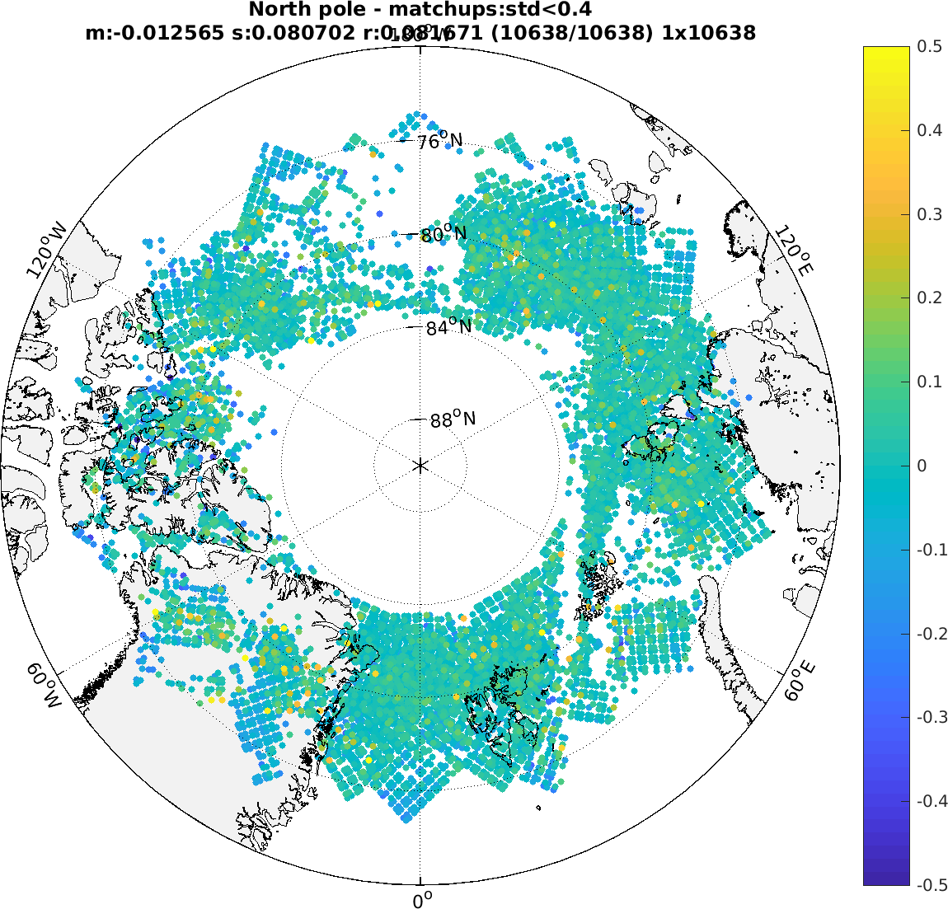
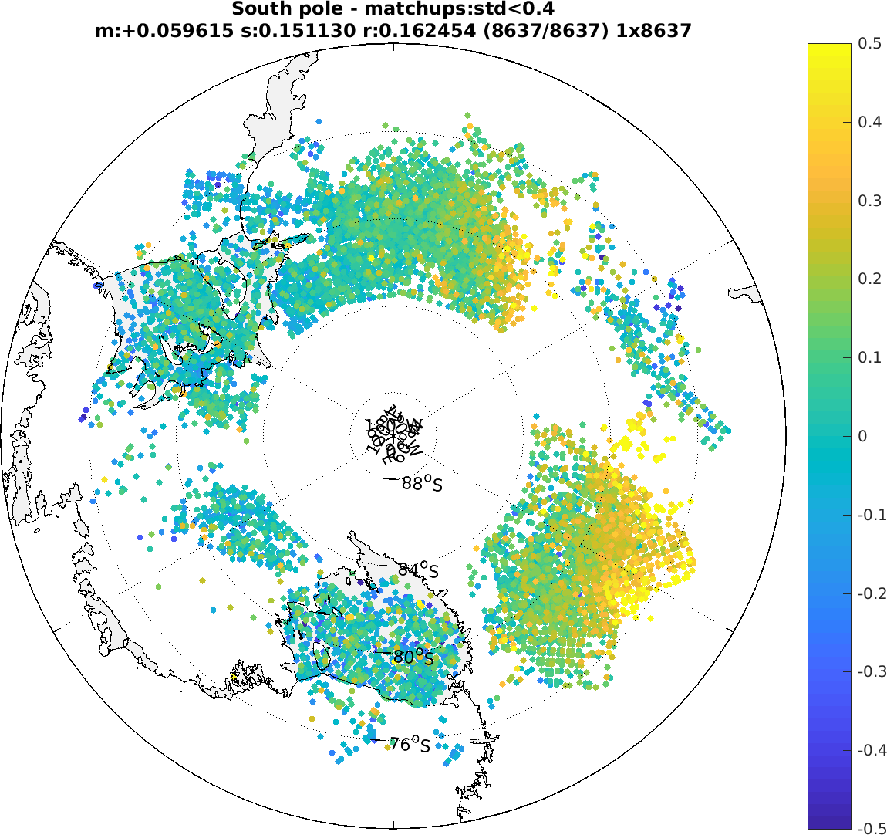
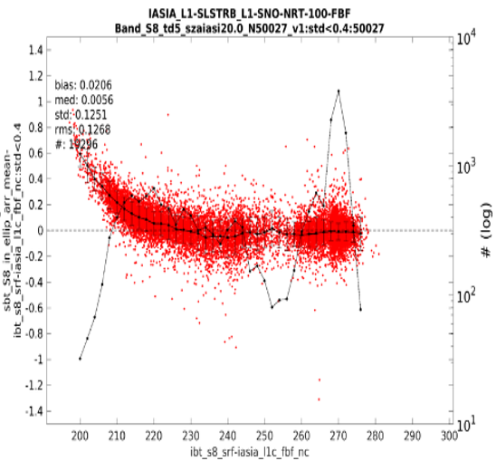
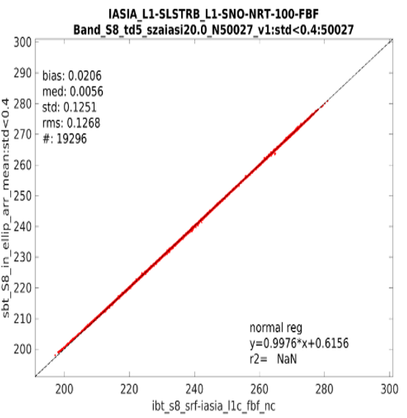
Example: Sentinel 3A/3B SLSTR (S8) L1 validation using SNO’s with Metop-A IASI
Example of SNO event (20-22.06.2018) during the S3 tandem phase (S3A/S3B 30 seconds apart)
Stable calibration
[~220K-~280 K] ≤ 0.05 K (similar to S3A
IASI-A vs SLSTR-A
Nadir: 10.8 µm (S8)
IASI-A vs SLSTR-B
Nadir: 10.8 µm (S8)
S3B preliminary commissioning results
(Tomazic, 2018)

Slide 18
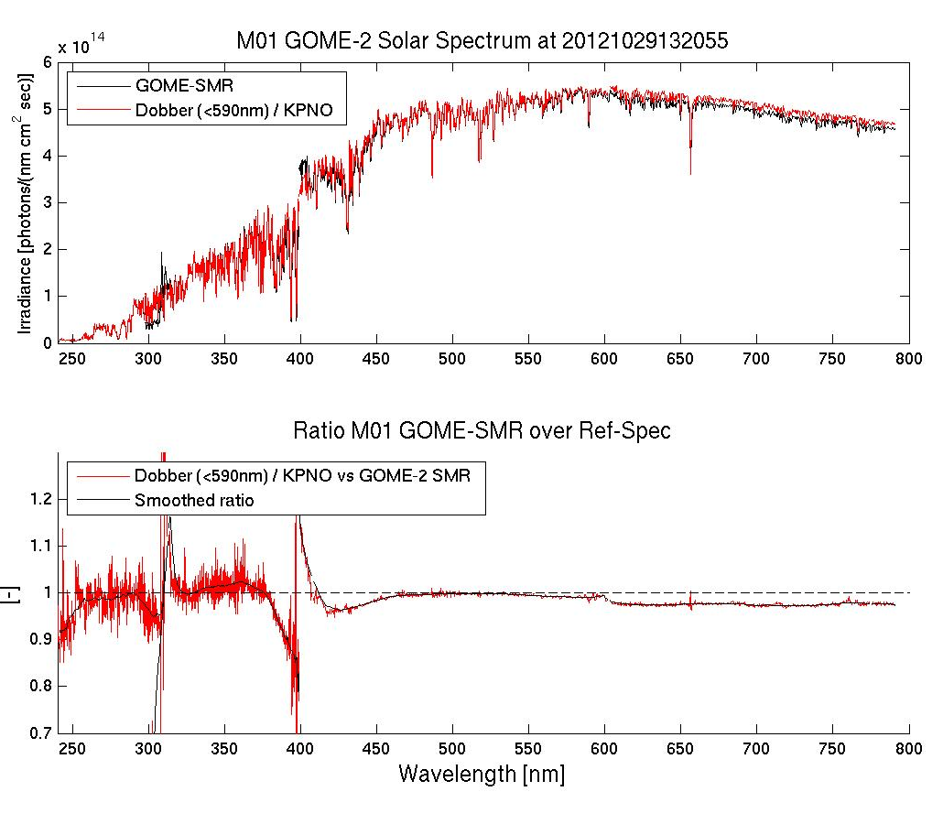
Example: Metop-B GOME-2 Validation during Commissioning
L1: Comparison between measurements and a reference spectrum
L2: Comparison between retrieved ozone profile and in-situ measurements (Antarctica); Courtesy of AC SAF (former O3A SAF)
(Lang, 2012)

Slide 19
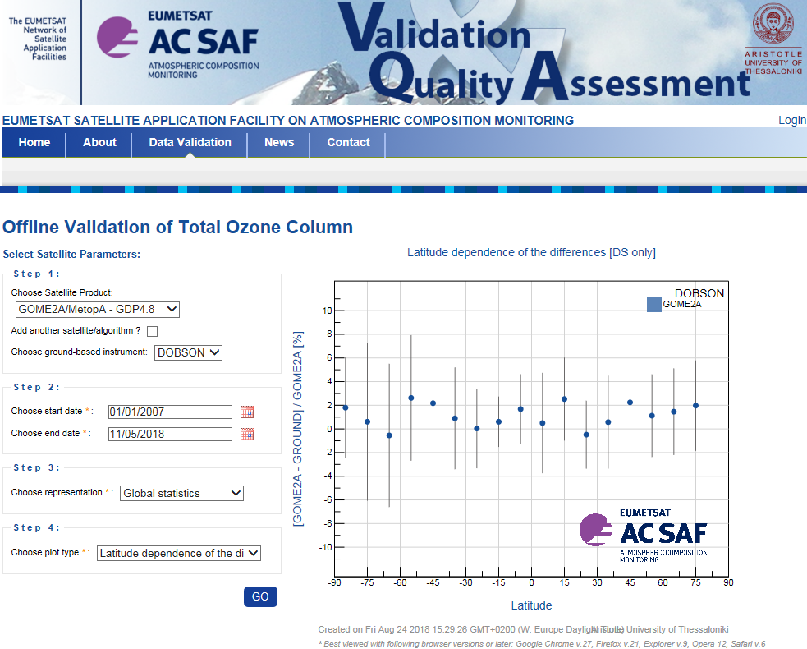
Example: Metop-A GOME-2 Validation during Operations
Monitoring Tool developed by AC SAF and available to all users:

Slide 20
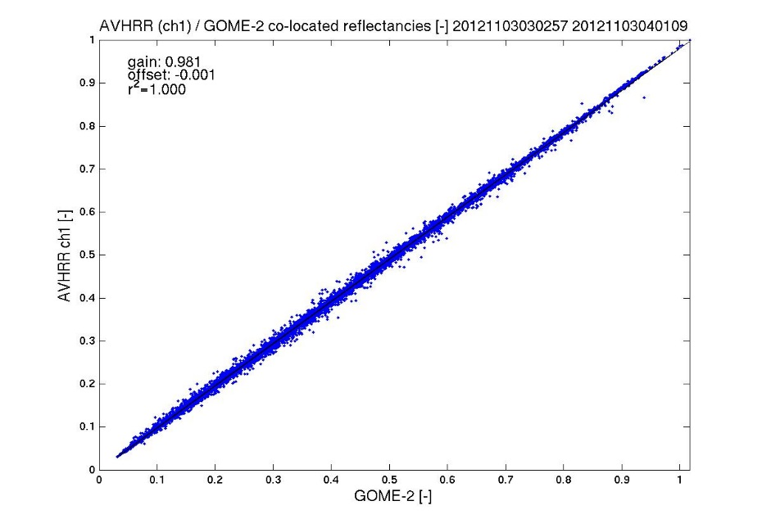
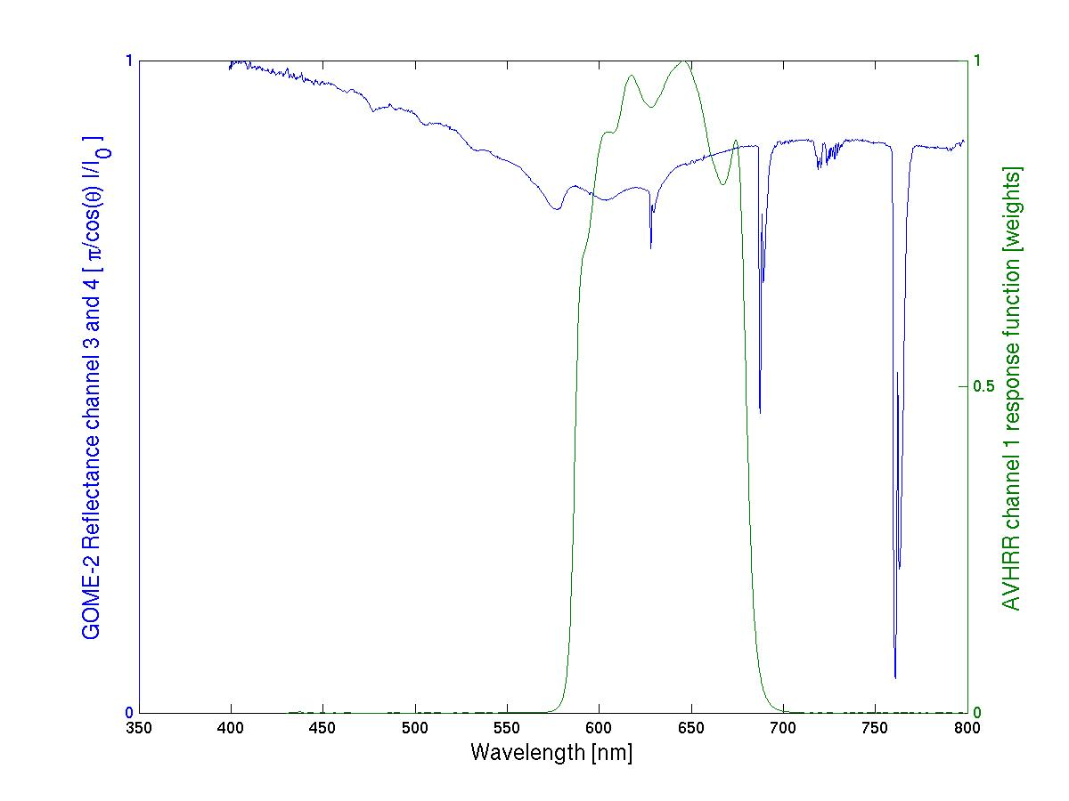
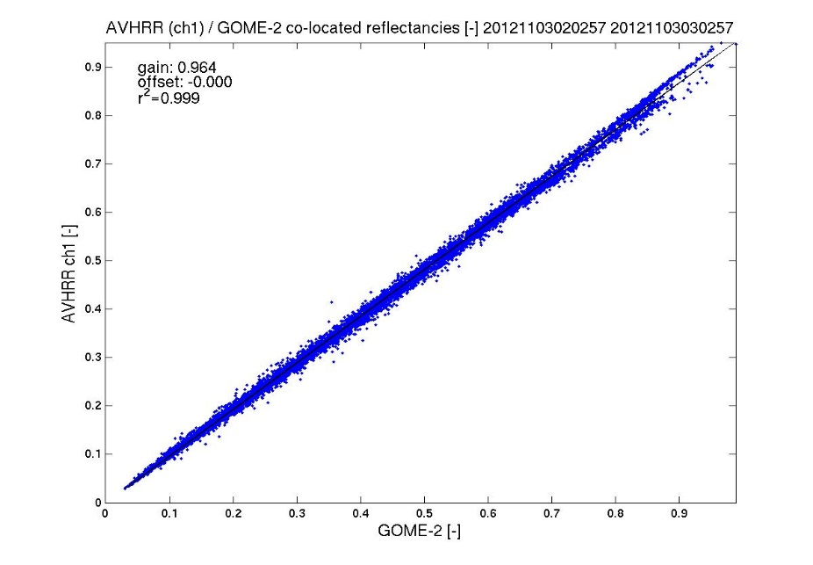
Example: Cross-Validation Metop AVHRR/3 Ch.1 vs. GOME-2
Homogeneous Scenes, 3. November 2012:
Generation of a ‘pseudo-AVHRR measurement’ using
colocated GOME-2 measurements and the actual RSP
Metop-B
Metop-A
(Lang, 2012)

Slide 21
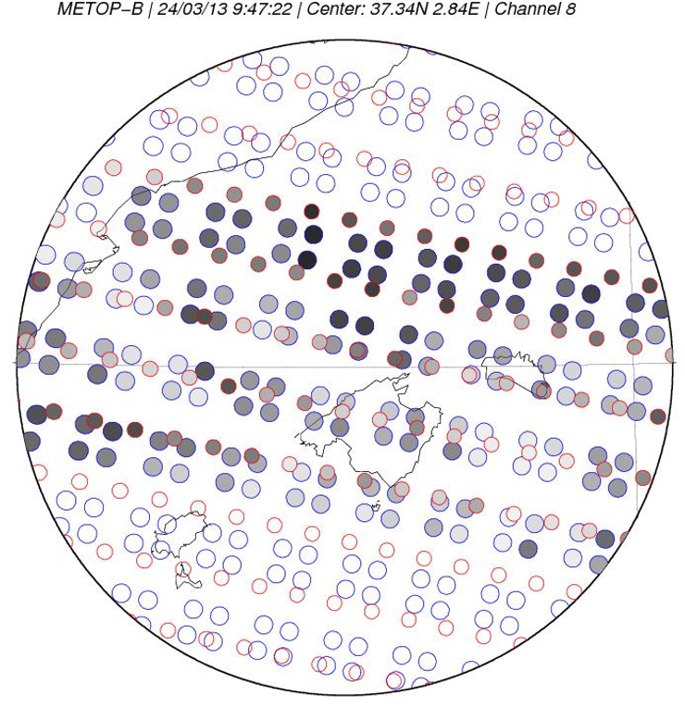
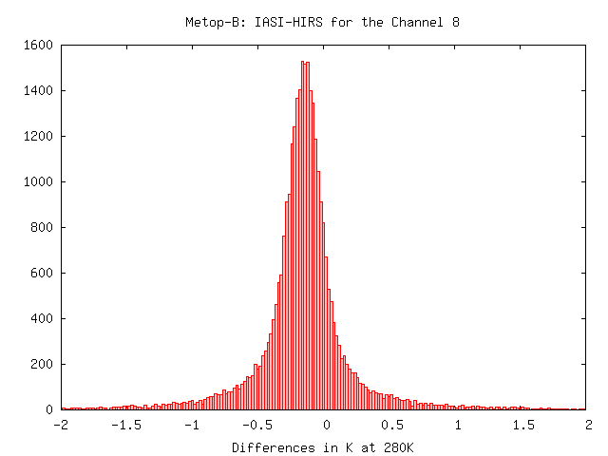
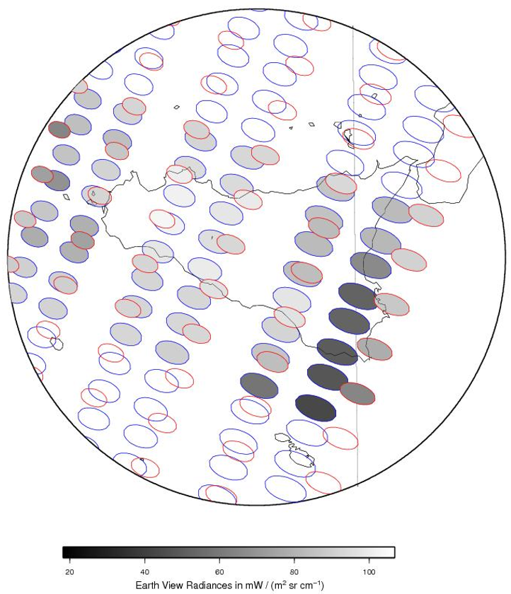
Example: Metop-B IASI HIRS monitoring
Nadir:
IASI
HIRS/4
Scan Edge:
IASI
HIRS/4
(Coppens, 2015)

Slide 22
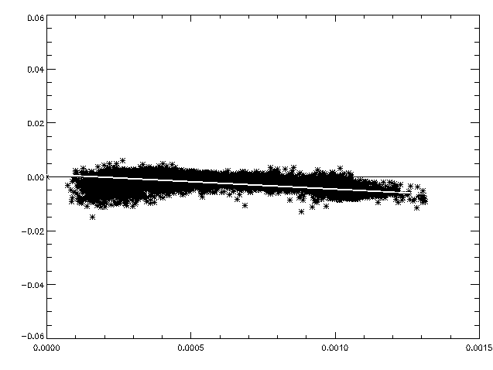
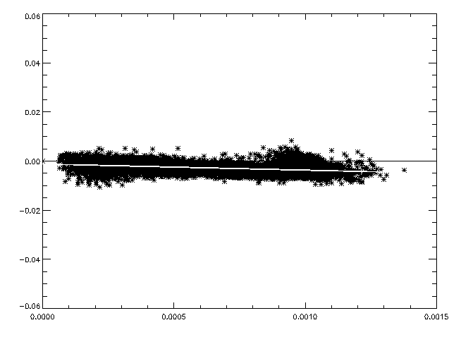
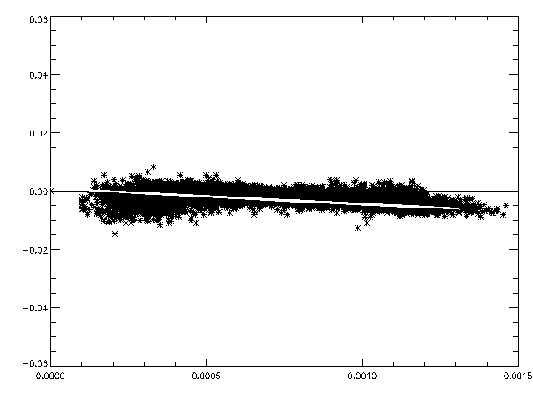
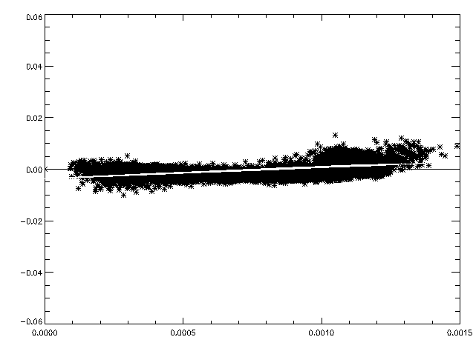


Example: Difference Metop IASI-AVHRR vs. AVHRR
$$∆R=A+B∙ R_{Orig}$$
Channel 4
Ch 4 | B | A in mW/(m² sr cm⁻¹)
M02 | -0.00552929 | +0.0977
M01 | -0.00250335 | -0.118
Radiance difference (10-5 W/m2.sr.cm-1)
M02
M01
Channel 5
Ch 5 | B | A in mW/(m² sr cm⁻¹)
M02 | -0.00489576 | +0.1079
M01 | +0.0041248 | -0.3821
Radiance difference (10-5 W/m2.sr.cm-1)
Radiance (W/m2.sr.cm-1)
Radiance (W/m2.sr.cm-1)
$$R_{Cor}= A+(1+B){∙R}_{Orig}$$
(Coppens, 2016)

Slide 23
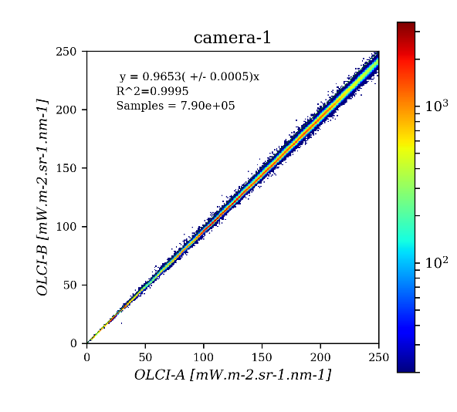

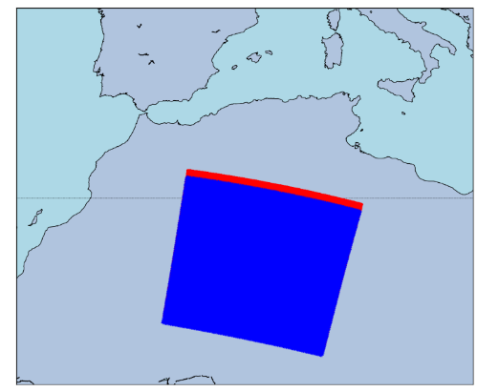
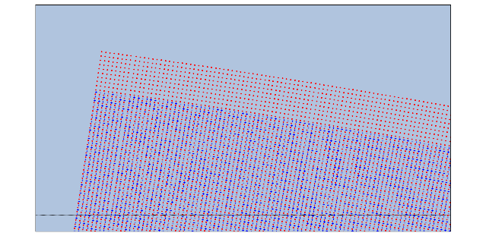
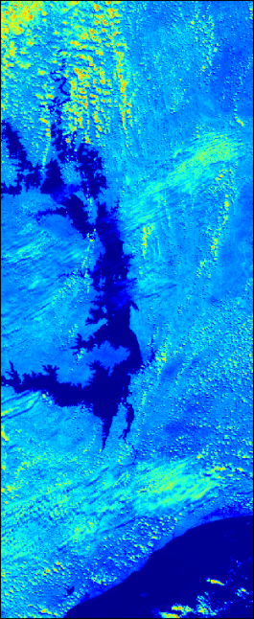
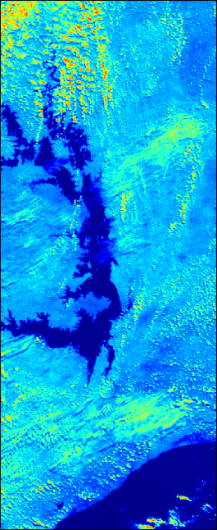
Example: Copernicus Sentinel-3 Tandem Validation
Sentinel-3 OLCI Tandem Configuration (30 s shift)
  Automatic product co-registration
  Direct pixel to pixel inter-comparison
  Possibility of selection of Targets by
  geographical area or Quality Mask
  Analysis of data per Camera Model
Oa15@767.5nm
Oa21@1020nm
Scenario [Sen3B, Sen3A]
Scenario Details
OLCI-B [Oa17@865nm]
OLCI-A [Oa17@865nm]
(Burini, 2018)

Slide 24
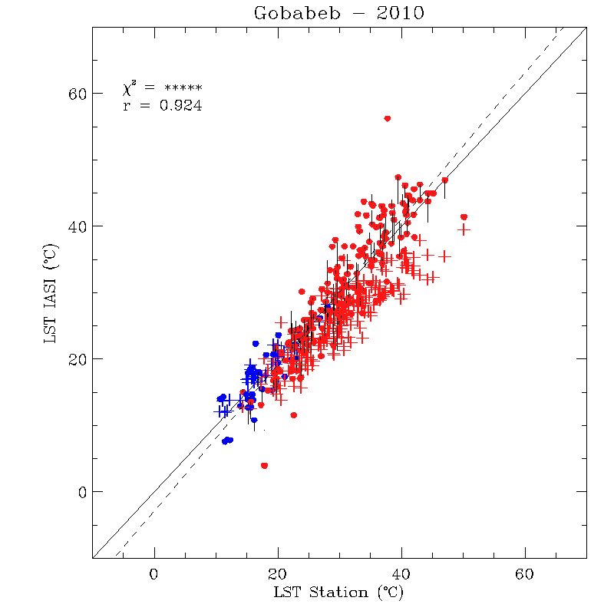
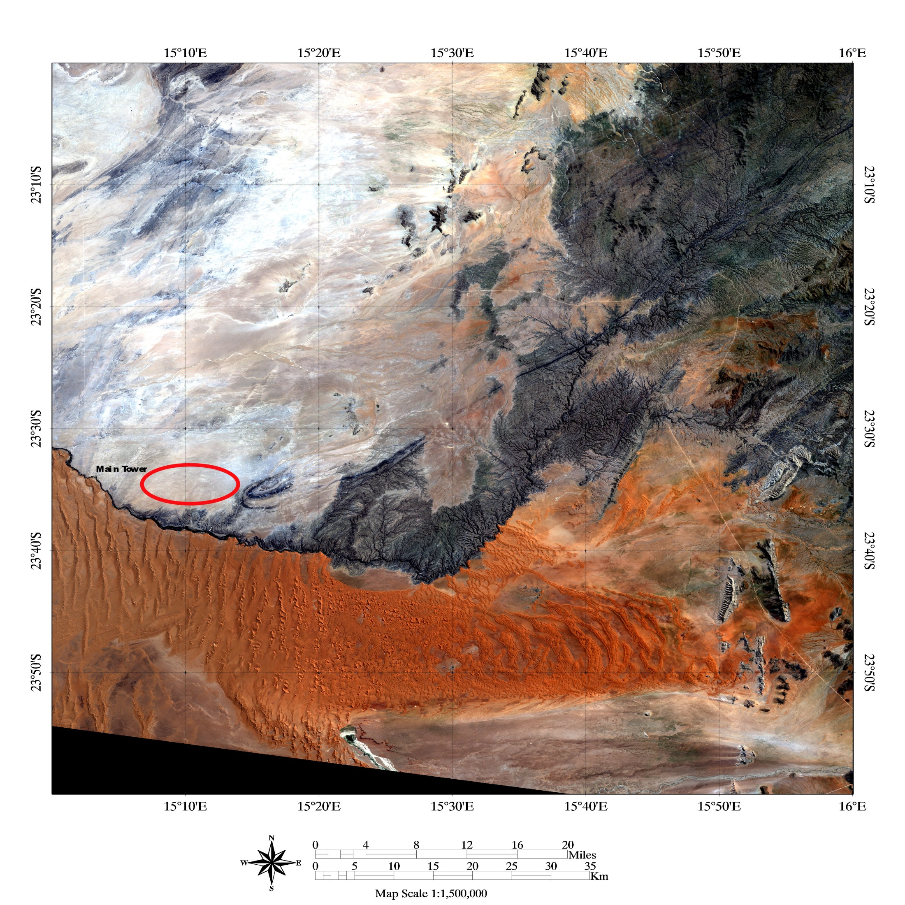
Example: IASI L2 validation (Land Surface Temperature) using ground-based measurements
LST retrieved from IASI measurements versus the LST measured on the ground
IASI overflies Gobabeb (one of the KIT LST validation stations) twice a day between 8 and 9 UTC in the morning and between 20 and 21 UTC in the evening
R=0.924
IASI (day)
IASI (night)
ECMWF (day)
➔ Correlation between IASI and in-situ measurements is very high (>0.92) with almost no bias. On the other hand, ECMWF analyses (blue and red crosses), appear to be biased by several K at daytime.
ECMWF (night)
(Coppens, 2018)

Slide 25
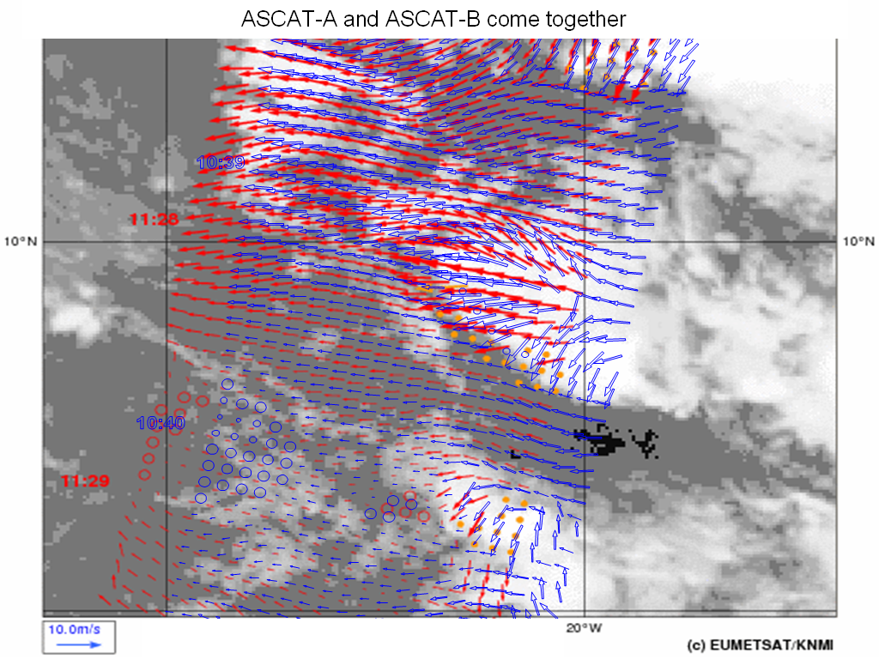
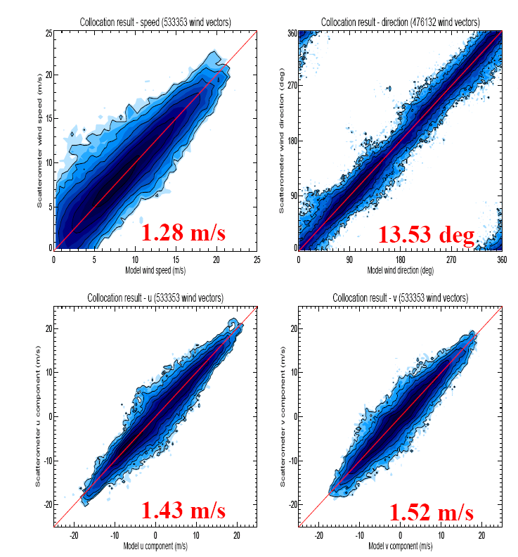
Example: Metop ASCAT L2 Winds – Courtesy of OSI SAF (KNMI)
ASCAT-A and –B winds very similar
Top: ASCAT-B in blue
Right: ASCAT-B statistics for wind speed, direction and u/v components, with respect to ECMWF winds: wind quality well within requirements!!
Also: buoy comparisons

Slide 26

Example: Metop GRAS Validation in October 2012 (against ECMWF)
Radio occultation statistics (left robust bias, right robust standard deviation as (O-B)/B) against co-located ECMWF forecast data. Note: 1K ≈ 1.5% change in bending angles; Grey area indicates Geometrical Optics limitation in processing.
(Marquardt, 2014)

Slide 27


Example: Assimilation of SEVIRI All Sky Radiance at 6.2 μm at ECMWF during MSG-4 Commissioning
Bias Corrected
Observation minus
Mean First Guess
in K

Slide 28







Example: MSG-4 SEVIRI Winds Validation during Commissioning
Consistency:
Comparison with Radiosondes:
(Müller, 2015)

Slide 29

Example: MSG-4 SEVIRI Cloud Amount during Commissioning
CLA Product: Cloud Amount Differences (MSG-4 – Met-10)
Time (UTC) | Total (%) |  | Low (%) |  | Mid (%) |  | High (%)
 | Bias | StdDev | Bias | StdDev | Bias | StdDev | Bias | StdDev
05:45 | -0.5 | 8.1 | -0.3 | 8.3 | 0.0 | 3.9 | -0.4 | 3.0
17:45 | 0.2 | 9.6 | 0.4 | 10.0 | 0.0 | 3.9 | -0.3 | 2.9
23:45 | 1.7 | 9.9 | 1.8 | 10.3 | 0.0 | 4.6 | 0.0 | 3.6
(Müller, 2015)

Slide 30



Example: SEVIRI Solar Channel Calibration System during Operations
Vicarious Calibration System
  For VIS/NIR Channels
  Based on modelled TOA radiances
    Surface BRDF model
    ECMWF model fields
  Over Pseudo Invariant Calibration Targets
    Desert Sites in Sahara & Arabia
    Rayleigh Scattering over Ocean (for QC)
  Developed for Meteosat/SEVIRI at 0°E
    Used operationally since 2006
Application at EUMETSAT:
  Running in operational offline environment
  MSG/SEVIRI, MFG/MVIRI (reprocessing)
  Runs automatically every 5 days
  Evaluating application to SEVIRI at 41.5°E
  S-3B/OLCI, MTG/FCI, EPS-SG/METimage+3MI
Integrating DCC Calibration System
    18 Bright Desert Targets
    9 Dark Ocean Targets
    Meteosat-9/VIS0.6 Gain derived from SSCC
    Seasonal variations
    ➔ Need several years to derive a reliable drift
(Hewison, 2018)
Notes:
Step towards a more automated, objective operational calibration system

Slide 31




Example: Recalibration of Meteosat First Generation Visible Imagery for Climate Data Records
Reconstruction of temporal variation of spectral response function due to detector ageing improves VIS calibration
(Schulz, 2016)
Notes:
Statement of the problem: The Meteosat First Generation MVIRI/VIS band spectral response pre-launch characterization is subject to large uncertainties and spectral aging processes modify its shape during the mission life time (nearly 20 years for Meteosat-7).
Objectives: to develop and apply an advanced reverse engineering method based on:
Simulated TOA spectral radiances over different well-characterized Earth targets.
Observed MVIRI/VIS radiances collected over these targets.
Modeled sensor spectral response to characterize the temporal and spectral variations in the MVIRI/VIS radiances.
Upper plot shows original calibration, with different trends for ocean and land targets and fewer and irregularly distributed calibrations over time.
Right plot shows temporal evolution of spectral aging in form of the reconstructed spectral response function.
Lower plot shows updated time series of calibration coefficients:
sea and desert targets have same trends now which means successful correction of the aging in the blue (shorter wavelength).
Computation of calibration coefficients is enabled under more extreme observation geometry after the move to IODC in 2006.

Slide 32




Example: Validation of re-calibrated radiance against Land Surface Temperature measurements for Climate Data Records
CM SAF validate re-calibrated MVIRI infra-red radiances against Land Surface Temperature (LST) measurements from stations in Namibia and Senegal;
Trend of mean deviations at 95% significance are:
-> 0.09 K/decade (Namibia)
-> 0.40 K/decade (Senegal)
(Note: global GCOS criteria is 1K/decade).
Time-series Namibia
Time-series Senegal
Courtesy: Anke Duguay-Tetzlaff, Meteo-Swiss
Notes:
Use of recalibrated Meteosat IR window channel for LST retrieval and comparison to surface station data in different regions in Africa. Main message is that the recalibrated radiance time series leads to a very stable LST time series.

Slide 33






Example: GSICS IASI-A/IASI-B Intercomparisons Using Double Differences
On-ground update IASI-A and IASI-B
On-board update IASI-B
No update
On-board update IASI-A
On-ground update IASI-A and IASI-B
Difference always lower than 0.1K NedT => good radiometric consistency
(Coppens, 2014)

Slide 34



Example: GSICS IASI/CrIS Intercomparisons Using Double Differences
(Coppens, 2014)

Slide 35




















Example: Metop-A HIRS/4 Performance Change due to a change of the instrument configuration monitored with GSICS
Increase of the Filter Wheel Housing Temperature
Increase of the Filter Wheel Motor Current
Two tests with this modified instrument configuration have been performed: 13. Jan and 19. to 26. Jan 2016

Slide 36





Example: GSICS Corrections for Meteosat IR channels
Collocate in Space, Time, Angle
  “Simultaneous Nadir Overpasses” (SNOs)
  Tie to contemporaneous reference
  With very small uncertainty
Hyperspectral Reference (IASI)
  Spectral Convolution
  Can diagnose SRF errors
Compare
  Regression of collocated radiances
Generate GSICS Correction
  Updated daily
  Upload to EUMETSAT GSICS Server
  Alternative Cal Coeff in L1.5 Header
  First Operational GSICS Products
Evaluate & Monitor Bias
Time Series of Bias for Standard Radiance Scenes in 8 IR channels of Meteosat-10/SEVIRI, generated from GSICS Plotting Tool
Example of calibration monitoring tool
(Hewison, 2018)

Slide 37



Example: GSICS Corrections for Meteosat VIS Channels
Deep Convective Clouds
Pseudo Invariant Targets
  Bright, natural solar diffusers
  Near Top Of Atmosphere
  Little water vapour, aerosol
  Globally available
  In Equatorial Band
Select coldest, brightest pixels
  Identify using T_{IR} threshold
  Homogeneity Tests
  Limit viewing and solar geometry & Normalise
Build up monthly PDF statistics
  Compare mode/mean with model/obs
Derive Calibration Coefficients
  Currently for VIS0.6 (VIS0.8 under study)
Running in operational offline system
Demonstration GSICS Products
Application to Re-processing activity
MTSAT-2 DCC detection 2012-07-01T04
10.8μm TB [K]
(Hewison, 2018)

Slide 38



Example: GSICS Lunar Calibration System for Meteosat VIS Channels
Moon as reference target
  Dark, natural solar diffuser
  Extremely stable – traceability possible
  Can apply retrospectively to generate FCDRs
  Globally available
Select pixels of Moon
  Applying threshold to IR image
  Calculate integrated irradiance
Compare with model
  GSICS Implementation of ROLO (GIRO) developed by USGS
  <1% relative uncertainty
  Applicable from 0.4 – 2.4 µm – All VIS/NIR
Application at EUMETSAT:
  Running in operational offline environment
  MSG/SEVIRI, MFG/MVIRI (+reprocessing)
  S-3B/OLCI, MTG/FCI, EPS-SG/METimage+3MI
Developing inter-calibration
  Tie to MODIS/VIIRS reference
  Combined with DCC method (Refl. =0.1-1.0)
SEVIRI L1.0 image
Meteosat-9/VIS06 Bias Change
wrt ROLO Model Lunar Irradiance
(after phase angle correction)
(Hewison, 2018)

Slide 39




Outlook: Mission-Integrated Calibration Monitoring and Inter-Calibration System (MICMICS)
Developing Mission-Integrated Calibration Monitoring and Inter-Calibration System (MICMICS)
  To integrate monitoring systems for onboard, vicarious and inter-calibration
  For GEO and LEO sensors in different spectral bands
Currently in System Definition & Prototyping phase
Expected to be fully operational in 2020
(Hewison, 2018)
SSCC
Relative scale
DCCs
Moon
Example of the VIS06 band on MSG2/SEVIRI. Grey/black big dots: SSCC gains. Black small dots: gains as available in Level 1.5 image headers (derived from SSCC). Blue dots: lunar calibration. Magenta: DCC gains

Slide 40
Outlook: MICMICS Development and Application Timelines
Calibration Method | 2018 | 2019 | 2020 | 2021 | 2022 | SEVIRI | SLSTR | OLCI | FCI | 3MI | MET image | LI | UVNS | MWI /ICI | IRS | UVN
First Launch |  |  |  |  |  | 2006 | 2016 | 2016 | 2021 | 2021 | 2021 | 2021 | 2021 | 2022 | 2023 | 2023
SSCC | # | # |  |  |  | 2002 | 2018 | 2018 | 2021 | 2021 | 2021
DCCCS | # | # |  |  |  | 2019 | 2019 | 2019 | 2021 | 2021 | 2021 | 2021
LCS | # | # | # |  |  |  | 2021 | 2021 | 2021 | 2021 | 2021
Rayleigh |  | # | # |  |  | 2020 | 2020 | 2020 | 2021 | 2021 | 2021 |  | 2021 |  |  | 2023
Ray-matching |  |  |  | # |  | 2021 | 2021 | 2021 | 2021 | 2021 | 2021 |  | 2021 |  |  | 2023
IR Inter-Cal | # | # |  |  |  | 2007 | 2018 |  | 2021 |  | 2021 |  |  |  | 2023
NWP+RTM |  |  | # | # |  |  |  |  | 2021 |  | 2021 |  |  | 2022 | 2023
MW Inter-Cal |  |  | # | # | # |  |  |  |  |  |  |  |  | 2022
(Hewison, 2018)

Slide 41
Outlook: Selected GRWG-UV Subgroup Baseline Projects (NOAA and EUMETSAT)
Reference Solar Spectrum
Aim: to evaluate the available reference solar spectra and make a recommendation for a reference solar spectrum for community use.
White Paper on Ground-based Characterisation of UV/Vis/NIR/SWIR spectrometers
Aim: to prepare a white paper documenting best-practise for the on-ground calibration of UV/Vis/NIR/SWIR spectrometers based on in-orbit experience from relevant missions.
Match-ups and Target Sites
Aim: to produce over-pass comparisons of UV sensors for specific target sites in use by the community. As a first step summaries of methods and results for target sites currently in use will be collected.
Cross-calibration below 300nm
Aim: To devise new methods for comparison of wavelength pairs for different viewing geometries taking into account contribution function equivalence to allow radiometric performance comparisons for ozone profile wavelengths from 240 – 200 nm.
(Munro, 2018)

Slide 42
Outlook: Wrap-up on EPS and EPS-SG
EPS:
Metop-C launch from Kourou is scheduled for the 6./7. November 2018:
Operational product processors have been updated and tested on system level
Cal/Val plans have been adapted
Cal/Val tools are in place for commissioning
Cal/Val rehearsal has been performed successfully
EPS-SG:
Metop-SG A and Metop-SG B launches are scheduled for 2021/2022 time frame:
Cal/Val plans have been drafted
Cal/Val tools for mandatory tests are under development

