Slide 1

Working Group on Calibration and Validation (WGCV): 44
Infrared Visible and Optical Sensors (IVOS) subgroup: report
Nigel Fox
NPL (with UKSA support)
WGCV 44

Slide 2
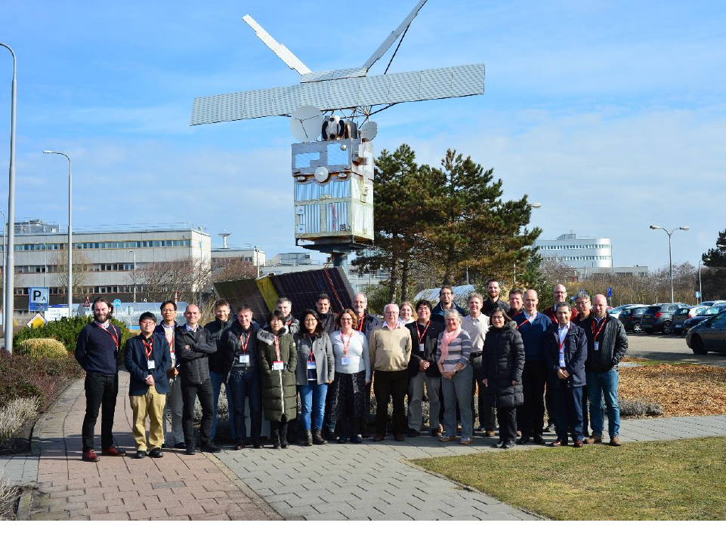
Summary of activities
IVOS 30 @ ESTEC,Noordwijk, Holland. hosted by ESA Mar 2018
24 agency/orgs represented
30 attendees + 7 remote
Most themes and topics (work-plan discussed or summarised
4 th MTF workshop (Mar 2018)
~ PICSCAR webex (Joint GSICS)
  2nd Meeting (4th inc pre-cursors)
  Surface Temp Val workshop (Oct 17)
  Rad cal workshop (Europe focus) Aug 17)
  mett
Special Projects:
RadCalNet team met Mar 2018 Various telecons
O-colour vicarious Cal comparisons started April 2017 (Workshop Oct 2018)
Terminology task team established
IVOS 31: WB March 26 2019 + - a few days for test site visits PERTH, Australia.

Slide 3
Terms of Reference
Promote international and national collaboration in the calibration and
validation of all IVOS member sensors.
Address all sensors (ground based, airborne, and satellite) for which there
is a direct link to the calibration and validation of satellite sensors;
Identify and agree on calibration and validation requirements and
standard specifications for IVOS members;
Identify test sites and encourage continuing observations and
inter-comparison of data from these sites;
Encourage the preservation, unencumbered and timely release of data
relating to calibration and validation activities including details of pre-launch
and in flight parameters.
In the context of calibration and validation encourage the full consideration
of “traceability” in all activities involved in the end-to-end development of
an EO product including appropriate models and algorithms.
6.

Slide 4
IVOS: Vision
To facilitate the provision of ‘fit for purpose’ information through enabling data interoperability and performance assessment through an ‘operational’ CEOS coordinated & internationally harmonised Cal/Val infrastructure consistent with QA4EO principles.
Pre-flight characterisation & calibration
Test – sites
Comparisons
Agreed methodologies
Community Good Practises
Interchangeable/readable formats
Results/metadata - databases
Key Infrastructure to be established and maintained independent of sensor specific projects and/or agencies

Slide 5
Work plan
Structured into themes and led by ‘champions’ (effectively vice chairs for CEOS WGCV constitution) (Plus specific projects)
  Look to develop good practises
  Organise comparisons
  Shared learning (research activities)
  Shared infrastructure / tools / Methods
  Recommendations as needed
Land surface reflectance - Czapler Myers (U of Arizona USA)
Ocean colour (link to IOCCG, VC-OCR etc) - Zibordi (JRC, EU) & Murakami (JAXA JPN)
Surface Temperature (link to VC-SST, GHRSST) - Corlett (U of Leicester, UK)
Geo spatial image quality - Helder (SDSU, USA) &
Viallefont (ONERA F)
Atmospheric Correction (Link to AC subgroup) - Thome (NASA, USA)
RT codes (context of IVOS use in calibration) - ?

Slide 6
Specific projects/cross-cutting
RadCalNet - Bouvet (ESA)
PICSCAR (with GSICS) - Henry (CNES, F)
Lunar (led by GSICS) - Wagener (Eumetsat)
SST/LST cross-comparison (+ VC-SST & LPV - Fox (NPL, UK)
(instrument Cal for LST)
O-Colour Vicarious Cal comparisons - Fox (NPL, UK)
Vocabulary - Wooliams (NPL, UK)
Others in progress/development/related
  Establishing a CEOS Reference and method of use for L1 radiometric interoperability (with GSICS) (including potential tools/databases)
  Good practise for convolving spectral data sets (solar/surface/sensor bandwidth) Selection of Reference Solar irradiance spectrum(CEOS WGCV (sub-groups) & GSICS) – Partly complete
  Comparison of Rayleigh and Sun-Glint methods

Slide 7
IVOS 30 Discussion Topics
Summary of workshops/task groups, MTF, RadCalNet, PICSCAR
Terminology
Sensor pre-flight calibration workshop
Sensor Pre- and In- flight Cal and Uc assessment
  Inc Moon, Stars
New Sensors
Surface reflectance (level 2) validation
Collaborations/interactions – WGCV, GSICS, VCs, Climate, Carbon ….
Metrology and Uc evaluation….
Minutes/Actions and presentations available at: CEOS CalVal Portal

Slide 8
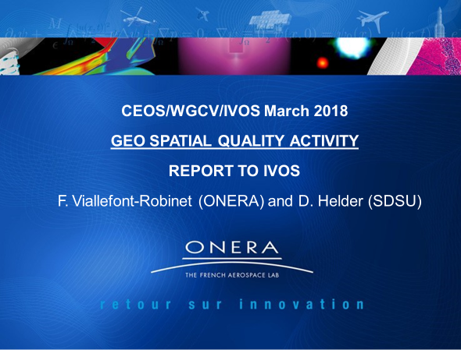
MTF activities & comparison
Task group created in 2015 and very active and successful providing a valuable
resource to the small but increasing community (particularly commercial sensors)

Slide 9
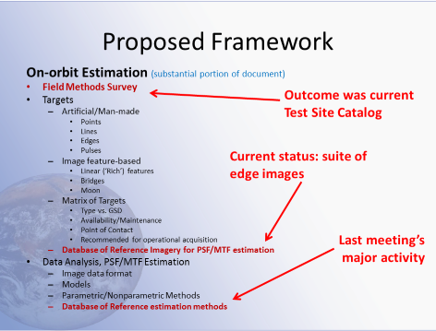
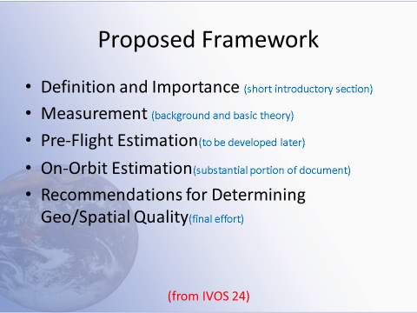
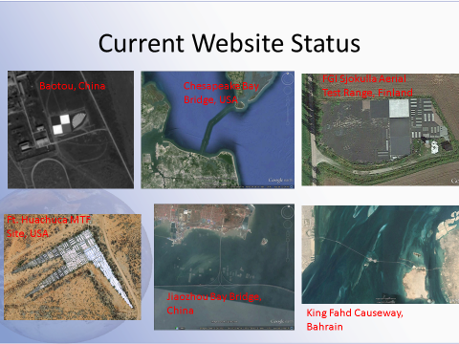
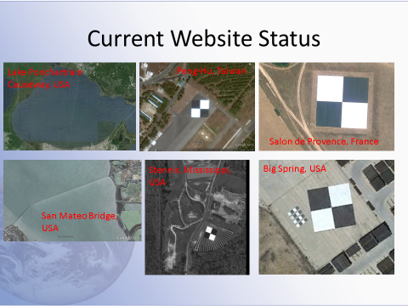
Establish good practise and community references
Catalogue is being migrated to CalVal Portal
Following completion of list of sites propose to CEOS WGCV acceptance
panel for formal CEOS Label to aid community & interoperability
New ISRO site being added anticipate list at IVOS 31 ready to submit
Following WGCV 43: Contact been made with GSICS regarding use of Moon

Slide 10
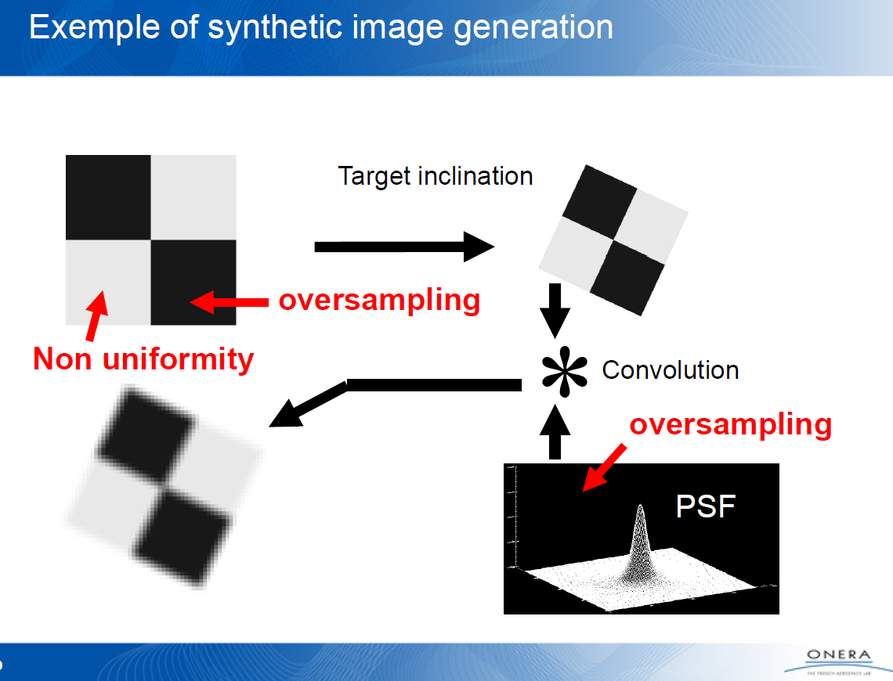
Comparison of methods
Results, methods drafted into paper for submission to Optics letters in Autumn 18
referencing CEOS data set and exercise (essentially a reference guide)
Create reference data set and access policy to allow blind-testing from Cal/Val Portal
as CEOS test set agreed at CEOS WGCV 42
DISCUSSIONS started on achieving a test platform on Cal/Val Portal
Next steps :
  List of metrics besides MTF curve: RER, RER slope, FWHM, …
  Establish a list of relevant information or feature for each metric: for instance, link with the requirements, sensitivity, link with other metrics, potential use…
  Evaluate some metrics and compute them as extensions to test data set

Slide 11

PICSCAR Joint with GSICS lead P Henry CNES
Pseuodo invariant sites used for Rad L1 Cal/comparison/monitoring
Work-plan
Bi-monthly community Telecons/webex to discuss methods and how to establish/compare (BRDF, Atmosphere, surface spectral reflectance)
  Organise comparison exercises to assess community state of the art
CNES to establish draft web ‘portal’
  Hosted on/via CalVal portal
  Good practises on how to use
  Repository of observations
  Repository of comparison results
  Characteristics of PICS and tools for users
NPL & CNES to consider how to evaluate Uc
Goal to establish a TOA ‘Radiance simulator’

Slide 12

Comparisons
Evaluate consistency of data extraction/data sets for Landsat 8 and Sentinel 2 (Libya 4) (initially some variances)
Define and supply a common set of data to participants for independent processing
Exercise 1: Intercompare L8 against S2A as Reference
Exercise 2: Intercompare MODIS Aqua against MERIS
Exercise 3: Assess the BRDF of the site (own model) to normalise MERIS TOA reflectance to a specific geometry.
Sensor | S2A/MSI | L8/OLI | MERIS | MODIS/Aqua
Green Band | B3 (560) | B3 (562) | B5 (560) | B4 (555)
Red Band | B4 (665) | B4 (655) | B7 (665) | B1 (645)
NIR band | B8A (865) | B5 (865) | B13 (865) | B2 (858)
Five teams so far provided results for Exercise 1)

Slide 13
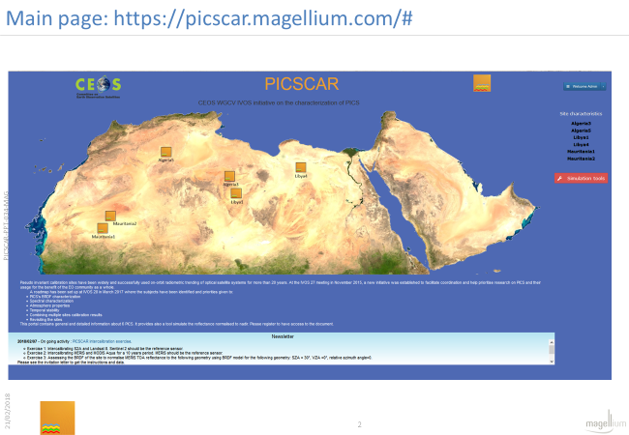
PICSCAR portal to be linked from Cal/Val portal

Slide 14
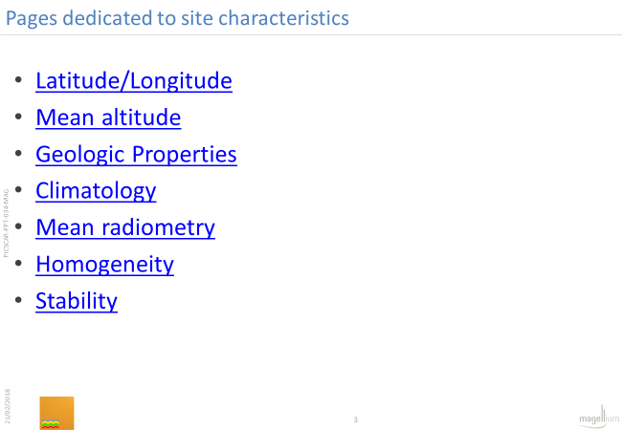
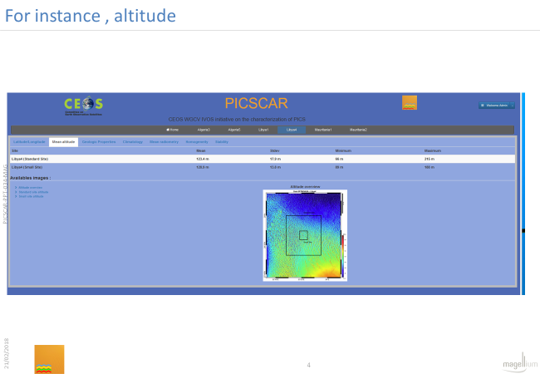
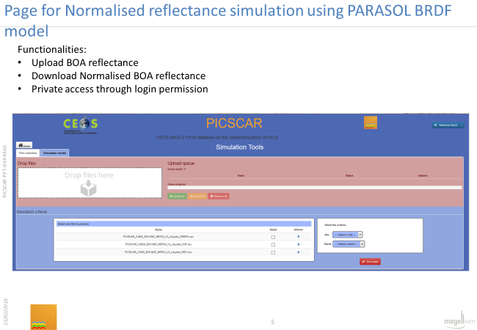
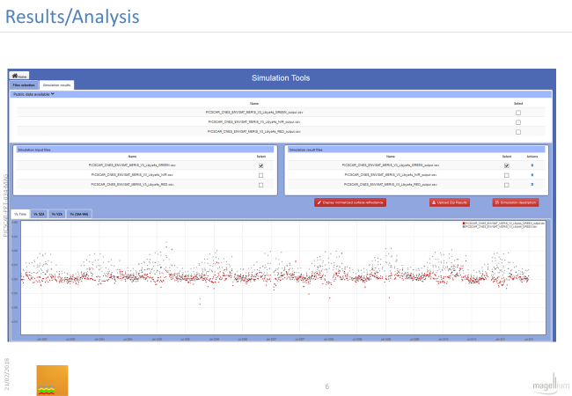
Draft content

Slide 15
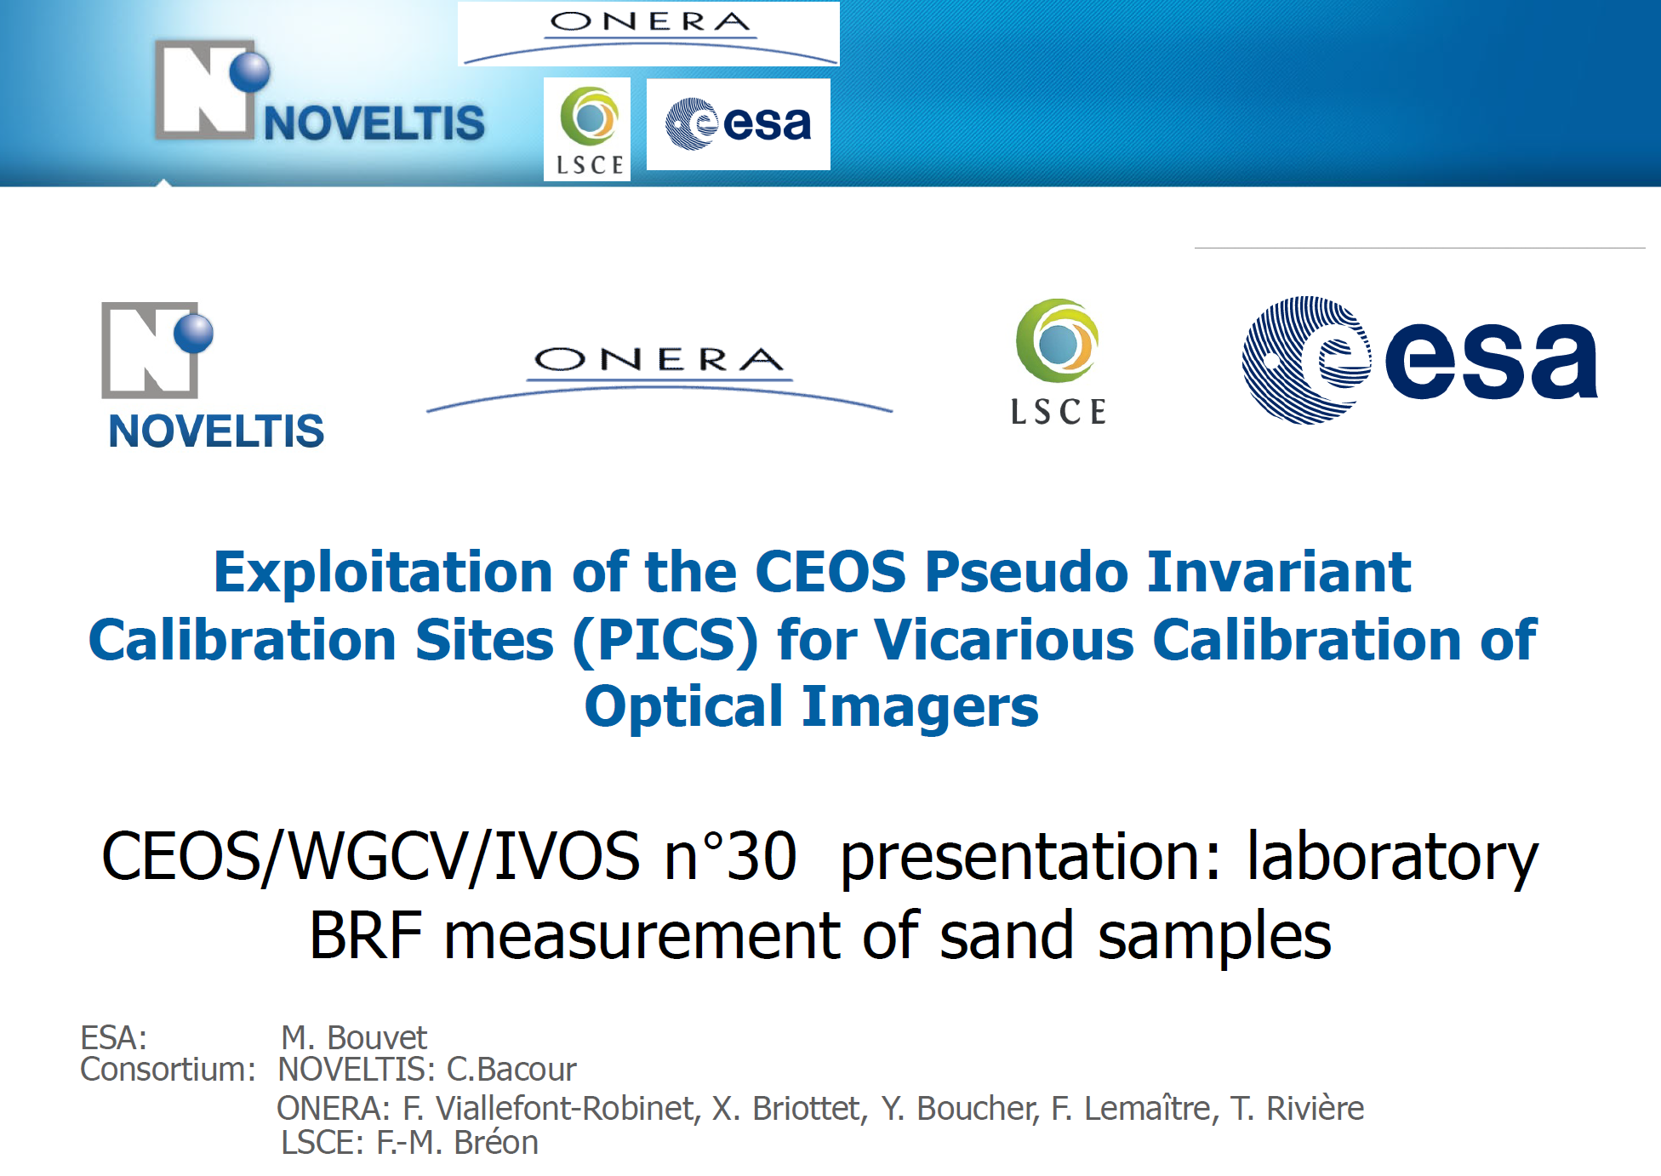
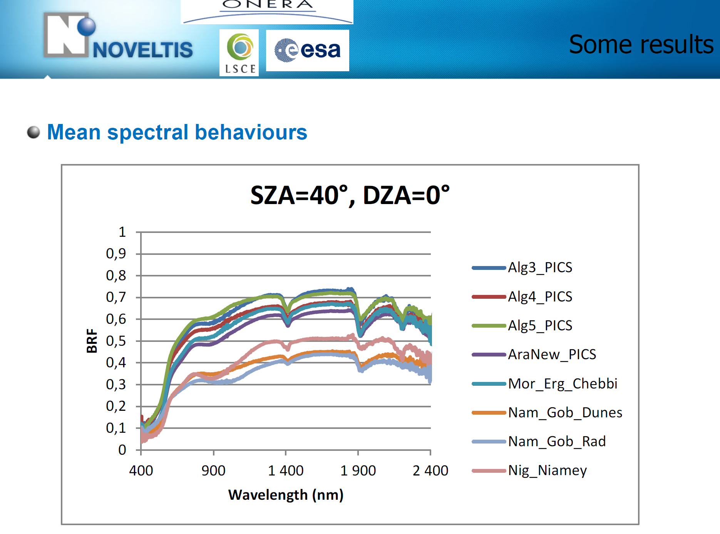
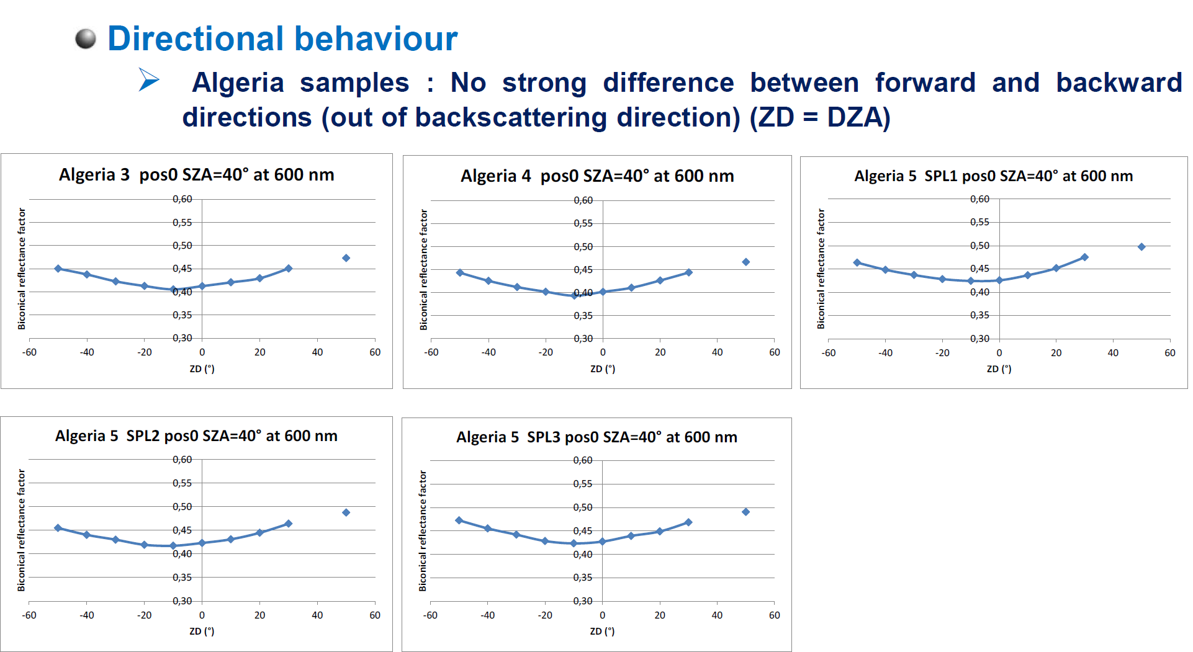
Project to evaluate possible new PICS and surface reflectance
Revisit selection of possible PICS sites
Establish database of measured characteristics of PICS sand
Attempt to build a BRF model (s)

Slide 16
Supporting CEOS VCs to establish global interoperability and address the needs of climate, carbon actions and meteorology:
An Ocean based case study

Slide 17
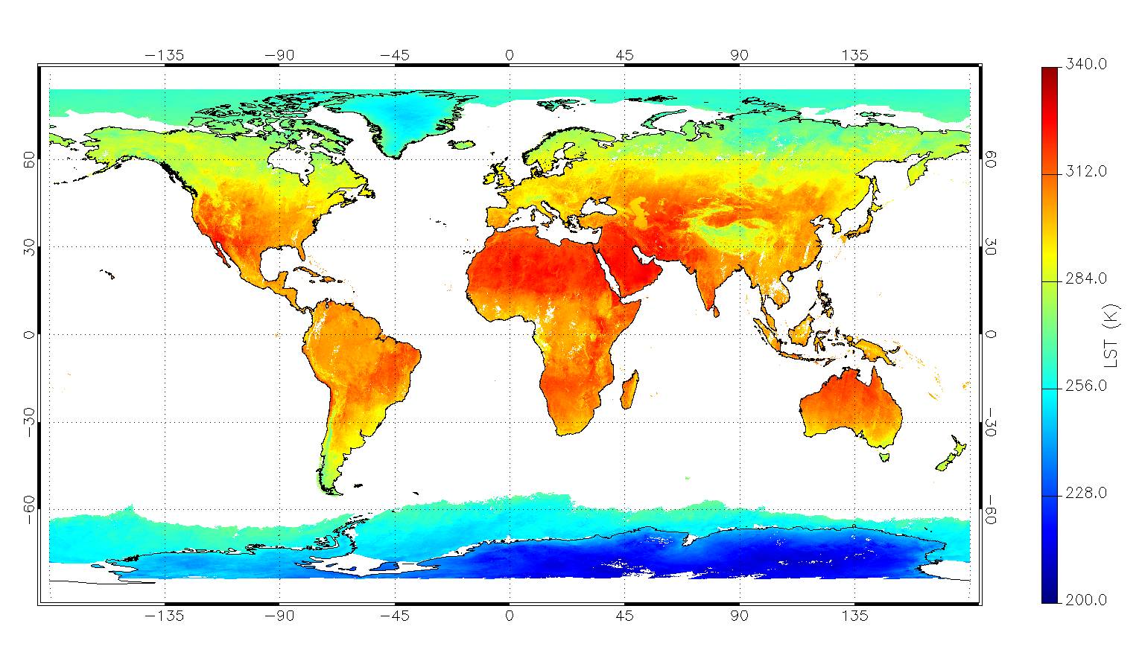
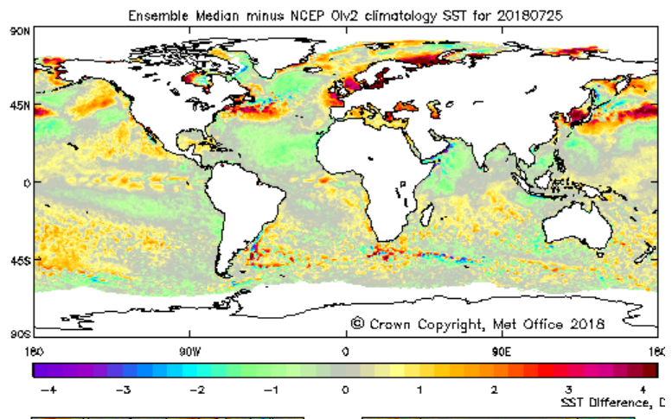
NEED: CEOS requests
SST & LST critical parameters for meteorology and climate
Long-time series (FCDRs) exist (AVHRR, ATSR+) and are being extended with new missions Sentinel 5, NOAA 20
Anomaly and trend detection require reliable detection of small signals from harmonised data sets
  Needs trustable uncertainty estimates
  Robust global validation with buoys & radiometers
CEOS WGCV historically supported community through organisation of comparisons (Miami 1-3)
Global Map of LST
2014: CEOS VC-SST & GHRSST (partly in support of WG-Climate) suggested to WGCV it was timely for a new comparison
6 yrs since previous CEOS comparison
Account for new best practise initiatives from QA4EO
New teams/instruments increased importance of LST
CEOS endorsed WGCV proposal for laboratory & field comparison
  ESA supported by NPL(UK) provided resource www.FRM4STS.org to organise a set of comparisons in 2016/17 to harmonise and ensure SI traceability of worlds validation teams on behalf of CEOS.
Map of SST anomaly

Slide 18

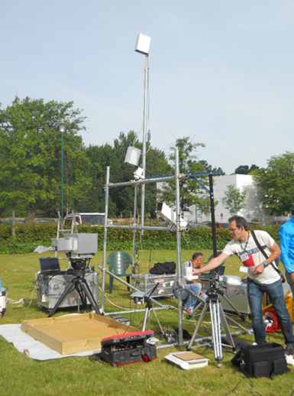
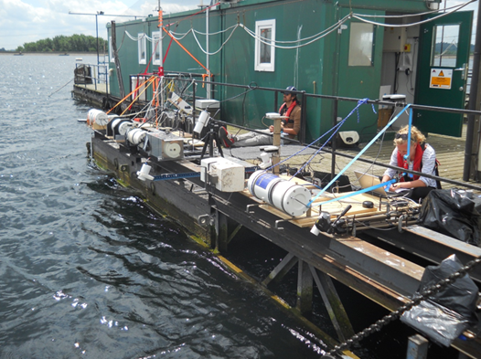
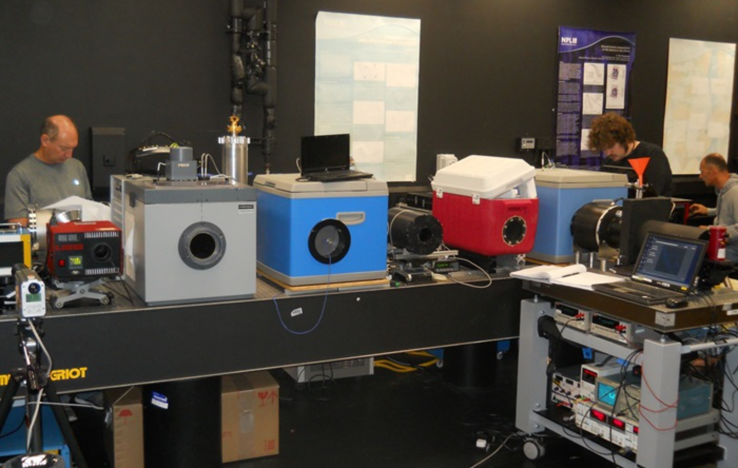
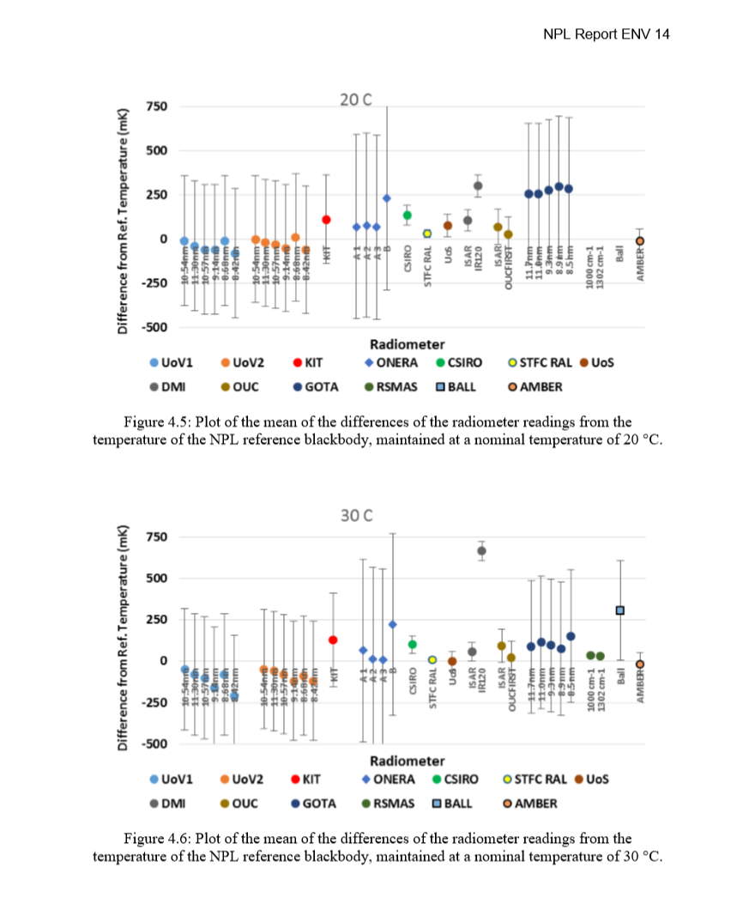
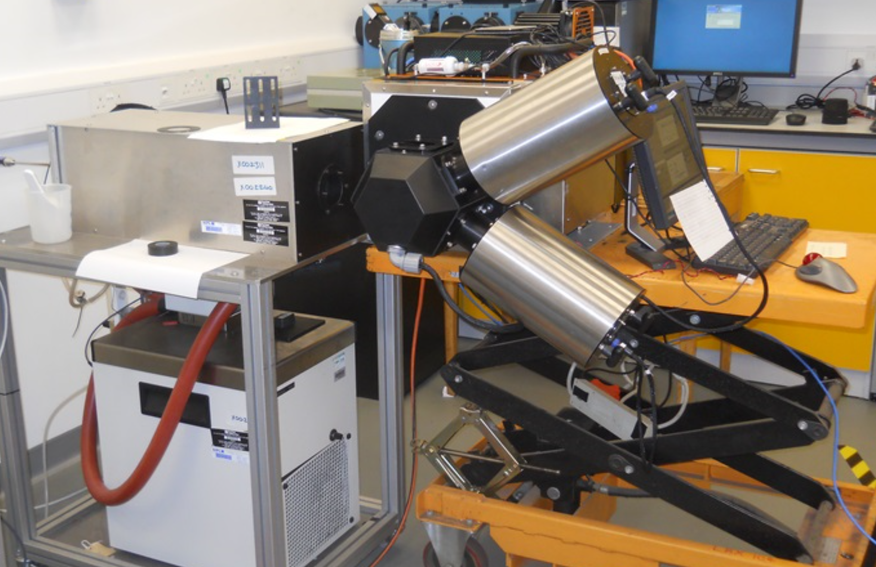
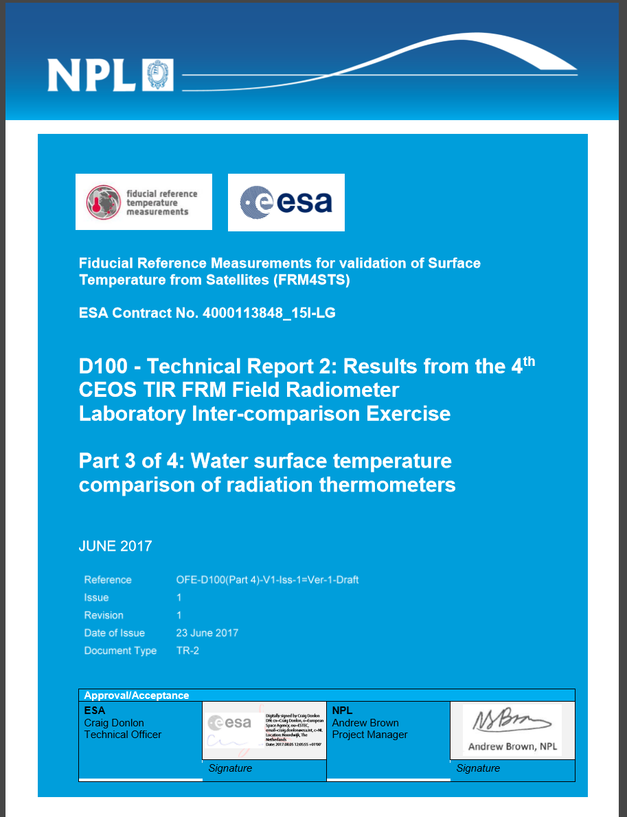
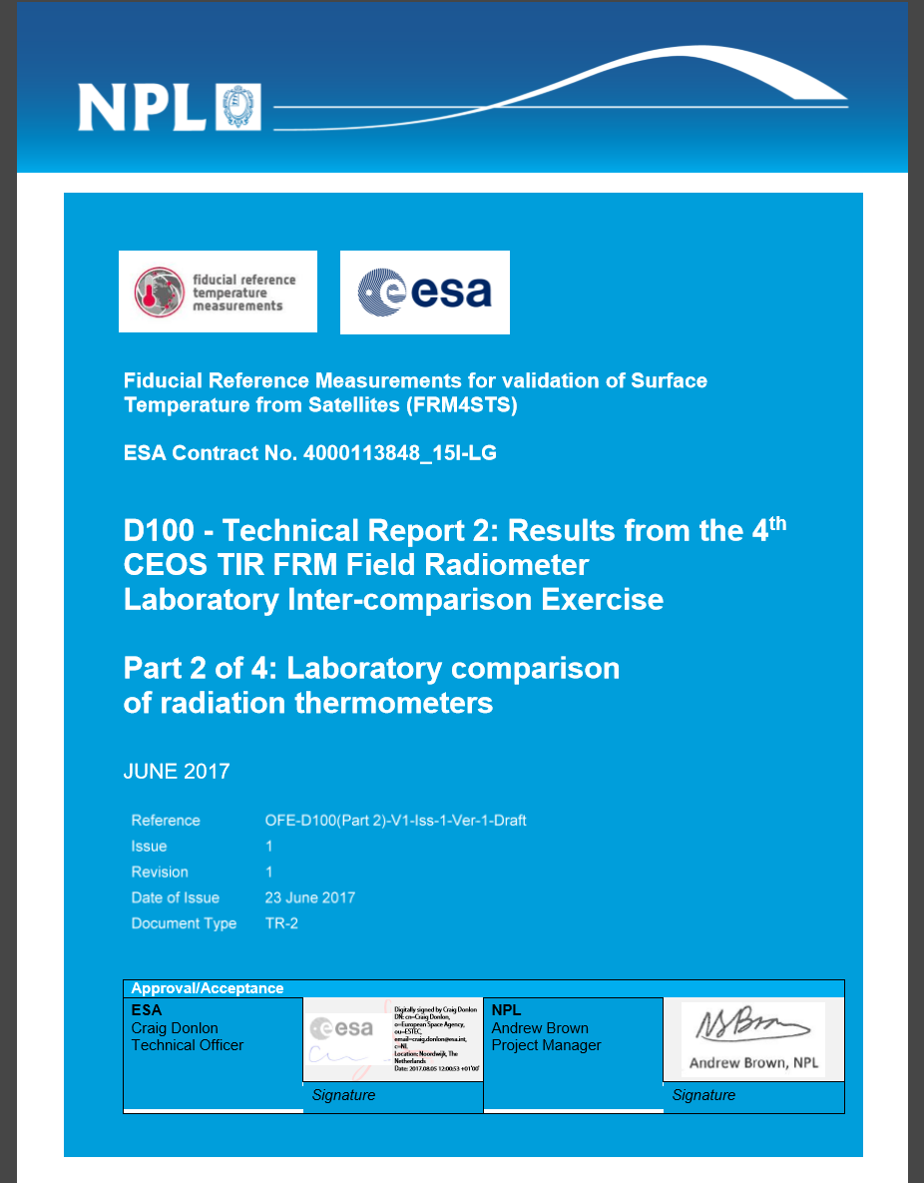
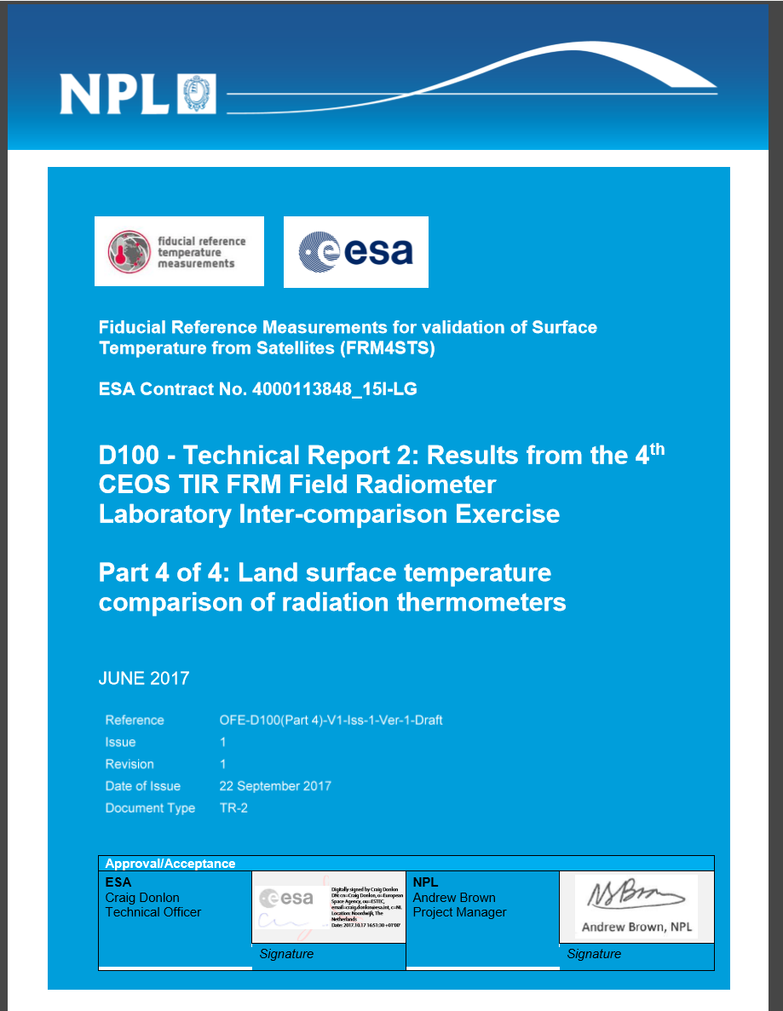
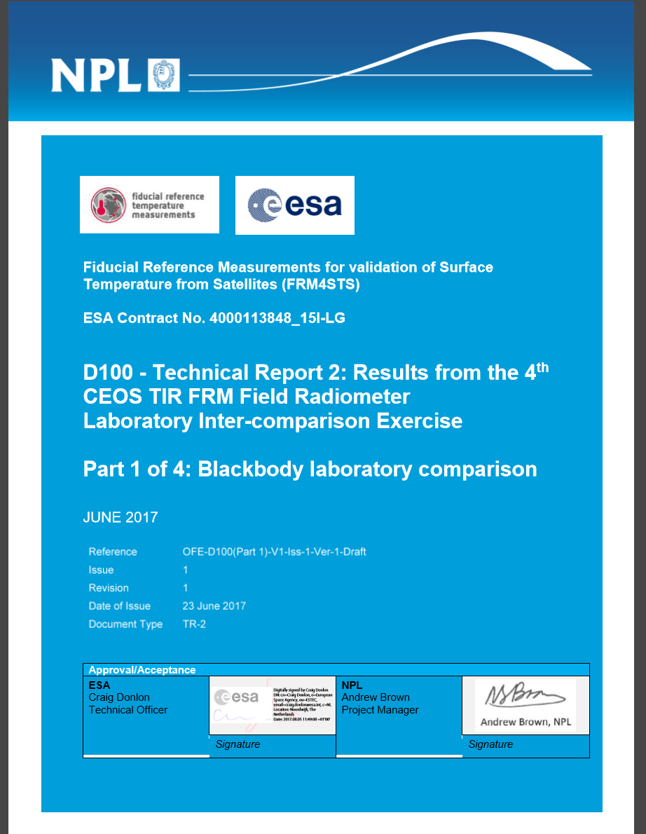
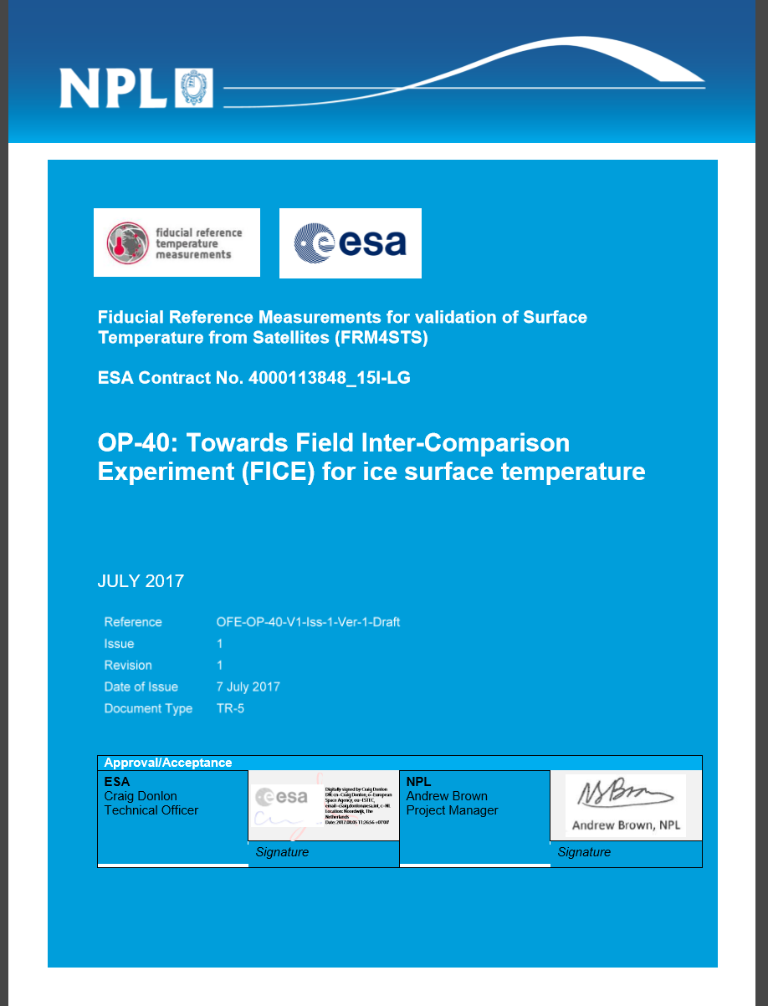
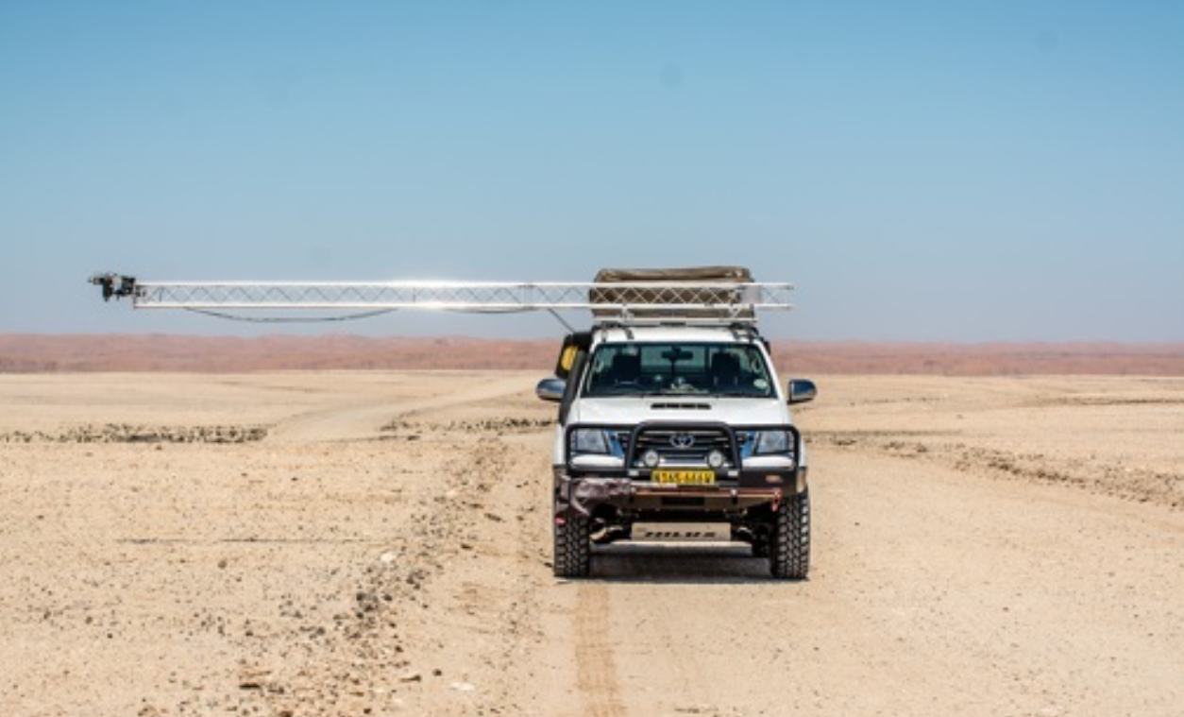

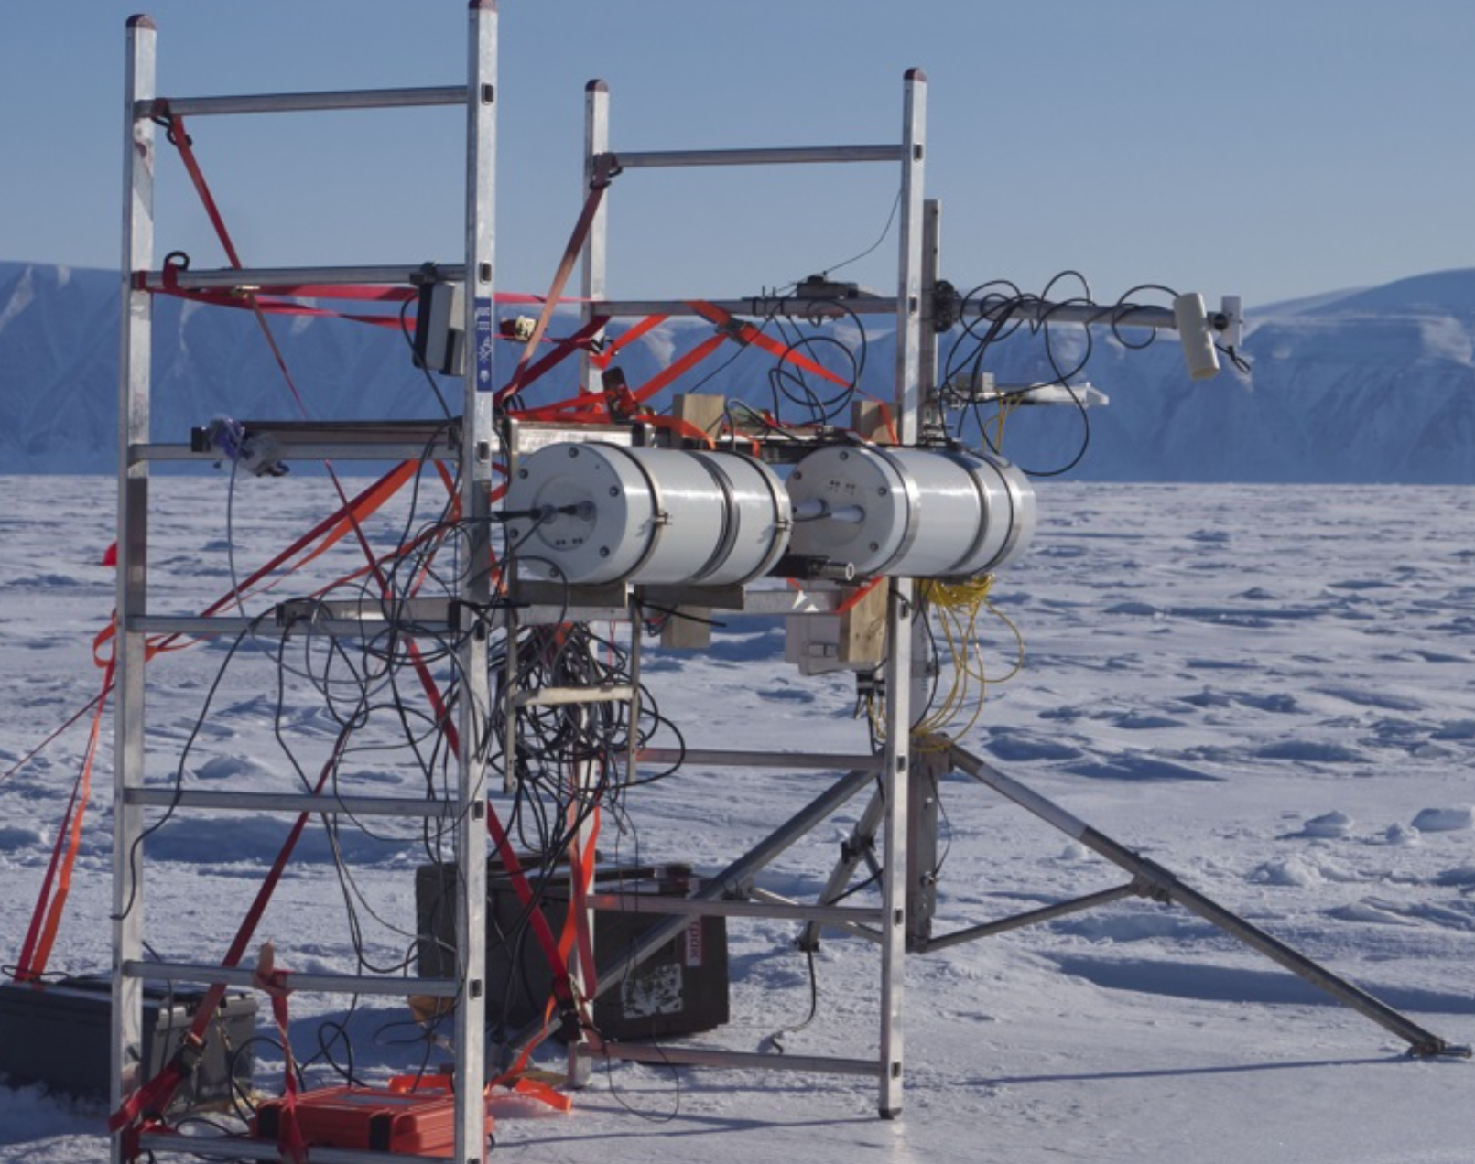
WGCV supported by
Has delivered to CEOS agencies and sub-bodies
10 types of comparison with 12 participants from 4 continents
8 best practices or protocols
Improved confidence, reliability and global consistency in validation of satellite derived Surface Temperature (Ocean, Land and Ice)
Community Improved knowledge of uncertainty evaluation
Legacy database to store future results
www.FRM4STS.org

Slide 19
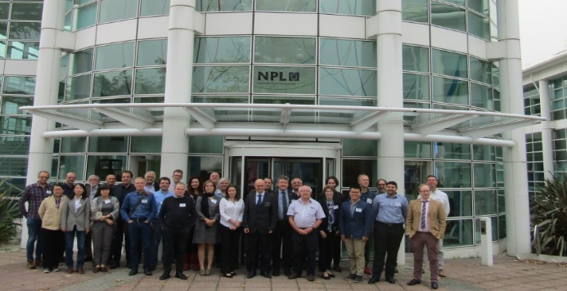
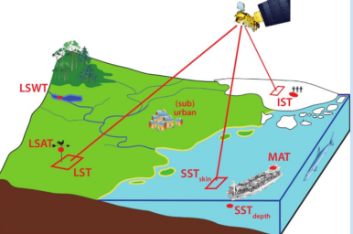
CEOS Workshop to develop long term strategy for Cal/Val (Temp)
Some Key Recommendations
CEOS to hold regular comparisons
- greater range of operational conditions
Improved cloud detection/masking
Research on ‘representativeness of validation
– scaling, global, ‘skin’ to bulk (water/snow)
Training on Uncertainty evaluation
Good practice guides
Oct 2017 40 world experts met at NPL, UK for a workshop to review results of comparisons, endorse protocols and develop recommendations/long-term strategy needed to sustain current and address future community (surface Temperature) needs
More Buoys & test sites
Encourage ‘super sites’ (multiple parameters)

Slide 20
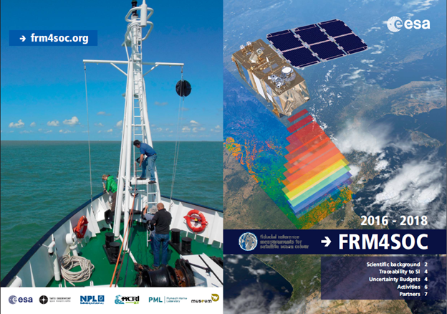
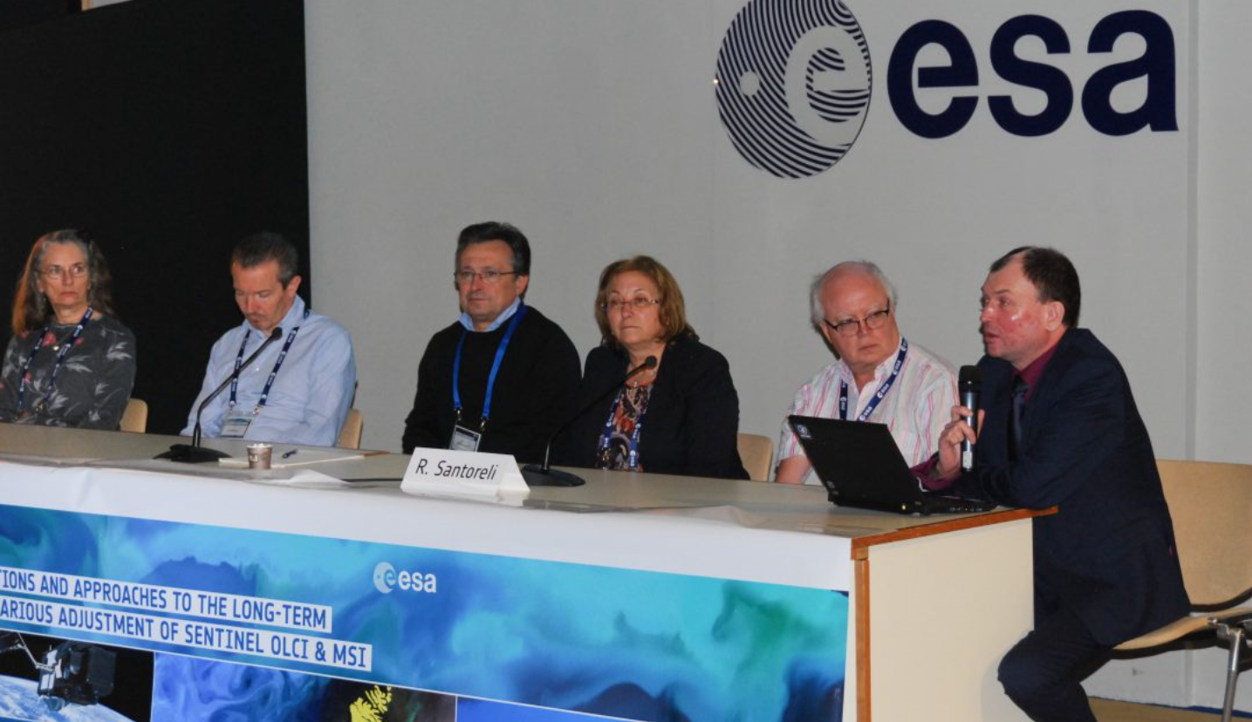

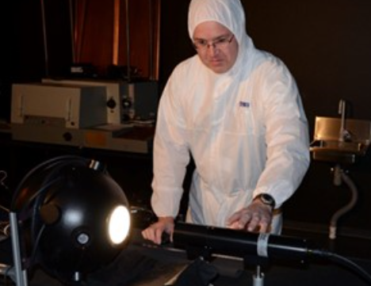
CEOS WGCV provides similar support for VC-OCR/IOCCG & Carbon
Need: Very high accuracy requirements for ocean colour not currently achievable without post-launch vicarious calibration of sensor system (inc. retrieval algorithm) using reference buoys (MOBY/BOUSSOLE) and validation from networks like Aeronet-OC and ship campaigns: Infrastructure and protocols need to be SI traceable and consistent to ensure interoperability and meet the needs of users particularly Climate & Carbon actions
Reviewed IOCCG and VC-OCR Cal/Val strategy documents
2017 initiated (with support from ESA FRM4SOC) set of international comparisons on Cal/Val instrumentation
  Laboratory based measurements
  Water based (in lake)
  Water based from ‘Venice tower’ platform in Mediterranean sea
  Ship based on Atlantic to Antarctic transect
Developed 5 protocols/good practice guides
Held an international workshop to consider long term Cal/Val strategies including criticality for reference buoys
Provides the forum to share best practices/synergy related to sensor pre-flight calibration between land/Atmosphere/Ocean (to be enhanced by forthcoming WGCV/GSICS workshop)
For more info see www.FRM4SOC.org

Slide 21
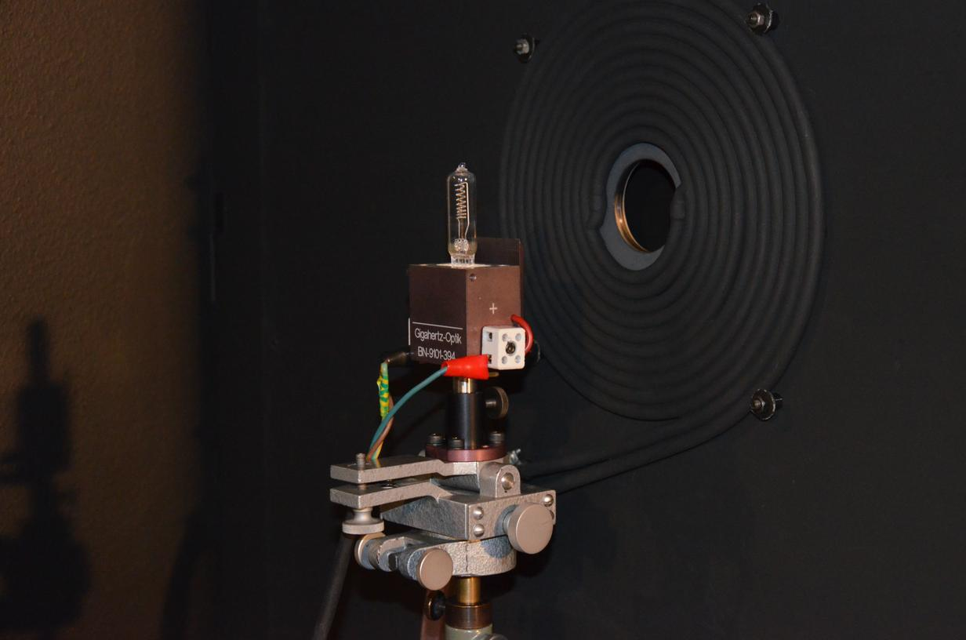
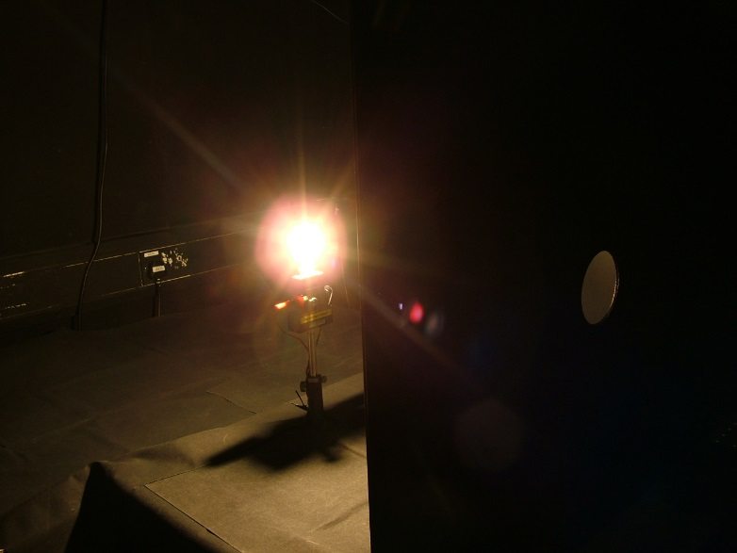

Irradiance comparison participants
Participant |  | Country
NPL | National Physical Laboratory | UK
TO | Tartu Observatory | Estonia
Satlantic | Seabird Scientific | Canada
CSIRO | Commonwealth Scientific and Industrial Research Organisation | Australia
NERC-FSF | Natural Environment Research Council’s Field Spectroscopy Facility | UK
LOV | Laboratoire d’Océanographie de Villefranche | France
NOAA | National Oceanic and Atmospheric Administration | USA

Slide 22
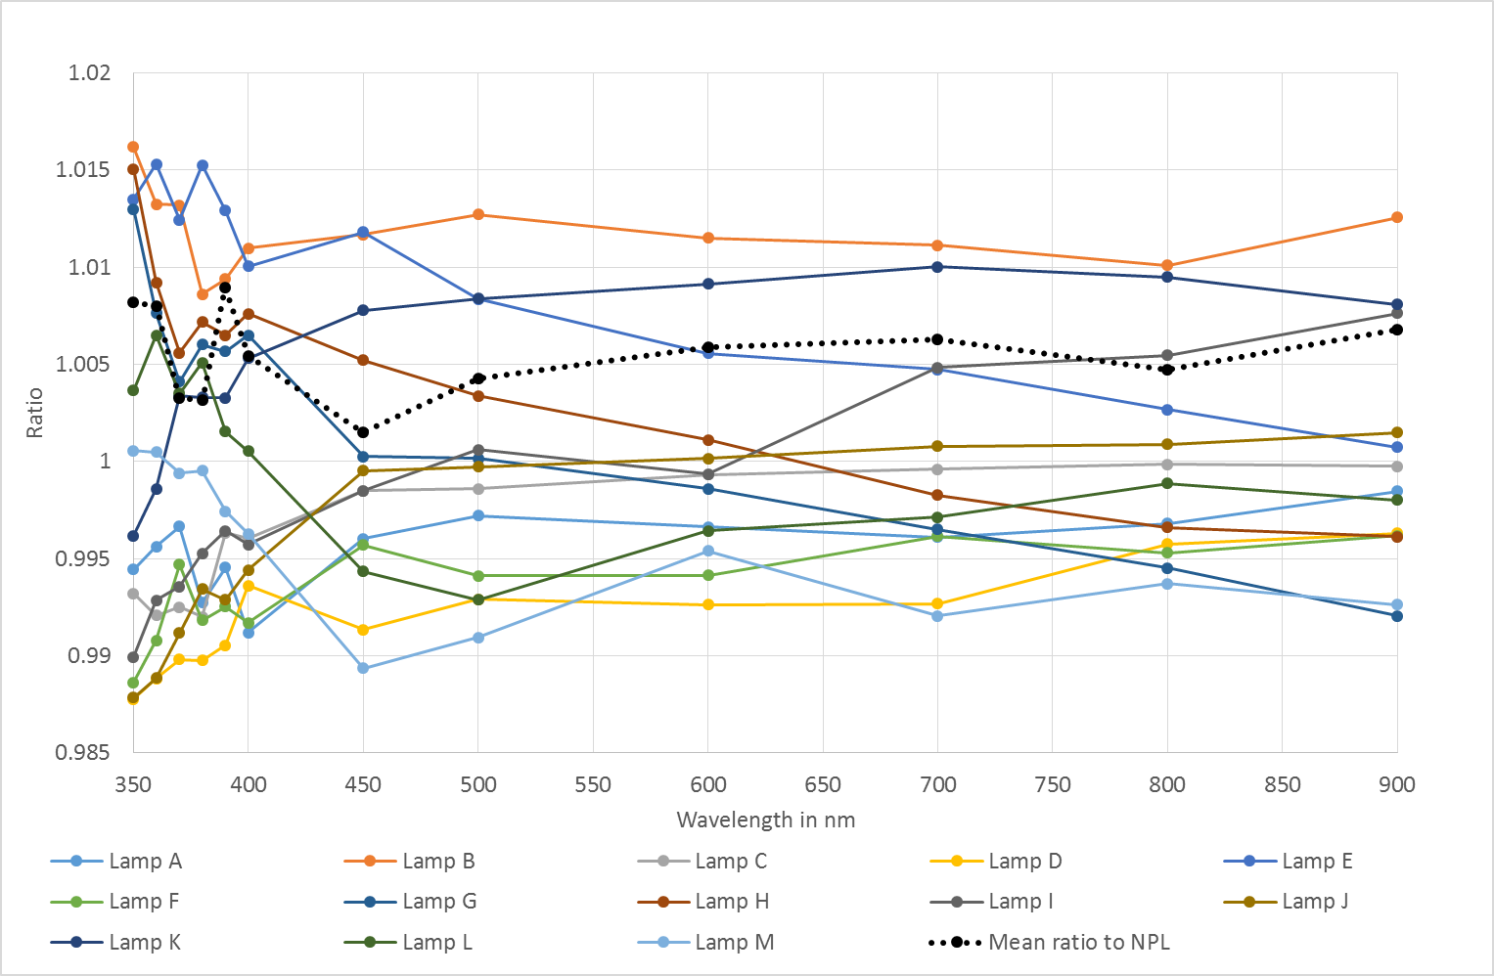
Irradiance Source Inter-comparison
Provisional
Summary of all lamps used in irradiance comparison

Slide 23
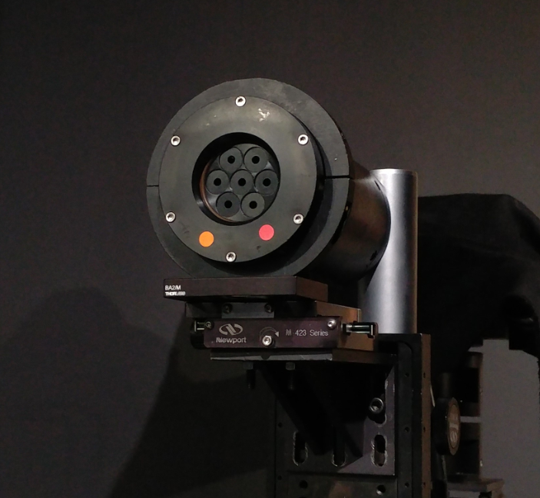
Radiance Comparison Radiometers
Channel | OCR-051 Wavelength nm | OCR-110 Wavelength nm
1 | 412.0 | 413.0
2 | 443.7 | 443.0
3 | 491.0 | 491.4
4 | 510.7 | 510.4
5 | 556.4 | 556.2
6 | 667.1 | 666.3
7 | 684.9 | 684.1

Slide 24
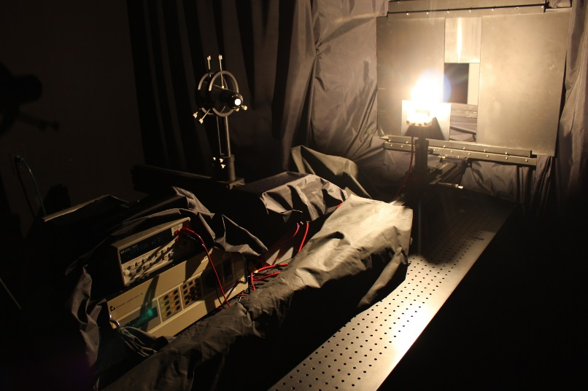
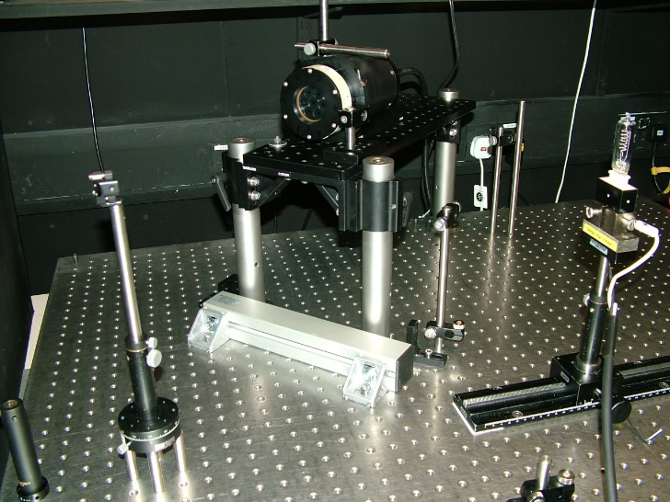
Radiance Comparison participants
Participant |  | Country
NPL | National Physical Laboratory | UK
TO | Tartu Observatory | Estonia
JRC | Joint Research Centre | European Commission
Satlantic | Seabird Scientific | Canada
CSIRO | Commonwealth Scientific and Industrial Research Organisation | Australia
NIVA | Norsk Institutt for Vannforskning | Norway
NERC-FSF | Natural Environment Research Council’s Field Spectroscopy Facility | UK
DLR-IMF | Remote Sensing Technology Institute, Deutsches Zentrum für Luft und Raumfahrt | Germany
LOV | Laboratoire d’Océanographie de Villefranche | France
NOAA | National Oceanic and Atmospheric Administration | USA

Slide 25
Radiance comparison provisional
(using original data provided by participants inc 8°/h reflectance)

Slide 26
Radiance Comparison provisional
(after 8°/h - 0:45 correction where necessary)

Slide 27
Radiance comparison provisional
(using original data provided by participants inc 8°/h reflectance)

Slide 28
Radiance comparison Provisional
(after 8°/h - 0:45 correction where necessary)

Slide 29
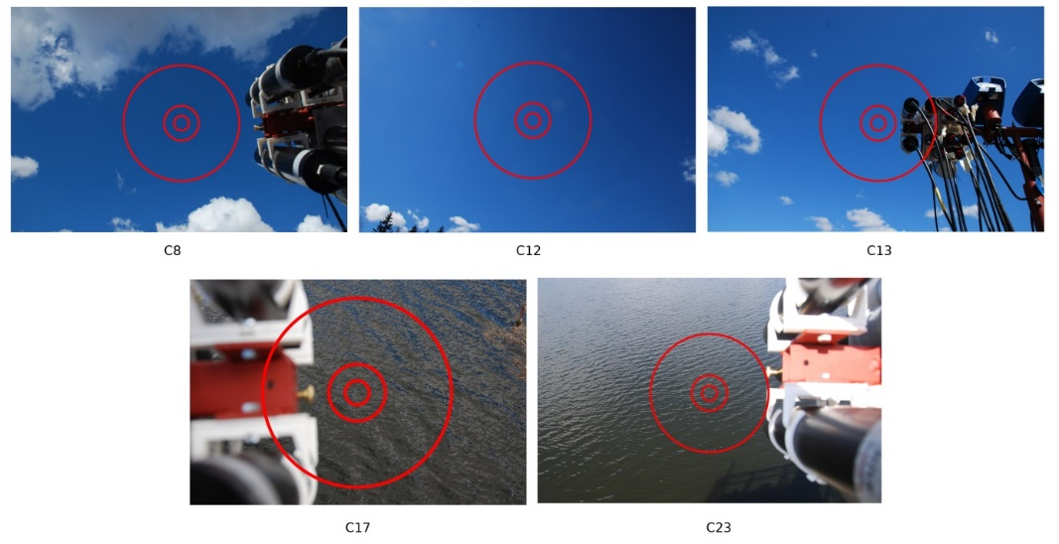
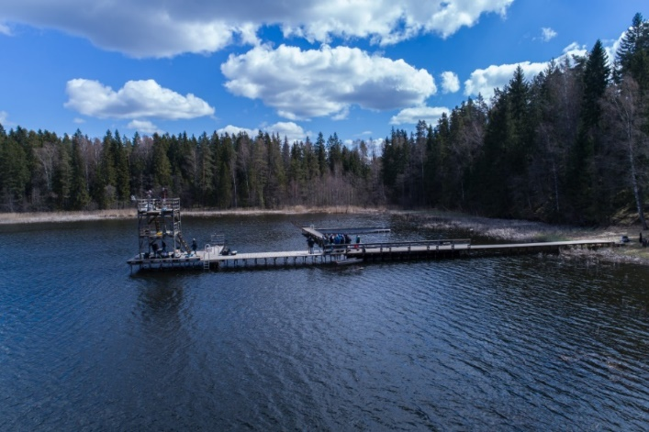
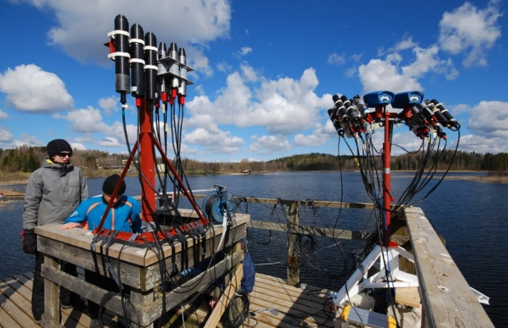
Water based comparison
11-12 May 2017, Lake Kääriku, Estonia
Measurement of sky and water radiance and downwelling irradiance
Conditions were not ideal due to cumulus clouds. Only casts with most stable signal were used for intercomparison
Irradiance and radiance sensors during the outdoor exercise
Lake Kääriku
Radiance casts used in the
intercomparison with approximate
FOV footprints of different radiometers.

Slide 30
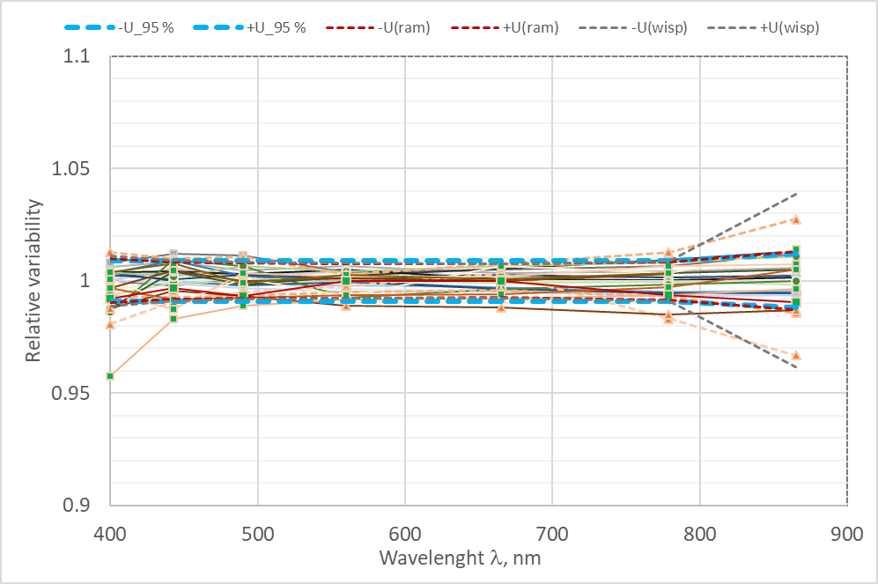
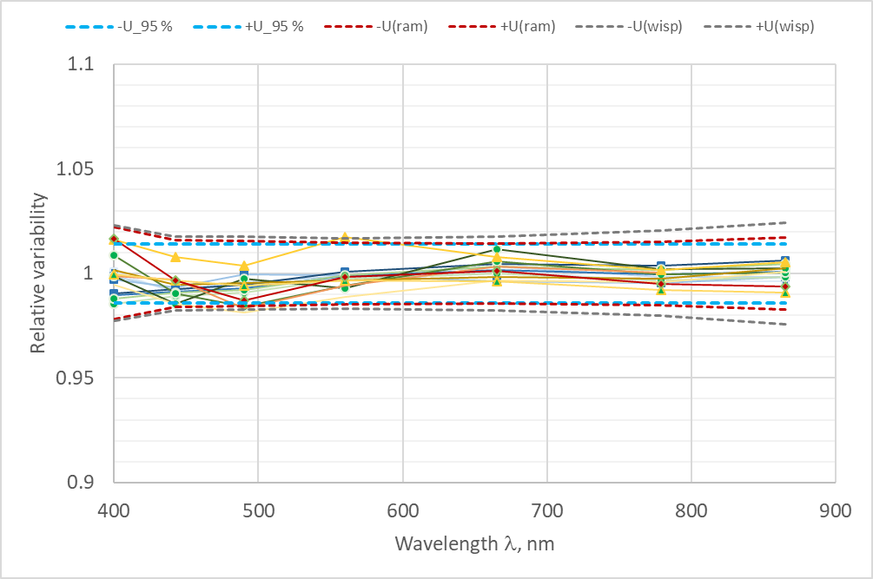
Provisional Lab results prior to water
Good agreement between participating radiometers was achieved after removal of several data processing mistakes and using unified data handling methods
The differences would probably have remained unnoticed for typical in situ measurement campaign without possibility to compare with other radiometers.
Indoor irradiance compared to
reference filter radiometer
Indoor radiance
compared to median

Slide 31
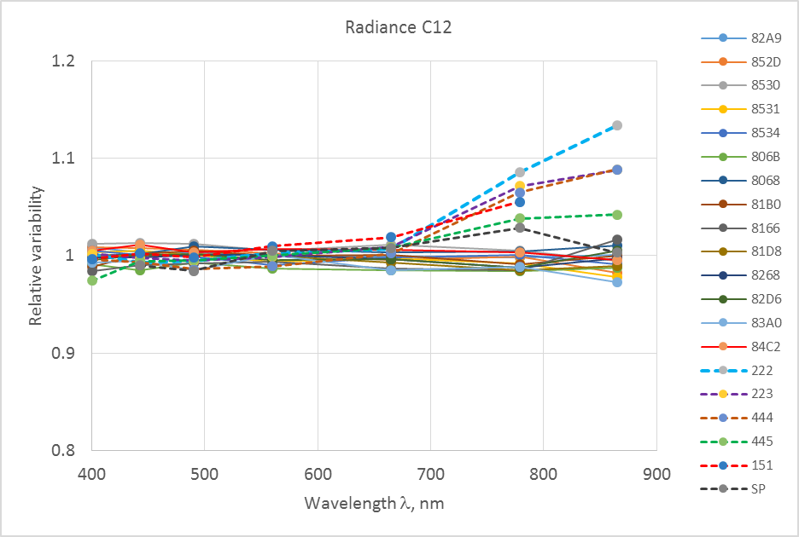
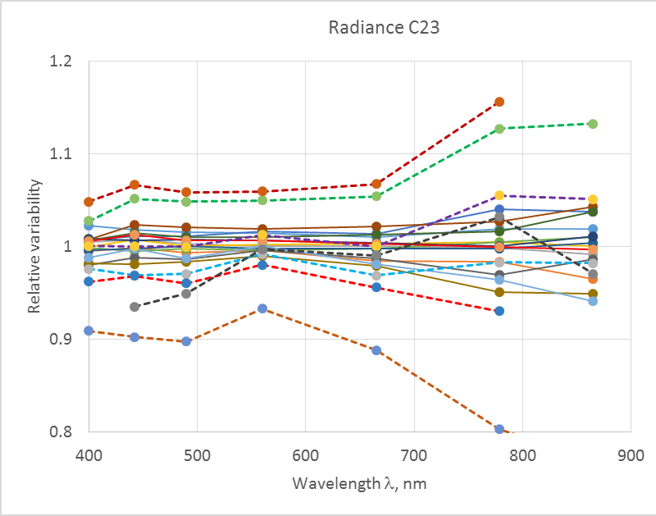
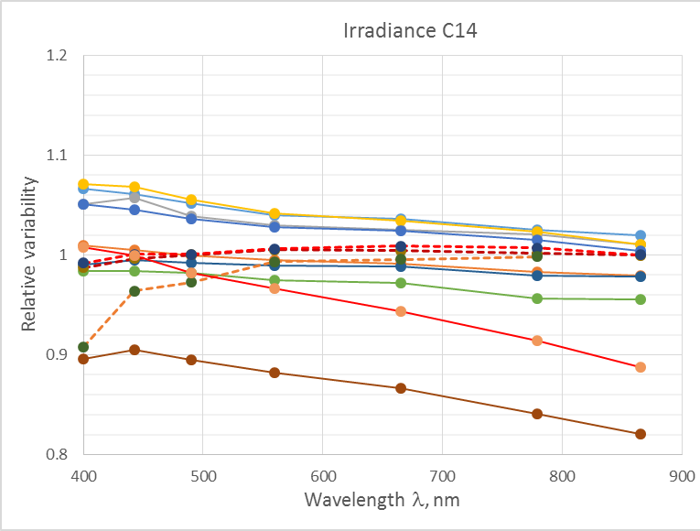
Provisional results Water
Agreement in outdoor experiment was worse, especially in the NIR
There were some outliers but their behavior was not always consistent and the reason is not fully understood (possibly nonuniformity of targets and differences in FOV)
Sky radiance
Water radiance
Irradiance

Slide 32
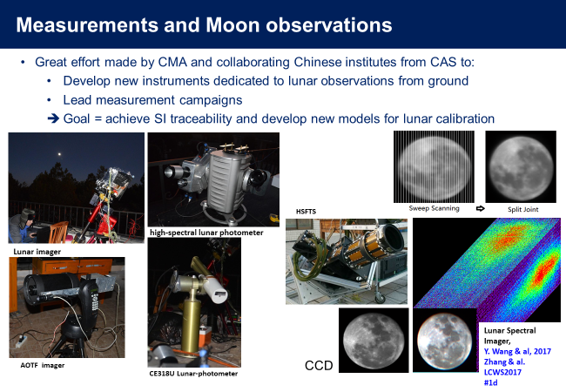
2nd GSICS/CEOS workshop on moon
Xi’an China, Nov 2017
14 agencies 26 attendees
22 agencies 60 attendees
USGS ‘ROLO’ new funding
Starting to look at new uses of
moon e.g MTF (link with IVOS)

Slide 33
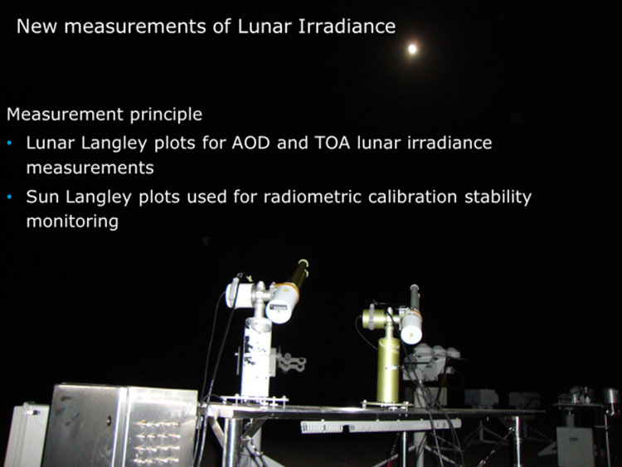


ESA project to measure lunar irradiance as a Cal reference
Define a strategy to derive the model regression coefficients (ROLO based) from the lunar measurements
Derive regression coefficients from database of measurements
Measurements uncertainty propagation in to the model parameters / regression coefficients

Slide 34
Terminology
Uncertainty
is not
the same as
Error

Slide 35
Task group on vocabulary formed
Name | Institute
Emma Woolliams | NPL
Steffen Dransfeld | ESA-ESRIN
Lingling Ma | AOE-CAS
Xinhong Wang | AOE-CAS
Hirokazu Yamamoto | AIST
Paolo Castracane | ESA-ESRIN
Name | Institute
Stefanie Holzwarth | DLR
Cindy Ong | CSIRO
Carol Bruegge | JPL-NASA
Cibele Teixeira Pinto | South Dakota State University
Martin Bachmann | DLR
Select some key terms and also concepts create a dictionary /
thesaurus and also small video explanations where useful

Slide 36



Benchmark Calibration/climate sensors
Plan to have a CEOS/GSICS workshop in Europe in 2019 WEBEX to define scope
Sep 13 organised by GSICS
CLARREO
TRUTHS
Chinese Benchmark sensor

Slide 37




A new community 3D RT code
vincent.leroy@rayference.eu

Slide 38

Project website created
Community interface
Requirements Specification
Strategy for development
Progress
www.eradiate.eu

Slide 39
Summary
IVOS active team expanding (good global coverage- agency and industry)
Thematic projects working effectively with motivated champions: Number sometimes make logistics for meetings an issue but are working well between IVOS plenaries via webex etc
Recommendations proposed and agreed at CEOS WGCV 42/43 (MTF sites and comparisons etc are being implemented.
Looking for good examples of ‘impact’
Many collaborations with GSICS and supporting VCs
Keen to revitalise and use Cal/Val portal as the community interface
Plan to have session on Hyperspectral imagers at next IVOS.
Still need to engage and bring on-board some agencies

