Slide 1

Addressing GHG Validation in GHG
Albrecht von Bargen
DLR
Agenda Item # 99
WGCV Plenary # 42
Canberra
May 16 - 19, 2017

Slide 2
Adressing GHG Validation
WGCV Plenary # 44
Presentation is not a complete survey but a starting point
Introduction of state-of-the-art network: TCCON
How to integrate in WGCV discussion related to GHG
Additional means / campaigns / activities to be taken into account
  COCON (KIT)
  EM-27
  COMET-1 campaign (-> presentation on Thursday)

Slide 3
The Total Carbon Column Observing Network (TCCON) – cal/val reference for all GHG satellite missions
Dietrich Feist
TCCON Deputy Chair Europe & Africa
Max Planck Institute for Biogeochemistry
Jena, Germany

Slide 4
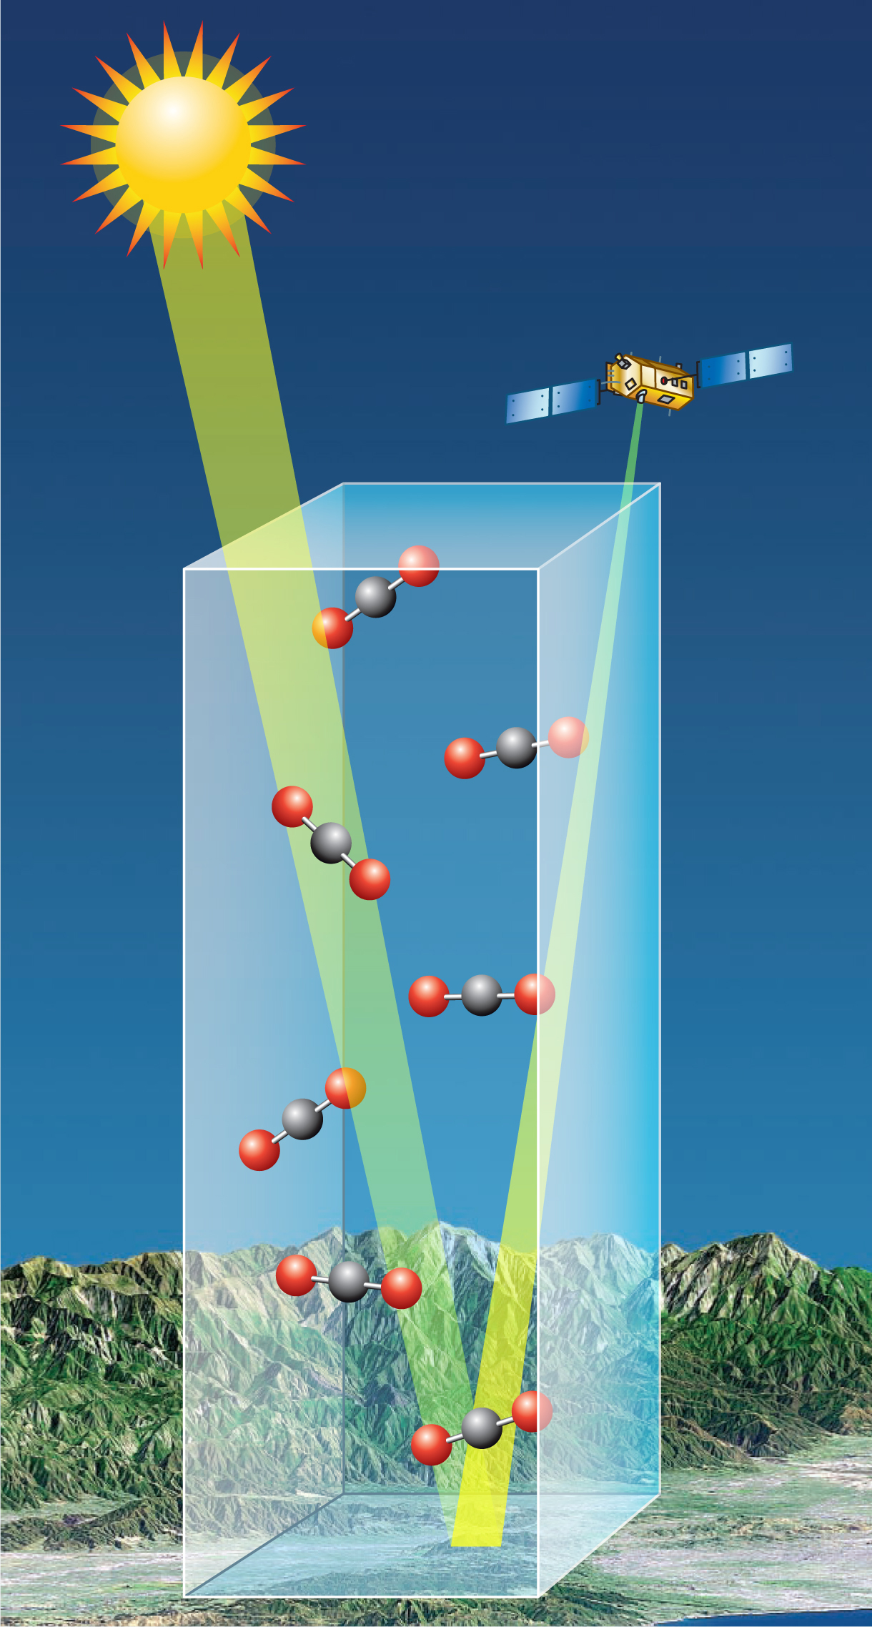
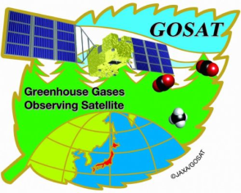

Remote sensing: column-averaged GHG observations
http://oco.jpl.nasa.gov/
GOSAT/Japan:
since 2009
OCO-2/USA:
since 2014
Covers full atmospheric column from ground to ~100 km
Measure total column of CO2/CH4 and use total column of O2 as proxy for airmass (assuming constant mole fraction of 0.2095)
Observed parameter is colum-averaged dry-air mole fraction => XCO2/XCH4
Division of columns minimizes broad-band spectral biases (e.g. from aerosols)

Slide 5
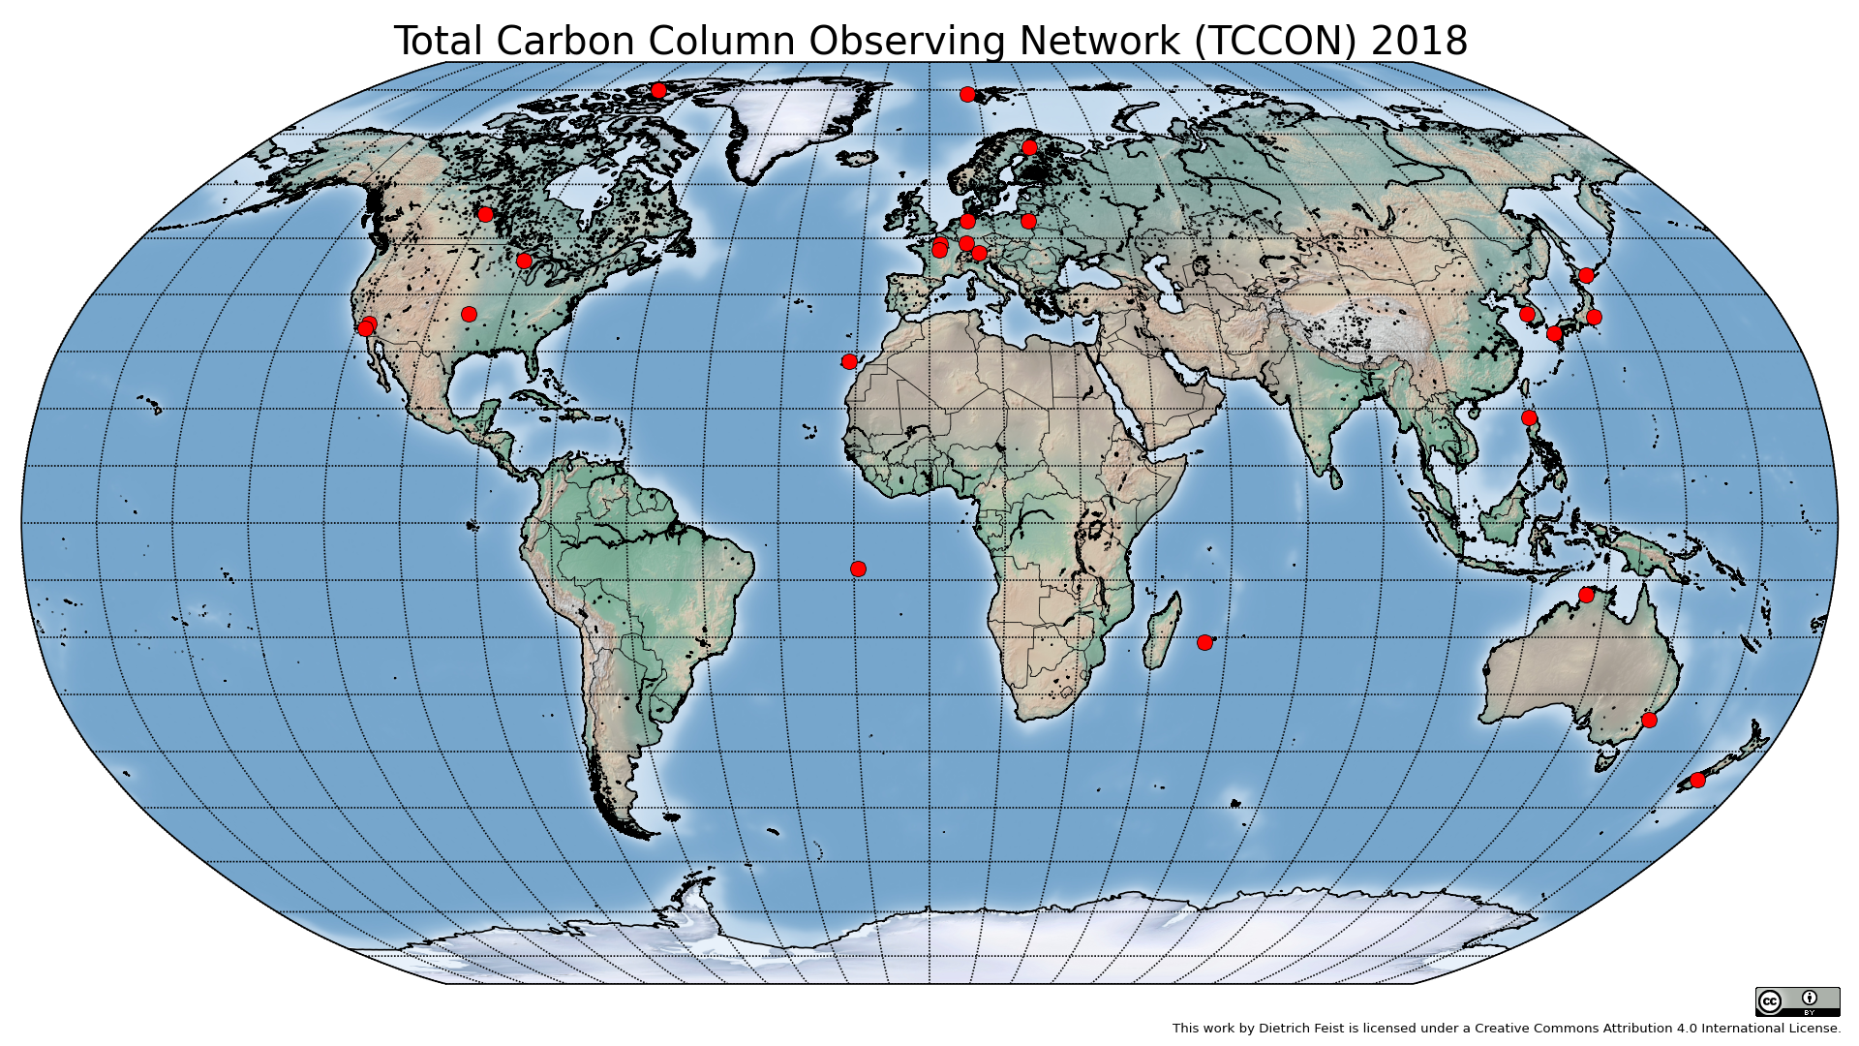
Total Carbon Column Observing Network (TCCON)
Network of ground based FTIR stations
Different groups, common standards
High-precision column observations of CO2, CH4, CO, N2O.
Crucial reference for satelllite GHG measurements

Slide 6
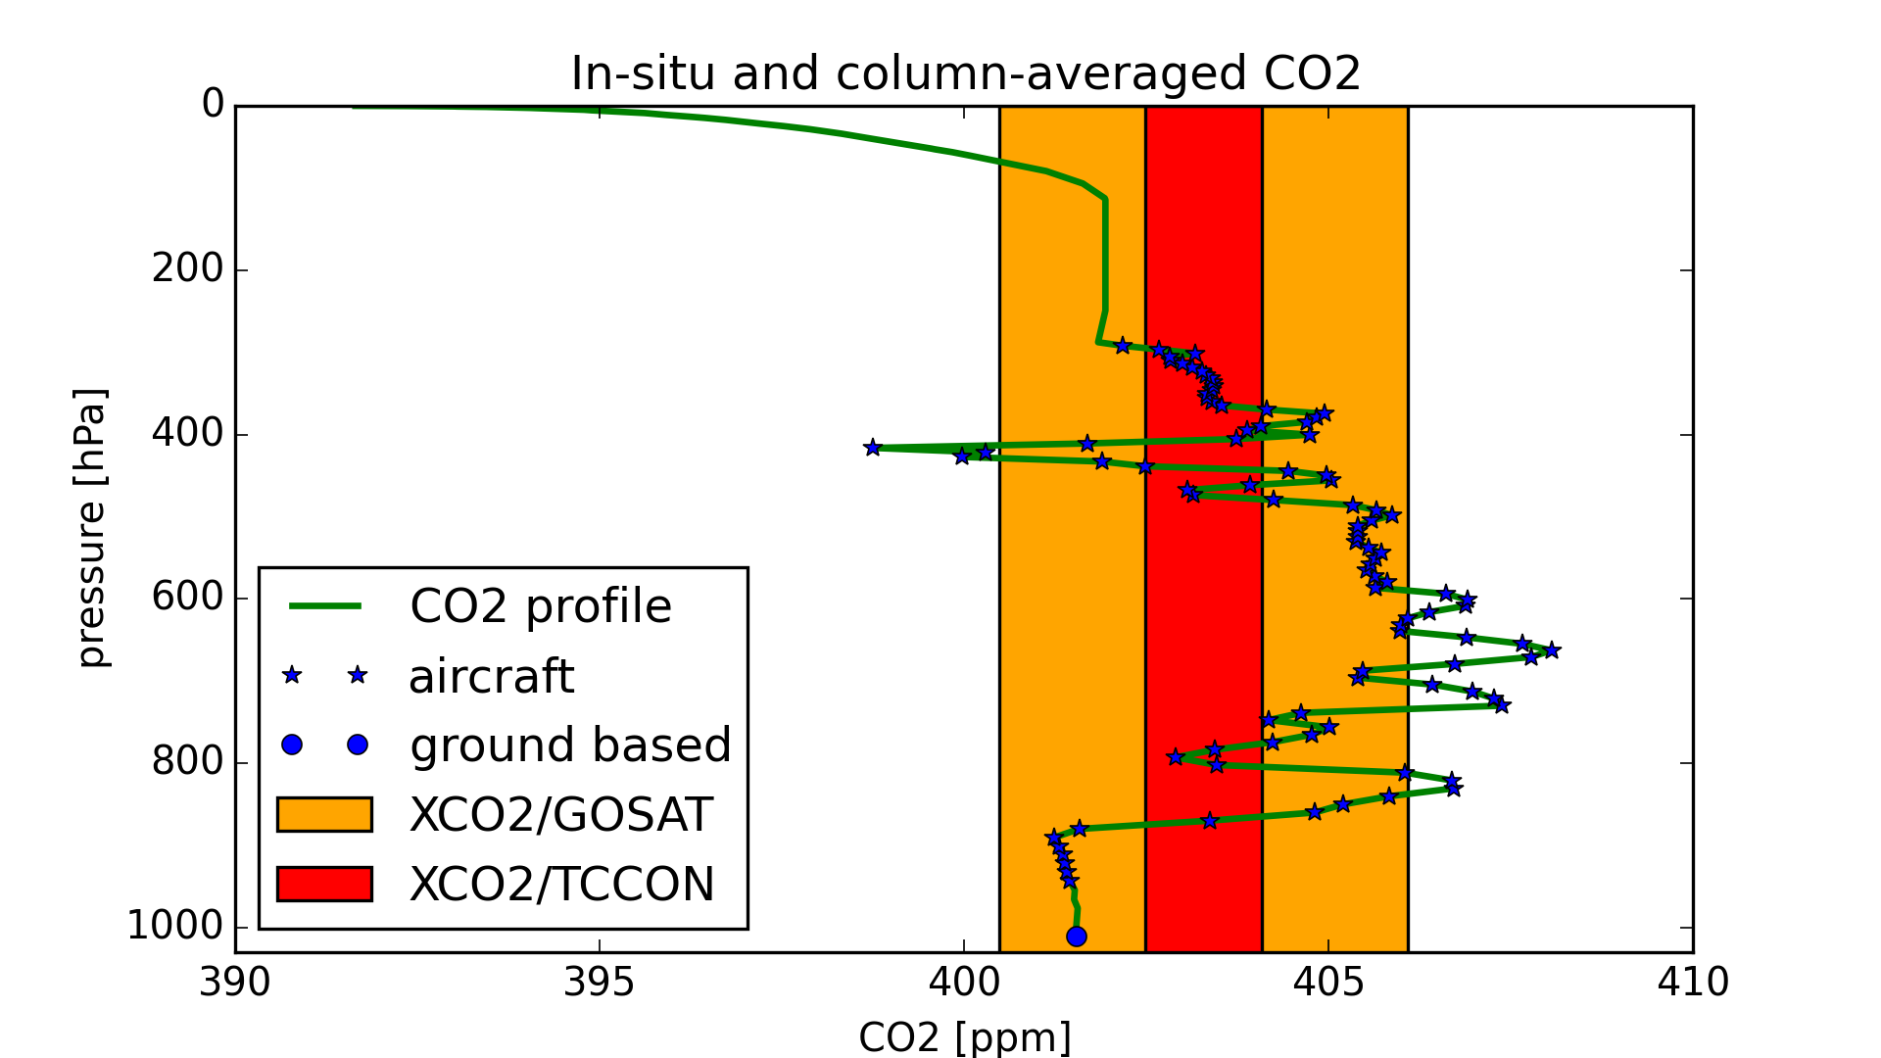
Column-averaged XCO2 and in-situ CO2 are hard to compare

Slide 7
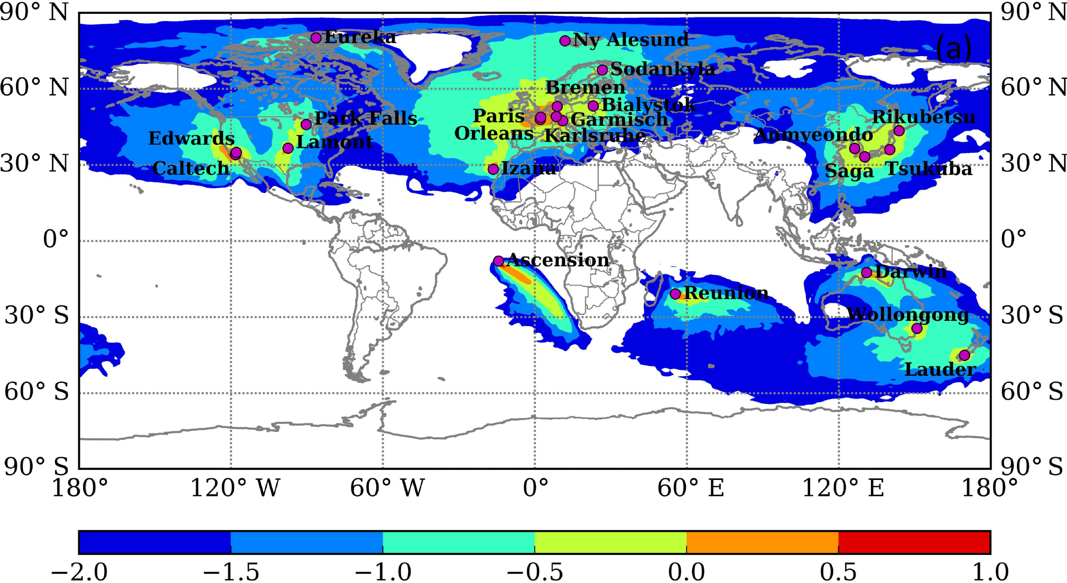
TCCON global coverage
Correlation with adjacent grid cells
From:
Belikov et al., ACP, 2017

Slide 8
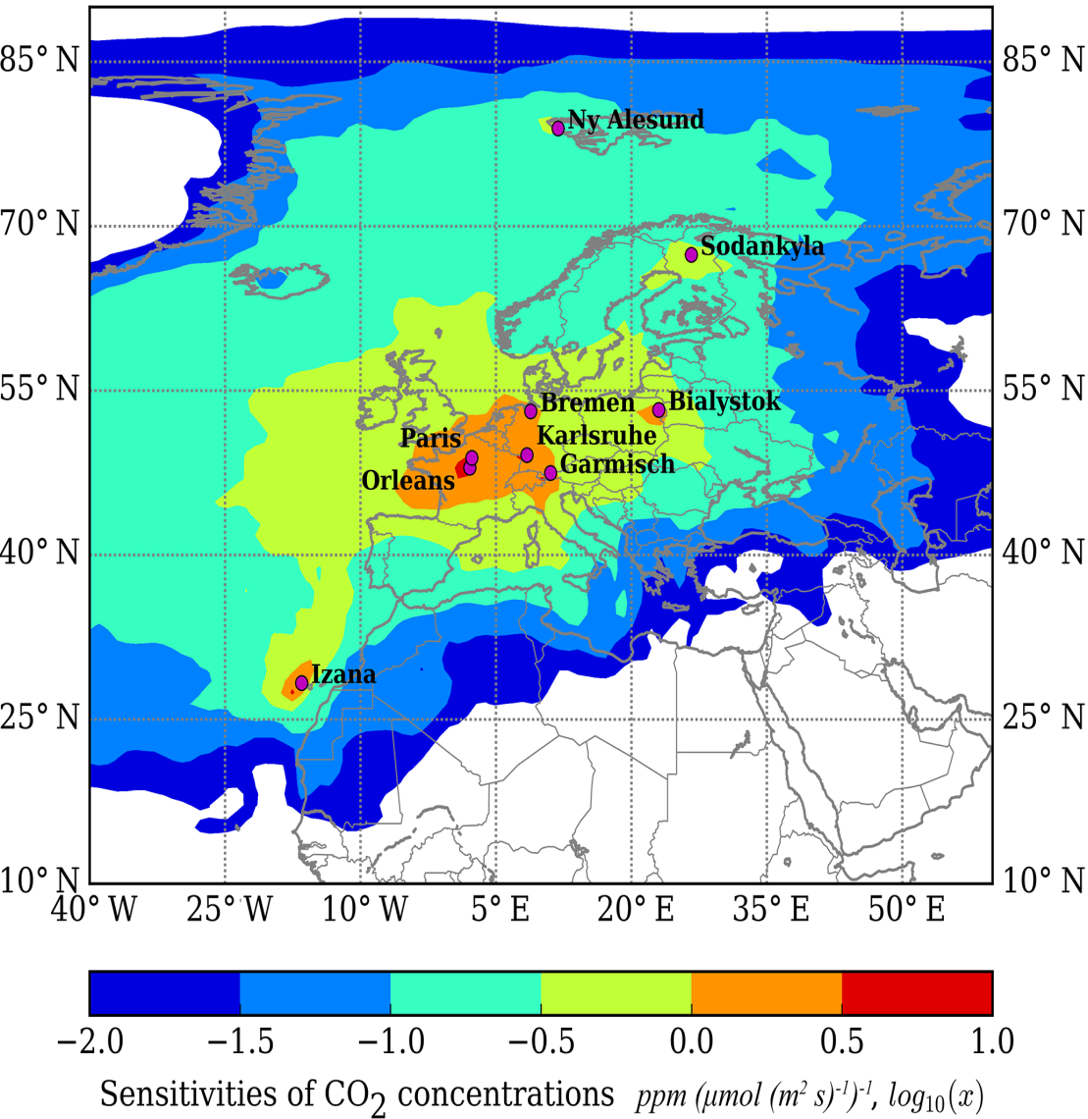
TCCON European coverage
From:
Belikov et al., ACP, 2017
Correlation with adjacent grid cells

Slide 9
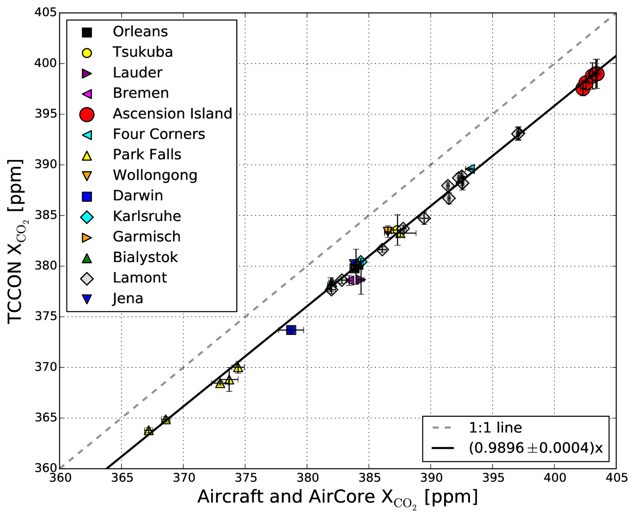
TCCON XCO2 is calibrated to WMO
CO2 in-situ scale
TCCON stations are calibrated vs aircraft in-situ profiles
Calibration provides network-wide scaling factor from spectroscopic scale to WMO in-situ scale
Very consistent over many years and different continents
TCCON provides link between in-situ networks and satellites

Slide 10
TCCON & ICOS
TCCON is currently not associated with ICOS.
Discussions to include (some) European TCCON stations in ICOS have been going on for some time. Official negotiations starting in Oct 2018.
Station operation in ICOS would have to be funded nationally. Issue: 8 out of 11 European TCCON stations are run by German groups.

Slide 11
Conclusions
TCCON is the cal/val reference for all current satellite GHG missions.
This reference cannot be provided by ground-based in situ observations readily.
Important regions like Africa and South America are currently not covered.
Very few TCCON stations have stable long-term funding.
All future satellite GHG missions at least plan to use TCCON data.

