Slide 1

JAXA Agency Report
Updates since WGCV-43
Committee on Earth Observation Satellites
Akihiko KUZE
(Earth Observation Research Center
Japan Aerospace Exploration Agency
CEOS WGCV 44
Darmstadt, Germany
August, 2018

Slide 2
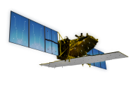
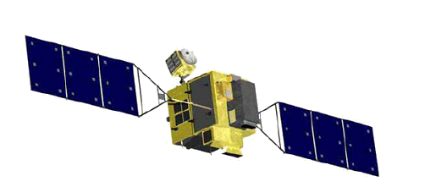

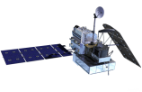
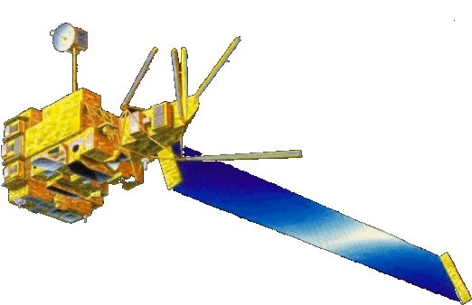


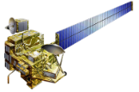
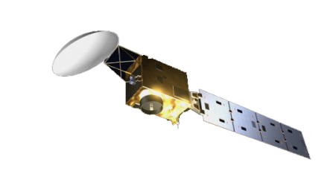


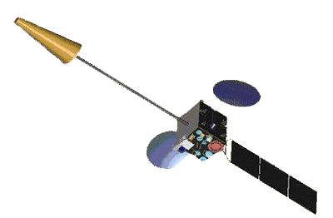
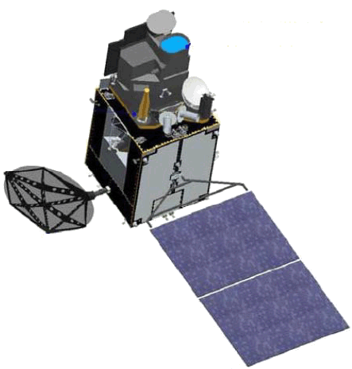
JAXA Earth Observation Satellite Lineup
Targets (JFY: Apr-Mar) |  | 2012 | 2013 | 2014 | 2015 | 2016 | 2017 | 2018 | 2019 | 2020 | 2021 | 2022
Disasters & Resources JERS1/OPS, SAR (1992-1998) ADEOS-I/AVNIR ALOS/AVNIR2, PALSAR (2006-2011)
Climate System Water Cycle ADEOS-I/AMSR (1996-1997) Aqua/AMSR-E (2002-2010)
Climate change ADEOS-I/OCTS (1996-1997) ADEOS-II/GLI (2003)
Greenhouse gases
[Land and disaster monitoring]
ALOS-2 / PALSAR-2
ALOS-4
ALOS-2CIRC
ISS/CIRC
ALOS-3
TRMM / PR 2013~
[Precipitation 3D structure]
Feasibility study
with NASA
GPM / DPR
with NASA
[Wind, SST , water vapor, precipitation]
AMSR2-F/O
GCOM-W / AMSR2
[Vegetation, aerosol, cloud, SST, ocean color]
GCOM-C / SGLI
[Cloud and aerosol 3D structure]
with ESA
EarthCARE / CPR
[CO_{2,} CH_{4,}
GOSAT / FTS, CAI 2009~
GOSAT2-F/O
[CO_{2,} CH₄, CO]
with MOE
GOSAT-2
JMA meteorological satellites
MTSAT-1R (Himawari-6)
MTSAT-2 (Himawari-7)
[Cloud, aerosol, SST]
[Cloud, SST]
Himawari-8/AHI
Himawari-9 (standby)
2
Mission status
On orbit
Development
Study
Pre-phase-A

Slide 3
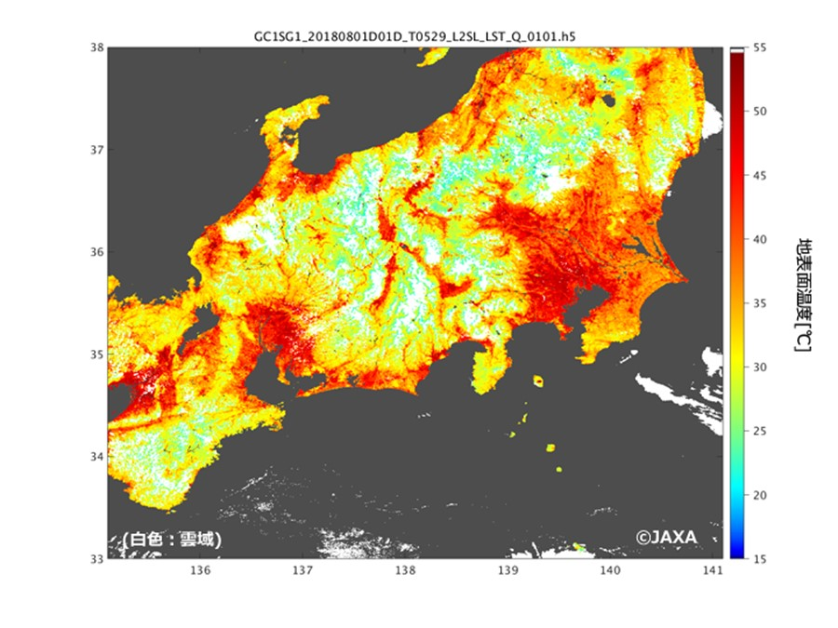
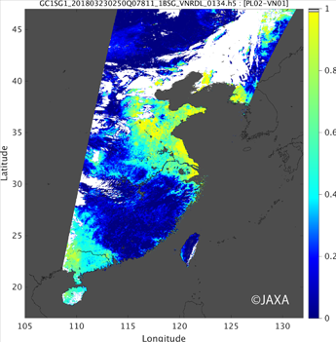
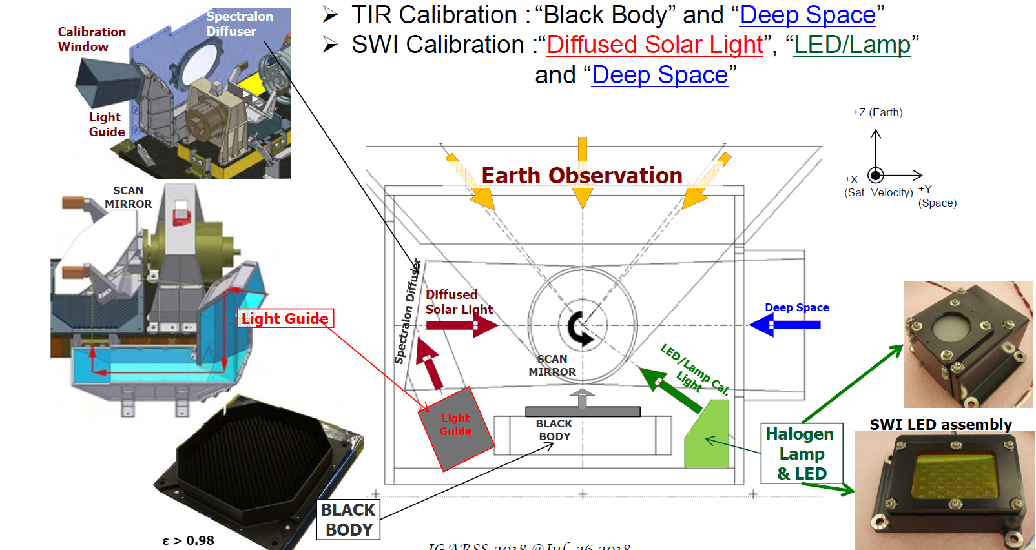
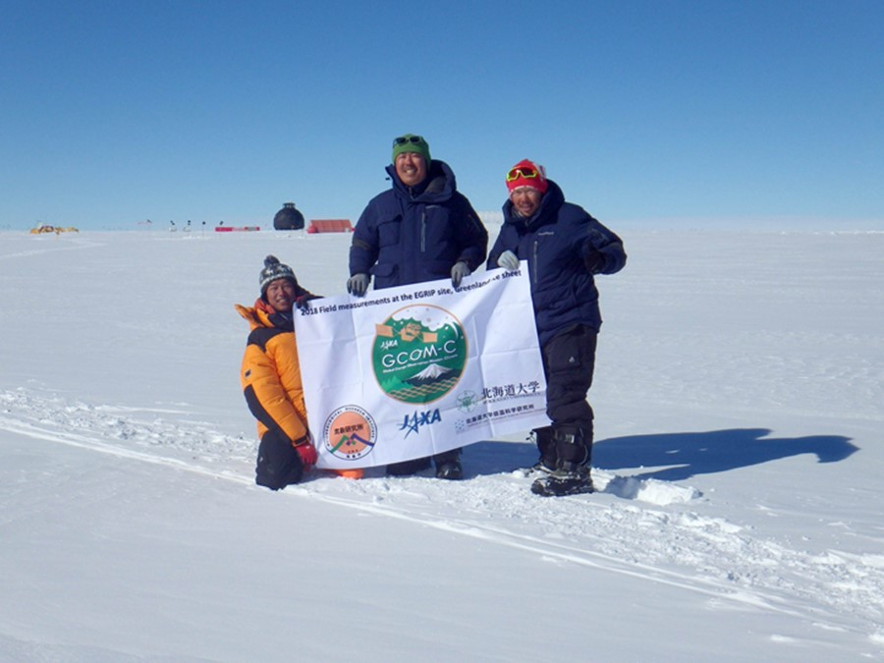

GCOM-C since 23 Dec. 2017
Hot summer 2018
Aerosol optical thickness
380 nm band
And polarization
Temperature ($℃$)
White (cloud)
3
Validation Campaign in Greenland, July 2018
SGLI onboard calibrations Okamura 2018

Slide 4
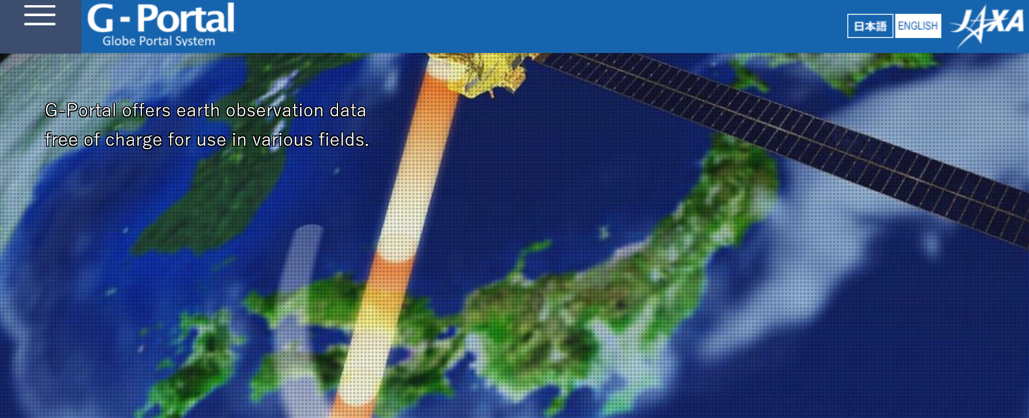
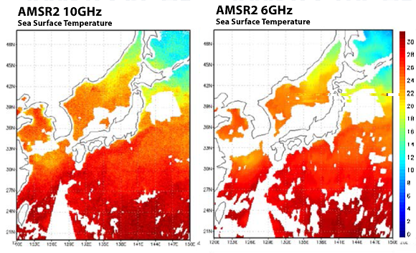
GCOM-W (2012-)
AMSR-2 microwave radiometer
June, 2018 AMSR-2 data site moved to G-Portal
The Roadmap for the Basic Plan on Space Policy was revised in Dec. 2017: “The government should conduct development research on AMSR2’s successor sensor on condition that hosted payload with GOSAT-3 in JFY2018.”
SST products
https://gportal.jaxa.jp/
4

Slide 5
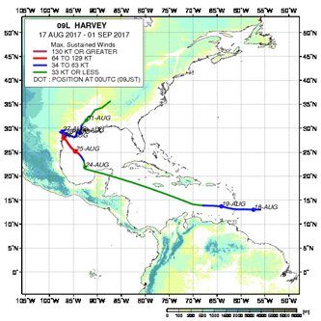
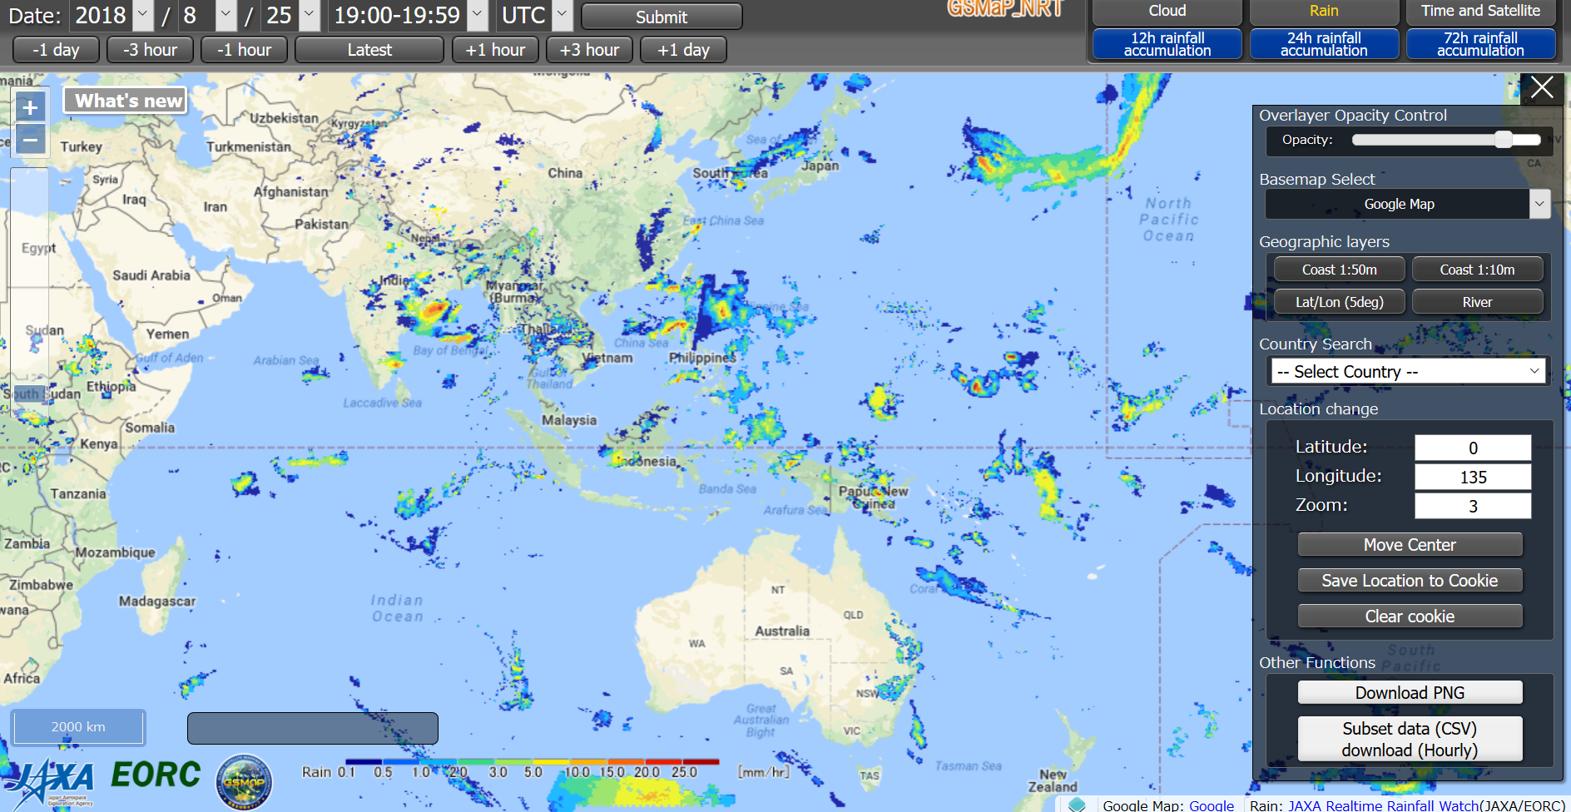
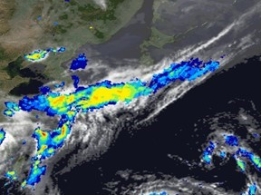
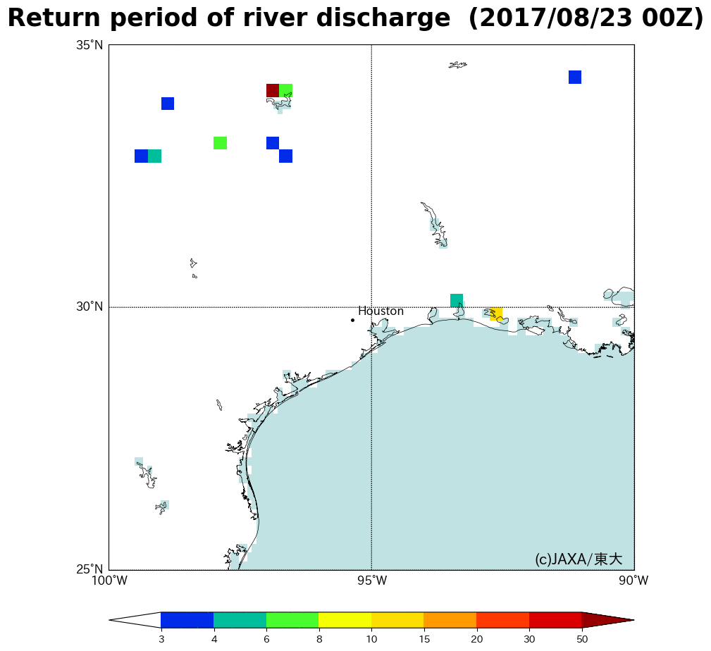
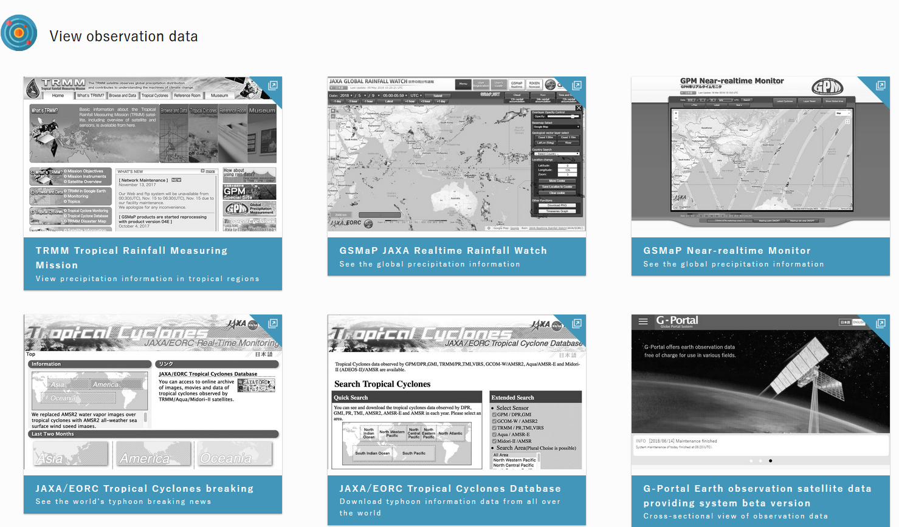
GPM/DPR (2013- ) and GSMAP
Global satellite map of precipitation (GsMAP)
Yesterday's Earth on EORC (YEE)
Record high rainfall in July 2018, Western Japan
New GPM web site since July 2018
Hurricane in 2017
5

Slide 6

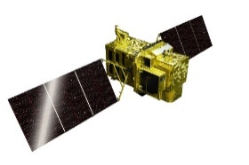
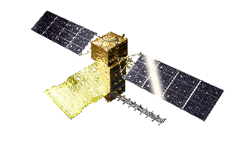
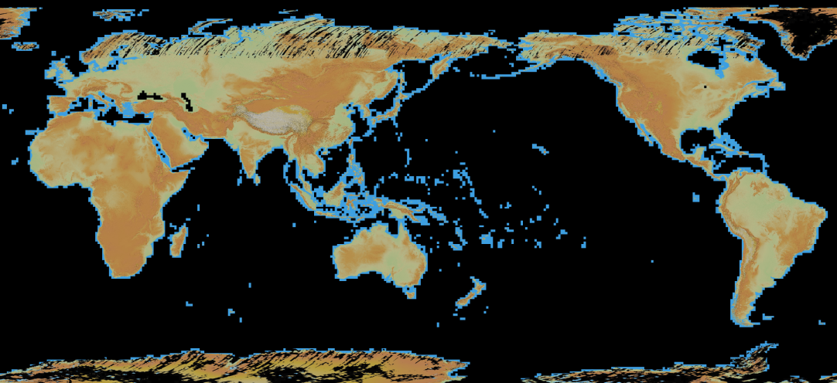
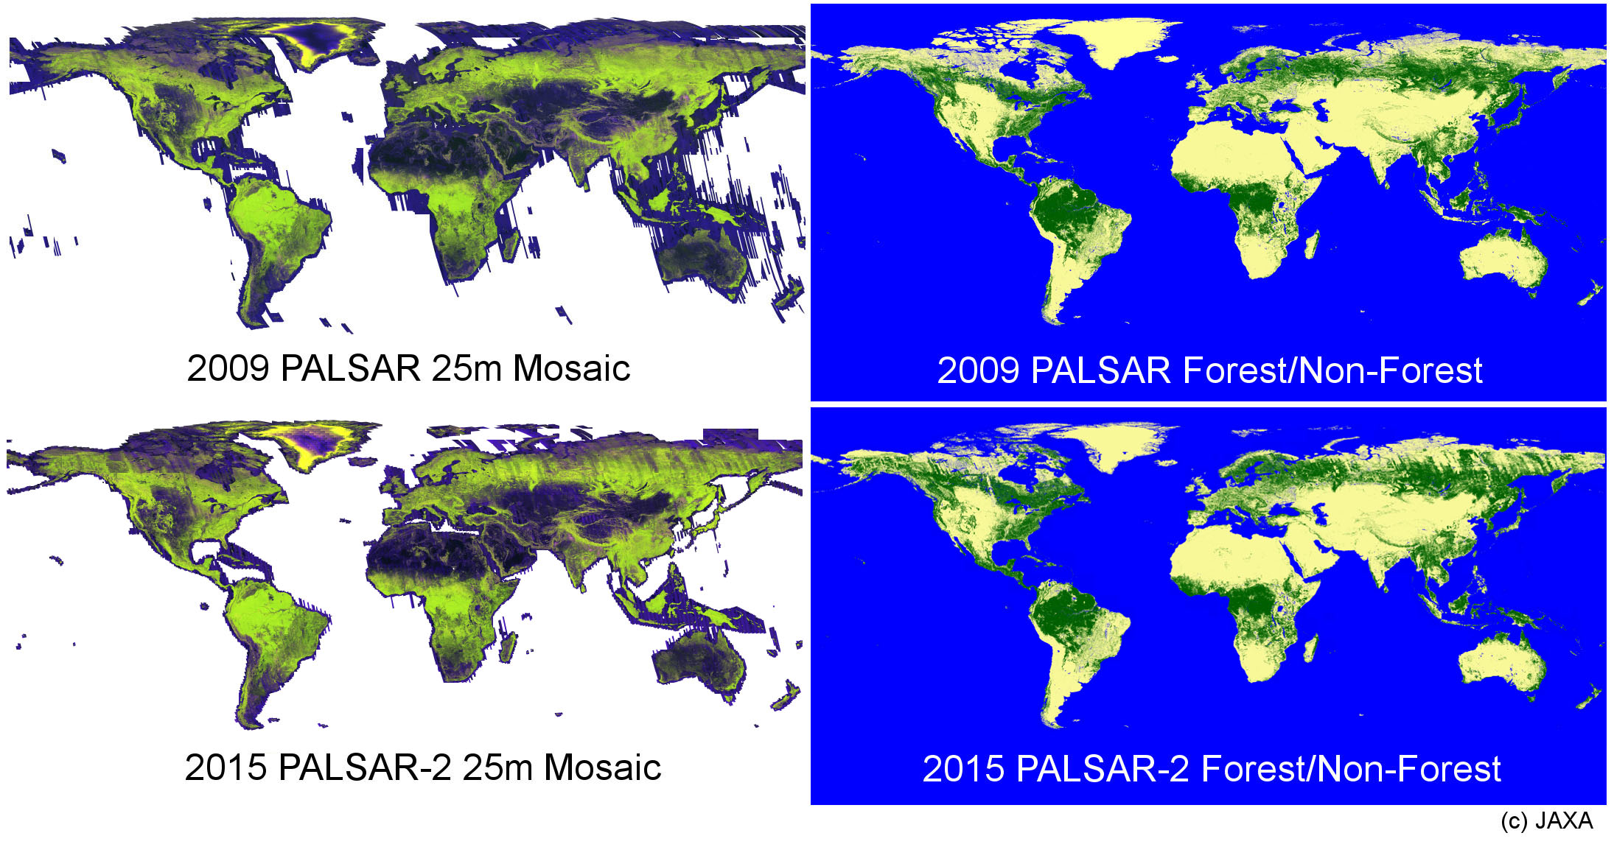
ALOS-2 (2014-)
Products update, ALOS-3 and ALOS-4
JFY2014 | 2015 | 2016 | 2017 | 2018 | 2019 | 2020 | 2021
May 24
ALOS-2 (L-SAR)
Launch
Product release
Mission operation (5 years)
Post-mission operation
ALOS-3
(Optical)
Development
Mission operation (7 years)
ALOS-4
(L-SAR)
Development
6
Global digital surface model (DSM) "ALOS World 3D - 30m (AW3D30) updated in July 2018
Mosaic and Forest/Non-Forest map updated in May 201( (PALSAR 2017 data)
6

Slide 7
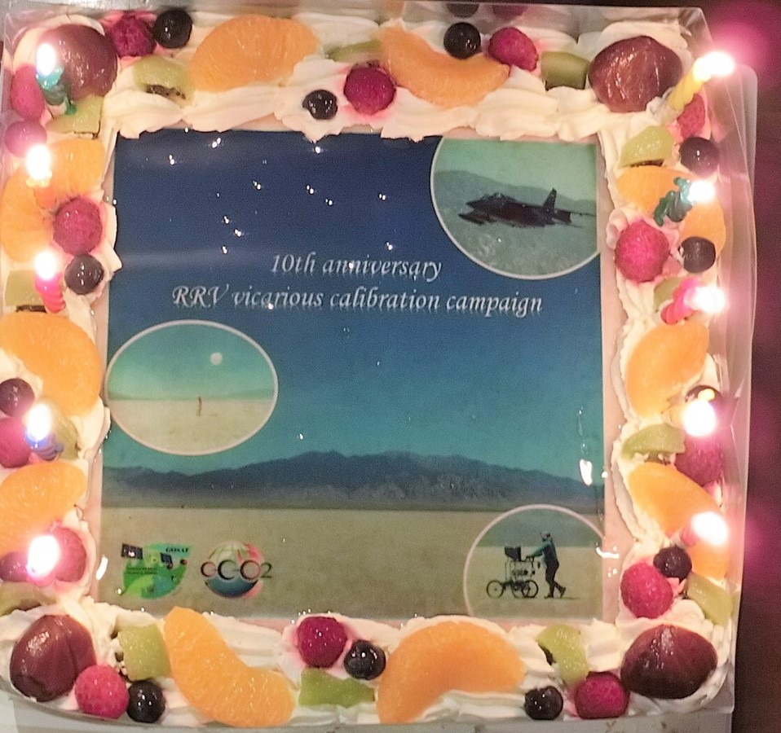

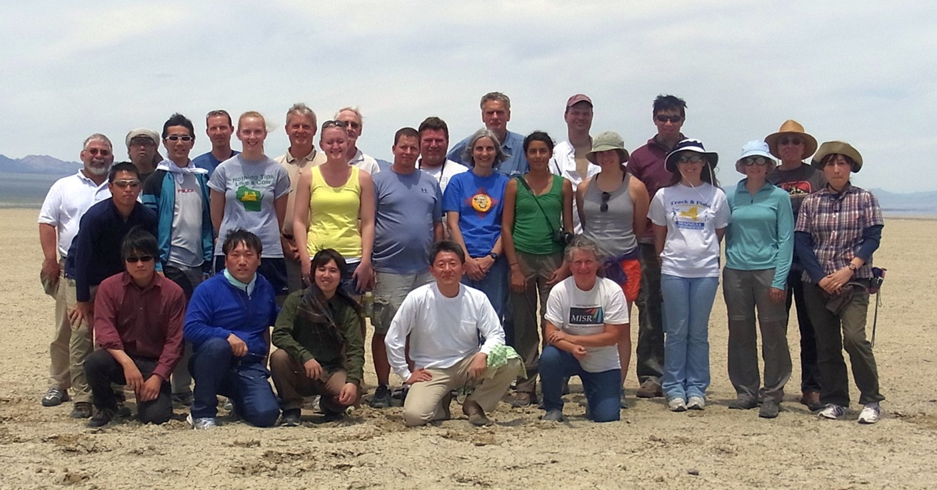
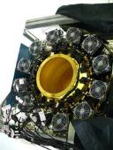
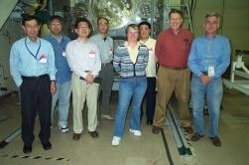
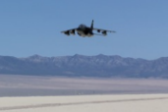
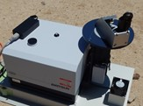
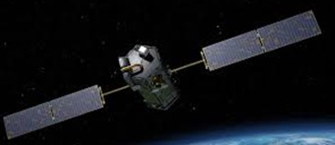
GOSAT (2009-)
RRV campaign 10th anniversary
LL from decade long annual vicarious calibrations at Railroad Valley
Needs for annual campaign and multiple-site observations.
(1) BRF is not spatially uniform within the GOSAT large foot print of 10 km
Southern site is more Lambertian but not constant with time (varies year to year).
(2) Forward reflection (view east) is more Lambertian, less affected by aerosol but not constant with time (varies year to year).
2008 2009 2010 2011 2012 2013 2014 2015 2016 2017 2018
Radiometric calibration
Prelaunch
X-CAL
Annual Vicarious Calibration at the desert playa in Nevada
CO₂ & CH₄ profile
In situ CO₂ and CH₄ on NASA AMES AJAX
XCO₂ XCH₄ XCO
2018 Campaign
10th Anniversary
Column with a compact FTS
Coincident Target
Inter-Comparison between GOSAT and OCO-2
International
Inter-comparison
2014/09～2016/05
XCO₂ Level2 matchup
Agreement:
(ACOS-GOSAT B7.3 vsOCO-2 B7)
< 0.18 ppm over Ocean
< 0.57 ppm over Land (high gain)
< 0.19 ppm over Land (desert)
Calibrated GOSAT and OCO-2 radiance spectra agrees within 5% for all bands (386 match up data).Katoka et al. (2017 MDPI, Remote Sensing)
7

Slide 8
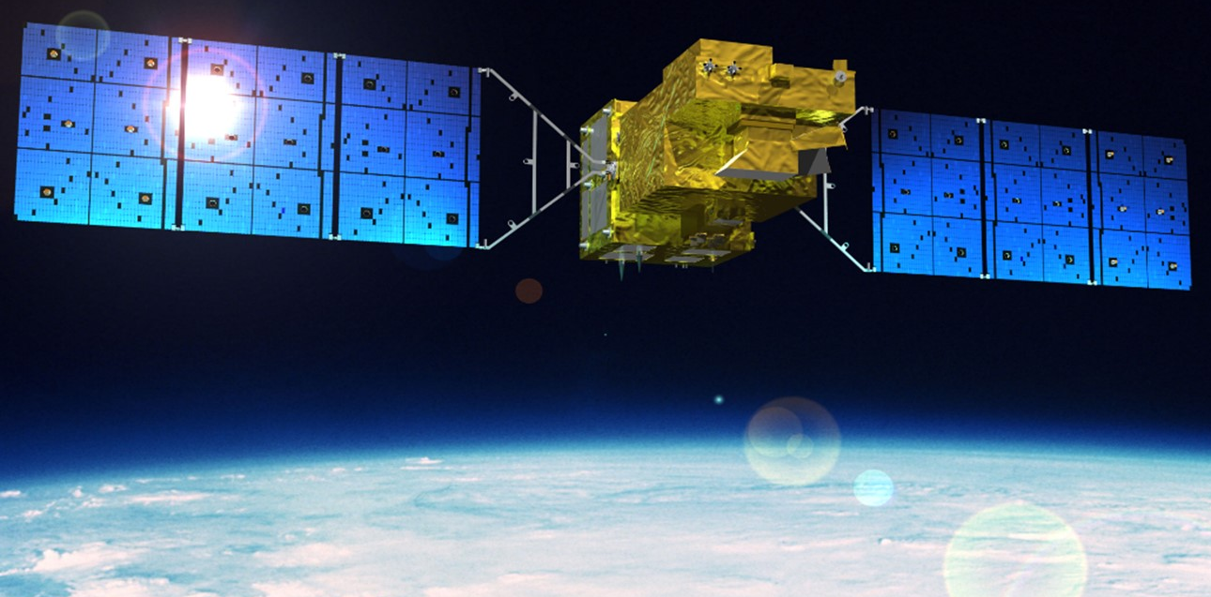
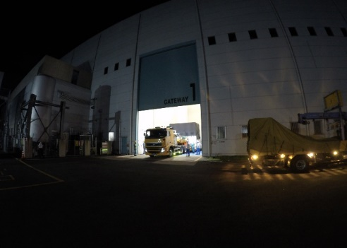
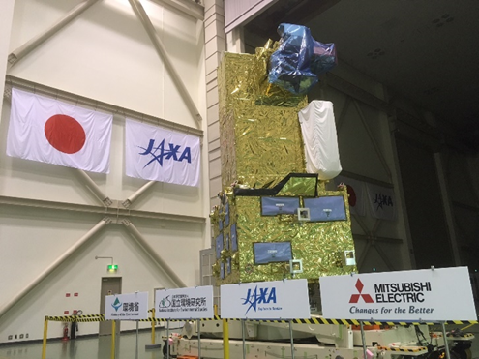
GOSAT-2 Launch (2018-)
TANSO-FTS-2 and CAI-2
GOSAT-2 was shipped from Tsukuba to Tanegashima-Launch site Aug. 20.
Challenges of in-orbit calibrations: slant viewing CAI-2, inter-band registration
TANSO-FTS-2
Characteristics
Life | 5 years
Orbit | Sun-Synchronous (628km)
Mass | About 2 t
Launch | 2018
Observation | CO₂, CH₄ and CO
TANSO-CAI-2
Simultaneous CO (carbon monoxide) measurement
All target mode capability
Cloud-avoiding pointing with onboard camera
TANSO-FTS-2
TANSO-CAI-2 (radiometer)
8

