Slide 1


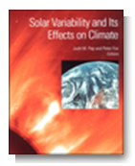

Reference Solar Irradiance Spectrum
AGU monograph 2003/4
Nigel Fox
WGCV Plenary # 42

Slide 2
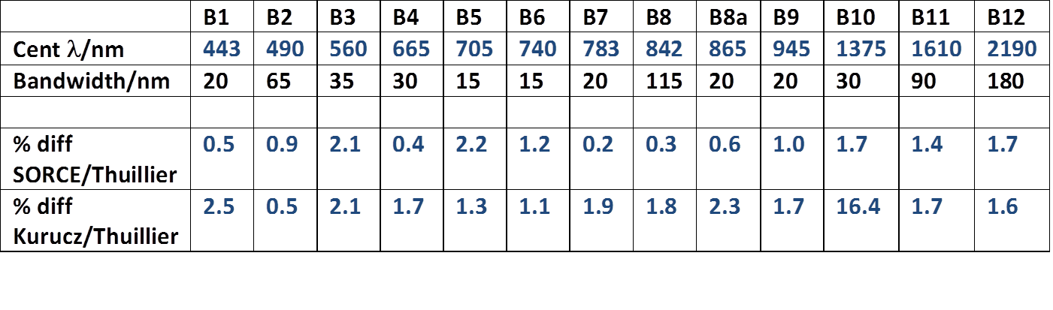
Background
From an IVOS perspective - Exo-atmospheric Solar spectral irradiance
key parameter to link Earth Viewed radiances and reflectances
- Band averaging, RT codes, interoperability etc
- Spectral range (largely) ~400 – 2400 nm but also TIR
- linkage and comparison of products from different sensors will depend on choice &
method of use of solar irradiance spectrum
- 2003 CEOS plenary adopted a resolution from WGCV to encourage agencies to
use a common spectrum (based on a composite from Thuillier et al paper) or as a
minimum to make clear what has, and how it has, been used.
- However, whilst significant agency uptake – not universal & is it still appropriate??
- Also interest from other groups: GSCIS & Atmospheric where UV important also
from climate perspective - Drivers are different and more complex (e.g. solar cycle)
E.G. Impact on Sentinel 2

Slide 3
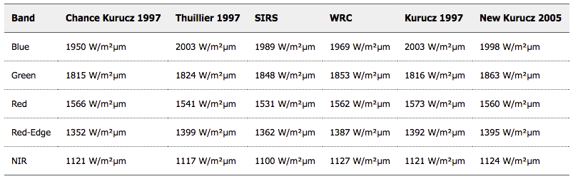
Methods for RadCalNet Data application
Example from RadCalNet Beta Testers
Convert RapidEye Imagery to TOA Reflectance
Extraterrestrial Irradiance (EAI), RapidEye

Slide 4
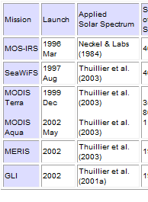
Discussion webex and conclusions (Oct 2013)
18+ attendees (inc commercial) No US Gov due to shut down.
From inputs: Pre- & during meeting
  ~ 75% used CEOS recommended Thuillier
    IOCCG formally recommend/encourage use of
    CEOS spectrum
  Kurucz used were high resolution is reqd e.g. FT spectrom
  also when integrated into other software packages (Modtran
  Neckels and Labs also used (in 6S)
  ISRO provides products utilising both Neck/Lab & Thuillier
  Landsat uses Chukar
  Eumetsat keen for spectrum to ~5 um most content 2.5 um
    380 nm enough for most IVOS but not Atmos Chem??
  Agreed there is value in a common spectrum but difficult to
  achieve for all applications particularly non Land/Ocean
  but should aim for:
    a few well defined spectra with accessible data via cal/val portal
    a ‘best practise for use/convolution with sensor/application characteristics
  Note that for Atmos Chem there is significant solar irradiance variability in UV
    Not as big an issue for Vis/SWIR
  Thuillier also created a high resolution spectrum
e.g. from IOCCG

Slide 5
Two Webex meetings organised by D Doerling GSICS 2016/17:
Increase scope/community dialogue and range of potential applications for recommended spectra
Various options for spectrally continuous spectra using different normalisations to link sensors / models and obtain differing spectral resolution
  Most used Thuiller observations (spectral shape) for VNIR/SWIR linked to Kurutz for IR extension
  Absolute level normalised to TSI (1361 – 1366) (~0.4%)
Is there merit and desire for a single continuous ref SSI for all applications? Probably in the long term but maybe pragmatic need in short term for Cal/Val (Land/Ocean type applications)
  Preference for an early decision on a baseline and then to study further and consider options for an optimal for all applications
  Is there a need to change Baseline from what we already have?
What spectral resolution is needed? Real spectrum in observation space or fixed spectral intervals?
Do we need to also agree on method for convolving SSI with instrument and potentially reflectance from other surfaces?
Access to spectra

Slide 6
Conclusion
Following third webex held during IVOS 29 and subsequently endorsed by GSICS technical group
Consider forming a longer term group to look at optimum Reference inc UV and thus accounting for temporal variation
Pragmatic to update current CEOS reference with latest composit & linked to IAU value for TSI.
  SOLID project (PMOD WRC of WMO)
  Extend functionality by increasing spectral resolution to 0.005 nm using a model (COSI) in discussion with T Stone.
  Make available via CalVal portal with details on its basis and useage as necessary

Slide 7
Reference Solar Spectrum Considerations
Greg Kopp
Univ. of Colorado / LASP &
Max-Planck-Institut für Sonnensystemforschung

Slide 8
Creating a Reference Spectrum – Summary
Get a high-level overview of possible input spectra
  Consolidate summary of spectral range, resolutions, accuracies, times, etc.
Identify which spectra provide the best qualities
  i.e. absolute accuracy, spectral resolution, etc. as function of wavelength
Combine into a composite spectrum
  Emphasize accurate absolute value over spectral resolution or range
  Space-based data have best absolute accuracy
Add spectral resolution from physics-based model
  Physics-based models have best spectral resolution
  Scale to absolute value from most accurate measurement-based spectra
Allow for temporal variations via irradiance models
  Needed for climate and solar-physics research

Slide 9
The PMOD/WRC Solar Reference spectrum
Margit Haberreiter, Nigel Fox, Tom Stone, Werner Schmutz
PMOD/WRC
May, 2017
Acknowledgement: Funding by the European Commission for the FP7 Project SOLID No 313188 is acknowledged
Notes:
TO do:
Sonnenbild von Davos, Sonne+haze, Strandbild Kauai....

Slide 10
PMOD/WRC Reference Spectrum
SOLID Composite will be used for the absolute scale
  Haberreiter et al. (2017), JGR, in press, DOI: 10.1002/2016JA023492
  In agreement with TSI value as recommended by IAU 2015 Resolution (Prsa et al, 2016)
COSI high-resolution synthetic spectrum
  NLTE radiative transfer code
  Developed at PMOD/WRC

Slide 11
PMOD/WRC Reference Spectrum
Spectral Coverage
  380 - 2000 nm: SSI observational composite
  300 - 15000 nm: COSI synthetic spectrum
Spectral Resolution
  SSI composite ≤ 623 nm: 1nm
  SSI composite > 623 nm: 2nm (and coarser)
  COSI: 0.005 nm (or higher)
Solar Activity Level
  Solar minimum, i.e. annual mean of 2008

Slide 12
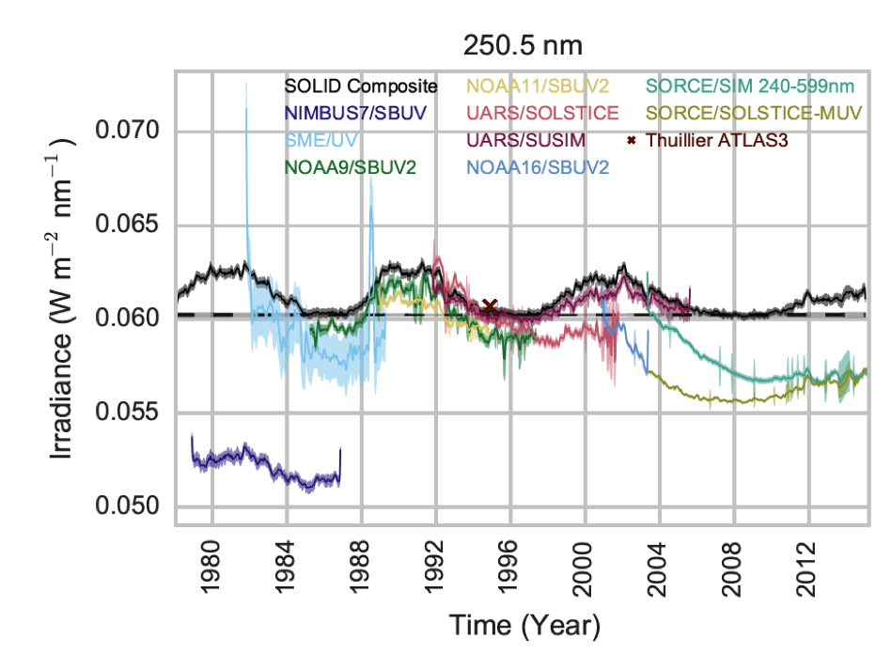
SOLID composite at 250 nm
Haberreiter et al. (2017)

Slide 13
Comparison SOLID and ATLAS3
SOLID takes into account the
ATLAS3 as absolute reference

Slide 14
Observations and Models

Slide 15
COSI in high resolution (log scale)

Slide 16
COSI in high resolution (linear scale)
≤ 2000nm: SSI SOLID composite for 2008 minimum available
300-15000nm:
COSI high-resolution

Slide 17
Advantages of SOLID + COSI dataset
Reference spectrum based on SOLID SSI observational composite for 2008 solar minimum
High-resolution component and extension to 15um using COSI calculations
Good agreement between COSI quiet Sun calculation and SOLID SSI 2008 composite

Slide 18
Gray lines: 3% uncertainty on absolute scale

Slide 19
Gray lines: 3% uncertainty on absolute scale

Slide 20
First evaluation of the uncertainty of Reference Spectrum
Absolute accuracy of SOLID composite from ATLAS3: 2-3 % (from Thuillier et al., 2003)
high resolution component from COSI calculation: 5% (of the order of the absolute scale, currently under evaluation)
Synthetic spectrum will be constrained by SOLID min 2008 spectrum
Combined uncertainty: still under carefull evaluation!!!

Slide 21
Availability/Recommendation
http://www.pmodwrc.ch/pmod.php?topic=solar_reference_spectrum
ftp://ftp.pmodwrc.ch/pub/SolarReferenceSpectrum
As both Ascii and NetCDF
Recommend to adopt the new reference but of course to keep the text .....‘to use CEOS spectrum or as a minimum make clear what has been used including details to facilitate interoperability
Ongoing work to extend to UV and dynamic temporal corrections when mature.

