Slide 1
NOAA Satellite Cal/Val Progress Update
Changyong Cao (WGCV NOAA Rep.)
Presented by Jason Choi
With contributions from Fred Wu (GOES-R) and JPSS teams
NOAA/NESDIS/STAR
42nd CEOS Working Group on Calibration and Validation Plenary (WGCV-42)
Sioux Falls, USA, May 15-19, 2017

Slide 3
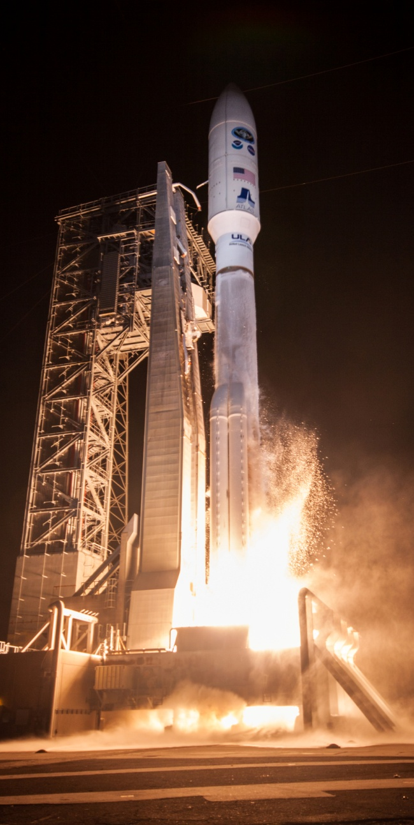
GOES-16 Launch
The Geostationary Operational Environmental Satellite R-Series (GOES-R) is the first of a new generation of the geostationary constellation for the NOAA.
The first of four satellites in the R series that will support NOAA’s geostationary constellation through 2036.
GOES-R was launched by the NASA aboard a United Launch Alliance (ULA) Atlas V rocket on November 19, 2016 at 2342 UTC (6:42 p.m. EST), from Cape Canaveral Air Force Station in Florida, USA.
After a number of orbit lifting maneuvers, it reached the geostationary orbit on November 29, 2016, when it was officially named GOES-16.

Slide 4
GOES-16 Payloads
Advanced Baseline Imager (ABI) Status
Visible and Near-IR Bands
The on-orbit Signal-to-Noise Ratios (SNR) are exceeding the requirement.
Instrument channel gains are very stable.
Dynamic ranges have adequate margins over the requirements.
Thermal bands
The Net Equivalent Delta Temperature (NEdT) are substantially better than the requirement (0.3K for 13.30 μm Channel; 0.1K for others) at 300K.
Dynamic ranges met the specifications in all IR bands.
Other instruments
Geostationary Lightning Mapper (GLM)
Solar Ultraviolet Imager (SUVI)
Extreme Ultraviolet and X-ray Irradiance Sensors (EXIS)
Space Environment In-Situ Suite (SEISS)
Magnetometer (MAG)

Slide 5
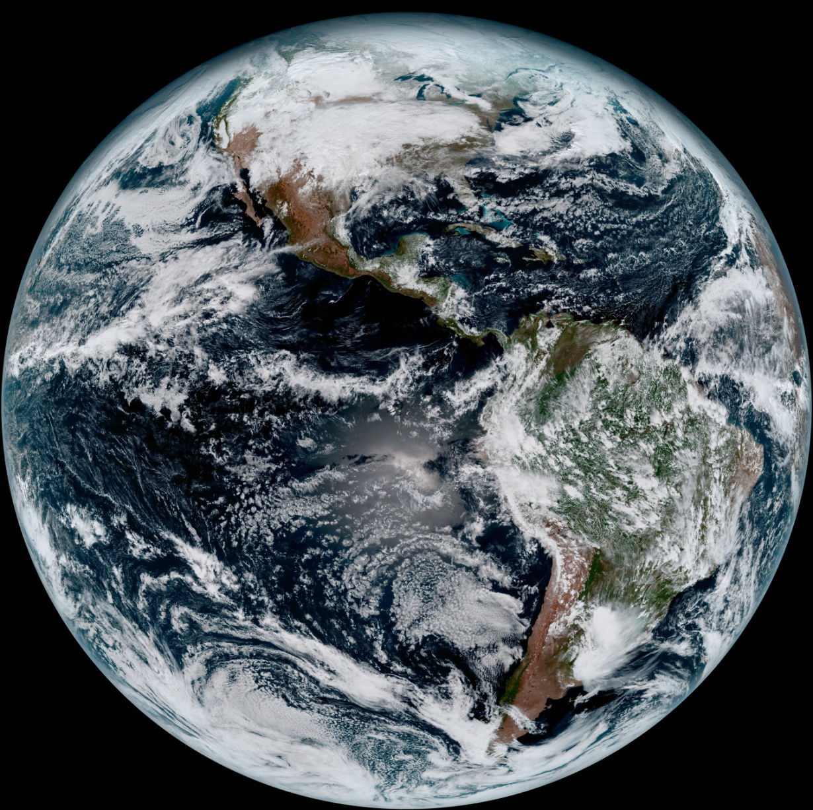
GOES-16 First Image
First Full Disk Image by Advanced Baseline Imager (ABI, 2017-01-23)

Slide 6
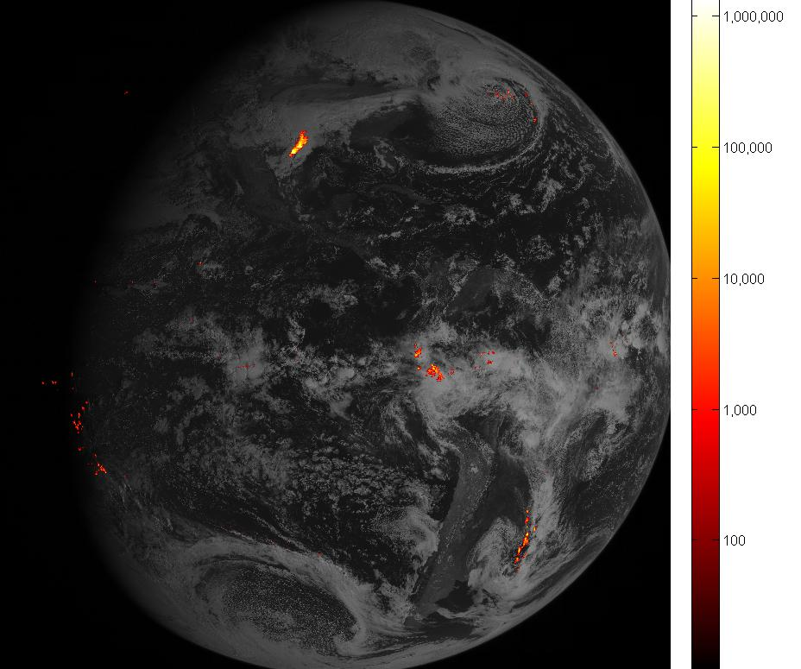
GOES-16 GLM First Image
First Image by Geostationary Lightning Mapper (GLM, 2017-03-06)

Slide 7
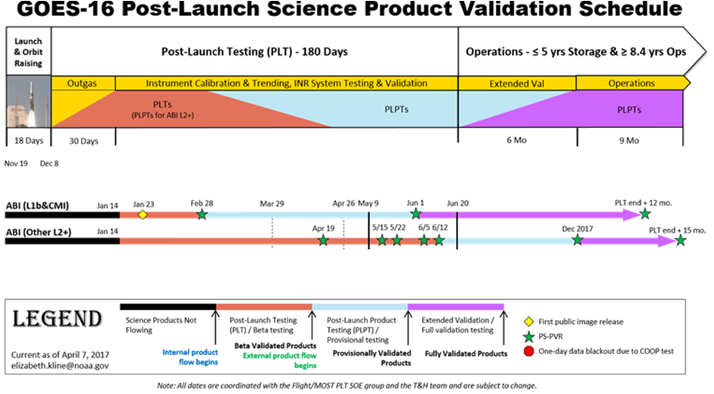
GOES-16 Schedule
CMI: Cloud & Moisture Image
Notes:
Post-Launch Tests
Re-certify instrument and ground system performance.
Focus on engineering, including data format and flow.
Lead to Beta Maturity
Post-Launch Product Tests
Quantify L1b products performance.
Focus on products.
Lead to Provisional Maturity.
Extended Tests
Demonstrate the products performance well for their intended applications in the intended environment.
Optimize instrument calibration.
Lead to Validated Maturity.

Slide 8
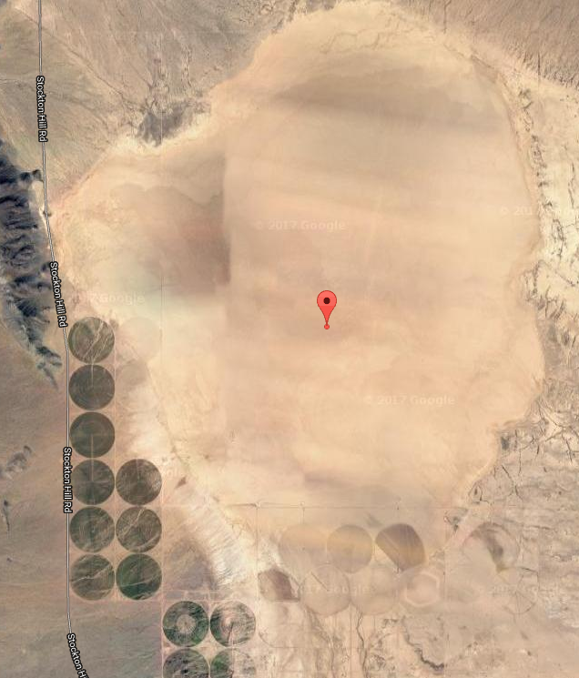
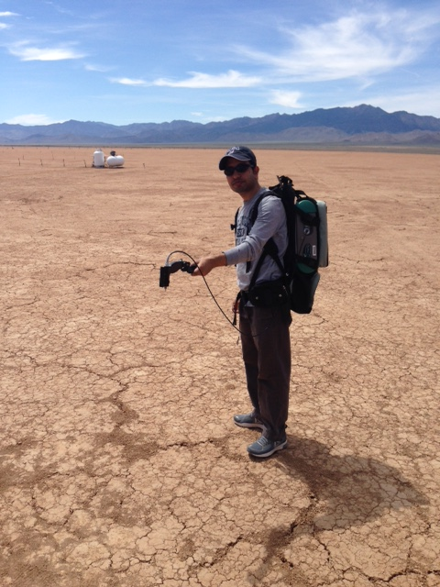
GOES-16 Field Campaign
Field Campaign at Red Lake, AZ
Dates: April - May 2017;
The primary objective is to support the vicarious cal/val for GOES-16.
Campaign activity supported by a group of affiliated with NOAA, NASA, University of Maryland.
Could also help to validate other instruments such as SNPP VIIRS.
Currently analyzing the field campaign data.

Slide 9
Notes:
Work on JPSS-3/-4 VIIRS instruments has began. JPSS-3/-4 models to follow JPSS-2 design, with limited changes. Specs were tightened to ensure scan-to-scan overlap near nadir. Engineering studies conducted to reduce polarization sensitivity for band M1. Other modifications are still under consideration.

Slide 10
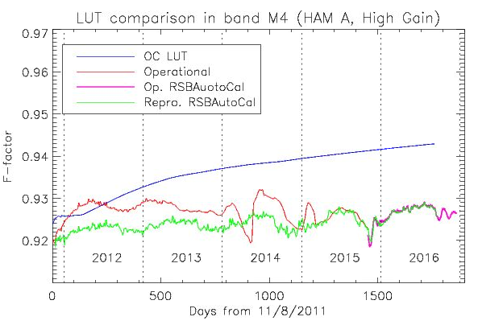
S-NPP Reprocessing Update
Reprocessing is completed for ATMS and CrIS sounders and OMPS.
Actively working on VIIRS reprocessing.
For reflective solar bands: M1-M11, I1-I3:
The reprocessing RSBAutoCal LUTs will correct up to 1.5% sudden operational changes (H-factor, C0=0, RSBAutoCal transition updates).
Improve early lifetime calibration uncertainties.
Reprocessed products have an option to use Ocean Color (OC) calibration ensuring OC product to meet their requirements (includes lunar corrections).

Slide 11
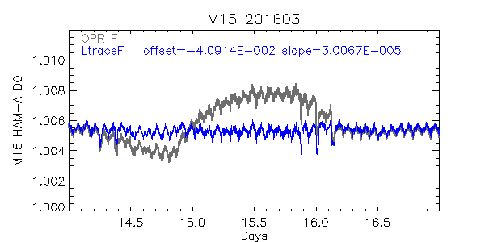
S-NPP Reprocessing Update
For thermal emissive bands (M12-M16, I4, I5):
Addressed multiple issues for the fire team (saturation, erroneous fire, etc)
Our new L_{trace} method successfully corrected SST’s Blackbody Warm-Up-Cool-Down related issues.
Cao et al. 2017 JGR, in press

Slide 12
S-NPP Reprocessing Update
For day/night band:
Fundamental change in calibration LUT.
~70% reduction in negative radiances.
Straylight & terrain corrections for complete time series.
Before LUT update
After LUT update
03/20/2012 (Improvement after Reprocessing)

Slide 13
S-NPP Reprocessing Update
DNB Straylight Correction Example
IDPS(12/16/2012)
(No Straylight correction)
Reprocessed Data
(Straylight Corrected)
Reprocessing implements straylight correction for all DNB SDR.
Significant improvements in all DNB data before August 2014.

Slide 14
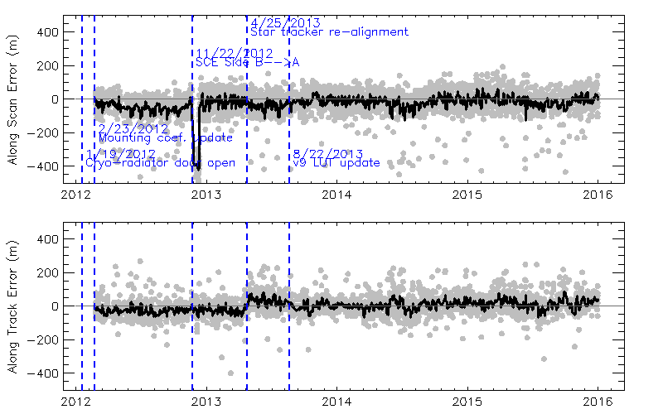
S-NPP Reprocessing Update
Operational geolocation, 2/23/2012 – 12/31/2015
1
2
3
Short-term anomalies: (1) before the initial instrument to spacecraft mounting matrix update; (2) the switch of scan control electronics (SCE) from Side-B to Side-A; (3) star tracker maintenance/re-alignment.

Slide 15
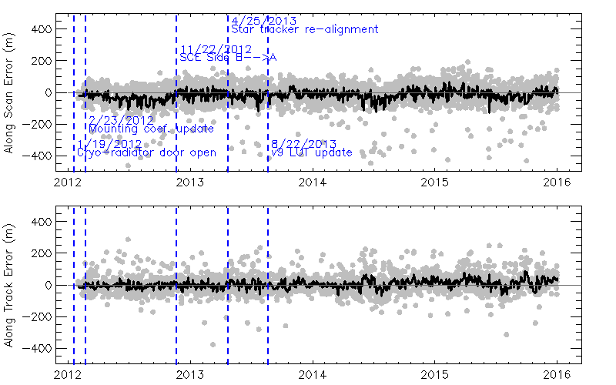
S-NPP Reprocessing Update
Reprocessed geolocation, 2/1/2012 – 12/31/2015
Short-term geolocation anomalies were removed after the reprocessing!

Slide 16
CEOS WGCV IVOS initiative on the characterization of PICS
Supported with two actions based on IVOS 28 meeting in July 2016:
Completed questionnaire dedicated to PICS usage by deadline
Collected a first set of data over Libya4 site (28.55 N/ 23. 39 E).
SNPP VIIRS data over Libya 4 site from 2012 and 2013 were collected and processed for small (20 km) and large (100km) region of interest (ROI).
Temporal mean and standard deviation for both ROIs along with parameters such as sensor and solar zenith/azimuth angles were supplied to CEOS team.
VIIRS data from 2013-2014 were uploaded on the FTP site ftp.magellium.fr
Suggested to CEOS team that VIIRS has undergone some major LUT updated during early launch period and once reprocessing is complete we will provide new sets of VIIRS data with consistent calibration.

Slide 17
GSICS & CEOS IVOS Collaboration
Developed combined method for calibrating VIS channels. ( Yu and Wu, 2015) . Uses Sonoron Desert site*
2. Transition of on-orbit VIS reference from Aqua MODIS to VIIRS
3. Use Deep Convective Clouds as a transfer to inter-calibrate GEO-VIS channels with MODIS/VIIRS (CEOS-IVOS Priority Action in 2010 )
Recommend a solar spectra for the GSICS community in collaboration with CEOS IVOS
Short term approach to construct a solar spectra based on the best solar spectra datasets, which have been scaled to a common TSI reference in the more temporal stable part of the spectra. (Thuillier and COSI datasets)
Long term approach to account for the variability in the UV radiation, the solar sunspot cycle, and higher spectral resolution using both observed and modeled datasets
Future Events
Second Joint GSICS/IVOS Lunar Calibration workshop, would be hosted by CMA in China: in Oct 2017
GSICS made available the GIRO , model. GIRO is the GSICS implementation of the ROLO model and simulates Lunar Irradiance and Radiance.
* Yu, F.; Wu, X. An integrated method to improve the GOES Imager visible radiometric calibration accuracy. Remote Sens. Environ. 2015, 164, 103–113.

Slide 18
Summary
GOES-R
Successfully launched on November 29, 2016.
All instruments are performing well.
Post-Launch Testing (PLT) → Post-Launch Product Testing (PLPT) is on-going.
Provisional maturity will be achieved in June 2017.
VIIRS Reprocessing
Radiometric calibration improvements in RSB, TEB, and DNB
Geolocation accuracy improvements especially for early lifetime.
CEOS WGCV IVOS initiative on the characterization of PICS
GSICS & CEOS IVOS interactions

