Slide 1


RadCalNet Status
Marc Bouvet ESA
& RadCalNet task team
WGCV Plenary # 42

Slide 2

What is RadCalNet? Network of test sites providing, via a common portal, TOA @ Nadir Ref with Uc in range 400 - 2500nm (10 nm band) every 30 mins
Calibration
& QC
& Processing
Surface reflectance and atmosphere products
(RadCalNet specific)
Raw measurements
Site X
Hyperspectral TOA reflectance @ 30 mn interval for nadir view
RadCalNet portal
FTP
RadCalNet
Processing
&
QC
FTP
Calibration
& QC
& Processing
Surface reflectance and atmosphere products
(RadCalNet specific)
Raw measurements
Site Y

Slide 3
Timeline since last WGCV meeting
Oct 2016: WGCV chairman sends invite to RadCalNet beta users
Nov. 2016: Rounds of teleconferences
Mar 2017: RadCalNet beta user workshop
Mar 2017: RadCalNet WG meeting
Apr/May 2017: Rounds of Teleconferences

Slide 4
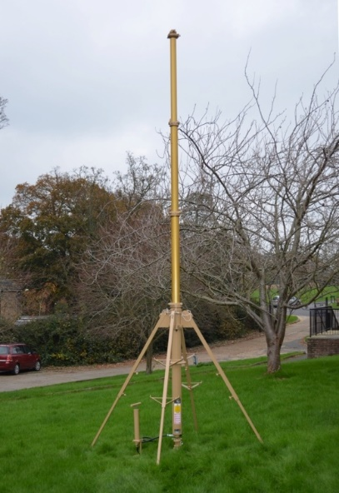
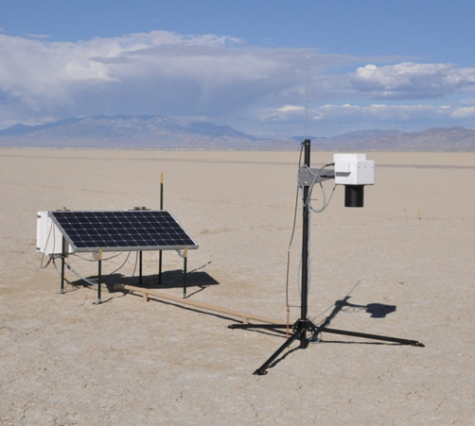
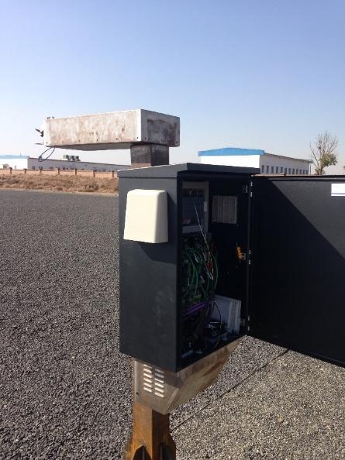
The sites
  Since have been efforts dedicated to:
  Operationally running the sites
  Feeding surface and atmosphere data to the RadCalNet processing ‘system’
  Defining measurement uncertainties

Slide 5
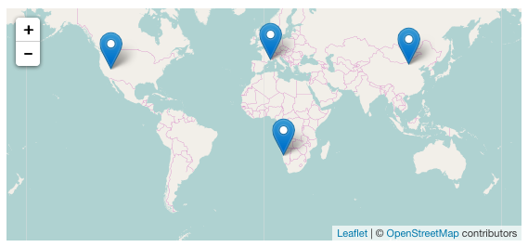
The sites
Railroad Valley Playa, La Crau and Baotou are operational and delivering data to RadCalNet
Gobabeb: instrument characterised and calibrated at NPL. Mast built and tested. Site characterised in Dec. 2015 by CNES and NPL. Full deployment and testing in UK. installation at Gobabeb July 2017 data transmission planned from July 2017.

Slide 6
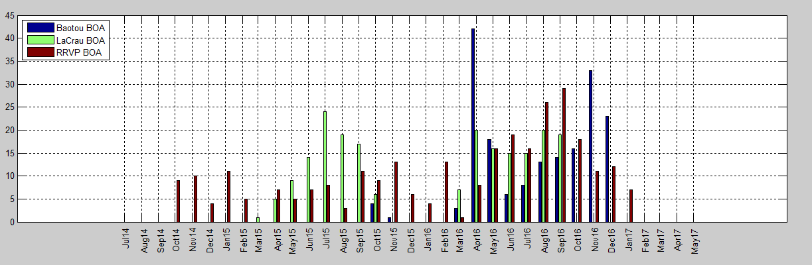
The data availability

Slide 7
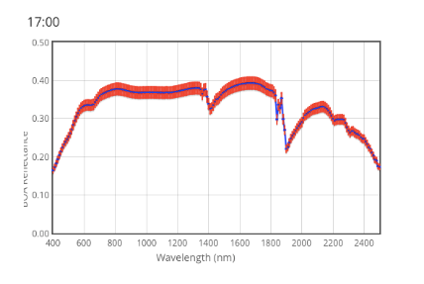
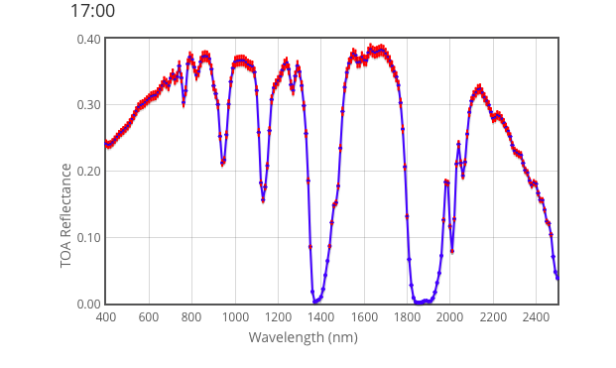
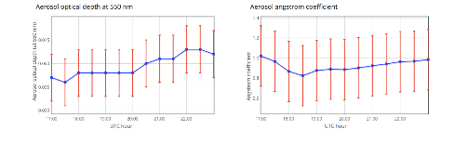
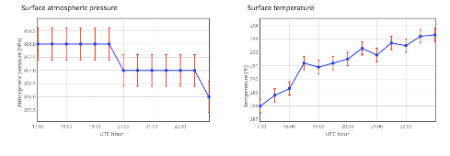
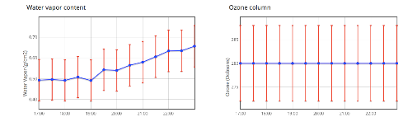
The RadCalNet processing
MODTRAN 5
On-going work by K. Thome / B. Wenny to propagate the surface / atmosphere uncertainties to TOA uncertainties via pre-computed LUT from Montecarlo MODTRAN runs
RadCalNet
Processing
Surface reflectance
TOA reflectance
Atmospheric measurements

Slide 8


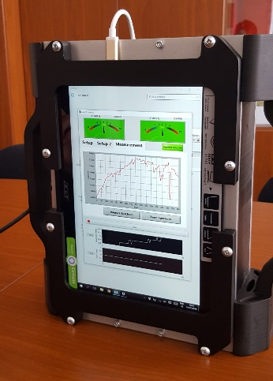
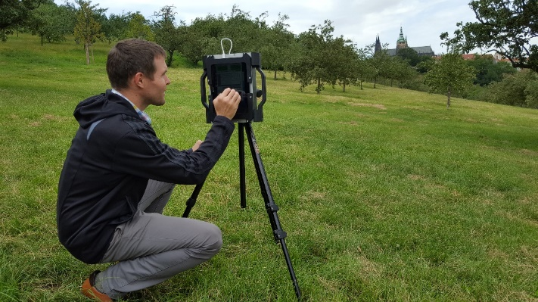
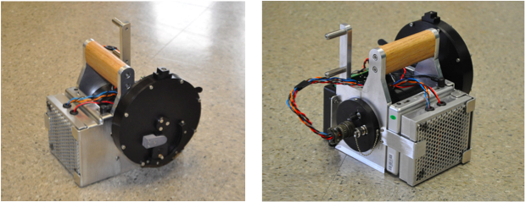
The BOA intercomparison of RadCalNet surface reflectance using portable transfer radiometers
Objective: identify site-to-site radiometric differences at surface radiance (reflectance) level. Will be available to support new sites joining
Status
  UoA and NPL transfer radiometer measurements compared in the lab and in the field
  Transfer radiometers might be operated at sites (blindly by site owners and/or with support) in the course of 2017

Slide 9
Documentation for users: site questionnaires
Document title | Status
RadCalNet quick start guide | Available on RadCalNet portal
RadCalNet data format and processing | V5 available on RadCalNet portal
RadCalNet data policy | Done – Available on RadCalNet portal
CEOS site questionnaire – Template | V1 available on RadCalNet portal
CEOS site questionnaire - Baotou | Available on RadCalNet portal
CEOS site questionnaire - La Crau | Available on RadCalNet portal
CEOS site questionnaire – Railroad Valley Playa | Available on RadCalNet portal
CEOS site questionnaire – Gobabeb | Available on RadCalNet portal (version 28 Jun 2016) but will need an update when site operational
Paper on measurement uncertainties - Baotou | In preparation
Paper on measurement uncertainties - La Crau | In preparation
Paper on measurement uncertainties – Railroad Valley Playa | In preparation
Paper on measurement uncertainties – Gobabeb | In preparation

Slide 10
Documentation for candidate site owners: general documentation
Document title | Status
Requirement Document: membership criteria | Done – Available on RadCalNet site
Requirement Document : site data provision | In preparation
Good Practice Guide 1: site selection | In preparation
Good Practice Guide 2: site characterisation | In preparation
Good Practice Guide 3: site instrumentation and data processing | In preparation
Good Practice Guide 4: site quality assurance | In preparation

Slide 11
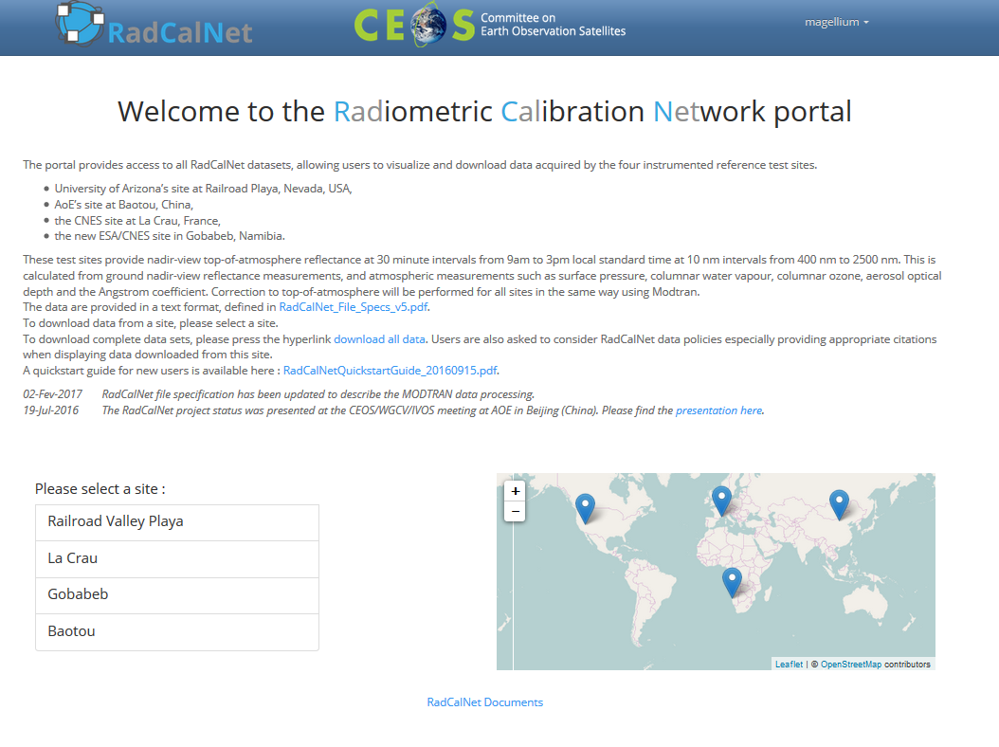
The portal

Slide 12
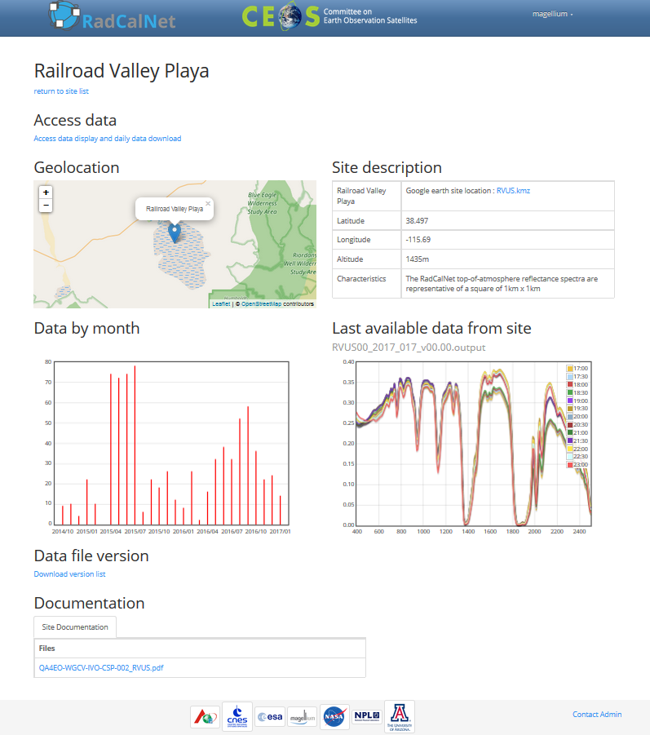
The portal
Daily Data Access
Site Characteristics
New
Dataset Availability
New
New
Last Spectrum
Site description

Slide 13
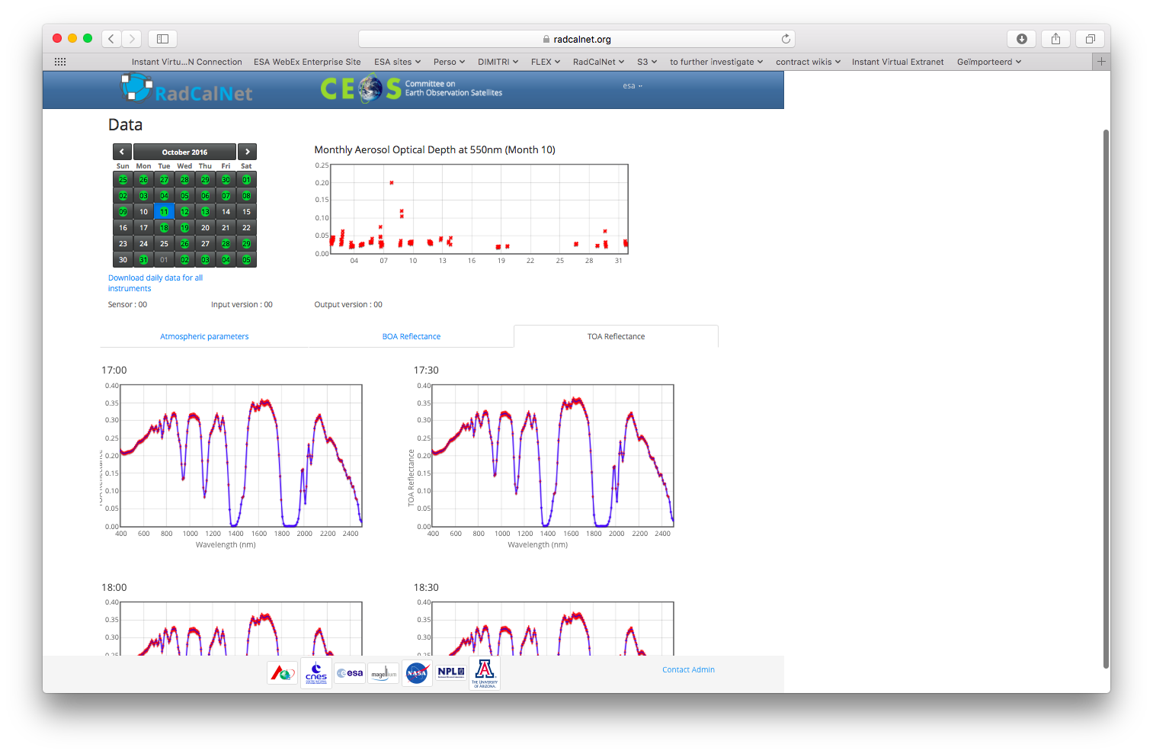
The portal

Slide 14
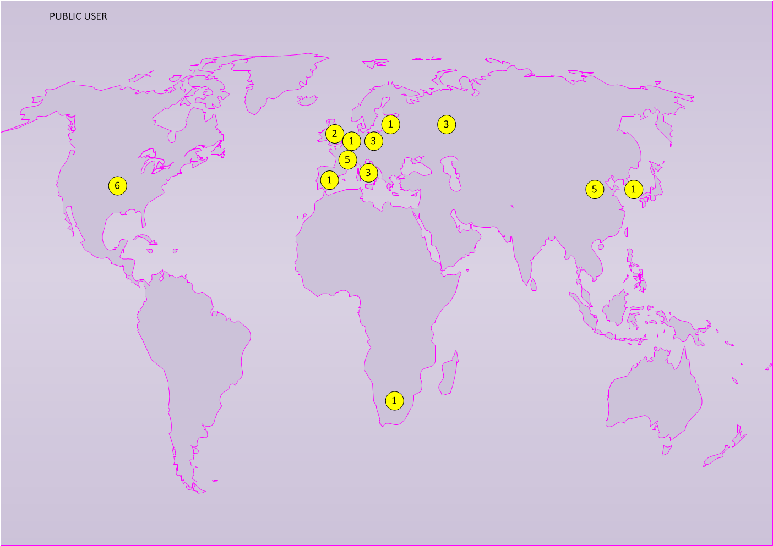
Candidate public user

Slide 15
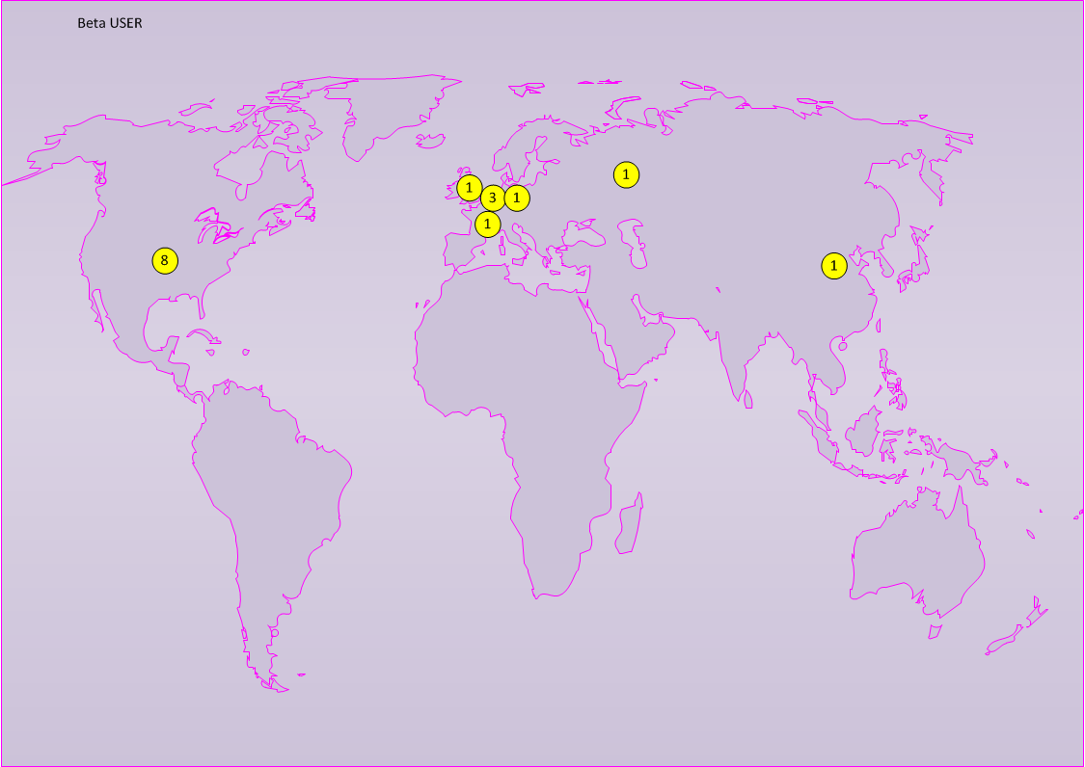
Current beta users
  Russian sensors (K. Emelyanov and V. Kovalenko)
  Proba-V (S. Adriaensen) (and S. Sterckx remotely)
  Sentinel-2 (T. Scanlon)
  Sentinel-2 (B. Alhammoud)
  Rapideye Constellation (A. Brunn)
  GOES-13/15 (X. Wu)
  Landsat 7/Landsat 8/Sentinel-2 (D. Helder and X. Jing)
  CBERS04, ZY02C, ZY3, GF1 and GF2 satellites (Q. Han)
  Digital Globe sensors (T. Ochoa)
  Dove Constellation (N. Wilson)

Slide 16
Beta Users Workshop Summary
General comments:
Comparison of sensor observations to RadCalNet TOA simulations at RVUS and LCFR point towards consistency across the two sites and with space sensors radiometry levels.
Beta users generally expressed their interest in using RadCalNet data to support their sensor in-flight radiometric performance assessment
Overall satisfied by the portal functionalities and documentation

Slide 17
Beta Users Workshop Summary
Users suggestions:
RadCalNet TOA simulation are provided for nadir view. Site BRDF data needed to exploit off-nadir sensor observations => requires collaboration with site owners
Additional QC on the RadCalNet data could be implemented
Additional information about site operation status would be useful to task sensors
Communicate via email processing updates / important changes on portal / additional data availability
In the long run, query tools (e.g.: API) to access RadCalNet data would be useful to automate data extraction
Additional met data might be useful (e.g.: anemometer/rain gauge)

Slide 18
Timeline since last WGCV meeting
Oct 2016: WGCV chairman sends invite to RadCalNet beta users
Nov. 2016: Rounds of teleconferences
Mar 2017: RadCalNet beta user workshop
Mar 2017: RadCalNet WG meeting
Apr/May 2017: Rounds of Teleconferences

Slide 19
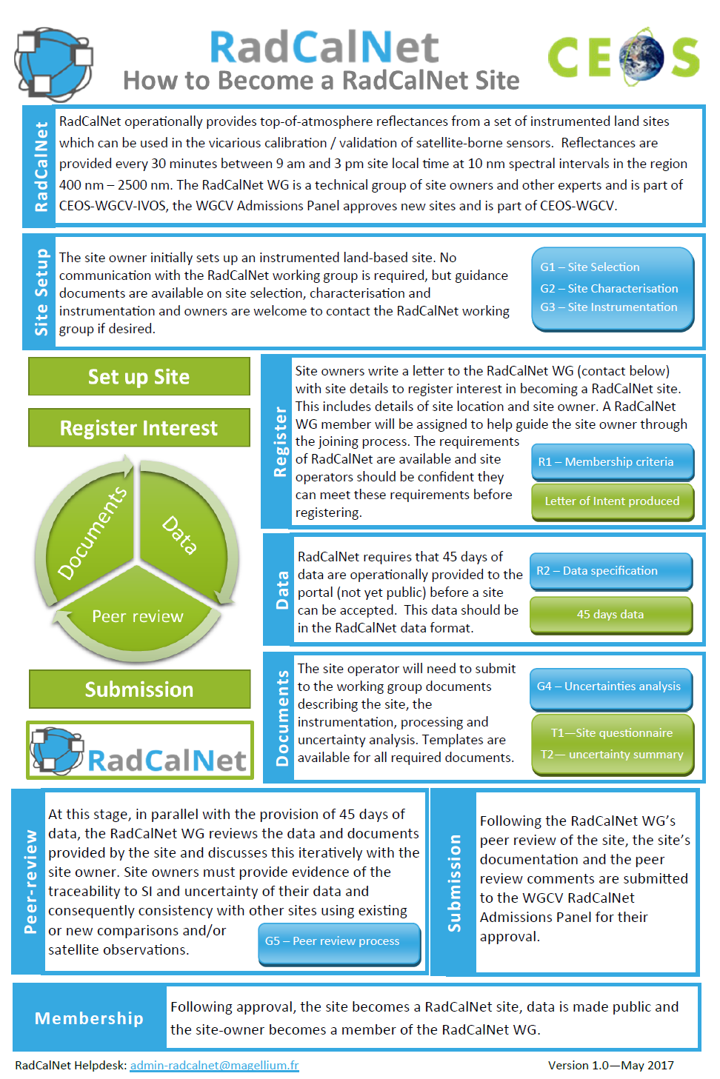
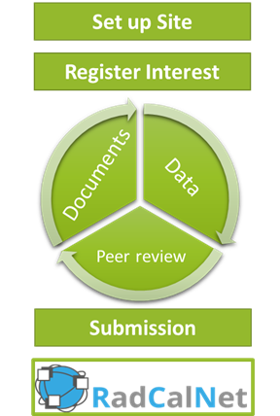

Slide 20
Next steps
Agreement on new input data format by 19th of May.
New data format document prepared and distributed by 26th of May.
Reprocessing by site owners of .input data with new format by 30th of June
Generation of uncertainty LUT for BOA to TOA uncertainty propagation
28th of July
Get the Gobabeb site operational July 30
Guidelines etc produced 15 Aug
Reprocessing of output data by 30th of August
Beta tester testing campaign in Sept/Oct
Sites should go through the formal RadCalNet acceptance process of WGCV Oct
Opening to public user in Nov. 2017
Start to add new sites (Baoutou desert, Dunhuang, JPL RRV, Australia?....)

