Slide 1
Cal/Val Activities:
ISRO
Arundhati Misra
SAC/ISRO
India

Slide 2
SAC & NRSC : Major Centres involved in Cal/Val Activities for ISRO’s RS Satellites
Cal/Val site selection, ground experiments, maintenance
Lab Cal Planning and implementation in pre-launch sensor design and testing phase
Post launch Cal /Val experiments
Permanent sites/data are desirable !!

Slide 4
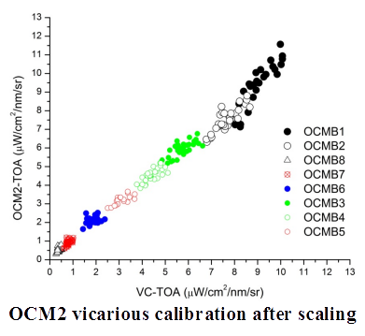
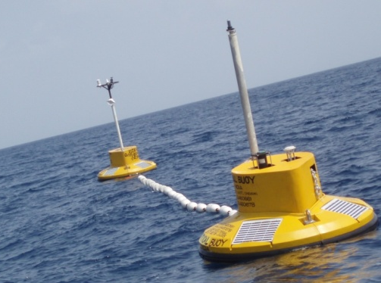
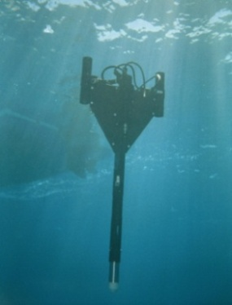
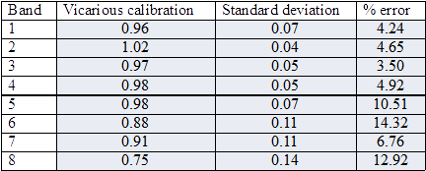
Vicarious calibration and Validation of ISRO’s Earth Observation satellites and their products viz. RESOURCESAT, CARTOSAT, OCEANSAT, SACTSAT INSAT, MEGHA-TROPIQUES, SARAL, RISAT-1, also ASAR …

Slide 5
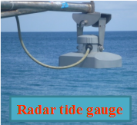
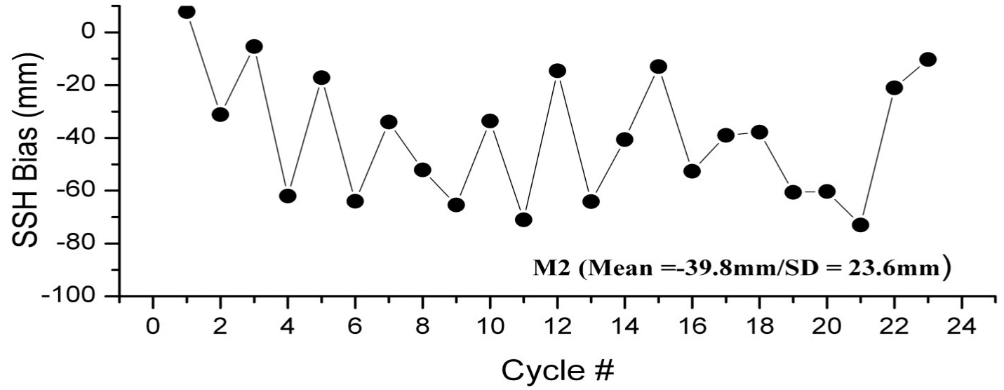
Sea Surface Height from SARAL/AltiKa

Slide 6
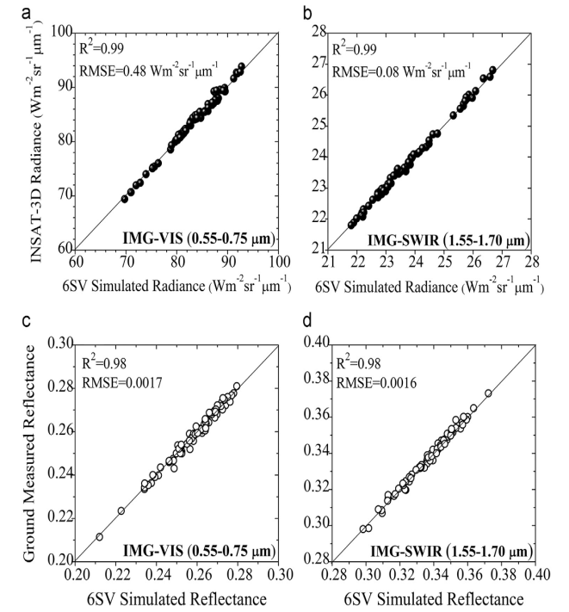
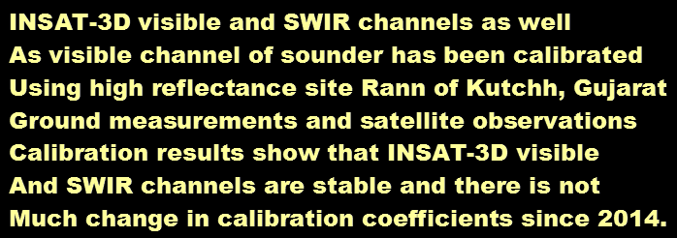
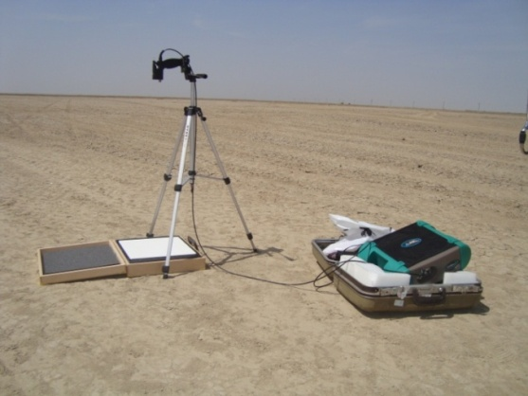

Slide 7
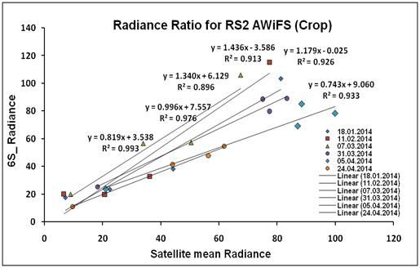
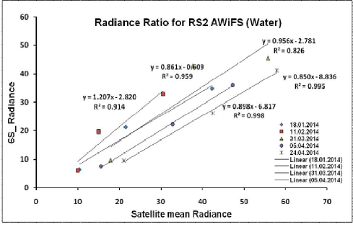
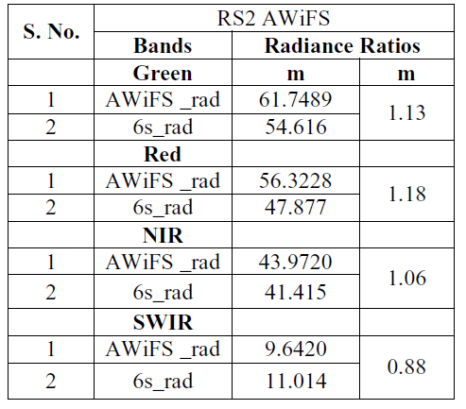

Slide 8
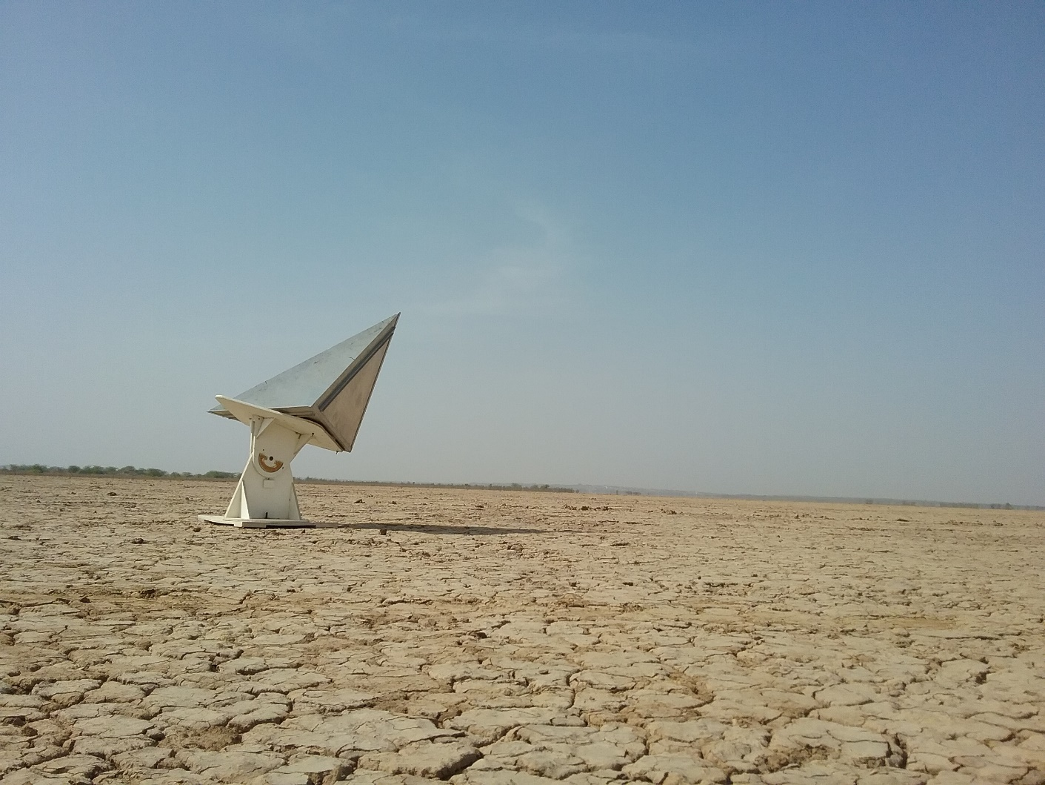
Radiometric and Geometric calibration of
RISAT-1 MRS/FRS Data
8

Slide 9
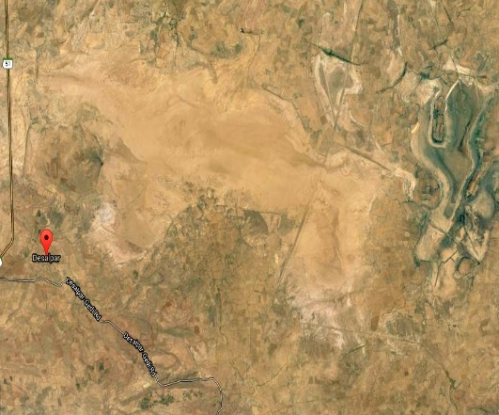
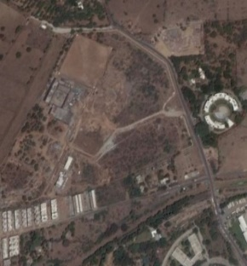
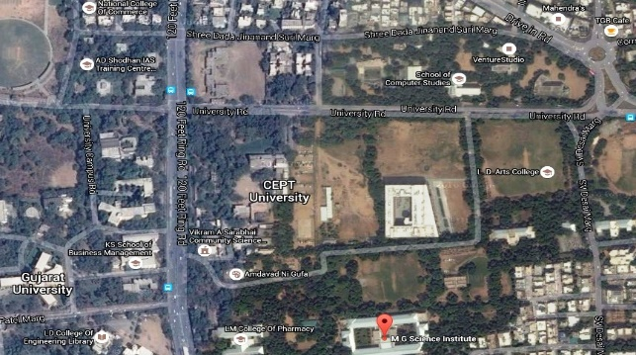
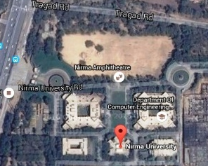
Desalpar, Rann of Kutch
Bopal, Ahmedabad
Operational Calibration Sites
MG Science Institute Grounds
Nirma University Ground
Additionally, we are planning for various distributed target sites like near Kavaratti coast, forest fields, Greater Rann etc
To cover SAR signal response over various surfaces

Slide 10
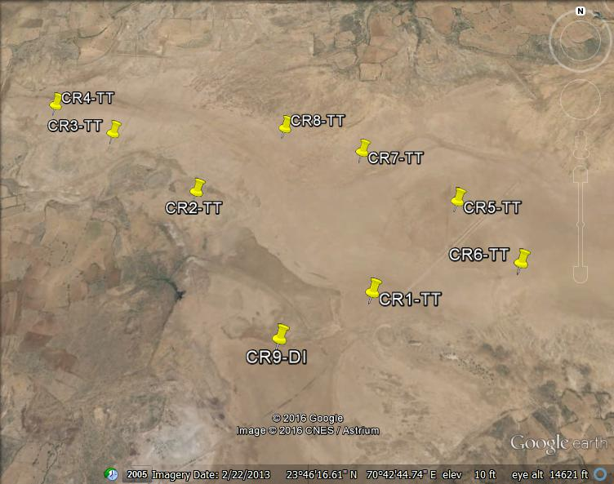
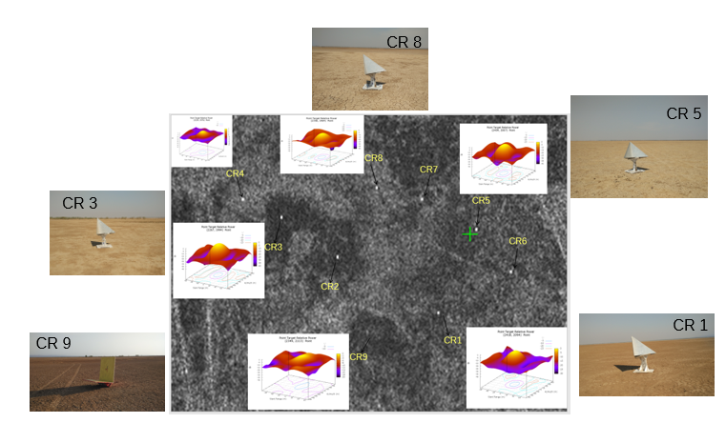
Point Target Analysis
Location of the deployed CRs
(courtesy: Google Earth)
Impulse Response function, field photograph and response of the deployed Corner Reflectors
as seen in RISAT MRS Image of 10th March 2016
10

Slide 11
5 July 15 14 Feb 2016
Distributed target (Amazon forest) radiometric calibration and Geometric calibration was also carried out
resulting in meeting the mission specifications

Slide 12
L & S Band Airborne SAR and NISAR
Calibration sites suitability tested with RISAT-1 data
Corner reflectors being designed, fabricated and developed at SAC to suit L & S Band (1.25 and 3.2 GHz)
Corner Reflector requirements
Large radar cross section (RCS)
Wide RCS pattern
Small physical size
Stable RCS and
Insensitive RCS to the surrounding environment

Slide 13
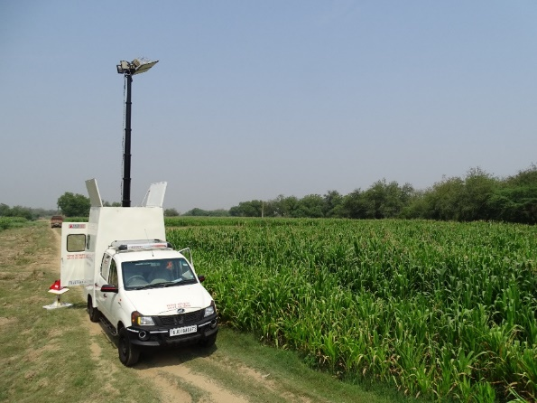
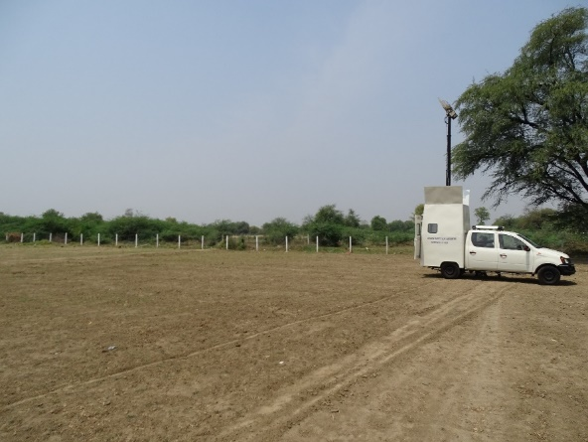
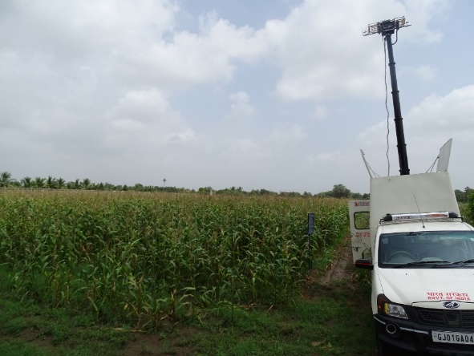
Initial Comparison between GB scat and RISAT-1 SAR data during 2016 Field campaign in Anand Agricultural University, Anand Gujarat
Field photographs
A good agreement observed between GBScat and RISAT-1 sigma-0 for HH, VV and HV-pol and minor discrepancy observed for VH-pol over bare soil.

Slide 14
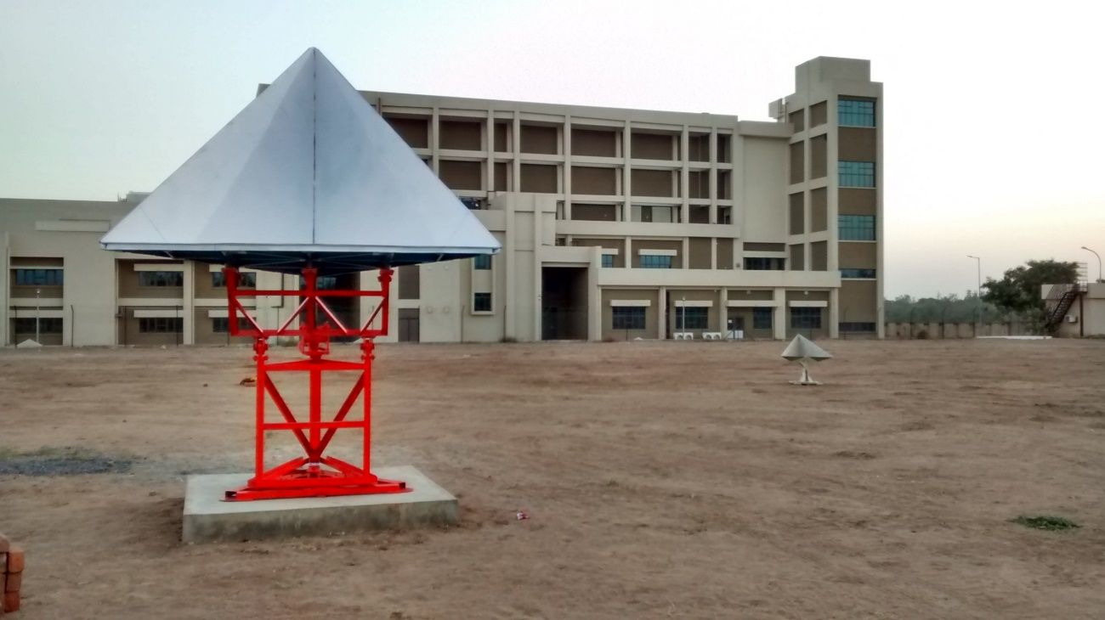
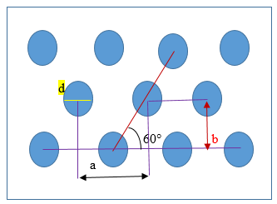
In-house designed, fabricated and developed 2 meter Corner Reflector for L & S band SAR Calibration
Perforated Corner Reflector Design in progress

Slide 15
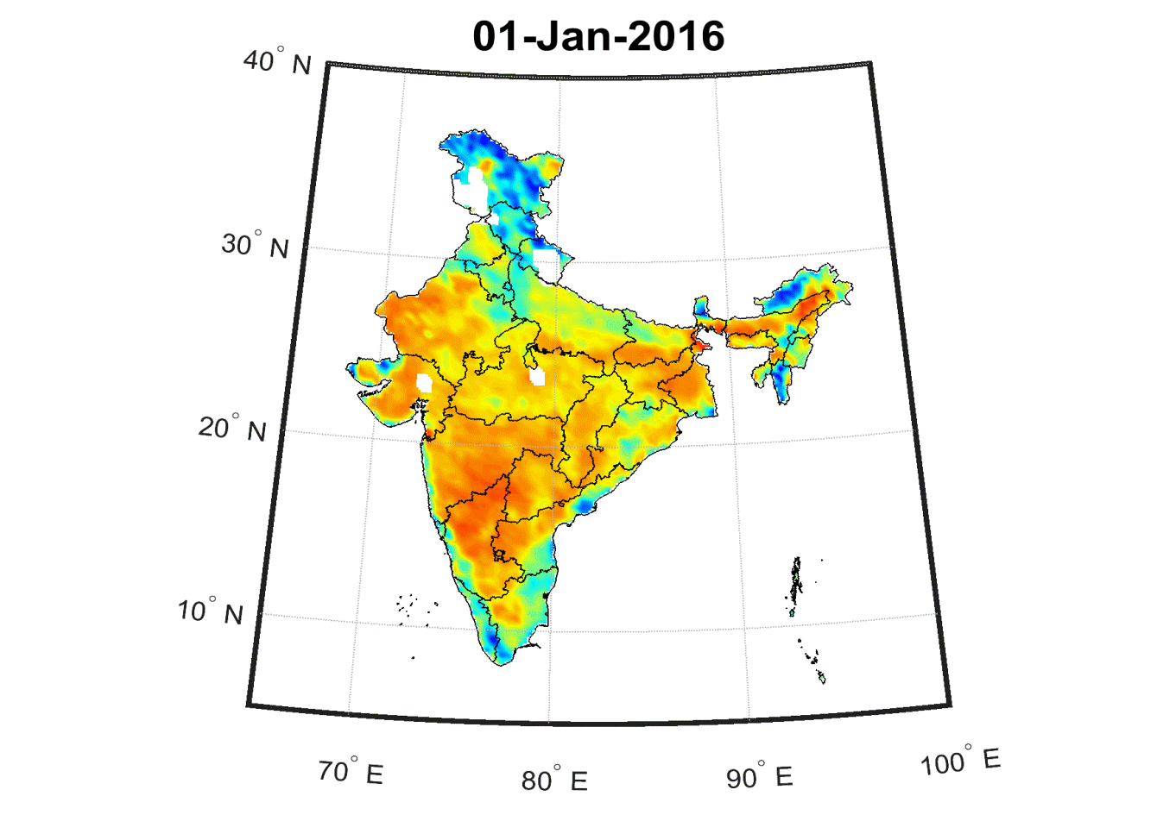
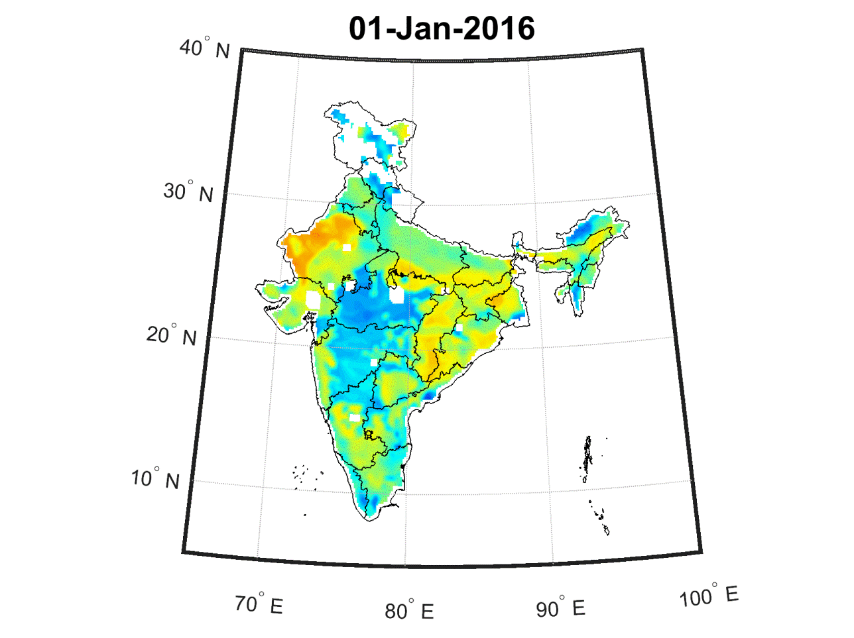
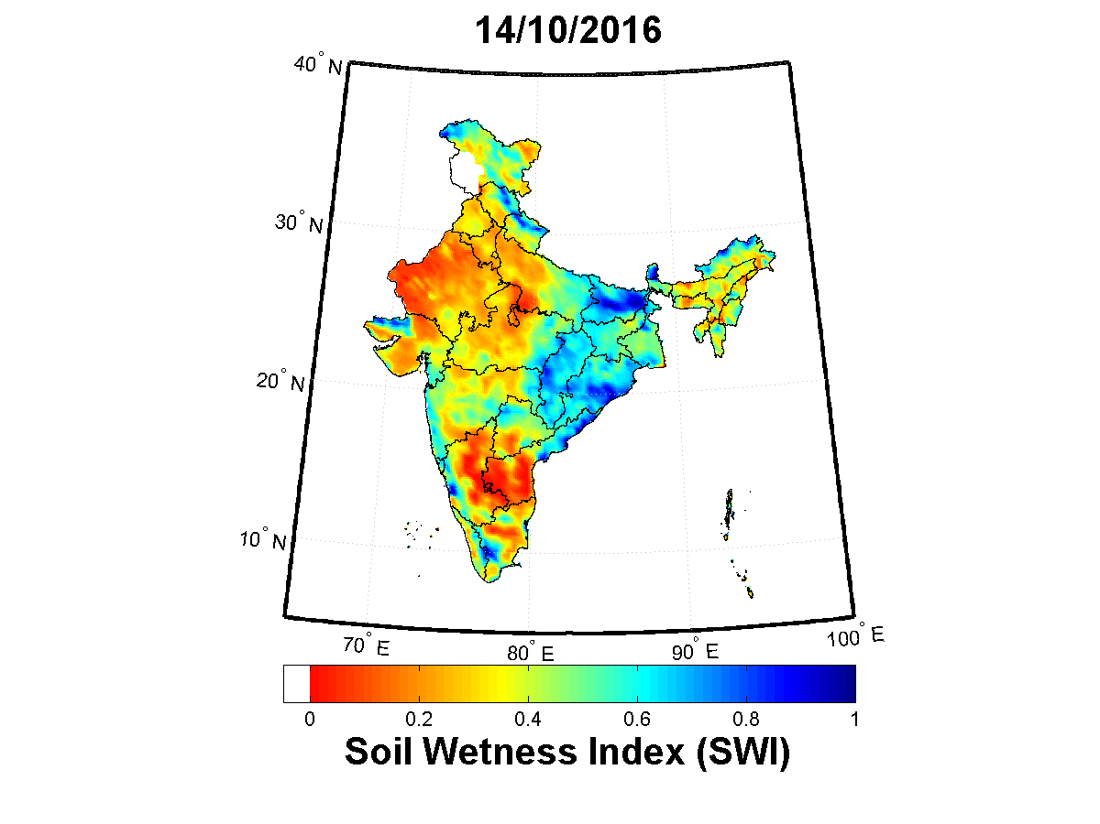
Large-scale Soil Moisture estimation over India using microwave radiometer data
Large-scale Soil Wetness Index (SWI) and Soil Moisture (SM) using SMAP L-band radiometer data.
Operational daily data product is available at www.mosdac.gov.in and www.vedas.sac.gov.in
Temporal dynamics over India (Jan to Oct, 2016)
Benefits :
Drought assessment and monitoring, Flood prediction, Input for Weather Forecasting and Climate change studies.

Slide 16
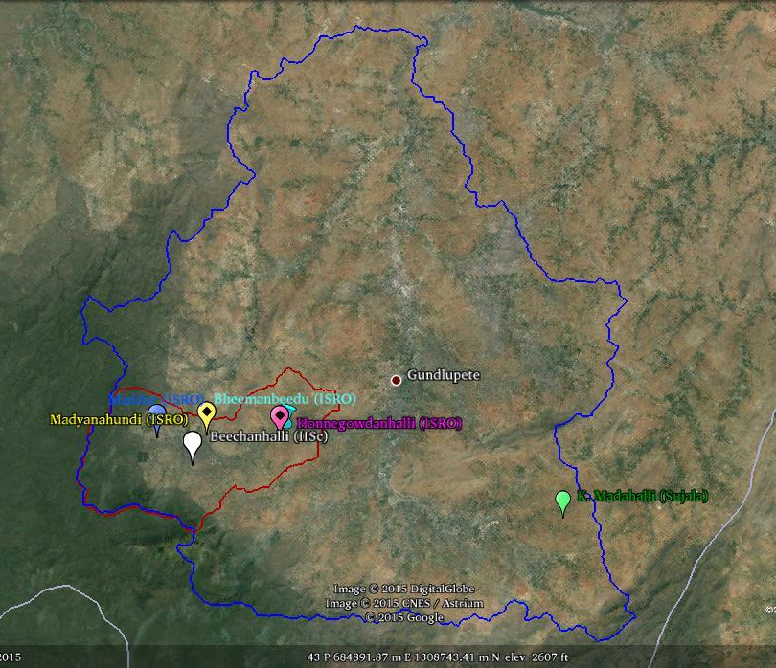
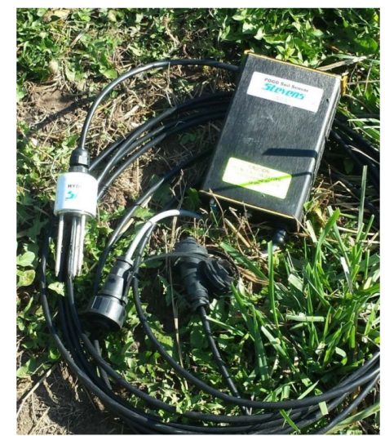
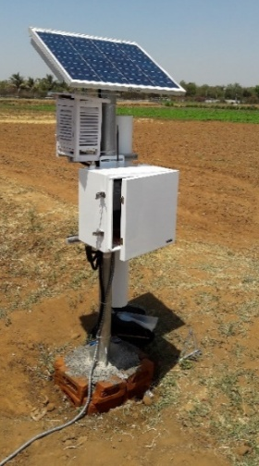
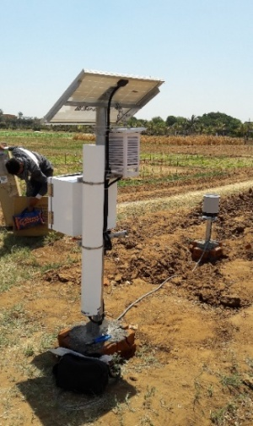
Able to capture progress of monsoon and unseasonal events like Mumbai & Chennai flood,
Hailstorms, very heavy rainfall due to cyclone etc.
Validation of satellite derived soil moisture using in-situ point observation
Portable mobile soil moisture probes
Automated hydra probe stations
COSMOS: COsmic-ray Soil Moisture Observing System
1
Hourly a eraged
6 Hourly averaged
3
2
4
2
5
Real-Time Data acquired from 12th to 19th April, 2017
Solar Panel 2. Cosmic ray Neutron Sensor
3. Temperature, RH and Atmospheric pressure sensor with enclosure
4. Data logger, GSM modem with antenna and battery 5. Rain-gauge
Extensive large-scale validation is continuing

Slide 17
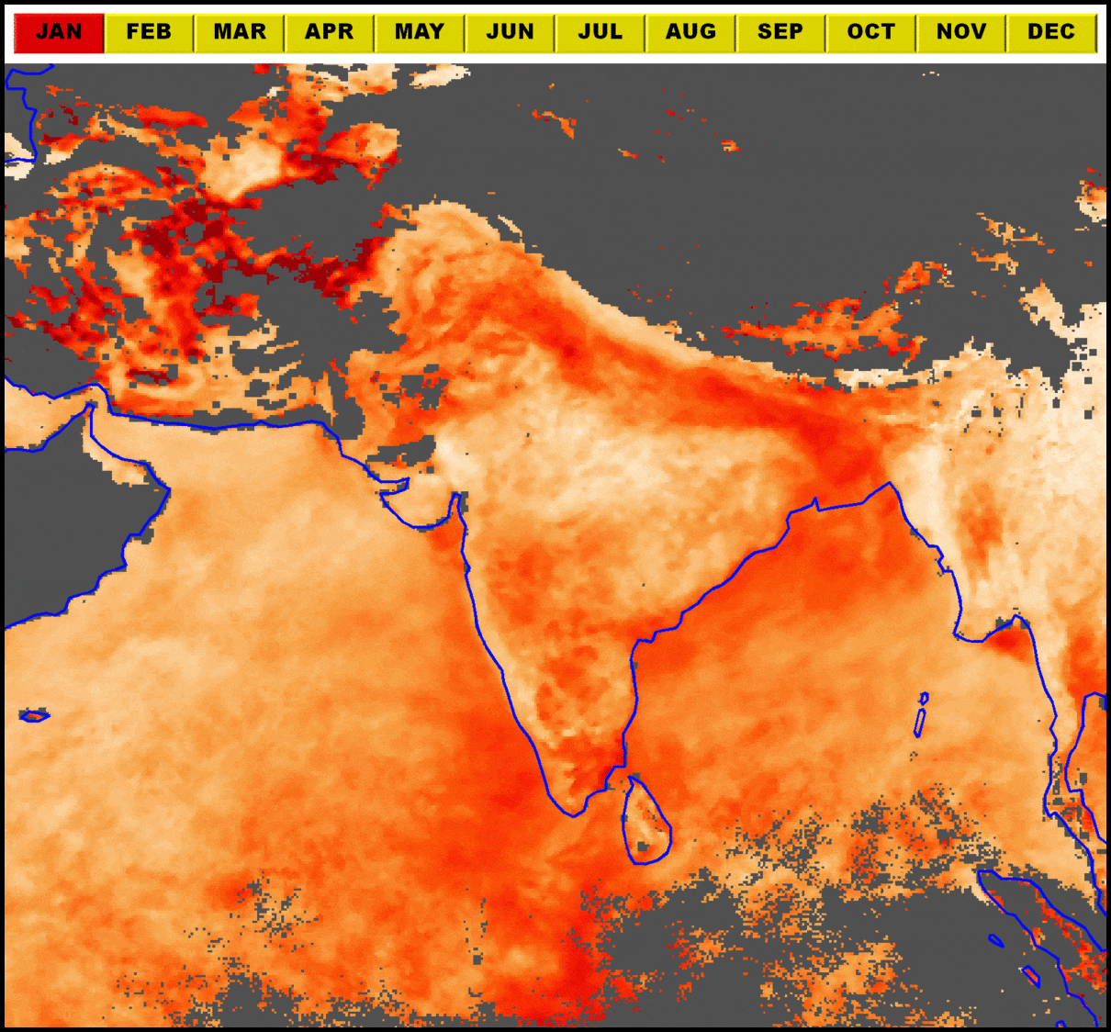
INSAT-3DR Aerosol Optical Depth (Validation Approach)
Operational Product: Aerosol Optical Depth from INSAT-3D /3DR
Spatial & Temporal resolution: 10 km at every ½ hrs during day time.
Validation Approach: Comparison of collocated (space and time) AODs derived from INSAT-3D/3DR and MODIS-aqua over Indian Subcontinent. Comparison of collocated (space and time) AODs derived from INSAT-3D/3DR and 5 AERONET sites and 1 ISRO Site.
Methodology:
INSAT AOD at 10 km resolution and the AERONET direct Sun measurements at 15-min intervals will be co-located in space & time.
At least 2 out of possible 5 in-situ measurements within ±30 min of INSAT-3D AOD retrieval time are required.
At least 5 out of possible 25 INSAT retrievals in a square box of 50 km centred over AERONET sites.
The mean values of the co-located spatial & temporal ensemble are then used in linear regression analysis and in calculating RMS errors.
INSAT-3D Monthly Mean AOD for the Year of 2016
Future Plan:
Establishment of new sun-sky radiometer sites in India for in-situ measurement of aerosols .
Data sharing from other agencies involved in direct sun irradiance measurements.
Five AERONET sites to be used for INSAT-3D.3DR AOD validation

Slide 18
Comparison of AODs (monthly average) derived from INSAT-3D/3DR and MODIS-aqua over Indian subcontinent Land mass
Correlation coefficient (R) varies from 0.52-0.91
Comparison of AODs (monthly average) derived from INSAT-3D/3DR and MODIS-aqua over Arabian Sea and Bay of Bengal
Correlation coefficient (R) varies from 0.51-0.92

Slide 19
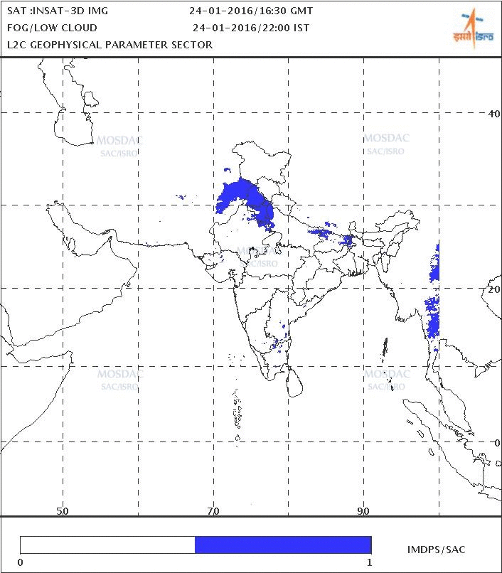
Fog Product using INSAT-3D/3DR and its validation
Fog product using INSAT-3D/3DR is generated since November 2014
Operationally available at www.mosdac.gov.in and www.imd.gov.in
Validation is regularly being carried out with visibility data at 5 Air-Ports located in the Indo-Gangetic Plains.
Validation using Ceilometer observations has been initiated from December 2016.
For all the years the percentage of detection (POD) ranges between 60-70%.
Being visible and IR imager, is not able to detect fog beneath high cloud.
Widely being used by aviation sector, railways and road transport services

Slide 20
12-May-17
Performance Improvements over OSCAT
OSCAT Observations | Scatsat-1
Scan-Angle Dependent Biases Observed. | Scan-Angle Dependent Biases are considerably minimized. Alternate Noise Measurement implemented.
Linearity of System Response was poor at low σ⁰ /low wind speed | Linearity of System response established
Data Saturation near Poles | Full 32-bit Processed Data precision Provision of raw data acquisition anywhere in an orbit.
Systematic Transmit Calibration Power variation over an orbit. | Cal Power Variation over temperature calibrated with PPM reading of TWTA. FESA Power Telemetry data calibrated with TWTA PPM reading over temperature
No Brightness Temperature Calibration | Brightness Calibration Coefficients established in Lab Periodic Recalibration during Deep Space Observation

Slide 21
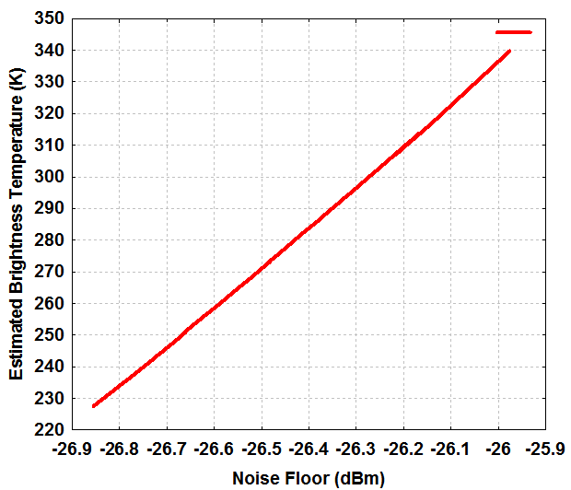
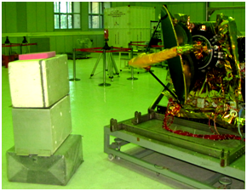
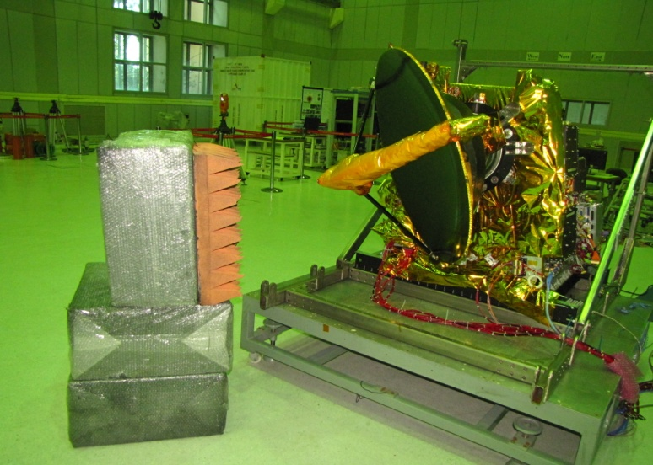
Scatsat-1 Radiometric Calibration
Radiometric Sensitivity of Scatsat-1 Scatterometer
Calibration Source: μ-wave Absorber immersed in Liquid N₂ as Cold Target and @ Lab Ambient as Hot Target
NE∆T (Hot) | NE∆T (cold)
22.5K | 16K

Slide 22
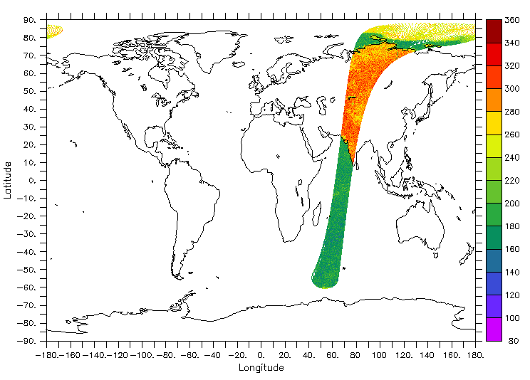
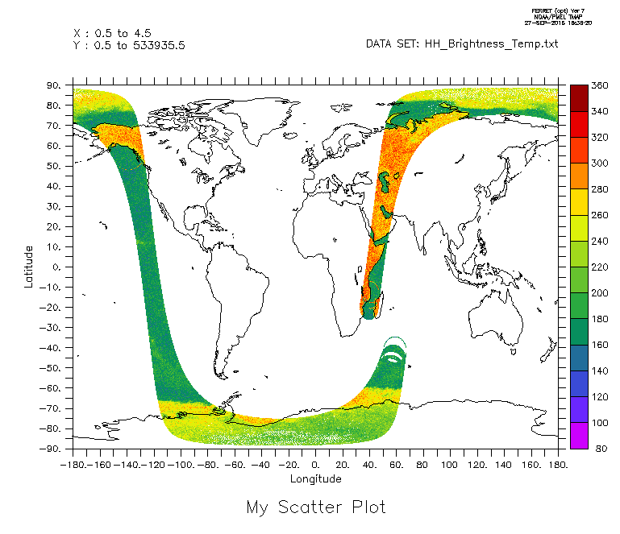
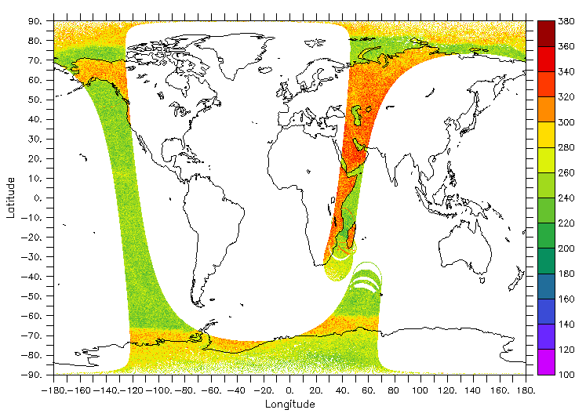
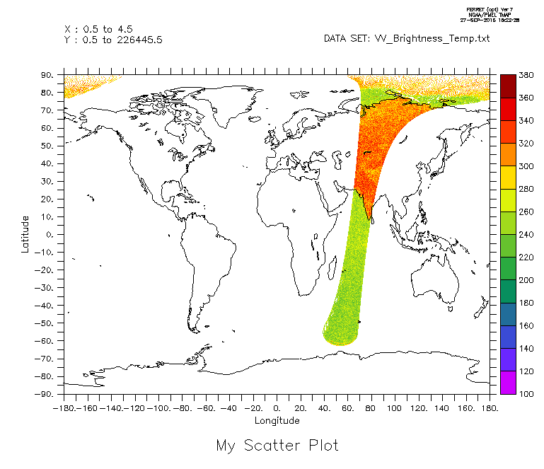
Brightness Temperature : First Images
H Pol
H Pol
V Pol
V Pol

Slide 23
Brightness Temperature from AMSR-2
HH Pol
VV Pol

Slide 24
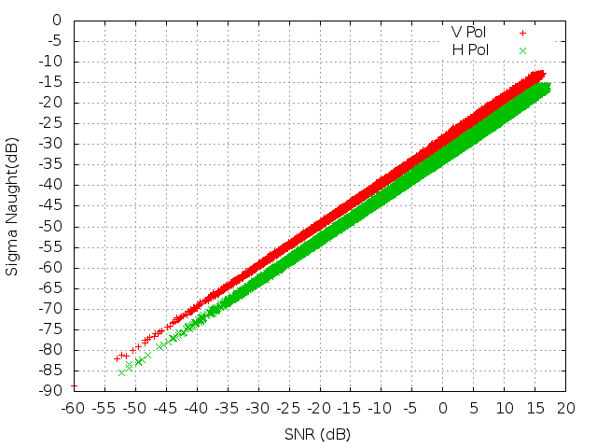
Scatsat-1 System Linearity

Slide 25
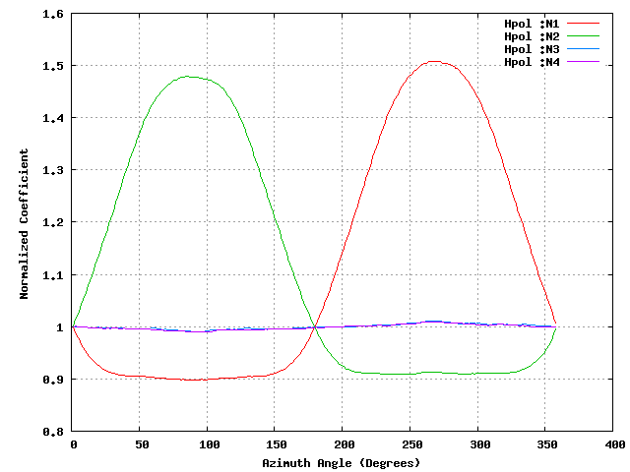
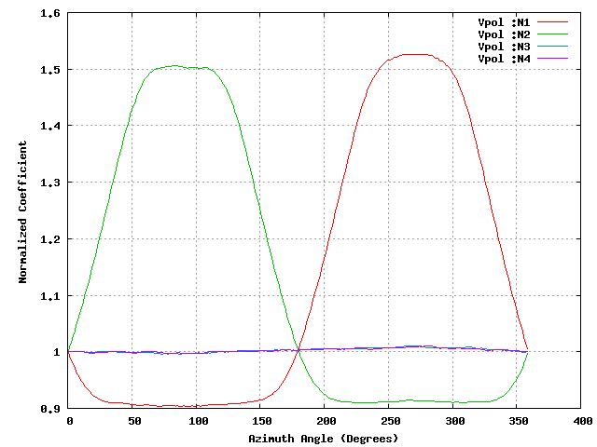
Scan-Bias from Deep-Space Observations
H pol
V pol

Slide 26
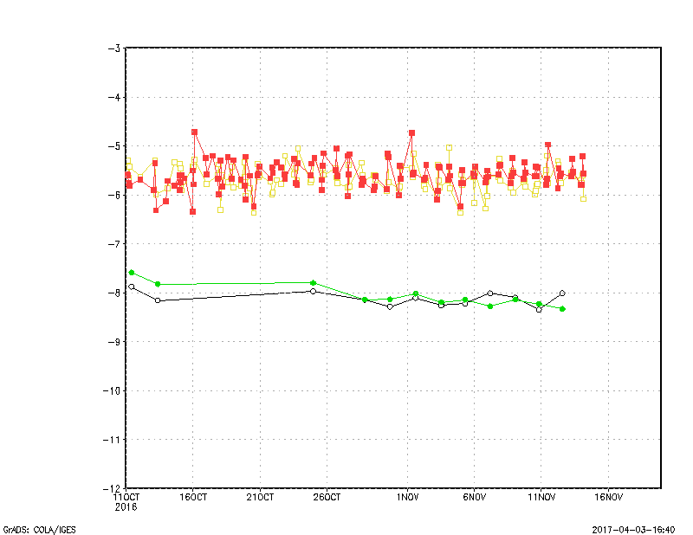
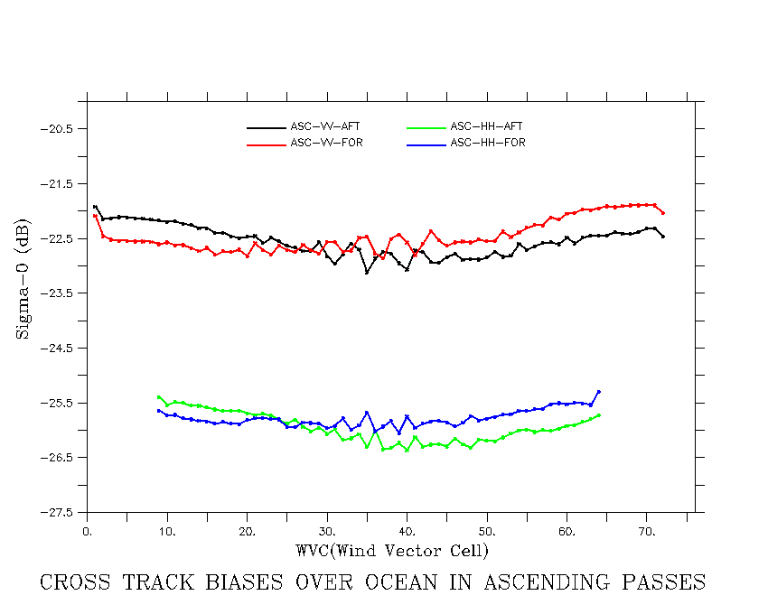
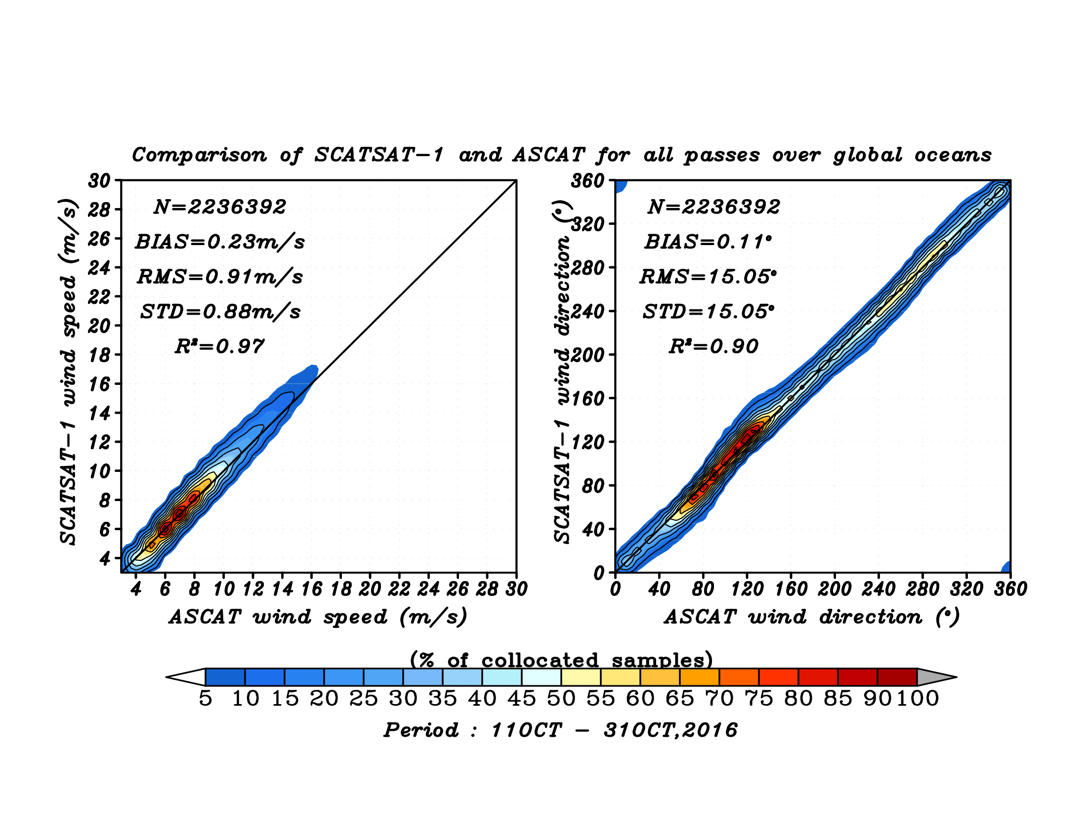
Figure: (a)Time series of sigma-0 over Amazon and Greenland in Oct-Nov 2016 which shows a better and smooth variability in sigma-0 (b) The improved cross track biases in latest version (c) The validation of SCAT wind from latest version with respect to ASCAT.

Slide 27
The entire cal-val exercise is a relative calibration which is well tested, however one of the lacking component is the active calibration chain.
In this regard a network of transponders/ground based scatterometers are required, that can operate during scat over pass and can be used for calibration.

Slide 28
Major Specifications Of RS2/RS2A LISS-3
Bands | Band-2 (0.52 – 0.59) µm Band-3 (0.62-0.68) µm Band-4 (0.77-0.86) µm Band-5 (1.55-1.7) µm
Quantization | 10 Bits
Ground Sampling distance at Nadir | Across: 23.5 m Along : 22 m
SNR@Saturation | >128
Saturation Radiance (mW/cm2/Sr/ µm) | B2: 53 B3: 47 B4:31.5 B5: 7.5
Operating Temperature | 20(+/-3) deg
Active Detectors | 6000
Detector Size | 10x7 µm for B-2,3,4 13x13 µm for B5 with 26 µm line pitch
Operating Modes | RS2:Main/Redundant with DPCM Enabled RS2A: RICE NUC Enabled/Disabled
5/12/2017
28

Slide 29
Major Specifications Of RS2/RS2A LISS-4
Bands | Band-2 (0.52 – 0.59) µm Band-3 (0.62-0.68) µm Band-4 (0.77-0.86) µm
Quantization | 10 Bits
Ground Sampling distance at Nadir | Across: 5.8 m Along : 6 m
SNR@Saturation | >128
Saturation Radiance (mW/cm2/Sr/ µm) | B2: 53 B3: 47 B4:31.5
Operating Temperature | 20(+/-3) deg
Active Detectors | 6000
Detector Size | 10x7 µm for B-2,3,4
Operating Modes | RS2:Main/Redundant with DPCM Enabled RS2A: RICE NUC Enabled/Disabled
5/12/2017
29

Slide 30
Major Specifications Of RS2/RS2A AWiFS-A/B
Bands | Band-2 (0.52 – 0.59) µm Band-3 (0.62-0.68) µm Band-4 (0.77-0.86) µm Band-5 (1.55-1.7) µm
Quantization | 12 Bits
Ground Sampling distance at Nadir | Across: 56.5 m at Nadir and 70 m at Off Nadir Along : 66 m
SNR@Saturation | >512
Saturation Radiance (mW/cm2/Sr/ µm) | B2: 53, B3: 47,B4:31.5 ,B5: 7.5
Operating Temperature | 20(+/-3) deg
Active Detectors | RS2: 6000 linear detectors for all bands RS2A: Band2-4 is of 6000 and Band5 is of 8 Rows × 6000 linear detectors
Detector Size | RS2 and RS2A: 10x7 µm for Band2-4 Band5 RS2:13x13 µm for B5 with 26 µm line pitch RS2A: 13x13 µm
Operating Modes | RS2:Main/Redundant with MLG Enabled RS2A:Main/Redundant with MLG Enabled
5/12/2017
30

Slide 31
Saturation Radiance Of RS2/RS2A For All Sensors
LISS-3
AWiFS-A/B
Band | Spec | RS2 | RS2A
2 | 53 | 52.00 | 52.00
3 | 47 | 47.00 | 47.00
4 | 31.5 | 31.5 | 31.5
5 | 7.5 | 7.5 | 7.5
Band | Spec | RS2 | RS2A
2 | 53 | 52.00 | 52.00
3 | 47 | 47.00 | 47.00
4 | 31.5 | 31.5 | 31.5
5 | 7.5 | 7.5 | 7.5
LISS-4
Band | Spec | RS2 | RS2A
2 | 53 | 52.00 | 52.00
3 | 47 | 47.00 | 47.00
4 | 31.5 | 31.5 | 31.5
5/12/2017
31

Slide 32
RS2/RS2A Product Specifications
Mission Specs
Geometric Accuracy
Achieved
Scene Based Product | LISS-3 | AWiFS | L4-MX
System Level Location Accuracy | <200M | <200M | <200M
BBR Goal | ±0.25 pixel | ±0.25 pixel | ±0.25 pixel
System Level Internal Distortion | < 3 pixels | <3 pixels | <5 pixel
Scene Based Product | LISS-3 | AWiFS | L4-MX
Improved Location Accuracy | <50M | <100M | <50M
BBR | ±0.25 pixel | ±0.25 pixel | ±0.25 pixel
Improved Internal Distortion | ~1 pixel | ~1 pixel | ~2 to 3 pixel
Radiometric Accuracy
Radiometric Accuracy:
Radiometeric Calibration using various
vicarious sites are going on. RS2A is Cross calibrated with OLI-8.
RS2 cross calibration with OLI8 is in Progress.
#: Fine tuning of RS2/RS2A is going on.
Targeted is RS2 and RS2A all sensors within 90%
Scene Based Product | LISS-3 | AWiFS | L4-MX
Radiometric Accuracy | Within 90% (B2-B4) # Within 80% (B5) | # Within 85% agreement | Within 90%
Multispectral response | OK | OK | OK

Slide 33
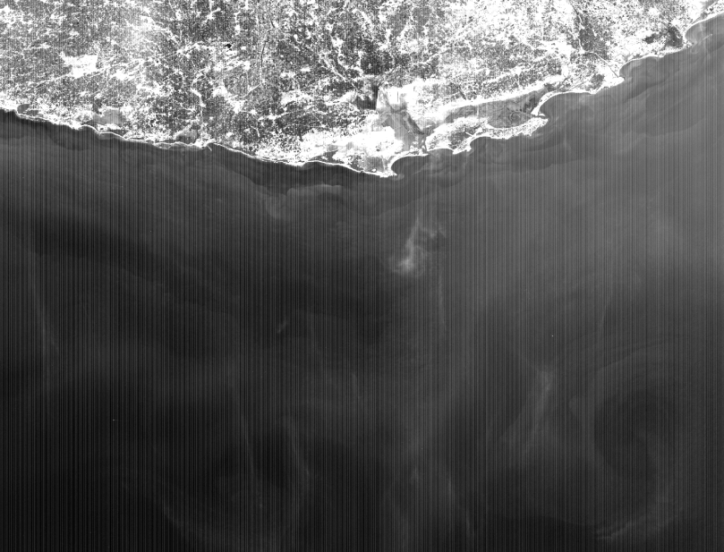
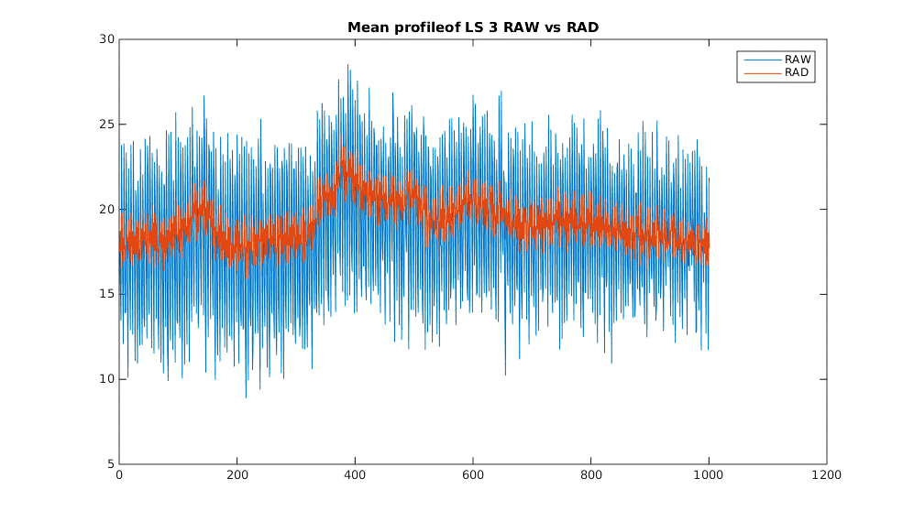
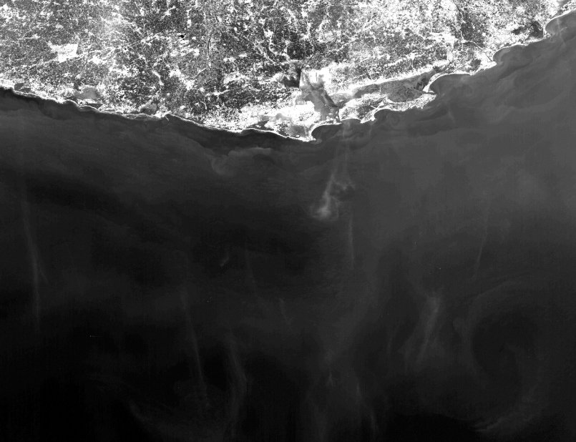
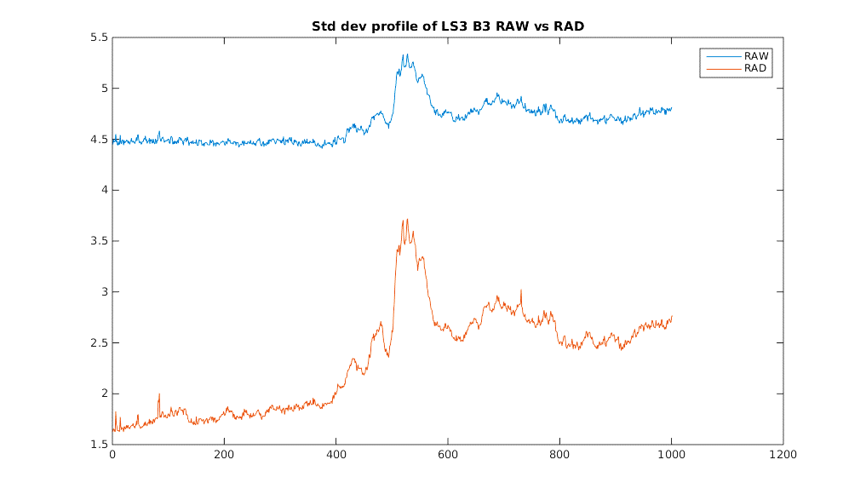
Transect Analysis Of LISS-3 Radiometrically Corrected
Band3 data (Result Of Radiometric Look-up-table)
Raw Data
Radiometrically Corrected

Slide 34


LISS – 3 DEBLUR + DENOISE
(NORMAL NON UNIFORMITY CORRECTED IMAGE)
(DEBLUR + DENOISE APPLIED RAD)
Band: 5
Scene ID: R2ALS300037017010210956
Path: 109 Row: 56 DOP: 02nd January, 2017

Slide 35


Cross Calibration of RS2A w.r.t OLI8
Spectral response comparison of L3/AWIFS with LANDSAT-8 OLI Radiance

Slide 36



Multispectral Radiometric Response Of RS2A Sensors

Slide 37

RS2 and RS2A LISS-3 Data
RS2
RS2A

Slide 38


CalVal
Important characteristics (of a calval site)
Essential
  Spatial Flatness & Uniformity
  Situated in Arid & Continental Zone
  Reflectance
  Lambertian Surface
Desirable
  Spectral Uniformity
  High Altitude
  Temporal Stability
  Proximity of Site
Bap test site, Rajasthan, India

Slide 39

Instrument Used
SVC Spectroradiometer: HR 1024 covers the UV, visible and NIR wavelength from 350 nm to 2500 nm. It uses 3 diffraction grating spectroradiometer with 1 silicon and 2 GaAs diode arrays. It has a capability to read in 1024 spectral bands. It gives the output in Signature (SIG) File Format which is a text file that contains the a header followed by spectral data information (wavelength, reference radiance, target radiance and reflectance).
Microtops II Ozonometer: It is 5-channel hand held device which allow measurement of the total ozone column and water vapor column.
Microtop II Sunphotometer: It is a 5-channel hand held device which measure the Aerosol Optical Thickness.
SVC Radiometer

Slide 40
CARTOSAT OVER SRC GROUND
SAC,AHMEDABAD
Surface plot of Sensor response to Grey Targets
Deployed cloths of variable grey targets
Sensor Image

Slide 41
CARTOSAT
Convex Mirror Target On Dark Background
Surface plot of Sensor response to Grey Targets
Convex Mirror Target on Dark Background
Sensor Image

Slide 42





PSF Estimation and Compensation Of Cartosat
Pattern Noise and Port Wise Noise Removed
MTF Compensated
Improvement in MTF at all frequencies
Original PSF
Corrected Image PSF
MTF curves indicate boost in contrast and sharpness

Slide 43
Cartosat Data Correction
Physical basis:
Over vegetated land surfaces, aerosol properties can be retrieved by taking advantage of the spectral relationship between surface reflectance in visible & NIR bands of Cartosat to account for effect of ever-changing dynamics of vegetation on surface reﬂectance.

Slide 44


2 % Linear stretched images from CARTOSAT-2S MX acquired on 1 NOV 2016
Top of the Atmosphere (TOA) reflectance
DN --> Radiance --> TOA Reflectance
Atmospheric scattering and absorption corrected reflectance
--> Gas (O_{x}, H₂O) abs. --> aerosol corr. --> Surface reflectance
B3: Min = 0.0, Max = 1.00, Mean = 0.161, STD = 0.024
B2: Min = 0.0, Max = 0.81, Mean = 0.199, STD = 0.017
B1: Min = 0.0, Max = 0.59, Mean = 0.229, STD = 0.014
B3: Min = 0.0, Max = 1.00, Mean = 0.075, STD = 0.056
B2: Min = 0.0, Max = 1.00, Mean = 0.101, STD = 0.046
B1: Min = 0.0, Max = 1.00, Mean = 0.102, STD = 0.039

Slide 45


2 % Linear stretched images from CARTOSAT-2S MX acquired on 1 NOV 2016
Top of the Atmosphere (TOA) reflectance
DN --> Radiance --> TOA Reflectance
Atmospheric scattering and absorption corrected reflectance
--> Gas (O_{x}, H₂O) abs. --> aerosol corr. --> Surface reflectance

Slide 46



Onboard Calibration for constellation of sensors
Techniques for onboard calibration
Standard lamp or LED
    Compact and easy to realize
    Relative calibration
    Degradation of lamp over period of operation
    Illumination only in certain field of the payload.
    Sometimes standard sources will be clubbed with integrating sphere.
  Solar calibration using diffuser
    Largest then the clear aperture size of the payload
    Absolute calibration
    The main error is due the instability diffuser plate, intense ultraviolet radiation and spacecraft contamination will change the diffuse reflectance, but diffuser plate will take long time to become instable
    As an alternative perforated plates are proposed but this technique lacks uniformity across the plate so it is not preferred.
  Vicarious calibration
    Spatially and temporally invariant terrestrial targets are required.
    Atmosphere model plays major role in vicarious calibration as at sensor level radiance is not known and can only be modelled. To avoid this some time moon is used for calibration.
    This technique can be used for inter-calibration between constellation of satellites.
    Such areas for large FOV sensors are highly unlikely.
Vicarious calibration site at NRSC

Slide 47

THANK YOU

