Slide 1
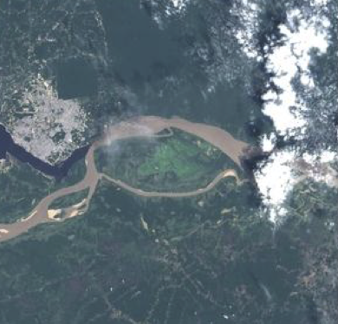
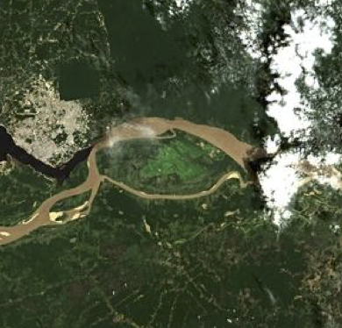
Atmospheric Correction Inter-comparison eXercise
ACIX

Slide 2
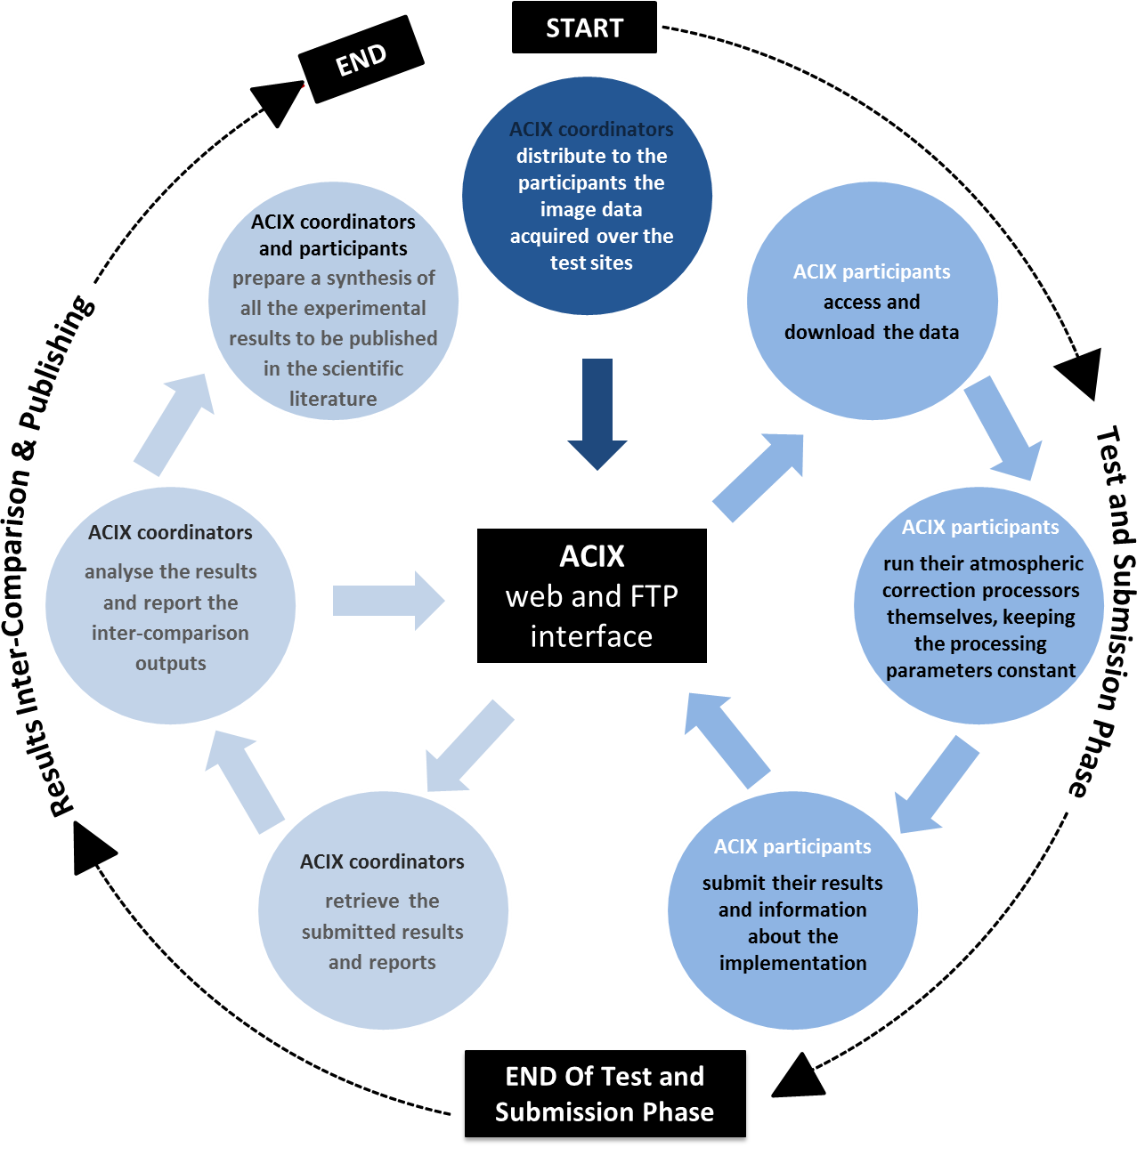
WHAT?
International collaborative initiative to inter-compare a set of atmospheric correction (AC) processors for Sentinel-2 and Landsat-8 imagery
Better understanding of the different uncertainty contributors and help in improving the AC processors
How?
Definition of the inter-comparison protocol
All the proposals were discussed at the 1st workshop and the final inter-comparison procedure was agreed by all participants.
Application of the AC processors
Participants applied their AC schemes for a set of test sites keeping the processing parameters constant.
Analysis of the results
ACIX coordinators processed the results submitted by all participants. All the results were presented and discussed during the 2nd ACIX workshop.
Notes:
The inter-comparison of the derived Bottom-of-Atmosphere (BOA) products is expected to contribute to the understanding of the different uncertainty contributors and help in improving the AC processors.

Slide 3
WHO?
Sensors Processors |  | Sentinel-2 (MSI) |  | Landsat-8 (OLI)
 |  | Mandatory Run | Optional Run | Mandatory Run | Optional Run
1 | ACOLITE [Belgium] |  | ✓ |  | ✓
2 | ATCOR [Germany] | ✓ | ✓ | ✓ | ✓
3 | Brockmann [Germany] |  | ✓
4 | FORCE [Germany] |  | ✓ |  | ✓
5 | GA-PABT [Australia] |  | ✓ (Only Canberra) |  | ✓(Only Canberra)
6 | LaSRC [USA] | ✓ |  | ✓
7 | LAC [France] |  | ✓
8 | MACCS [France] | ✓ | ✓
9 | OPERA [Belgium] | ✓ | ✓ | ✓ | ✓
10 | SCAPE-M [Germany] |  | ✓
11 | SeaDAS [USA] |  |  |  | ✓
12 | Sen2Cor [France&Germany] | ✓ | ✓
✓ | Data provided
 | Data NOT provided

Slide 4
Conclusions
Many lessons learned for all processors that will help in improving them
Learning on the configuration and performance of other processors
Importance of quality flagging pixels (cloud/high-aerosol) to guarantee a good AC
ACIX results need to be further analysed and quality controlled
Provision of per-pixel uncertainties hampered by the quality of cloud/high-aerosol masks
Recommendations
Metrics in terms of global difference (combining mean and std)
Results’ presentation for each test site, per band all the processors, time series
Consistency in usage of sun irradiance model
Flag to indicate that processors switch to default values
Harmonisation of the data processed by all participants to have conclusions over the same sites/same dates
Development of a platform supporting the online validation of the processors

Slide 5
!
All the plots and results of ACIX will be available soon on CEOS Cal/Val portal {http://calvalportal.ceos.org/home}
!
All the plots and results of ACIX will be available soon on CEOS Cal/Val portal {http://calvalportal.ceos.org/home}

Slide 6
Way Forward
- Next steps for ACIX
Consolidate results/metrics (organizing committee) considering conclusions/feedback
Distribute the ACIX report to all participants & Receive their feedback
Videoconference to discuss and agree on the final report (target September)
Publication in a scientific journal
!
All the plots and results of ACIX will be available on CEOS Cal/Val portal {http://calvalportal.ceos.org/home}
- Plans for ACIX 2
Complete time series from L8/S2A/S2B of at least 1 year period
Selection of sites to be refined
Metrics: the same of the 1st ACIX + comparison with RadCalNet, AeroNet OC, smoothness in time series, consistency across tiles
Assess quality of cloud/shadows masks
Go to higher spatial resolution (pixel scale)
Single run (with adjacency, without BRDF/topography corrections)
Harmonise the datasets between participants

Slide 7
Perspective of WGCV Chair
Teams learned many lessons of where to improve their schemes while at the same time increasing their confidence in their schemes
Will be difficult for some of the tailored schemes to go broader
Flagging of results improved
Many lessons learned during the first exercise that will help any follow-on activities
Cloud mask characterization is needed
DEM at global scale with SRTM quality for processing is sufficient
Pixel-by-pixel uncertainty reporting for interoperability is not feasible right now
Complexity of the problem prevents any confidence in a result developed
More resources needed to develop a pixel-by-pixel and to validate that uncertainty
Uncertainties with view angle? - Solar zenith angle >75 is
suspect.
View angle is not an issue out to MODIS scan angles.
BRDF? - diffuse light included in code - not typically.
The correction to an equivalent nadir reflectance is not
recommended because knowledge of surface type limits accuracy
ant the DEM is limitation for surface slope correction.
Ground truth reflectance? - LandValNet

Slide 8
Perspective of WGCV Chair
Uncertainties from angle
Results at solar zenith angle >75 are suspect
View angle is not an issue out to MODIS scan angles
BRDF
Diffuse light effects typically not included
Correction to an equivalent nadir reflectance is not recommended because knowledge of surface type limits accuracy and DEM is a limitation for surface slope correction
Ground truth reflectance could be obtained from RadCalNet

