Slide 1
CEOS/WGCV/LPV Update
Miguel Román (NASA)
Miguel.O.Roman@nasa.gov
Fernando Camacho (EOLAB)
Fernando.Camacho@eolab.es

Slide 2
CEOS-LPV Structure and Agency Programs
Group | First Name | Surname | Country | Supporting Agency / Program | Institution
Chair | Miguel | Román | USA | NASA | NASA
Vice Chair | Fernando | Camacho | Spain | ESA | EOLab
Secretariat | Jaime | Nickeson | USA | NASA | GSFC
Land Use/Cover | Martin | Herold | The Netherlands | GOFC-GOLD/ESA | Wageningen University
 | Pontus | Olofsson | USA | NASA | Boston University
LAI | Hongliang | Fang | China | CAS | CAS
 | Oliver | Sonnentag | Canada | IAI/NSERC | University of Montreal
Fapar | Nadine | Gobron | Italy | JRC | Joint Research Centre
 | Arturo | Sanchez | Canada | IAI/NSERC | Univ. of Alberta
Active Fire - Burn Area | Gareth | Roberts | UK | EUMETSAT | Univ. of Southampton
 | Andrew | Edwards | Australia | DCBR/B&NHCRC | Charles Darwin University
 | Luigi | Boschetti | USA | USGS/NASA | University of Idaho
BRDF/Albedo | Zhuosen | Wang | USA | NOAA/NASA | UMD/NASA GSFC
 | Alessio | Lattanzio | Germany | EUMETSAT | EUMETSAT
Soil Moisture | Alexander | Loew | Germany | LMU | LMU
 | Michael | Cosh | USA | USDA | USDA ARS
LST & Emmisivity | Pierre | Guillevic | USA | NOAA/NASA | UMD/NASA GSFC
 | Frank | Goettsche | Germany | EUMETSAT | KIT
Phenology | Jadu | Dash | UK | ESA | Univ. of Southampton
 | Matt | Jones | USA | NASA | University of Montana
Vegetation Indices | Tomoaki | Miura | USA | NOAA | University of Hawai'i
 | Swinnen | Else | Belgium | VITO | VITO
Snow Cover | VACANT
 | Thomas | Nagler | Austria | ESA | ENVEO
Biomass | Laura | Duncanson | USA | NASA | UMD/NASA GSFC
 | John | Armston | USA | NASA | University of Maryland
 | Mathias | Disney | UK | ESA | University College London
POC: Hank Margolis
(LPV Chair + 5 Focus Areas)
POC: Ferran Gascon
(WGCV-ACIX; 4 Focus Areas)
POC: Ivan Csiszar
(4 Focus Areas)
POC: Alessio Lattanzio
(3 Focus Areas)
POC: John Dwyer
(LSI-VC; WG-Climate;
1 Focus Area)
POC: Hongliang Fang
(1 Focus Area)
POC: Nadine Gobron
(GCOS-TOPC;
1 Focus Area)
Notes:
When an agency supports a focus area lead, it supports all the activities surrounding that variable including:
Regularly participate in LPV telecons (every 1st Tuesday of every 2nd month) and report on activity, meetings, new products, funding mechanisms
Engage community members (via listserve): update them on progress and activities a minimum of one time annually, seek information on data collection and sites they are involved with
Organize at least 1 topical workshop - (either every 2 years or minimum of 1 within leadership term) - these will likely be attached to another science meeting
Expand LPV activities, field sites, collaboration beyond North America and Europe!
Lead, oversee, be involved in product inter-comparison activities
Lead the development and writing of “good practice” land product validation guidelines/protocols
Keep the listserv and your Focus Area web pages up to date!
When we talk about LPV, we are not just talking about NASA and ESA. Both are the lead coordinating agencies; but many other CEOS agencies and partners, including many experts in academia and industry, contribute to CEOS-LPVs’ mission.
Take away: These agencies are generating multiple Land products and are required to validate them. LPV focus areas provide expertise across products. This results in substantial benefits to these agencies and their stakeholders including:
(1) increased traceability of product uncertainties, (2) a reduction of costs through sharing of quality-assessed in-situ reference data, (3) structuring of work distribution between expert communities and stakeholders, and (4) uncertainty terminology and methodological development across agencies developing land products from multiple missions.

Slide 3
USGS Contributions to LPV
CEOS leadership – Current CEOS chair
Leadership of Land Surface Imaging Virtual Constellation (LSI-VC)
Member of WG Climate
Coordinating with NASA on development of an online validation exercise tool.
Created their intercomparison tool, the Land Product Characterization System (LPCS).

Slide 4
NASA Contributions to LPV
LPV leadership – LPV chair and secretariat, LPV Web site
Several LPV focus area leads funded by NASA – LC, Burned Area, Albedo, LST, Biomass, Phenology
Working to develop and validate new and innovative products combining field data, satellite observation, and models
Hosted special session on Validation of Land Products at AGU
Support for WG and Focus Area meetings at ESA LPS and in US.
Lead SMAP mission and validation efforts
Responsive to CEOS Carbon Strategy Actions

Slide 5
ESA Contributions to LPV
LPV leadership – LPV vice-chair
Several LPV focus area leads funded by ESA – Land Use/Land Cover Change, Phenology, Snow, Biomass
CCI and Copernicus - improving global products through validation
Leading ACIX - 2nd Workshop of CEOS-WGCV Atmospheric Correction Inter-comparison Exercise
Sentinel validation efforts, including OLCI and SLSTR land products, and fused S2/Landsat-8 products, S2/S3 Validation Team meetings
Working to establish network of operational test sites and validation campaigns
QA4EO SnowPEx: Satellite Snow Product Intercomparison and Evaluation Exercise
Responsive to CEOS Carbon Strategy Actions

Slide 6
NOAA Contributions to LPV
LPV focus area leads funded by NOAA – Vegetation Indices, Albedo, Land Surface Temperature
Creates operational NDVI, Fire, Snow products
NOAA PIs on the VIIRS Land Science team are developing and validating VIIRS Environmental Data Records (EDRs)

Slide 7
EUMETSAT Contributions to LPV
CEOS leadership – vice-chair of WG Climate
Albedo focus area lead supported by EUMETSAT
Sustained, Coordinated Processing of Environmental Satellite Data for Climate Monitoring – SCOPE-CM – retrieval of satellite albedo from geostationary satellites from various agencies

Slide 8
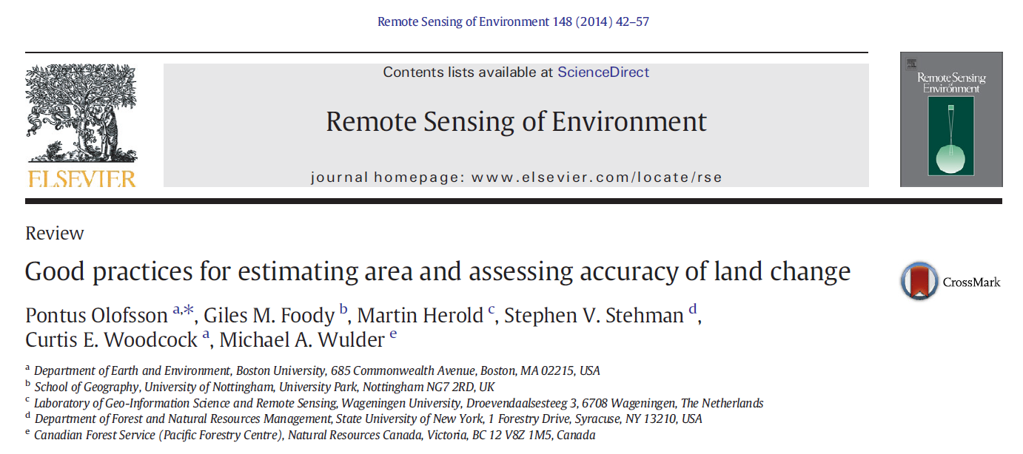
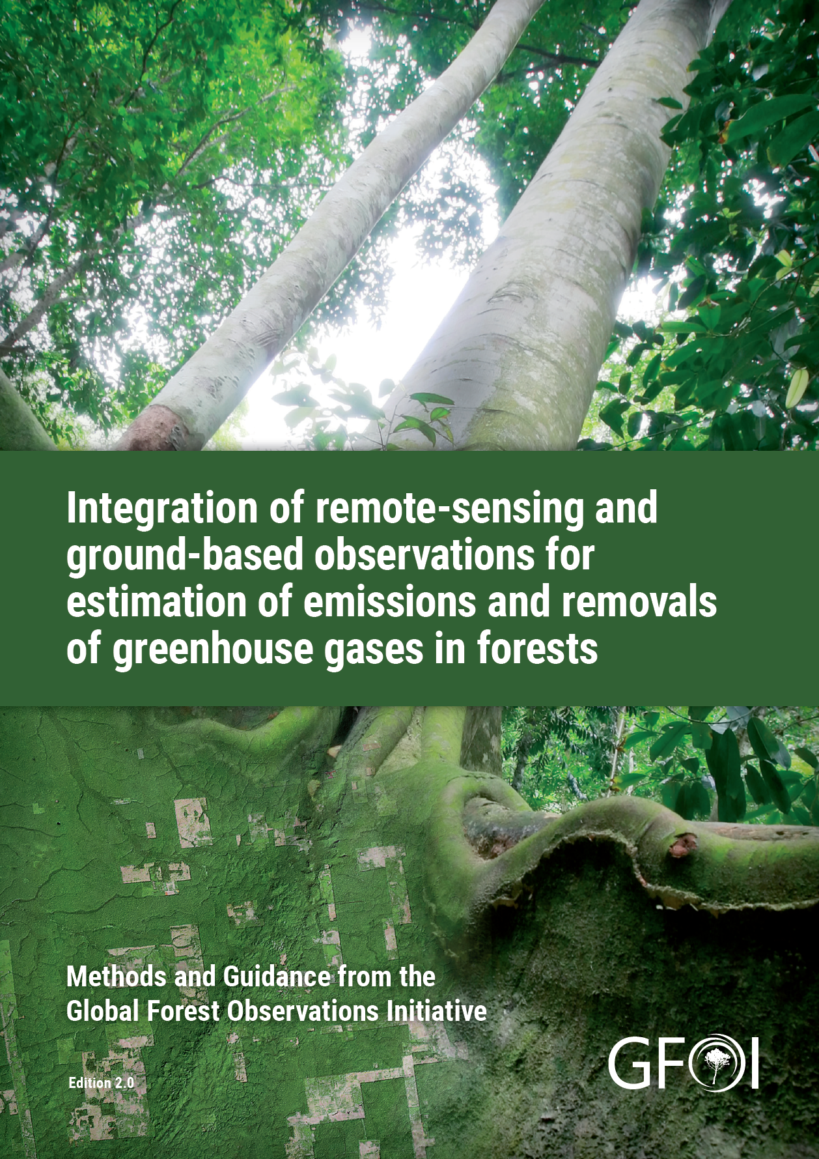
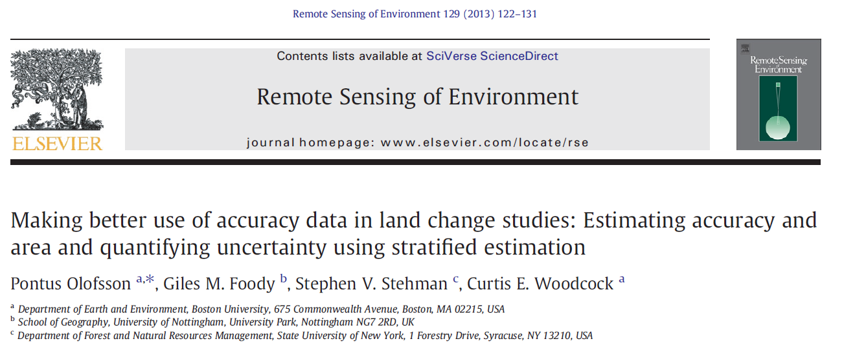
Area and accuracy estimation of land change Pontus Olofsson (Boston University)
- Image classification errors can greatly biased mapped areas of land change – also, “pixel-counting” in maps is incompliant with IPCC criteria reporting of land change.
- CEOS-LPV is providing guidance to implement protocols for unbiased estimation of area and accuracy.
- NASA and other agencies support development and implementation of estimation protocols.

Slide 9
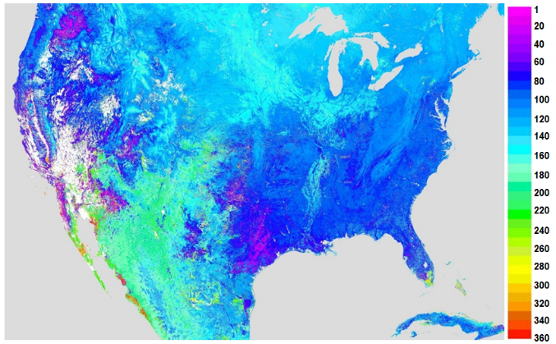
Tracking Nature’s Calendar using Suomi-NPP VIIRS
NASA/NOAA satellites enable scientists and decision makers to track the timing and magnitude of plant growth.
NASA’s phenology products provide accurate information related to the timing of ecosystem properties, which is important for monitoring forests, croplands, grazing lands, and as input for modeling weather and biospheric processes.
X. Zhang, SDSU
Start of growing season (in day of year)
Who’s using NASA’s phenology products? (1) Farmers, ranchers, and meteorologists that want to monitor drought extent and severity; (2) foresters that want to detect disturbances related to wind damage, pests, disease outbreaks, and invasive species; (3) public health officials looking for short-term forecasts of allergenic pollen; (4) meteorologists looking to improve weather models; and (5) tourists and the travel industry looking for information on the timing and location of spring wildflowers blooms or peak fall foliage.

Slide 10
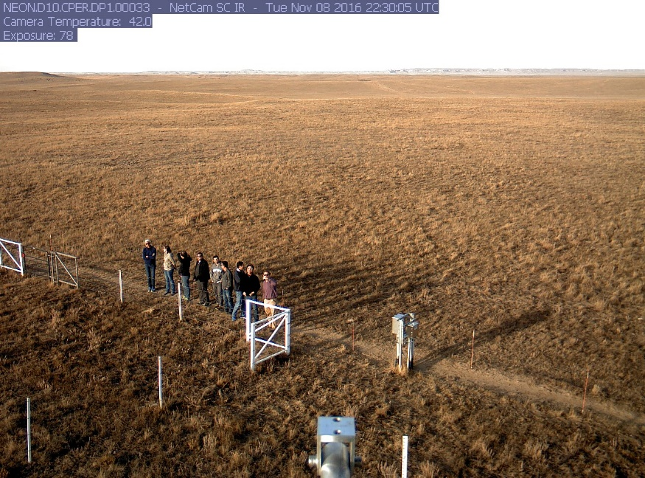
LPV Vegetation Index & Land Surface Phenology Workshop
Phenology - identified four primary steps to advance validation efforts, leads identified for each step
Identify data requirements for validation (list was created) and initial analysis of Flux/PhenoCam sites.
Conduct analysis of potential sites with a resulting publication (e.g. “Evaluation of the Representativeness of Networks of Sites for the Global Validation and Inter-comparison of Land Surface Phenology”). Lead for this has now been identified.
Support an on-going effort by Colin Talbert (NWCSC) to relate phenology camera data footprints to remote sensing product pixel extents.
Establish a validation database that combines the results of steps 1, 2, and 3.
Vegetation Indices - identified 3 components of VI validation that were needed – Focus area recently launched, working on web content
Uncertainty of VIs in their units (e.g., DNDVI)
VI sensitivity to vegetation biophysical/physiological conditions
Long-term stability of VI time series data
Participants touring NEON site caught on the PhenoCam!

Slide 11
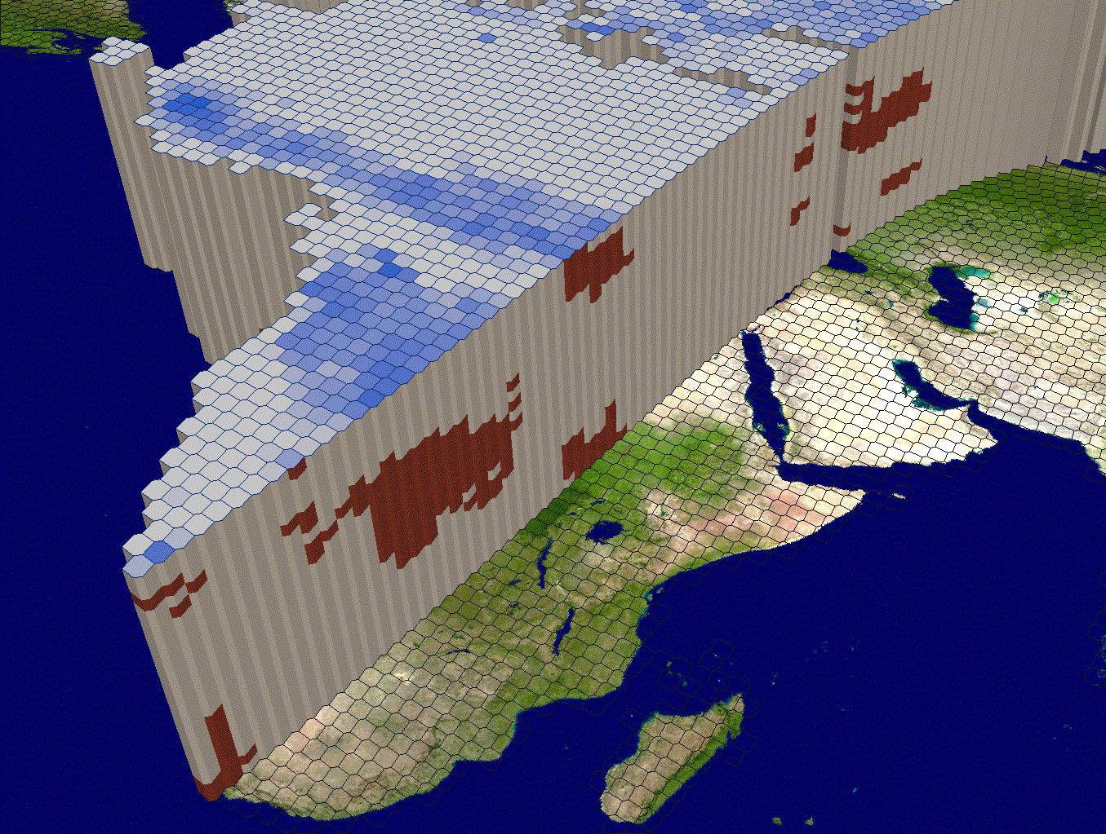
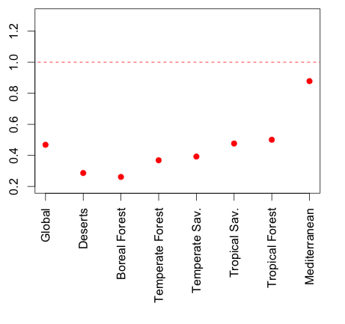
Spatial and temporal sampling for global burned area validation
Luigi Boschetti (U Idaho, CEOS Land Product Validation Subgroup)
David P. Roy (South Dakota State)
Stephen V. Stehman (SUNY-ESF)
Overall Accuracy
Burned Area Total
Stratified Standard Error (SE) vs
Simple Random Sampling (SRS)
Rigorous design-based validation of global burned area products, in which reference data are selected via a probability sampling design, is effective in reducing the standard errors of accuracy and area estimators compared to simple random sampling.

Slide 12
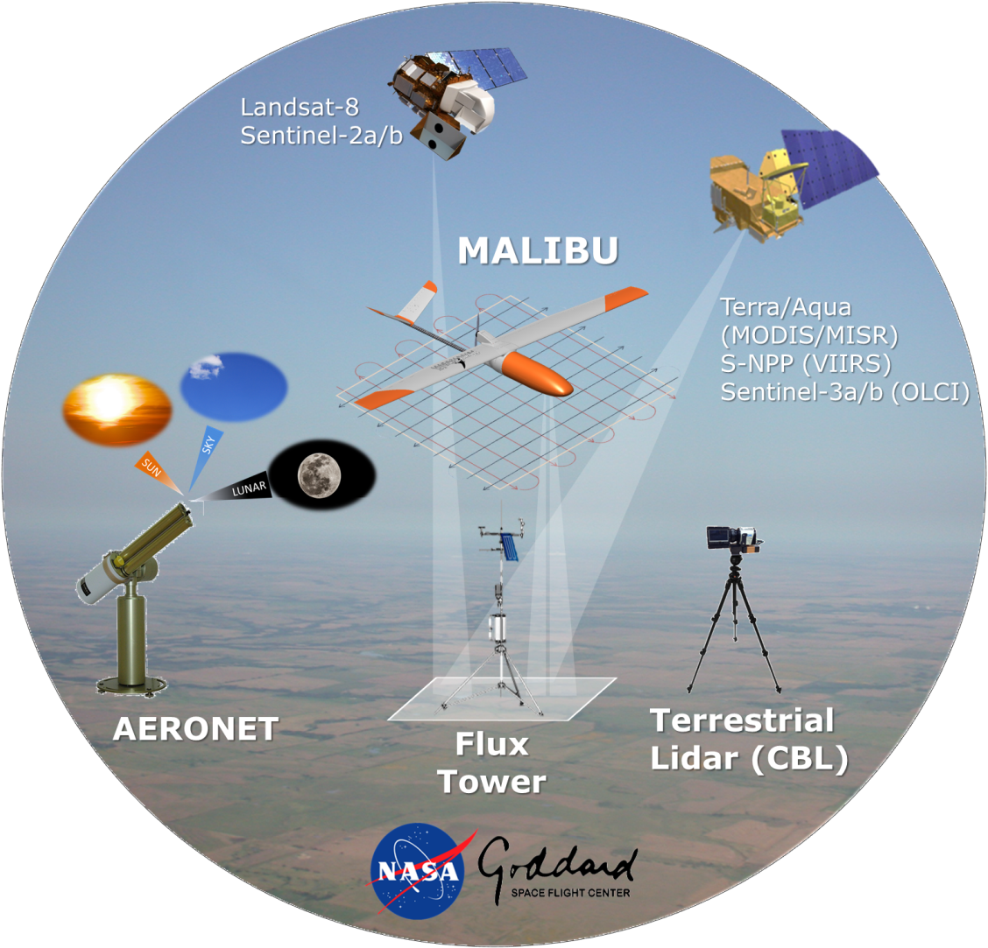
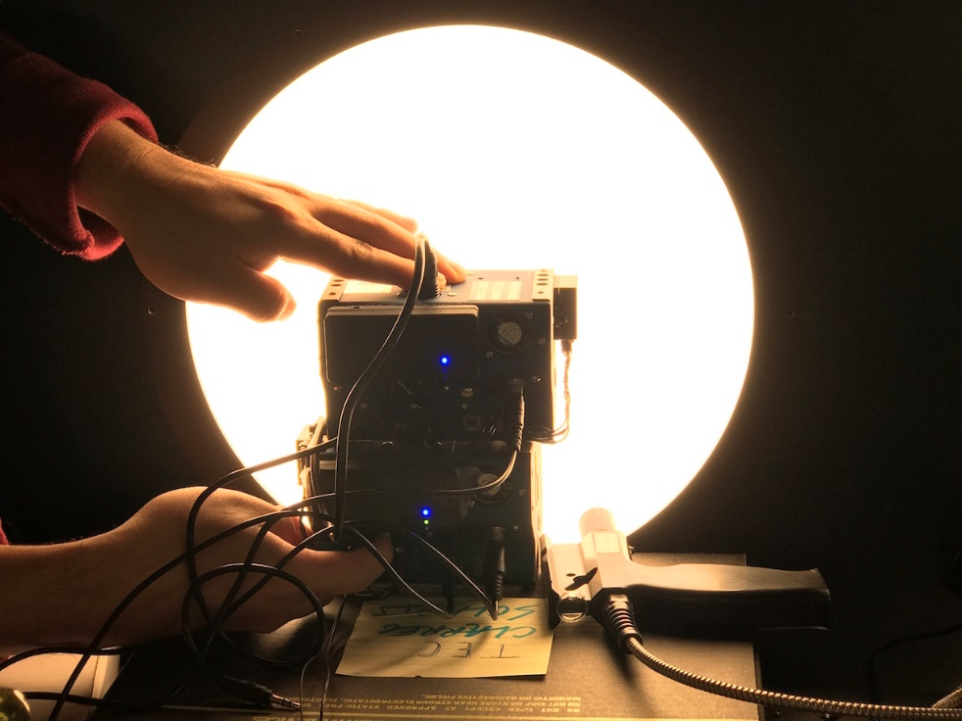
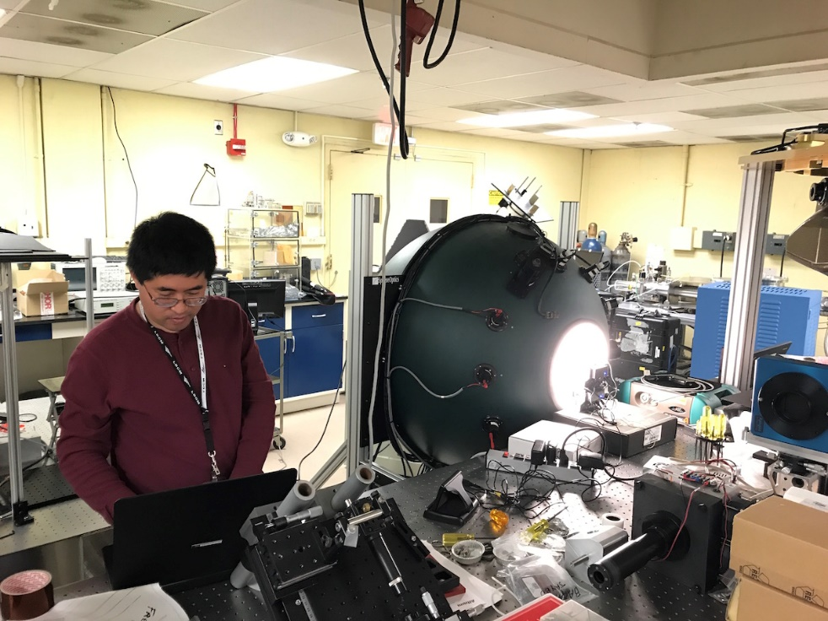
Multi AngLe Imaging BRDF Unmanned aerial system
https://viirsland.gsfc.nasa.gov/Campaigns.html

Slide 13
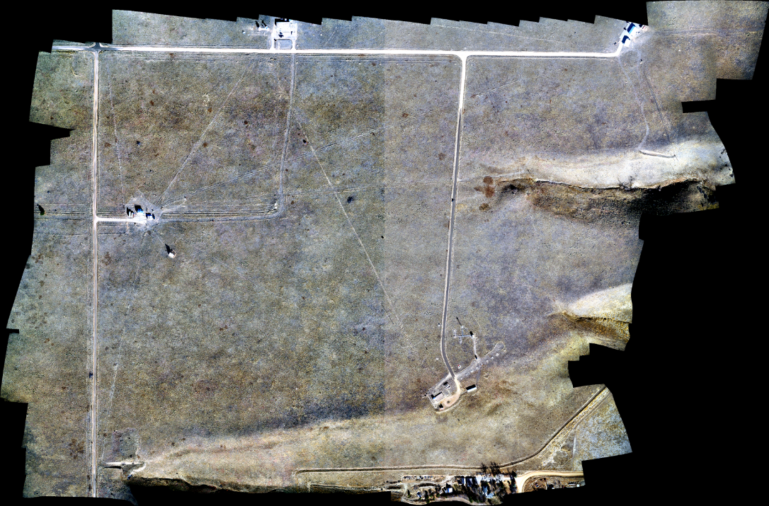
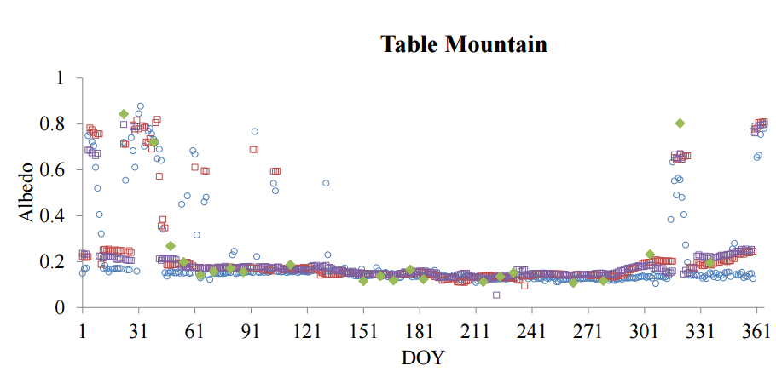
MALIBU Campaign Status
Ortho-rectified imagery @ BSRN Table Mountain (Nov 30, 16.)
FAA approvals went through without a hitch – from flight request, to approval, to deployment in < 2 weeks!
Time Series plot from: https://www.esrl.noaa.gov/gmd/grad/meetings/BSRN_talks/P2_3_Crystal_Schaaf_BSRN_validation_2016_v0.8.pdf

Slide 14
CEOS LPV Supersites
CV-12 WGCV action: Evaluation of validation supersites and new validation approaches
Evaluation of well-characterized supersites with data continuity prospects for validation purposes that allow for testing of products, algorithms, and validation strategies through radiative transfer modeling.
LPV Supersite Definition
A Supersite should be fully characterized (3D canopy structure, plus key land variables) to allow a RT model parameterization, whereas a core site refers typically to the same variable.
A Supersite should be useful for the validation of several land products ( > 3 ) .
Candidates Networks:
TERN Australian Super Sites
ICOS Ecosystem network
NEON
Sites proposed by LPV members

Slide 15
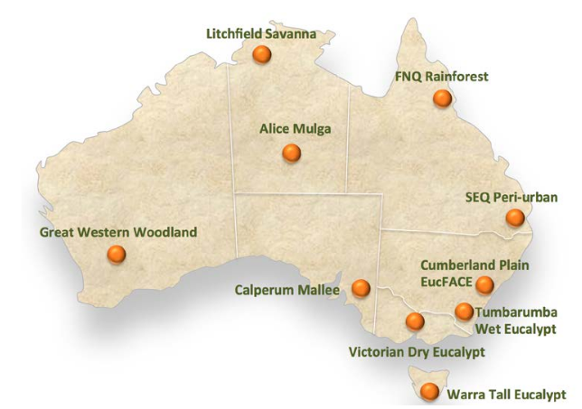
TERN Supersites
Australian supersite Network (ASN)
Aims to improve the scientific understanding of how key ecosystems in Australia are responding to environmental change.
A core set of experiments is conducted at each supersite to measure ecosystem properties in an appropriate manner for the ecosystem being studied.
Data collected from the supersites are described, formatted and indexed to create a complete record available for use by the scientific, management and policy communities and the wider public.
The Australian supersite Network is managed by James Cook University.
The supersite repository is managed by the supersite/LTERN Data Team.
Flux towers in the supersite network are supported by the OzFlux network.
The Australian Supersite network includes 10 sites located in significant biomes around Australia, when some of the sites have several nodes.
The infrastructure is also used to provide base-line calibration and validation data for modeling and remote sensing.
AUSCOVER provides airborne hyperspectral and LiDAR data
Open access to SuperSites data is provided through a dedicated data portal.
Contact:
Mirko Karan: Coordinator Australian SuperSites
mirko.karan@jcu.edu.au
Source: http://www.supersites.net.au/
http://www.tern.org.au/Australian-Supersite-Network-pg17873.html

Slide 16
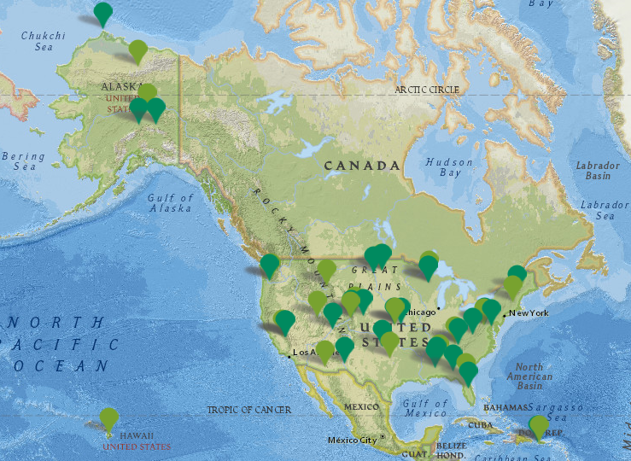
NEON Network
National Ecological Observatory Network (NEON)
Continental-scale ecological observation facility sponsored by the National Science Foundation to gather and synthesize data on the impacts of climate change, land use change and invasive species on natural resources and biodiversity
Strategically locates sites across the U.S. to capture variability in ecological and climatological conditions (terrestrial and aquatic stations)
Coordinates local measurements in the field with high-resolution airborne remote sensing.
Provide resources for the ecological community to integrate observations and datasets independently, such as collection and processing protocols.
NEON network includes core and relocatable terrestrial sites across the U.S. (including Alaska, Hawaii and Puerto Rico). Core sites (20) are fixed, collect data for a minimum of 30 years and are designed to represent and capture wildland conditions. Relocatable sites (27) move through time to capture environmental gradients not captured at core sites
Open access to sites data is provided through the NEON data portal (http://data.neonscience.org/home).
Contact:
Shelley Petroy
source: http://www.neonscience.org/science-design/field-sites
http://www.neonscience.org/science-design/spatiotemporal-design

Slide 17
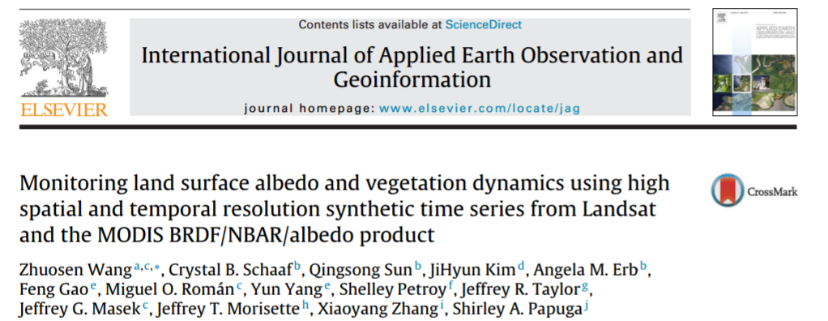
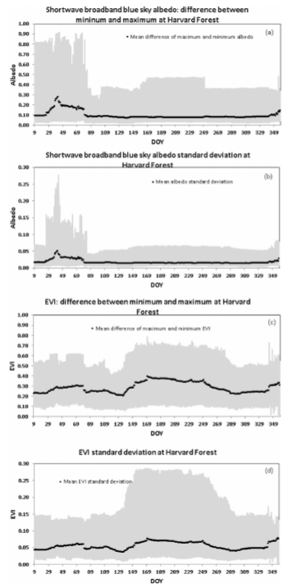
NEON Network

Slide 18
Candidates Selection Status
Overall, 61 Supersites selected out of:
TERN : 18 nodes in 10 Supersites
ICOS: 71 sites
NEON: 47 sites
LPV : 13 sites
The networks referred previously have been investigated to select the candidate sites. Two major criteria were first applied:
Availability of data: the station is active.
Spatial representativeness: to guarantee the highest level of homogeneity and to minimize issues associated with spatial representativeness in the point-to-pixel comparison.
Using high resolution satellite images (available via Google Earth™), to identify those matching the requirement of homogeneity in the area surrounding the measurement tower
Only visually homogeneous sites at 3x3 km and 1x1 km are considered.

