Slide 1

Working Group on Calibration and Validation (WGCV): 42
Infrared Visible and Optical Sensors (IVOS) subgroup: report
Nigel Fox
NPL (with UKSA support)
WGCV 41

Slide 2
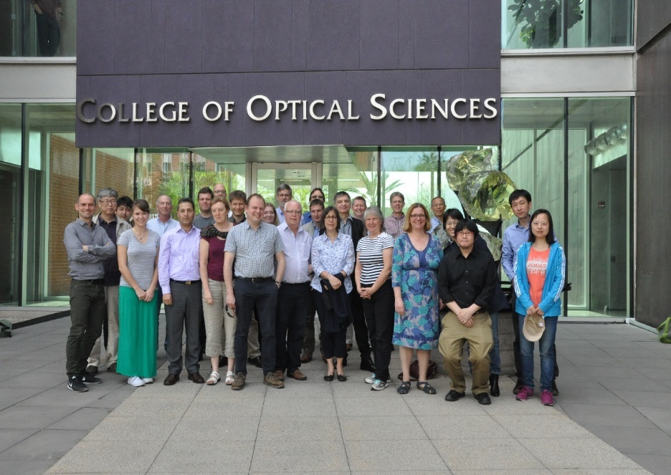
Summary of activities
IVOS 29 @ Tucson, Arizona, USA hosted by Uni of Arizona Mar 2017
26 agency/orgs represented
30 attendees + 10 remote
All themes and topics (work-plan discussed or summarised
3 joint (GSICS) webex on solar irradiance
3 rd MTF workshop (Mar 2017)
2 PICSCAR webex (Joint GSICS)
  1st Meeting (3rd inc pre-cursors)
  IVOS 30 ESA Estec Holland Q1-2 2018
  mett
Special Projects:
RadCalNet team met Mar 2017@Tucson
  Beta testing results workshop
SST/LST comparison (under sponsorship from ESA) took place @NPL (June-July 2016)
O-colour vicarious Cal comparisons started April 2017

Slide 3
IVOS: Vision
To facilitate the provision of ‘fit for purpose’ information through enabling data interoperability and performance assessment through an ‘operational’ CEOS coordinated & internationally harmonised Cal/Val infrastructure consistent with QA4EO principles.
Pre-flight characterisation & calibration
Test – sites
Comparisons
Agreed methodologies
Community Good Practises
Interchangeable/readable formats
Results/metadata - databases
Key Infrastructure to be established and maintained independent of sensor specific projects and/or agencies

Slide 4
Terms of Reference
Promote international and national collaboration in the calibration and
validation of all IVOS member sensors.
Address all sensors (ground based, airborne, and satellite) for which there
is a direct link to the calibration and validation of satellite sensors;
Identify and agree on calibration and validation requirements and
standard specifications for IVOS members;
Identify test sites and encourage continuing observations and
inter-comparison of data from these sites;
Encourage the preservation, unencumbered and timely release of data
relating to calibration and validation activities including details of pre-launch
and in flight parameters.
In the context of calibration and validation encourage the full consideration
of “traceability” in all activities involved in the end-to-end development of
an EO product including appropriate models and algorithms.
6.

Slide 5
Work plan
Structured into themes and led by ‘champions’ (effectively vice chairs for CEOS WGCV constitution) (Plus specific projects)
  Look to develop good practises
  Organise comparisons
  Shared learning (research activities)
  Shared infrastructure / tools / Methods
  Recommendations as needed
Land surface reflectance - Czapler Myers (U of Arizona USA)
Ocean colour (link to IOCCG, VC-OCR etc) - Zibordi (JRC, EU) & Murakami (JAXA JPN)
Surface Temperature (link to VC-SST, GHRSST) - Corlett (U of Leicester, UK)
Geo spatial image quality - Helder (SDSU, USA) &
Viallefont (ONERA F)
Atmospheric Correction (Link to AC subgroup) - Thome (NASA, USA)
RT codes (context of IVOS use in calibration) - ?

Slide 6
Specific projects/cross-cutting
RadCALNet - Bouvet (ESA)
PICSCAR (with GSICS) - Henry (CNES, F)
SST/LST cross-comparison (+ VC-SST & LPV - Fox (NPL, UK)
(instrument Cal for LST)
O-Colour Vicarious Cal comparions - Fox (NPL, UK)
Others in progress/development/related
  Establishing a CEOS Reference and method of use for L1 radiometric interoperability (with GSICS) (including potential tools/databases)
  Good practise for convolving spectral data sets (solar/surface/sensor bandwidth) Selection of Refererence Solar irradiance spectrum(CEOS WGCV (sub-groups) & GSICS)
  Comparison of Rayleigh and Sun-Glint methods
  Vocabulary

Slide 7
IVOS 29 Discussion Topics
Summary of workshops, MTF, RadCalNet, PICSCAR
OC Rad validation comparison
Sat surf Temp measurements- Comparison results, GHRSST, SST-VC
Terminology
Sensor to sensor interoperability (support for CEOS intitiative)
Sensor Pre- and In- flight Cal and Uc assessment
  Inc Moon, Stars, Mirrors
New Sensors
CEOS Ref solar irradiance spectrum
Collaborations/interactions – WGCV, GSICS, VCs, Climate, Carbon ….
Metrology and Uc evaluation….

Slide 8
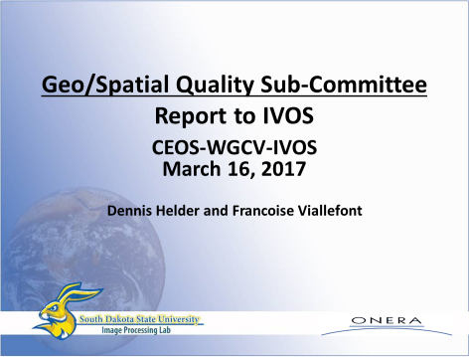
MTF activities & comparison

Slide 9
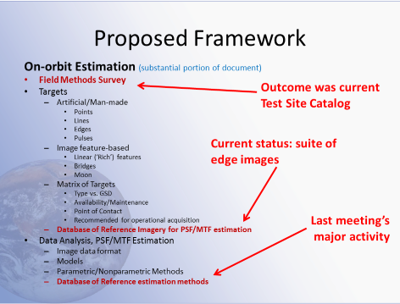
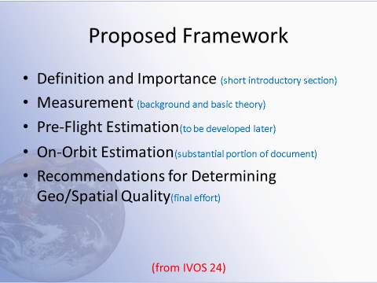
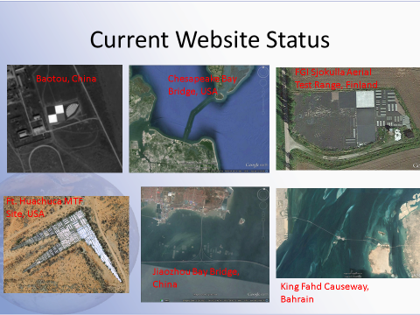
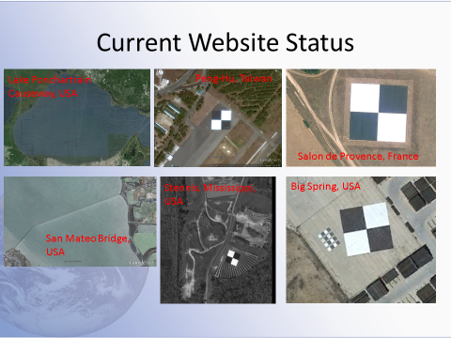
Establish good practise and community references
Catalogue to be migrated to CalVal Portal
IVOS seeks approval of CEOS WGCV to assign CEOS recommendation
label to aid community & interoperability following assessment of maintenance

Slide 10
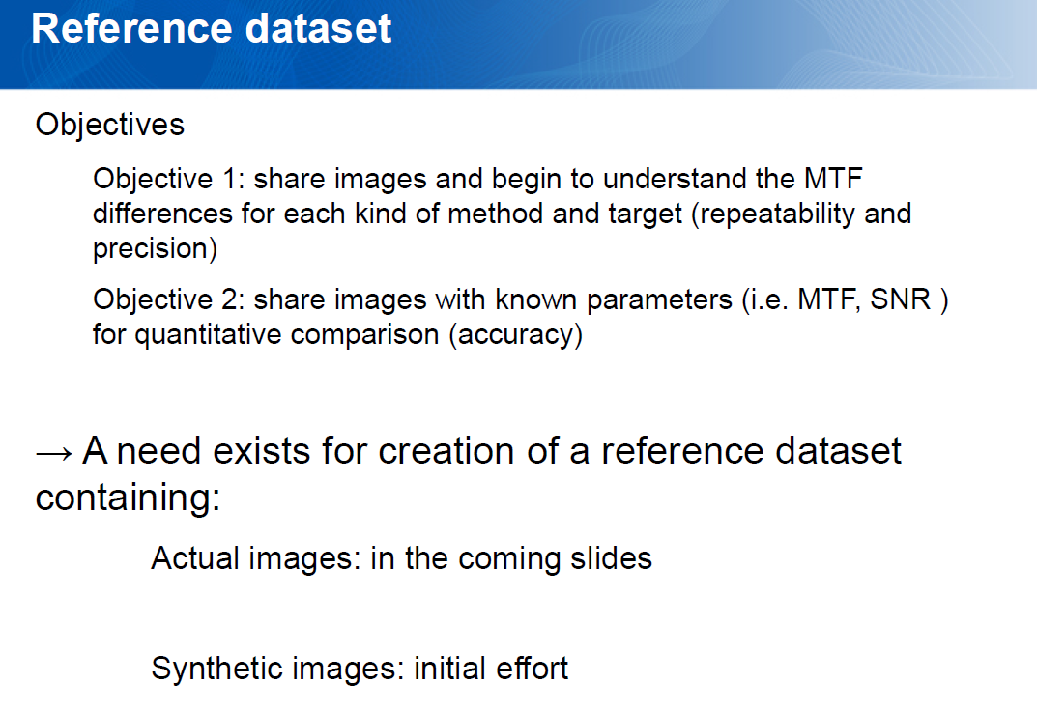
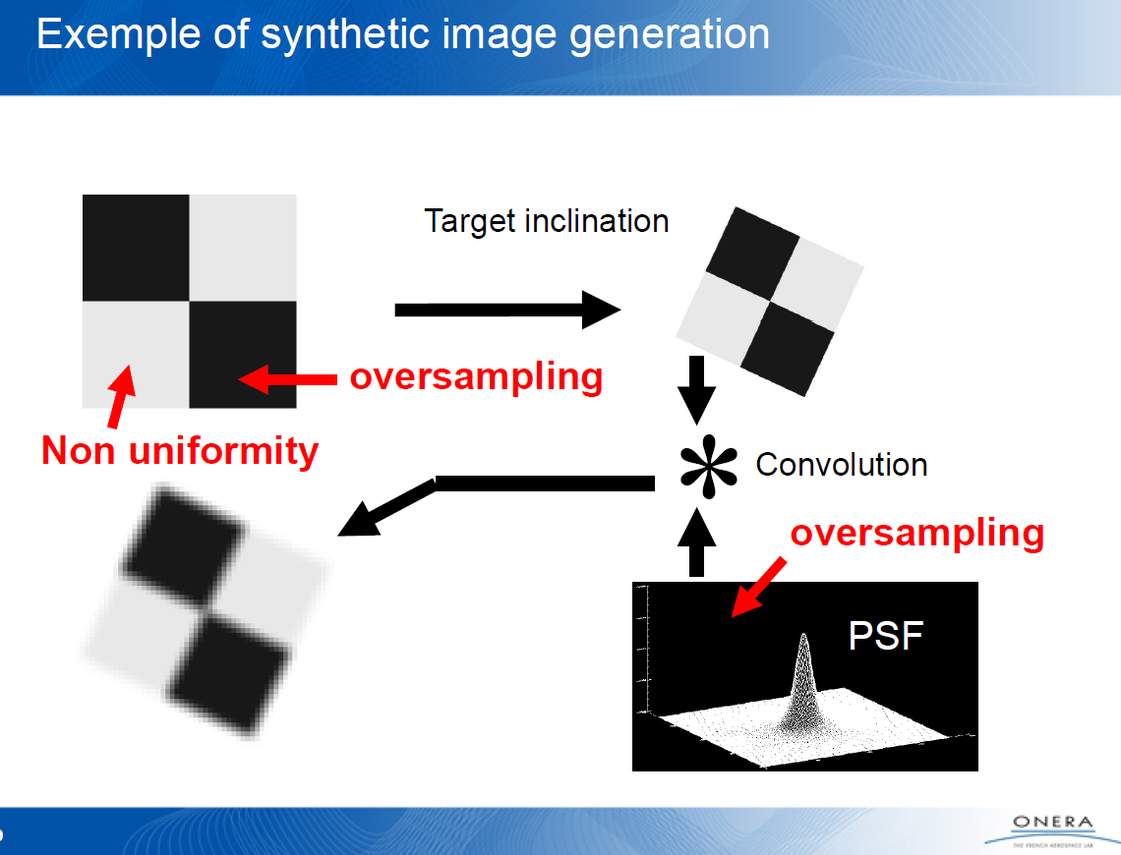
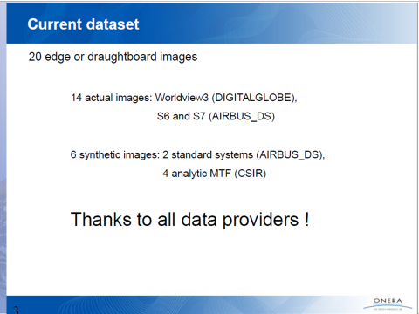
Comparison of methods
NOV 2015
Discussion of Results
Some Reprocessing
Leading to Good consistency for most
Comparison did its job
          identified errors in processing

Slide 11
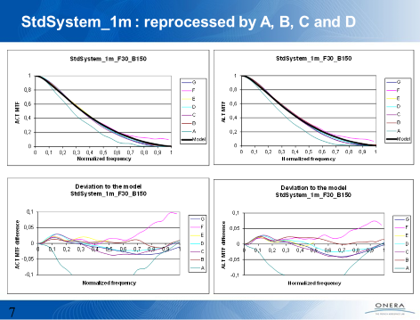
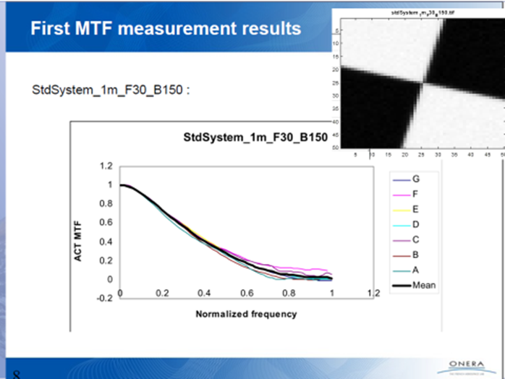
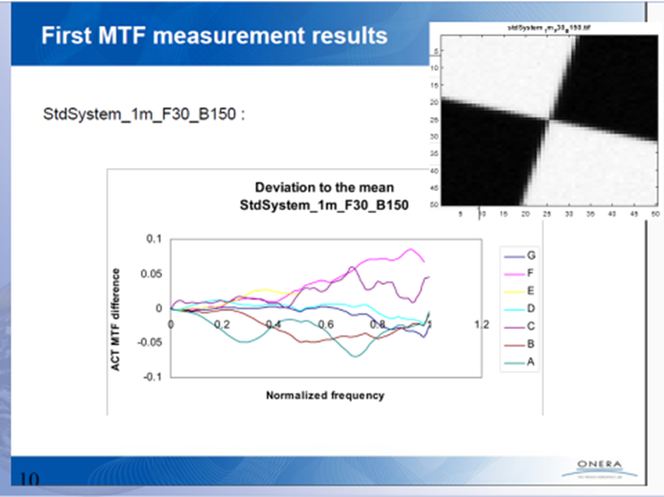

Slide 12
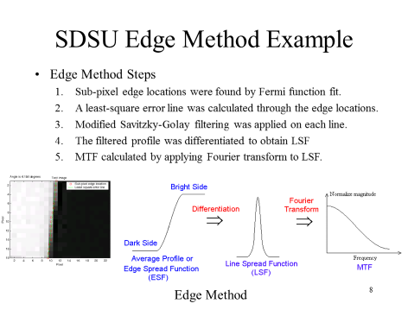
Methods discussed,
‘peer review’

Slide 13
Next steps
First objective: a journal paper including all participants
  Serves as a reference paper for this effort
  Content: Methods, Estimates generated from ‘High Priority Data’, Discussion, Conclusions
  Mention of existing standards? (such as ISO 122233)
Second objective: creation of a first ‘CEOS reference dataset’ based on six ‘High Priority Data’ images
  Create a directory in the CalVal Portal with free access to selected data
  Define the corresponding reference MTF result for each test image as the mean (with outlier rejection) of the submitted estimates when actual model is not available
  Ask users to submit their « blind test results » before accessing the reference results in order to improve the reference MTF dataset
Future activities
  Create additional targets for testing
  Consider ‘figures of merit’: FWHM, Edge slope, RER etc
  Assignment of uncertainty and traceability issues

Slide 14
Recommendations/Requests to WGCV
R.2017-3 | IVOS recommends that the test sites in the MTF catalogue should be made available as CEOS recommended sites.
R.2017-4 | IVOS recommends that a CEOS-recommended reference dataset is provided for the community to test their MTF estimation methodologies

Slide 15
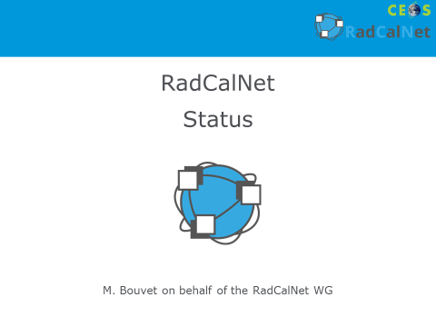
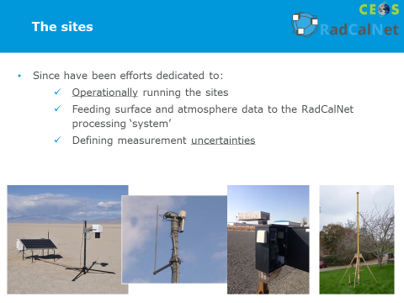
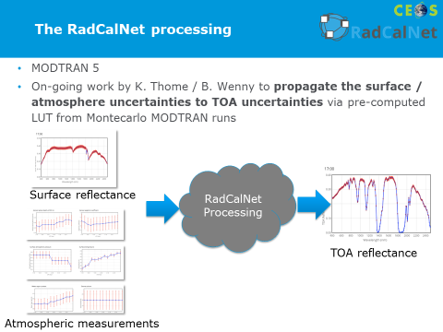
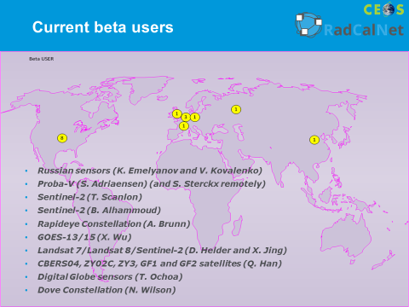
RadCalNet: Wednesday

Slide 16
Request to CEOS WGCV
R.2017-1 | Following the successful Beta Testing of RadCalNet, IVOS is looking for CEOS-WGCV endorsement for opening as an operational network (once the remaining tasks listed in the RadCalNet WG minutes are complete). IVOS asks WGCV to set up the necessary governance structure to approve RadCalNet sites.
Following full operational access: IVOS requests agencies/site owners to consider enhancing RadCalNet through contributing new sites

Slide 17

PICSCAR lead P Henry CNES
Pseuodo invariant sites used for Rad L1 Cal/comparison/monitoring
Questionnaire sent to ~180 people (CEOS contacts) (Sep 2016)
  15 Replies
  Seek to identify useage, priorities of PICS
Seek to collect observational data from heritage priority site, Libya 4
  Standardised format and location
  6 teams formally submitted independent data sets (2002 -2017)
Some initial processing of one data set (FY3) using a common BRDF model
Two telecons to discuss preliminary inputs and priorities
Workshop held aligned to IVOS 29 to define a project plan/roadmap

Slide 18
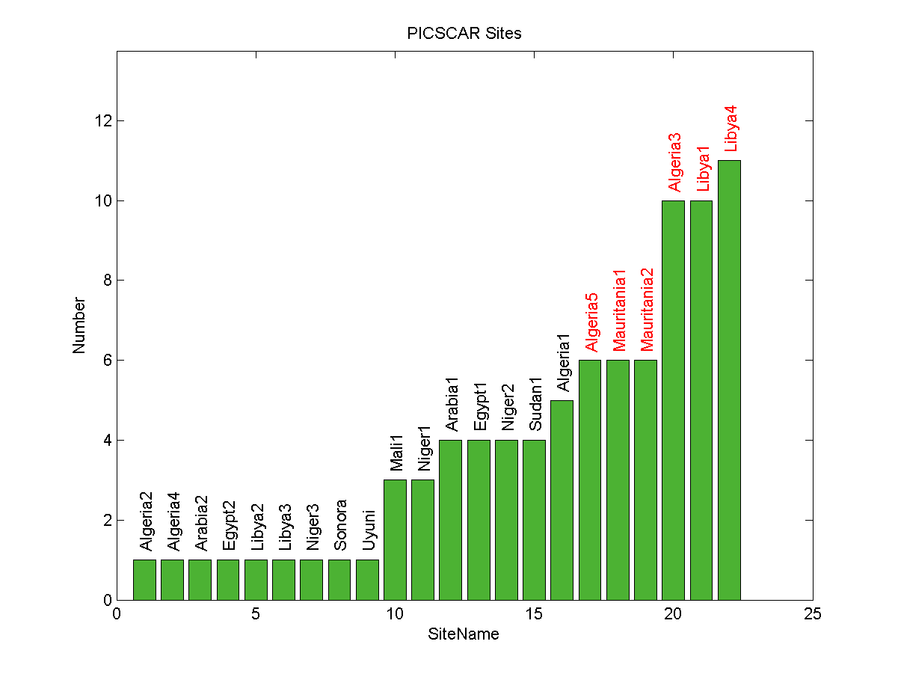
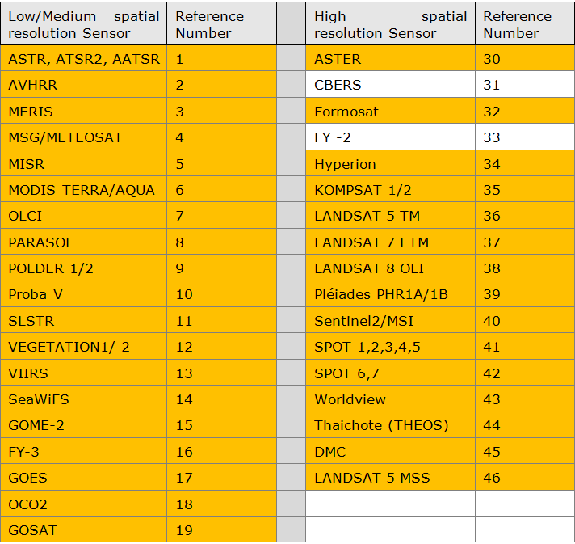
Survey of use
30 sites identified as being used by 33 sensors
Top 6 as already identified by CEOS

Slide 19
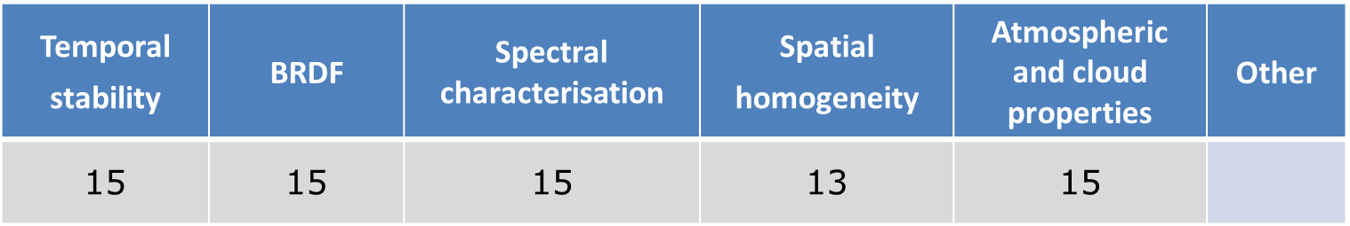
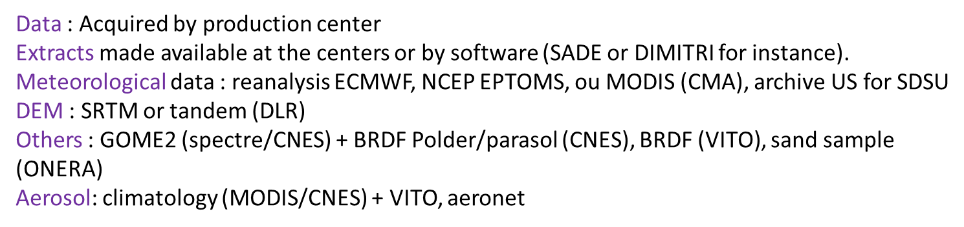
Information needed and where from
Look to focus on perhaps 5 to 10 sites
Community keen and willing to work together

Slide 20
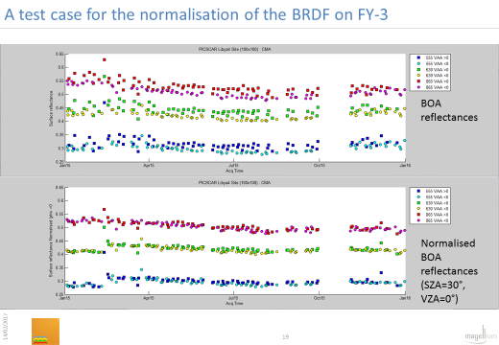
See to use all available data to assess site stability : Harmonise!

Slide 21
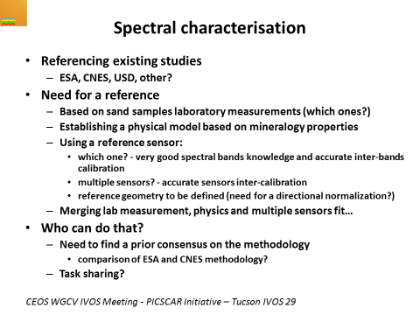
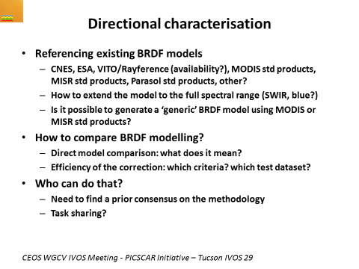
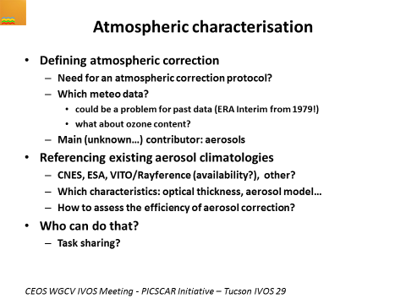
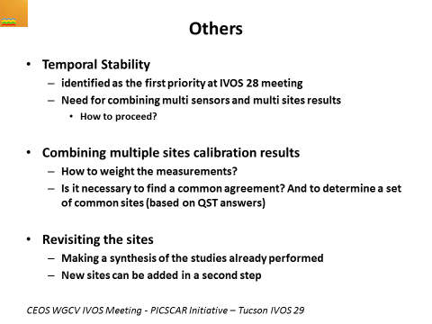
Roadmap for the future

Slide 22
Summary: next steps
Bi-monthly community Telecons/webex to discuss methods and how to establish/compare (BRDF, Atmosphere, surface spectral reflectance)
CNES to establish draft web ‘portal’
  Hosted on/via CalVal portal
  Good practises on how to use
  Repository of observations
  Repository of comparison results
  Characteristics of PICS and tools for users
NPL & CNES to consider how to evaluate Uc
Goal to establish a TOA ‘Radiance simulator’

Slide 23







FRM4STS: Fiducial Reference measurements for validation of Surface Temperature from Satellites www.FRM4STS.org
Nigel Fox
NPL (ESA Project)

Slide 24
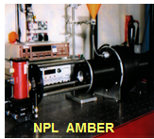
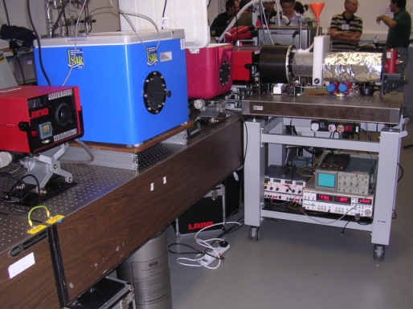
SI traceability: LCE (June 2016)
Necessary for all participants to assess biases to SI under Laboratory conditions
ITS-90
T= ~250 – 325 K
Non-vacuum
NPL BB
PTB BB
NPL Rad
(AMBER)
PTB Rad
Rad 1
Rad 2
Rad 3
Rad 4
Rad n
BB1
BB 2
BB 3
BB 4
BB n
Room Environment with variable T

Slide 25
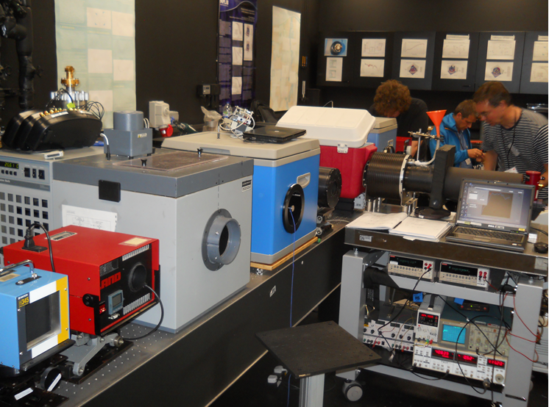
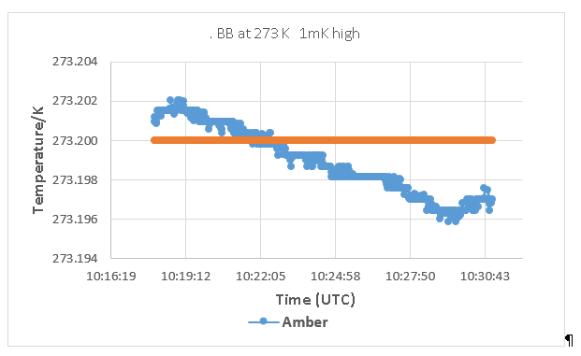
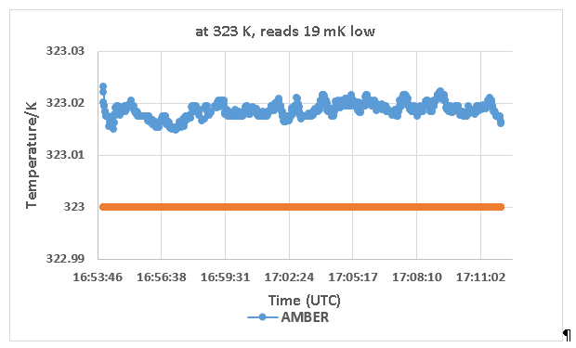
BB comparison (June 2016)
Miami University - USA
ONERA - France
University of Valencia- Spain
University of Southampton - UK
Qing Dao -China
RAL - UK
CSIRO - Australia
8. KIT- Germany
273 K to 323 K (0 to 50 °C)

Slide 26
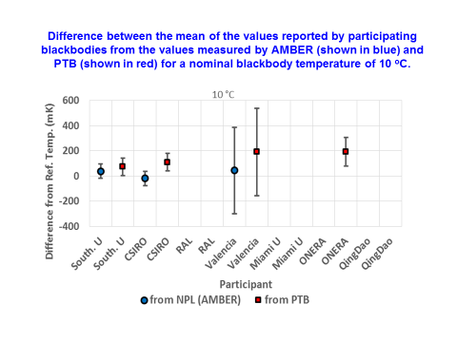
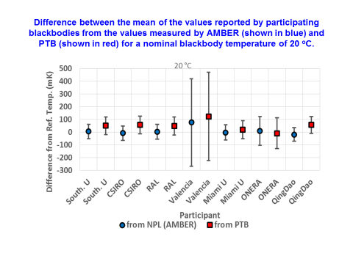
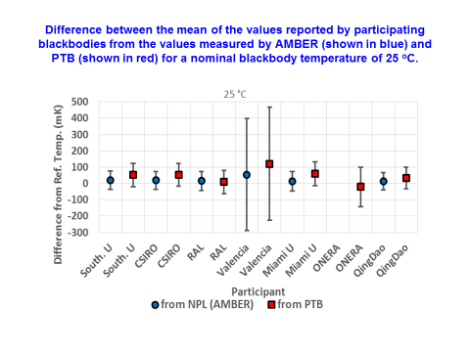
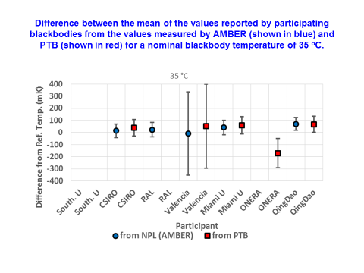
Selection of Results of BB comparison to SI

Slide 27
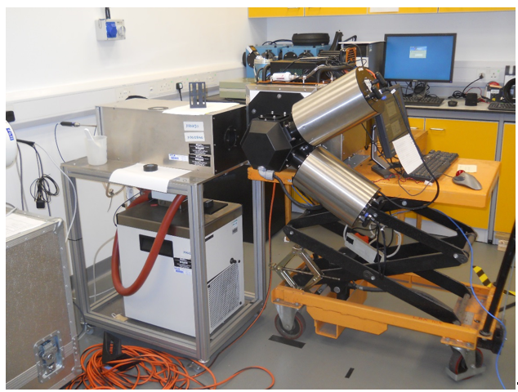
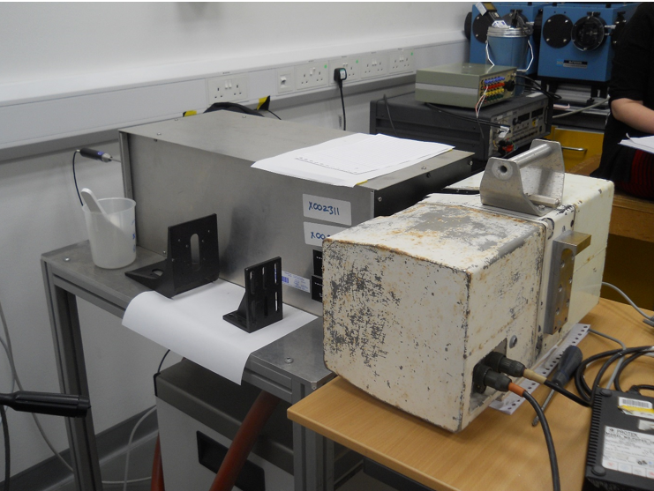
2016 Radiometer comparison
Miami University (USA)
ONERA (France)
University of Valencia (Spain)
University of Southampton (UK)
Qing Dao (China) -1
Qing Dao (China) -2
RAL (UK)
CSIRO (Australia)
KIT (Germany)
DMI (Denmark)
GOTA (Canary Islands
JPL NASA (USA)
Ian Barton (Australia)
MAERI (UofM) viewing NPL ammonia Heat pipe
240 K to 318 K
SISTER (RAL) viewing NPL
ammonia Heat pipe

Slide 28
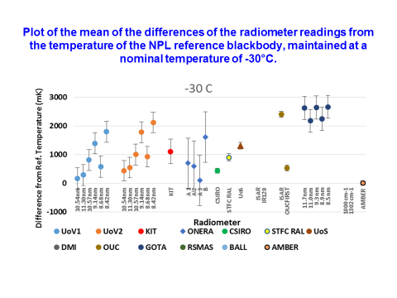
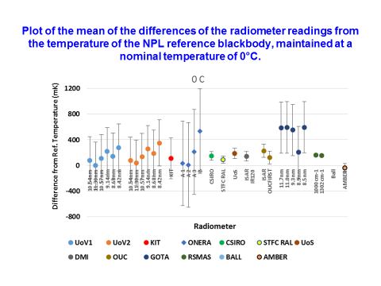
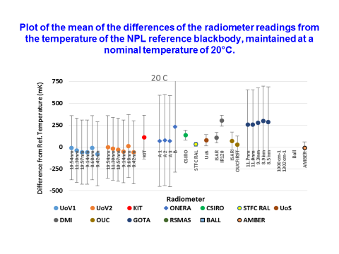
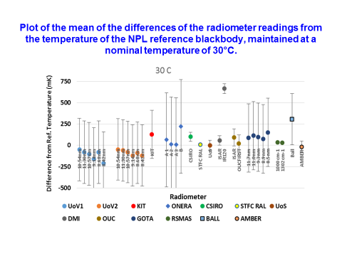
Selection of Results of Lab
Radiometer comparison to SI

Slide 29
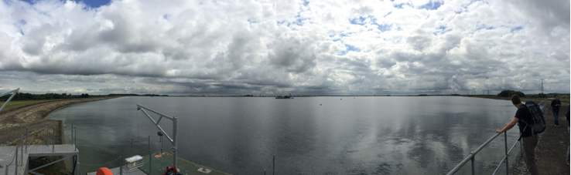
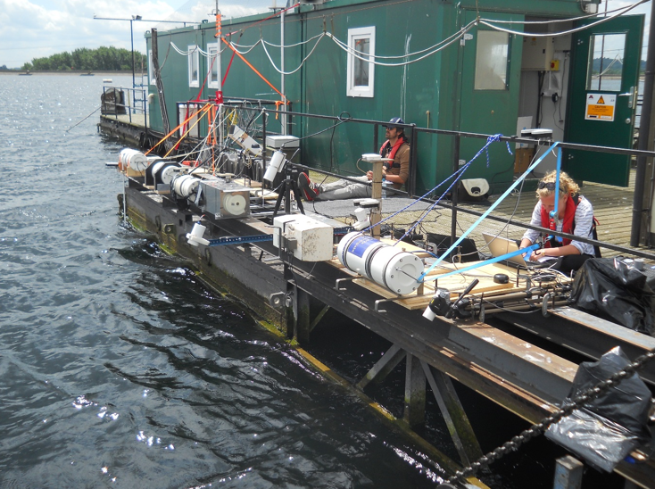
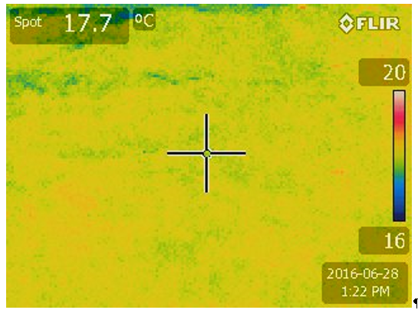
WST comparison
University of Valencia (Spain)
University of Southampton (UK)
Qing Dao (China) -1
Qing Dao (China) -2
RAL (UK)
CSIRO (Australia)
KIT (Germany)
DMI (Denmark)
GOTA (Canary Islands)
JPL NASA (USA)

Slide 30
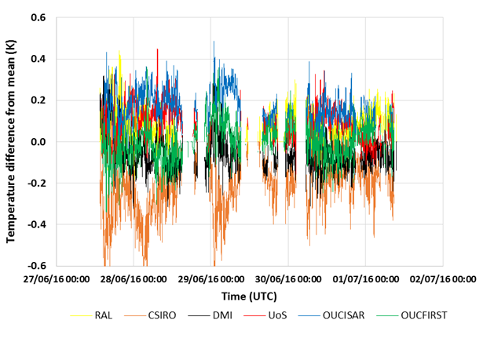
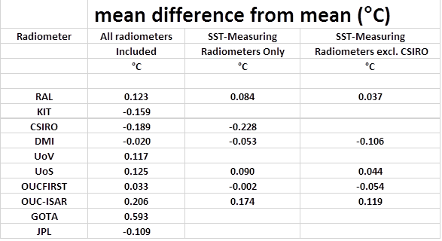
Difference from mean for SST designed radiometers only

Slide 31
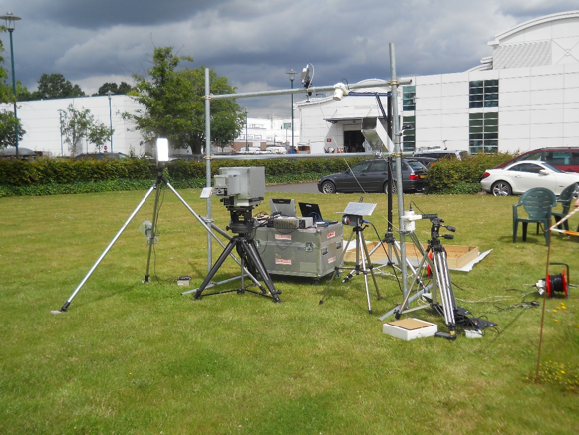
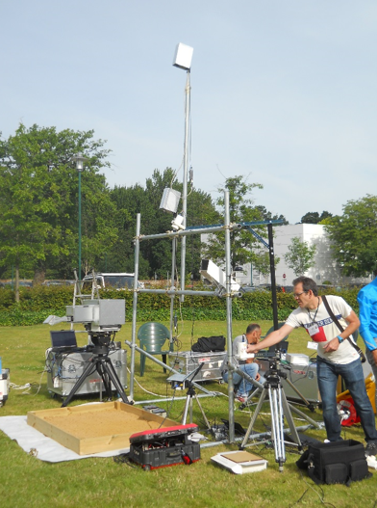
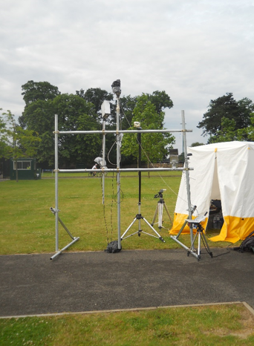
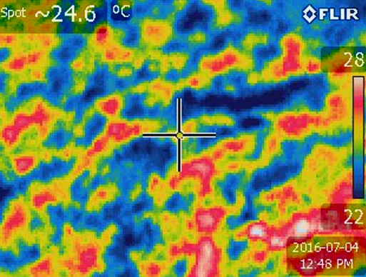


LST (Sun & Cloud)
University of Valencia (Spain)
KIT (Germany)
JPL NASA (USA)
ONERA (France)
Emissivity

Slide 32




Selection of Results of
Radiometer comparison to LST

Slide 33

LST @ Namibia Jun 2017
5 participants

Slide 34

• Session 1: Science requirements
Session 2: The space based element
:• Session 3: Metrological framework:
• Session 4: Post-launch validation:
deployed radiometers
• Session 5: Post-launch validation: non-returnable systems
• Session 6: Establishing a sustainable framework

Slide 35

Ocean Colour
To help address IOCCG white paper
Run comparisons of validation instruments
  Lab
  Ocean
  Ref standards
Ensure SI traceability and Uc to SI
Draft protocols for how to establish/maintain traceability
Review requirements for future infrastructure
ESA sponsored project www.FRM4SOC.org
To support CEOS VC-OCR

Slide 36






FRM4SOC International Workshop on Options and Approaches to the Long-term Vicarious Adjustment of
Sentinel- OLCI & MSI A/B/C and D Instruments
Took place at ESA-ESRIN, Frascati, Italy, 21-23 Feb, 2017
30+ participants from Europe, USA, Canada, Australia & S.Korea
Included many of the world’s leading experts in the field

Slide 37

Laboratory comparison of reference sources

Slide 38


Comparisons of instruments
Uncertainty analysis with support
Ocean platforms and ship transects

Slide 39
Terminology
Uncertainty
is not
the same as
Error
But also many terms have different interpretations e.g. Harmonisation, Levels 1A,1B, 1C …., Ancilliary data ……
IVOS Activity: Also to support wider CEOS WGCV initiative NPL to create and administer ‘Wikki’ web page (via cal/val portal) to discuss/define terminology and establish ‘thesauras’ of definitions as necessary also with simple graphic/videos to make clear concepts.
Small international task group in process of being established

Slide 40

CEOS (GSICS) Reference Solar spectral Irradiance (Thursday)
IVOS recommends the selection of a high spectral resolution solar spectrum to become a reference spectrum that is based on the SOLID approach linking the 20 sensor composite inc Thuillier and COSI spectra giving both an extension into the IR and providing higher spectral resolution (target 0.005 nm), along with a technical note on how to interpret and use this model. THIS is AGREED with GSICS as a pragmatic interim solution to update current CEOS recommendation >~380 nm spectral range

Slide 41
Summary
IVOS active team expanding (good global coverage- agency and industry)
Thematic projects working effectively with motivated champions: Number sometimes make logistics an issue
New activity on ‘CEOS L1 reference and method for interoperability’ to be launched at IVOS 30 (IVOS 29 too busy)
Several recommendations to WGCV for endorsement/action
Keen to revitalise and use Cal/Val portal as the community interface
  Minutes and presentations of plenary meetings on portal
GSICS/CEOS 3rd Lunar workshop Nov 2017, Xi’An China

