Slide 1
New generation meteorological satellite
CEOS WGCV-42 Working Group on Calibration & Validation
May 16, 2017
Sioux Falls, SD
Notes:
1

Slide 2
Topics
Topics
(1) Himawari 8 and 9 status
(2) Himawari Monitor Products
(3) Airborne S-HIS GOES-R GOSAT intercomparison
We thank Miyamoto-san, Takahashi-san, and Okuyama-san of Japan Meteorological Agency (JMA).

Slide 3
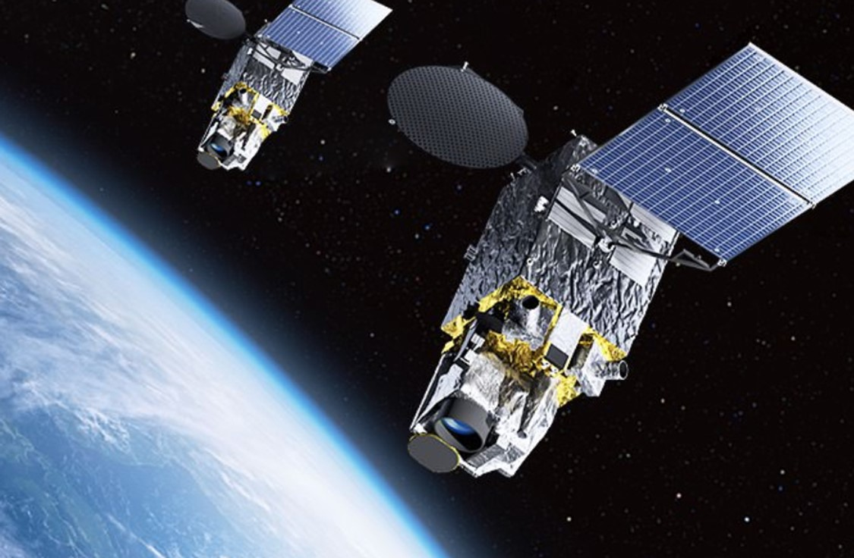
New generation meteorological satellite
Himawari 8 and 9
Himawari 8 (operational)
Launched on Oct. 7, 2014
Operation started on July 7, 2015
After 2022, standby
Himawari 9 (Standby)
Operational From 2022 to 2029
Launched on Nov. 2, 2016
AHI initial test completed in Feb. 2017
From Mar. 15, 2017, back up operation
Himawari 6, 7 > Himawari 8, 9
Visible/NIR 1 band > 6 band, more frequent and higher spatial res.------→ ex. aerosol
IR 3 bands > 10 bands ------→ radiance comparison with spectrometer
Products other than for weather forecast

Slide 4
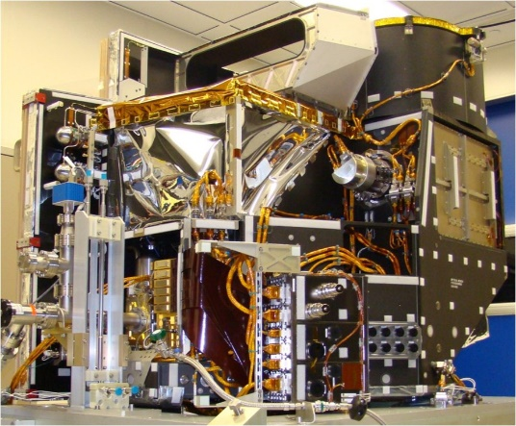
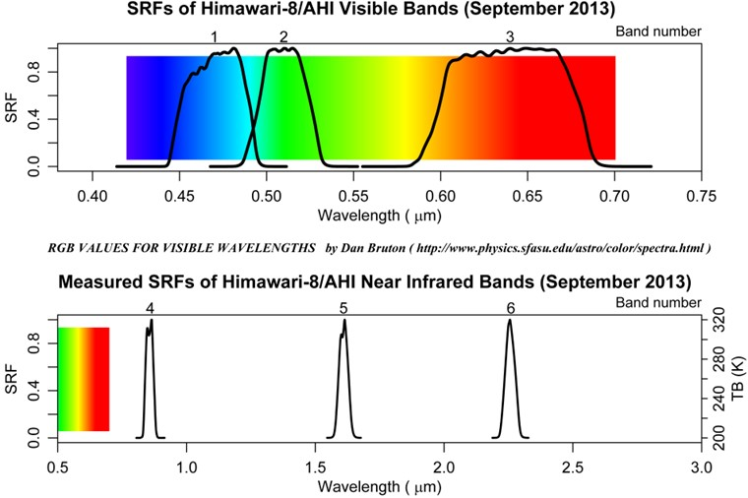
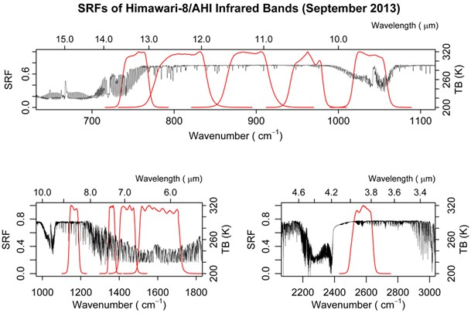
Advanced Himawari Imager (AHI)
area | Band number (see Table 1) | Spatial resolution at SSP (sub satellite point)[km] | Numbers of pixels
 |  |  | East-west direction | North-south direction
Full Disk | 3 | 0.5 | 22,000 | 22,000
 | 1,2,4 | 1 | 11,000 | 11,000
 | 5-16 | 2 | 5,500 | 5,500
JMA homepage

Slide 5
JAXA Himawari Products
 | Product name |  | Grid size | Interval | Format
L1 | Reflectance (6 bands) Brightness temperature (10 bands) |  | 500m/1km/2km | 10min(full) 2.5min(Japan) | HSD
 |  |  |  |  | NetCDF
L2 | Atmos-phere | Aerosol properties | 5km | 10min/1hr | NetCDF
 |  | Cloud properties | 5km | 10min
 | Ocean | Sea surface temperature | 2km | 10min/1hr/1dy
 |  | Ocean color (Chlorophyll-a) | 5km(full) 1km(Japan) | 1hr
 | Land | Wild fire | 2km | 10min | CSV
 | Flux | Photosynthetically active radiation (PAR) & Shortwave radiation (SWR) | 5km(full) 1km(Japan) | 1hr | NetCDF
 |  | Photovoltaic Power (image only) | 1km/4km | 10min | -
Retrieval Algorithms are based on those developed for JAXA Earth Observation Satellite Projects. References are available at the web site. (http://www.eorc.jaxa.jp/ptree)

Slide 6
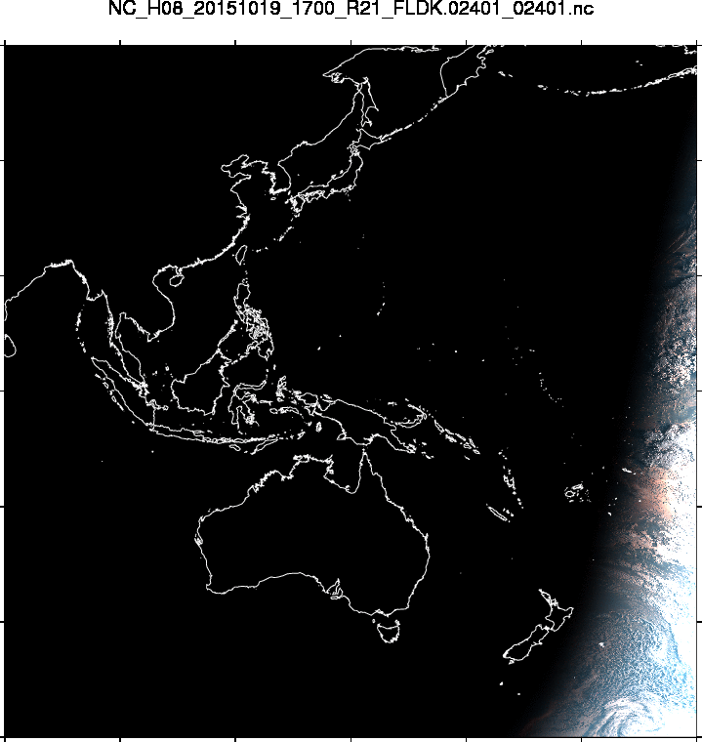
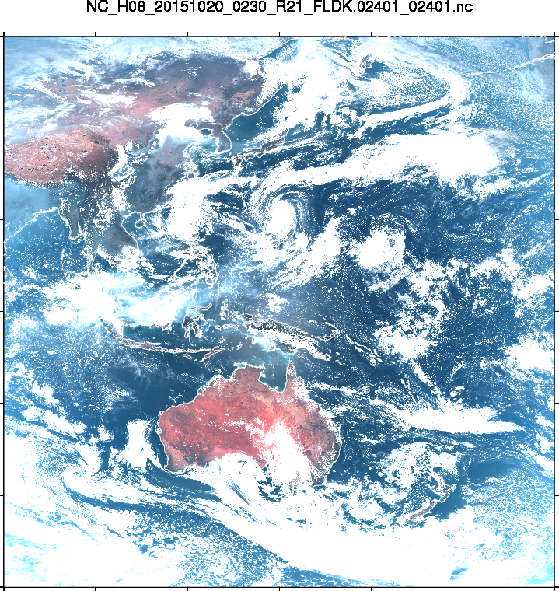
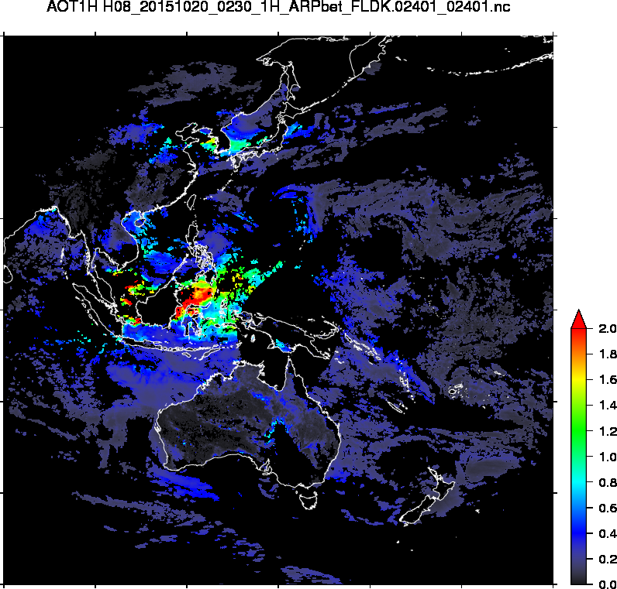
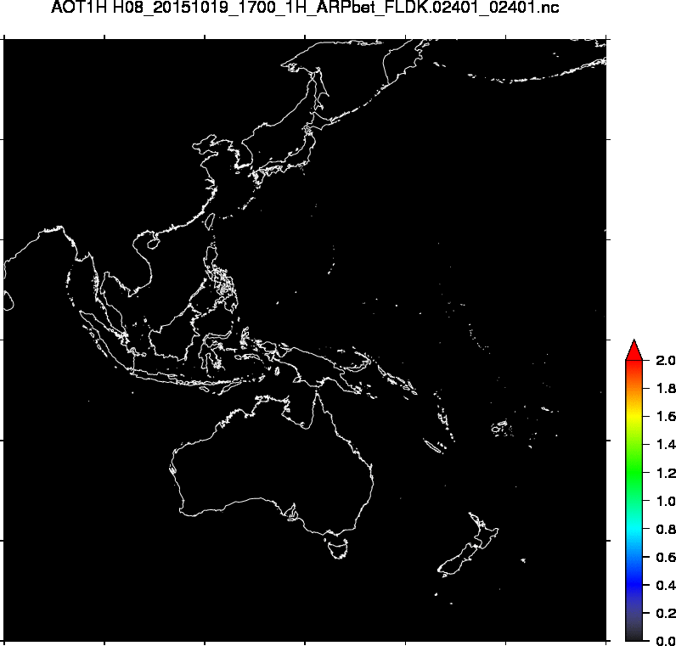
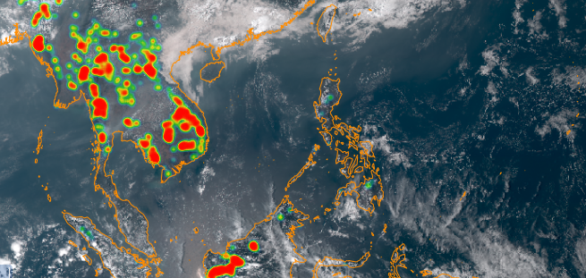
Himawari-8 Product : Aerosol and Hot Spot
Aerosol Optical Thickness
JAXA EORC applied the aerosol algorithm developed for JAXA LEO missions (GCOM-C, EarthCARE, GOSAT-2) to GEO Himawari-8
Wild fire in Borneo Island (Indonesia), atmospheric pollutant from Chinese continent and hot spot over Southeast Asia
Hot Spot Detection

Slide 7
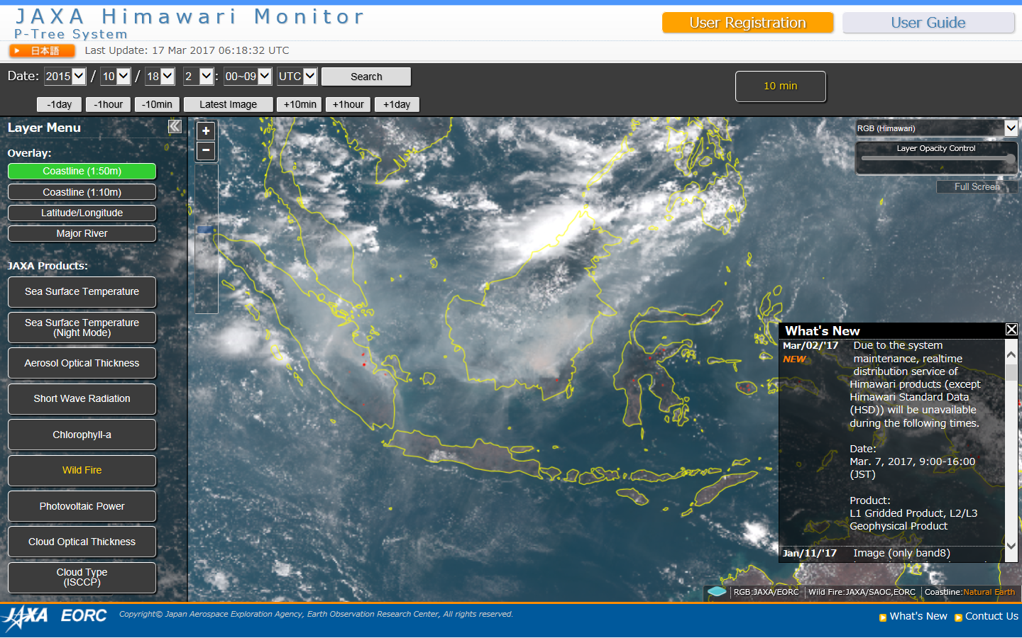
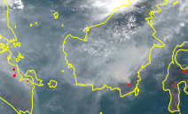
Hot Spot on 2:00UTC 18 Oct 2015 by Himawari-8
http://www.eorc.jaxa.jp/ptree/index.html

Slide 8
Dataset - Aerosol Products -
Two aerosol products:
  L2 Aerosol Properties
    snapshot product, processed every 10 minutes
  L3 Aerosol Properties
    hourly-combined, strict quality control
    processed every 1 hour (possible to process every 10 minutes if requested)
NetCDF4 format, 0.05° Equal lat-lon grid, full disk (Asia-Oceania)
Disseminated within approximately 1 hour after observation
Possible to provide extracted NetCDF/text data around South-East region
Note : aerosol cannot be derived at cloud pixels

Slide 9
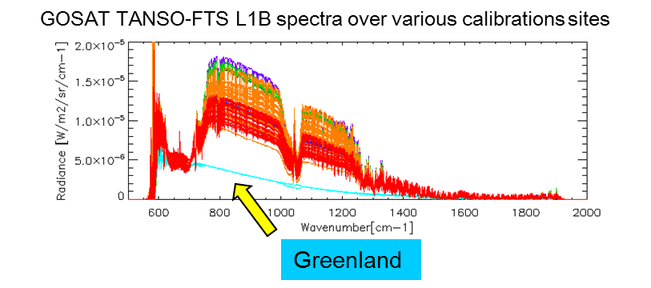
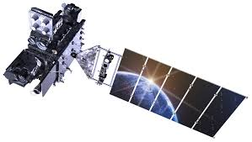
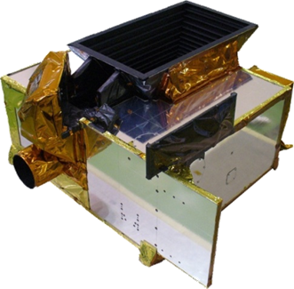
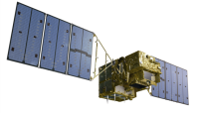

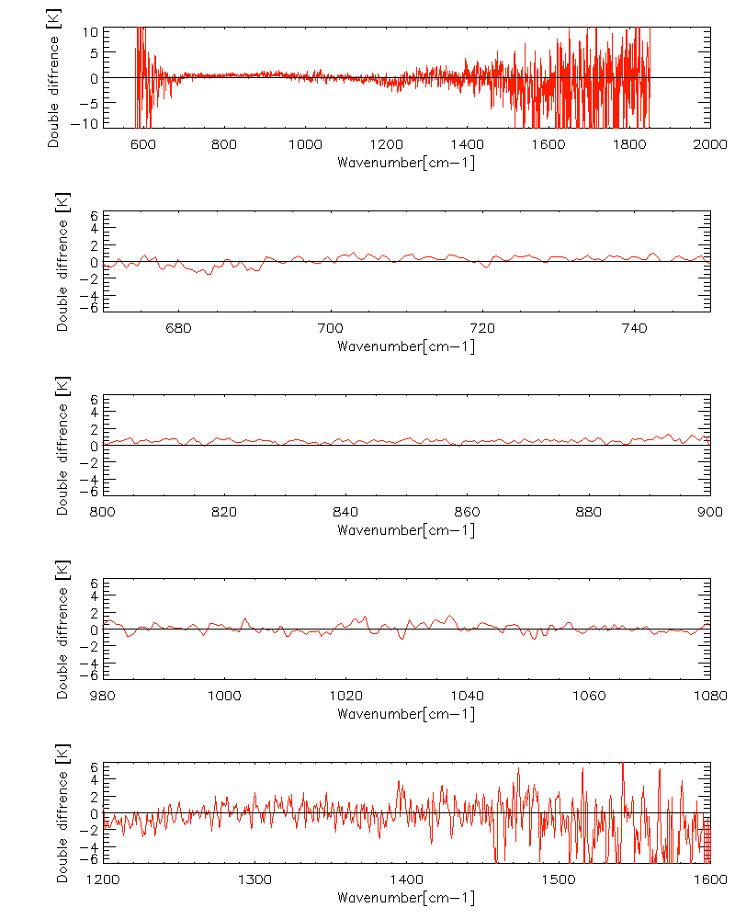




Airborne S-HIS GOES-R GOSAT intercomparison
ABI Radiometer
GOES-R
10 IR band
TANSO-FTS
GOSAT
0.2 cm⁻¹ res. FTS
Truncate operation to 0.5 cm⁻¹
0.5 cm⁻¹ res. FTS
ER-2
S-HIS
CO₂
CH₄
O₃
CH₄
Number of match up data were limited.
Radiometric Validation for Nonlinearity correction of wide dynamic range FTS
Consistency between surface, cold atmosphere and spectral surface emissivity
CO₂
Sonoran Desert (Day)
Gulf of Mexico (Night)
March-April 2017, GOES-R Calibration

Slide 10
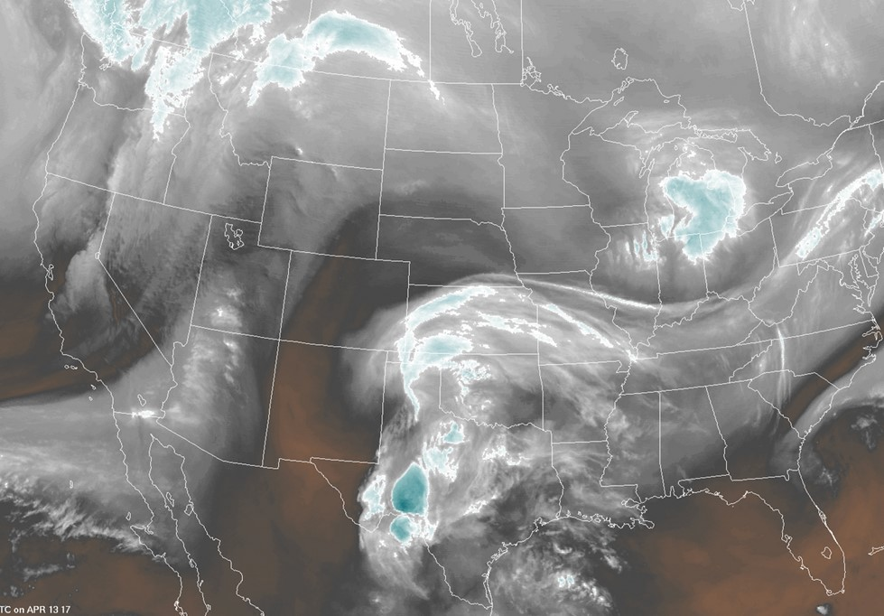
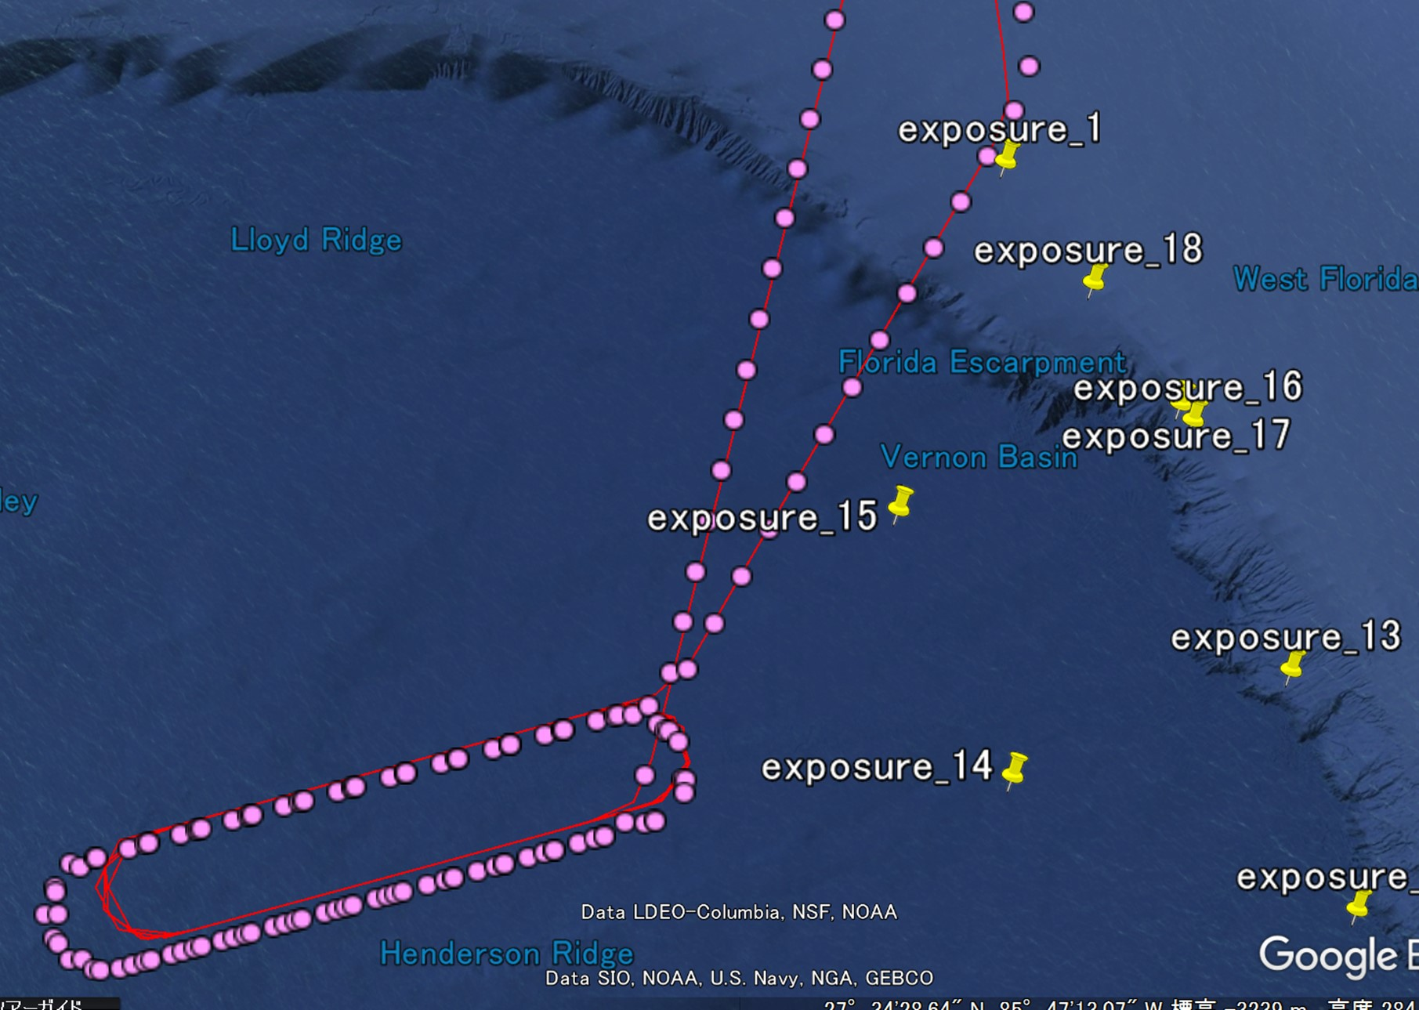
S-HIS GOES-R GOSAT campaign, March-May, 2017
Night flight over Gulf of Mexico
Night of April 13 Grid & Target (2 hours difference)
Clear sky night date
S-HIS
08:10:15
GOSAT
06:10:01
GOES-R
TANSO-FTS
S-HIS
The analytical results of cross-calibration will be presented in the next meeting.

