Slide 1
Industry & CEOS ARD
LSI-VC-9 Teleconference #2

Slide 2
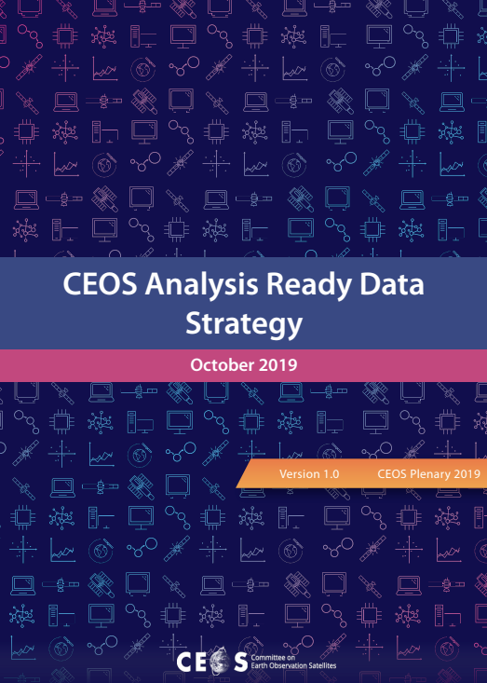
Background
Some relevant objectives of the CEOS ARD Strategy:
Identify opportunities for ARD-oriented collaboration with the growing number of commercial smallsat constellations providing EO data;
Establish a broad understanding of, and participation in, CEOS efforts to define, produce, apply, and promote ARD in support of societal needs;
Ensure effective engagement of the three key stakeholder groups: EO data providers (both public and private); Big Data hosts and aggregators who stage increasing amounts of CEOS Agency free and open data; and data users.

Slide 4
Overview of this call
Introduction
Industry Consultation Findings
Review findings from:
the industry consultation call (Lewis),
VH-RODA / ESRIN panel discussions (Siquiera),
WGCV IVOS, JACIE, etc. (Labahn)
Industry Engagement Paper
Review progress on the discussion paper on industry interactions with CEOS ARD
Discussion on all of the above
CARD4L PFS applicability to higher resolution datasets
Discussion
CEOS-Industry ARD Workshop (September ?)
Planning discussion
Critical milestones and targets

Slide 5
Questions Responding to questions in the chat (discussion session is later)

Slide 6
Industry Consultation Findings
A. Lewis, S. Labahn

Slide 7
Industry telecon summary points (A. Lewis)
Comparability between commercial and ‘official’ government products
Access to government validation data and protocols
Access to methods and workflows (even if not open-source) to allow adjustment
Being engaged, understanding roles, contributing, understanding the outlook
Participation meetings but well structured, purposive and brief
Understanding where CEOS ARD is headed, so that they can identify their niche
Clarity on methods; standardised approaches, a level-playing field
Processes that are easy to understand and use, such as guidance on metadata, benchmark products as a reference for procedures - e.g., self assessment procedures.
Peer reviewed and published standards
Having the CEOS community to set a clear CARD standards and lay down the rules for a competition (objective tests on quality and samples of ideal products to aspire to) so that the private sector can provide the best possible service to clients which ultimately will open market opportunities and stimulate competition and productivity.
Notes:
In July 2019 through the ARD19 conference, and In February 2020 the LSI-VC leads invited some known and familiar industry people to an open discussion on analysis ready data.
Industry can be ‘upstream’ through to ‘downstream’. Satellite operators, software producers, cloud operators, applications specialists.

Slide 8
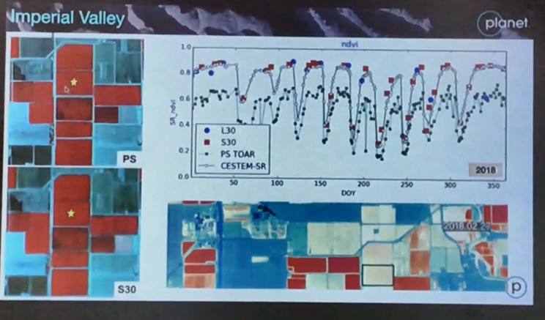
Highlights from ARD19 (July 2019)
Matching 30m Sentinel and Landsat data with Planet Daily Surface Reflectance

Slide 9
VH-RODA Discussion Panel on ARD: Questions
There is confusion on the actual meaning of ARD
What is ARD for Commercial Space?
What is ARD for the Institutional Space?
How can Commercial Space participate and be involved in the definition process of the CEOS ARD Specifications?
Should dedicated specifications be defined for Very-High Resolution missions? (e.g. via creation of a dedicated sub-group?)
What are the next steps that need to be taken to start a dialogue between Commercial Space and Institutional Space in practical terms?
ttps://earth.esa.int/documents/700255/3754648/EDAP_REP_018_VH-RODA_and_CEOS_SAR_2019_Workshop_Summary_v1_0_draft.pdf/fd4df398-46f2-4976-b391-97ad54f9e2ca
Notes:
VH-RODA and WGCV SAR workshop summary

Slide 10
VH-RODA Discussion Panel on ARD: Key Outcomes
The ambiguity in interpretation of ARD was acknowledged, work on CEOS ARD specifications as a first step was noted
Participation by commercial sector in CEOS CARD4L forums might be challenge due to org structure constraints, example of CEOS sub groups such as IVOS with members from the commercial sector noted
The need to address specifications for higher resolution data that is typically the domain of commercial sector, was recognised
Improving interactions between institutional and commercial sectors, along the lines of JACIE and VH-RODA highlighted, with a proposal to host a session on ARD standards with commercial sector participation at the next IVOS meeting
Notes:
VH-RODA and WGCV SAR workshop summary

Slide 11
IVOS-32 Outcomes - Interoperability & High Res
Survey conducted amongst the attendees on what the definition of interoperability was - quite a range of ideas (supports need for better understood and adopted definition)
Plan to re-circulate survey across IVOS and include commercial entities
Several definitions introduced new terms that would need to be defined
Interoperability definition needs to recognize it is application-specific
Recognition that we have currently targeted medium resolution observations and need exists to extend into higher resolution observations to better support CEOS and commercial entities

Slide 12
IVOS-32 Outcomes - PFS Quality Measures
In the initial CARD4L PFS definition phase, IVOS made the suggestion of introducing specific quality measures into the CARD4L PFSs, but LSI-VC has tried to be agnostic to that aspect and to let users/consumers make their own judgement for their particular application based on the required metadata being reported – a primary one being the measurement of uncertainty (including traceability and radiometric accuracy). Is this still the case?

Slide 13
IVOS-32 Outcomes - PFS Quality Measures
Still anticipating IVOS-32 feedback regarding suggested adjustments to PFS uncertainty requirements at Threshold and Target levels as well as a possible recommendation to include an ‘Intermediate’ level of requirements to better support evolving maturity levels.
IVOS is primarily interested in discussions with CEOS and commercial entities focused on these quality measures - again mostly uncertainty analysis - and moving users further along the interoperability continuum beyond the basic CARD4L requirements. Whereas, LSI-VC, I believe, is currently primarily interested in basic CARD4L PFS compliance at the moment.
IVOS has been pursuing Best Practice Guidelines within EDAP (ESA’s Earthnet Data Assessment Pilot) to provide the community with an approach for how to measure uncertainty.

Slide 14
IVOS-32 Outcomes - PFS Involvement
It seems that many of the commercial entities aren’t necessarily that interested in making suggestions or adjustments to the CARD4L PFSs themselves - they are mostly taking those at face value.
However, to promote industry buy-in, we should still invite commercial entities to participate in the preparation and annual review of the PFSs.

Slide 15
JACIE (Joint Agency Commercial Imagery Evaluation)
The Joint Agency Commercial Imagery Evaluation (JACIE) program was formed to leverage (U.S.) federal agencies’ resources for the characterization of commercial remote sensing data and to share those results across the federal government and beyond. Consisting of representatives from the U.S. Geological Survey (USGS), the National Geospatial-Intelligence Agency (NGA), the National Aeronautics and Space Administration (NASA), the National Oceanic and Atmospheric Administration (NOAA), and the U.S. Department of Agriculture (USDA). The JACIE team performs product analysis of commercial and other remote sensing data and information products, providing Earth Scientists and other users with awareness and independent verification of commercial imagery data quality.
2019 Workshop Participants
Astro Digital | CNES
Digital Globe | ESA-ESRIN
Innovative Imaging and Research | GA
Labsphere | KARI
L3Harris Technologies | UK National Physics Laboratory
Maxar
Planet
Raytheon

Slide 16
JACIE
19th JACIE Workshop
September 22-24, 2020
NOAA Center for Weather and Climate Prediction
College Park, Maryland USA
JACIE 2020 Topics include:
Calibration methods, techniques, and tools
Calibration Test Sites, Reference Datasets, and other resources
Calibration of operating and future missions
Radiometric, Geometric, and Spatial Characterization
Cross Calibration, Fields campaigns, and other validation methods
Product Validation methods and results
Artificial Intelligence and other ideas for future Calibration/Validation
Interoperability, Harmonization, and Analysis Ready Data (ARD): Working with multi-source data

Slide 17
Questions Responding to questions in the chat (discussion session is later)

Slide 18
CEOS Paper on Industry Interactions with CEOS ARD
A. Lewis

Slide 19
Introduction - Industry Paper Background
Discussion Paper circulated for comment from CEOS. The paper:
In response to Task 2.4 of the CEOS Analysis Ready Data Strategy - Interplay of Industry and CEOS ARD.
Presents an initial evaluation of the views from the private sector on how the CEOS community needs to engage to take CARD to the next level.
Provides an overarching rationale and possible next steps to engage with data providers, data hosts and data users in the private sector.

Slide 20
CEOS feedback - at SIT and upto April 17th
ESA emphasised the importance of engaging with the private sector.
No ‘push-back’ on the the core idea of engaging, and of the industry workshop. No other concerns.
NOAA provided some important feedback on CEOS-ARD as a whole, i.e., that it is important to also address data policy, data formats, interoperability & etc.
Reference the work of SST-VC and GHRSST
Introduce new elements in the CARD framework?
Definition
PFS
Processes
Advisory notes?

Slide 21
Target Outcomes from Engagement
Successful engagement with the private sector would lead to (2-3 year period):
Industry and CEOS efforts on Analysis Ready Data are coordinated
Private sector companies produce products according to CEOS Analysis Ready Data Specifications
Specifications are improved through the involvement of industry expertise and viewpoints
Stronger evidence base for the value of CEOS Analysis Ready Data / understanding of what is important to industry users.

Slide 22
Recommendations from the Discussion Paper
Establishing mechanisms for constructive and appropriate engagement with the private sector
Avoid unnecessary barriers to participation (from industry) in the CARD discussion and processes (don’t say ‘no’, without a clear reason).
Provide appropriate documentation on CARD
Identify a CEOS ARD framework process for assessing private data products for compliance with Specifications
Move CEOS concepts into the broader ‘standards’ realm to include the private sector.

Slide 23
Proposed Next Steps
Continue to share Information on CEOS Analysis Ready Data to build support
Add supplementary materials such as videos, papers, presentations and the latest updates
Understand the Industry Perspective;
Continue ‘light touch’ teleconferences and emails
Reach out to industry leaders for tactical advice and ideas including on how to run a workshop for industry
Convene a workshop with industry, in particular European industry
Leverage existing opportunities / meetings where possible, rather than creating our own
Engage Industry in Specifications
Engage industry specialists in specifications working groups
Move CEOS specifications into the broader community

Slide 24
Questions Responding to questions in the chat (discussion session is later)

Slide 25
CARD4L PFS for High Resolution Datasets
S. Labahn

Slide 26
High Resolution Datasets
@ LSI-VC-8: KARI noted sub-10m ARD products are not addressed by the current CARD4L framework
KARI have produced some initial ARD based on CARD4L with sub-10m data from KOMPSAT.
There will be challenges in verification of fine resolution products to within CARD4L PFS parameters, but there may also be an opportunity to learn from KARI’s experience.
@ WGCV IVOS-32: It was recognized that we have currently targeted medium resolution observations and need exists to extend into higher resolution observations to better support CEOS (potential higher resolution future missions) and commercial entities
As part of our commercial engagement, it seems that we may need some concentrated effort on ensuring the PFSs are applicable to the sub-10m products (perhaps along with commercial partners, a thorough review of each requirement)… and update the existing ones accordingly ...or create new ones

Slide 27
Questions Responding to questions in the chat (discussion session is later)

Slide 28
Discussion

Slide 29
Seed Questions / Discussion points
JACIE and VH-RODA provide existing forums for key commercial entity interactions. IVOS already very plugged-in and perhaps LSI-VC could be as well. It may be more efficient for commercial entities as well, rather than introducing yet another forum/meeting for interacting with CEOS entities.
As part of the overall CEOS ARD Strategy, is there a better construct to help organize these activities and keep all affected entities in-sync (including LSI-VC, IVOS, WGCV, and WGISS), and in particular our somewhat independent discussions with external/commercial entities? (perhaps SIT Chair Team led)

Slide 30
Seed Questions
Q 1: Do we agree on the objectives of engagement with industry?
Q 2: Reflections on the proposed next steps
Q3: Is IVOS an appropriate forum for us to use or are they focussed on Cal-Val? (Covered off by Nigel Fox - they can help with some parts, e.g., accuracy )
Q4: How should we take forward and share our interoperability work?
Q5: Do we need to adapt our specifications to support higher spatial resolution data?

Slide 31
Seed Questions / Notes
Do we broaden CEOS ARD to include coverage of other important matters that are (intentionally) not included in the PFS? Data Policy, Accessibility, Format, Interoperability, Standards.
NOAA : “"Section 3.2, Matters Not Covered in the Specifications" undermines the whole goal of ARD

Slide 32
CEOS-Industry ARD Workshop Planning Session
Z. Szantoi

Slide 33
Workshop Prospectus
CEOS ARD impact will be amplified by augmentation with commercial data and platforms
CEOS has sought to coordinate with the commercial sector.
Workshop organised to strengthen the dialogue
Explore interfaces and cooperative activities to increase data use, choice and flexibility for users
Draft prospectus here.

Slide 34
Key Topics - Objectives for the WS
Roadmap for CEOS Agency ARD development
Strategies to reach users, incl. with commercial sector to maximise impact
Suitability of the CEOS ARD Specifications and Framework to commercial sector data providers and their customers, and interest in adopting the concept
CEOS services for the validation of commercial ARD products
CARD4L and new approaches (cloud hosting/processing, online analysis platforms, COG, STAC, machine learning, etc.)
Strategies for coordinated global data flows
Avoiding duplication of effort in this space
Future directions for CEOS ARD

Slide 35
Seed Questions / Notes
Required decision: our plan for this event now:
When do we do it?
Online or on site?
Go/No-Go point for face-to-face meeting?
Able to achieve what we wanted with a virtual workshop?
Whom to invite, based on what criteria (EARSC?)
Compile a list of companies (geography focus)
New contact from Planet

Slide 36
Wrap-up
LSI-VC Leads

