Slide 1
Sen2Like: a processor to generate harmonized and fused surface reflectance ARD products.
Ferran Gascon
LSI-VC #8, Anchorage, USA, 4-6 September 2019

Slide 2
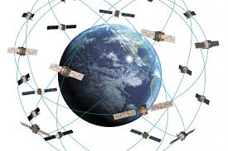
Context
There is a growing need from several applications (e.g. smart farming) of having Analysis Ready Data (ARD) providing surface reflectance measurements with frequent temporal revisit.
In parallel, several optical imaging sensors are flying, and a growing number are planned to be launched in the coming years.
All these missions together have a strong potential if they were to be combined in a single and coherent data stream providing consistent surface reflectance measurements with a higher revisit frequency.

Slide 3
Smart Farming
Not an exhaustive list...

Slide 4
Sen2Like - Goal
In this context, ESA decided to develop a new processor named “Sen2Like” designed to generate ARD harmonized and fused time series of Sentinel-2 and Landsat-8 products.
First demonstration Phase-0 just completed, we are now approaching to Phase-1 (2019-2020).
In the future other optical missions will be integrated.

Slide 5
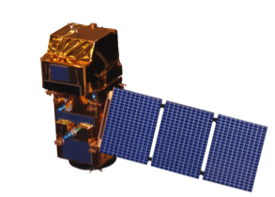
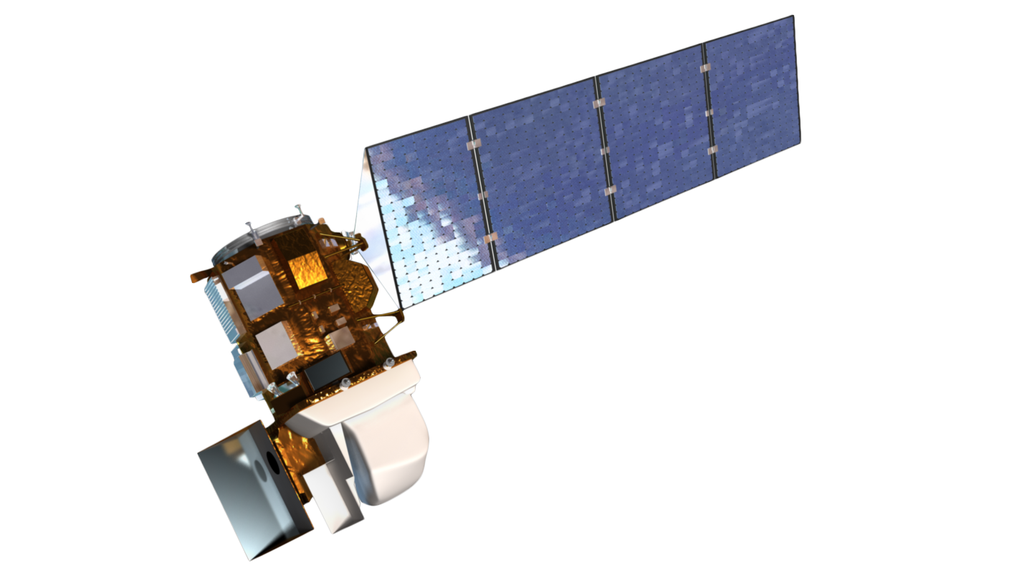
Sen2like - Method
Harmonisation includes consistent atmospheric corrections, spectral adjustments, BRDF adjustments and re-gridding.
Fusion brings L8 resolution to S2.
L2F
S10
L10
S2 L2A
BRDF Adjustment
Fusion
L8 L1T
Geometric Processing
Atmospheric Correction
BRDF Adjustment
Band-pass
Adjustment
L2H
S10
L30
Geometric Processing includes:
- Geometric Quality Control
- Geometric correction (registration to the common reference)
- Reframing to MGRS

Slide 6
Sen2Like – New “ARD” Products
Level-2H: harmonised Sentinel-2 and Landsat-8 products (native spatial resolutions kept):
L2H-S2: B01 B02 B03 B04 B8A B11 B12 + red-edge bands + B8.
L2H-L8: B01 B02 B03 B04 B05 B06 B07 + (B08 B10 B11).
Level-2F: fused Landsat-8 to Sentinel-2 products (S2 spatial resolution for Landsat data):
L2F-S2: B01 B02 B03 B04 B8A B11 B12 + red-edge bands + B8.
L2F-L8: B01 B02 B03 B04 B05 B06 B07 + (B08 B10 B11).

Slide 7
Sen2like - processing steps
Processing step | Method
Atmospheric Correction | As short-term solution to use SMAC algorithm to correct both S2 and L8 products in order to get coherent L2 ARD data. As long-term solution Sen2Cor will be adapted to be able to process L8 data products.
Geometric Processing | Includes: + Geometric QC check + Geometric correction (registration to the common reference) + Reframing to MGRS Target: 0.3 pixel at 2-sigma registration.
BRDF Adjustment | BRDF correction to be applied for both Sentinel-2 & Landsat-8 is Roy et al. 2016 (Remote Sensing of Environment 176 (2016) 255–271)
Band-pass Adjustment | Optional processing step. HLS NASA coefficients used.
Fusion | Predict Sentinel-2 + Downscaling Landsat-8. In-house method developed to be consolidated in Phase-1 (2019-2020).

Slide 8
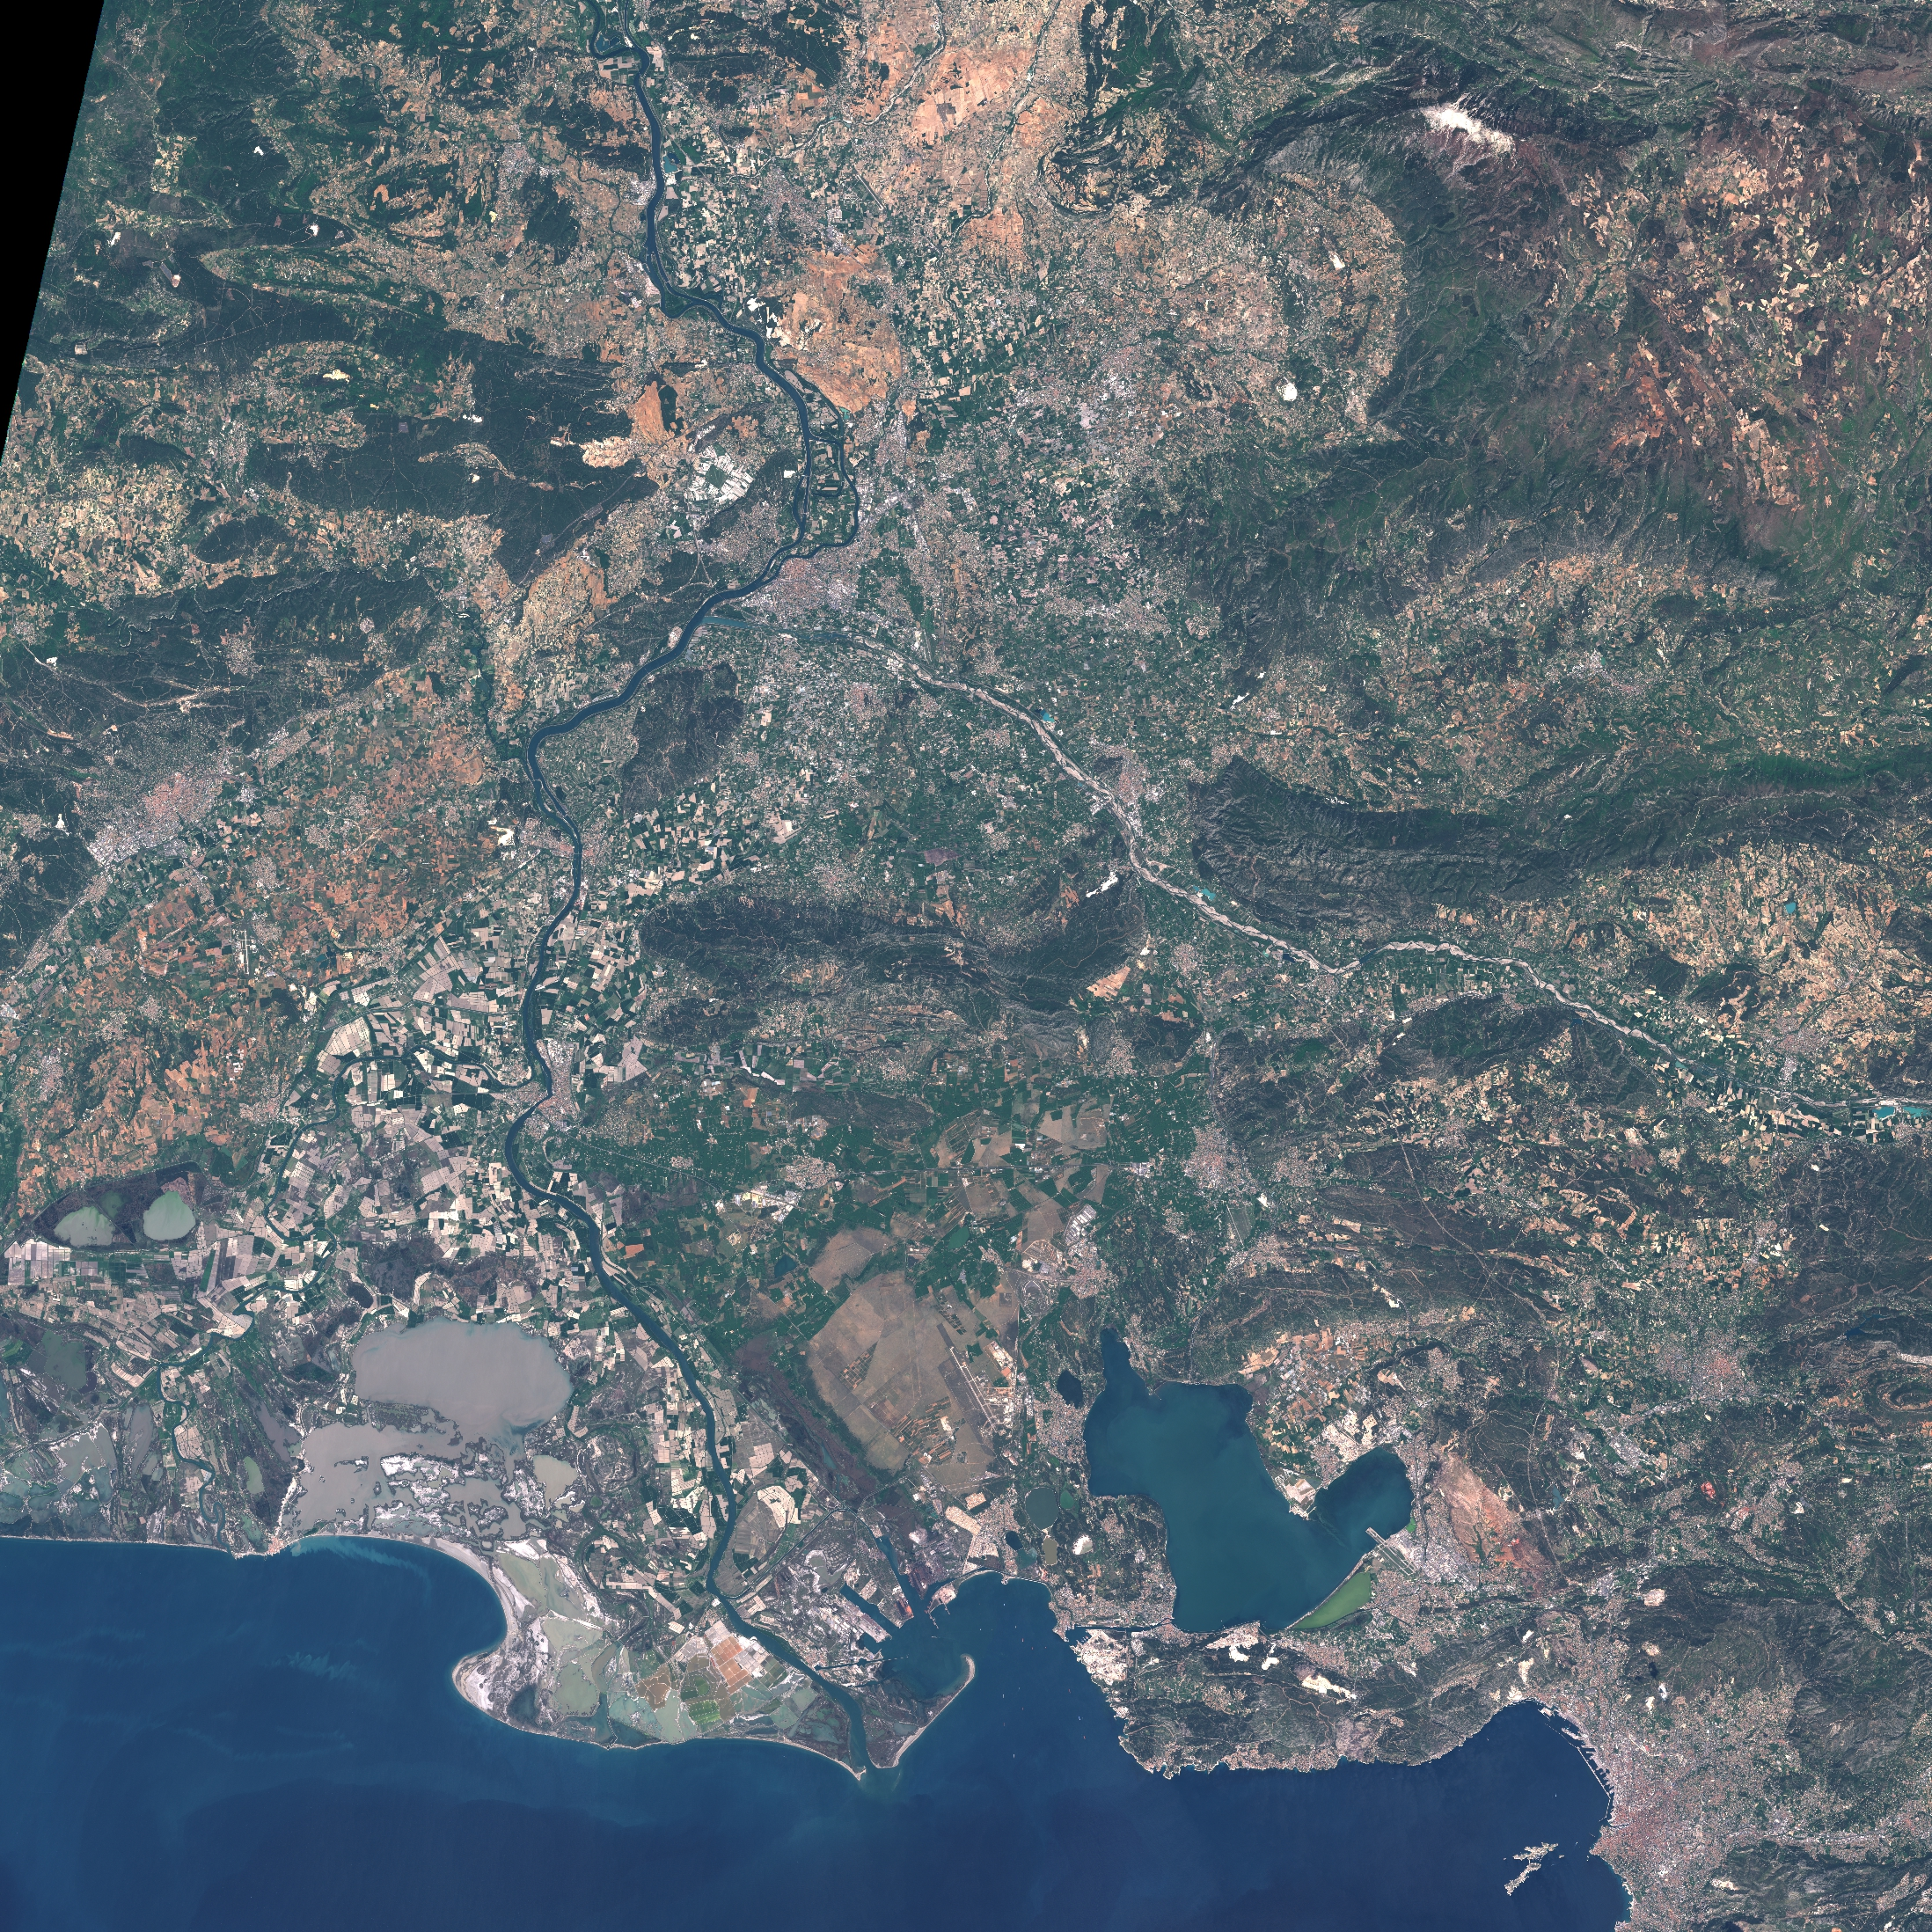
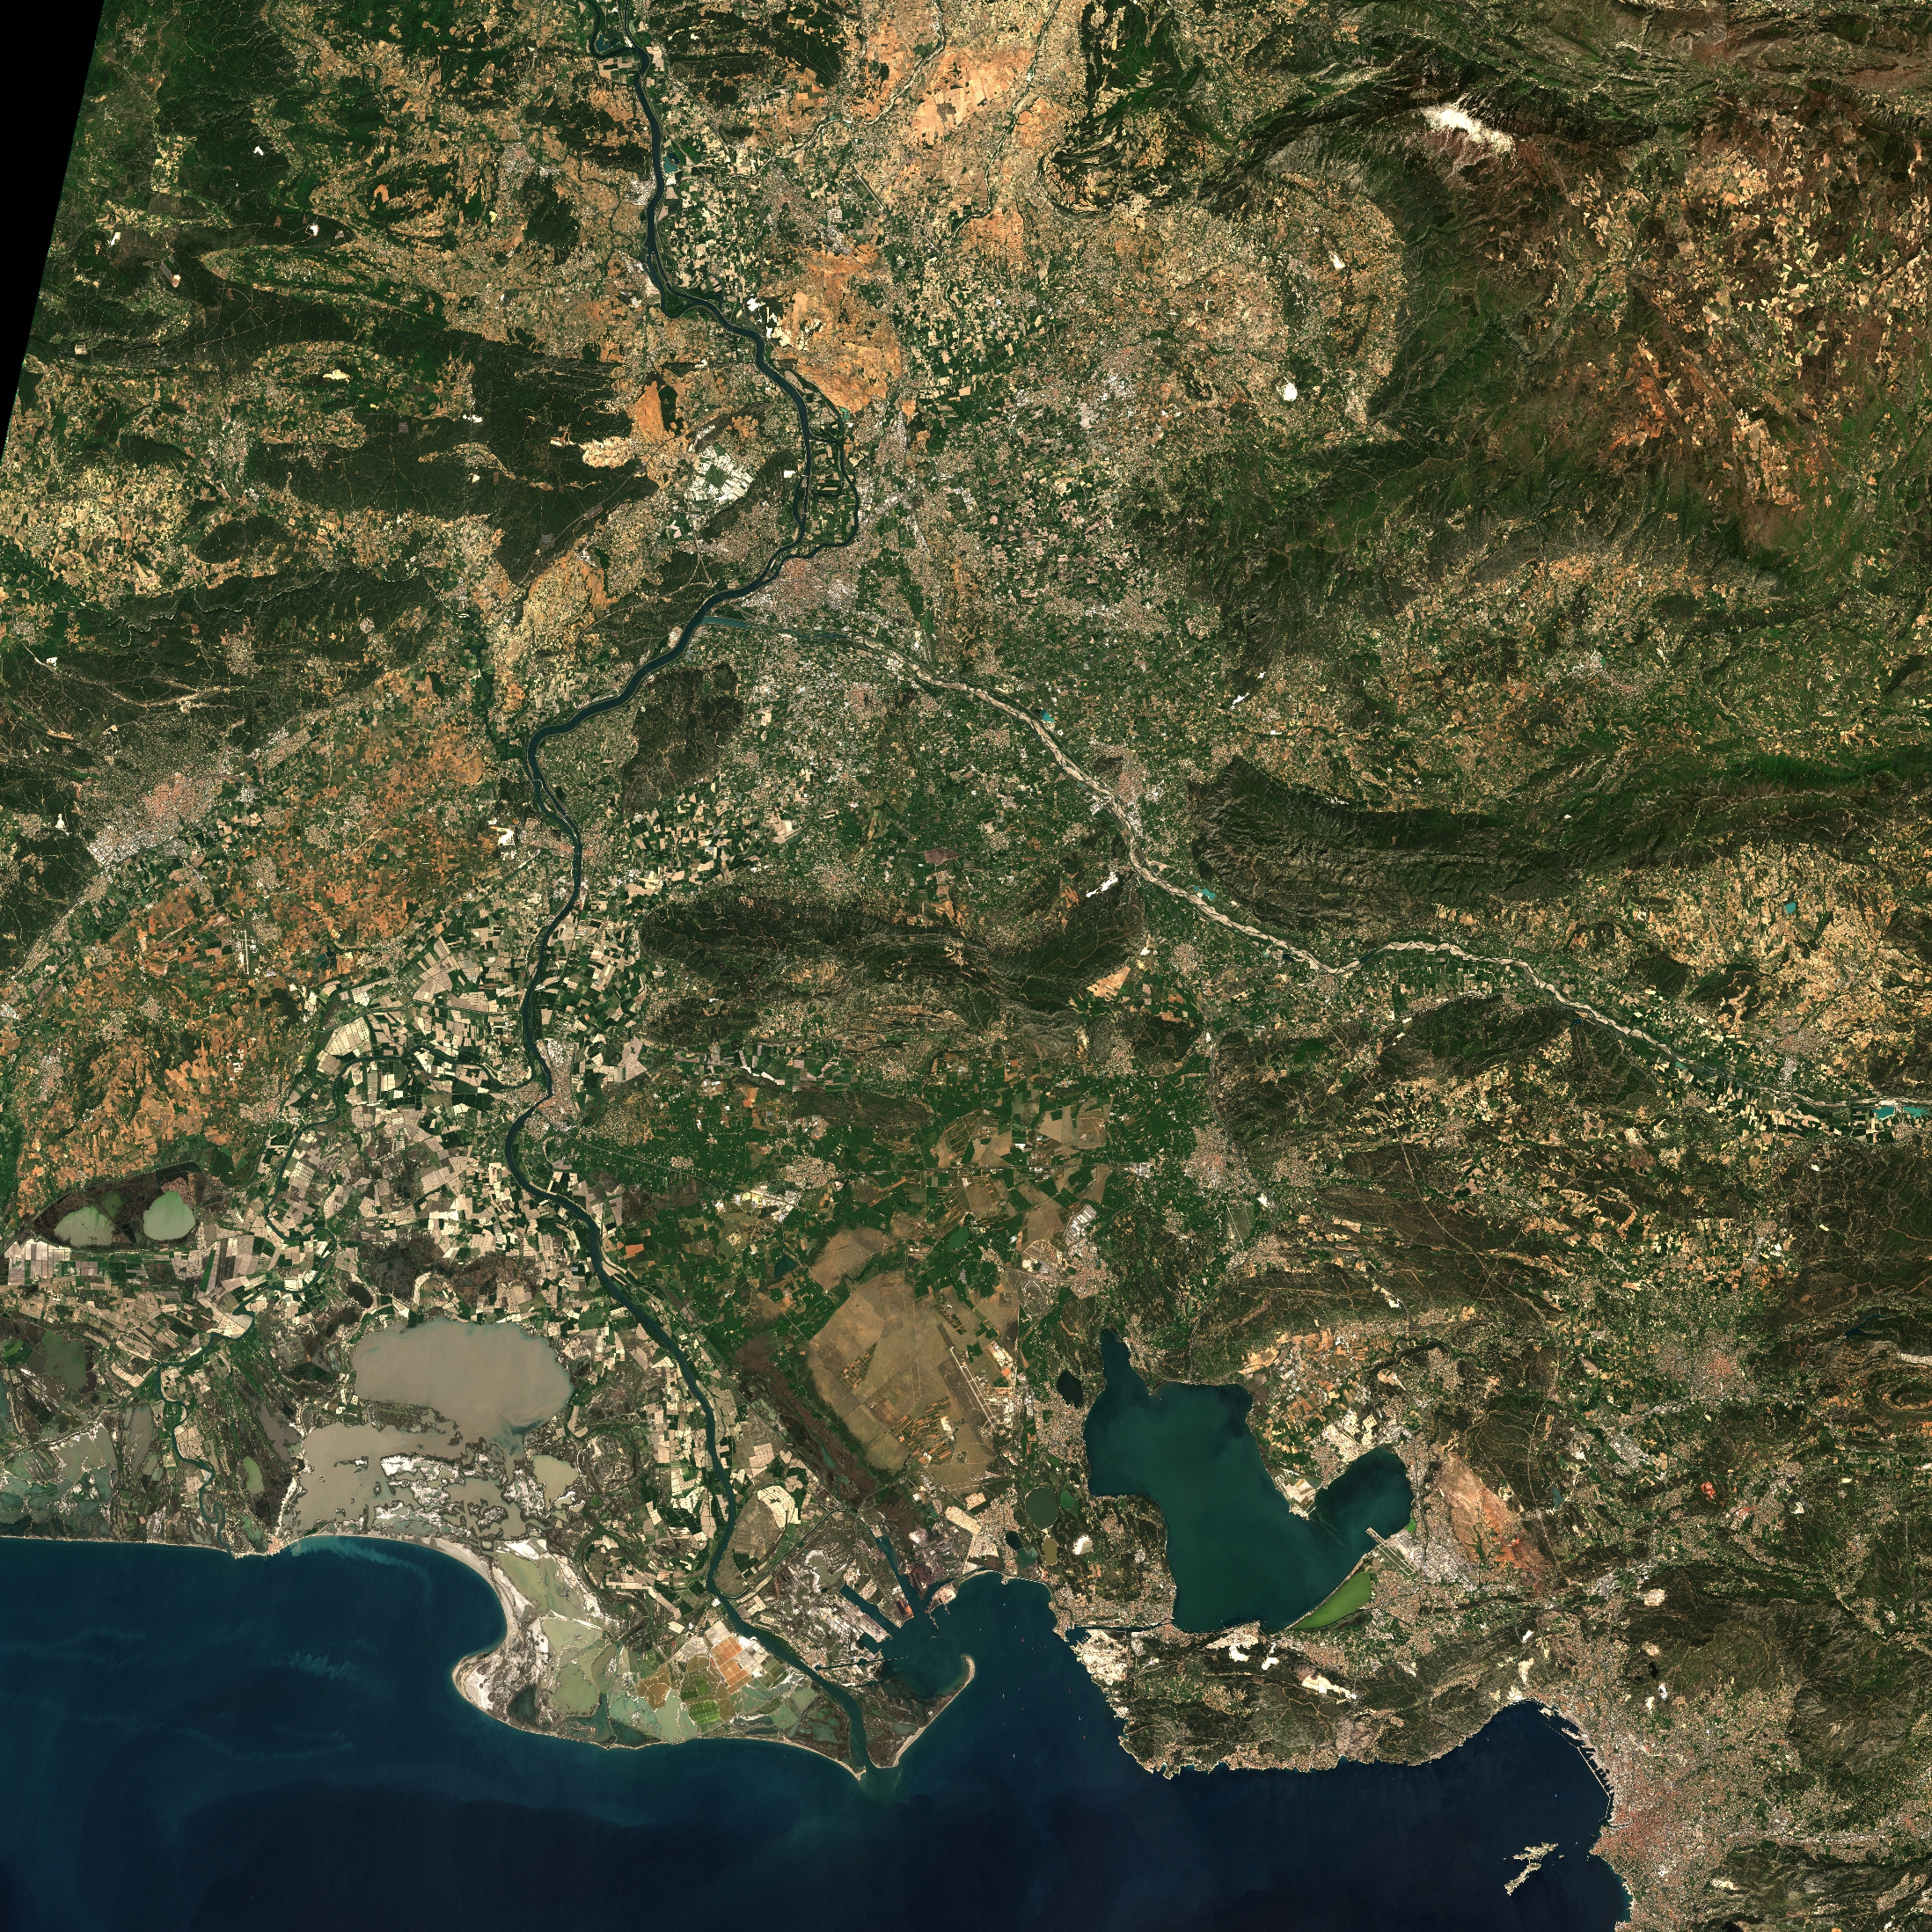
Sen2like - Atmospheric Correction
First Sen2like prototype:
Atmospheric Correction
based on SMAC with solar geometry, viewing geometry, meteorological information (Pressure, AOD, Ozone, Water Vapour) as inputs.
Phase 1 Sen2like prototype (2020) will implement Atmospheric Correction with Sen2Cor adapted to Landsat-8/9 images.
Copernicus Atmosphere Monitoring Service (CAMS) auxiliary data
Top of Atmosphere Reflectance
Surface reflectance
Notes:
For this first version of Sen2Like a common method is proposed to perform the atmospheric correction of LS8-OLI and S2-MSI Top-Of-Atmosphere (TOA) images.
This method is based on SMAC, a simplified method for the atmospheric correction of satellite measurements in the solar spectrum [RD 2] that uses simple analytic formulas, based on the 5S model. This SMAC method uses a set of 49 coefficients, fitted using a large number of radiative transfer simulations with the 6S model (not 6SV). Those coefficients are computed for each band of each instrument (OLI, MSI-A and MSI-B) and were retrieved from the CESBIO repository for SMAC coefficients [RD 5]. In addition, the information of the acquisition geometry (solar and viewing angles) is required as well as the information of atmosphere composition above the tile of interest: the pressure, the aerosol optical depth, the ozone content and the water vapour content. This meteorological information is derived from the data provided by the Copernicus Atmosphere Monitoring Service (CAMS). Either short term forecasts or re-analysis CAMS datasets could be used for that purpose.
From a processing point of view the method is very interesting because it is fast, band independent and could potentially be applied per pixel.

Slide 9
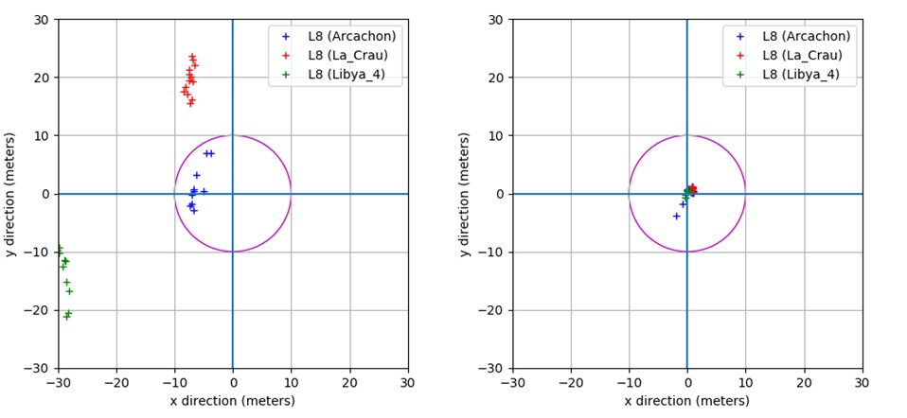
Sen2like - Geometric Processing
Geometric registration accuracy assessment of Landsat8 images (NIR) vs one Sentinel-2 reference image.
References: Arcachon: 2017/06/18 (S2A) La_Crau: 2017/04/20 (S2A) Libya_4: 2017/09/05 (S2B)
Initial Sen2like prototype:
Medicis CNES Tool
Before correction
After correction
Notes:
The development of the algorithm has been motived with following assumptions / drivers:
It is assumed that the S2 geometry is temporally stable with no correction brought to S2 data
The sampling stage is reduced whenever possible
The NIR band image is used for matching and the Landsat 8 data is registered to the Sentinel 2 data
A single correction is applied whatever the bands, also the inter band registration accuracy is not changed.
The Quality Control is systematically performed.
10 m radius circle only for illustration.

Slide 10
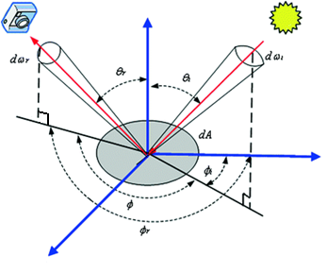
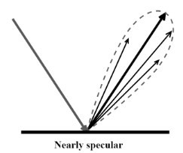
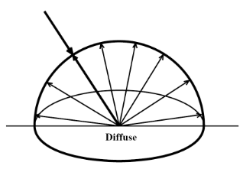
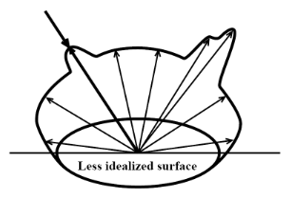
Sen2like - BRDF Adjustment
Initial Sen2like prototype:
Roy et al. 2016 method implemented.
The BRDF parameters are unique, these global factors have been derived from MODIS data (MCD43). A constant BRDF shape is assumed.
The proposed BRDF model is used to produce Nadir BRDF Adjusted Reflectance (NBAR) values.
Bidirectional reflectance distribution function (BRDF)
Notes:
”A constant BRDF shape is assumed” => Linearity of the BRDF in the S2/LS8 zenith angle range – narrow viewing close to NADIR
Fixed Solar viewing angle depending on the latitude of the tile.

Slide 11
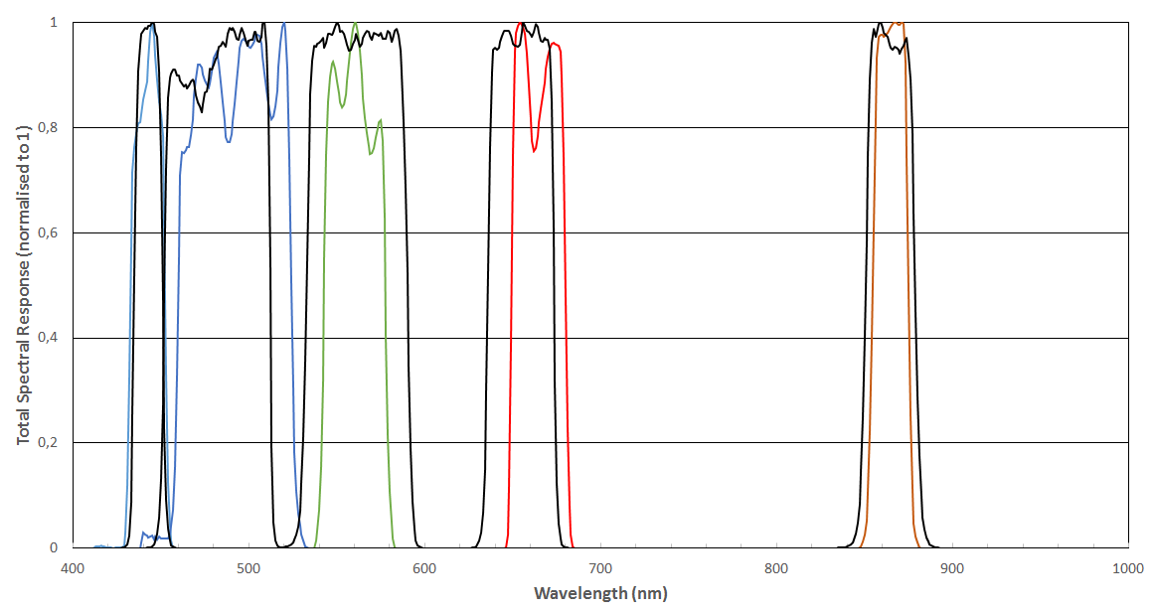
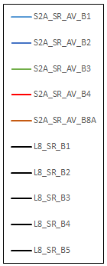
Sen2like Band Pass Adjustment
Sen2like: L8-OLI , S2B-MSI surface reflectances are adjusted to S2A-MSI
Using slopes and offset from (HLS NASA) Product User’s Guide. Version 1.4, October 2018
Notes:
There is no adjustment for Red Edge and Water vapour Bands
The SBAF coefficients might be refined for the blue band, accounting for difference between S2A & S2B – herein coefficient set is the same.
The small differences between MSI and OLI equivalent spectral bands need to be adjusted. The slope and offset coefficients were computed by HLS NASA team based on 500 hyperspectral spectra selected on 160 globally distributed Hyperion scenes processed to surface reflectance and used to synthesis MSI and OLI bands.
Attention: Instrument calibration, Surface reflectance spectral shape and Knowledge of Instrument spectral response contribute to the calculation of these coefficients.
Other studies (CEOS / PICSCSAR) show similar results.

Slide 12
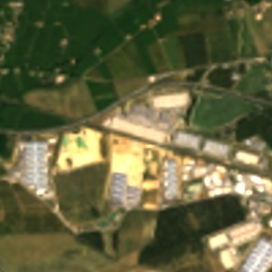
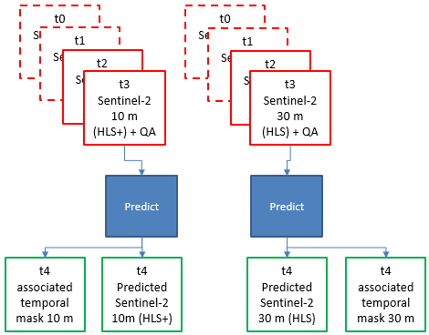
Sen2like - Fusion: Predict + Downscaling
Initial Sen2like prototype:
In-house method.
Prediction of Sentinel-2 surface reflectance at Landsat-8 acquisition date
Landsat-8 RGB image native resolution = 30 m (zoom 3km x 3 km)
10 m and 30 m resolution Sentinel-2 predicted image B04, B03, B02 with associated temporal mask
Notes:
The objective of the data fusion step is to fuse Sentinel-2 data with Landsat-8 data for improving the spatial resolution of L8. The data fusion algorithm aims therefore at downscaling the input OLI 30-meter data up to the MSI 10-meter data pixel spacing.
The fusion algorithm is performed in two steps:
Prediction of Sentinel-2 surface reflectance at Landsat-8 acquisition date
Downscaling of Landsat-8 data towards 10 m resolution using Sentinel-2 predicted data at 10 m

Slide 13
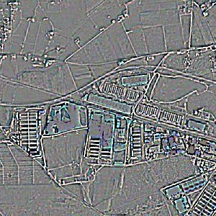
Sen2like - Fusion: Predict + Downscaling
Initial Sen2like prototype:
In-house method.
Downscaling of Landsat-8 data to 10 m resolution using Sentinel-2 predicted data at 10 m
Landsat-8 RGB image native resolution = 30 m (zoom 3km x 3 km)
High Resolution information extracted from Sentinel-2 predicted image (zoom 3 km x 3km)
Notes:
The objective of the data fusion step is to fuse Sentinel-2 data with Landsat-8 data for improving the spatial resolution of L8. The data fusion algorithm aims therefore at downscaling the input OLI 30-meter data up to the MSI 10-meter data pixel spacing.
The fusion algorithm is performed in two steps:
Prediction of Sentinel-2 surface reflectance at Landsat-8 acquisition date
Downscaling of Landsat-8 data towards 10 m resolution using Sentinel-2 predicted data at 10 m

Slide 14
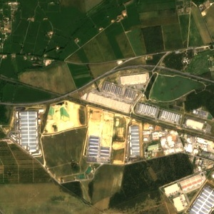
Sen2like - Fusion: Predict + Downscaling
Initial Sen2like prototype:
In-house method.
Prediction of Sentinel-2 surface reflectance at Landsat-8 acquisition date
Downscaling of Landsat-8 data towards 10 m resolution using Sentinel-2 predicted data at 10 m
High resolution information from Sentinel-2 sensor.
Landsat-8 radiometry preserved
Landsat-8 RGB image after fusion step
(zoom 3 km x 3km)
Landsat-8 RGB image native resolution = 30 m (zoom 3km x 3 km)
Notes:
The objective of the data fusion step is to fuse Sentinel-2 data with Landsat-8 data for improving the spatial resolution of L8. The data fusion algorithm aims therefore at downscaling the input OLI 30-meter data up to the MSI 10-meter data pixel spacing.
The fusion algorithm is performed in two steps:
Prediction of Sentinel-2 surface reflectance at Landsat-8 acquisition date
Downscaling of Landsat-8 data towards 10 m resolution using Sentinel-2 predicted data at 10 m

Slide 15
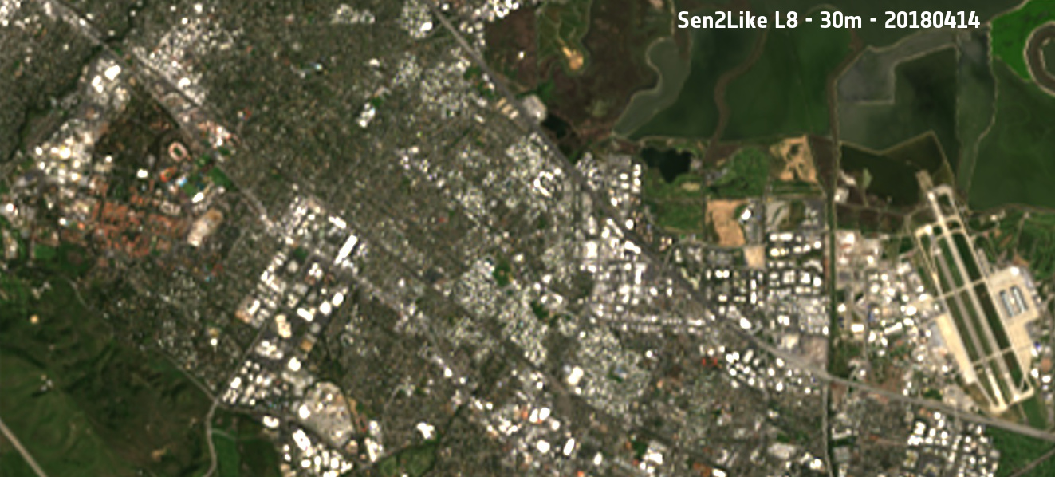
Sen2like – Output example

Slide 16
Validation
Notes:
Coastal, Green, NIR, SWIR1, SWIR2 looks less affected than Blue band and Red band.

Slide 17
Processing steps validation
Validation Item | Objective | Approach
Geolocation Accuracy | Certify registration accuracy within 0.3 pixel in multi-temporal | Analysis of processing results (Visual inspection, log) & independent validation by using a raster reference
Atmospheric Correction | Estimate agreement with L2 reference data | Visual inspection/comparison of SR data for different image regions, scatter plot by using as reference LEDAPS data / Sen2Cor data.
BRDF Adjustment | Assess impact of BRDF correction | Cross Comparison with an alternative BRDF correction method for specific regions.
SBAF | Validate proposed HLS coefficients | Inter calibration of LS8-OLI / S2-MSI by using Pseudo Invariant Calibration Target

Slide 18
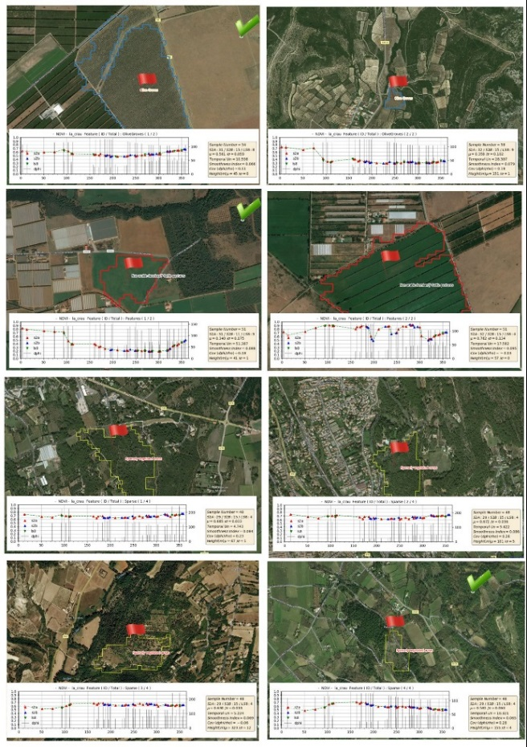
Time Series End to End Validation
The impact of each processing step (e.g. BRDF, Fusion) on the quality of the time series is assessed using some indexes (e.g. NDVI, TSI).
This validation exercise is performed for several types of land cover. (ESA CCI Land Cover)
Notes:
The values of the second y axis (right) corresponds to the phase angle (delta azimuth), meaning difference between the two solar / viewing angle values. We observed that depending on the orbit, this angle is varying from 50 degree to 180 degree matching with a backward / forward relative position.

Slide 19
Sen2like - Conclusion and Roadmap
The first “Sen2Like” prototype processor enables the production of multi-temporal surface reflectance datasets with the Landsat-8 mission as additional data source.
A generic / flexible processor has been developed during Phase-0 allowing to plug different thematic blocks and test different processing configurations.
It has been shown to build very consistent time series of vegetation indexes (e.g. NDVI).
In the second phase (Phase-1) 2019-2020, it is planned to consolidate the operational performance of the prototype (cloud oriented), working in parallel on the adaptation of Sen2Cor to Landsat-8/9 data and improving main methods (e.g. fusion, BRDF, etc.).

Slide 20
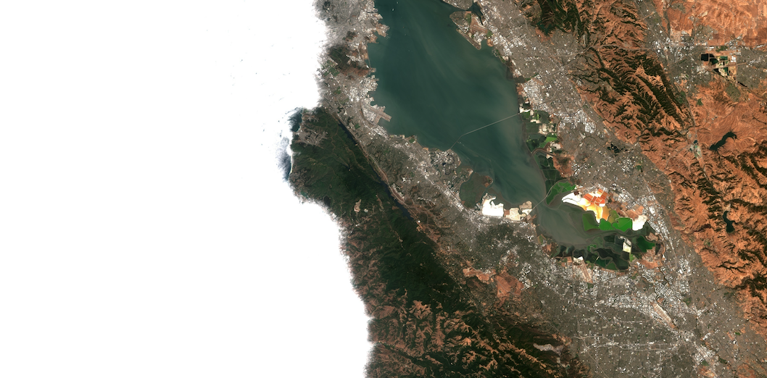
Many thanks for your attention!
San Francisco bay area seen by S2

