Slide 1
USGS Status
Jenn Lacey, USGS EROS
LSI-VC
USGS Agency Status
Anchorage, AK
4-6 September 2019

Slide 2
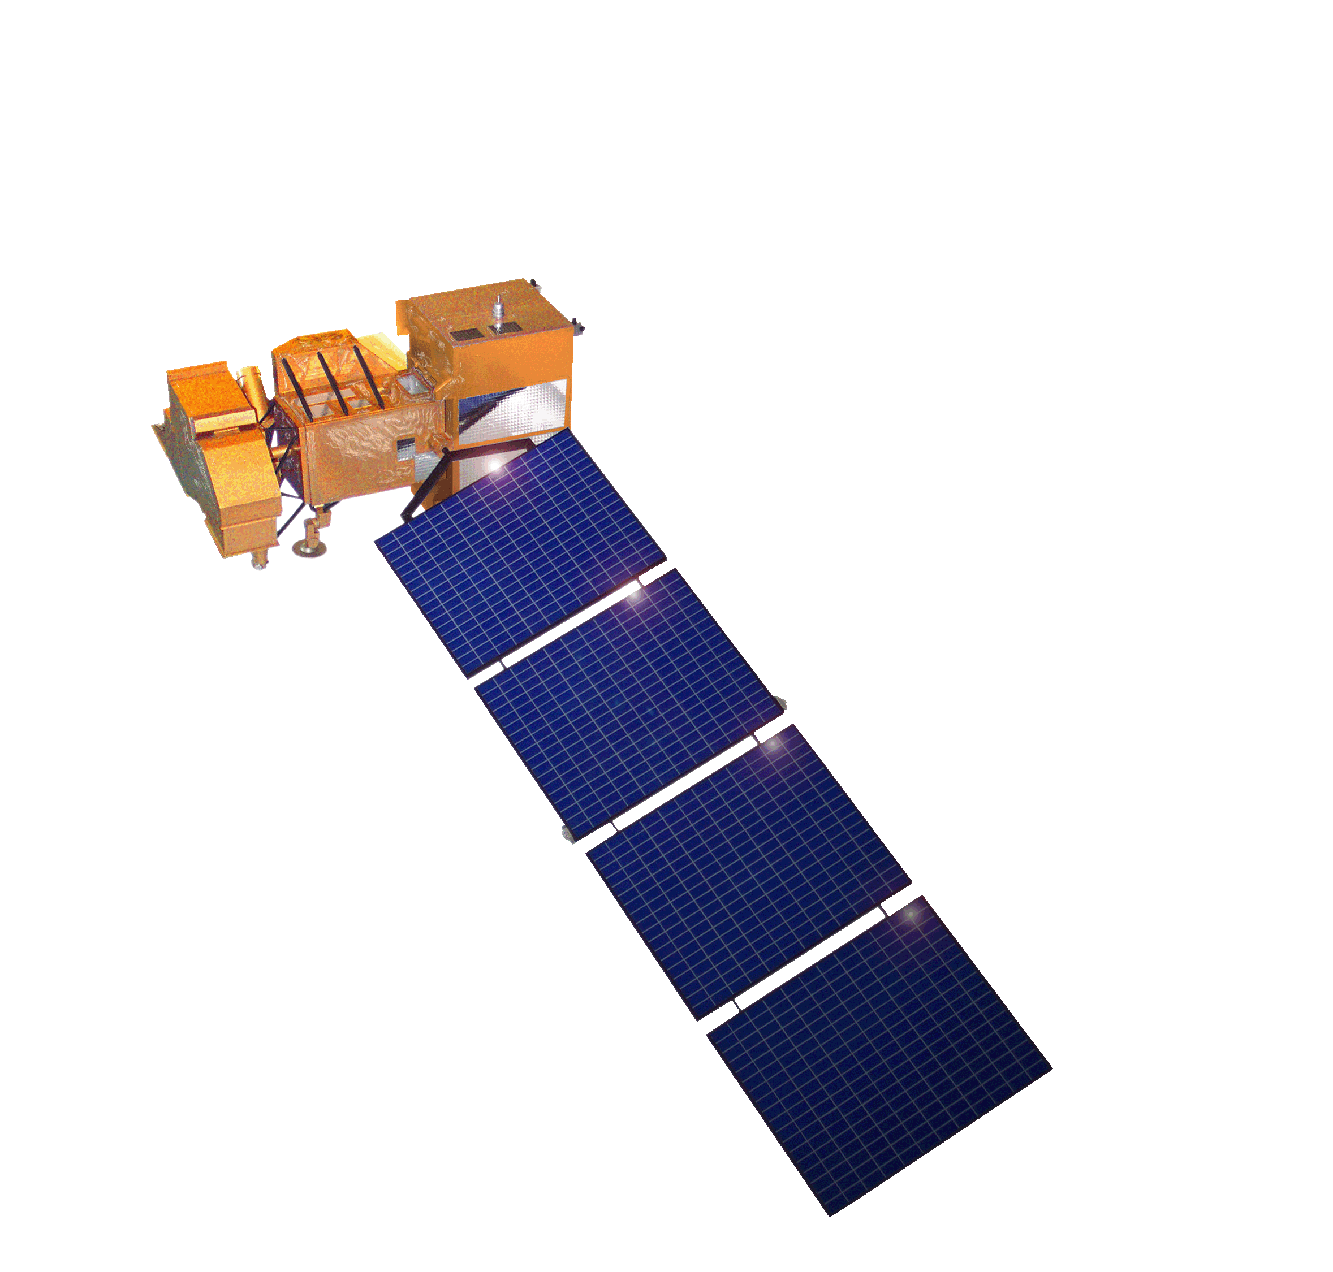
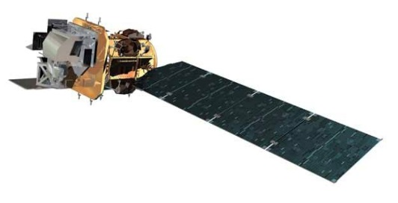
Landsat Operational Mission Status
Landsat 7
Acquiring image data at a rate of ~470 scenes per day through a continental acquisition strategy
On-orbit performance of Landsat 7 observatory continues to be outstanding
Finalized end of mission planning to extend Landsat 7 science operations to overlap with Landsat 9 launch readiness
  Assumes December 2020 launch readiness date for Landsat 9
  Science mission life-cycle potential extends to July 2021
  Decommissioning will follow the launch of Landsat 9 or the end of science mission operations, whichever comes first
Landsat 8
Acquiring image data at a rate of ~740 scenes per day with continental acquisition strategy
On-orbit performance of Landsat 8 observatory continues to be outstanding
TIRS Scene Select Mirror (SSM) Encoder Circuit B-side operations concept performing very well
Enhanced Landsat Ground Network (LGN) robustness and reliability through use of international partnerships
International Cooperator (IC) network currently at 22 certified IC stations and growing
Flight Operations now performed under USGS contract for combined mission operation and Landsat Multi-satellite Operations Center (LMOC) development

Slide 3
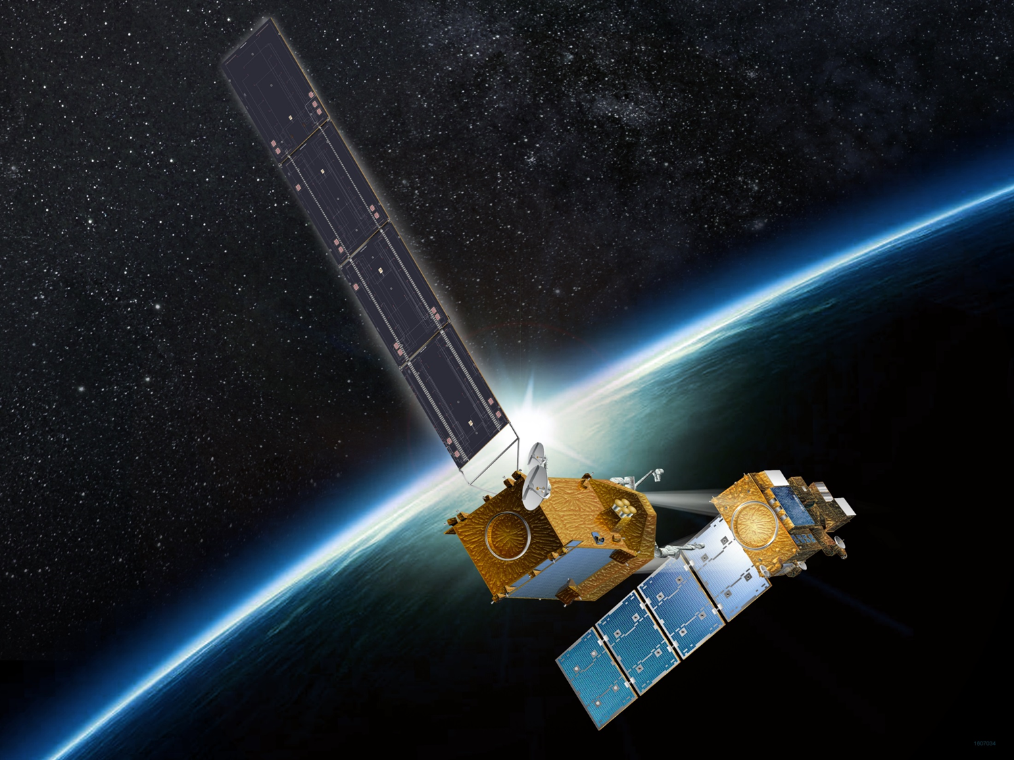
Landsat and Restore-L
USGS is working with NASA on technology demonstration
  Landsat 7 is principle client for NASA Restore L
The Landsat 7 End-of-Mission Plan was recently developed with key points that dovetail into Restore-L mission timeline
Restore L Mission Objectives
  Launch Restore L Servicing Vehicle (RSV)
  RSV approach Landsat 7 and perform inspection using on-board cameras
  RSV capture and secure Landsat 7 to create combined “stack”
  Transfer between 10-110 kg of fuel from RSV to Landsat 7
  Relocate combined stack to new orbit
  Release Landsat 7 and retreat to safe orbit

Slide 4
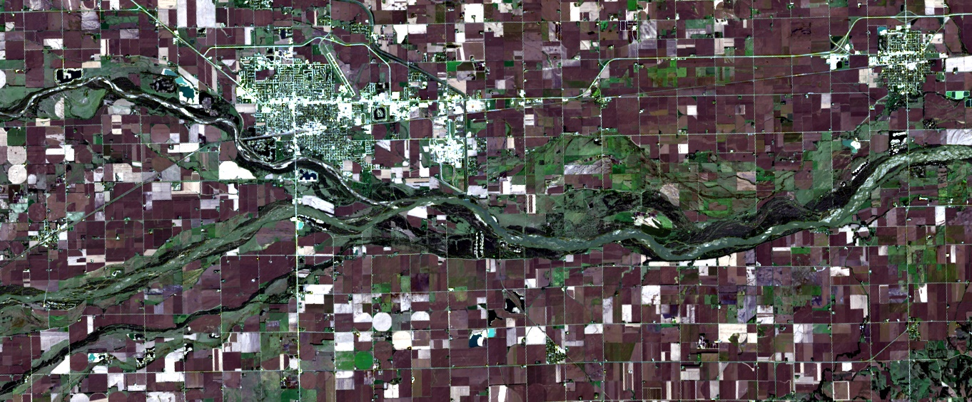
Collection 2
Landsat 8 Level-2 Surface Reflectance
Path 29 / Row 31
October 8, 2016
True-color RGB (4/3/2)
LPGS v15.2.0 (7/22/2019)
LaSRC 1.4.1 (SR)
Single-Channel 1.3.0 (ST)

Slide 5
Landsat Advisory Group Report:
Cost Sharing Models for Landsat Data
Why?: DOI leadership seeking to better understand economic and data policy considerations and impacts in relation to user needs, as well as the potential for public-private partnering (“P3”), with respect to various cost sharing models for Landsat data.
LAG initiated work on the report in 2018
Final Report issued June 12, 2019
LAG report is now published on the NGAC website: https://www.fgdc.gov/ngac

Slide 6
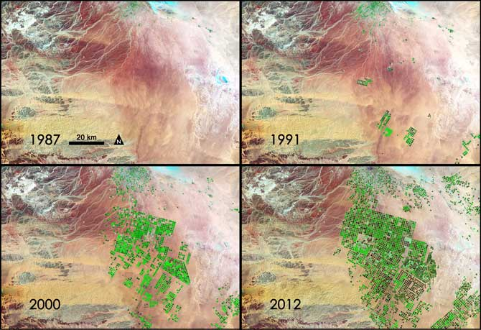
Landsat 9 Mission Overview
  Mission Objectives
Provide continuity in multi-decadal Landsat land surface observations to study, predict, and understand the consequences of land surface dynamics
  Core Component of Sustainable Land Imaging program
  Mission Parameters
Single Satellite, Mission Category 1, Risk Class B
  5-year design life after on-orbit checkout
  At least 10 years of consumables
Sun-synchronous orbit, 705 km at equator, 98°inclination
16-day global land revisit
Partnership: NASA & USGS
  NASA: Flight segment & checkout
  USGS: Ground system and operations
Category 3 Launch Vehicle
Launch: Management Agreement - December 2020
Agency Baseline Commitment – November 2021
  Mission Team
NASA Goddard Space Flight Center (GSFC)
USGS Earth Resources Observation & Science (EROS) Center
NASA Kennedy Space Center (KSC)
Instruments
Operational Land Imager 2 (OLI-2; Ball Aerospace)
    Reflective-band push-broom imager (15-30m res)
    9 spectral bands at 15 - 30m resolution
    Retrieves data on surface properties, land cover, and vegetation condition
Thermal Infrared Sensor 2 (TIRS-2; NASA GSFC)
  Thermal infrared (TIR) push-broom imager
  2 TIR bands at 100m resolution
  Retrieves surface temperature, supporting agricultural and climate applications, including monitoring evapotranspiration
Spacecraft (S/C) & Observatory Integration & Test (I&T)
Northrop Grumman Innovation Systems (NGIS), formerly Orbital ATK (OA)
Launch Services
United Launch Alliance (ULA) Atlas V 401
Mission Operations Center (MOC) and Mission Operations
General Dynamics Mission Systems (GDMS)
Increase in pivot irrigation in Saudi Arabia from 1987 to 2012 as recorded by Landsat. The increase in irrigated land correlates with declining groundwater levels measured from GRACE (courtesy M. Rodell, GSFC)

Slide 7
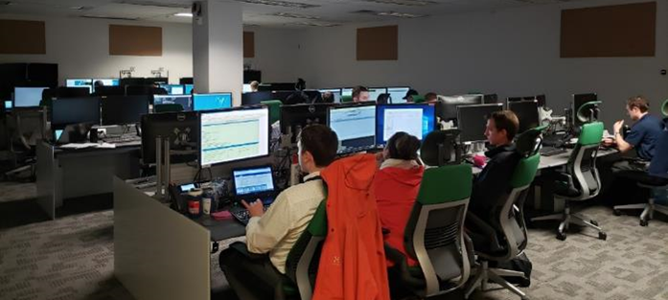
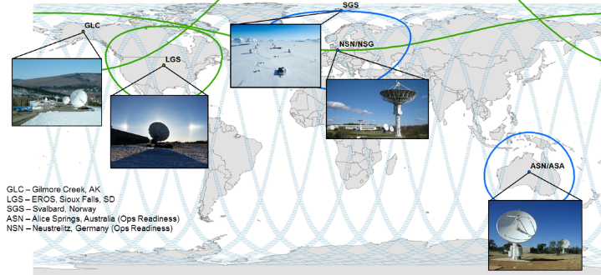
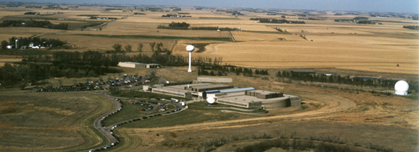
Landsat 9 Ground System
Landsat Multi-satellite Operations Center (LMOC)
  Contract for LMOC/bLMOC development and Flight Ops Team awarded to General Dynamics Mission Systems (GDMS) in June 2017
  Landsat Mission Operations (LMO) contract provides Landsat 8 and Landsat 9 MOC development and FOT services
  Landsat Multi-satellite Operations Center (LMOC) and bLMOC facilities
Ground Network Element (GNE)
  Landsat Ground Network (LGN) stations provide X- and S-band communications with the Observatory
  LGN stations in Sioux Falls, SD; Fairbanks, AK; and Svalbard, Norway
  Neustrelitz, Germany and Alice Springs, Australia for use after commissioning
  Data Collection and Routing Subsystem (DCRS) gathers mission data from LGN stations into complete intervals to transfer to the DPAS
Data Processing and Archive System (DPAS)
  Provides data ingest, storage and archive, image assessment, product generation, and data access and distribution
  Includes scope to integrate the Landsat 4-8 Level-2 algorithms into the operational system
  DPAS facility at USGS EROS Center
GSFC, Greenbelt, MD
EROS, Sioux Falls, SD
Notes:
The ground system has three elements, all of which leverage a significant amount of heritage and existing staff from LDCM/L8 with the most reuse within the GNE.
Implemented through various contracts most notably the TSSC and LMO and GNE Agreements / Contracts.
The LMOC is a modified version of the existing LDCM LMOC with the most significant changes coming from the change to a more efficient scheduling subsystem (CPAW) operational concept to collect all land mass. The rest of the system is receiving modification to accommodate the new spacecraft.
As mentioned, GNE leverages a significant amount of heritage, however, this time we’ve seen challenges with prioritization and success of lower-level integration tests, surprisingly at Svalbard who have traditionally been stellar performers. The project has been able to overcome these challenges and the stations are now progressing very well.
The DPAS is mainly reuse, however it must accommodate new packetized formats for space to ground, modified algorithms (e.g. TIRS SSM modes) as well as integration of the Level-2 (ARD) algorithms for Collection 2 data.

Slide 8
SLI Draft Requirements
To guide architecture development, the AST developed a draft set of SLI Science Requirements: https://www.fbo.gov/utils/view?id=25beed08973428c9c649250fa5c546f7
Draft requirements derived via assessment of heritage Landsat and Copernicus Sentinel 2 continuity and performance, USGS user needs elicitation, input from the Landsat Science Team (LST), and subject matter expertise
These draft SLI requirements are currently provided at two levels of prescribed capability
  Low-level – threshold – is defined as the minimally acceptable performance level, below which SLI fails to meet science application needs for the Global Survey Mission
  Mid-level – goal – is defined as the desirable level that greatly enhances the performance for scientific applications and remains in scope with the SLI Global Survey Mission objective
Current draft requirements do not preclude hyperspectral instruments or observations

Slide 9
Draft SLI Threshold Requirements
Supports most minimum user needs
Clear observation every ~14 days (8 day revisit)
VSWIR bands at 30m, TIR/atmospheric bands at 60m
Current Landsat spectral bands with minor additions
  Water vapor (S2; atmospheric correction)
  Red edge bands (S2; vegetation condition/health & water quality)
  8.6mm TIR band (ASTER/MODIS; emissivity/LST separation)
  Referred to in Architecture Analysis as “Multispectral” set
 | Band name | GSD (m) | Center wavelength (nm) | Band width (nm)
1 | Coastal Aerosol | 60 | 443 | 20
2 | Blue | 30 | 490 | 65
3 | Green | 30 | 560 | 35
4 | Red | 30 | 665 | 30
5 | Red Edge 1 | 30 | 705 | 15
6 | Red Edge 2 | 30 | 740 | 15
7 | Red Edge 3 | 30 | 783 | 20
8 | NIR | 30 | 865 | 20
9 | Water vapor | 60 | 945 | 20
10 | Cirrus | 60 | 1375 | 30
11 | SWIR 1 | 30 | 1610 | 90
12 | SWIR 2 | 30 | 2190 | 180
14 | TIR 1 | 60 | 8650 | 350
15 | TIR 2 | 60 | 10800 | 1000
16 | TIR 3 | 60 | 12000 | 1000
Notes:
CA for aquatic science, need higher SNR rather than higher resolution
Heritage ASTER TIR11

Slide 10
Draft SLI Goal Requirements
Supports many breakthrough user needs
Clear observation every ~5 days (3 day revisit)
VNIR at 10m; narrow bands and SWIR at 20m; atmospheric/TIR at 60m
Additional, high-priority narrow bands
  Referred to in architecture analysis as “Superspectral” set
 | Band name | GSD (m) | Center wavelength (nm) | Band width (nm) | Rationale
1a | Violet | 60 | 410 | 20 | Improved aerosol retrieval; CDOM from inland/coastal water
1 | CA | 60 | 443 | 20 | Landsat
2 | Blue | 10 | 490 | 65 | Landsat
3 | Green | 10 | 560 | 35 | Landsat
4a | Orange | 20 | 620 | 20 | Phycocyanin detection for Harmful Algal Blooms
4 | Red | 10 | 665 | 30 | Landsat
5 | Red Edge 1 | 20 | 705 | 15 | LAI, Chlorophyll, plant stress (S2)
6 | Red Edge 2 | 20 | 740 | 15 | LAI, Chlorophyll, plant stress (S2)
7 | Red Edge 3 | 20 | 783 | 20 | Water quality (TBR) (S2)
8 | NIR_Broad | 10 | 842 | 115 | 10m NDVI (S2)
8a | NIR1 | 20 | 865 | 20 | Continuity (note – S2 narrower than L8)
9 | Water vapor | 60 | 945 | 20 | Improved atmospheric correction for LST, SR (S2)
8b | NIR2 | 20 | 1035 | 20 | Snow grain size for water resources
10 | Cirrus | 60 | 1375 | 30 | Landsat
11 | SWIR 1 | 20 | 1610 | 90 | Landsat
12a | SWIR 2a | 20 | 2040 | 30 | Subdivided for cellulose/crop residue measurement (Landsat)
12b | SWIR 2b | 20 | 2100 | 40 | Subdivided for cellulose/crop residue measurement (Landsat)
12c | SWIR 2c | 20 | 2210 | 40 | Subdivided for cellulose/crop residue measurement (Landsat)
13 | MWIR* | 60 | 3980 | 300 | Active fire, volcanos, fire radiative power (MODIS)
14a | TIR 1a | 60 | 8300 | 350 | Mineral and surface composition mapping (ASTER)
14 | TIR 1 | 60 | 8650 | 350 | Emissivity separation, volcanos (SO2) (MODIS/ASTER)
14b | TIR 1b | 60 | 9100 | 350 | Mineral and surface composition mapping (ASTER)
15 | TIR 2 | 60 | 10800 | 1000 | Surface temperature (Landsat)
16 | TIR 3 | 60 | 12000 | 1000 | Surface temperature, snow grain size (Landsat)
*MWIR currently being evaluated for value/feasibility

Slide 11
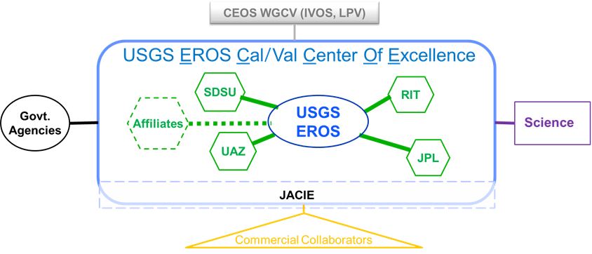
EROS Calibration/Validation Center of Excellence (ECCOE)
EROS Cal/Val Center of Excellence (ECCOE) established 2017 for: “improving the accuracy, precision, and efficiency of radiometric, geometric, and spatial characterization, calibration, and cross-calibration of optical remote sensing systems to achieve the highest degree of interoperability of remote sensing data products.”

Slide 12
Questions

