Slide 1
Agency Report: Geoscience Australia
Medhavy Thankappan, Andreia Siqueira, Adam Lewis
LSI-VC8
Anchorage, AK USA
4-6 September 2019

Slide 2
Outline
DEA Landsat Collection upgrade
DEA Labs initiative
ARD product validation
InSAR CARD4L
DE Africa

Slide 3

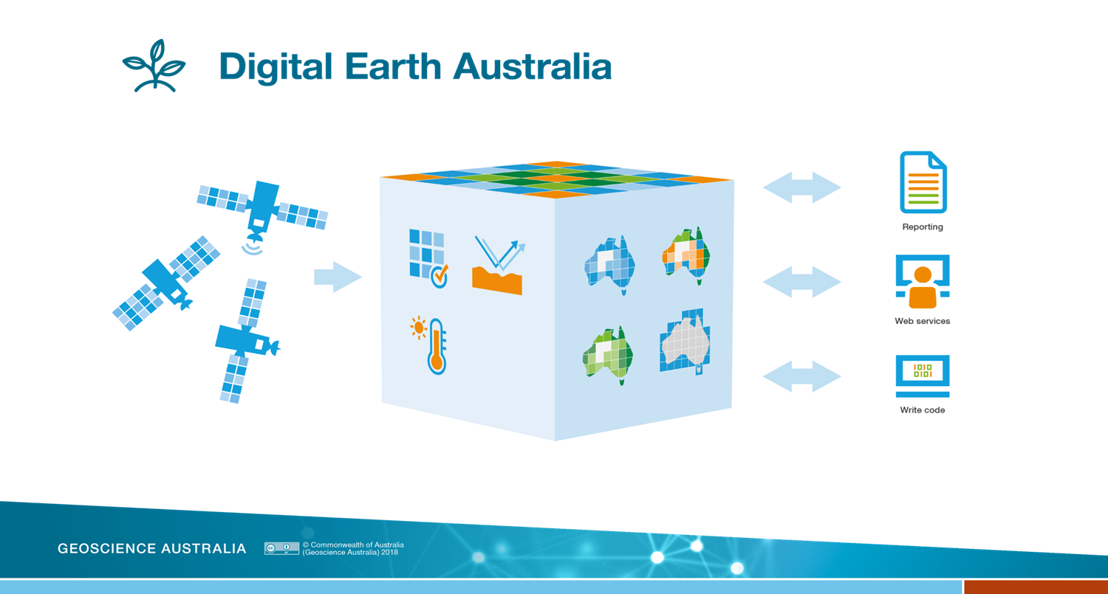
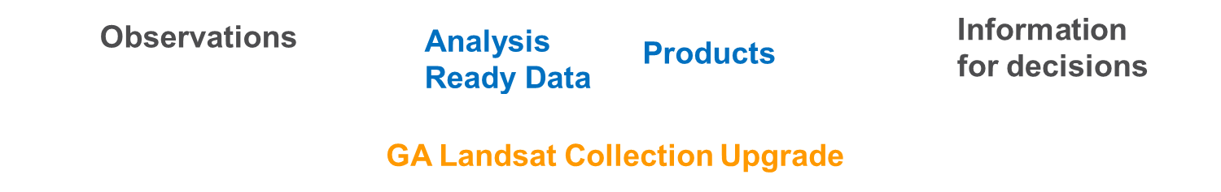
DEA Collection Upgrade
Digital Earth Australia

Slide 4
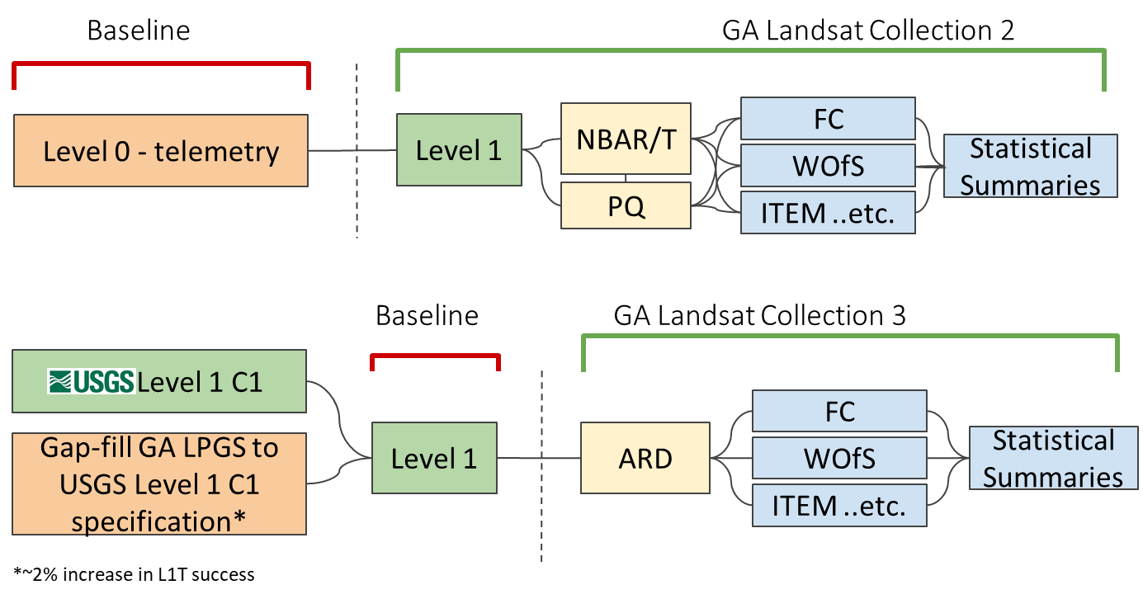
Landsat Collection Upgrade

Slide 5
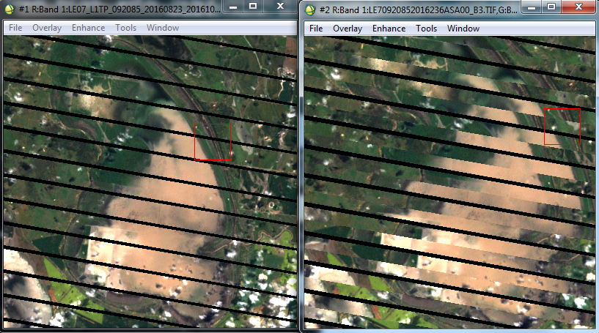
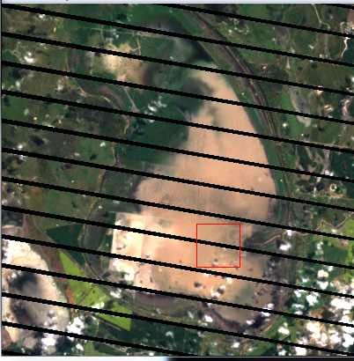
Collection Upgrade
What does it include?
  Latest calibration, coastal gap-filling
  Higher resolution Pan band
  New solar irradiance table
  BRDF Collection 6 & MODTRAN 6
  Cloud Optimised GeoTiff
  Spatial Temporal Asset Catalog (STAC) compatible
  Metadata to support Data Cube native load / multi-resolution
  15/30 m resolution, centre aligned
  UTM projection
USGS Collection 1
GA current
GA Collection Upgrade

Slide 6
Collection Upgrade Schedule
  Jul 2019 Sample ARD product available
  Sep 2019 Complete ARD production backlog
  Oct 2019 Derivatives production commenced
  Feb 2020 Derivatives production complete
  Jun 2020 GA Landsat Collection 2 decommissioned

Slide 7
DEA Labs Initiative
DEA Labs initiative core component of the DEA industry engagement strategy
Funding for three projects of up to $50,000 each to private sector companies that demonstrate new products and services with DEA data and infrastructure
Successful proposals were announced last month

Slide 8
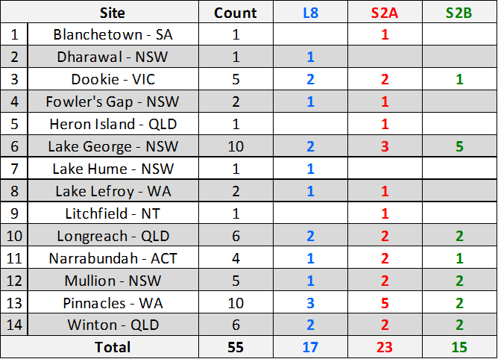
Validation of SR - Phase 1
Total field data acquisitions at all sites

Slide 9
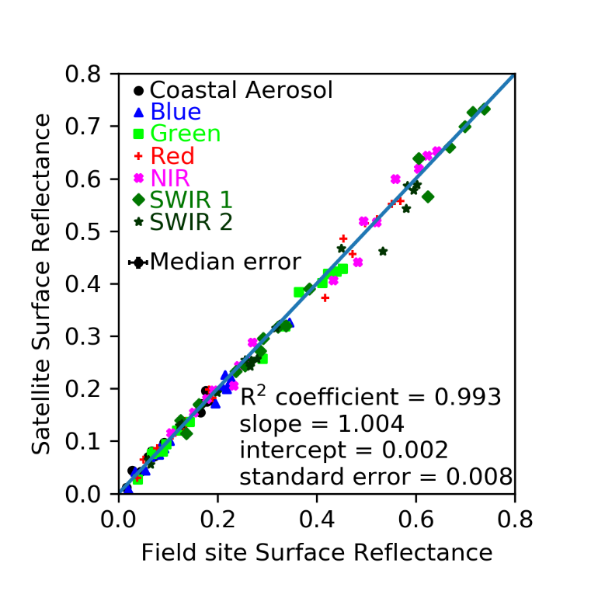
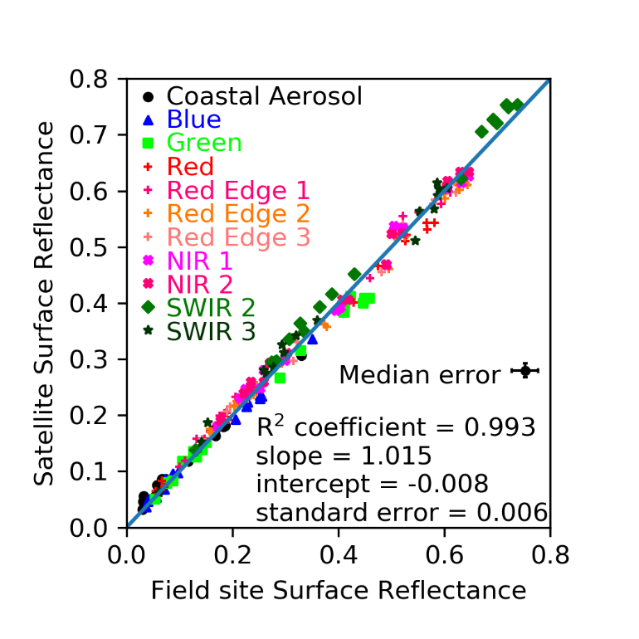
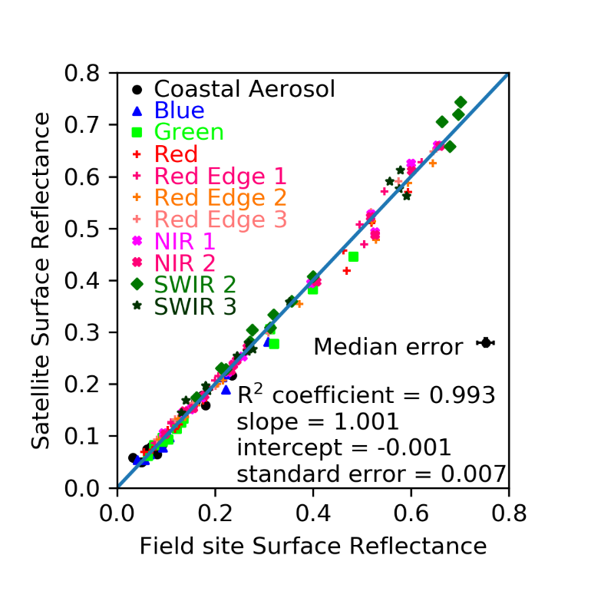
SR Validation - Phase 1 Results
Landsat-8
Sentinel-2A
Sentinel-2B

Slide 10
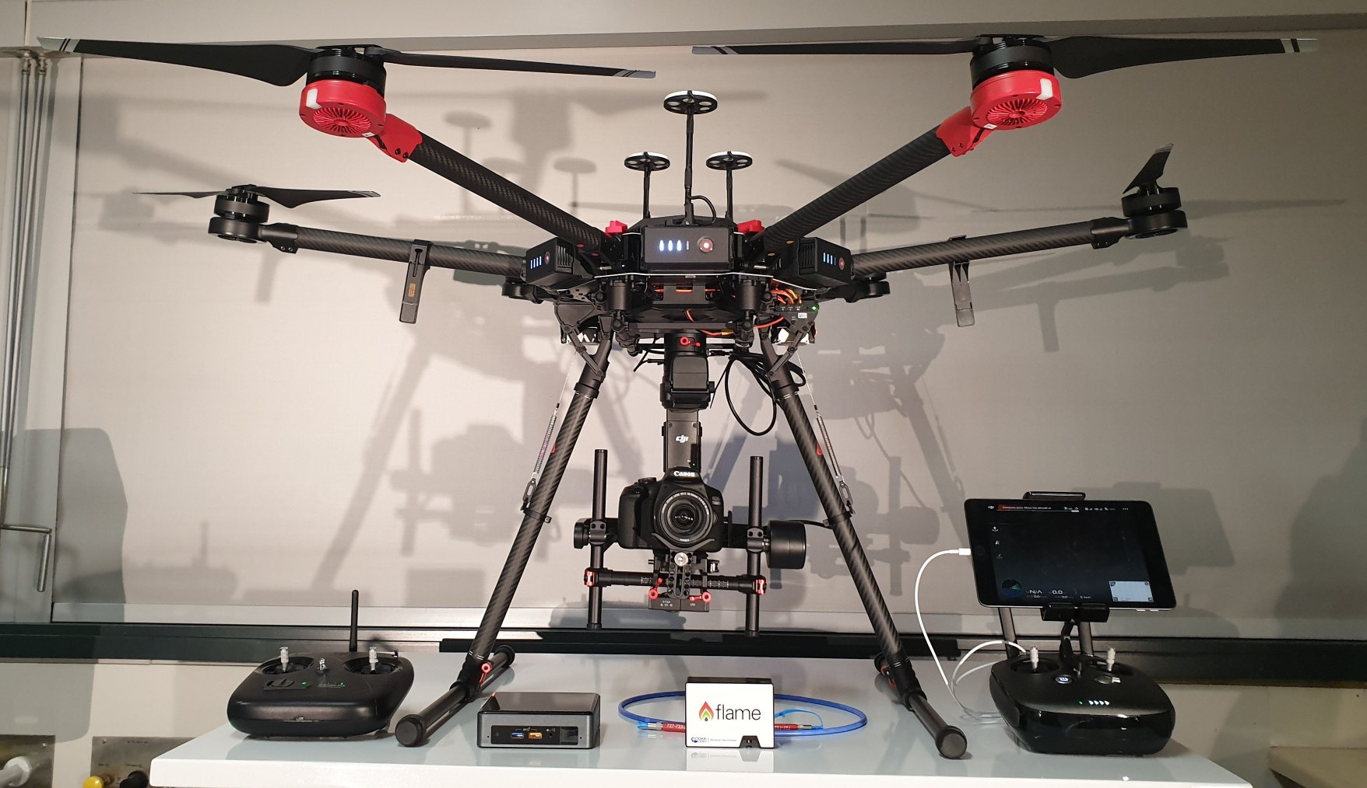
Validation of SR - Phase 2
Scoping for Phase 2 in progress; cross-over with new LPV, IVOS initiatives and USGS ECCOE plans being explored
UAS platform and payload acquired; training to fly UAS completed
Validation sites being determined; collaboration with USGS

Slide 11
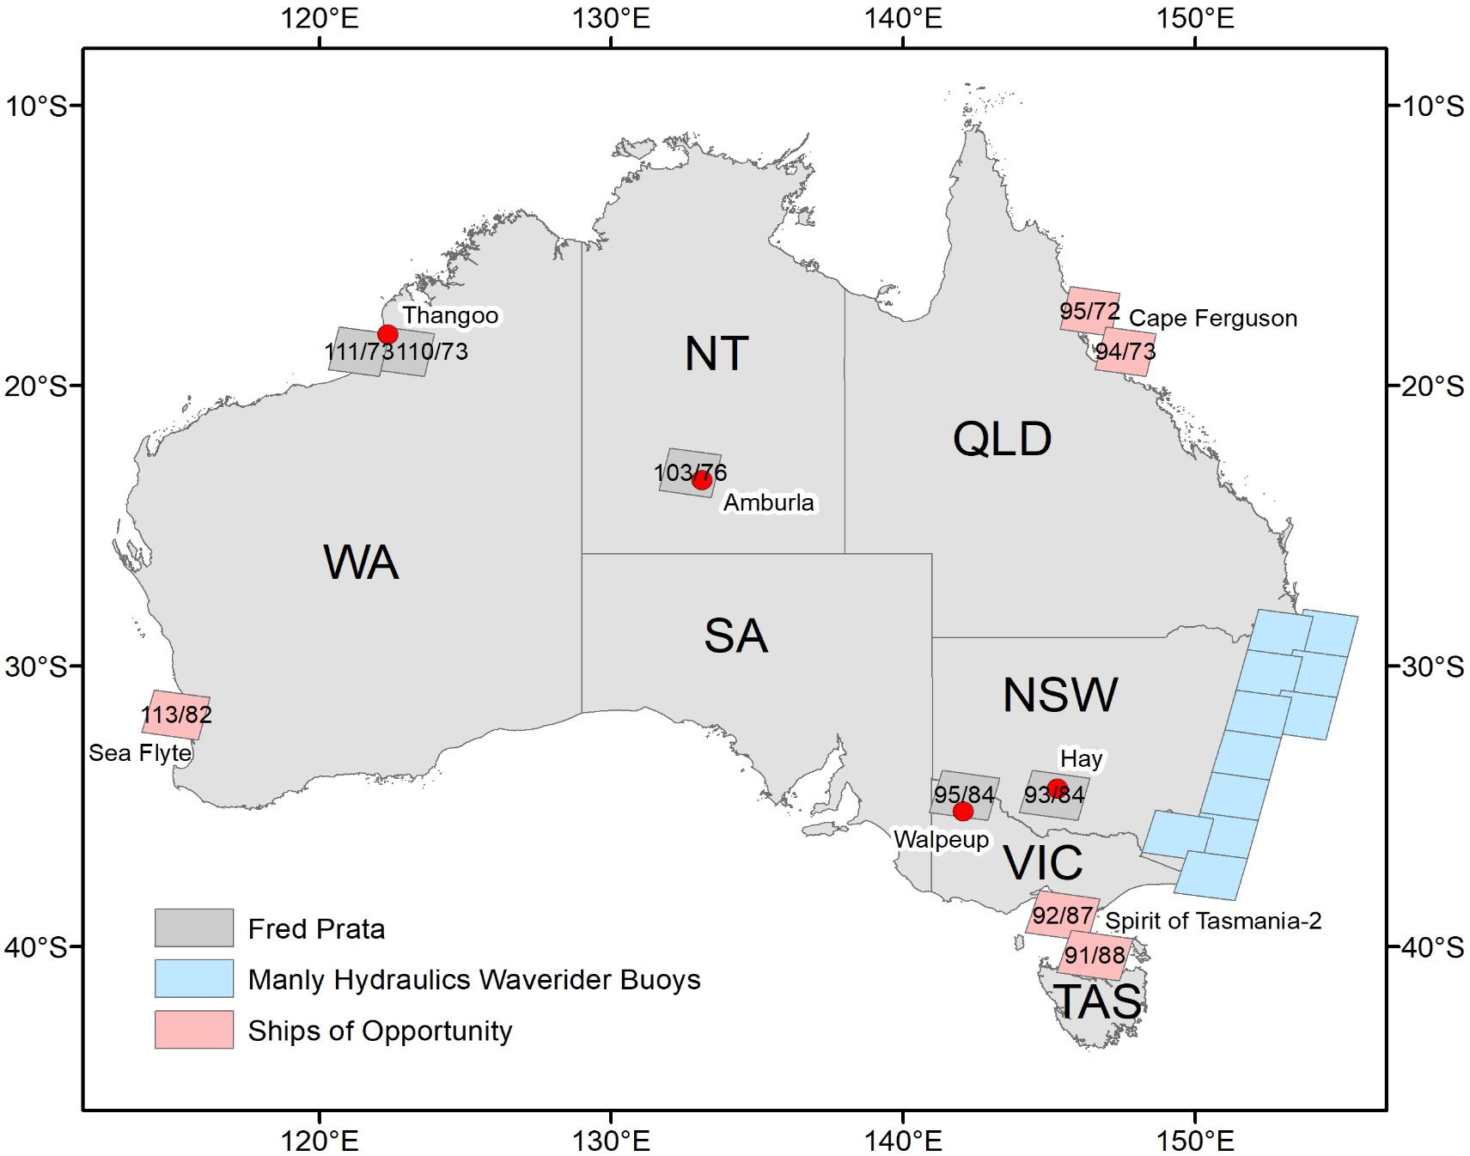
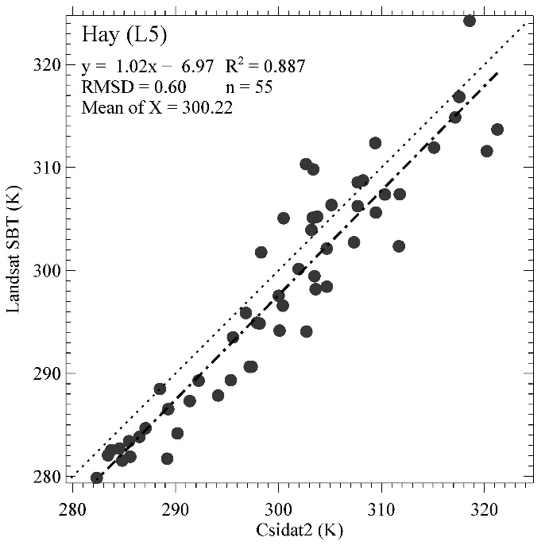
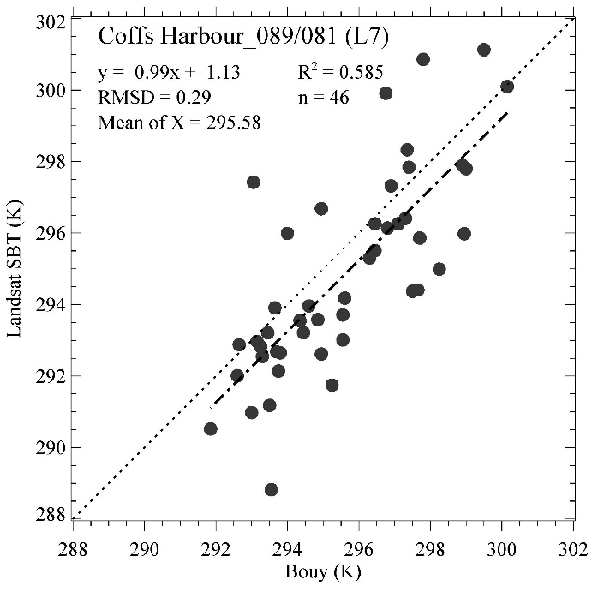
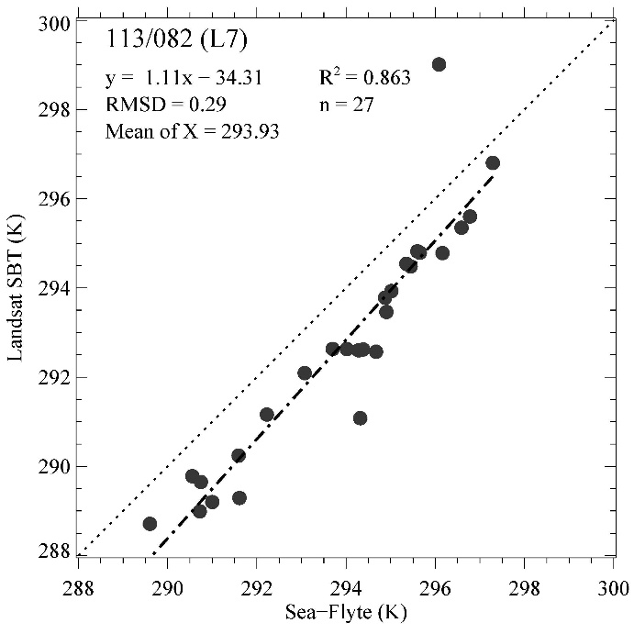
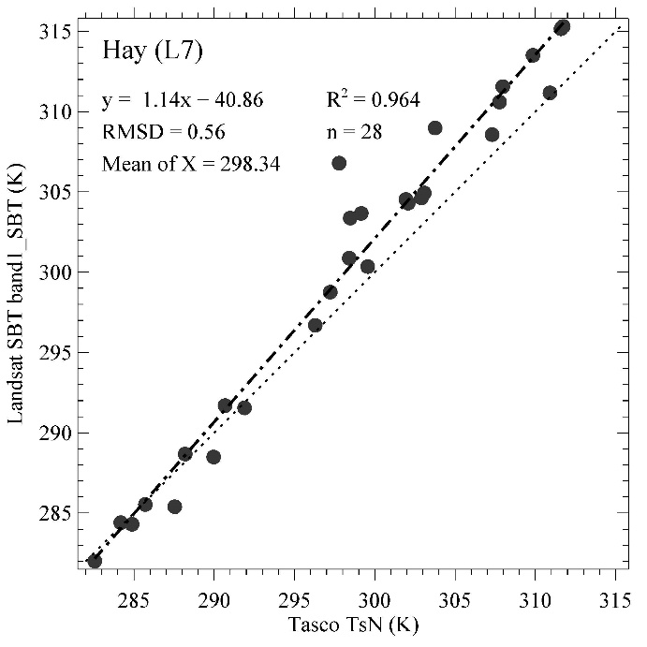
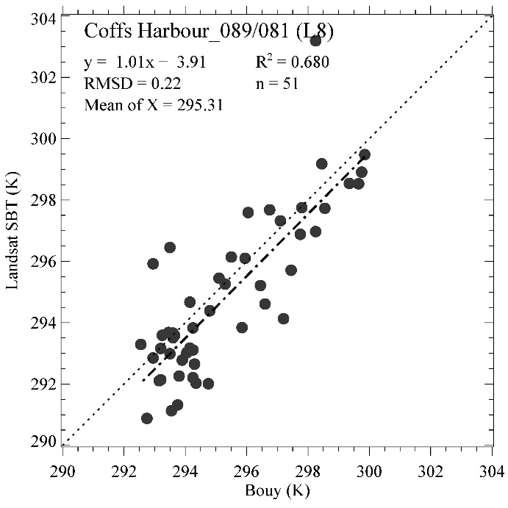
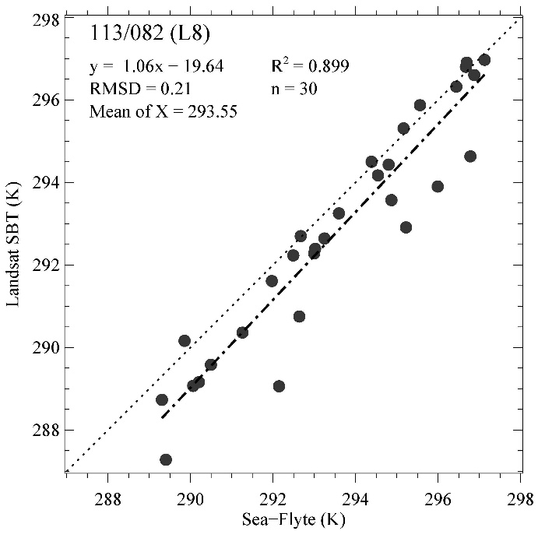
Surface Brightness Temperature
Validation
Ground Based Radiometer
Waverider Buoys
Ships of Opportunity
Independent validation of GA’s Landsat SBT product using field data
Tim R. McVicar, Lingtao Li, Alfredo ‘Fred’ J. Prata and Helen M Beggs
Ground Based Radiometer
Waverider Buoys
Ships of Opportunity

Slide 12
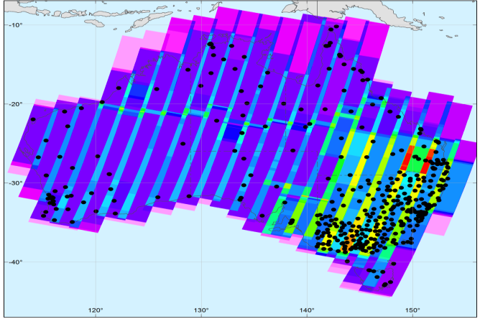
Operational ARD Processing for SAR
Scaling up processing of Sentinel-1 SAR ARD data in Australia through DEA
As part of the project GA is contributing to definitions for InSAR CARD4L products, working with LSI-VC:
  Interferograms (Wrapped / Unwrapped)
  Coherence
Workflow to be implemented for the Australian State of Victoria and validated for scaling up to a national product
Paper published in online journal - Data
Building a SAR-Enabled Data Cube Capability in Australia Using SAR Analysis Ready Data
Catherine Ticehurst, Zheng-Shu Zhou, Eric Lehmann, Fang Yuan, Medhavy Thankappan, Ake Rosenqvist, Ben Lewis and Matt Paget

Slide 13
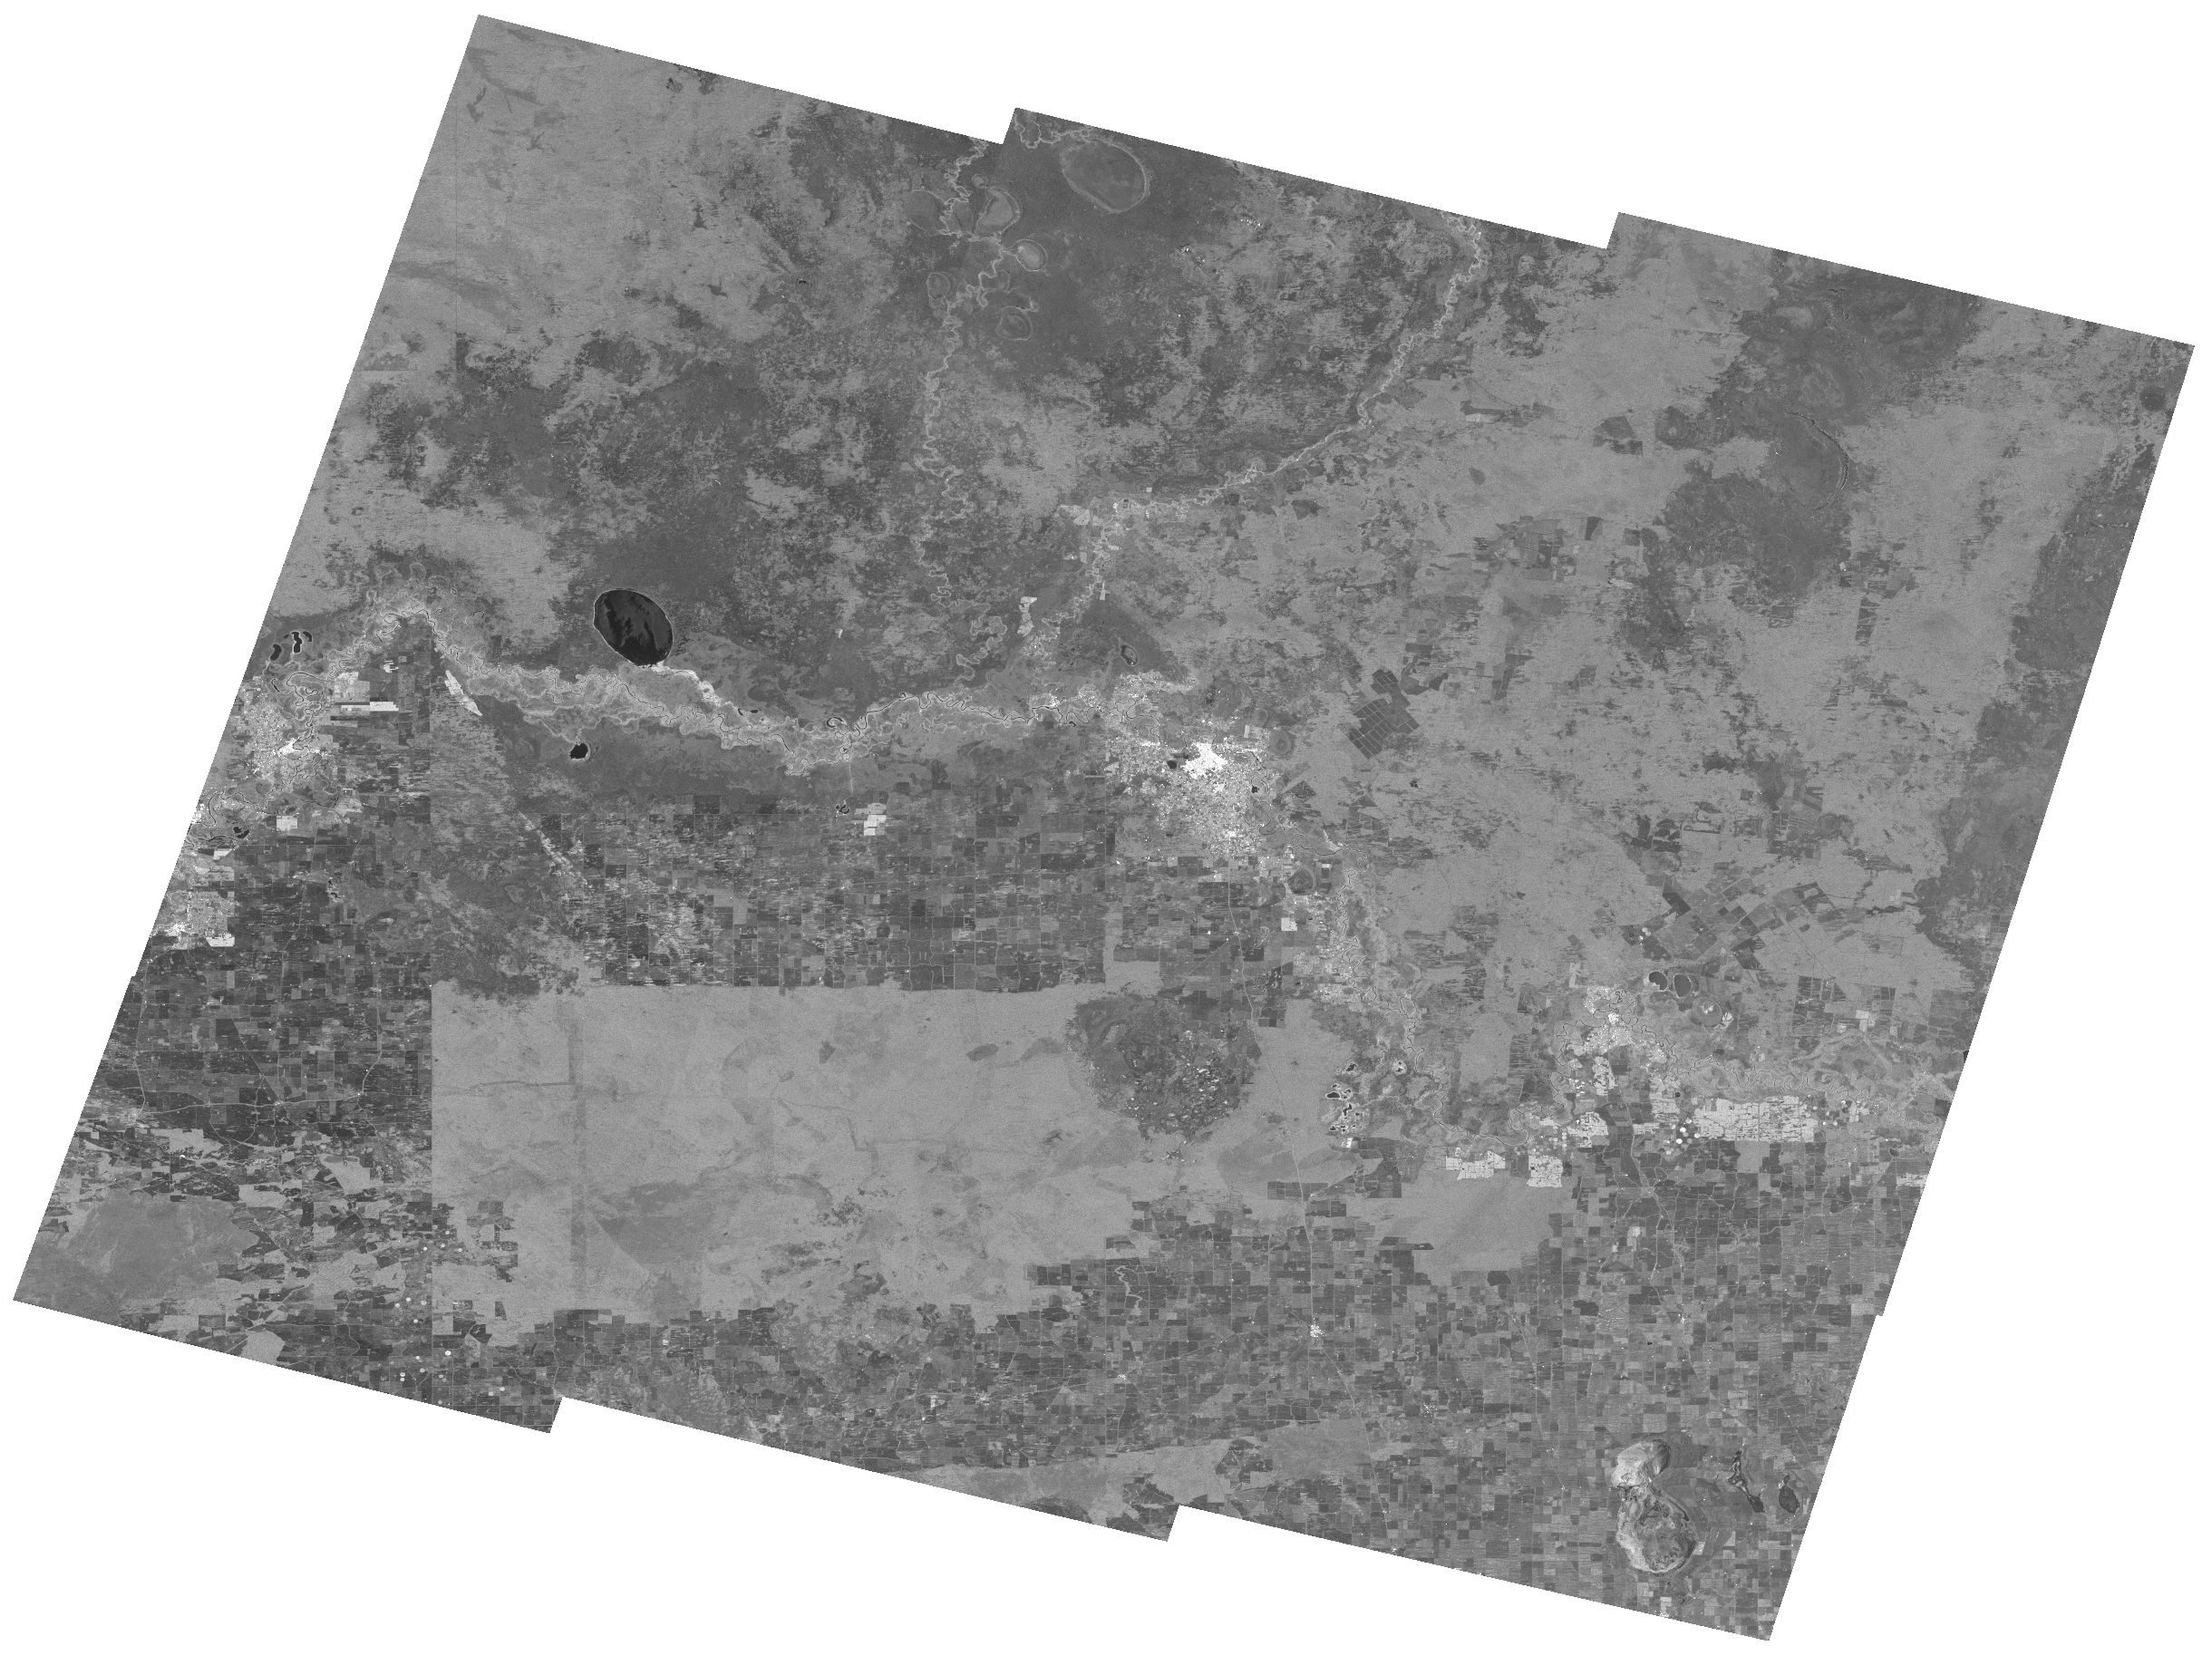
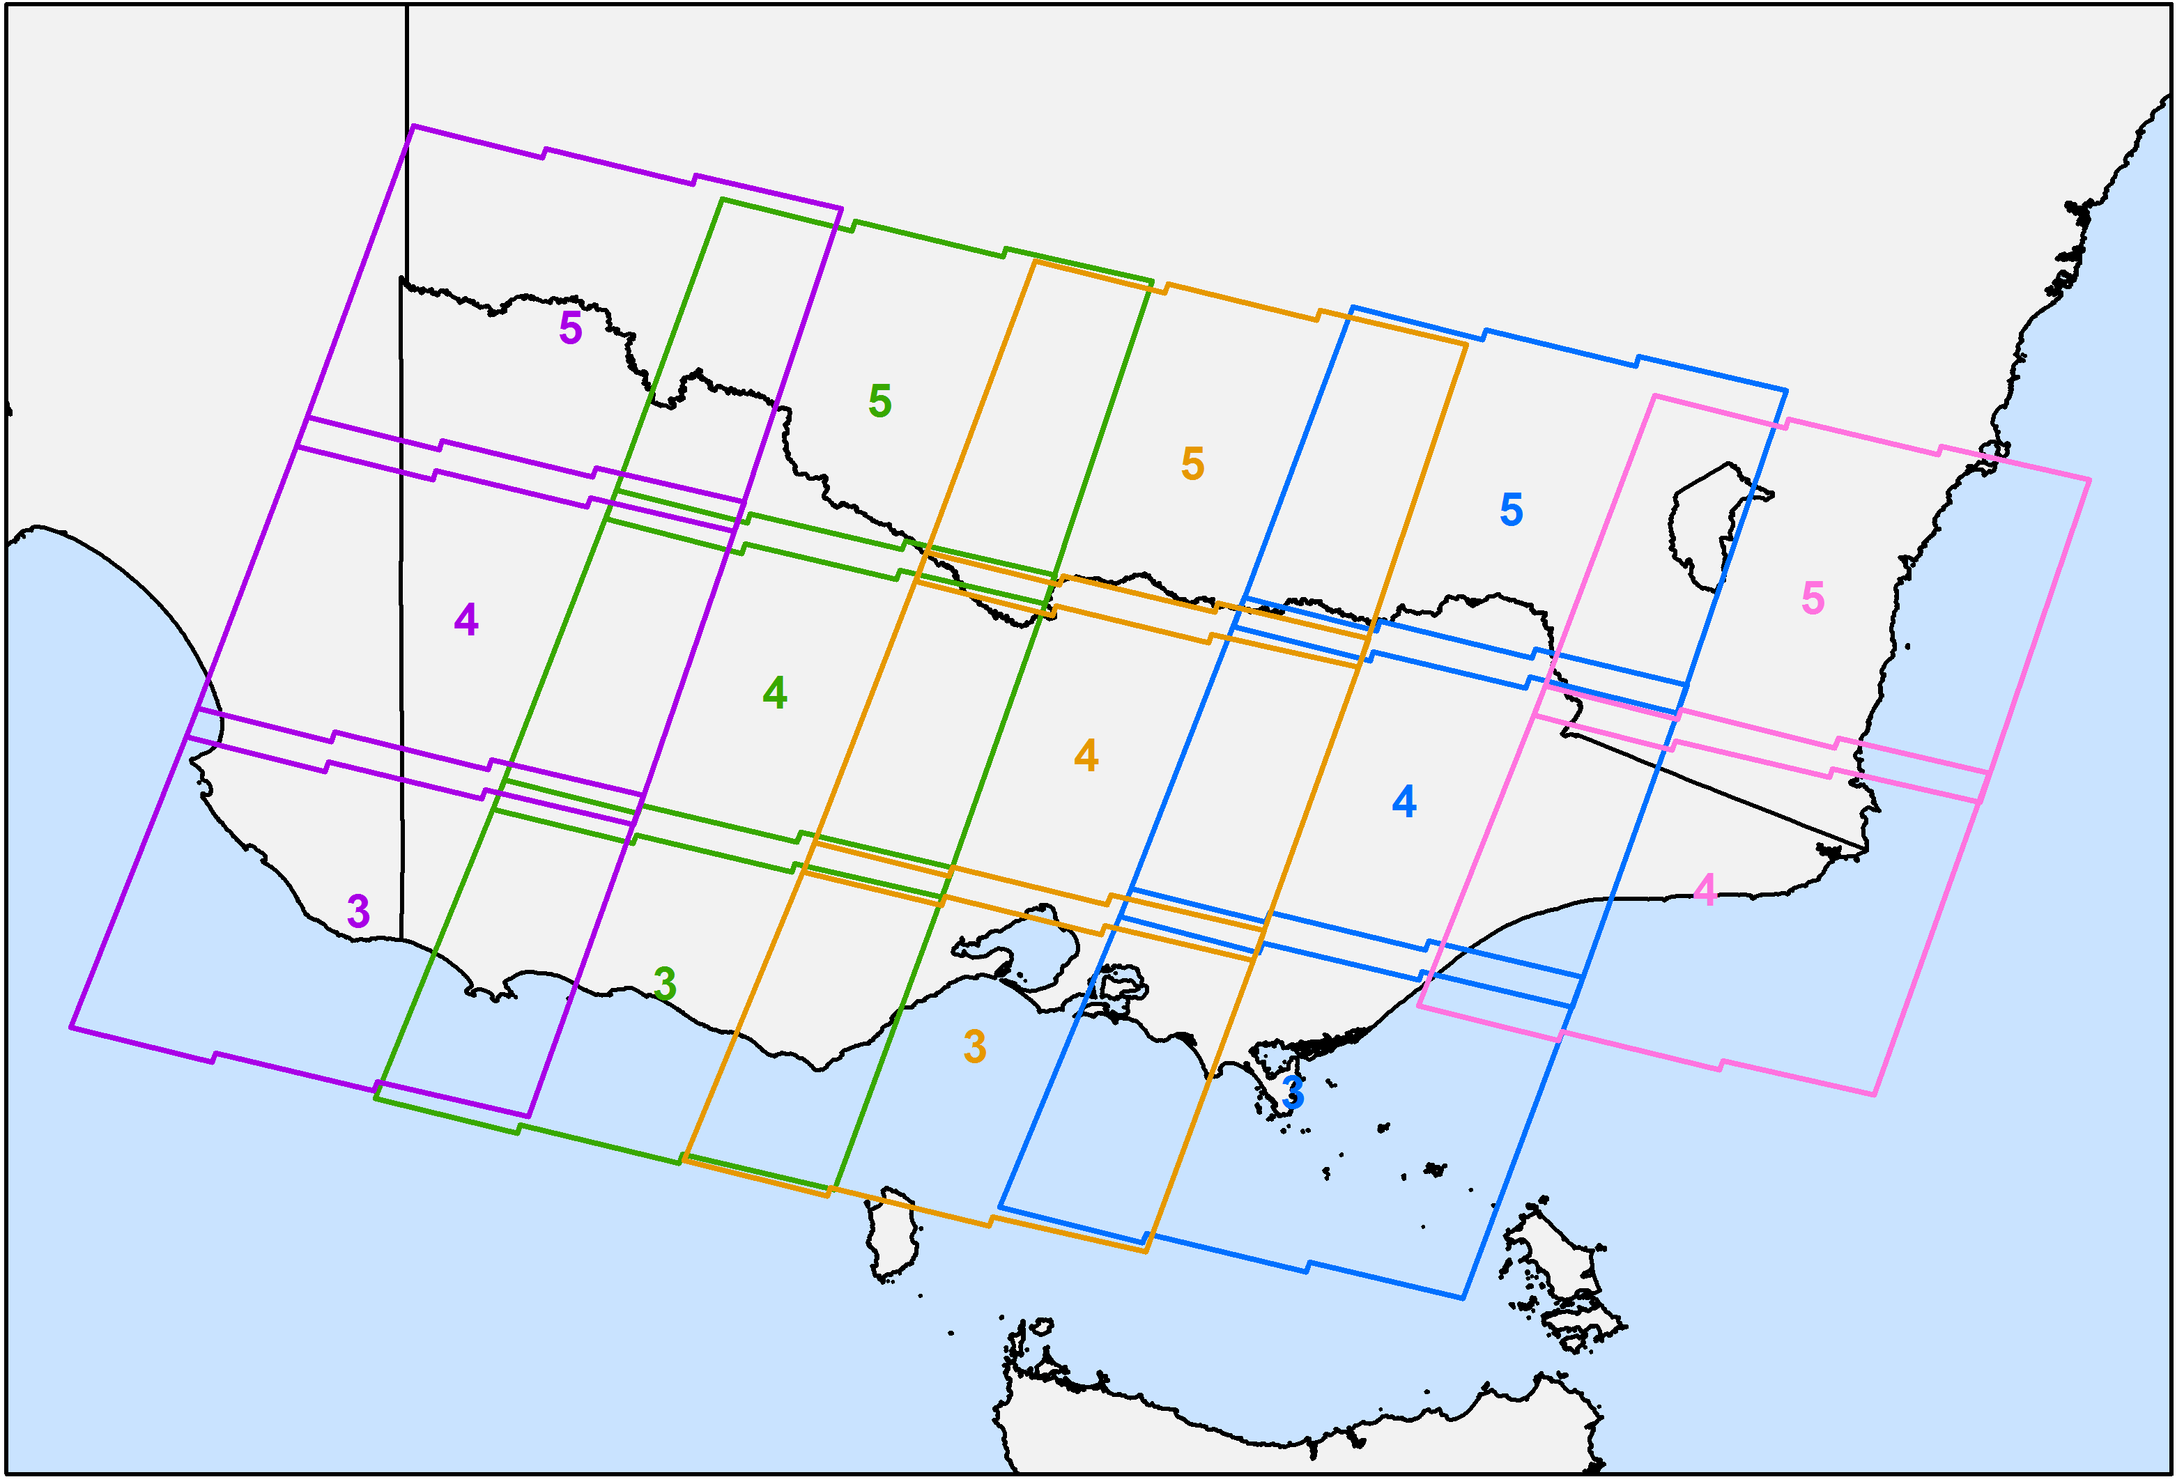
Example Radar Backscatter Product

Slide 14
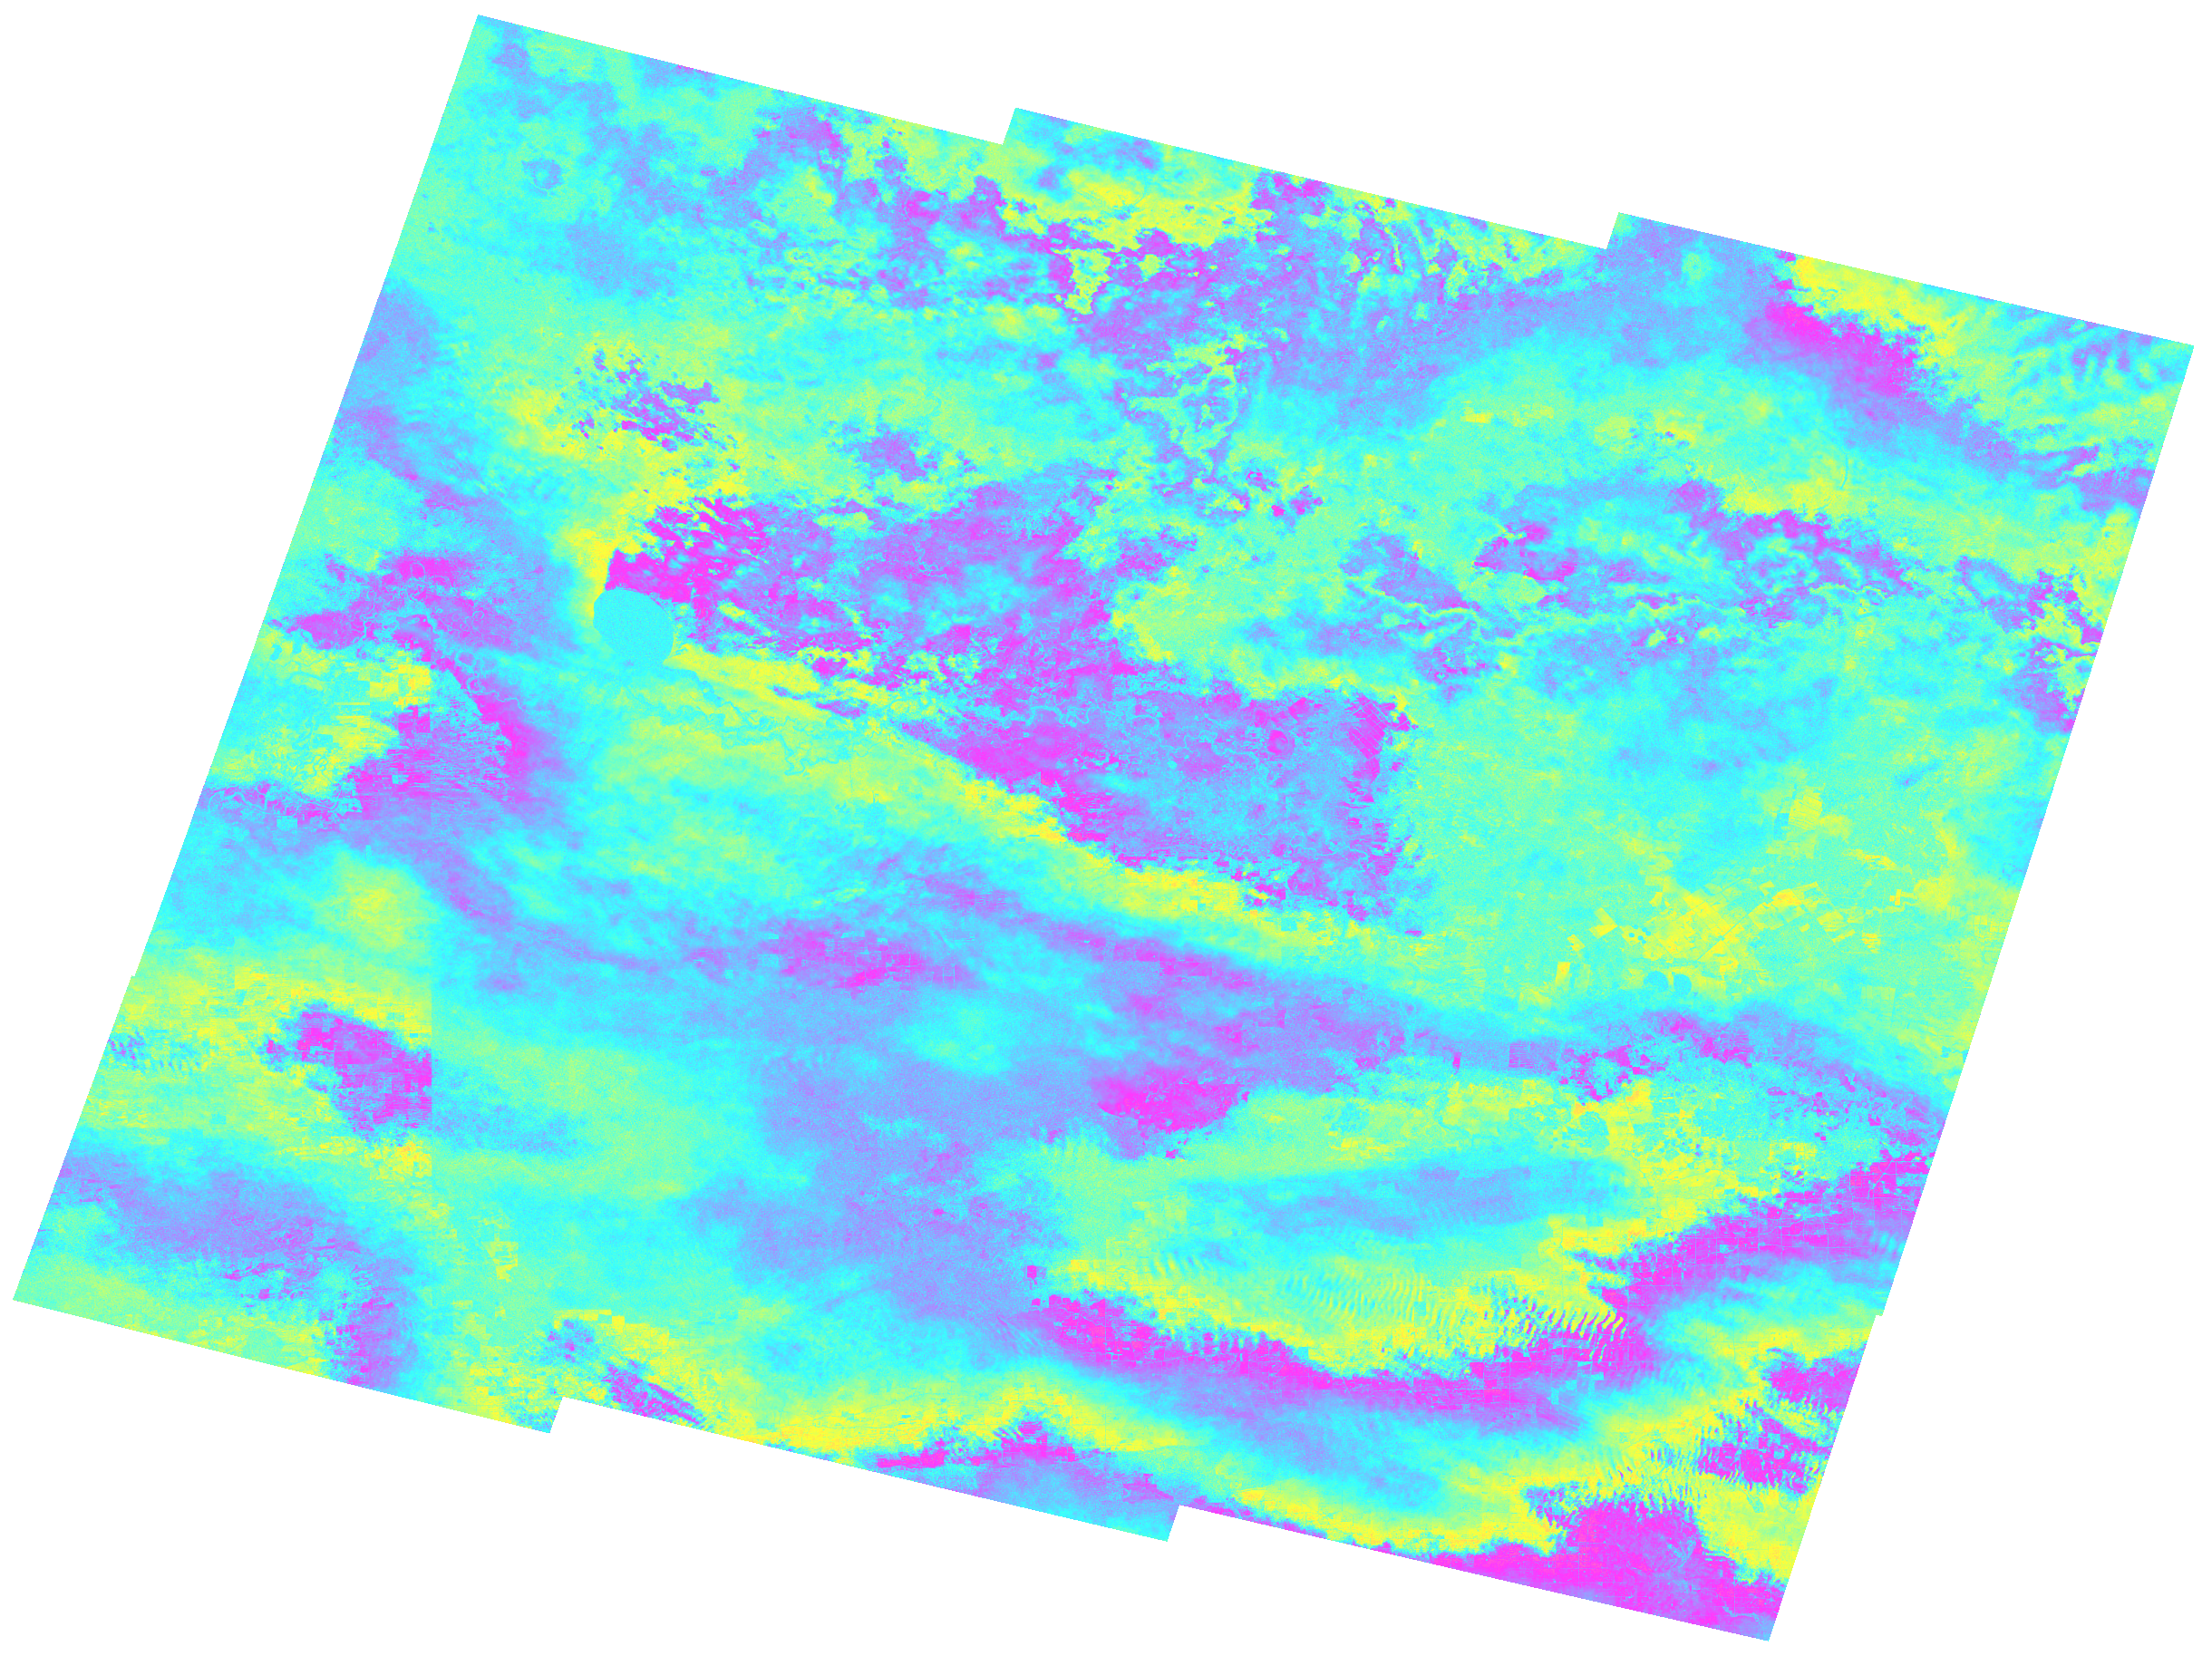
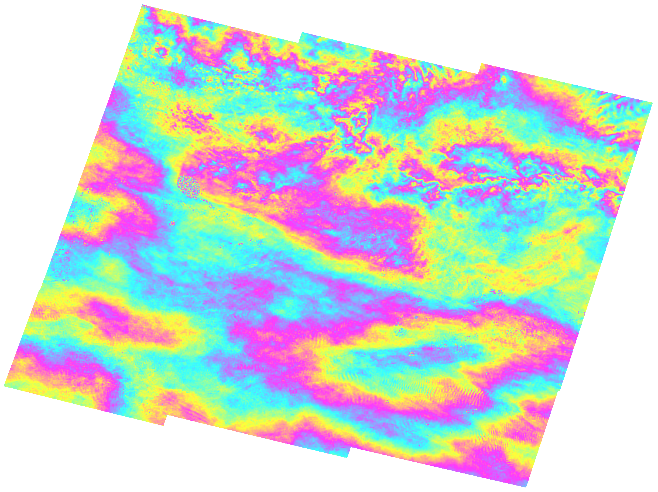
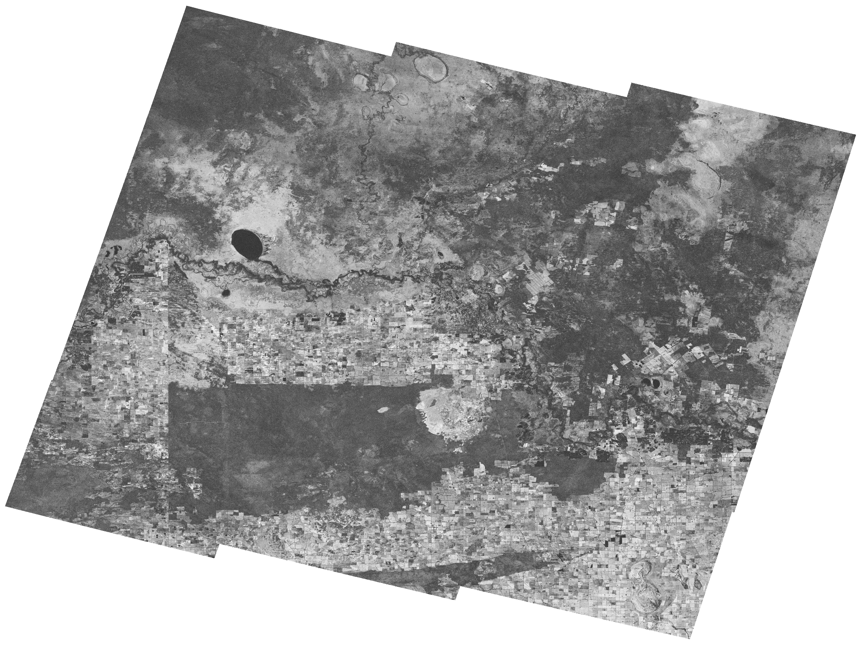
Example InSAR ARD Products
Wrapped interferogram
  Studying large deformation events e.g. earthquakes
  Time series analysis, using Persistent Scatterer algorithms
Unwrapped interferogram
  Time series analysis, using DInSAR-SBAS algorithms
Interferometric coherence
  Change detection, land-cover applications

Slide 15

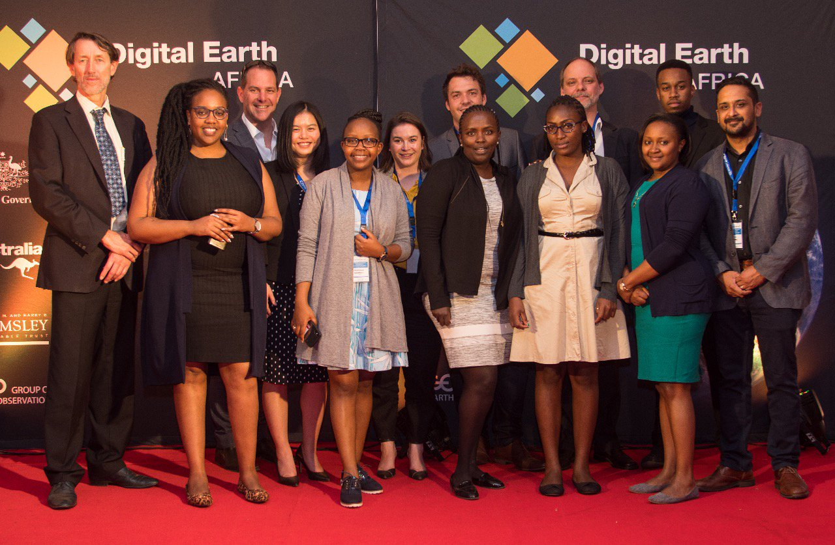
Digital Earth Africa
US based Helmsley Charitable Trust and the Australian Government have funded the establishment of DE Africa
Digital Earth Australia will provide technical and operational guidance
DE Africa will eventually be a sovereign operational and analytical capability for Africa with in-country expertise in EO data analysis and management

Slide 16
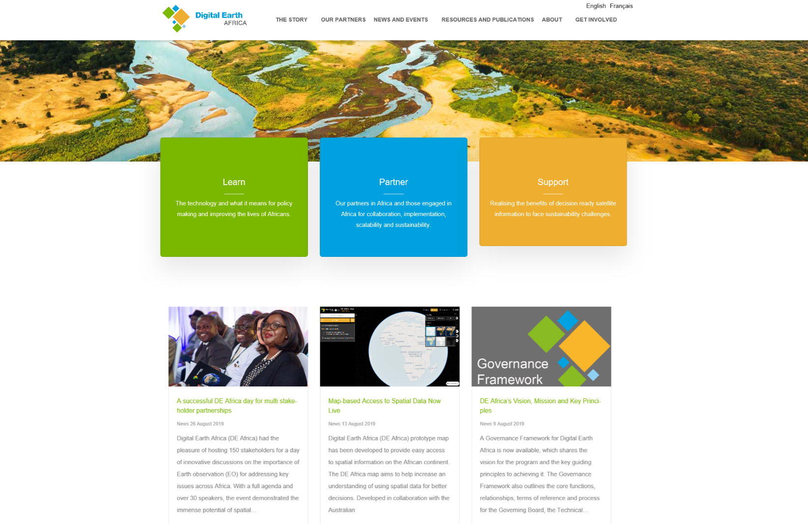
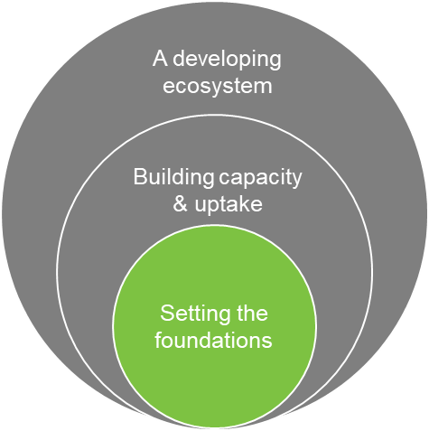
DE Africa: Current Status
https://www.digitalearthafrica.org/
Strategy and vision
Governance framework
Institutional hosting arrangements
Build data and infrastructure
Communications
Africa-wide events
Establish key partnerships with
in-country enablers and others
Investment Design
Basic technical foundation including data cube environment

Slide 17



Upcoming
DE Africa / FAO (SEPAL) meeting – Oct 2019
DE Africa GEO secondment - 2020
CSIRO / GA SIT Chair term from Oct 2019
GEO Week 2019 4-9 Nov 2019 Canberra

Slide 18
Questions
medhavy.thankappan@ga.gov.au

