Slide 1
JAXA EO Missions and Datasets Update LSI related activities Takeo Tadono (JAXA) Ake Rosenqvist (soloEO) for JAXA LSI-VC-8, Anchorage, AK, US. Sep 4-6, 2019
Committee on Earth Observation Satellites

Slide 2
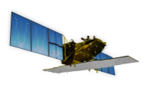
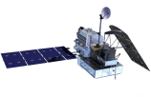
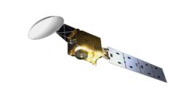
JAXA’s Satellites & Missions
As of September 2019
Targets (JFY) |  | 2014 | 2015 | 2016 | 2017 | 2018 | 2019 | 2020 | 2021 | 2022 | 2023 | 2024
Disasters & Resources
Climate Change & Water Cycle Water Cycle
Climate Change
GHGs
Technology Demonstration
Communications
[Land and disaster monitoring]
ALOS-2 / PALSAR-2
ALOS-4 (SAR)
ALOS-3 (Optical)
[1997〜2015]
TRMM / PR
[Precipitation 3D structure]
GPM / DPR
[2012〜]
[Wind, SST , water vapor, precipitation,]
GCOM-W / AMSR2
AMSR3
[Vegetation, aerosol, cloud, SST, ocean color]
GCOM-C / SGLI
[Cloud and aerosol 3D structure]
EarthCARE / CPR
[2009〜]
[CO_{2,} CH₄]
[CO_{2,} CH₄, CO]
GOSAT /FTS, CAI
GOSAT-2
GOSAT-3
SLATS
(Super Low Attitude Test Satellite)
[2008〜]
(Wideband InterNetworking engineering test
and Demonstration Satellite)
WINDS
ETS-9 (Engineering Test Satellite No.9)
Japanese Data Relay System (JDRS)
Mission status:
On orbit
( )
Development
Study
Extended Life Period

Slide 3
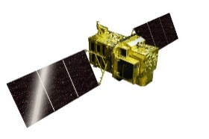
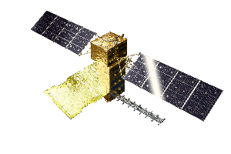
ALOS Series Missions
Continuous observations successor “Daichi” (ALOS) from 2006 to 2011
Contribute to ensure the safety and security of citizens, i.e. disasters monitoring and management, land deformation monitoring, national developing management, foods and natural resources, environmental issues in global etc. as common issues.
Contribute to industrial development based on Earth observation data i.e. National Spatial Data infrastructure (NSDI) and new applications.
JFY2014 | 2015 | 2016 | 2017 | 2018 | 2019 | 2020 | 2021
May 24
ALOS-2 (L-SAR)
Launch
Nominal Operation Review Meeting
Initial C/O
Initial Cal-Val
Product release
Mission operation (5 years)
Post-mission operation
ALOS-3
(Optical)
Development
Mission operation
(7 years)
ALOS-4
(L-SAR)
( )
Development

Slide 4
ALOS-2 - 2019
ALOS-2 and PALSAR-2 instrument status nominal
Completing 5 years in orbit. ALOS-2 entering “post-operational” phase from May 2019
Reduction of duty cycle from 50% to 30%
Impact on Basic Observation Scenario (BOS)
10 m dual-pol Fine Beam mode
Observations reduced to single global coverage per year at top priority
Additional observations planned at low priority → focus on Super Sites
50 m ScanSAR
No change.
Every 42-day repeat maintained

Slide 5
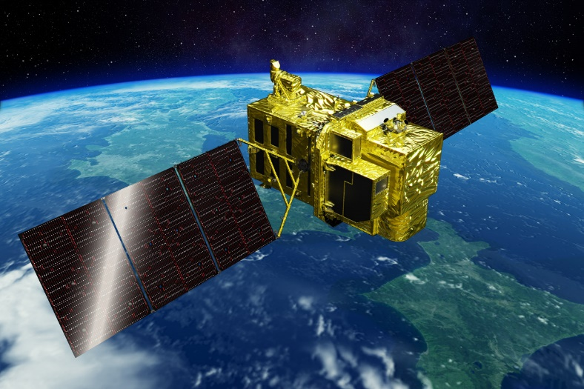
Advanced Optical Satellite (ALOS-3)
Items |  | Specifications
Orbit | Type | Sun-synchronous sub-recurrent
 | Altitude | 669 km at the equator
 | Local Sun Time | 10:30 am +/- 15 minutes at the descending node
 | Revisit | 35 days (Sub-cycle 3 days)
Instruments |  | - Wide-swath and high-resolution optical imager (WISH, as a tentative) - Dual-frequencies Infrared sensor (hosted payload)
Ground Sampling Distance (GSD) |  | - Panchromatic band of WISH (Pa): 0.8 m - Multispectral band of WISH (Mu): 3.2 m (6 bands)
Quantization |  | 11 bit / pixel
Swath width |  | 70 km at nadir
Mission data rate |  | Approx. 4 Gbps (after onboard data compression: 1/4 (Pa) and 1/3 (Mu))
Mission data downlink |  | - Direct Transmission: Ka and X-band - via. the Optical Data Relay Satellite
Mass |  | Approx. 3 tons at launch
Size |  | 5 m×16 m×3.5 m on orbit
Duty |  | 10 mins / recurrent
Design life time |  | Over 7 years
Phase D
Wide-swath and high-resolution optical imager

Slide 6
Characteristics of ALOS-3
Observation channel band allocations among optical satellites (visible to near-infrared).
Wavelength | 400 nm |  |  |  |  |  |  |  |  |  | 500 nm |  |  |  |  |  |  |  |  |  | 600 nm |  |  |  |  |  |  |  |  |  | 700 nm |  |  |  |  |  |  |  |  |  | 800 nm |  |  |  |  |  |  |  |  |  | 900 nm
 | 0 | 1 | 2 | 3 | 4 | 5 | 6 | 7 | 8 | 9 | 0 | 1 | 2 | 3 | 4 | 5 | 6 | 7 | 8 | 9 | 0 | 1 | 2 | 3 | 4 | 5 | 6 | 7 | 8 | 9 | 0 | 1 | 2 | 3 | 4 | 5 | 6 | 7 | 8 | 9 | 0 | 1 | 2 | 3 | 4 | 5 | 6 | 7 | 8 | 9 | 0 | 1 | 2 | 3 | 4 | 5 | 6 | 7 | 8 | 9
ALOS-3
Blue
Green
Red
Near-IR
Coastal
RedEdge
ALOS PRISM AVNIR-2
Blue
Green
Red
Near-IR
WorldView -2, 3
Blue
Green
Red
Near-IR1
Coastal
Yellow
RedEdge
Near-IR2

Slide 7
Advanced Land Observing Satellite-4 (ALOS-4)
Phase D
Solar array paddle
Launch | JFY 2020, H3 launch vehicle
Orbit | Same orbit as ALOS-2 Sun-synchronous sub-recurrent orbit Altitude: 628 km Inclination angle: 97.9 degree Local sun time at descending: 12:00 ± 15 min. Revisit time: 14 day (15-3/14 rev/day)
Lifetime | 7 years
Satellite Mass | approx. 3 tons
Downlink | 3.6 Gbps/1.8 Gbps (Ka-band)
Data recorder | 1 TByte
Mission Instruments | PALSAR-3 (Phased Array type L-band Synthetic Aperture Radar-3) SPAISE3 (SPace based AIS Experiment 3)
Prime contractor | Mitsubishi Electric Corporation
PALSAR-3
antenna
Ka-band DT antenna
SPAISE3
antenna

Slide 8
Characteristics of PALSAR-3
Expanding swath width without decreasing the resolution and image quality of PALSAR-2 by using the digital beam forming (DBF).
To guarantee the continuity of ALOS-2 applications, PALSAR-3 would inherit the major function and performance (NESZ, S/A, etc.) of PALSAR-2
The same reference orbit as ALOS-2
 | PALSAR-3 | PALSAR-2
Stripmap (res. 3/6/10 m) | 100-200 km | 30-70 km
ScanSAR (res. 25m*) | 700 km | 350-490 km
Spotlight (res. 1 x 3 m) | 35km×35km | 25km×25km
LST
Descending 12:00
Ascending 24:00
< 500 m
Repeat-pass
PALSAR-3
200 km × 1 beam
PALSAR-2 beam U2: 50 km × 4 beam
*single look nominal

Slide 9
InSAR Capability between PALSAR-2 and PALSAR-3
Master/slave of InSAR pair |  | ALOS-4 |  | ALOS-2
 |  | Stripmap 100/200 km | ScanSAR 700 km | Stripmap 50/70 km | ScanSAR 350/490 km
ALOS-4 | Stripmap 100/200 km | ○ | ○ | ○ | ○
 | ScanSAR 700 km | ○ | ○ | ○ | ×
ALOS-4 reference orbit is the same as ALOS-2
Controlling accuracy is within +/- 500 m (= small baseline)

Slide 10
JAXA’s EO Data Distribution Plan
Promote Open and Free
Principle available spatial resolution
10 meter resolution or coarser
Enhance provision of available products on the internet
To be open upon processed
ALOS/AVNIR-2 Global → ALOS PALSAR Global
G-Portal (Standard Products)
JJ-FAST, JASMES, JASMIN（for GFOI, GEOGLAM）
ARD or CARD4L compliant by format conversion software

Slide 11
JAXA’s EO Data Open & Free Plan
Satellite/ Sensor |  | Before | NOW
MOS/JERS/ADEOS/ADEOS-2/ AMSR-E/TRMM |  | ○ | ○
GOSAT |  | ○ | ○
GCOM-W and GCOM-C |  | ○ | ○
GPM |  | ○ | ○
ALOS | AVNIR-2 (10m) | ー | ○
 | PALSAR (10m, 100m) | ー | ○
 | DSM (30m) | ○ | ○
 | Annual Global Forest map / mosaic (25m) | ○ | ○
ALOS-2 | ScanSAR (50m) | ー | Partially
 | Fine mode (10m) | ー | Under Negotiation with PD

Slide 12
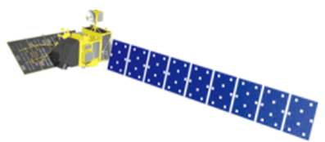
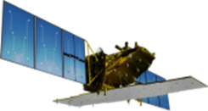
[Last time] Schedule of ALOS/ALOS-2 Data Processing and Open Free Access
As of February 2018
 |  | 2018 |  |  |  | 2019
 |  | 1Q Jan Mar | 2Q Apr Jun | 3Q Jul Sept | 4Q Oct Dec | 1Q Jan Mar | 2Q Apr Jun | 3Q Jul Sept | 4Q Oct Dec
ALOS | AVNIR-2 (10 m)
 | PALSAR (10 m)
ALOS-2 | ScanSAR (100 m)
 | Fine Mode (10 m)
Japan Area
±60
Degree Area
Global
Data Processing
Japan Area
±60
Degree Area
Global
Data Processing
on Supercomputer
JICA-JAXA JJ-FAST intermediate products (ARD) processing
Data Processing
Under negotiation with PD

Slide 13
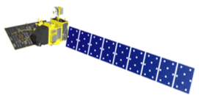
Schedule of ALOS/ALOS-2 Data Processing and Open Free Access
As of September 2019
 |  | 2019 |  |  |  | 2020
 |  | 1Q Jan Mar | 2Q Apr Jun | 3Q Jul Sept | 4Q Oct Dec | 1Q Jan Mar | 2Q Apr Jun | 3Q Jul Sept | 4Q Oct Dec
ALOS | AVNIR-2 (10 m)
 | PALSAR FBS, FBD, POL (10-20 m) ScanSAR (100 m)
ALOS-2 | PALSAR-2 ScanSAR (50 m)
 | PALSAR-2 Fine Mode (10 m)
±60
Degree Area
Global
Data Processing
±60
Degree Area
Global
Preparation
on Supercomputer
JICA-JAXA JJ-FAST intermediate products (ARD) processing
Data Processing
Under negotiation with commercial data provider

Slide 14
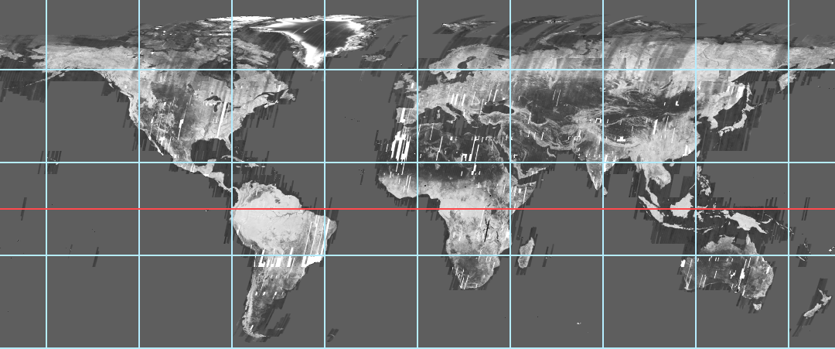
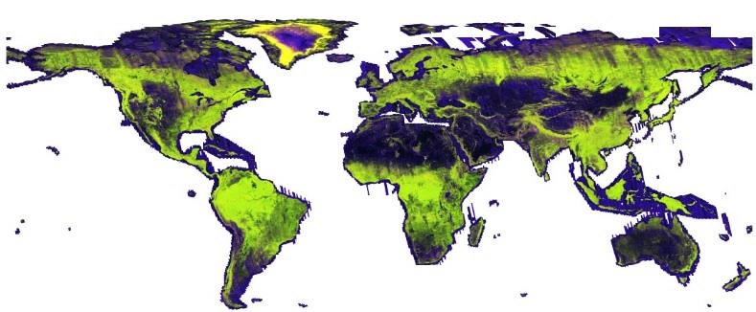
GFOI Core Data Set –
25 m L-band SAR Mosaics and Forest/Non-Forest Maps
Annual global mosaics and Forest/Non-Forest (FNF) map
JERS-1 (1996) ~ ALOS (2007-2010) ~ ALOS-2 (2014-2017) → Over 20 years changes
• HH backscatter (gamma-0) 16 bits
• HV backscatter (gamma-0) 16 bits
• Mask image (no-data, water, layover, shadowing.) 8 bits
• Local incidence angle image, 8 bits BYTE
• Observation date image (DN = days after mission launch) 16 bits
• Forest/Non-forest map
1996 JERS-1
(only HH-pol.)
2007-2010 ALOS
2015-2017
ALOS-2

Slide 15
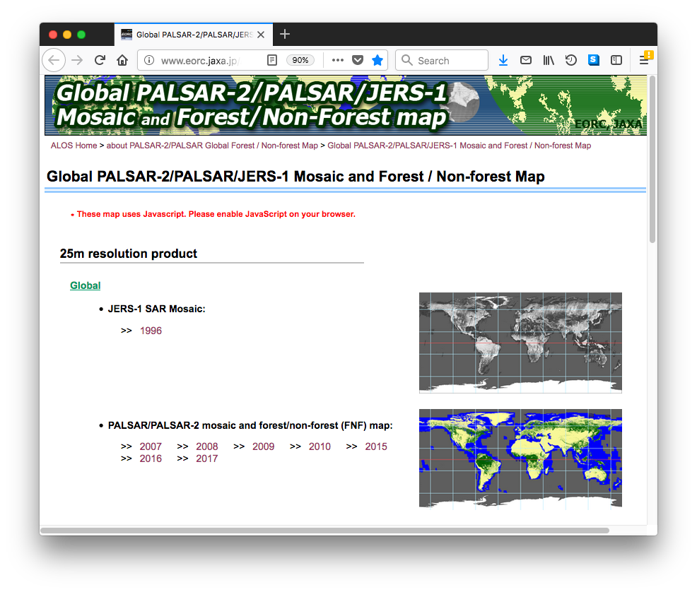
GFOI Core Data Set –
25 m L-band SAR Mosaics and Forest/Non-Forest Maps
Global coverage
PALSAR-2 2018 (release
Q4 2019)
PALSAR-2 2017
PALSAR-2 2016
PALSAR-2 2015
PALSAR 2007 – 2010
JERS-1 ~1996
Free download at:
https://www.eorc.jaxa.jp/ALOS/en/palsar_fnf/fnf_index.htm

Slide 16
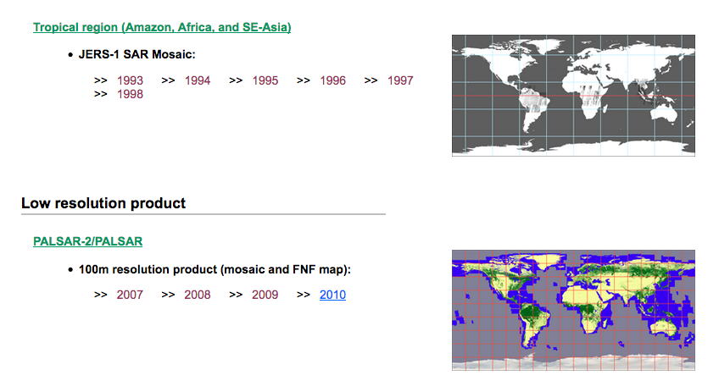
GFOI Core Data Set –
25 m L-band SAR Mosaics and Forest/Non-Forest Maps
Regional (pan-tropical) coverage (25m)
JERS-1: 1996 – 1998
Global low resolution (100m) coverage
JERS-1: 1996 – 1998
Free download at:
https://www.eorc.jaxa.jp/ALOS/en/palsar_fnf/fnf_index.htm

Slide 17
Summary
JAXA’s EO missions and dataset processing status updated:
ALOS-2 is working well, and entering to post-operation phase
ALOS-3/-4 are to be launched in JFY2020 (~Q1/2021)
Clarify Open & Free data policy
Whole PALSAR scene-bases data reprocessing started, and will be completed by mid/2020
CEOS ARD for Land (CARD4L):
Started from SAR Global Mosaics: reprocessing started
Compliant as much as possible: PALSAR, PALSAR-2…
Something will be considered for optical: AVNIR-2, ALOS-3

