Slide 1
ESA update
for LSI-VC
Ferran Gascon
LSI-VC-8, Anchorage (USA), 4-6 September 2019

Slide 2
Copernicus – continue global leadership in EO
> 225.000
6 operational services
registered users
= tip of the iceberg
Land
Atmosphere
Ocean
Climate
Disaster
Security
7 satellites flying
250 TB satellite data distributed per day
S1 | S2 | S3 | S4 | S5P | S5 | S6
●● | ●● | ●● |  | ●
full, free & open data policy
preparing Copernicus 2.0
Notes:
This infographic captures the key elements of the Copernicus EO system 🡺 explain a few.
Copernicus is the Reference Backbone for an integrated EO observing system and, it is an excellent example of European global leadership in space.
Copernicus enables us to provide a routine health check of our planet.

Slide 3
Sentinel-1 mission status
Sentinel-1A and Sentinel-1B mission operations 🡪 nominal
Sentinel-1 contribution to emergency activations, in particular from the Copernicus Emergency Management Service, continues to be very high, for flood monitoring in particular
A dedicated campaign aiming at demonstrating the monitoring of hurricanes over seas / oceans has been successfully conducted
Sentinel-1 is operated close to its full mission capacity (i.e. difficulty to accommodate additional observations)
A slight increase of the SAR operating time duty cycle constraint has started (outside 3-month eclipse season), mainly allowing to further stabilise the observation scenario

Slide 4
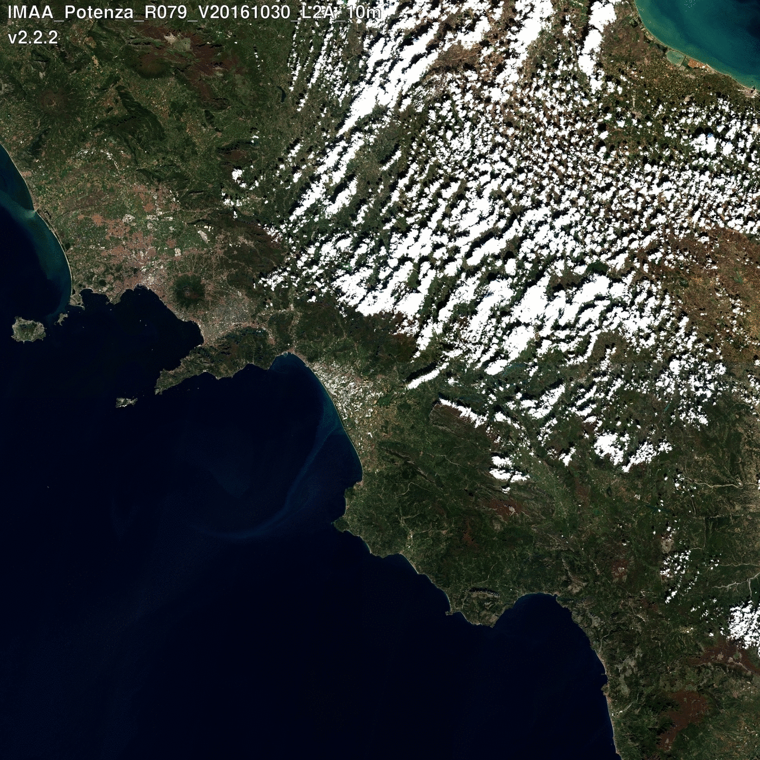
Sentinel-2 Mission Status
Nominal Sentinel-2 constellation operations with Sentinel-2A and Sentinel-2B.
Routine provision of Sentinel-2 data to operational services
Level-2A surface reflectance product generated worldwide systematically since 13 December 2018.
Good health of both Sentinel-2A and Sentinel-2B satellites.
Sentinel-2 is operated beyond the initially required observation scenario.
Example of Level-2A surface reflectance versus Level-1C (top-of-atmosphere)
Copyright: Contains modified Copernicus Sentinel data (2018)

Slide 5
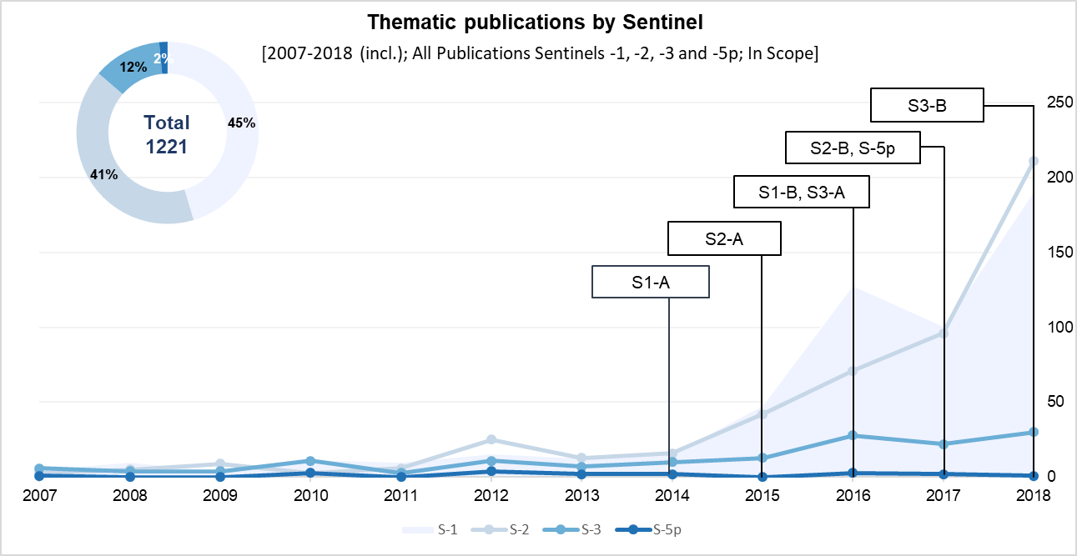
Sentinel-2 Thematic Journal Publications
For Sentinel-2, the bulk of the publications focus on Agriculture and Land Ecosystems, followed by Forests and Inland Water.
Copernicus study by EARSC “Exploring sectoral uptake of Sentinel data within academic publications”

Slide 6
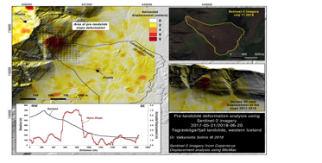
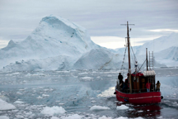
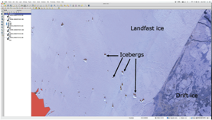
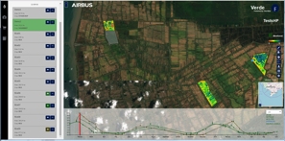
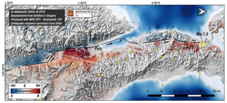
Large range of new applications...
Iceberg Monitoring
Smart Farming on cloudy regions
Ground motion
(in complement of S1)

Slide 7
Mission Outlook (up to 2020 yearly review)
2019 Q3: Level-2A on-demand service for Copernicus Services and later to all.
2019 Q3: Extension of Observation Scenario (Sentinel HLOP update).
2019 Q4: Start of the geometry-refined production using the Global Reference Image (GRI).
2020: Usage of improved DEM for Level-1C and Level-2A productions.
Improvement of Level-1C and Level-2A products.
On-line products anomaly database with Application Program Interface (API).
Definition of the orbital configuration with Sentinel-2C.
Generation of Level-2F demonstration fused product.

Slide 8
Mission Outlook / Level-2F demonstration product
Objective: To combine S2 with Landsat in a single fused data stream with S2 characteristics in terms of spatial resolution and spectral response.
S2 L2A
BRDF Adjustment
L2F
L8 L1T
Geometric Processing
Atmospheric Correction
BRDF Adjustment
Band-pass
Adjustment
Fusion

Slide 9
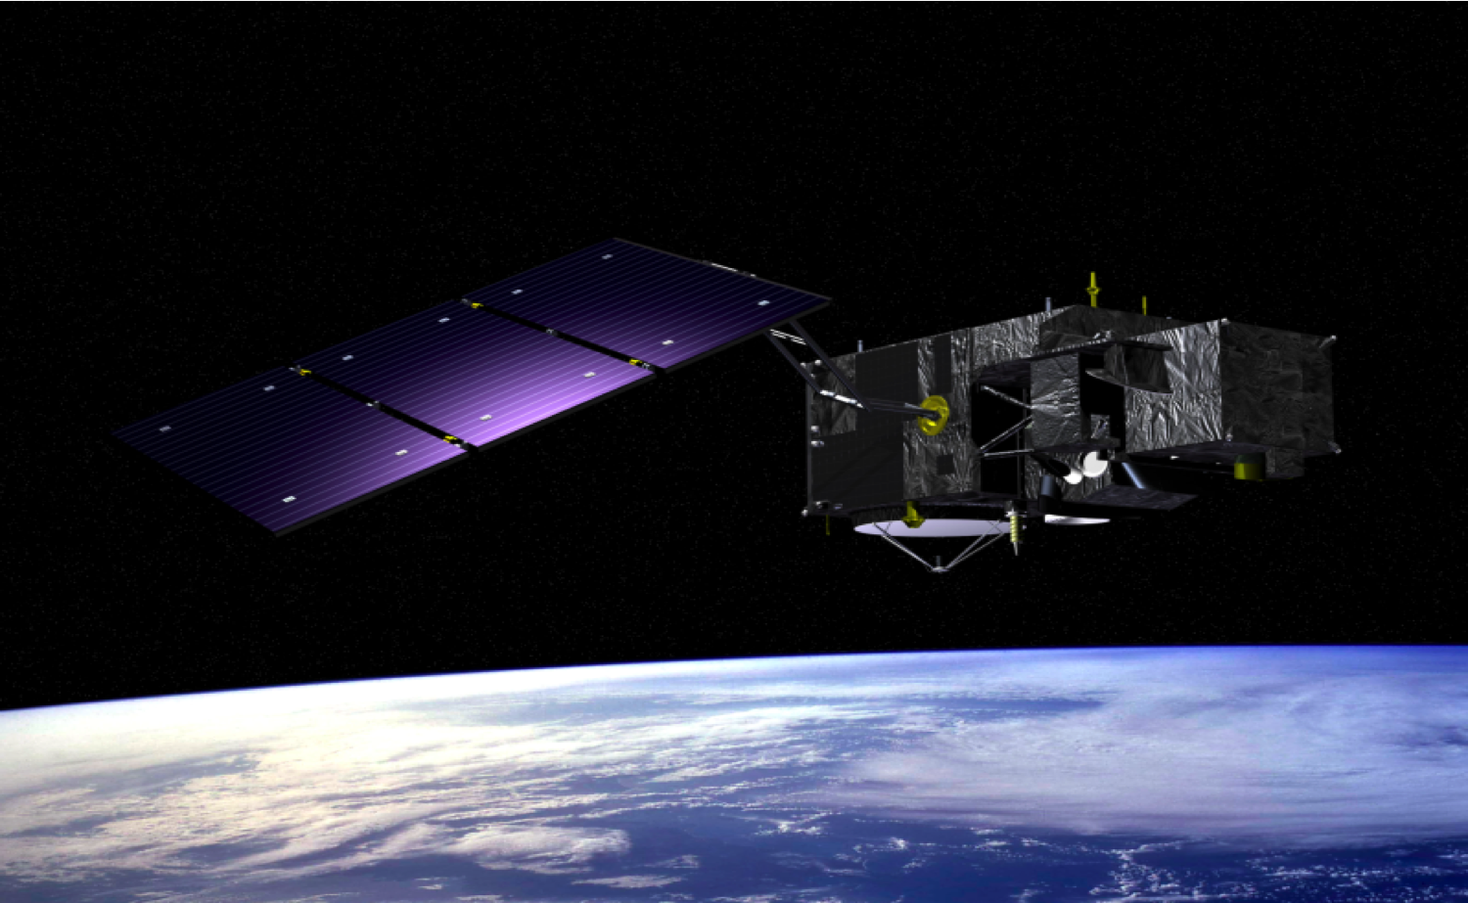
Sentinel-3 mission status
Sentinel-3A mission operations 🡪 nominal
New Level 2 synergy products released in October 2018
The definition and implementation of two new core data products, the Aerosol Optical Depth (AOD) and Fire Radiative Power (FRP) is on-going with sample products expected to be available in 2019.
Reprocessing activities are on-going:
For SRAL, a full mission reprocessing (starting from March 2016) has been completed for both the Land and the Marine products. The Land products release is scheduled for Q4 2018.
For SLSTR, Level 1 and 2 data reprocessing started in June 2018 and was completed in September 2018, including an updated cloud masking. The release is planned for Q4 2018.
For OLCI a full mission reprocessing from April 2016 has been carried out and made available to users in September 2018.

Slide 10
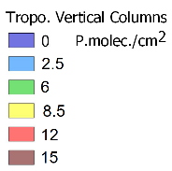
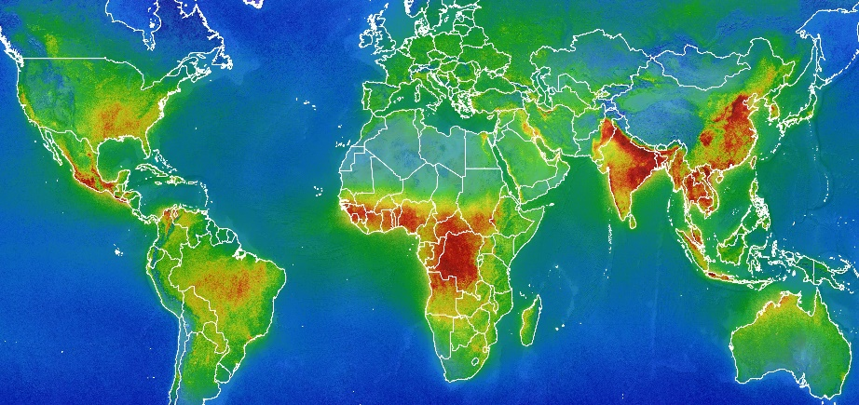
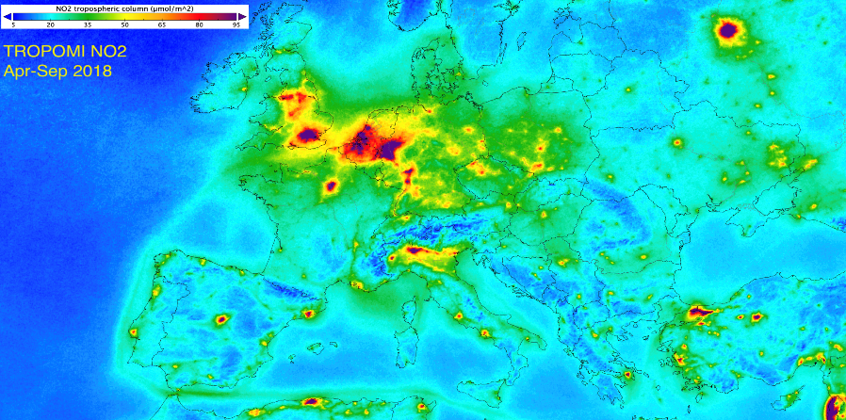
Sentinel-5 Precursor mission status
HCHO
Sentinel-5 Precursor mission operations
🡪 nominal, with on-going ramp-up of data availability
First data released in July 2018:
Total Columns of Ozone (O3),
Nitrogen Dioxide (NO2),
Carbon Monoxide (CO),
Cloud & Aerosol information
New data released in October 2018:
Sulfur Dioxide (SO2, in NRT),
Formaldehyde (CH2O, in NRT)
TROPOMI HCHO:
Nov 2017 – Oct. 2018
Credits – BIRA
Credits – KNMI

Slide 11
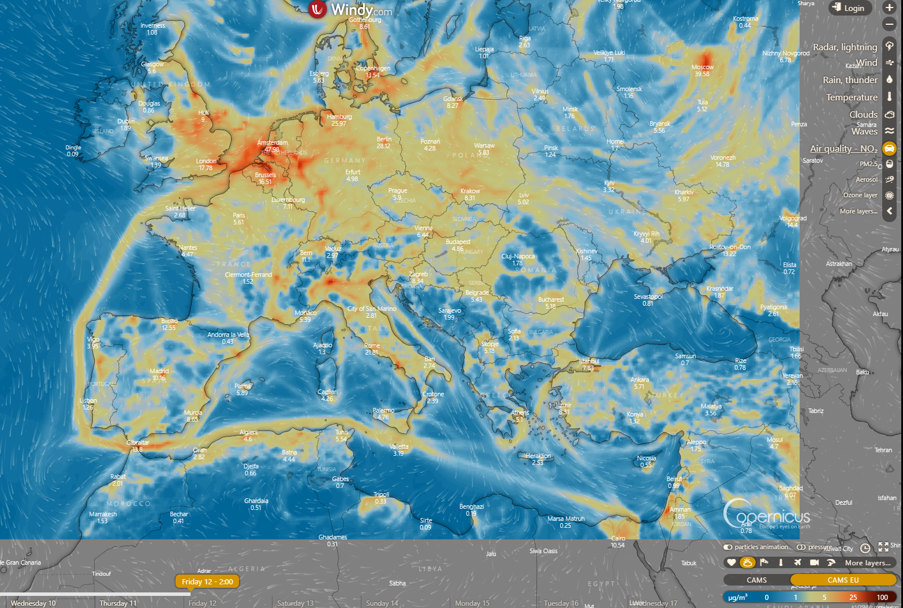
Sentinel-5P
NO2
CAMS – EU
https://www.windy.com

Slide 12
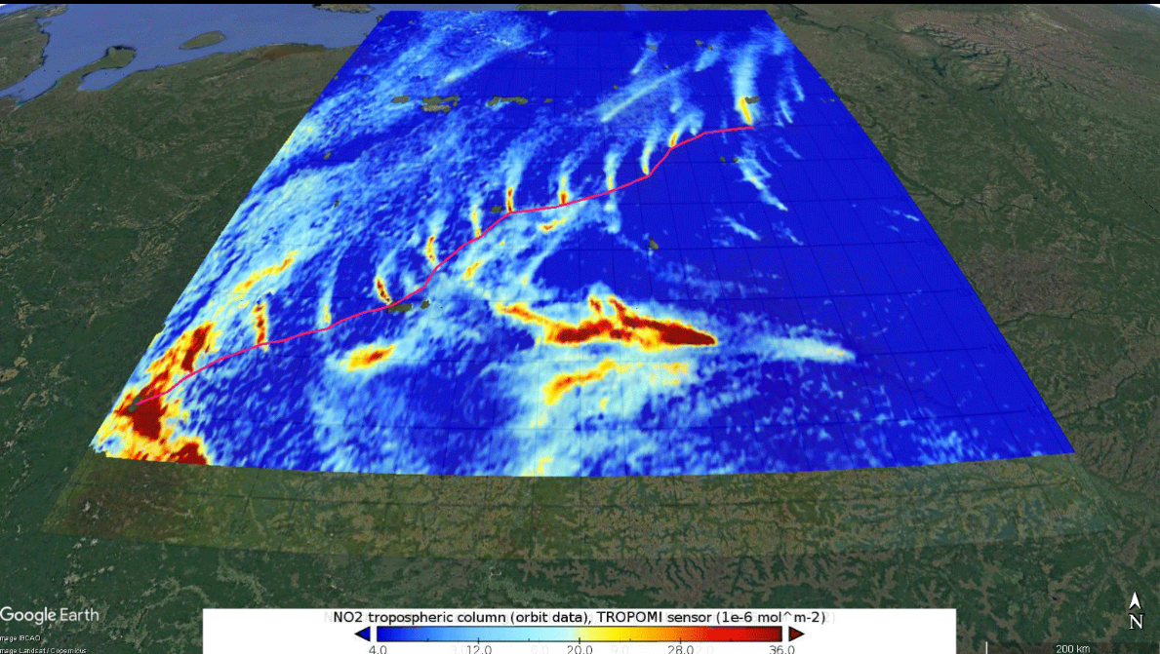
The Urengoy–Pomary–Uzhhorod pipeline is one of Russia’s main natural gas export pipelines. In order to maintain the pressure and flow over long distances, a series of compressor stations are strategically placed to help push the gas along.

Slide 13
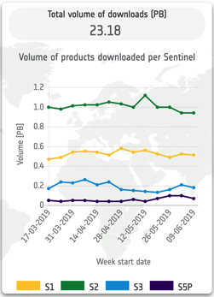
Data Access
Private companies re-distributing Sentinel products through free and pay-per-use schemes
Copernicus Data Hubs
Collaborative mirror sites
International partners mirror sites disseminating towards own national communities

Slide 14
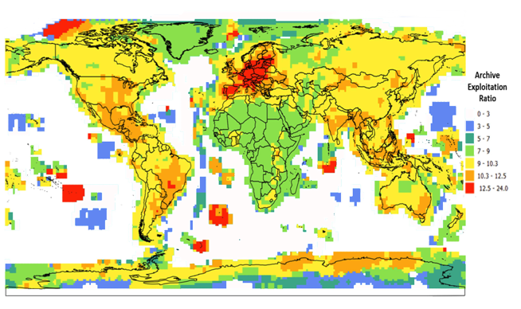
Data Access / Archive Exploitation Ratio
Available online

Slide 15
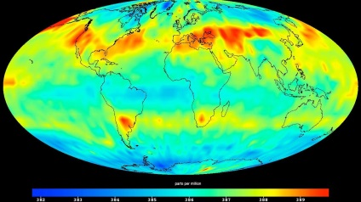
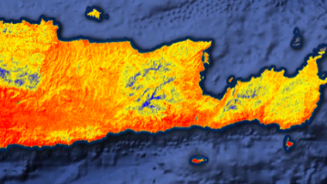
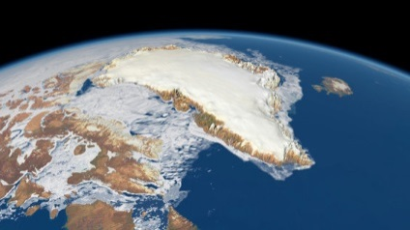
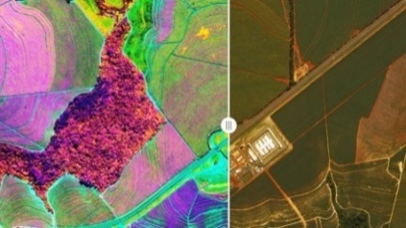
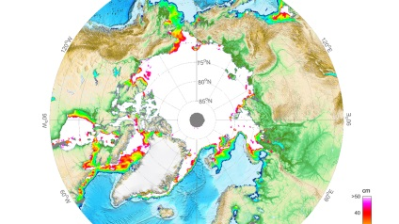
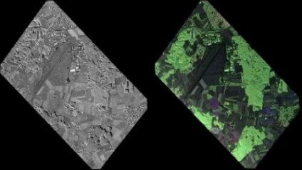
Copernicus 2.0 – 6 High Priority Candidate Missions
 | Monitor causes of Climate Change 🡺 CO₂ Imaging Spectrometer |  | Agriculture & Water Productivity 🡺 High Res. Surface Temperature
 | Monitor effects of Climate Change 🡺 Polar Ice & Snow Topography |  | Food Security, Soil & Minerals, Biodiversity 🡺 Hyperspectral Imaging
 | Sea Ice Conc. & SST 🡺 Passive Microwave Imaging |  | Vegetation & Ground Motion & Moisture 🡺 L-band SAR
Notes:
Kick-Off & Progress
Potential Sentinel expansion system study activities initiated
End-to-end performance simulation campaigns
Scientific studies in support of mission requirements definition
Pre-developments of most critical technologies.
Copernicus Long Term Scenario
20 new spacecraft
6 new mission domains: CO₂ imaging spectrometry, thermal / hyperspectral / microwave imaging, etc.
Integration of NewSpace and national mission data
Sophisticated, operational data access
Cost Estimate for Space: 8 Bn Euro (EU MFF + ESA CM)
CM19 proposal: 1,4 bn Euro (+0,6 bn at CM22/25)

Slide 16
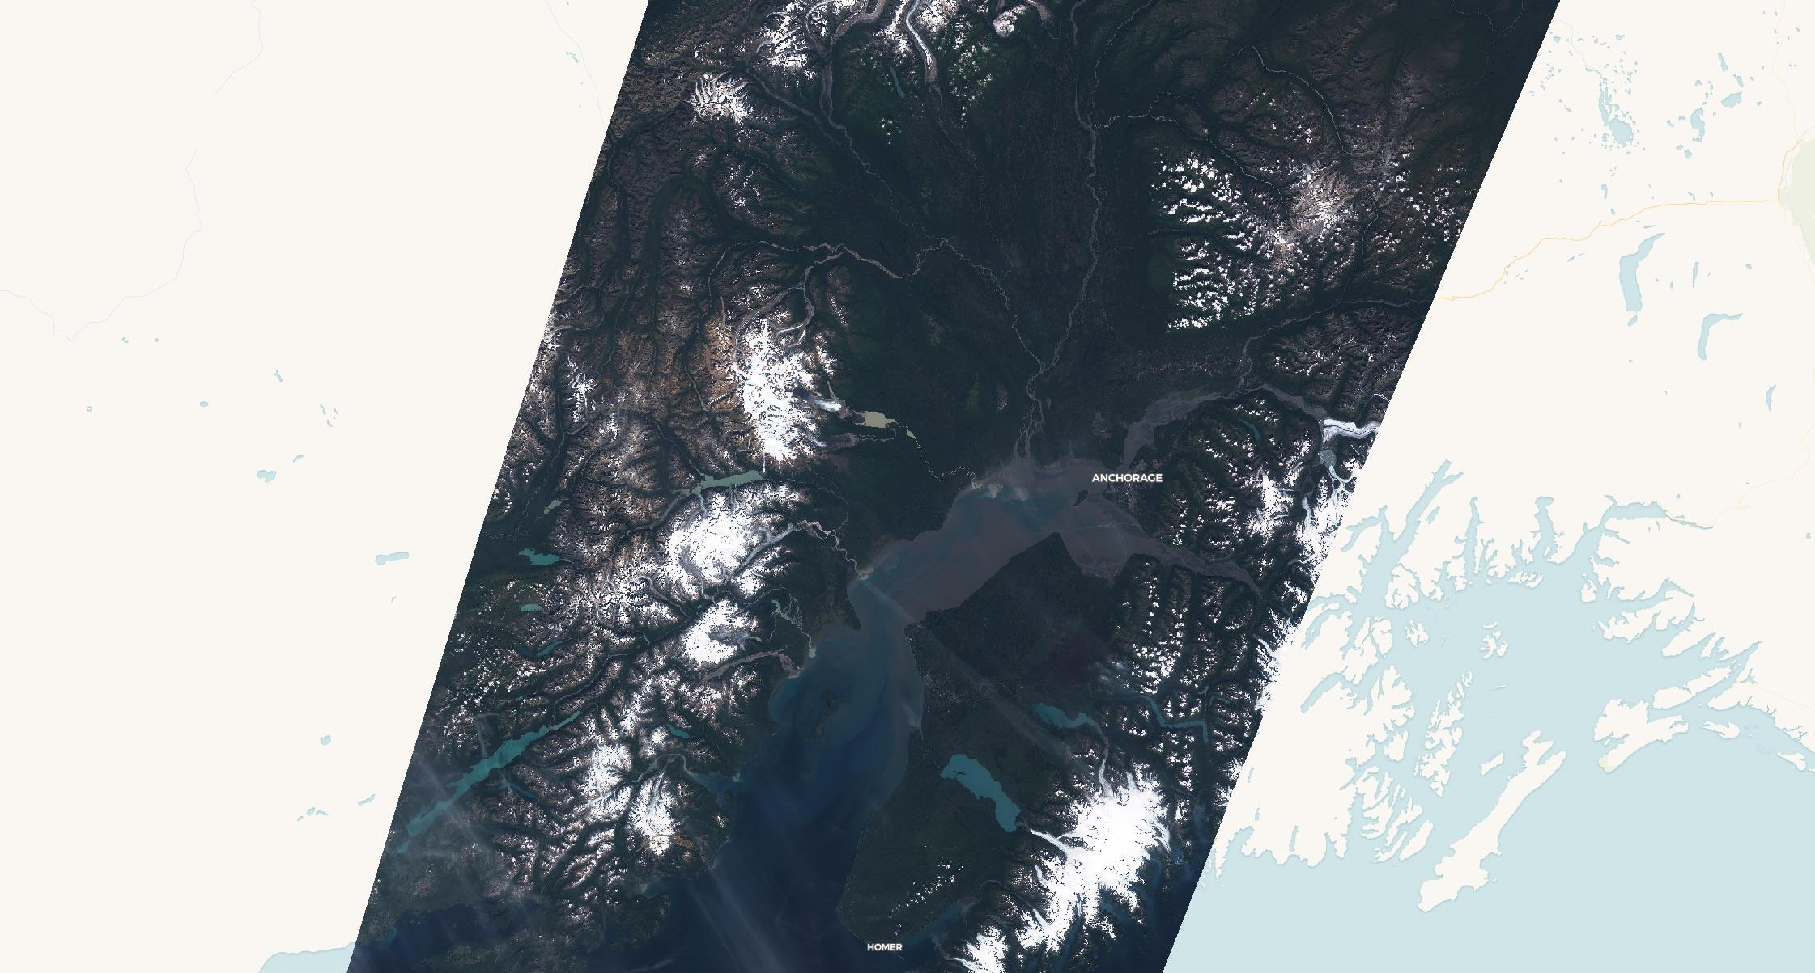
Anchorage by Setinel-2, 11/08/2019

