Slide 1

EO Data Coordination,
CEOS, & EAVs for GEOGLAM
Alyssa K. Whitcraft, on behalf of GEOGLAM EO Data Thematic Team
Joint LSI-VC Meeting, 5 September 2019
Anchorage Alaska

Slide 2

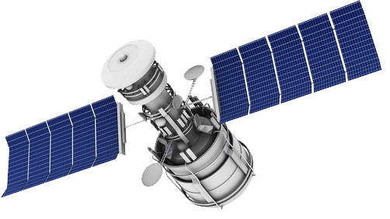
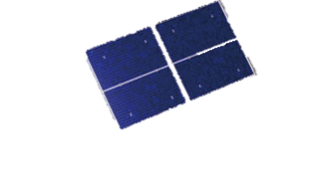
In-situ Data
AgroMet Data
Crowd-sourcing
Public Space Sector
(CEOS)
Commercial Space Sector
EO Data Coordination
Acquisition
Access
Continuity
Operational R&D
Method Development &
Improvement
Food Security
Early Warning
SUSTAINABLE DEVELOPMENT
Research-to-Operations
Capacity Development for EO
Food Production
Markets & Trade
CLIMATE CHANGE
Strengthened
Monitoring Systems
National • Regional • Global
FOOD SECURITY
Outlooks for Markets & Trade
Vulnerability & Impact Assessments
National & International Food Policy
Science-Based Information
Decision • Policy • Action
Support to
Food Aid Organizations
Agricultural Subsidies
Insurance & Investments
G20 Action Plan on Food Price Volatility & Markets
UN Sustainable Development Goals

Slide 3
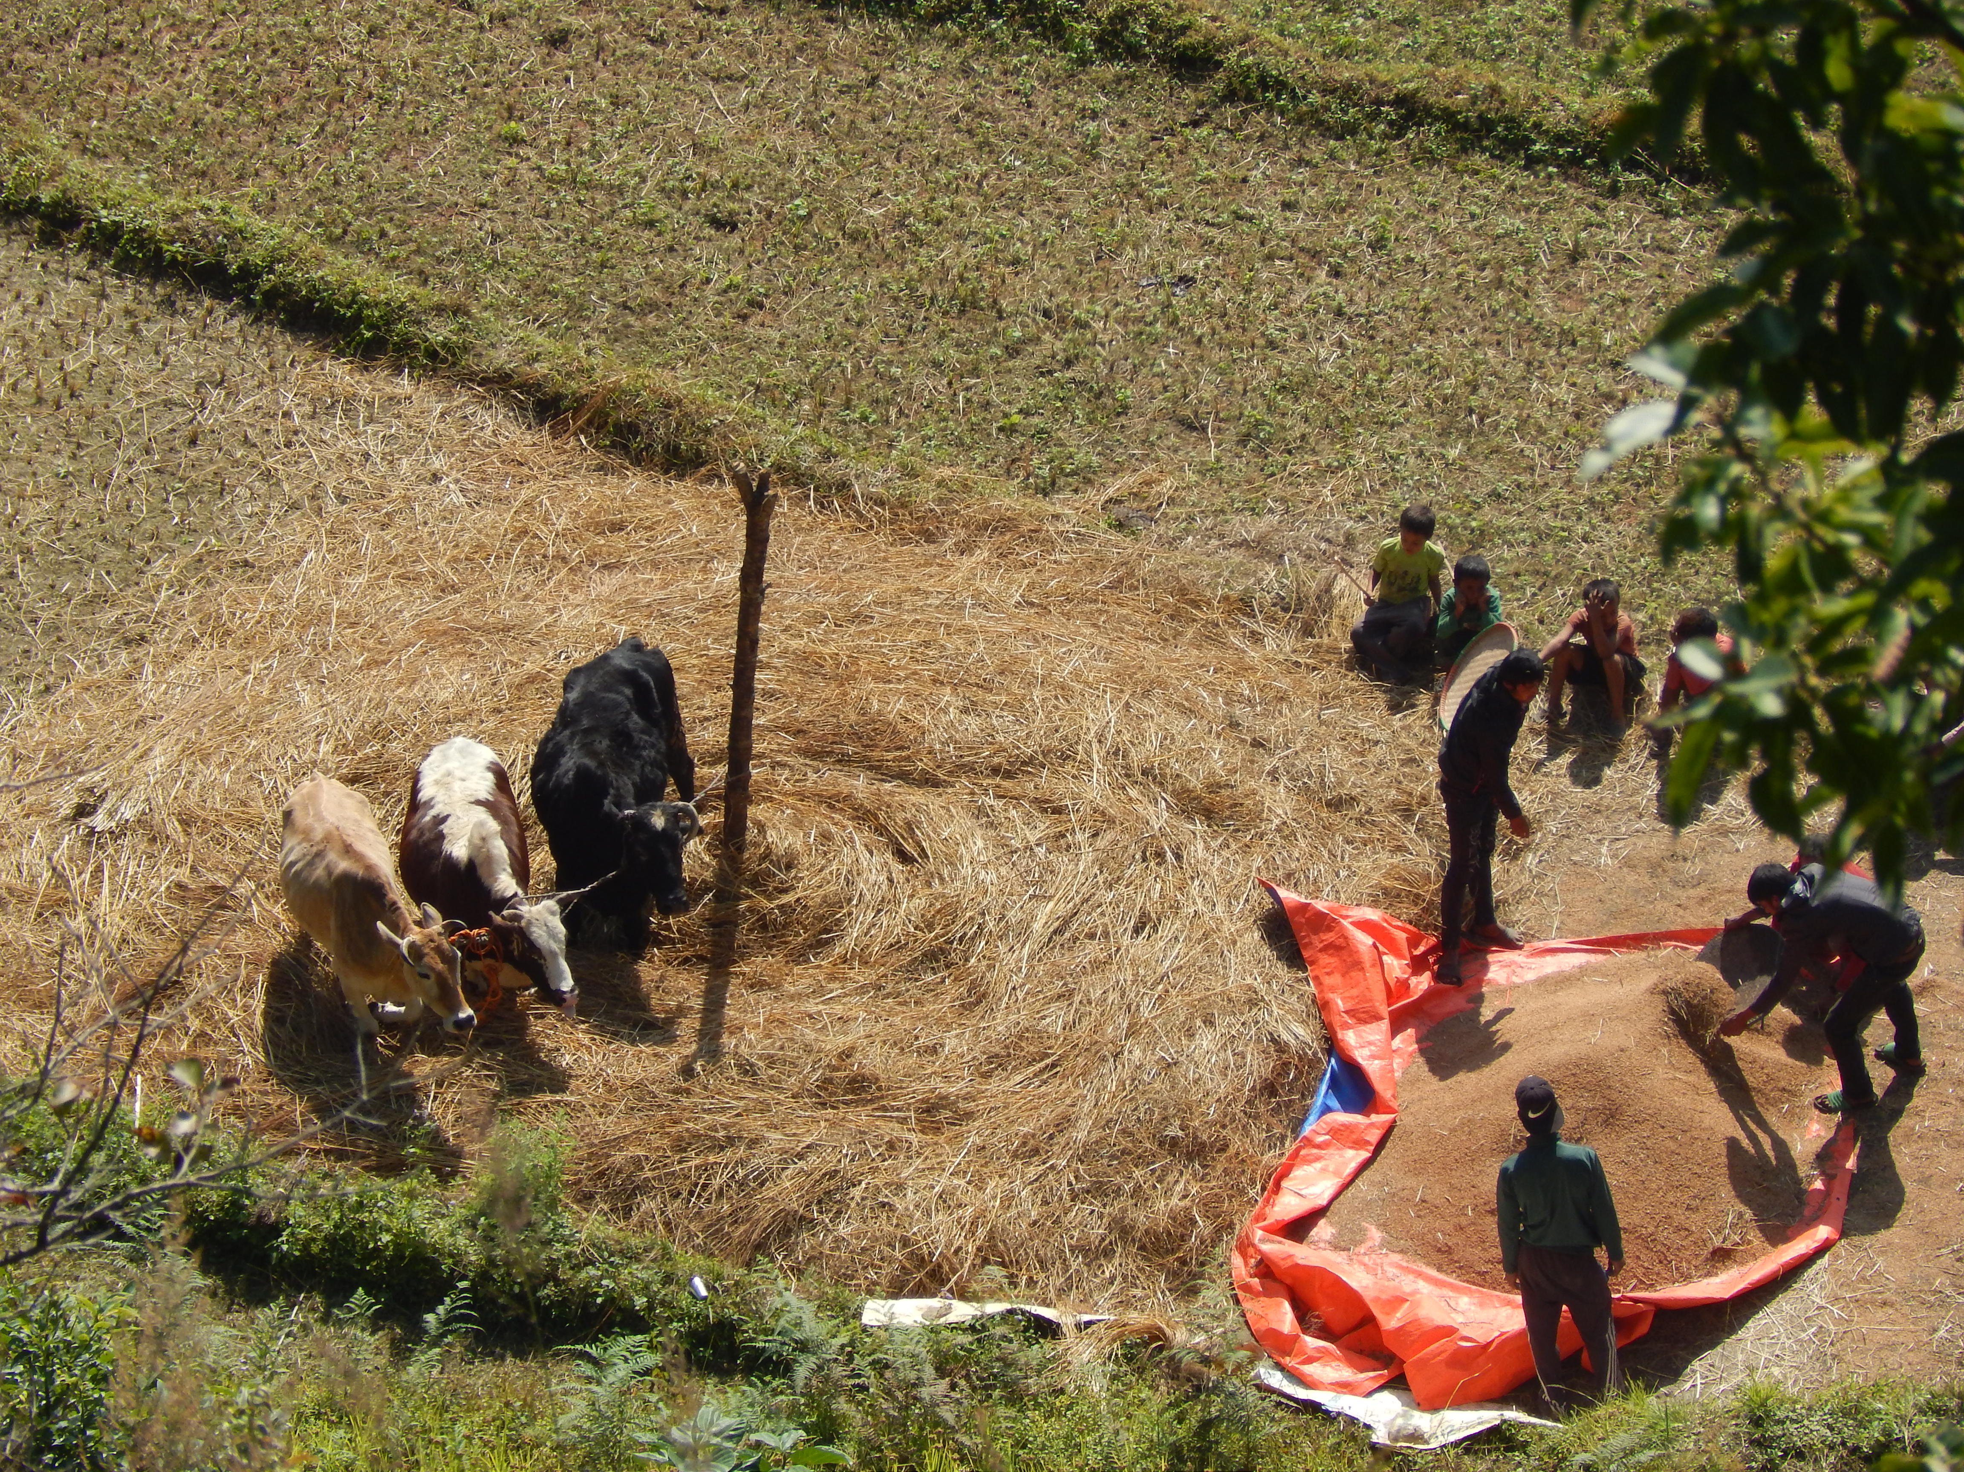
EO Data Requirements

Slide 4
Scroll through Document
New version – EO requirements (acquisition, access, future bands, cap dev… more holistic) as list with CEOS responses beneath

Slide 5

EAVs

Slide 6
Table 1
Table 2
Table 3
(GEOGLAM Data Requirements Table)

Slide 7
 | Table 1: Core Information Product (TBC) | Spatial Resolution, Accuracy, and/or Precision | Frequency of Production | End Use: Knowledge & Sustainable Decisions Supported
1 | Cropland mask | 300m to 3m | Monthly within season | State and Change: Federal/State land use policy; infrastructure investment; statistics; SDGs, climate change impacts
2 | Irrigated vs non irrigated cropland | 300 to 3m | seasonal | Water management and monitoring; SDGs (water use efficiency)
3 | Crop type map | 300m to 3m | Monthly within season | Fed/State/Int’l Market information; infrastructure investment; supplement/replace survey statistics; SDGs, climate change impacts
4 | Crop type area | Admin Level 1, +/- 10% | Every 2 months within season | Market information; supplement/replace survey statistics on production; logistics planning; food security-early warning
5 | Crop condition | 300m to 3m | 1-2 weeks | Market information; food security-early warning; Fed/state policy and program response; production insurance
6 | Crop yield forecast | Admin Level 1, +/- 10% | Monthly throughout season(s) | Market information; supplement/replace survey statistics on production; logistics planning; food security-early warning; SDGs; climate change impacts
7 | Crop Yield Estimation | field level | Seasonal, post-harvest | Market information; supplement/replace survey statistics on production; logistics planning; food security-early warning; SDGs; climate change impacts
8 | Rangeland and pasture mask | 300m to 3m | Seasonal | State and Change: Federal/State land use policy; statistics; SDGs, climate change impacts
9 | Rangeland and pasture condition assessment | 300m | Monthly throughout season(s) | Food security-early warning; SDGs; climate change impacts

Slide 8
 | Table 2: Essential Agricultural Variables for GEOGLAM (TBC) | Spatial Resolution, Accuracy, and/or Precision | Frequency of Production | Core Information Product Supported (Table 1)
Primary | Biomass | 300m to 3m | 2-3 days | Crop condition Yield forecast Rangeland condition
 | LAI? fAPAR, fractional cover? | 300m to 3m |  | Crop condition Yield forecast Rangeland condition
 | Phenological transition dates: start of season, max of season, end of season | 300m to 3m | Ongoing annual assessment guided by crop calendars | Crop condition Yield forecast Crop type map Crop type area
 | Field & Plot Delineation | +/- 10% | 3-5 years | Crop mask Crop type map Crop type area Rangeland mask
Supporting (Ancillary Data and EVs) | Crop calendars (Range of seeding and harvest dates) | Admin Level 1, +/- 2 weeks | 3-5 years | Crop condition Yield forecast Crop type map Crop type area
 | Surface water mapping
 | Precipitation
 | Land Surface Temperature
 | Evapotranspiration
 | Surface albedo
 | Land Cover and Land Use (ECV) | 1km to 3m |  | Rangeland mask
 | Surface Soil Moisture* |  | 2-3 days
 | Cloud climatology

Slide 11
Next Steps
October 21-26: GEOGLAM ExCom, EAV, and CapDev team meetings (Belgium)
  Finish articulation of framework and variable ID
  Ensuring clarity across GEOGLAM ecosystem (EO Reqs, Research Agenda, CapDev)
  How should the EAVs intersect with other EVs?
  Timeline for executing the EAVs?
    When is the EAV work done?
  Process for it becoming a community-endorsed document

Slide 12
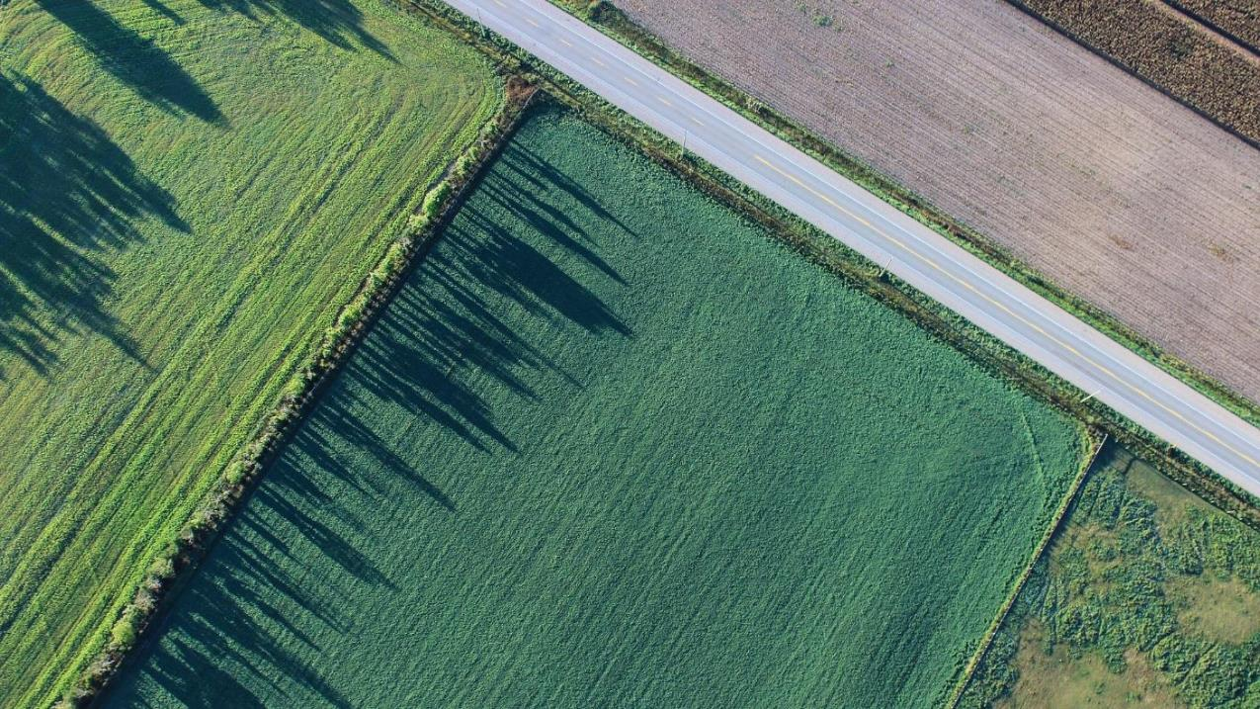
GEOGLAM CapDev Team

Slide 13

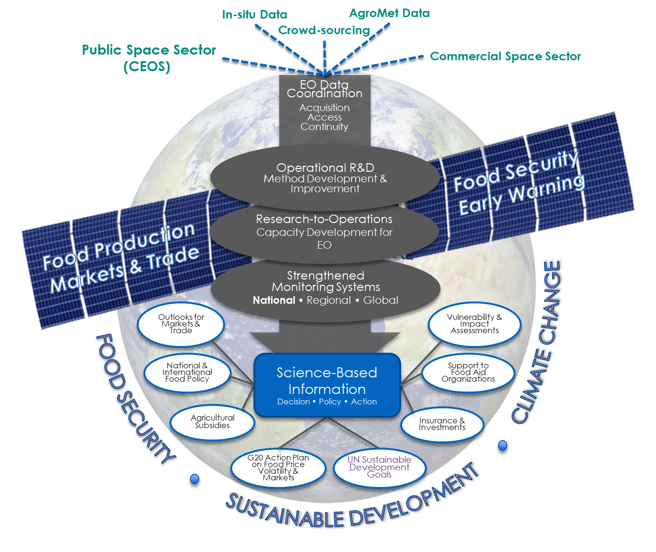

Why a coordinated GEOGLAM Capacity Development effort?
Capacity development has been a key activity within GEOGLAM since its inception, but decentralized.
The working group (GEOGLAM CapDev Team) aims to better coordinate and harmonize capacity development across these initiatives – minimize duplication of effort and “confusion” of end users, ensure that operational transition is supported as intrinsic to projects

Slide 14

Aims of the GEOGLAM CapDev Team
Develop a strategic vision for capacity development for GEOGLAM
Facilitate transition from GEOGLAM R&D activities to operations
Document and promote best practices around capacity development for EO for agriculture

Slide 15
Proposed activities in CapDev Team
1. Leverage what GEOGLAM members are doing in capacity development:
Identify examples of good capacity development practice by GEOGLAM members.
Work with GEOGLAM members to document the processes to develop and implement them.
2. Promote good capacity development practices:
Develop and distribute guidance documents
Increase awareness of capacity development good practices
Contribute materially to GEO’s call for “reproducibility” and “reusability”
3. Recommend ways to accelerate implementation in additional countries and regions:
Support members in the development of theory of change (ToC) models
Recommend the most appropriate ToC and good practices for additional countries
Recommend guidelines for documentation/stewardship of materials for future reuse

Slide 16
Proposed activities in CapDev Team
4. Recommend selection criteria to identify and characterize countries for future capacity development interventions
5. Identify opportunities for training workshops and knowledge transfer with capacity development networks and Regional Network Coordinators and share these with co-chairs and relevant networks

Slide 17

Deliverables: Guidance document on good practices for CapDev, by 2020
A document on good practices for designing and implementing CapDev relationships at individual, organizational and/or institutional levels.
It will also include narratives from GEOGLAM members and stakeholders on examples of successful engagement.
When & how to identify and engage with stakeholders
Carrying out a user needs assessment, with examples of what one looks like
How to develop & deploy training materials that consider the audience
Options for longer-term stewardship & maintenance of training materials
Approaches to co-design/co-production, with examples of the benefits
Evaluations to assess what is/is not working throughout the process
The order of operations & timelines for carrying out each of the above

Slide 18
Future of GEOGLAM-CEOS Relationship

Slide 19
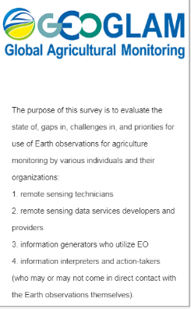
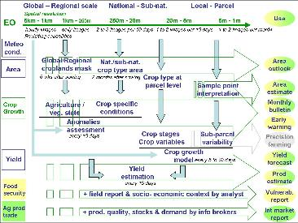
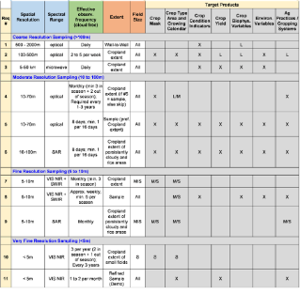
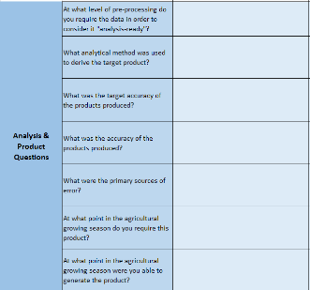
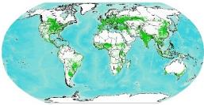
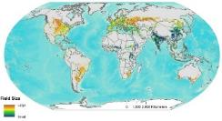
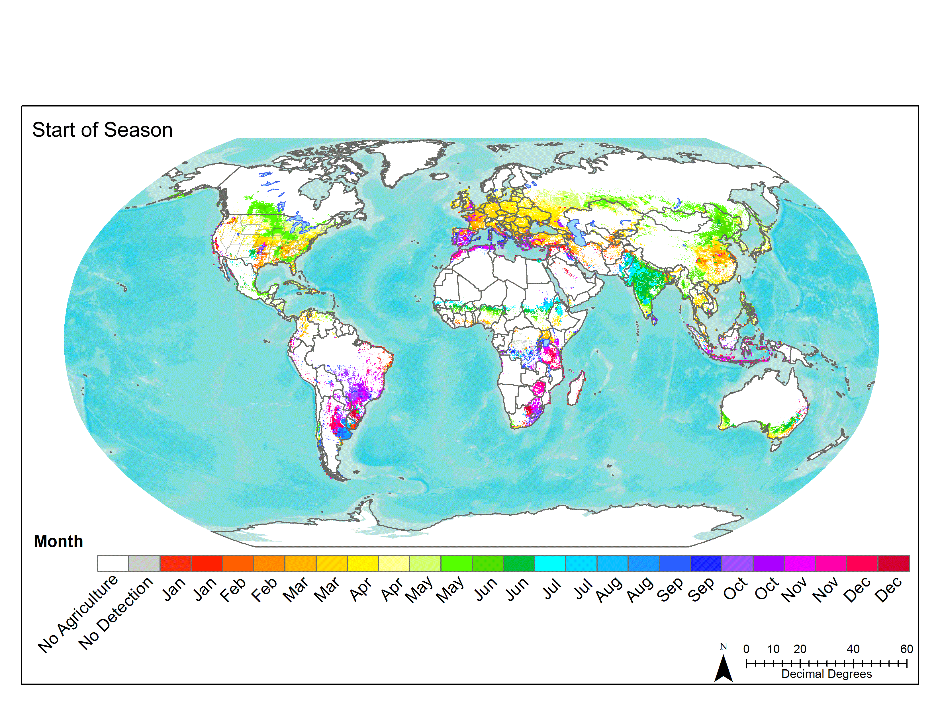
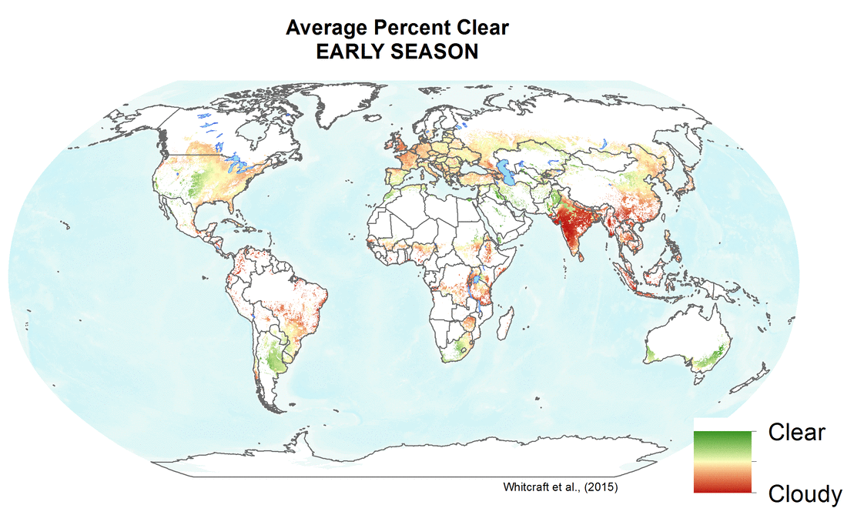
Requirements Summary: Timeline gives an approximation of CEOS-GEOGLAM relationship
2010 Defourny Diagram
2012-2014 GEOGLAM Reqs v1
2016-2017
R&D-driven Refresh
2017
CEOS Meeting
2018 - User Reqs Workshop (Ispra)
  Sensor-agnostic requirements that document observables, their underlying data, and their use
  Spatially explicit requirements by product/variable and by sensor type
  Question template to R&D sites
  New variables
  Minimum vs. preferred
  Discussion of R&D results, recognition of need for operational perspective
  State of use unknown
  Survey deployed on continuum of needs
  National, Regional, Global Users

Slide 20
CEOS-GEOGLAM: Why?
EO data core to GEOGLAM activities. We need to communicate to space agencies:
  Agricultural monitoring observation requirements
  AgMon EO data and processing requests
  AgMon implications for future missions
We provide to CEOS and opportunity for interaction with “next users” and hear “end user” needs – sharing of experiences that enrich individual agency activities
What has been effective?
  CEOS AHWG provides forum for bilateral (GEOGLAM-agencies) and multilateral engagement
  Documentation of observation needs in common forum – ingested by individual space agencies for their decisions
  SEO tools customization for agricultural communities
  Acquisitions for R&D sites
  Product evolution & evaluation
  Exploration of mutually encountered challenges (e.g. everything from cal/val to private sector engagement)
  Lots of other stuff

Slide 21
Looking ahead…
Is our job done?
  No.
  But, the foundations have been laid and are strong.
  New missions, evolving state of the science, broader and expanding usership – all will influence how EO data are accessed and used
    Req’s will evolve but massive changes are unlikely
  The value of user – space agency contact is huge.
    GEOGLAM is a resource for CEOS
Challenges:
  Participation – what should agency participation in GEOGLAM look like? What about agency participation in CEOS-GEOGLAM?
  Slot before the Plenary is critical for us

Slide 22
A decent proposal
How do CEOS and its constituent agencies want to take advantage of GEOGLAM?
Agriculture (… really GEOGLAM), as sub-group of LSI-VC
  What does that look like operationally?
    Responsibilities?
      Work is done by GEOGLAM EO data TCT; any “requests” (acq, systems, etc.) comes through sub-group
      GEOGLAM-CEOS communicates space agency interactions/processes, successes (thematic and process), needs (e.g. observation requirements and now cal/val, R&D, cap-dev.
      …
    Role in LSI-VC leadership?
    Role of LSI-VC participants on Ag/GEOGLAM sub-group?
    Interaction with SDCG?
    Who from GEOGLAM serves on team?
  Can we ensure GEOGLAM presence before CEOS Plenary?
  How do we interact with other relevant CEOS Groups
    e.g. CapD, Cal/Val, WGISS

