Slide 1

Asia-RiCE Report
Committee on Earth Observation Satellites
M. Steventon for S. Sobue
LSI-VC-8
Session 8
Anchorage, Alaska, USA
4-6 September 2019

Slide 2
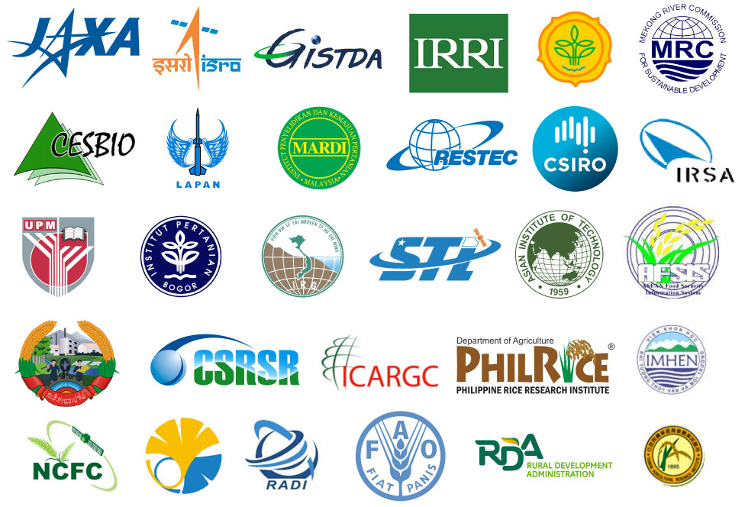

Background
Asia-RiCE is the work of an ad hoc team of stakeholders with an interest in the development of an asian rice crop estimation and monitoring component for the GEOGLAM initiative.

Slide 3
Background
Asia-RiCE is now in its third phase (April 2019 to March 2021). Phase 3 aims to:
Promote the use of EO data for wall-to-wall rice crop monitoring;
Promote the use of new generation tools for big EO data analysis, such as the Open Data Cube and cloud-based systems with available data sources and tools (such as INAHOR and GEORICE);
Share outcomes, output applications, research results, and progress at international conferences;
Continue to promote the generation of rice crop outlooks in Asia using agromet information from Japan (JASMIN) and India (MOSDAC).
In addition, the following research topics are also priorities:
Creating ARD time series from SAR and optical data for rice crop monitoring using Open Data Cube;
Rice crop models for yield estimation;
Methane emission from paddy fields;
Standardization of field surveys (in cooperation with GEORICE);
The practicality of potential integration of operational systems such as FASAL (India);
Capacity building in Asia in cooperation with available training centres such as ARTSA, IIRS, CSSTEAP.

Slide 4
Today’s Topics
2019 CEOS Chair Initiative – Rice Crop Monitoring
JJ-FAST ALOS-2 CARD4L Compliance and Pilots
New APRSAF Space Applications For Environment Rice Crop Activity (SAFE Evolution)

Slide 5
2019 CEOS Chair Initiative
JAXA is providing data and tools in support of the 2019 CEOS Chair Initiative.
ALOS-2 JJ-FAST data has been supplied for Vietnam, Cambodia, Laos, and Thailand (Jan 2018 - June 2019).
JAXA has analysed the ALOS-2 backscatter time series with JAXA’s rice crop monitoring tool (INAHOR-NEO; machine learning version developed by RESTEC for JAXA) and generated rice crop maps for the 2018 rainy season.
Validated rice crop maps generated by VNSC (Sentinel-1 & ALOS-2), CESBIO & CNES (Sentinel-1) and JAXA (ALOS-2) will be shared for cross-validation in Vietnam. JAXA works with Cambodia, Thailand and Lao to validate ALOS-2 products with available statistical and other information
VNSC will use in situ data from the Red River and Mekong Delta regions to validate the rice maps provided by CESBIO and JAXA.
In September the maps will be uploaded to the Vietnam Data Cube for the CEOS Plenary demonstration. They will also be demonstrated at AOGEO in Australia and APRSAF-26 in Japan.

Slide 6
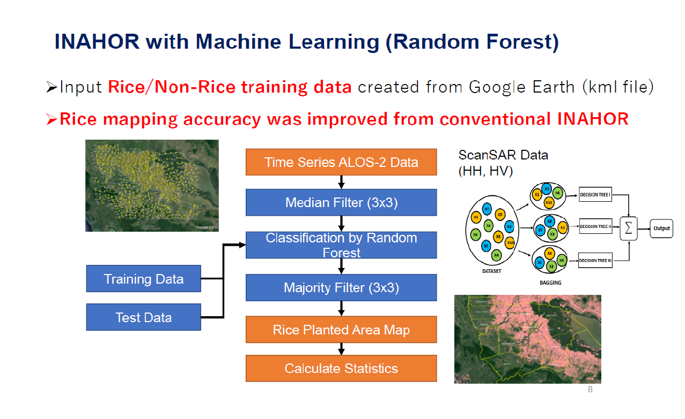
Cambodia Rice Crop monitoring in APRSAF SAFE

Slide 7
JJ-FAST ALOS-2 CARD4L Compliance and Pilots
JJ-FAST: JICA-JAXA Forest Early Warning System in the Tropics.
  ALOS-2 data is available through this system.
  It is processed using SIGMA-SAR and was originally processed for the JICA-JAXA forest cover change monitoring project in tropical regions.
  Orthorectified/slope-corrected gamma-nought data.
There is interest from JAXA in assessing this data as CARD4L. An internal investigation is underway to determine changes necessary for compliance.
Request: can the LSI-VC team provide support with the self-assessment? JAXA is ready to provide sample data.
Potential for CARD4L pilots using this data and Asia-RiCE contacts.

Slide 8
New APRSAF Space Applications For Environment Rice Crop Activity
Aim of the project is the development of a satellite-based observation system to monitor damage and losses to rice crops caused by variable disasters in the ASEAN region.
This is one of two APRSAF ‘SAFE Evolution’ projects – the other is on agromet and focused on cross-validation work (ISRO-JAXA and GISTDA-JAXA) for various agromet products.
Expecting JAIF funding with an ASEAN secretariat. Implementers, etc. are still TBD.
Will also be contributing to the GEOGLAM Capacity Building Component through this activity.

Slide 9
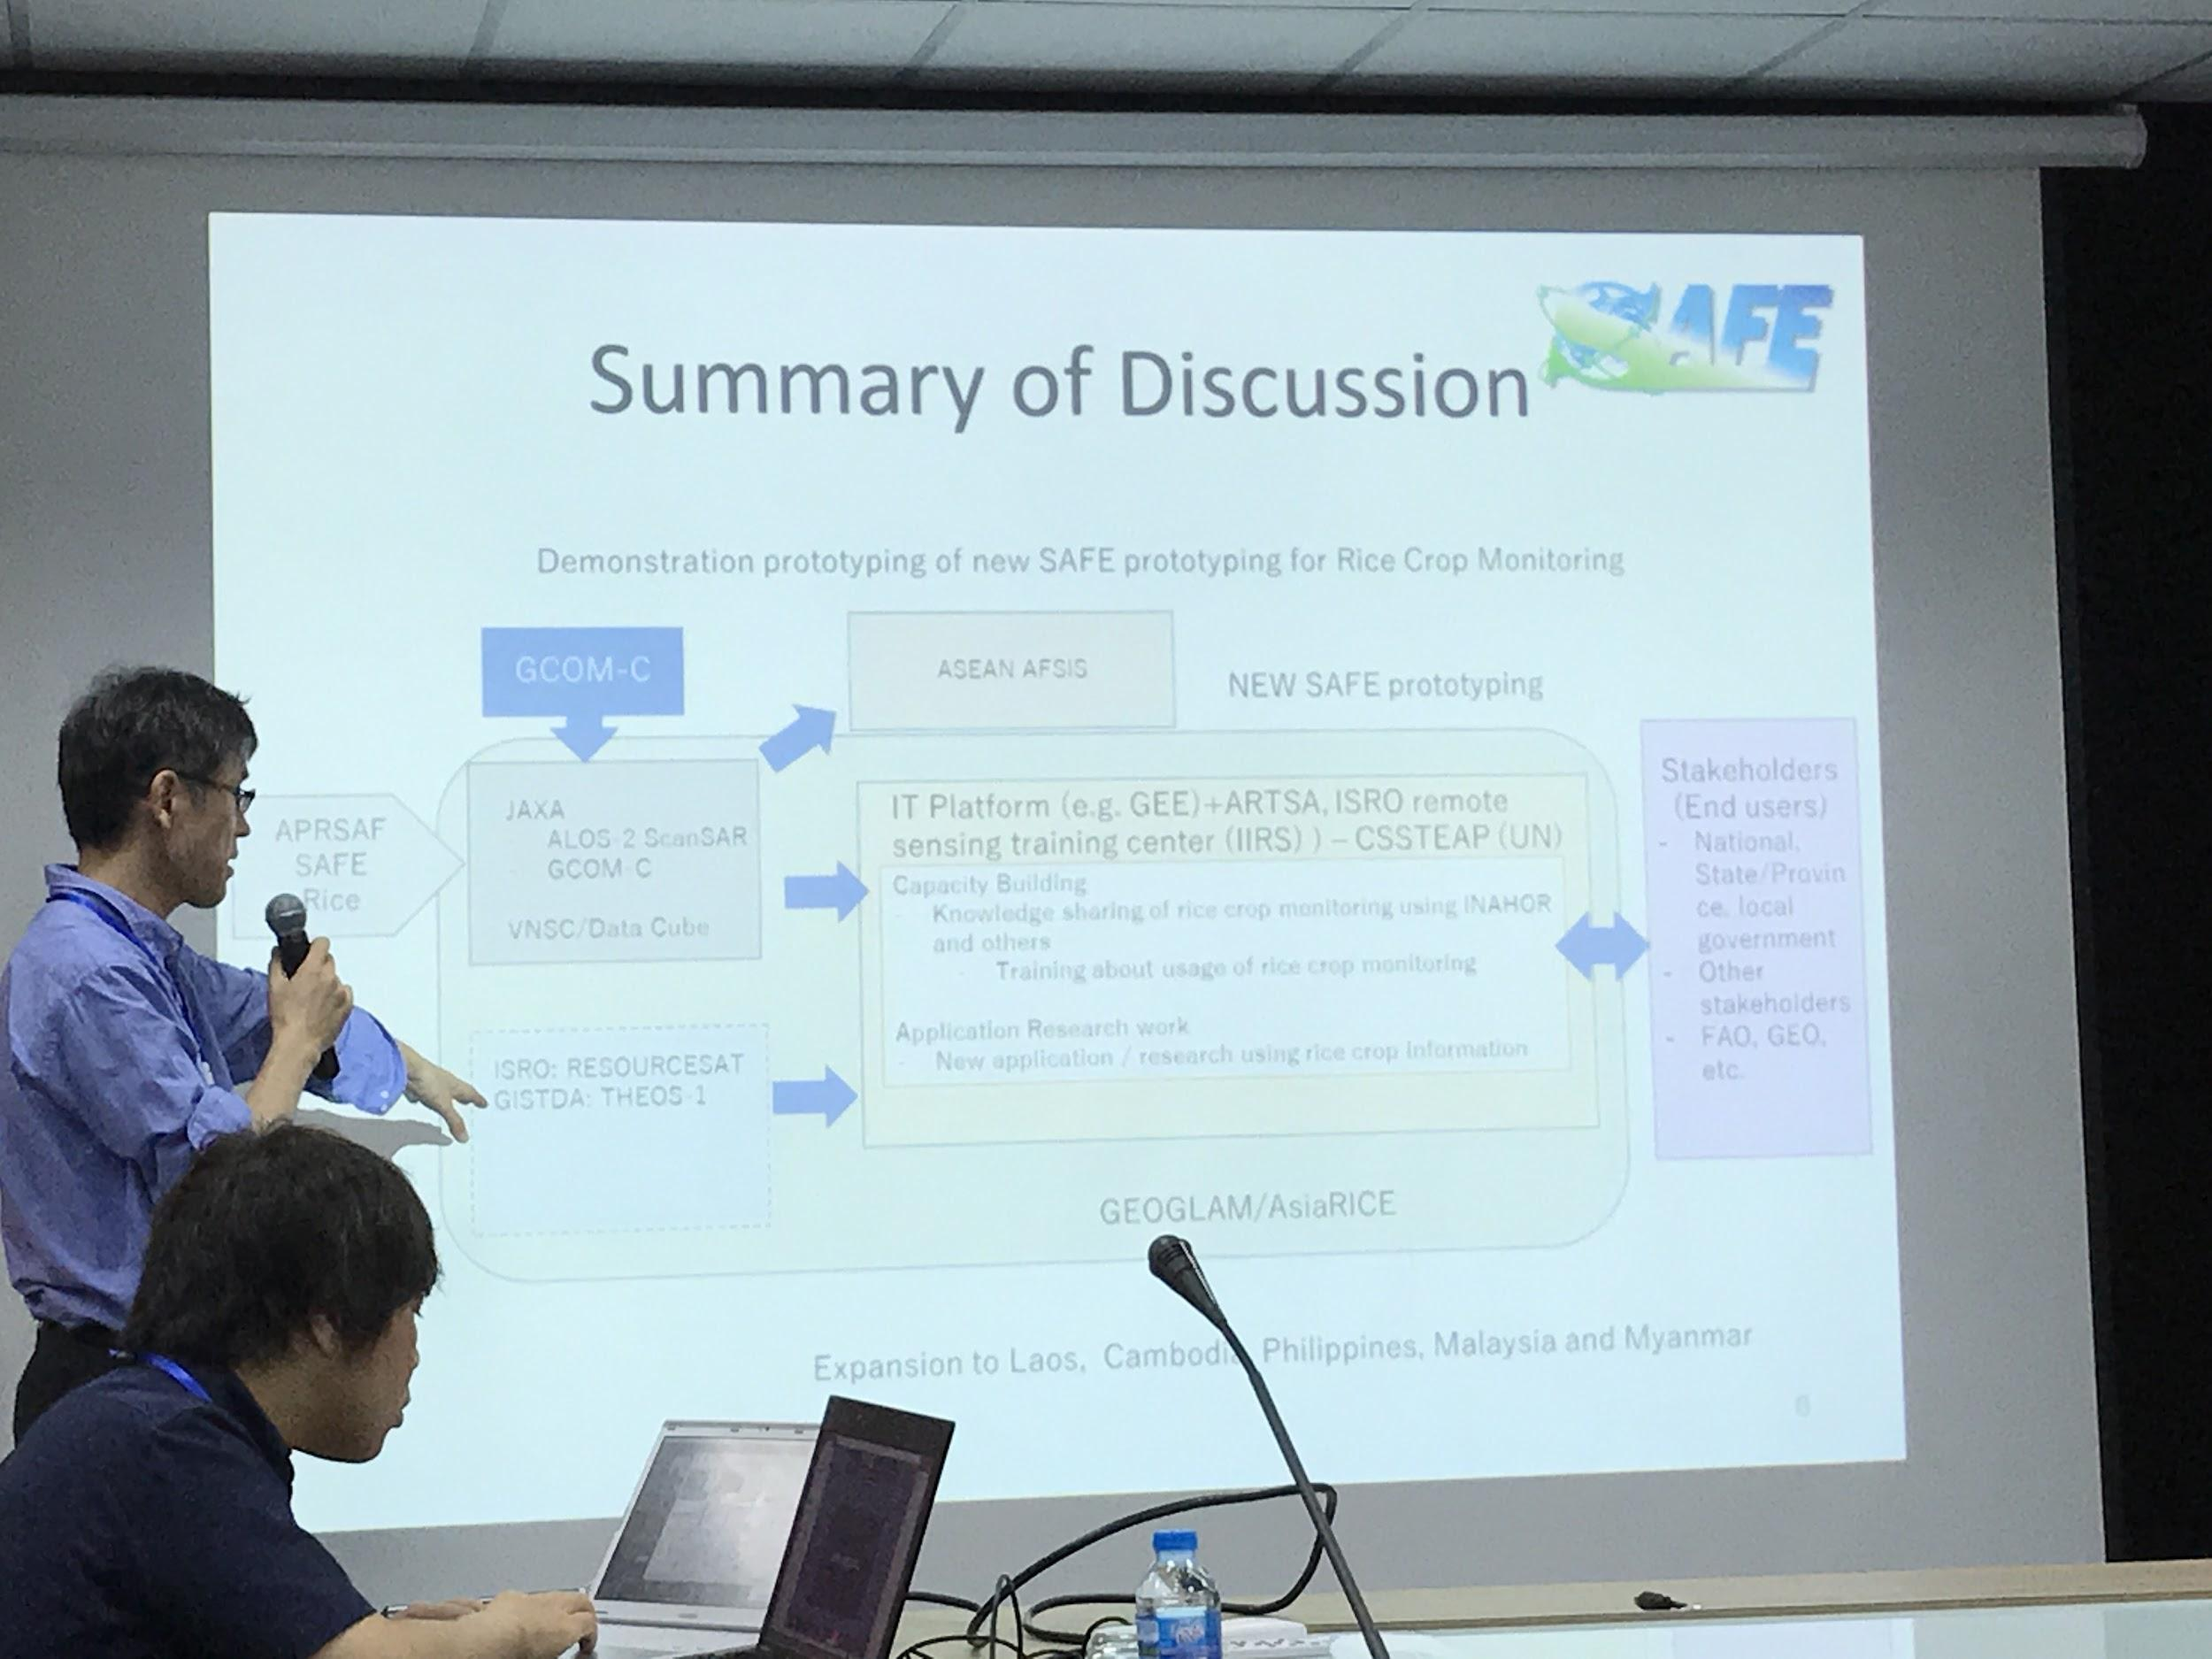
New APRSAF Space Applications For Environment Rice Crop Activity

Slide 10
Questions?
Committee on Earth Observation Satellites

