Slide 1
GFOI-SDCG
LSI-VC-8 meeting
Session 7: Forests & Biomass Subgroups
Anchorage, Alaska, USA
4-6 September 2019

Slide 2
Forests & Biomass Session
GFOI Framework Update
New SDCG Work Plan
Support to the SIT Chair Prospectus 2020-2021, including for Biomass
Discussion on collaboration with LSI-VC & GFOI on CEOS ARD strategy (pm)
Revisiting organisational issues & Ispra meeting conclusions (tomorrow am)

Slide 3
GFOI Update
Leads agreed GFOI to continue to be identified as GEO Flagship and in the GEO WP
Norwegian initiative to offer commercial hi-res data for forest monitoring
Tenders closed 5 Aug – link
$US50mn
Next LT meeting at UNFCCC SEC
Relevant to Convention Engagement Strategy (Aus-SIT, EC)
Role of GFOI in global stocktake
SilvaCarbon/USGS/USAid volunteered new Data Component Manager(s)
Vacant last 2 years since Australia stopped funding
Chris Barber (space - USGS/EDC), Sara Geoking (insitu - USFS)

Slide 4
GFOI Update
Continued emphasis on Capacity Building aspects & country engagement
Registry of Tools being developed to simplify advice to GFOI countries
CEOS agencies and partners welcome to submit their preferred systems
thus far only INPE, EC/JRC and SEO (COVE, ODC) have done so
Baseline space data somewhat taken for granted
continued pressure to assure GFOI advocates for free and open CEOS data
Reduced cadence of engagement possible for CEOS with global baseline solved
reduced SDCG attendance through personnel changes, budgets, natural evolution
merger with LSI-VC seems timely and natural

Slide 5
SDCG
Work Plan updated to reflect slimmer profile
Continued focus on the core business of assurance of data suitable for annual NFMS reporting
Healthy supply allows time to focus on additional value
data access, formats, ARD
support to LSI-VC on ARD pilots with thematic communities
working with FAO to link their SEPAL with Open Data Cube (Digital Earth Africa)
working through new USGS Co-chair (Chris Barber) to SilvaCarbon (eg ARD feedback)

Slide 6
SDCG WP

Slide 7
SDCG WP

Slide 8
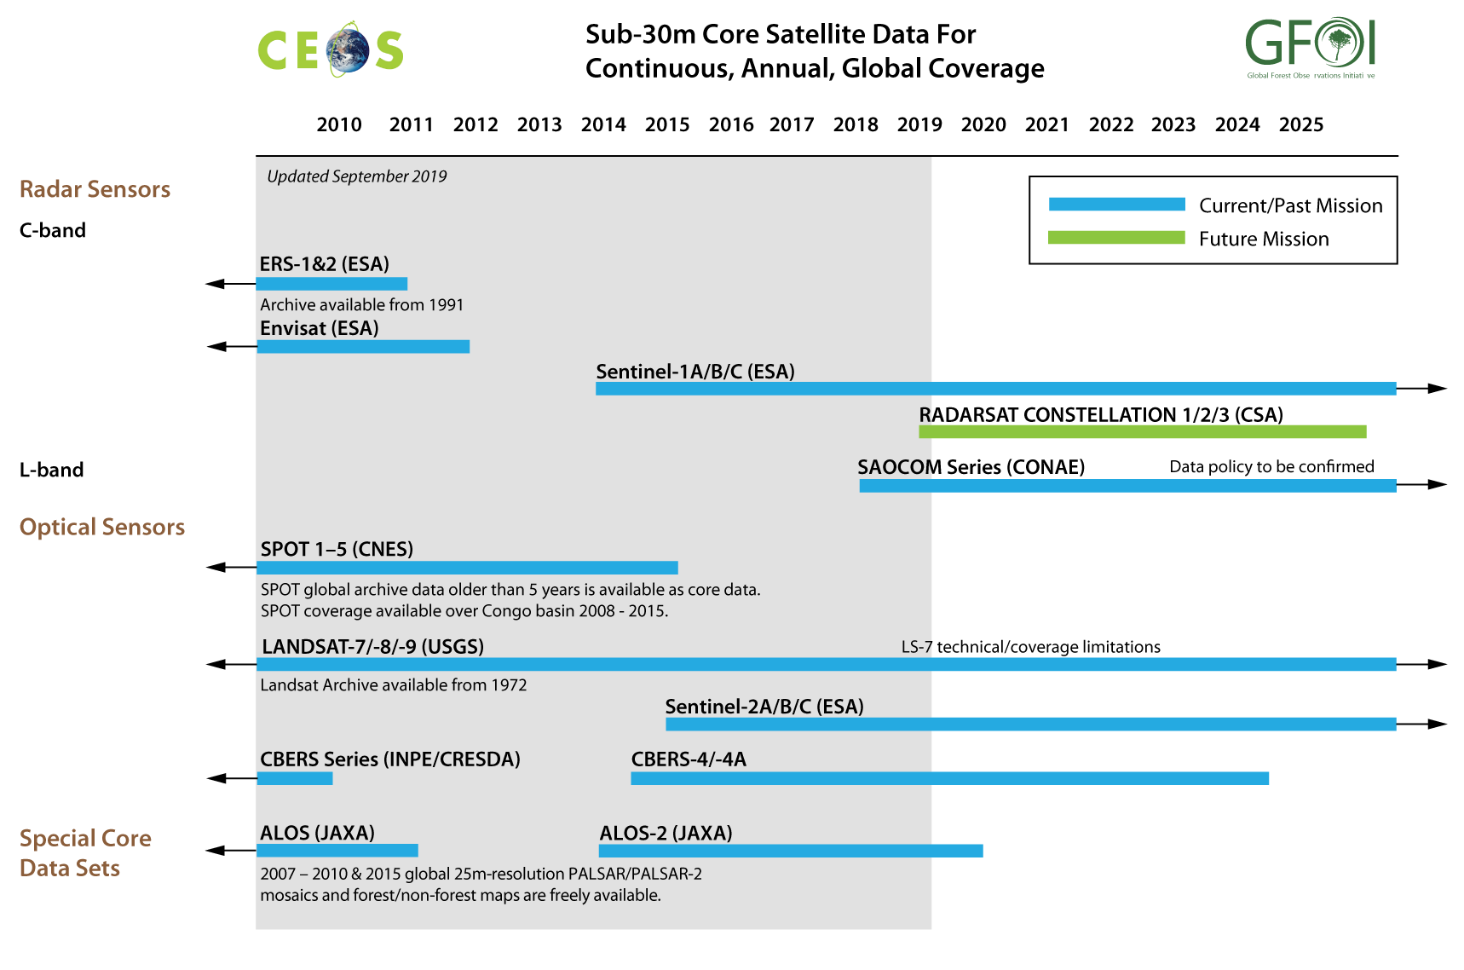
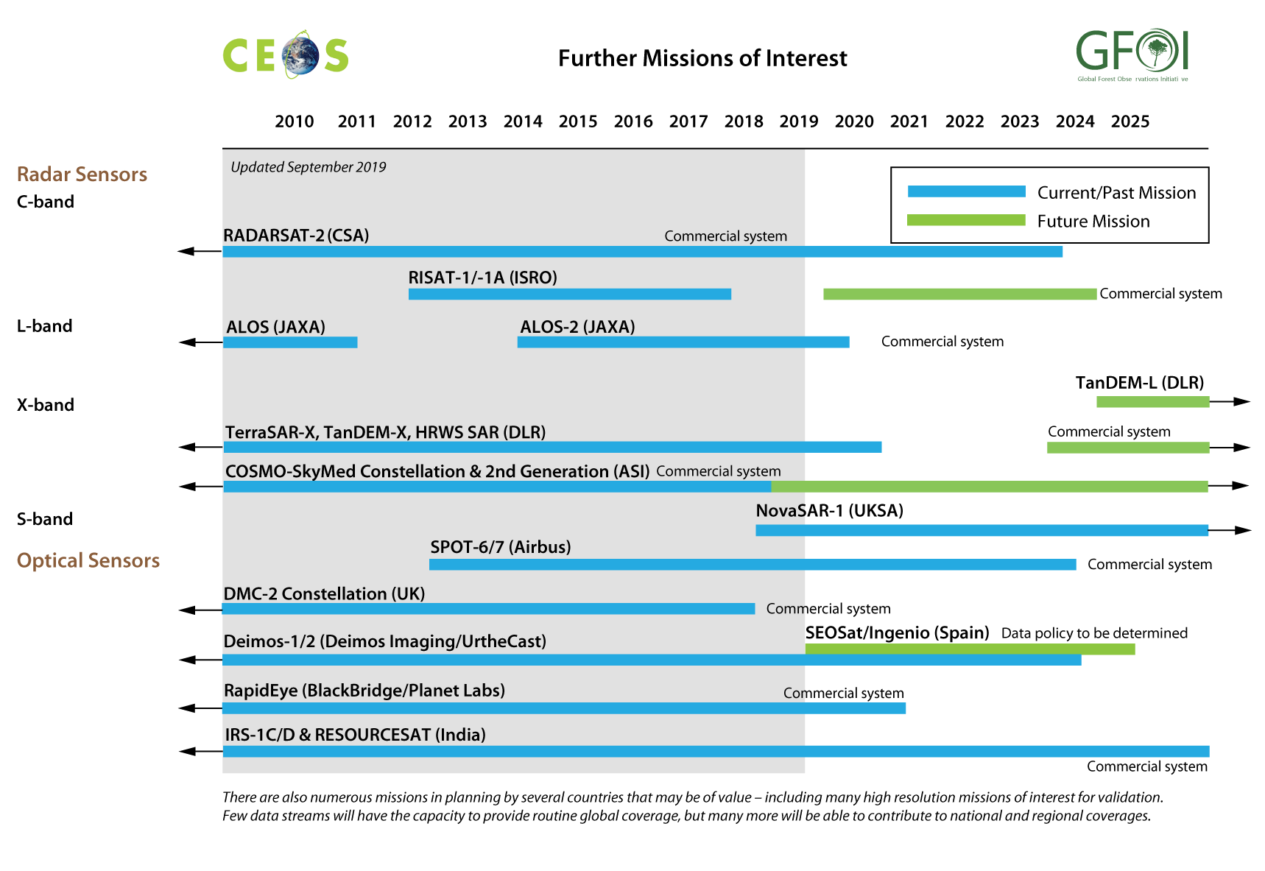
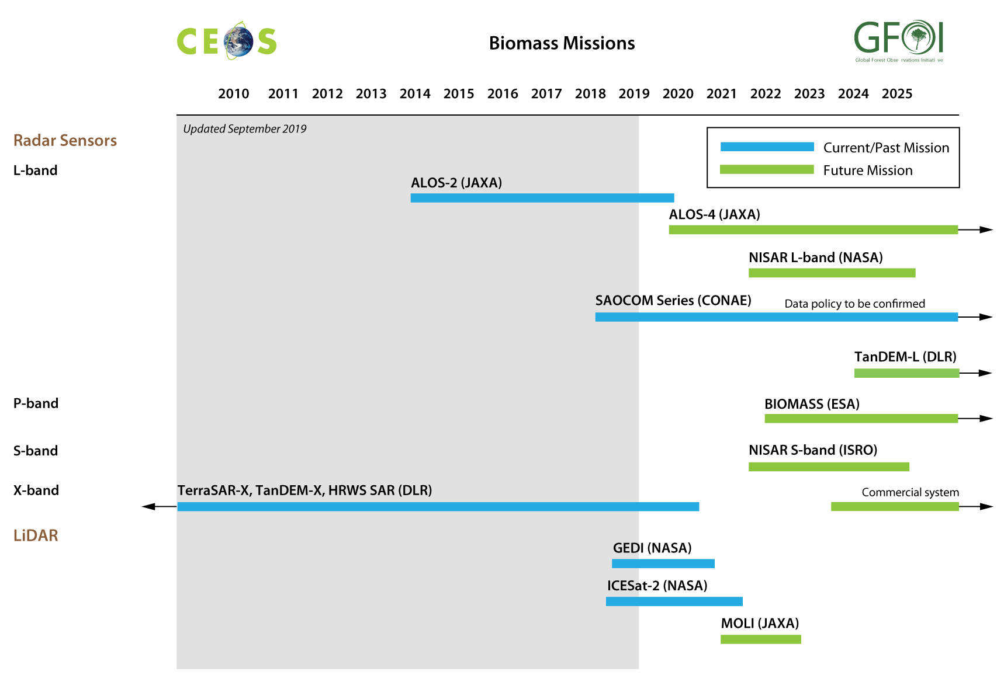
SDCG WP - Global Baseline Acquisitions
Excess capacity (finally) - no need to compile detailed annual reports
SEC will maintain the supply charts only
Further intervention only by exception
Could be broadened if needed for LSI-VC

Slide 9
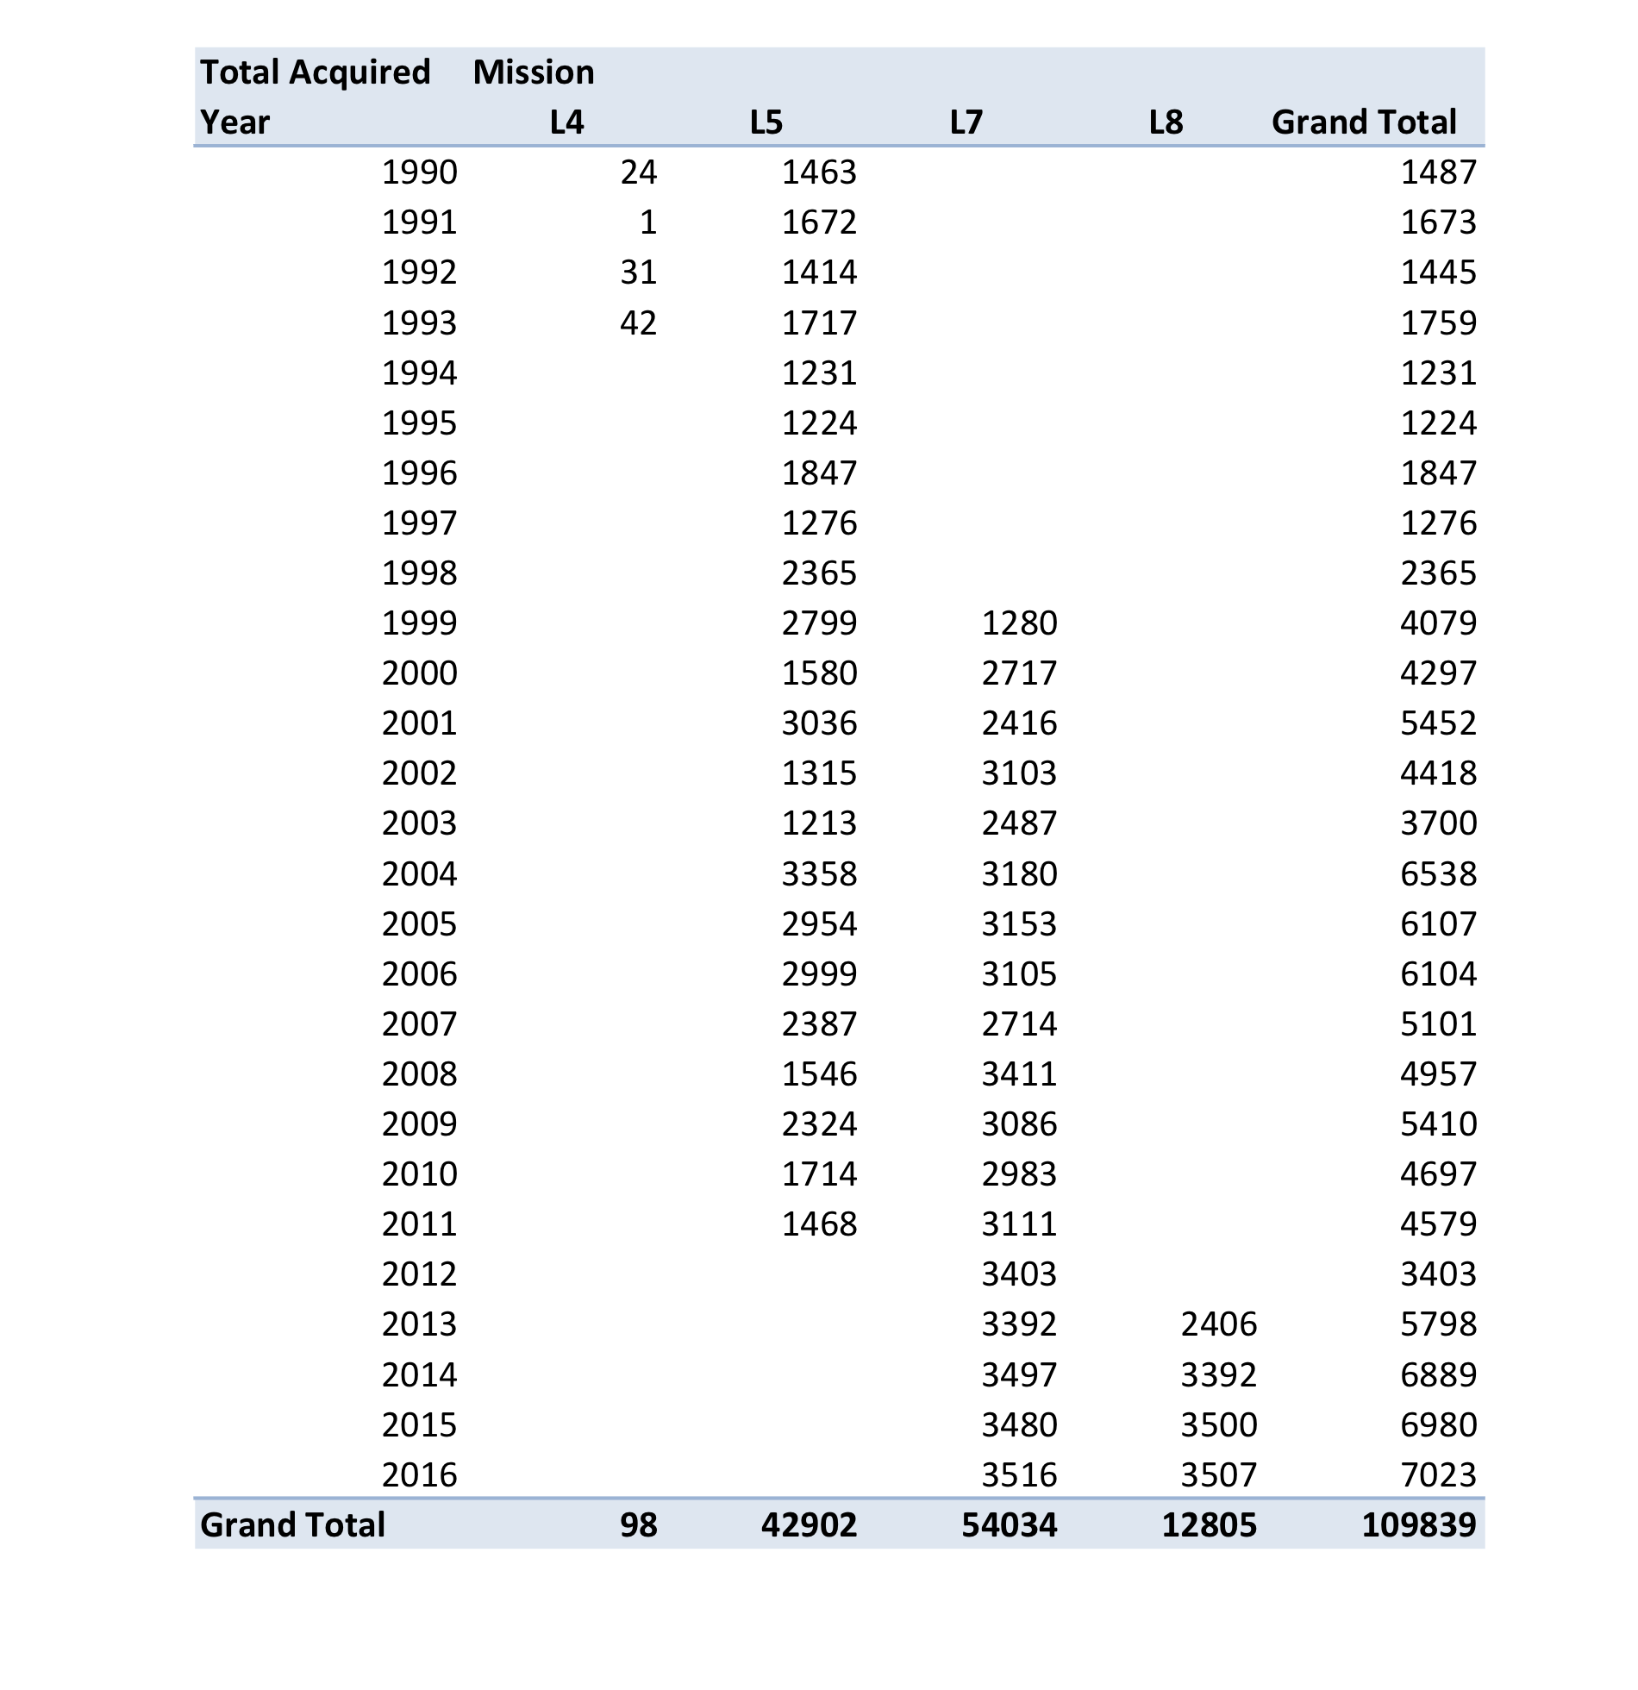
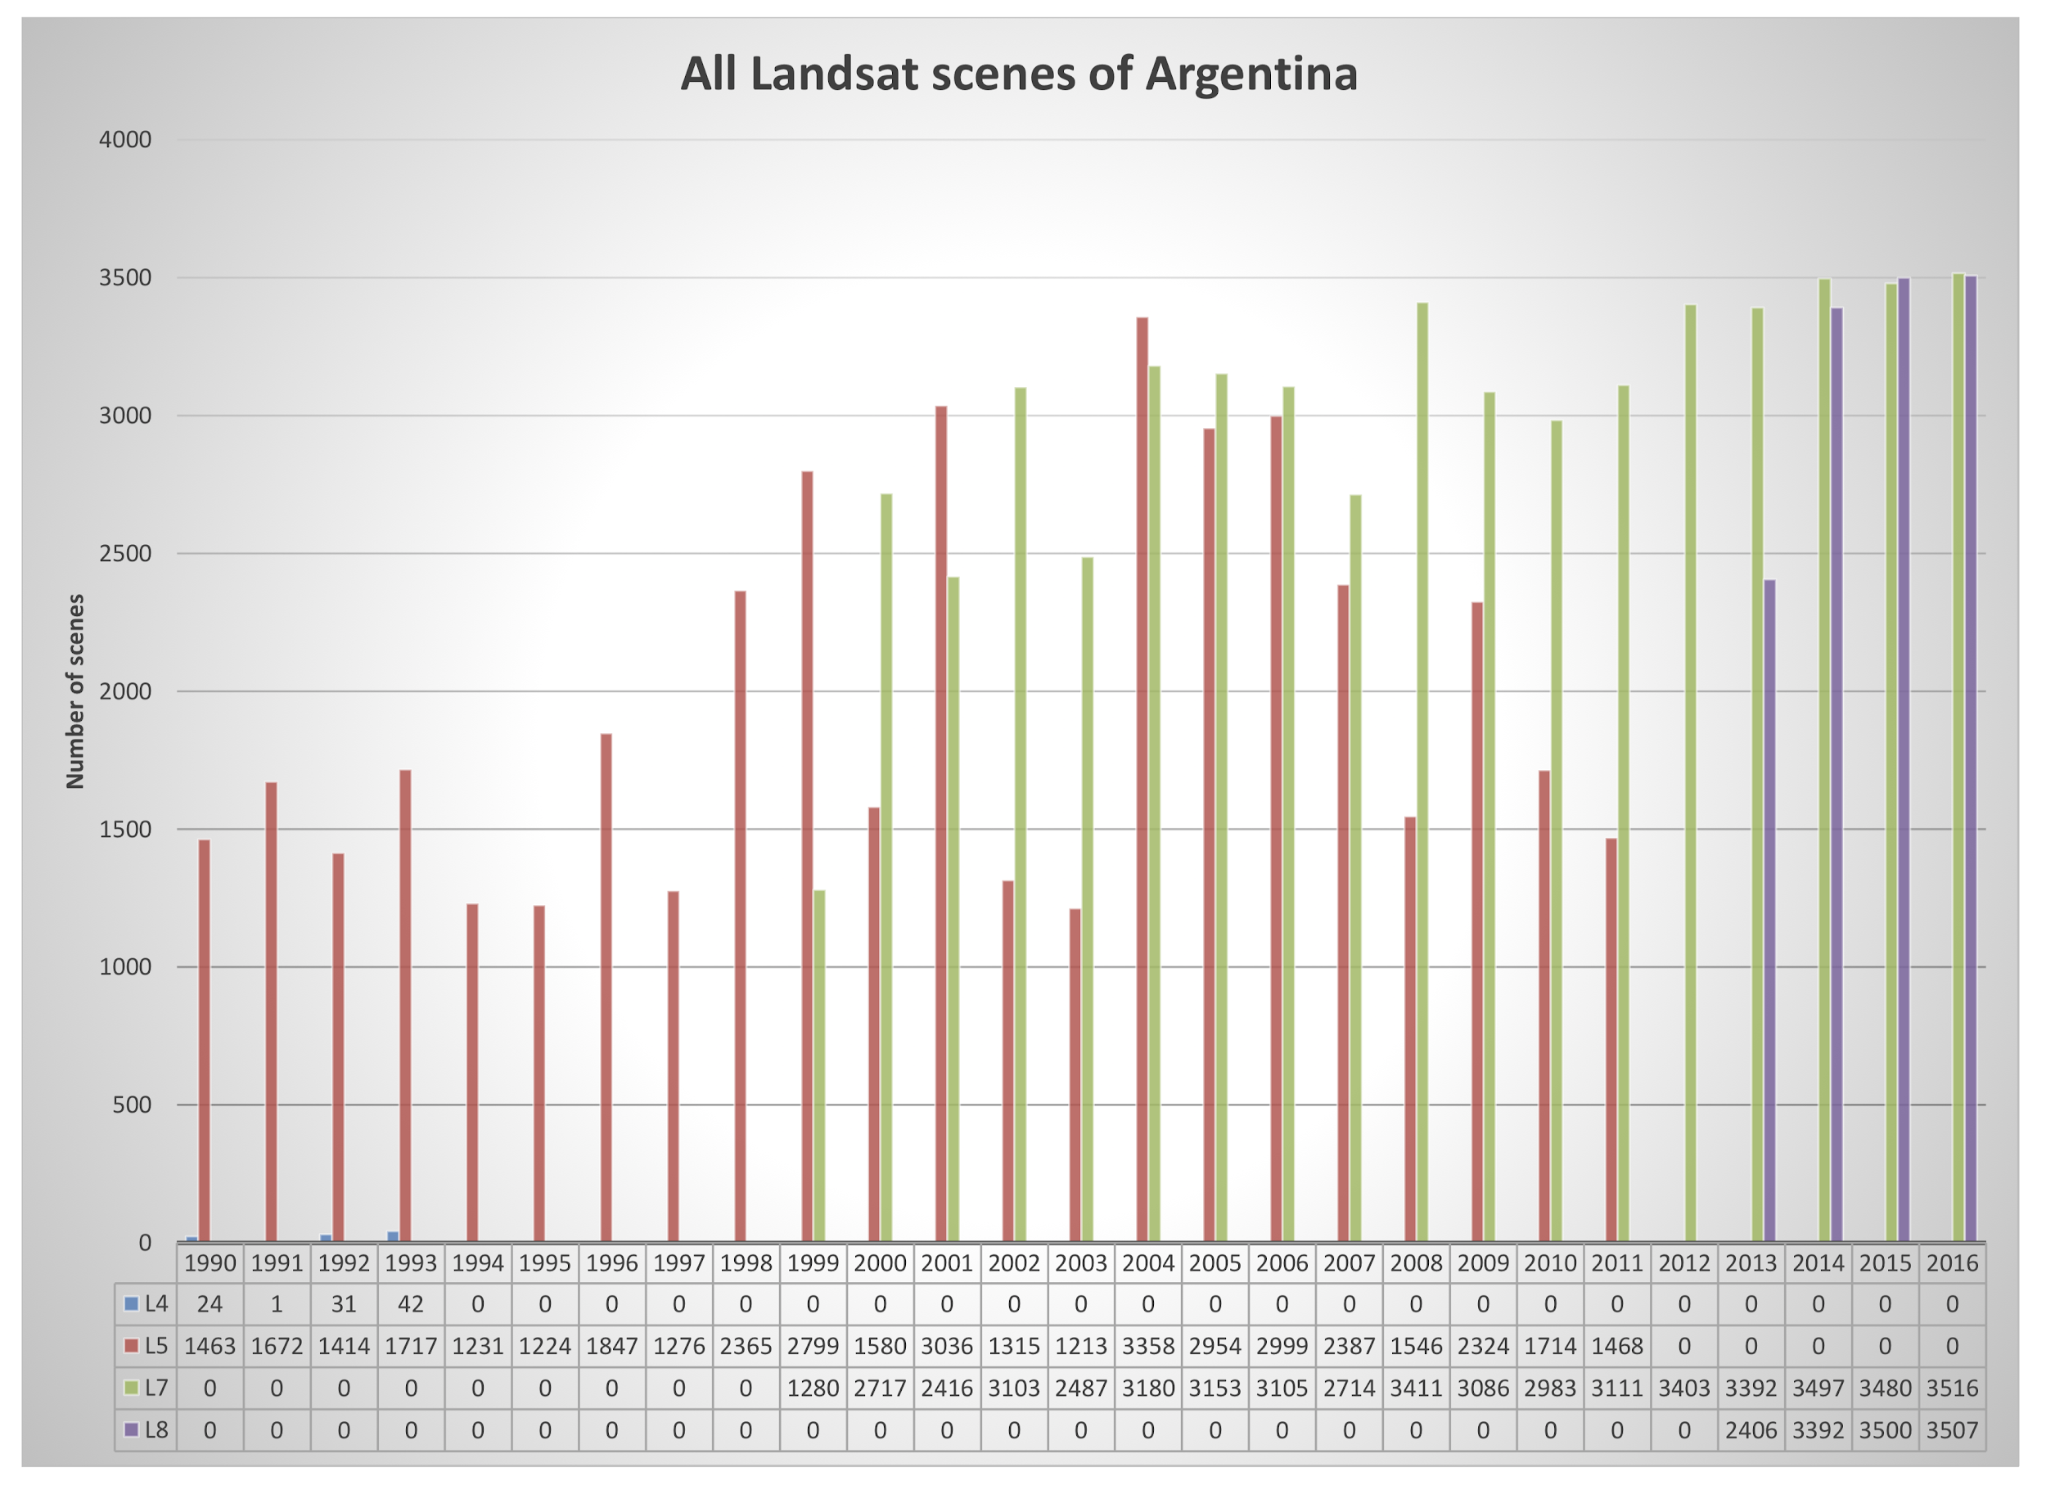
SDCG WP - Data access and uptake
SEO does archive characterisation for GFOI countries
ARD reach into GFOI is new
for discussion
Chris Barber role as bridge to SilvaCarbon
Collection 2 release a good foundation
SAR uptake is a proposal to increase uptake
for discussion also
Pilots proposed to support ARD strategy with LSI
already discussed with Adam/GA and FAO
DE-Africa & SEPAL collaboration
GEOGLAM engagement would be ideal

Slide 10
SDCG WP - Data access and uptake
Space Data blog is just a communication tool for CEOS to reach GFOI countries
could be broader for LSI
Data support is some hand-holding for countries with particular needs
thanks to USGS aiding VNSC for the CEOS Plenary demo (eg)

Slide 11
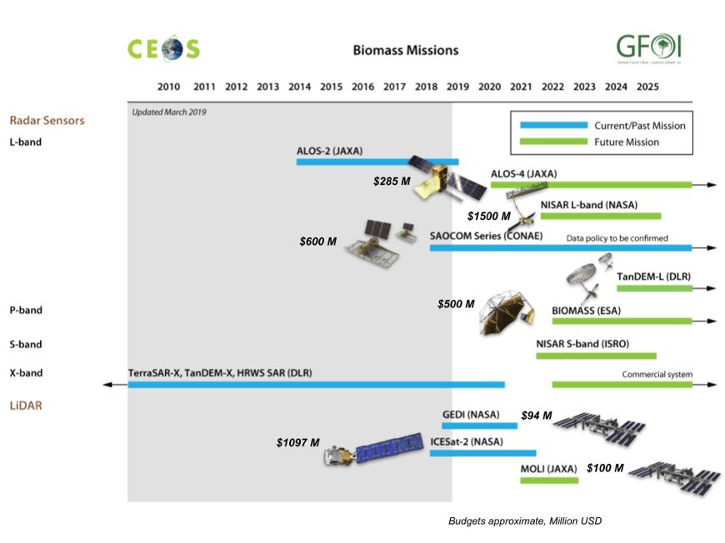
SDCG WP - Biomass Data
Substantial investment ($4Bn+!) in biomass- related mission launches 2018-2024
Strong interest in biomass from sectors related to carbon emissions, forests, and ag
Need to optimise policy relevance & utility of space data - through fora such as GFOI, World Bank..
Friday discussion on CEOS organisation
New data is complex
needs communication, support, market development
looking to work with SilvaCarbon and CB component
CARD4Lidar?

Slide 12
SDCG WP - Biomass Data
CEOS Biomass Protocol anticipated soon
seeks to characterise accuracy of datasets using new data
SDCG will promote uptake within GFOI
Slow engagement of LPV and agency folks to interact with incoming SIT Chair

Slide 13
SDCG WP - Capacity Building component
Seeking to rebuild the bridge to the GFOI users
through SilvaCarbon, using Chris Barber
of benefit to LSI generally
Anchorage the first SDCG/LSI meeting for Chris
Details to be fleshed out

Slide 14
SDCG WP - Convention engagement
Mark Dowell proposing broader & systematic CEOS engagement strategy for Conventions
Building on the IPCC progress led by JAXA
Including the GHG Roadmap
With a workshop at JRC in early summer 2020?
GFOI Leads meet at UNFCCC SEC later this month

Slide 15
SDCG WP - MGD representation
Ake our rep to ensure adequate representation of space data issues

Slide 16
SDCG WP - R&D, and Early Warning
Pending clarity and funding

Slide 17
Issues for discussion
Thread and Task Leads confirmed
ACTION on those Leads to suggest milestones and outcomes thru end 2020
Consider the LSI engagement where needed
CEOS handling of biomass - Friday am?

Slide 18
SDCG WP

Slide 19
SDCG WP

Slide 20
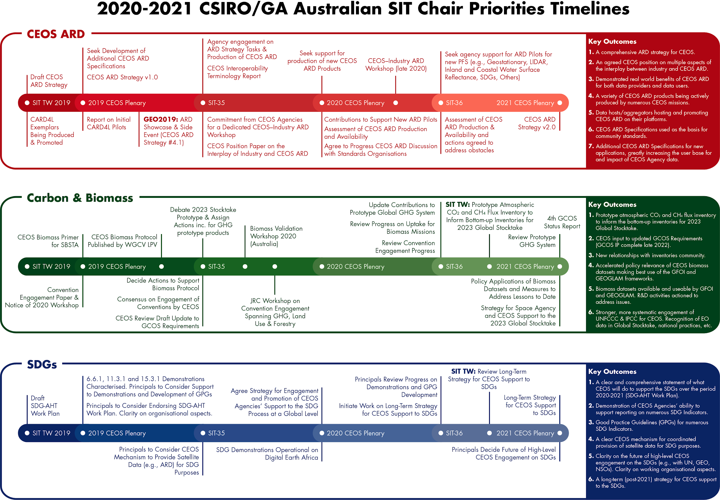
Support to SIT Chair Prospectus

Slide 21
Support to SIT Chair Prospectus
Supporting the GHG Roadmap process – escalating, elevating, and accelerating progress towards major milestones, including for 2023 Global Stocktake. 2021 prototype flux products.
Encouraging stronger and more systematic engagement by CEOS of convention frameworks – building on IPCC outreach
And national inventories communities as our future users
Reflecting $4Bn+ investment (2018-2024) in Above-Ground Biomass missions and seeking to accelerate the policy relevance of these new data (GFOI, GEOGLAM…)
Promote uptake of biomass datasets beyond science community – forest monitoring, inventories…

Slide 22
Support to SIT Chair Prospectus: LSI questions
Do LSI representatives have interest in participating any of the proposed activities and outcomes?
or have colleagues that might?
or have suggestions to contribute?
The issue of Biomass issues coordination within CEOS
Biomass validation workshop, Brisbane, week 2nd March 2020
Suggestions on interfacing to the multi-mission group and having an effective POC identified
Meetings and processes - LSI view on working team interaction with CEOS management?

Slide 23
Organisational issues - Ispra meeting conclusions
Timely for a smaller SDCG to proceed with the agreed organisation

Slide 24
Questions?

