Slide 1
SEO Updates for SDCG
Brian Killough, NASA, SEO
Anchorage, Alaska, USA
4 September 2019

Slide 2
SEO SDCG Actions
SDCG-15-01 - This action should be closed. I have reached out to Hank on the topic of supporting SDCG and the biomass topic and getting a commitment for Laura Duncanson. In an email from Hank on June 3 he stated ... I have funded Laura Duncanson to spend some of her time on CEOS Biomass issues. She would be the main NASA-funded person available to possibly devote some time to one or more of these items."
SDCG-15-04 - GEO Announcement of ALOS data for DE-Africa. We (SEO) have worked with Ake to prepare all of the ALOS Mosaic data (not time series) for Africa. This is now on AWS and ready to use. We will have a demo notebook (and hopefully a sandbox) in place for GEO to demo.
SDCG-15-05 - USGS parameters and settings for COG formats. I think this action should go to the new USGS contact for SDCG.
SDCG-15-07 - ODC and COVE into GFOI Tools Registry. This was completed several months ago and should be CLOSED.
SDCG-15-10 - SEPAL and ODC integration ... this action is still OPEN and in the works. I will get an update from the AMA team on this situation before we get to SDCG.
SDCG-15-14 - COVE API issues with Landsat. All API issues have been resolved and COVE is functioning well with its Landsat data connection. The connection to Collection-2 will likely add new complexities to be resolved.
SDCG-15-15 - MGD utilities for ODC and links to SEPAL ... no work has been completed on this task. Likely needs discussion at SDCG to understand how to proceed, if anything.
SDCG-BMD-07 - Adding GEDI and NISAR to COVE - GEDI is modeled in COVE using two methods. One is a nadir track and the other is the fully accessible FOV (40km is each direction). NISAR is not currently in COVE, but could be modeled as a "notional" future mission. We would need to be given guidance on how to model the orbit and viewing geometry. After reviewing the NISAR handbook, I see 12-day repeat, 240 km swath, 33-47 degree viewing angle (right looking).

Slide 3
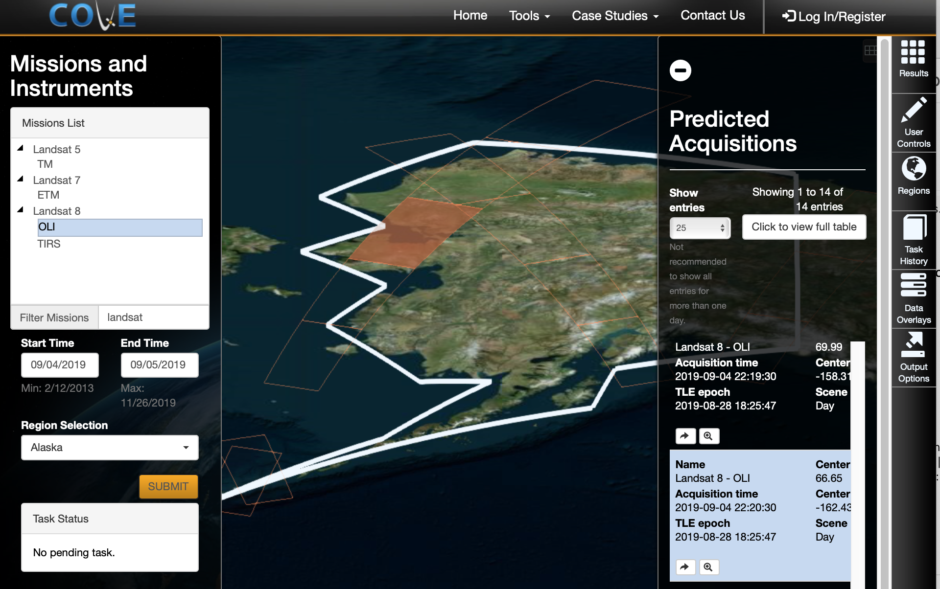
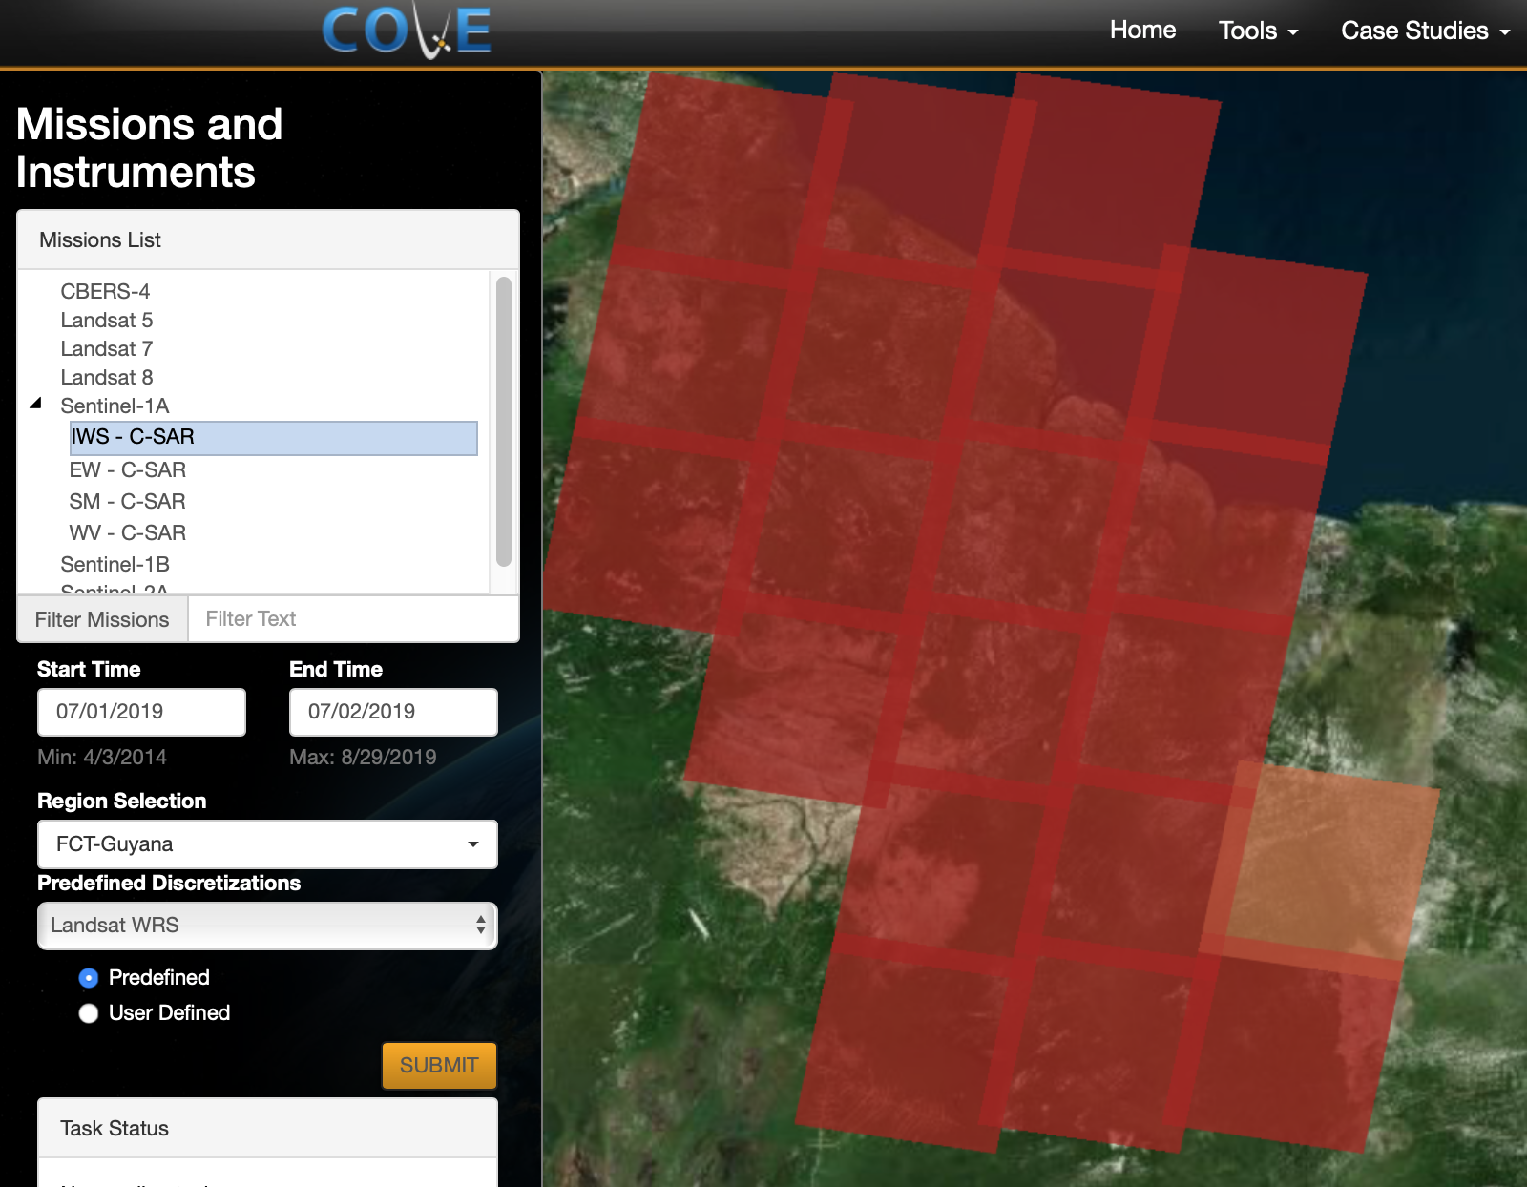
COVE Tool Summary
The CEOS Visualization Environment (COVE) is a browser-based suite of tools for searching, analyzing, and visualizing actual and potential satellite sensor coverage.
COVE is FREE and OPEN for anyone to use! The tools includes over 131 missions and is linked to mission archives to get metadata and browse images for: Landsat-5/7/8, Sentinel-1, and Sentinel-2.
Tools include: Acquisition Forecaster (past and future groundtracks), Coverage Analyzer (past acquisitions and browse images), Data Browser (data filtering), Data Policy (link to portal), and Utilities (swath calculator).
www.ceos-cove.org

Slide 4
COVE Status
Lost our COVE developer in mid-2018 and it has taken some time to find a replacement and get that person (Kim Brooks) trained and working on COVE updates.
Corrected many issues with the TLE database (mission orbit positions) and API connections to mission archives. Things are running well for Landsat, S1 and S2 now. The acquisitions are now updated daily. We have chosen not to include other mission archive connections as the demand is low and the connections (via CWIC) have caused issues (e.g. CBERS-4).
Added Google Analytics for better tracking of users.
Custom missions feature now allows future missions to be modeled and their coverage viewed. Without actual TLE (orbit position) data, this is the only way to view notional mission coverage. For example, we will add NISAR as one of the custom missions to show its potential footprint.
Updates for late 2019 include a new coverage/revisit performance feature. Updates for 2020 include a new capability for coincident observation calculations for single missions or for mutlipel missions over a given location and time window. This will be ideal for Cal-Val work.
GFOI Country Reports: http://ceos.org/ourwork/ad-hoc-teams/sdcg/country-reports/
The reports have been updated for Landsat, S1 and S2 thru 2018 for more than 70 GFOI countries. The data is available in PDF or EXCEL format.

Slide 5
Other Topics
What is the status of the ALOS data in S3 and indexing?
All the raw ALOS data was copied to the GA’s S3 bucket earlier this month, and we are expecting Alex Leith (GA) to put it in the right format for us to index. On our NASA-SEO end, we are performing the same task, to have a short-term backup.
What is the status of the ODC Sandbox?
We (NASA SEO) have the ODC sandbox working and have indexed S3 COGS data successfully. So far, we have indexed ARDC COG data on S3. We will target DCAL notebooks and other algorithms.
What is the status of the Google Earth Engine API connection?
NASA-SEO is working this task. This is still work in progress where we are in the process of figuring out the workflow. At some point in mid-September, we will call for another telecon with GEE folks. For example, can we adjust our Data Cube API so that it points to the GEE data and we use their data as if it were in AWS? That is the ultimate goal.

Slide 6
Verizon WIFI Info
Verizon-MiFi8800L-119A
Password: 5c208313
Verizon-MiFi8800L-1178
Password: efafc352
Verizon-MiFi6620L-55D8
Password: afb070cf

