Slide 1
Digital Earth Africa
Update
Medhavy Thankappan, Andreia Siqueira
(with input from the DE Africa Team)

Slide 2

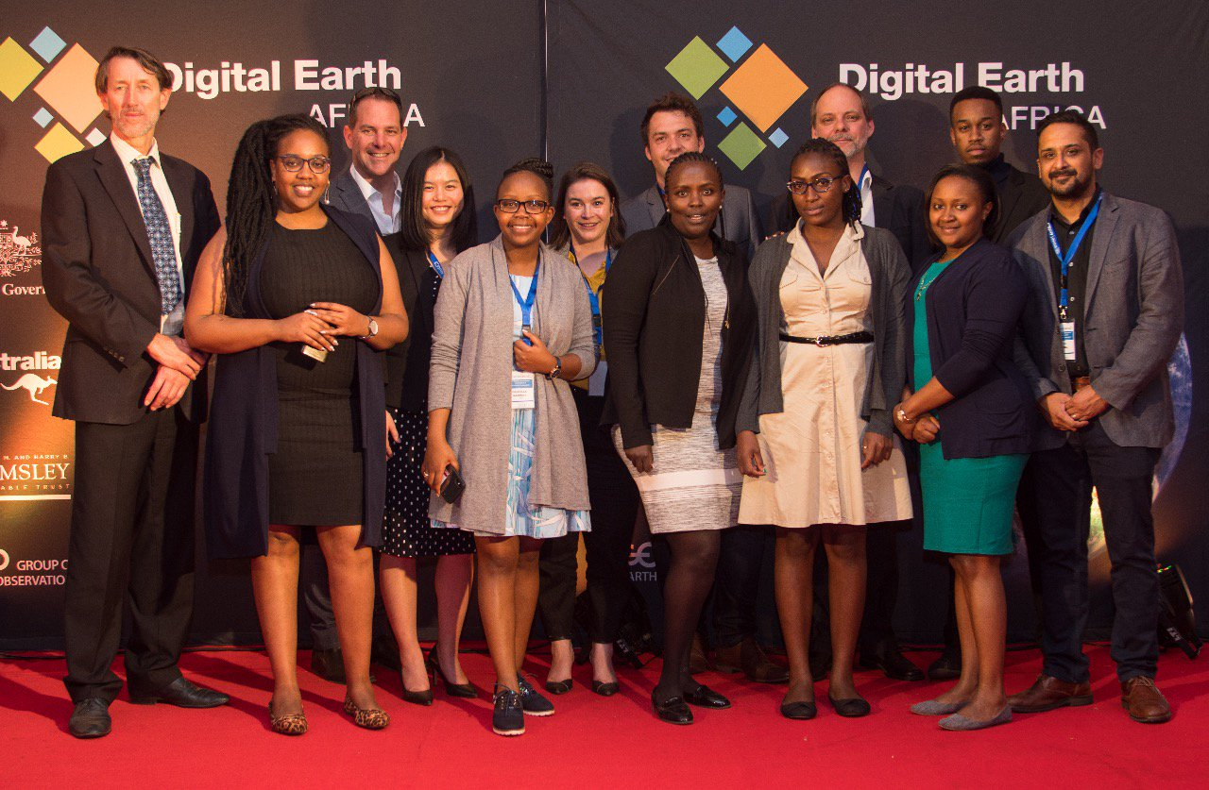
DE Africa: Introduction
US based Helmsley Charitable Trust and the Australian Government have funded the establishment of DE Africa
Digital Earth Australia will provide technical and operational guidance
DE Africa will eventually be a sovereign operational and analytical capability for Africa with in-country expertise in EO data analysis and management

Slide 3
Governing Principles for DE Africa
Accountability and transparency
Continental-scale
Operational service
Responsive to African priorities
Foster collaboration
Open and free data
Sustainable
Diversity and inclusion
Multi-sector perspectives
Span data communities
Domain expertise
Agile, nimble and action oriented
Interoperability
Privacy and Integrity

Slide 4
Governance Structure
Governing Board
Stakeholder Community Group
Technical Advisory Committee
Strategic guidance, oversight and accountability
Expert Advice and Guidance
Ensure successful achievement of the mission and vision of DE Africa
Products Roadmap and Annual works
Alignment and growth opportunities
Engagement with key users to deliver with impact.
Cross-community stakeholder engagement
Provide diverse representation, across sectors, geography and gender
Facilitate communications to and from the broad stakeholder base
Access the views of a wide stakeholder base and diverse organisations
Notes:
The Governance Framework has now been established and available on the DE Africa website.

Slide 5
Year 1
Strategy and vision
Governance framework
Institutional hosting arrangements
Recruitment of DE Africa staff
Build data and infrastructure
Continental-wide beta data product
Communication, outreach and stakeholder engagement strategies
Africa-wide events
Establish key partnerships with
in-country enablers
Alignment strategy
Investment Design
Basic foundation including data cube environment and datasets
Setting the foundations
Building capacity & uptake
A developing ecosystem
Notes:
The program is currently in the first year of a 3 year plan.

Slide 6
Year 2
First Annual Users Meeting
Product roadmap
3 data products
DE Africa office fully staffed
Regular training / capacity building program
Engagement at the country level on uptake of developed data products
Increased ability at the country level to exploit data and tools
Study of EO data economic value for Africa
Increased political engagement
Co-investment from additional philanthropic / aid agencies
In Africa, run by Australians and Africans
Setting the foundations
Building capacity & uptake
A developing ecosystem

Slide 7
Year 3
Setting the foundations
Building capacity & uptake
A developing ecosystem
> 5 data products
Case studies on the impact of EO data for policy and coordination mechanisms at the country level
A developing business case for direct country-level investment based on delivered value
Data is independently ingested into new, innovative applications
Sustainability plan for continued operations
In Africa, run by Africans

Slide 8
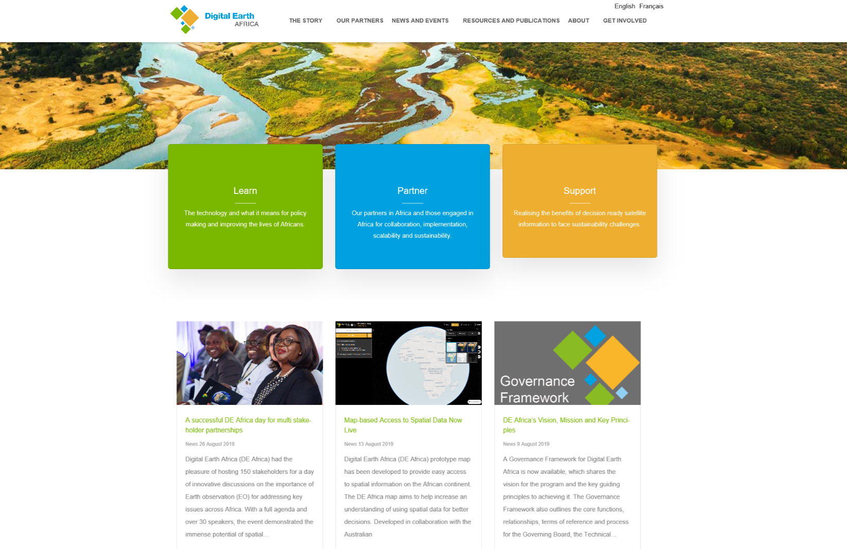
DE Africa Website https://www.digitalearthafrica.org/

Slide 9
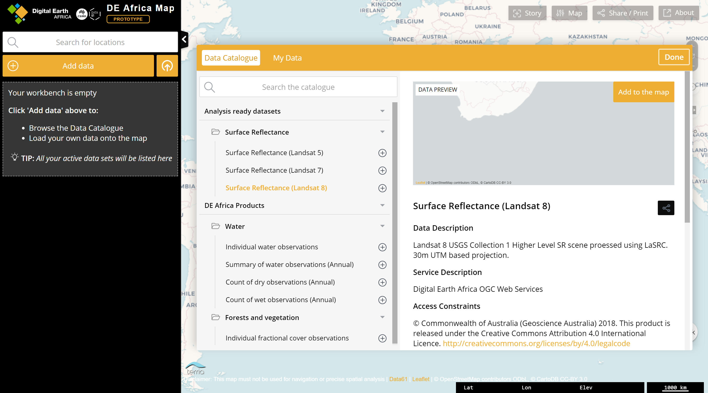
maps.digitalearth.africa
Notes:
The DE Africa Map prototype currently provides Surface Reflectance from Landsat 5, 7 and 8.

Slide 10
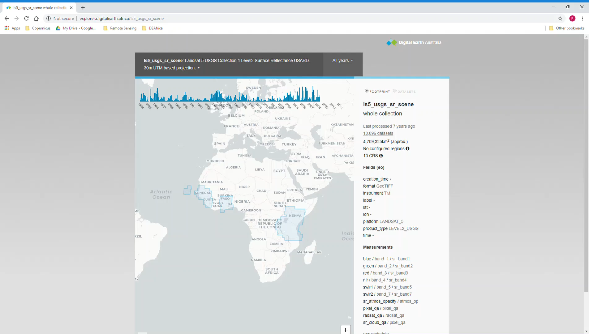
DE Africa Explorer - http://explorer.digitalearth.africa/
Countries covered:
Kenya
Senegal
Sierra Leone
Ghana
Tanzania
Rwanda
Burundi
Cape Verde
The Gambia
Togo
Guinea-Bissau

Slide 11
Upcoming DE Africa Datasets
Digital Elevation Models
ALOS JERS, PALSAR and PALSAR2 Mosaics (radar)
USGS Collection 2 Landsat Surface Reflectance
Water observations
All at continental scale

Slide 12
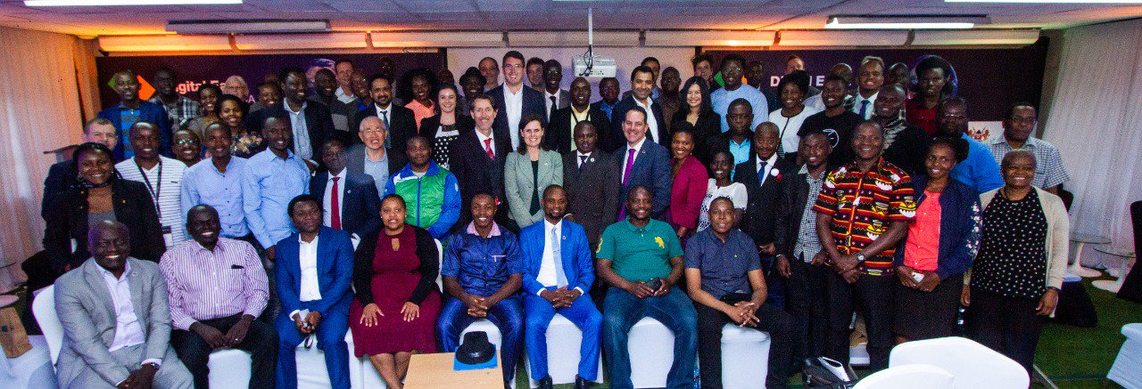
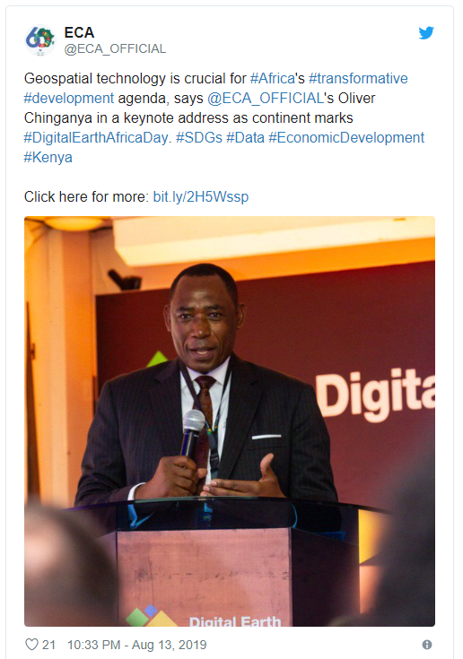
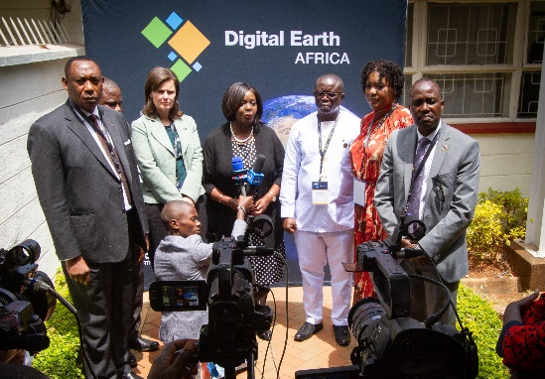
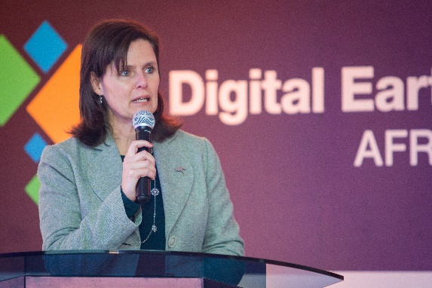
Digital Earth Africa Day - #DEAfricaDay
Notes:
Digital Earth Africa Day held on Mon 12 Aug on the sidelines of RIC 2019 in Nairobi, Kenya. Over 150 stakeholders attended and over 30 speakers including key notes from Oliver Chinganya, Director of UNECA’s Africa Centre for Statistics; Alison Chartres, Australian High Commissioner to Kenya, Tanzania, Uganda and Rwanda; Hon William Kwasi, Deputy Minister for the Republic of Ghana; Hon Mamadi Gobeh Kamara, Deputy Minister, Republic of Sierra Leone; and Ambassador Raychelle Omamo ‘SC’, Cabinet Secretary for Defense, Republic of Kenya.

Slide 13
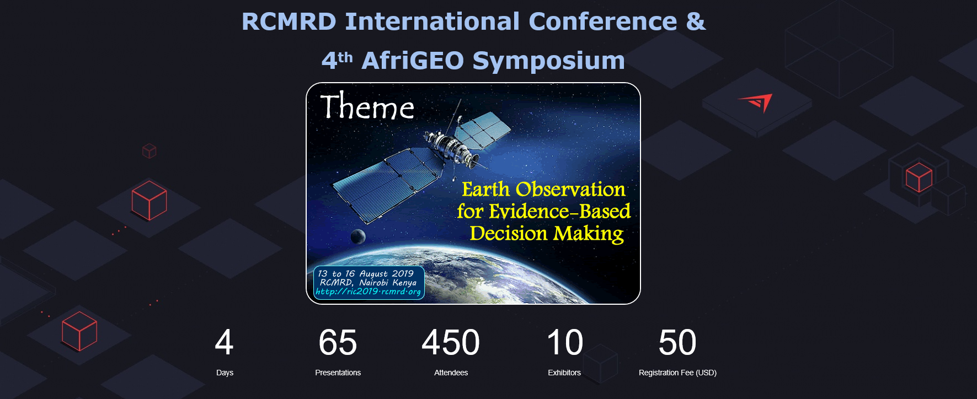
RCMRD Conference and AfriGEO Symposium

Slide 14
Upcoming DE Africa Events
Australia Africa Week Perth, Australia 4 September 2019: DE Africa presentation to update Australia’s Head of Missions and African Ministers
DE Africa Presentation at World Economic Forum Africa Summit, Cape Town, South Africa 4-6 September 2019
Signing of MoU with the United Nations Economic Commission for Africa (UNECA) - the institutional host for DE Africa Office, in Addis Ababa, Ethiopia (September 2019)
Continental-scale beta product release at GEO Week 2019

Slide 15

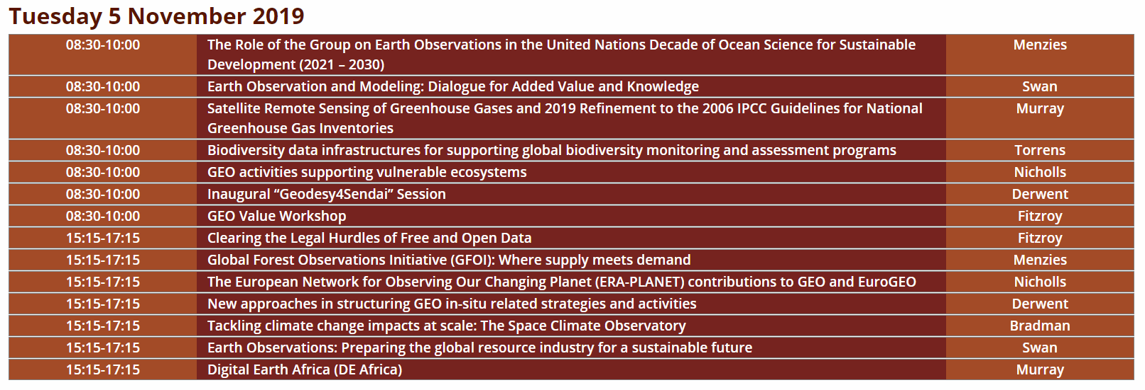
GEO Week 2019
4-9 November 2019 Canberra, Australia

Slide 16
Thank you

