Slide 1
Discussion: Accessibility & Location of ARD
Committee on Earth Observation Satellites
G Dyke
LSI-VC-8
Session 4
Anchorage, Alaska, USA
4-6 September 2019

Slide 2
Discussion Topic
Link to agenda item
Discussion: Accessibility & Location of ARD
Revisiting the paradigm of “bringing the users to the data”
How ARD is produced and made available
Going in Questions
Where and in what format(s) will Landsat Collection 2 be? This will likely be a leader in user expectations.
How can we amplify Sentinel-2 ARD from SciHub? The data is there and being produced systematically, but location, access and format are reported bottlenecks.

Slide 3
Answers from Initial Discussion
Link to agenda item
Where and in what format(s) will Landsat Collection 2 be? This will likely be a leader in user expectations.
AWS S3, US West, COG support
3x metadata formats, incl STAC
Existing access/service level preserved, w/ capped risk
Many new possibilities opened up with cloud move
How can we amplify Sentinel-2 ARD from SciHub? The data is there and being produced systematically, but location, access and format are reported bottlenecks.
Is this worthwhile? Or is it better to wait for a more comprehensive strategy for S2 ARD?
Would this be resisted in deference to DIAS?
ADD: How can we amplify ARD flows in general? ALOS Mosaics, etc.

Slide 4
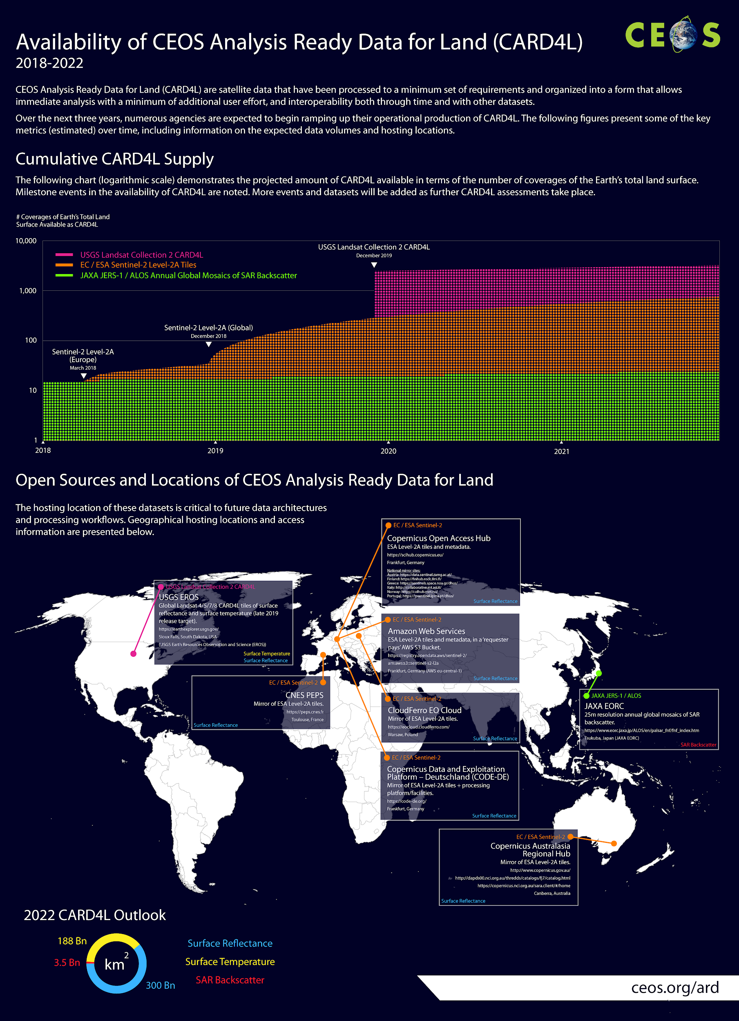

Slide 5
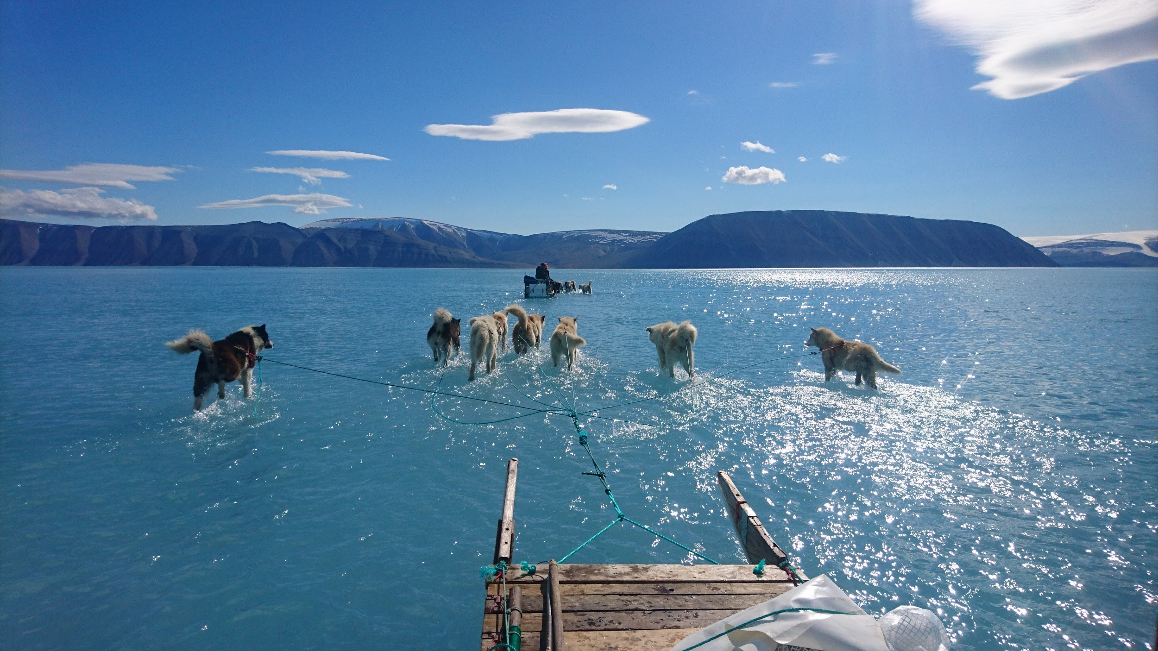
Drill Down: “Bring the user to the data”.
Is this real?
Are we moving in the right direction?
What are best current or likely examples?
Is CEOS doing all we can to enable this?
https://twitter.com/rasmustonboe/status/1139504201615237120?s=11

Slide 6
Background: FDA
2016 SDCG Global Data Flows Study (doc | presentation)
2017 Strategic Discussion Paper
2017 CEOS Plenary Presentation
2018: WGISS-45: FDA Workshop
2018: CEOS Chair (COM) FDA Big Data Workshop (at SIT-33)
Lots of existing and ongoing thinking in agencies and in CEOS

Slide 7
CEOS Plenary 2017
From CEOS Plenary 2017

Slide 8
From WGISS-45
Where to locate ARD…?
LSI-VC

Slide 9
Backup

Slide 10
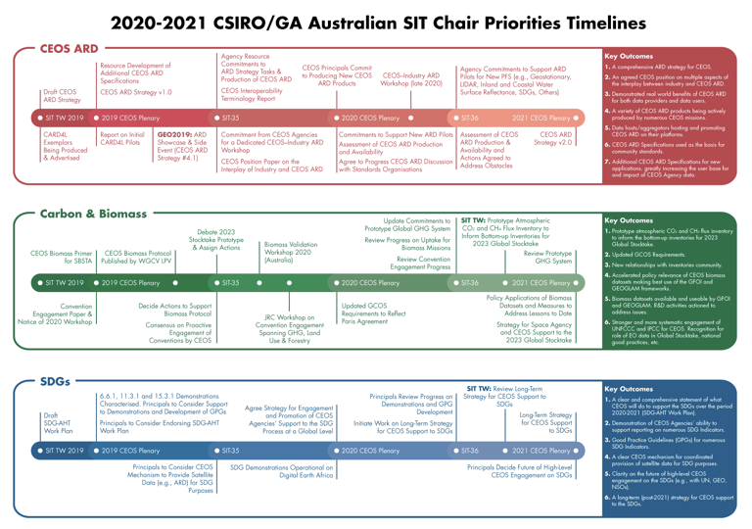
2020-2021 SIT Chair Priorities

Slide 11
1: CEOS ARD User Needs & Specifications
1.1: Continue development of the CARD4L Product Family Specifications
1.2: Identify the need for and prioritise development of future target products as the basis for new CEOS ARD standards
1.3: Develop further CEOS ARD technical specifications based on established need and prioritisation
1.4: CEOS Interoperability Terminology Report
The terms Analysis Ready Data (ARD), interoperability, and harmonization are often used and, to a large extent, used inconsistently. To rectify this, CEOS will produce a report discussing and providing examples of key terms.

Slide 12
2: Assured Production and Access
2.1: Engage Big Data hosts and aggregators and establish formal pipelines and procedures to promote CEOS ARD hosting and uptake on their platforms.
CEOS needs to engage in a coordinated fashion with Big Data hosts and aggregators that are already re-hosting publicly available free and open data to: streamline the movement of data to global platforms, improve consistency of data and provide some means for users to verify data provenance and quality, ensure CEOS Agencies are appropriately recognized and referenced as the data source, and to promote the uptake/rehosting of CEOS ARD specifications/datasets.
2.2: Survey users’ needs with regard to ARD accessibility and provide feedback to all data providers.
2.3: CEOS Position Paper on the Interplay of Industry and CEOS ARD.
Look into the different roles industry may play (e.g., as data users, data providers, data hosts, and as providers of processing chains to produce data that meet CEOS ARD specifications) and seek to establish a CEOS position on each aspect.
Key considerations: machine-to-machine communication (including the role of COG and STAC technologies), machine learning, automation, and analysis platforms.

Slide 13
3: Pilots and Feedback
3.1: Production of CEOS ARD and supply to data aggregators and platforms.
CEOS Agencies to commit to producing CEOS ARD as a standard product for their missions
Ensure this data is easily accessible by the public, both through in-house, proprietary access portals but also through redistribution by third-party global IT platforms
3.2: Open Data Cube/Digital Earth Africa Pilot
3.3: GFOI Pilot
SDCG-GFOI to coordinate
ARD supply and access trials for select users in the GFOI/forest monitoring community
3.4: GEOGLAM Pilot
ARD supply and access trials for select users in the GEOGLAM/JECAM agricultural monitoring communities
3.5: Mekong Data Cube Pilot
Building on the effort started through the 2019 CEOS Chair Initiative
3.6: Other Pilots
e.g., COVERAGE

Slide 14
4: Communication & Promotion
4.1: GEO showcase and side event: Analysis Ready Data
4.2: CEOS–Industry ARD Workshop
CEOS Agencies commit to organise a dedicated CEOS ARD workshop, inviting agencies, researchers and the private sector to continue engagement between EO data providers (public and commercial), big data hosts/aggregators, and data users.
2020; perhaps co-located with ARD3 and LSI/SDCG/GEOGLAM meeting?
4.3: CEOS ARD stocktake and outlook
Define and maintain a clear statement as to the current and future availability of the different datasets produced to its ARD standards, and how to access them
4.4: Promotion of CEOS ARD to standards organisations
Explore whether CEOS ARD specifications might be used as the basis for broader, official community standards (e.g., via OGC)
4.5: Promotion of CEOS ARD to data providers
4.6: Communication with CEOS ARD users

