Slide 1
WGCV-45 Update
Medhavy Thankappan
LSI-VC8
Anchorage, AK USA
4-6 September 2019

Slide 2
WGCV Introduction
The mission of the CEOS Working Group on Calibration & Validation (WGCV) is to ensure long-term confidence in the accuracy and quality of Earth Observation data and products and to provide a forum for the exchange of information about calibration and validation, including the coordination of cooperative activities.
Calibration is the process of quantitatively defining a system’s response to known and controlled signal inputs. Validation, on the other hand, is the process of assessing, by independent means, the quality of the data products derived from those system outputs.
WGCV addresses the need for standardizing the ways that different data sources are combined to ensure interoperability among existing and future Earth Observing systems. WGCV promotes the international exchange of technical information and documentation, joint experiments, and the sharing of facilities, expertise, and resources. Focal point for all things related to calibration and validation in the international user community. WGCV Subgroups also conduct many activities around specific topics and sensor types.

Slide 3
WGCV Subgroups
The CEOS Working Group on Calibration & Validation (WGCV) supports six Subgroups that operate as individual entities and focus on specific technical areas related to calibration and validation:
Atmospheric Composition (ACSG)
Infrared Visible Optical Sensors (IVOS)
Land Product Validation (LPV)
Microwave Sensors (MSSG)
Synthetic Aperture Radar (SAR)
Terrain Mapping (TMSG)

Slide 4
WGCV-45 key outcomes
The concept for a new Australian supersite to support multi-mission SAR calibration was presented and discussed. An action was taken to scope out exact requirements, plan, timelines, etc. for discussion at the SAR subgroup meeting in November. The Guideline for Ground Surface Reflectance Validation Measurements and Uncertainty Quantification was presented. WGCV will do a review of the document, submit it to close CEOS Work Plan Task CV-17 and then take this forward within WGCV and create some more specific and global protocols for CEOS to endorse. The WGCV CARD4L peer review process presented was agreed; an initial pool of reviewers was also identified. WGCV is now in a position to peer review the CARD4L self-assessments. WGCV will be proactive in engaging in the GHG Roadmap development. The WGCV Vice Chair will connect with the AC-VC and WGClimate GHG Task Team to ensure that the cal/val requirements in the GHG Roadmap are developed in coordination with IVOS to ensure the requirements are suitable and actionable. The new Cal/Val Portal will be made live at the end of October. The Terrain Mapping Subgroup (TMSG) was renewed with Peter Strobl/EC as the lead. The first task will be to develop a detailed plan for the DEMIX (DEM intercomparison) task that was proposed during the meeting. WGCV-46 is targeted for March 23-27 at Caltech. WGCV-47 is proposed to be joint with WGISS, and ROSCOSMOS offered to host (14-18 September 2020, Sochi).

Slide 5
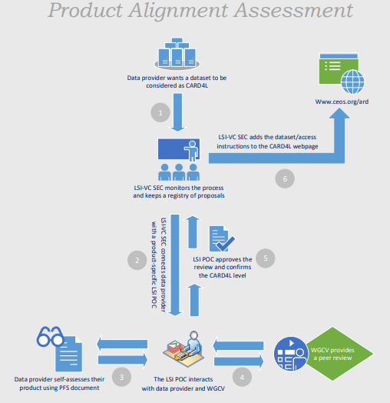
CARD4L product alignment assessment
A process to assess products that are CARD4L compliant has been defined
Data providers proposing products for CARD4L assessment would do a self-assessment of products against the CARD4L specs as the first step
Data providers would then approach LSI-VC for endorsement of a product as CARD4L compliant
LSI-VC would work with WGCV to assess the product against CARD4L specifications

Slide 6
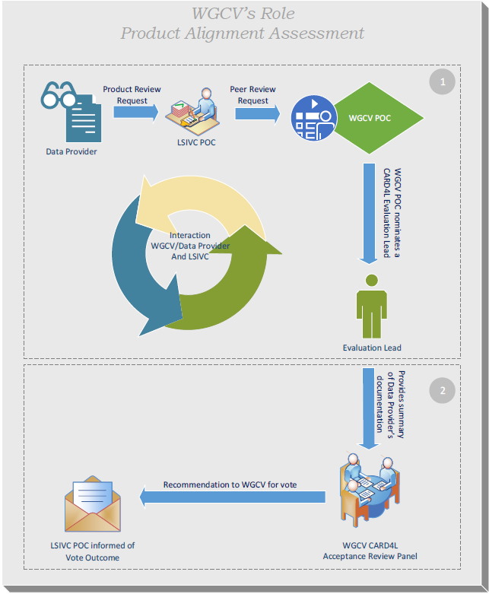
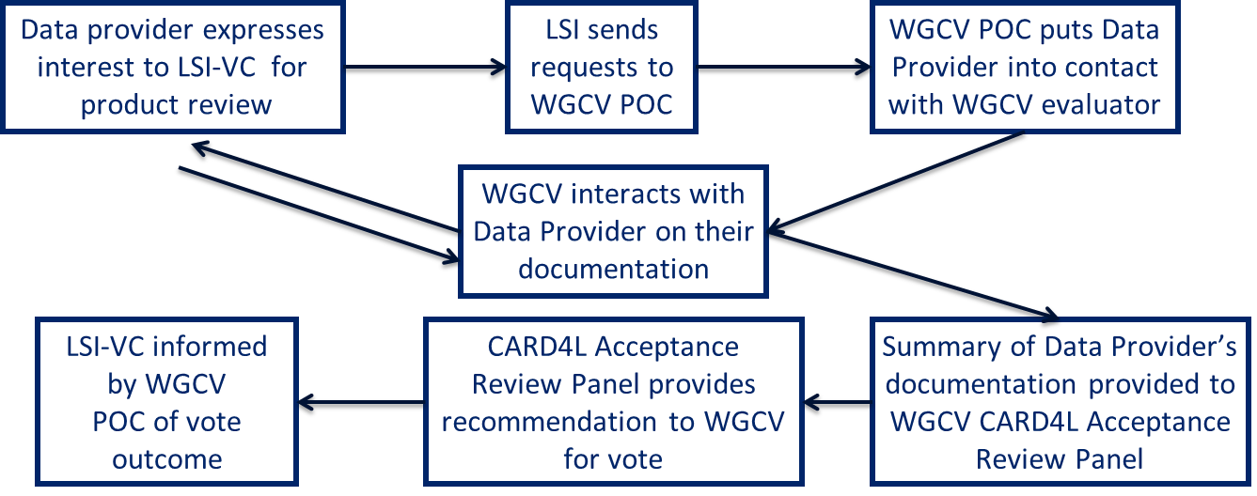
CARD4L product assessment: WGCV role

Slide 7
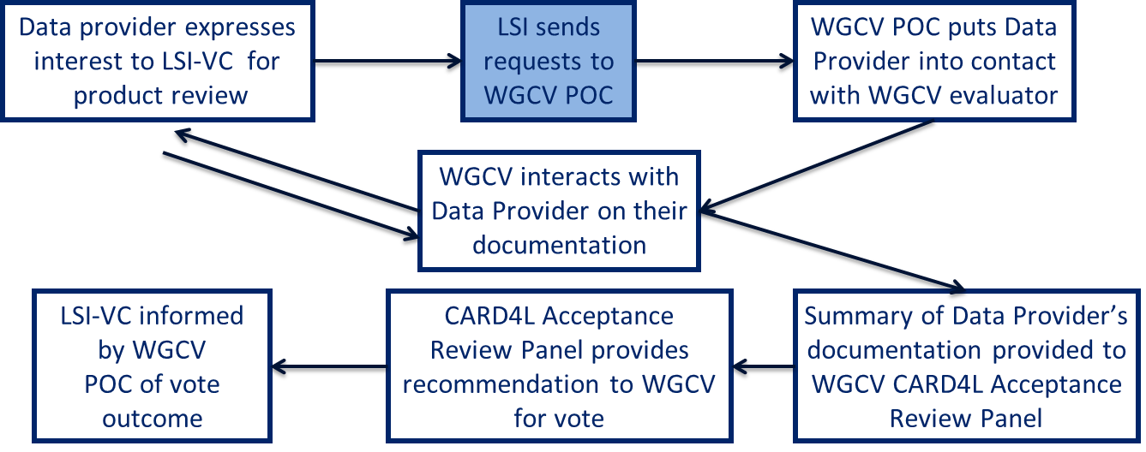
WGCV PoC / Evaluation Lead
WGCV PoC would be similar to the RadCalNet WG lead
CARD4L evaluation lead would be a WGCV member approved for a two-year term at a WGCV plenary meeting with no service limits
CARD4L evaluation lead acts as:
  Point of Contact with LSI-VC
  Initial point of contact with data provider

Slide 8
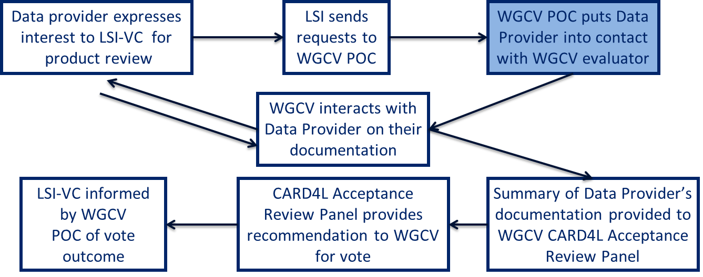
Evaluation process
CARD4L evaluation lead determines the best contact point within WGCV for the Data Provider to interact during the evaluation process
Options available for this step:
  Volunteers provided by WGCV subgroup leads
  Subgroup leads
  WGCV member

Slide 9
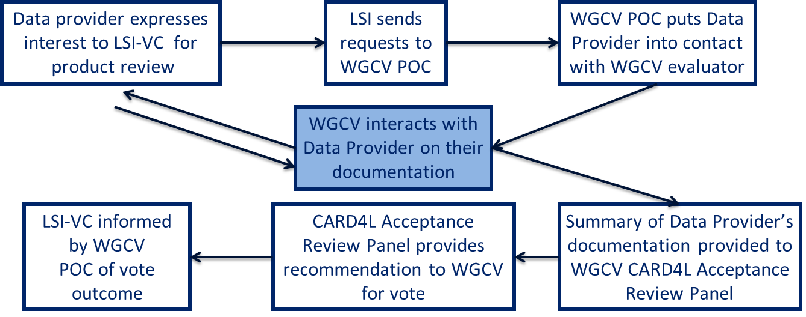
Documentation
Evaluation process involves interaction between the WGCV representative and the Data Provider
Collaborative process
  Help ensure documentation follows accepted nomenclature
  Clear demonstration of necessary quality
  Goal is to help Data Provider move toward acceptance
Data Provider has a choice to move documentation to the WGCV’s CARD4L Acceptance Review Panel without the WGCV representative’s approval

Slide 10
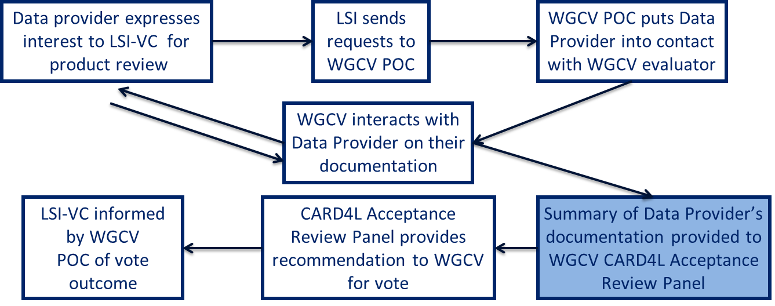
CARD4L Review Panel
WGCV will assemble a CARD4L Acceptance Review Panel, lead would be the CARD4L Evaluation Lead
WGCV representative supplies summary evaluation of the Data Provider’s documentation to the CARD4L Acceptance Review Panel
Suggested total of five members on the panel including:
  One WGCV member
  Three members who are either WGCV members or sub-group members nominated by the sub-group chairs
  Not more than one member from a given sub-group
  Two-year terms for all members

Slide 11
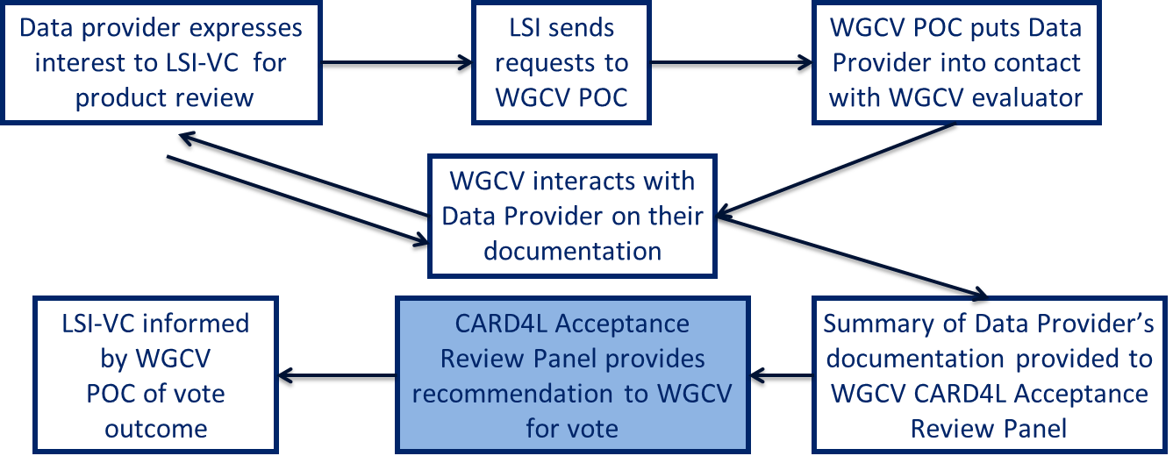
Review Panel recommendation
CARD4L Acceptance Review Panel evaluates the summary from the WGCV evaluator and formulates a recommendation
Recommendation of approval requires concurrence by majority
Evaluation can be done via telecons / email, and should take place within 6 weeks of receiving the evaluator’s summary
Recommendation of approval / disapproval is carried forward to the WGCV membership for a vote

Slide 12
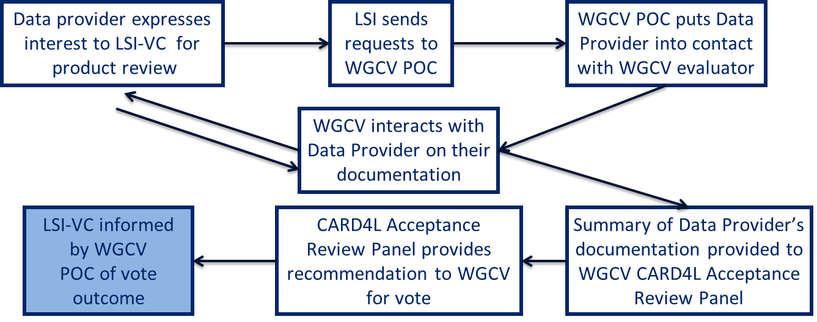
WGCV vote
WGCV membership votes on the Data Provider’s documentation not the panel recommendation
WGCV vote can take place either via email or at a WGCV meeting
Documentation is accepted at a WGCV meeting unless three present members indicate disapproval; default is to wait until next WGCV meeting unless Data Provider requests the process be done via email
Documentation and panel recommendation forwarded to full WGCV membership for at least one month, and accepted unless five members register disapproval by email

Slide 13
CARD4L Review Panel - member pool
Initial pool members identified at WGCV-45
Evaluation Lead (M Thankappan)
WGCV member at large (N Fox)
IVOS subgroup (J Czapla-Meyers, C Anderson, L Ma)
LPV subgroup (F Gascon, F Camacho)
SAR subgroup (B Chapman, D Guedtner, N Miranda, T Tadono)
Land Surface Temperature (D Ghent, F Goettsche)

Slide 14
Questions
medhavy.thankappan@ga.gov.au

