Slide 1
USGS Landsat Collection 2
Steve Labahn, USGS
LSI-VC-8 / GEOGLAM / SDCG-16 Joint Meeting
Session 3.1
Anchorage, Alaska USA
4-6 September 2019

Slide 2
Topics
Collection 1
Collection 2
  Level-1 Products
    Level-1 Recipe / Projection Specification
    Registration Base Harmonized to Sentinel-2 GRI
    Updated DEM Sources
  Level-2 Products
    Atmospheric Auxiliary Data Sources
    Quality Band and Metadata Updates
Collection 1 vs. Collection 2 Summary
CARD4L Self-Assessment
Collection 2 Schedule

Slide 3
Collection 1
Current Processing Status
Collection 1 forward processing nominal for new Landsat 7 and Landsat 8 data
  All Landsat 1-8 data capable of being processed to Level-1 included in Collection 1
  New historical Landsat Global Archive Consolidation (LGAC) scenes added daily
Level-2 U.S. Analysis Ready Data (ARD) tiles are being generated over the continental United States, Alaska, and Hawaii
  Includes both Surface Reflectance (SR) and Surface Temperature (ST) bands
Collection 1 to remain available for both forward processing and archive access for at least one year after the start of Collection 2

Slide 4
Collection 2
Level-1 Products
Level-1 products will only undergo minor changes to preserve capabilities for users relying on our current Level-1 offerings
  Angle bands (solar and sensor viewing zenith and azimuth) are being added to assist users who want to generate their own TOA reflectance and brightness temperature bands
  Minor metadata enhancements and consistency changes based on Metadata Tiger Team recommendations
Other processing changes remain as previously briefed
  Updated geometric registration base harmonized to Sentinel-2 Global Reference Image (GRI)
  Modernized Digital Elevation Model (DEM) for terrain correction
  Improvements to the precision modeling process to allow more products to process to Level-1TP
  Algorithm to detect Internal Calibrator (IC) shutter intrusion events and flag them in the metadata
  Minor bug fixes and Cal/Val enhancements

Slide 5
Collection 2
Level-1 Recipe / Projection Specification
No major changes made to the Level-1 processing recipe for Collection 2 products:
  Projection: Universal Transverse Mercator (UTM) / Polar Stereographic (PS)
    U.S. ARD products will be generated in the Albers projection, per current specification
  Resampling Method: Cubic Convolution (CC)
  Pixel Size (Reflective) (MSS, TM / ETM+, OLI): 60m / 30m
  Pixel Size (Thermal) (TM / ETM+ / TIRS): 30m / 30m / 30m
  Datum: WGS84
Updated global Digital Elevation Model (DEM) will replace the current Collection 1 GLS DEM by incorporating more modern sources
  Includes NASADEM, CDEM, SNF, Alaska NED, GIMP, NPI, and ArcticDEM
Metadata changes are planned for both Level-1 and (especially) Level-2
  Additional details on Level-2 metadata will be provided in a forthcoming slide

Slide 6
Collection 2
Registration Base Harmonized to Sentinel-2 Global Reference Image (GRI)
Global re-adjustment to harmonize Landsat 8 OLI-based ground control with Sentinel-2 GRI is complete
  Comparisons of GRI and Collection 1 OLI data show 26m CE90 registration accuracy
  New OLI GCPs were extracted and triangulated to the Sentinel-2 GRI
  Results show that the updated Collection 2 control yields Landsat / Sentinel-2 registration accuracy better than 10m CE90

Slide 7
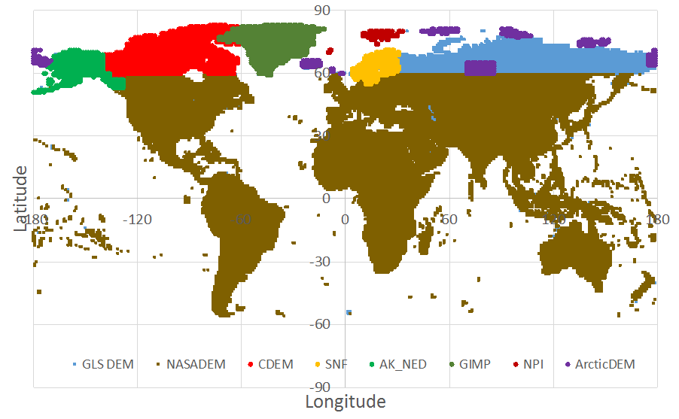
Collection 2
Updated DEM Sources

Slide 8
Collection 2
Level-2 Product Composition
Level-2 products will be processed from all Level-1 inputs (Tier 1 or Tier 2) that meet the Solar Zenith Angle (SZA) constraint and that have required auxiliary data
  Level-2 products only generated for L4-5 TM, L7 ETM+, and L8-9 OLI/TIRS
    L1-5 MSS atmospheric correction capabilities under investigation
  LEDAPS and LaSRC provide the Level-2 Surface Reflectance (SR) processing capabilities
  Single-channel algorithm will provide Surface Temperature (ST) retrievals for all instruments
  Auxiliary bands associated with ST processing will be included with the product
    Emissivity, emissivity standard deviation, atmospheric transmittance, upwelled radiance, downwelled radiance, thermal radiance, and cloud distance
  L7 ETM+ products will include a single ST band
    ST will be derived from Band 6H if it is unsaturated (better radiometric resolution) and 6L otherwise
Updated, consistent Quality Band specification for both Level-1 and Level-2 products

Slide 9
Collection 2
Level-2 Atmospheric Auxiliary Data
Auxiliary Data Type | TM / ETM+ | OLI / TIRS
Air Pressure | NCEP Grid | Internally Calculated
Water Vapor | NCEP Grid | MODIS CMA
Air Temperature | NCEP Grid | MODIS CMA
Aerosols | Internally Calculated | MODIS CMA
Ozone | OMI / TOMS | MODIS CMG
Atmospheric Elevation Model | Global Climate Model DEM | Global Climate Model DEM
Atmospheric Reanalysis Source | GEOS-5 FP-IT (new data) MERRA-2 (archive data) | GEOS-5 FP-IT (new data) MERRA-2 (archive data)
Emissivity Source | ASTER GED | ASTER GED

Slide 10
Collection 2
Quality Band Specification – Landsat 8 Level-1
Landsat 8 Level-1 Quality Band 1 (QB1): BQA
Bit | Name | # Bits | Source | Description / Notes
0 | Fill | 1 | CFMask | Use same approach as Level-2 processing to characterize which pixels are fill
1 | Dilated Cloud | 1 | CFMask
2 | Cirrus | 1 | OLI/TIRS CCA Algorithm
3 | Cloud | 1 | CFMask | Current implementation: Only pixels classified as a cloud (not dilated clouds) get this bit set
4 | Cloud Shadow | 1 | CFMask | Current implementation: Cloud shadow is based on dilated clouds
5 | Snow | 1 | CFMask
6 | Clear | 1 | CFMask | Clear bit is set to OFF if the cloud or dilated cloud bits are set
7 | Water | 1 | CFMask
8 | Cloud Confidence | 2 | CFMask
9
10 | Cloud Shadow Confidence | 2 | CFMask | Currently only has high and low settings, so "intermediate" confidences would be a future enhancement.
11
12 | Snow / Ice Confidence | 2 | CFMask | Currently only has high and low settings, so "intermediate" confidences would be a future enhancement.
13
14 | Cirrus Confidence | 2 | OLI/TIRS CCA Algorithm | Currently only has high and low settings, so "intermediate" confidences would be a future enhancement.
15
Landsat 8 Level-1 Quality Band 2 (QB2): RADSAT_QA
Bit | Name | # Bits | Source | Description / Notes
0 | Band 1 Saturation | 1 | Level 1 RPS + Resampler Saturation
1 | Band 2 Saturation | 1 | Level 1 RPS + Resampler Saturation
2 | Band 3 Saturation | 1 | Level 1 RPS + Resampler Saturation
3 | Band 4 Saturation | 1 | Level 1 RPS + Resampler Saturation
4 | Band 5 Saturation | 1 | Level 1 RPS + Resampler Saturation
5 | Band 6 Saturation | 1 | Level 1 RPS + Resampler Saturation
6 | Band 7 Saturation | 1 | Level 1 RPS + Resampler Saturation
7 | Band 8 Saturation | 1 | Level 1 RPS + Resampler Saturation | Not currently populated, kept in for consistency with L2 pixel_qa
8 | Band 9 Saturation | 1 | Level 1 RPS + Resampler Saturation
9 | Band 10 Saturation | 1 | Level 1 RPS + Resampler Saturation | Bands 10 and 11 are not currently checked for saturation in Level 1, but are in Level 2
10 | Band 11 Saturation | 1 | Level 1 RPS + Resampler Saturation | Bands 10 and 11 are not currently checked for saturation in Level 1, but are in Level 2
11 | Terrain Occlusion | 1 | Terrain Occlusion App
12 | Unused | 1 | N/A | Not used / populated in Level 1 QB
13 | Unused | 1 | N/A | Not used / populated in Level 1 QB
14 | Unused | 1 | N/A | Not used / populated in Level 1 QB
15 | Unused | 1 | N/A | Not used / populated in Level 1 QB

Slide 11
Collection 2
Quality Band Specification – Landsat 8 Level-2
Landsat 8 Level-2 Quality Band 3 (QB3): SR_AEROSOL_QA
Bit | Name | # Bits | Source | Description / Notes
0 | Fill | 1 | LaSRC
1 | Valid Aerosol Retrieval (center pixel of 3x3 pixel window) | 1 | LaSRC
2 | Water Pixel (or water pixel was used in the fill-the-window interpolation) | 1 | LaSRC
3 | Cloud or Cirrus | 1 | LaSRC | need to revise attribute description for current cloud and shadow bits these bits use PQA in their calculation, but are not populated directly from PQA
4 | Cloud Shadow | 1 | LaSRC | need to revise attribute description for current cloud and shadow bits these bits use PQA in their calculation, but are not populated directly from PQA
5 | Non-center window pixel for which aerosol was interpolated from surrounding 3x3 window center pixels | 1 | LaSRC
6 | Aerosol Level 00 = Climatology 01 = Low | 2 | LaSRC
7 | 10 = Medium 11 = High |  | LaSRC

Slide 12
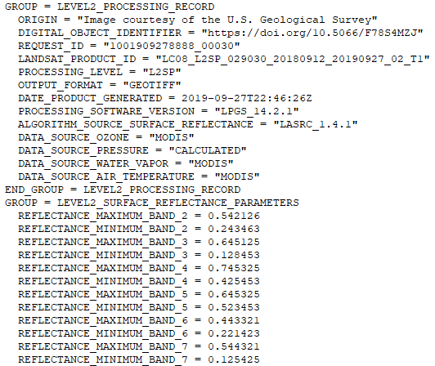
Collection 2
Level-2 Metadata Files
Level-2 metadata file specification has been developed in three standard formats for delivery with products
  Current MTL (traditional ODL-based) format
  Adding XML format (enable scripted / machine-to-machine interaction
  Adding STAC (cloud-enabled) format
Sample metadata files will be provided soon on the Landsat Mission Website
  Writeup is currently in peer review
  https://www.usgs.gov/land-resources/nli/landsat/landsat-sample-products

Slide 13
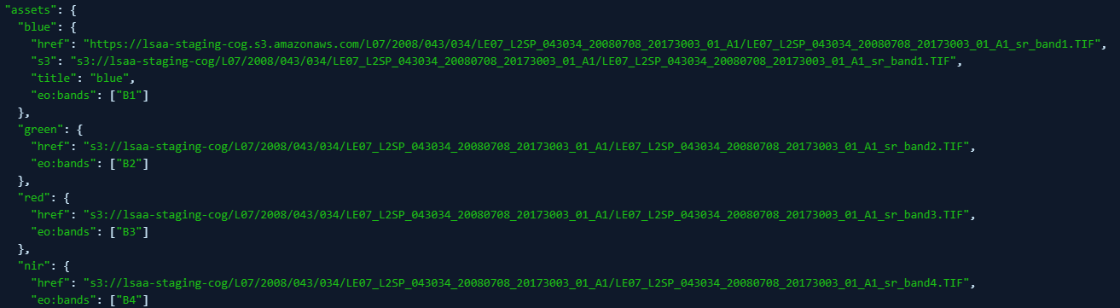
SpatioTemporal Asset Catalog (STAC)
New collaborative standard for managing data assets
Leverages the cloud by creating a light version of access metadata
Normalizes bands across sensors/platforms with real names
Gaining wide adoption by the remote sensing community

Slide 14




AWS Cloud Data Access Concepts
Cloud Optimized GeoTIFFs (COGs)
SpatioTemporal Asset Catalog (STAC) / STAC Browser
New Visualization Tool (LandsatLook)
  Utilizes the Cloud Optimized GeoTIFF format
  Mosaics imagery together
  Enables area of interest (AOI) data extraction
  Creates band composites on-the-fly using serverless compute
Connections to Third Party Tools

Slide 15
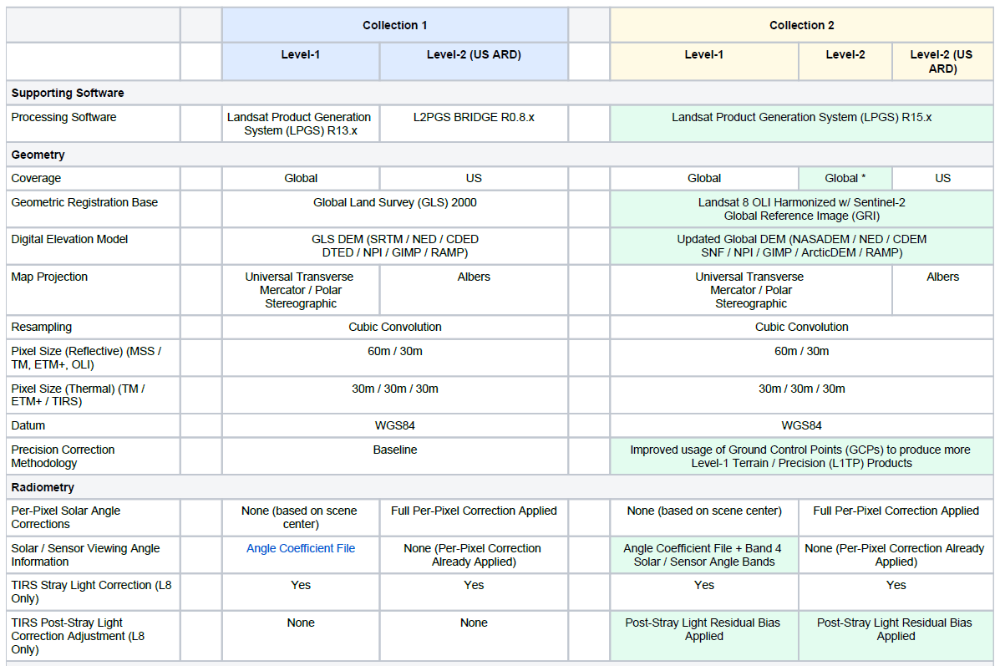
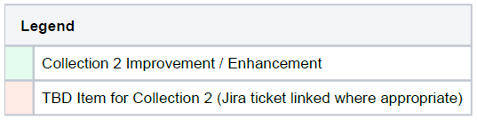
Collection 1 vs. Collection 2 Summary

Slide 16
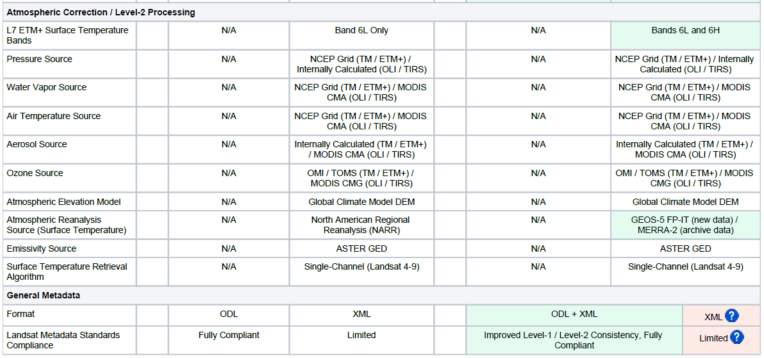
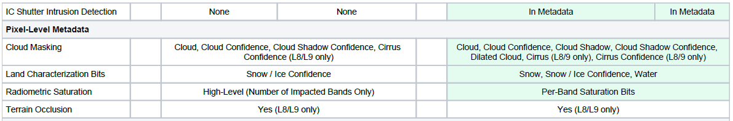
Collection 1 vs. Collection 2 Summary

Slide 17
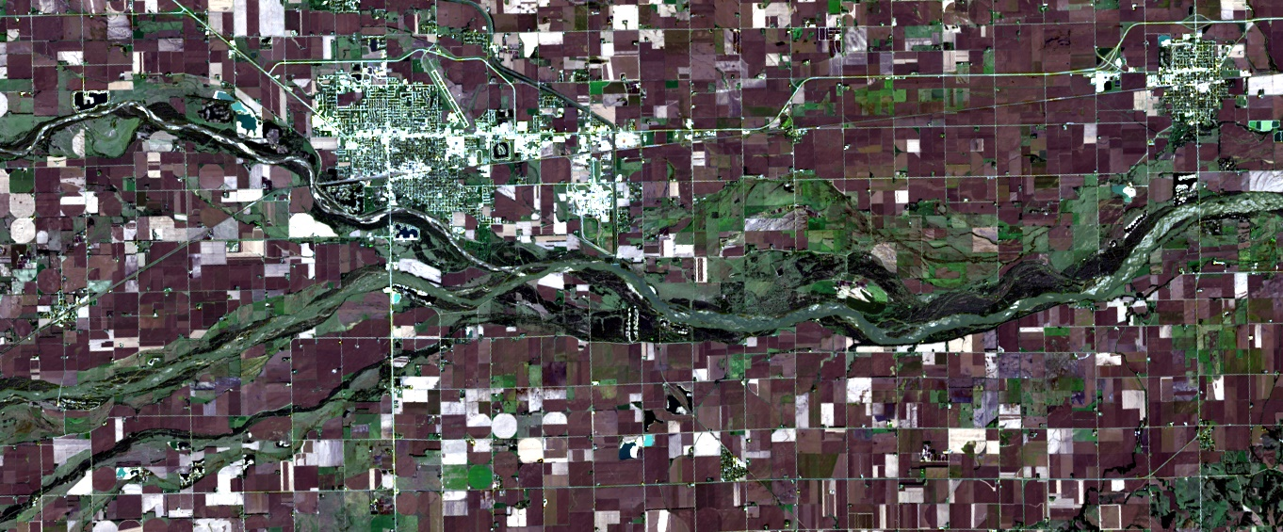
Collection 2
Landsat 8 Level-2 Surface Reflectance
Path 29 / Row 31
October 8, 2016
True-color RGB (4/3/2)
LPGS v15.2.0 (7/22/2019)
LaSRC 1.4.1 (SR)
Single-Channel 1.3.0 (ST)

Slide 18
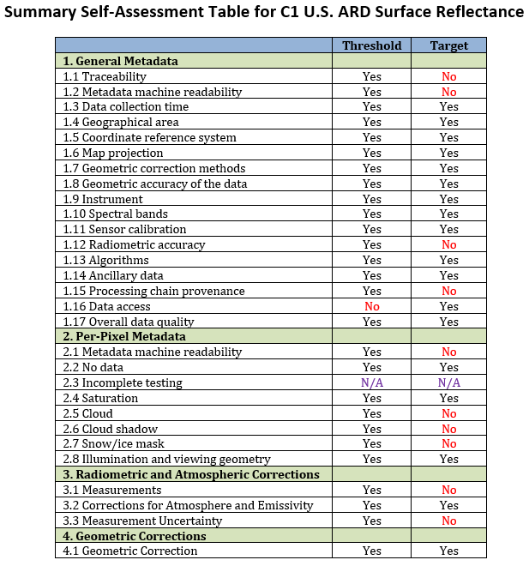
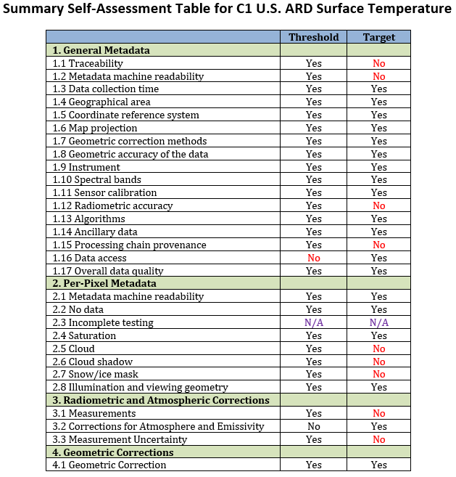
CARD4L Self-Assessment
Collection 1 U.S. ARD
Plan to begin Collection 2 CARD4L self-assessment process in the next few days as sample products become available

Slide 19
Collection 2 Schedule
✔ PKO 28 September 2017
✔ SRR / PDR 25 April 2019
✔ - IAS/LPGS Delivery L2 9 July 2019
✔ CDR 15 August 2019
TRR Level-2 15 October 2019
- IAS/LPGS Delivery C2 25 November 2019
TRR Collection 2 10 December 2019
ORR 24 December 2019
Landsat Collection 2 Processing Start ~ January 2020

Slide 20
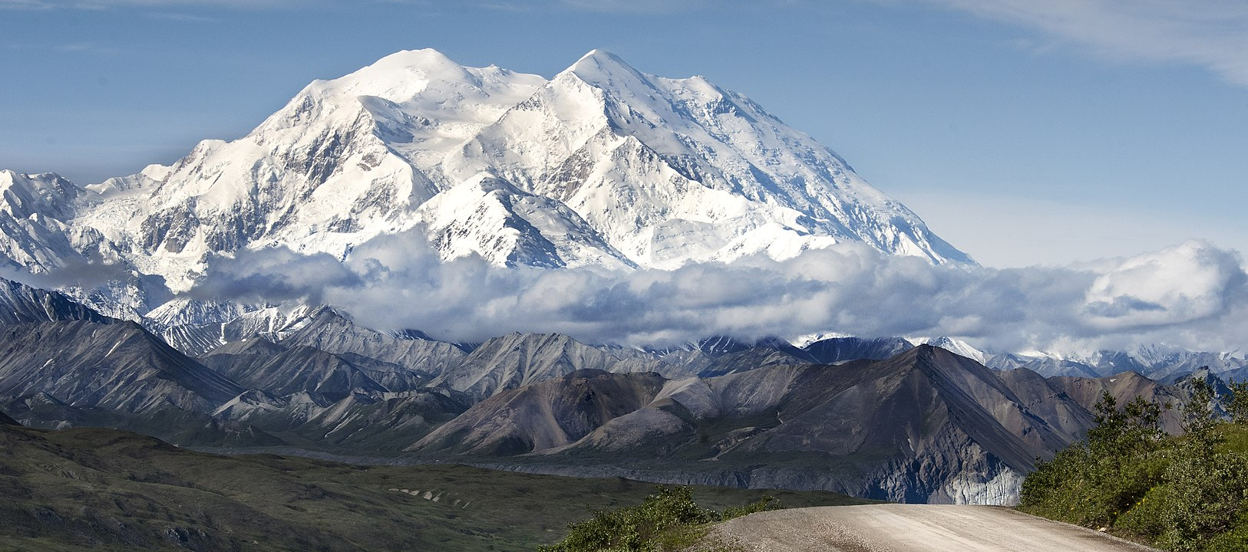
Questions?

