Slide 2
An Overview of Copernicus Sentinel-2
Surface Reflectance Products from an
Analysis Ready Data Perspective
Valentina Boccia¹, Rosario Q. Iannone², Ferran Gascon¹, Philippe Goryl¹, Enrico Cadau³, Jérôme Louis⁴, Uwe Müller-Wilm⁵, Bringfried Pflug⁶, Magdalena Main-Knorn⁶, Vincent Debaecker⁴
¹ESA - European Space Agency, Frascati, Italy
²RHEA System S.p.A., Frascati, Italy
³Serco Italia, Frascati, Italy
⁴Telespazio Vega France
⁵Telespazio Vega Deutschland
⁶DLR - German Aerospace Center, Remote Sensing Institute, Berlin, Germany

Slide 3
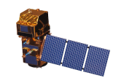
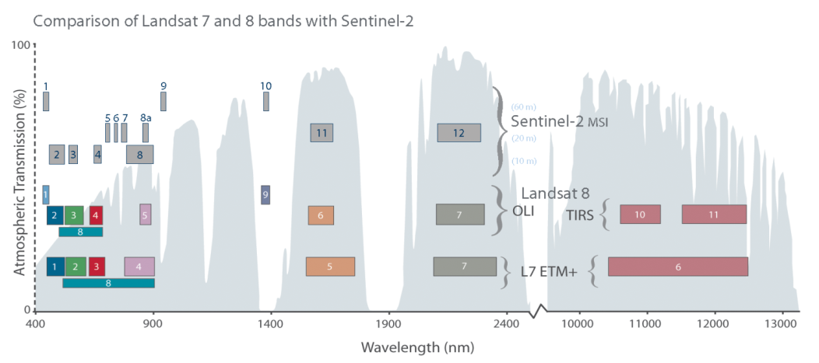


Copernicus Sentinel-2 Constellation
Optical multi-spectral mission for the monitoring of land and in-land/coastal waters.
Constellation of two satellites (Sentinel-2A and Sentinel-2B).
Polar sun-synchronous orbit at an altitude of 786km, with LTDN 10h30.
Swath of 294km.
  Free & open products for feeding a large range of applications.

Slide 4
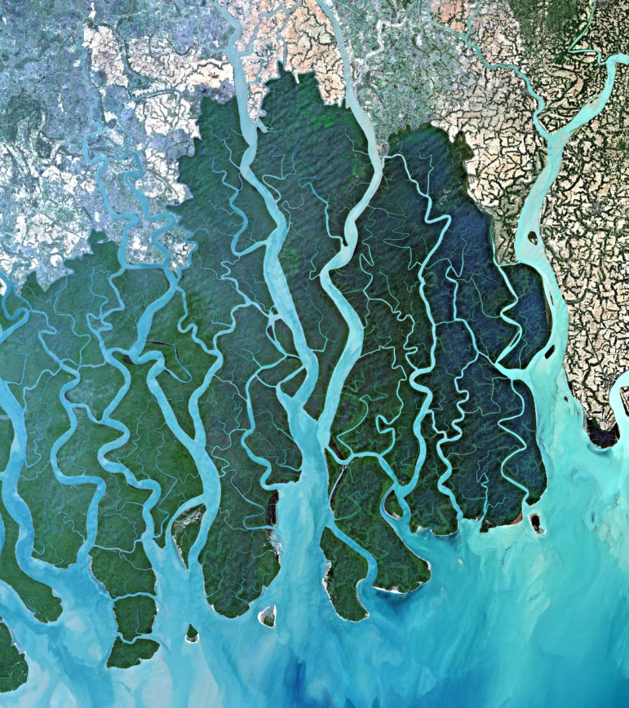
Sentinel-2 Mission Products Catalogue
Product Name | Measurement Provided | Distribution | Production
Level-1B | Top-of-atmosphere radiance in sensor geometry | Expert users (planned) | Systematic
Level-1C | Top-of-atmosphere reflectance in cartographic geometry | Public | Systematic
Level-2A | Surface reflectance and pixel classification in cartographic geometry Analysis Ready Data (ARD) | Public | Systematic + SNAP
Ganges Delta, India

Slide 5
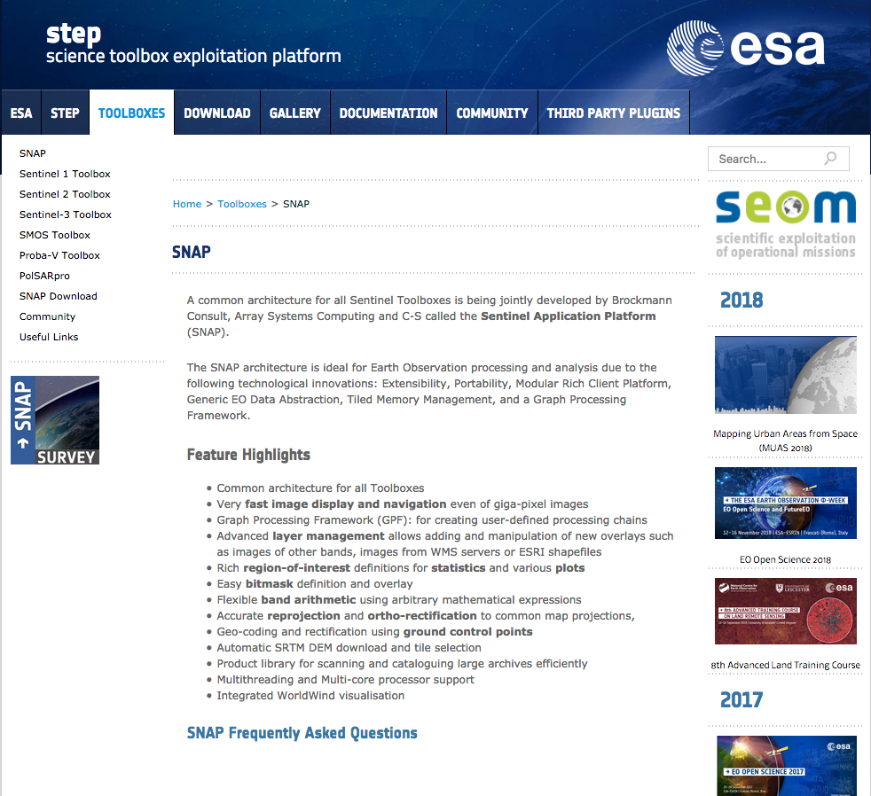
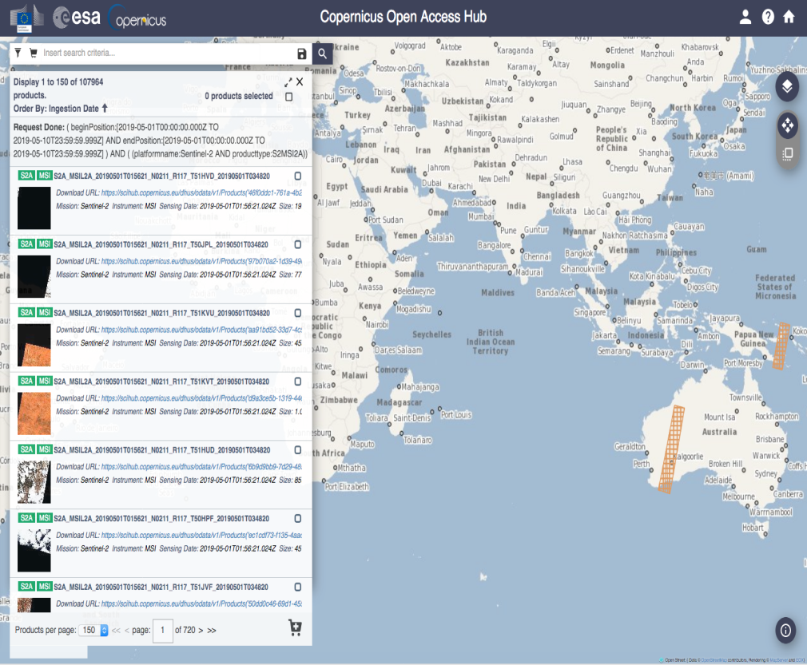
Sentinel-2 Mission Products Catalogue
Data Access Overview (Systematic): ESA data access is ensuring that Sentinel-2 core products are accessible to all users online
Sentinel Toolbox available as open source software
http://step.esa.int/main/download/
https://scihub.copernicus.eu/dhus/

Slide 6
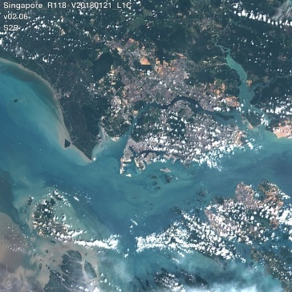
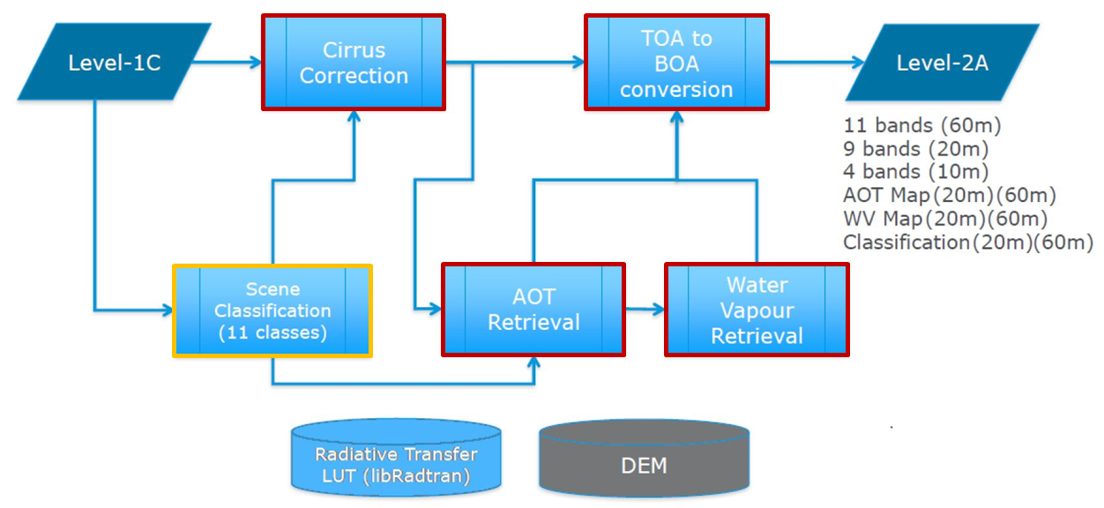
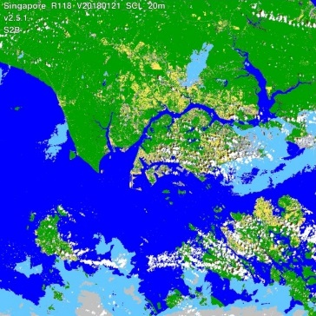
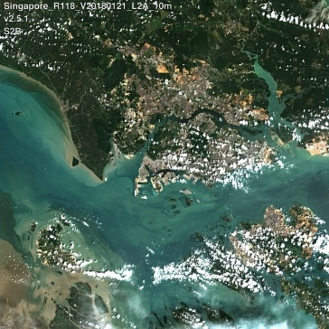
Sen2Cor processor overview
Atmospheric correction processor for Sentinel-2 (S2) data
Two main modules :
  Scene Classification (SCL)
  Atmospheric Correction (AC)
TOA-RGB (L1C-input)
SCL (L2A-output)
BOA-RGB (L2A-output)

Slide 7
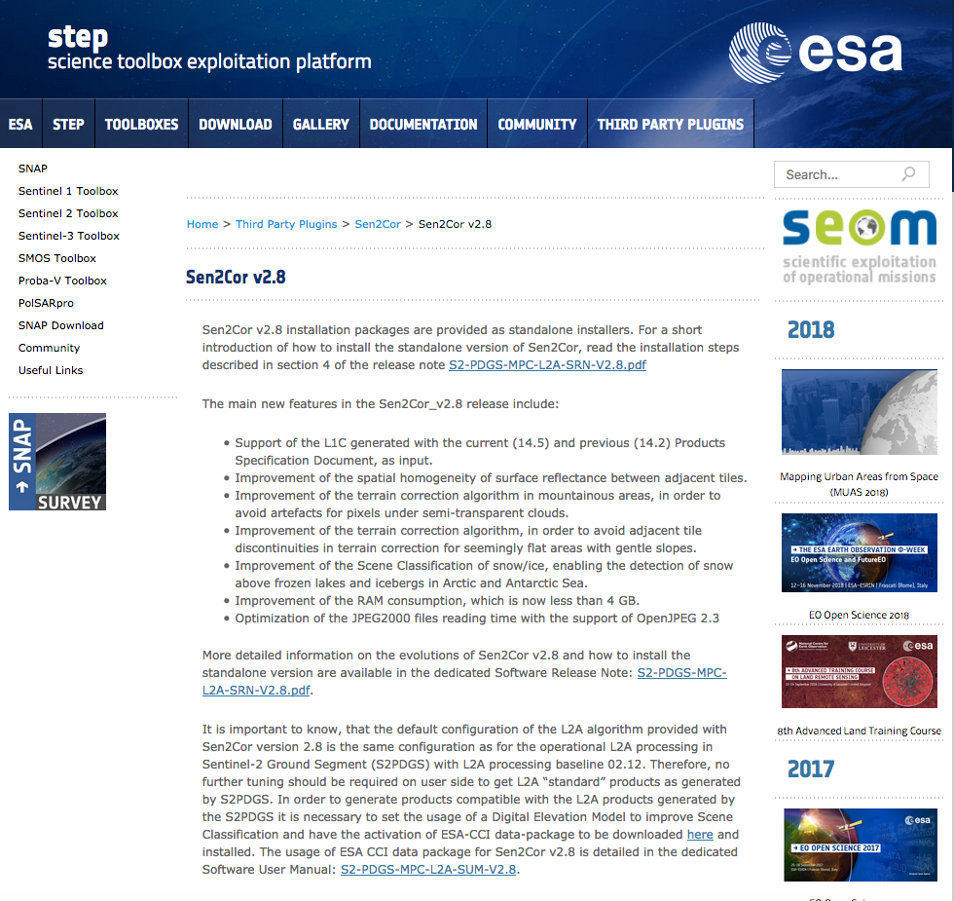
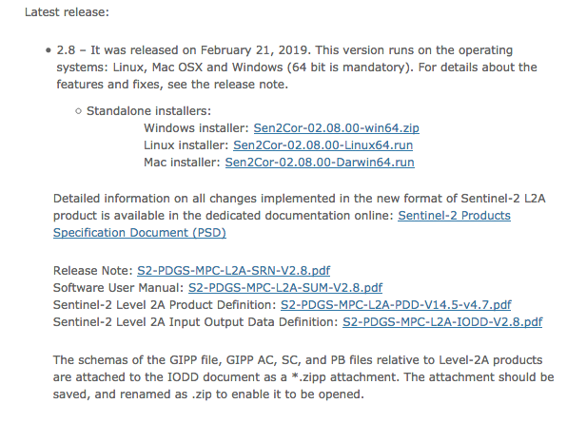
New Sen2Cor 2.8
http://step.esa.int/main/third-party-plugins-2/sen2cor/sen2cor_v2-8/

Slide 8
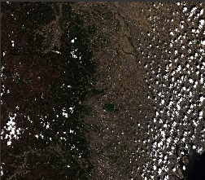
Sentinel-2 – Product Structure
Manifest
XML
Product
Metadata
Metadata
Auxiliary data
Image data
Quality indicator data
QC check reports
XML
L2A -Tile
Granule
S2 Level-2A
product
XML
Datastrip1
Datastrip
Metadata, Quality indicator data,
QC check reports
XML
Aux_Data (optional)
Processing Parameters, IERS bulleting, …
HTML
Banners Image, User Product
Index HTML

Slide 9
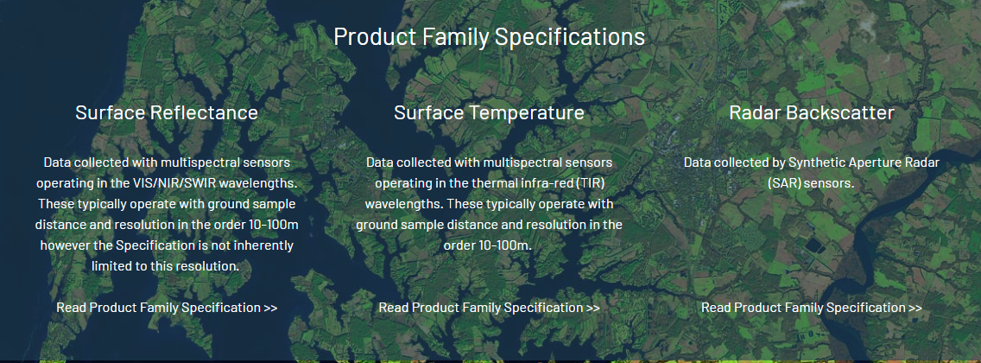
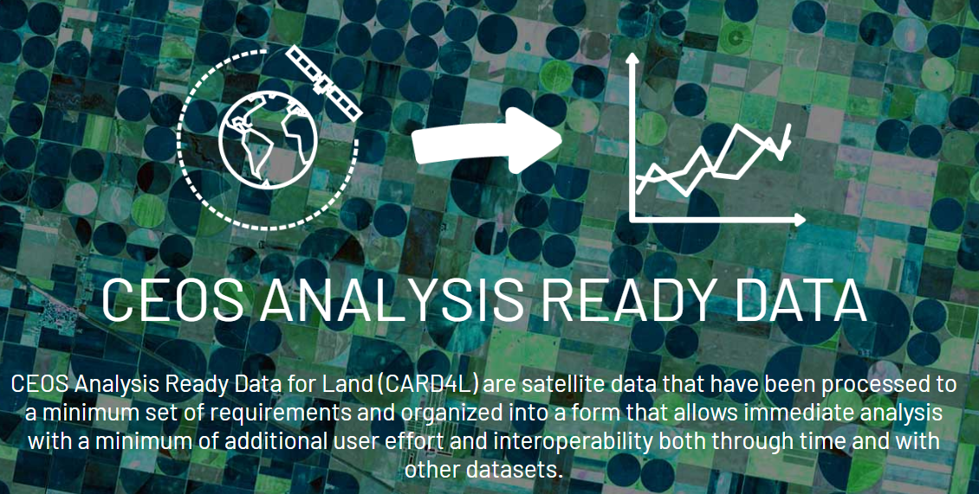
CARD4L
ceos.org/ard

Slide 10
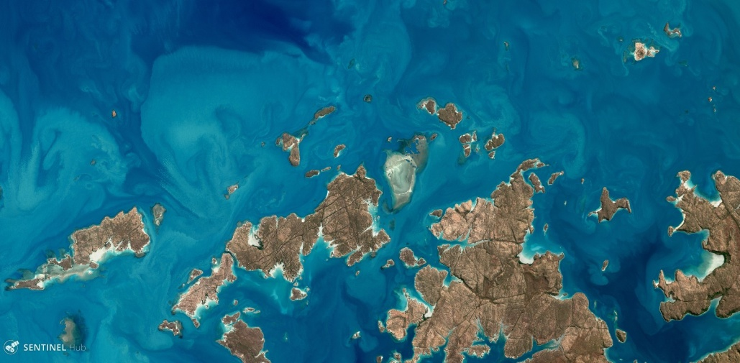
CARD4L Surface Reflectance
The specifications provided by the CARD4L Product Family Specifications for Surface Reflectance include requirements regarding:
General metadata
Per-pixel metadata
Radiometric and atmospheric correction
Geometric correction
For each parameter:
  Threshold – minimum requirement considered sufficient to render the product ready for analysis;
  Target – more stringent requirement that further improves the product quality/usefulness.
Augustus Island, Australia

Slide 11
CARD4L Requirements on “General Metadata” ”(Threshold and Target)
THRESHOLD (Minimum Requirements) General Metadata
S2 products Status:
TARGET (Desired) General Metadata
Not Required
Traceability
Metadata machine readability
Data collection time
Geographical Area
Coordinate Reference System
Map Projection
Geometric Correction Methods
Geometric Accuracy of the Data
Instrument
Spectral Bands
Sensor Calibration
Radiometric Accuracy
Algorithm
Ancillary Data
Processing Chain Provenance
Data Access
Overall Data Quality
Traceability
Metadata machine readability
Data collection time
Geographical Area
Coordinate Reference System
Map Projection
Geometric Correction Methods
Geometric Accuracy of the Data
Instrument
Spectral Bands
Sensor Calibration
Radiometric Accuracy
Algorithm
Ancillary Data
Processing Chain Provenance
Data Access
Overall Data Quality
Compliant
Not Compliant
Digital Object Identifier (DOI) planned for product type
An initial assessment of the general metadata indicate that S2 products meet the THRESHOLD requirements in nine instances (2, 3, 4, 5, 6, 9, 10, 13, 14), and non-compliance in one instance (16), TARGET in fourteen instances (4 - 17), and non-compliance in three instances (1, 2, 3).

Slide 12
CARD4L Requirements on “General Metadata” ”(Threshold)
THRESHOLD (Minimum Requirements) General Metadata
Data Collection Time
The start and stop time of data collection is identified in the metadata, expressed in date/time, to the second, with the time offset from UTC unambiguously identified.
Spectral Band
The central wavelength for each band for which data is included is identified in the metadata, expressed in SI units.
Not Required
Traceability
Metadata machine readability
Data collection time
Geographical Area
Coordinate Reference System
Map Projection
Geometric Correction Methods
Geometric Accuracy of the Data
Instrument
Spectral Bands
Sensor Calibration
Radiometric Accuracy
Algorithm
Ancillary Data
Processing Chain Provenance
Data Access
Overall Data Quality
Compliant
Not Compliant
Algorithm
All algorithms, and the sequence in which they were applied in the generation process, are identified in the metadata. For example, these may be available through Algorithm Theoretical Basis documents
Geographical Area
The surface location to which the data relates is identified, typically as a series of four corner points, expressed in an accepted coordinate reference system (e.g.,WGS84).
Coordinate Reference System
The metadata lists the coordinate reference system that has been used.
Ancillary Data
The metadata identifies the sources of ancillary data used in the generation process, ideally expressed as a single DOI landing page. Note 1: Ancillary data includes DEMs, aerosols etc. data sources.
Map Projection
The metadata lists the map projection that has been used and any relevant parameters required in relation to use of data in that map projection.
Data Access
Information on data access should be available in the metadata as a single DOI landing page. Note 1: Manual and offline interaction action (e.g. log in) may be required.
Metadata machine readability
Metadata is provided in a structure that enables a computer algorithm to be used to consistently and automatically identify and extract each component part for further use.
Instrument
The instrument used to collect the data is identified in the metadata.

Slide 13
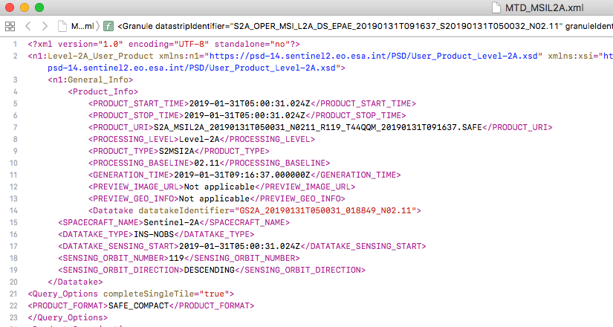

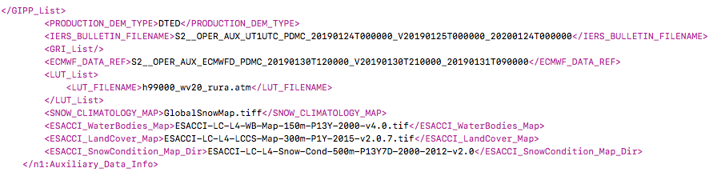
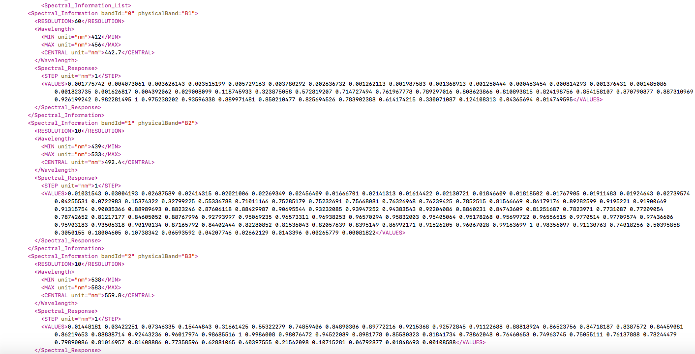
CARD4L Requirements on “General Metadata”(Threshold)
Data Collection Time
Coordinate Reference System
Geographical Area
Ancillary Data
Spectral Band

Slide 14
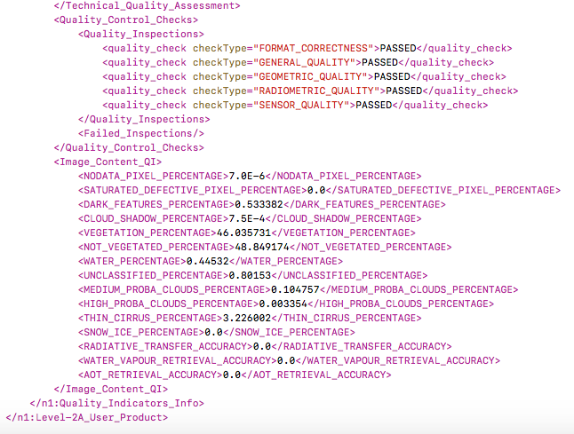
CARD4L Requirements on “General Metadata” (Target)
DOI planned for product type (e.g. Surface Reflectance)
Overall Data Quality
Machine-readable metrics describing the overall quality of the data are included in the metadata, at minimum the cloud cover extent, i.e.:-Proportion of observations over land (c.f. ocean) affected by non-target phenomena, e.g., cloud and cloud shadows.

Slide 15
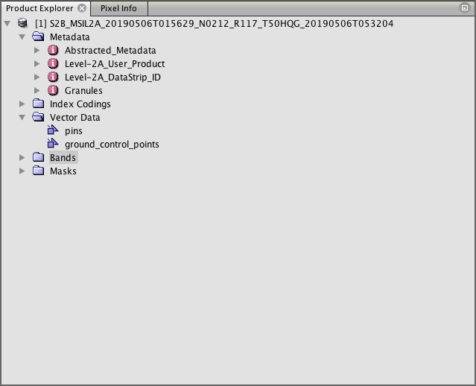
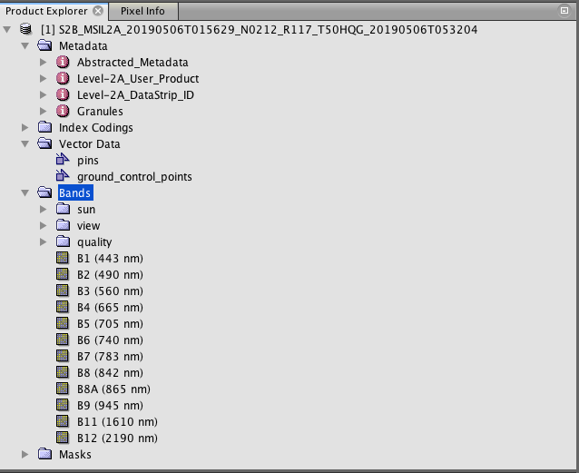
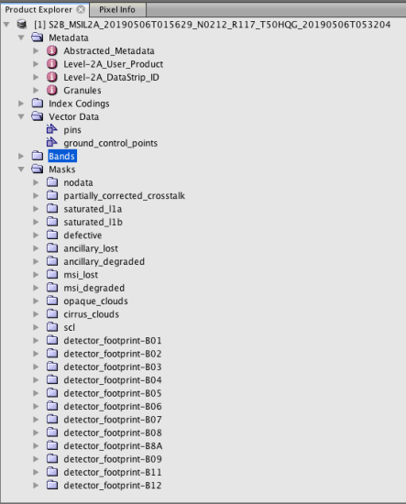
CARD4L Requirements on “Per Pixel Metadata” (Threshold)
THRESHOLD Per-Pixel Metadata
Metadata Machine Readability
Metadata is provided in a structure that enables a computer algorithm to be used to consistently and automatically identify and extract each component part for further use.
No Data
Pixels that do not correspond to an observation (‘empty pixels’) are flagged.
Incomplete Testing
The metadata identifies pixels for which the per-pixel tests (below) have not all been successfully completed. Note 1: This may be the result of missing ancillary data for a subset of the pixels.
Metadata machine readability
No Data
Incomplete Testing
Saturation
Cloud
Cloud Shadow
Land/Water Mask
Snow/Ice Mask
Terrain Shadow Mask
Terrain Occlusion
Illumination and Viewing Geometry
Aerosol Optical Depth Parameters
Saturation
Metadata indicates where one or more spectral bands are saturated
Cloud
Metadata indicates whether a pixel is assessed as being cloud.
Cloud Shadow
Metadata indicates whether a pixel is assessed as being cloud shadow.
Illumination and Viewing Geometry
Provide average viewing and average illumination for the threshold requirement
Not Required
Compliant
Not Compliant

Slide 16
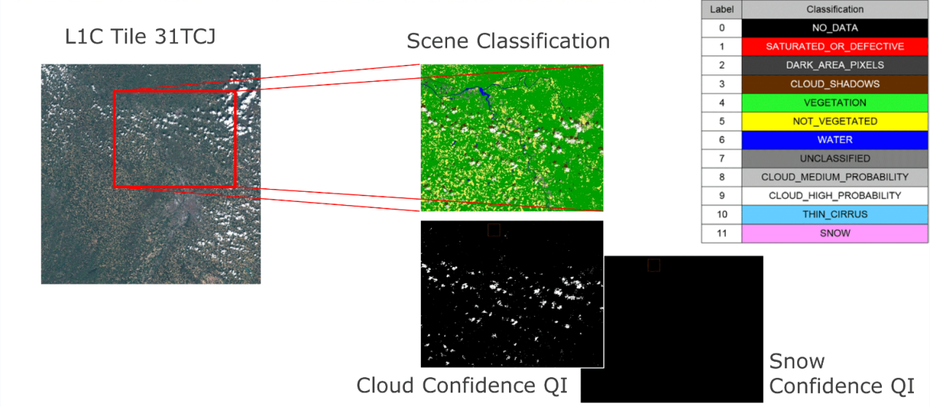

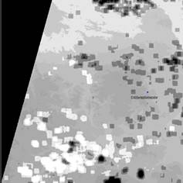
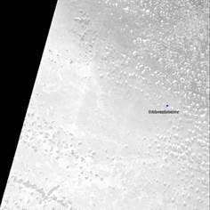
CARD4L Requirements on “Per Pixel Metadata” (Threshold and Target)
viewZenithMean and viewAzimuthMean that contains average viewing incidence angles (zenith and azimuth) across all bands and detectors
AOT
WVP
THRESHOLD Per-Pixel Metadata
TARGET (Desired) Per-Pixel Metadata
Metadata machine readability
No Data
Incomplete Testing
Saturation
Cloud
Cloud Shadow
Land/Water Mask
Snow/Ice Mask
Terrain Shadow Mask
Terrain Occlusion
Illumination and Viewing Geometry
Aerosol Optical Depth Parameters
Metadata machine readability
No Data
Incomplete Testing
Saturation
Cloud
Cloud Shadow
Land/Water Mask
Snow/Ice Mask
Terrain Shadow Mask
Terrain Occlusion
Illumination and Viewing Geometry
Aerosol Optical Depth Parameters
S2 products Status:
Digital Object Identifier (DOI) planned for product
Not Required
Compliant
Not Compliant

Slide 17
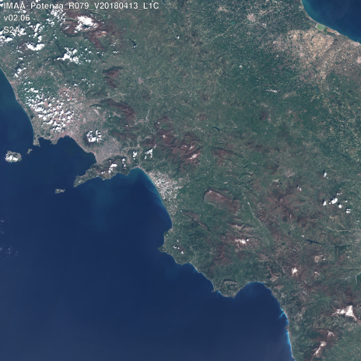
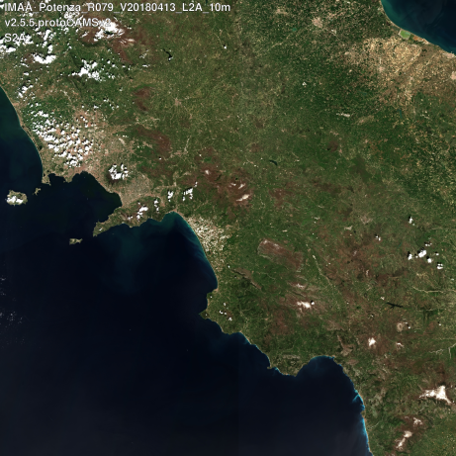
CARD4L Requirements on “Radiometric and Atmospheric Correction”
THRESHOLD Radiometric and Atmospheric Correction
S2 products Status:
TARGET Radiometric and atmospheric Correction
Measurement
Measurement Uncertainty
Measurement Normalisation
Directional Atmospheric Scattering
Water Vapour Corrections
Ozone Corrections
Not Required
Measurement
Measurement Uncertainty
Measurement Normalisation
Directional Atmospheric Scattering
Water Vapour Corrections
Ozone Corrections
Compliant
Not Compliant
Measurement
Pixel values that are expressed as a measurement of the Surface Reflectance of the land. This is a dimensionless value.
Directional Atmospheric Scattering
Corrections are applied for aerosols and molecular (Rayleigh) scattering. Metadata contains a single DOI landing page with references to:-a citable peer-reviewed algorithm, -technical documentation regarding the implementation of that algorithm -the sources of ancillary data used to make corrections. Note 1: Examples of technical documentation include an Algorithm Theoretical Basis Document, product user guide, etc.
Water Vapour corrections
Corrections are applied for water vapour. Metadata contains a single DOI landing page with references to:-a citable peer-reviewed algorithm, -technical documentation regarding the implementation of that algorithm. Note 1: Examples of technical documentation include an Algorithm Theoretical Basis Document, product user guide, etc.
Digital Object Identifier DOI planned for product
Level-1C
Level-2A

Slide 18
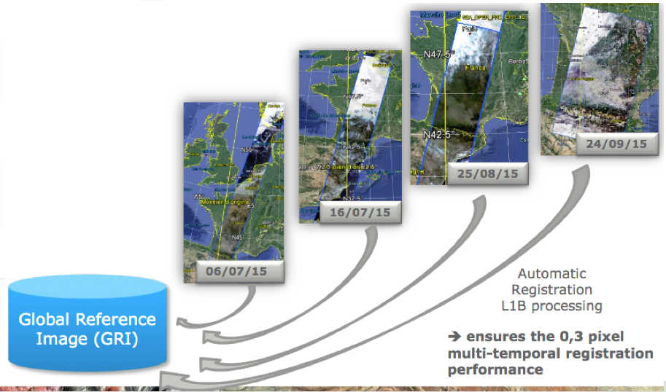
CARD4L Requirements on “Geometric Correction”
THRESHOLD Geometric Correction
Geometric Correction
Sub-pixel accuracy is achieved in relative geolocation, that is, the pixels from the same instrument and platform are consistently located, and in thus comparable, through time.
Sub-pixel accuracy is taken to be less than or equal to 0.5-pixel radial root mean square error (rRMSE) or equivalent in Circular Error Probability (CEP) relative to a defined reference image.
S2 products Status:
TARGET Geometric Correction
Geometric Correction
Not Required
Compliant
Not Compliant
From 2nd half of 2019, processing will be based on the usage of the GRI (Global Reference Image ) as a source of GCPs.
A full repeat cycle dataset of well-localized and as cloud-free as possible mono-spectral (band 4) Level-1B products

Slide 19
ESA’s contribution to ARD for Surface Reflectance - Conclusion
Pilot ARD assessment shows that Sentinel-2 products are “Almost” compliant to CARD4L Specifications for Surface Reflectance.
Active involvement in the defining process of the CARD4L Product Family Specifications document;
Actions undertaken in order to align Sentinel-2 data to CARD4L specifications;
New ARD activities
  ARD on demand

Slide 20

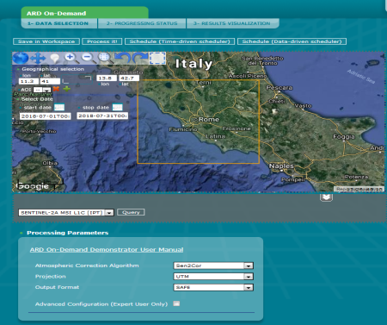
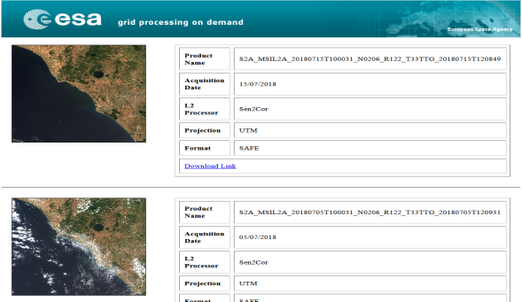
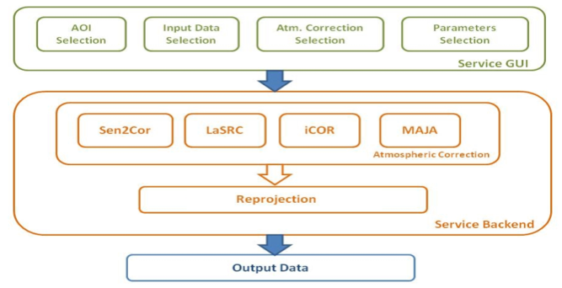
ARD on Demand Demonstrator
The ARD On-Demand Demonstrator service is a prototype implementation provided by the ESA Research and Service Support (RSS) with the purpose of demonstrating the ARD On-Demand concept
ARD On-Demand allows to configure the ARD as desired and tailored on user needs
ARD On-Demand should also facilitate and allow the interoperability of the various data sets and sensors, which is one of the major goal of GEOS
Features of the ARD On-Demand Demonstrator:
Works with Sentinel-2 and Landsat-8 data
Supported atmospheric correction algorithms: Sen2Cor, LaSRC, iCOR, MAJA
Custom output projection (UTM, Lat/Lon WGS84)
Custom output format (SAFE, GeoTiff, HDF, NetCDF)
Operable by a web interface
Relying on the IPT Poland IaaS (CREODIAS precursor)
https://wiki.services.eoportal.org/tiki-index.php?page=ARD+On-Demand+Demonstrator+User+Manual

Slide 21
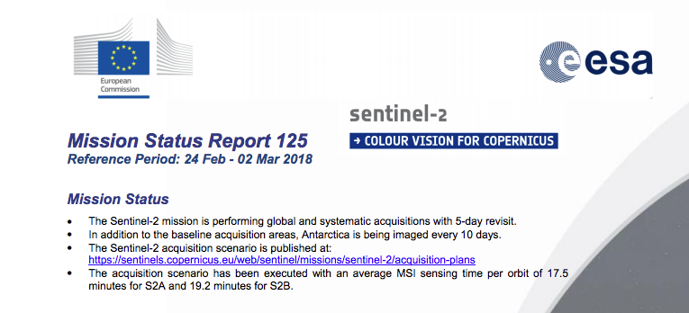
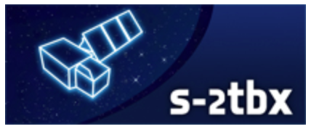
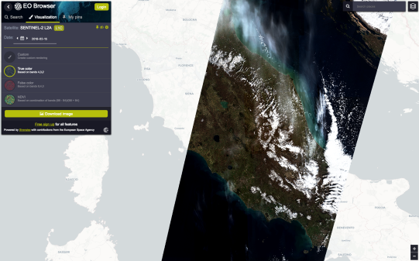
S2-Related Resources
Sentinel-2 Mission Status Reports available at:
https://sentinel.esa.int/web/sentinel/missions/sentinel-2/mission-status
Data Quality Reports available at:
https://sentinels.copernicus.eu/documents/247904/685211/Sentinel-2_L1C_Data_Quality_Report
https://sentinels.copernicus.eu/documents/247904/685211/Sentinel-2-L2A-Data-Quality-Report
SNAP: Visualisation & processing of Sentinel-2 MSI data and other optical data: http://step.esa.int/
sen2cor: Level-2A processor:
http://step.esa.int/main/third-party-plugins-2/sen2cor/
EO-BROWSER: Visualisation of Sentinel-2, Sentinel-3, Landsat, Proba-V data:
http://apps.sentinel-hub.com/eo-browser/

Slide 22
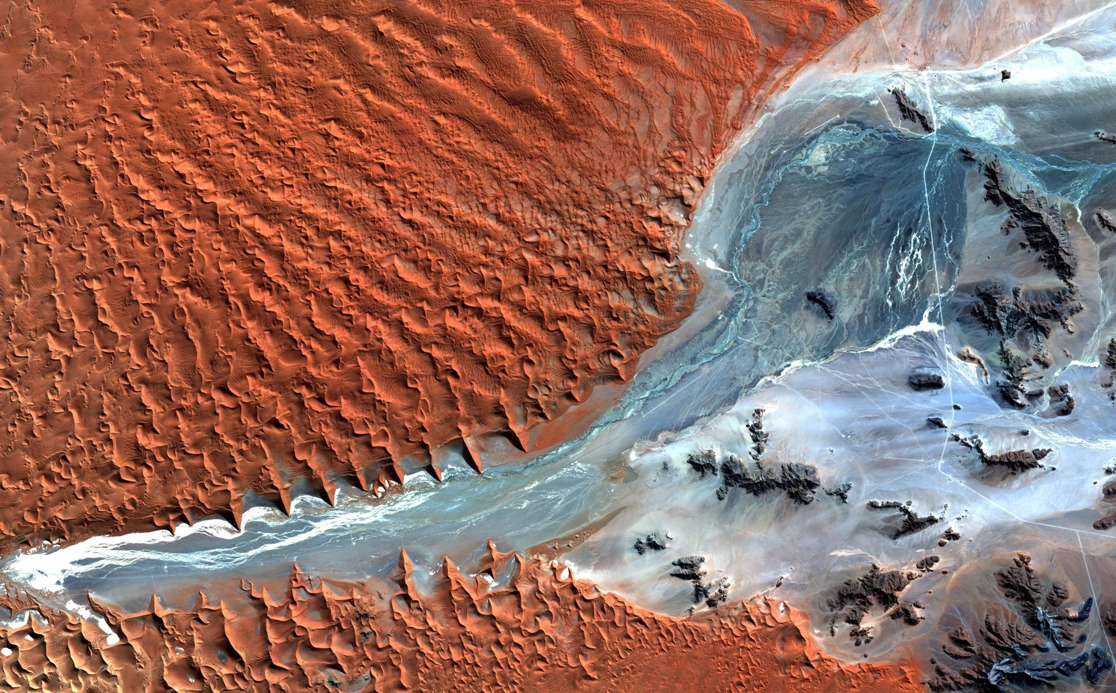
Namibia
Thank You!

Slide 23
General Metadata Requirements
# | Item | Threshold (Minimum Requirements | Target (Desired) Requirements
1.1 | Traceability | Not required. | Data must be traceable to SI reference standard. Note 1. Relationship to 3.2. Traceability requires an estimate of measurement uncertainty. Note 2: Information on traceability should be available in the metadata as a single DOI landing page.
1.2 | Metadata machine readability | Metadata is provided in a structure that enables a computer algorithm to be used to consistently and automatically identify and extract each component part for further use. | As threshold, but metadata is formatted in accordance with ISO 19115-2.
1.3 | Data Collection Time | The start and stop time of data collection is identified in the metadata, expressed in date/time, to the second, with the time offset from UTC unambiguously identified. | Acquisition time for each pixel is identified (or can be reliably determined) in the metadata, expressed in date/time at UTC, to the second.
1.4 | Geographical Area | The surface location to which the data relates is identified, typically as a series of four corner points, expressed in an accepted coordinate reference system (e.g.,WGS84). | The geographic area covered by the observations is identified specifically, such as through a set of coordinates of a closely bounding polygon. The location to which each pixel refers is identified (or can be reliably determined) with the projection system (if any) and reference datum provided.
1.5 | Coordinate Reference System | The metadata lists the coordinate reference system that has been used. | As threshold.
1.6 | Map Projection | The metadata lists the map projection that has been used and any relevant parameters required in relation to use of data in that map projection. | As threshold.
1.7 | Geometric Correction Methods | Not required. The user is not explicitly advised of the geometric correction source and methods. | Information on geometric correction methods should be available in the metadata as a single DOI landing page, including reference database and ancillary data such as elevation model(s) and reference chip-sets.
1.8 | Geometric Accuracy of the Data | Not required. The user is not provided with results of geometric accuracy assessments pertaining to the dataset. | The metadata includes metrics describing the assessed geodetic accuracy of the data, expressed units of the coordinate system of the data. Accuracy is assessed by independent verification (as well as internal model-fit where applicable). Uncertainties are expressed quantitatively, for example, as root mean square error (RMSE) or Circular Error Probability (CEP90, CEP95), etc. Note 1: Information on geometric accuracy of the data should be available in the metadata as a single DOI landing page.

Slide 24
# | Item | Threshold (Minimum Requirements | Target (Desired) Requirements
1.9 | Instrument | The instrument used to collect the data is identified in the metadata. | As threshold, but information should be available in the metadata as a single DOI landing page with references to the relevant CEOS Missions, Instruments, and Measurements Database record.
1.10 | Spectral Bands | The central wavelength for each band for which data is included is identified in the metadata, expressed in SI units. | As threshold, with instrument spectral response details (e.g. full spectral response function) also included or directly accessible using details in the metadata. Central wavelength and bandwidth at full-width half maximum value of the relative spectral response function are provided at least. Note 1: Information on spectral bands should be available in the metadata as a single DOI landing page.
1.11 | Sensor Calibration | Not required. The general metadata does not include sensor calibration details | Sensor calibration parameters are identified in the metadata or can be accessed using details included in the metadata. Ideally this would support machine to machine access. Note 1: Information on sensor calibration should be available in the metadata as a single DOI landing page.
1.12 | Radiometric Accuracy | Not required. The general metadata does not include information on the radiometric accuracy of the data. | The metadata includes metrics describing the assessed absolute radiometric uncertainty of the data, expressed as absolute radiometric uncertainty relative to appropriate, known reference sites and standards (for example,. pseudoinvariant calibration sites, rigorously collected field spectra, PICS, Rayleigh, DCC, etc.)Note 1: Information on radiometric accuracy should be available in the metadata as a single DOI landing page.
1.13 | Algorithms | All algorithms, and the sequence in which they were applied in the generation process, are identified in the metadata. For example, these may be available through Algorithm Theoretical Basis documents. | As threshold, but only algorithms that have been published in a peer-reviewed journal. Note 1: It is possible that high quality corrections are applied through non-disclosed processes. CARD4L does not per-se require full and open data and methods. Note 2: Information on algorithms should be available in the metadata as a single DOI landing page.
1.14 | Ancillary Data | The metadata identifies the sources of ancillary data used in the generation process, ideally expressed as a single DOI landing page. Note 1: Ancillary data includes DEMs, aerosols etc. data sources. | As threshold, but information on ancillary data should be available in the metadata as a single DOI landing page for free online download, contemporaneously with the product.
1.15 | Processing Chain Provenance | Not required. | Information on processing chain provenance should be available in the metadata as a single DOI landing page containing detailed description of the processing steps used to generate the product, including the versions of software used, giving full transparency to the users.
1.16 | Data Access | Information on data access should be available in the metadata as a single DOI landing page. Note 1: Manual and offline interaction action (e.g. log in) may be required. | The metadata identifies an online location from where the data (including any available new records) can be consistently and reliably retrieved by a computer algorithm without any manual intervention being required. Note 1: Some manual interaction action may be required in the first instance(‘one off’ basis) to establish ongoing access to the data.
1.7 | Overall Data Quality | Not applicable. | Machine-readable metrics describing the overall quality of the data are included in the metadata, at minimum the cloud cover extent, i.e.:-Proportion of observations over land (c.f. ocean) affected by non-target phenomena, e.g., cloud and cloud shadows.

Slide 25
Per Pixel Metadata Requirements
# | Item | Threshold (Minimum Requirements | Target (Desired) Requirements
2.1 | Metadata machine readability | Metadata is provided in a structure that enables a computer algorithm to be used to consistently and automatically identify and extract each component part for further use. | As threshold, but metadata is formatted in accordance with ISO 19115-2.
2.2 | No Data | Pixels that do not correspond to an observation (‘empty pixels’) are flagged. | As threshold.
2.3 | Incomplete Testing | The metadata identifies pixels for which the per-pixel tests (below) have not all been successfully completed. Note 1: This may be the result of missing ancillary data for a subset of the pixels. | The metadata identifies which tests have, and have not, been successfully completed for each pixel.
2.4 | Saturation | Metadata indicates where one or more spectral bands are saturated. | Metadata indicates which pixels are saturated for each spectral band.
2.5 | Cloud | Metadata indicates whether a pixel is assessed as being cloud. | As threshold, information on cloud detection should be available in the metadata as a single DOI landing page.
2.6 | Cloud Shadow | Metadata indicates whether a pixel is assessed as being cloud shadow. | As threshold, but information on cloud shadow detection should be available in the metadata as a single DOI landing page.
2.7 | Land/Water Mask | Not required. | The metadata indicates whether a pixel is assessed as being land or water. Information on land/water mask should be available in the metadata as a single DOI landing page.
2.8 | Snow/Ice Mask | Not required. | The metadata indicates whether a pixel is assessed as being snow/ice or not. Information on snow/ice mask should be available in the metadata as a single DOI landing page.
2.9 | Terrain Shadow Mask | Not required. | The metadata indicates pixels that are not directly illuminated due to terrain shadowing.
2.10 | Terrain Occlusion | Not required. | The metadata indicates pixels that are not visible to the sensor due to terrain occlusion during off-nadir viewing.
2.11 | Illumination and Viewing Geometry | Provide average viewing and average illumination for the threshold requirement | The solar incidence and sensor viewing angles are identified for each pixel, including coefficients used for terrain illumination correction.
2.12 | Aerosol Optical Depth Parameters | Not required. | To be determined.

Slide 26
Radiometric and Atmospheric Correction Requirement
# | Item | Threshold (Minimum Requirements | Target (Desired) Requirements
3.1 | Measurement | Pixel values that are expressed as a measurement of the Surface Reflectance of the land. This is a dimensionless value. | Surface Reflectance measurements are SI traceable (see also 1.1).
3.2 | Measurement Uncertainty | Not required. Note 1: In current practice, users determine fitness for purpose based on knowledge of the lineage of the data, rather than on a specific estimate of measurement uncertainty. | An estimate of the certainty of the values is provided in measurement units. Note 1. This is a requirement for SI traceability. See also 1.1.Note 2: Information on measurement uncertainty should be available in the metadata as a single DOI landing page.
3.3 | Measurement Normalisation | Not required | Measurements are normalised for illumination and viewing conditions including nadir view angle and specified solar altitude and azimuth. This may include BRDF correction. Relevant meta-data (pixel-level solar illumination an viewing geometry, etc.) are included as per 2.11.
3.4 | Directional Atmospheric Scattering | Corrections are applied for aerosols and molecular (Rayleigh) scattering. Metadata contains a single DOI landing page with references to:-a citable peer-reviewed algorithm, -technical documentation regarding the implementation of that algorithm -the sources of ancillary data used to make corrections. Note 1: Examples of technical documentation include an Algorithm Theoretical Basis Document, product user guide, etc. | As threshold.
3.5 | Water Vapour Corrections | Corrections are applied for water vapour. Metadata contains a single DOI landing page with references to:-a citable peer-reviewed algorithm, -technical documentation regarding the implementation of that algorithm. Note 1: Examples of technical documentation include an Algorithm Theoretical Basis Document, product user guide, etc. | As threshold.
3.6 | Ozone Corrections | Not Required | Data is corrected for ozone. Relevant metadata must be provided under 1.8 and 1.9. Metadata contains a single DOI landing page with references to:-a citable peer-reviewed algorithm, -technical documentation regarding the implementation of that algorithm

Slide 27
Geometric Correction Requirements
# | Item | Threshold (Minimum Requirements | Target (Desired) Requirements
4.1 | Geometric Correction | Sub-pixel accuracy is achieved in relative geolocation, that is, the pixels from the same instrument and platform are consistently located, and in thus comparable, through time. Sub-pixel accuracy is taken to be less than or equal to 0.5-pixel radial root mean square error (rRMSE) or equivalent in Circular Error Probability (CEP) relative to a defined reference image. A consistent gridding/sampling frame is used, including common cell size, origin, and nominal sample point location within the cell (centre, ll, ur). Relevant metadata must be provided under 1.8 and 1.9. Note 1. The threshold level will not necessarily enable interoperability between data from different sources as the geometric corrections for each of the sources may differ. | Sub-pixel accuracy is achieved relative to an identified absolute independent terrestrial referencing system (such as a national map grid). A consistent gridding/sampling frame is necessary to meet this requirement. Relevant metadata must be provided under 1.8 and 1.9. Note 1: This requirement is intended to enable interoperability between imagery from different platforms that meet this level of correction and with non-image spatial data such as GIS layers and terrain models.

