Slide 1
Session 2: CARD4L Product Family Specification (09:40-10:00)
Committee on Earth Observation Satellites
Geoscience Australia
SLI-VC8 Meeting
Anchorage, Alaska, USA
4th September 2019

Slide 2
CARD4L Overview
2015
2016
Framework
2017
PFSs (SR, LST, NB)
2018
2019
Engagement
PFS endorsement
Formal Self-assess
ARD strategy
LSI-VC
Definition
Feedback
Define ARD products
Endorsement
PFS update
SAR CARD4L created
PFS review
Self-assessment
Peer-review
Self-assess guidelines

Slide 3
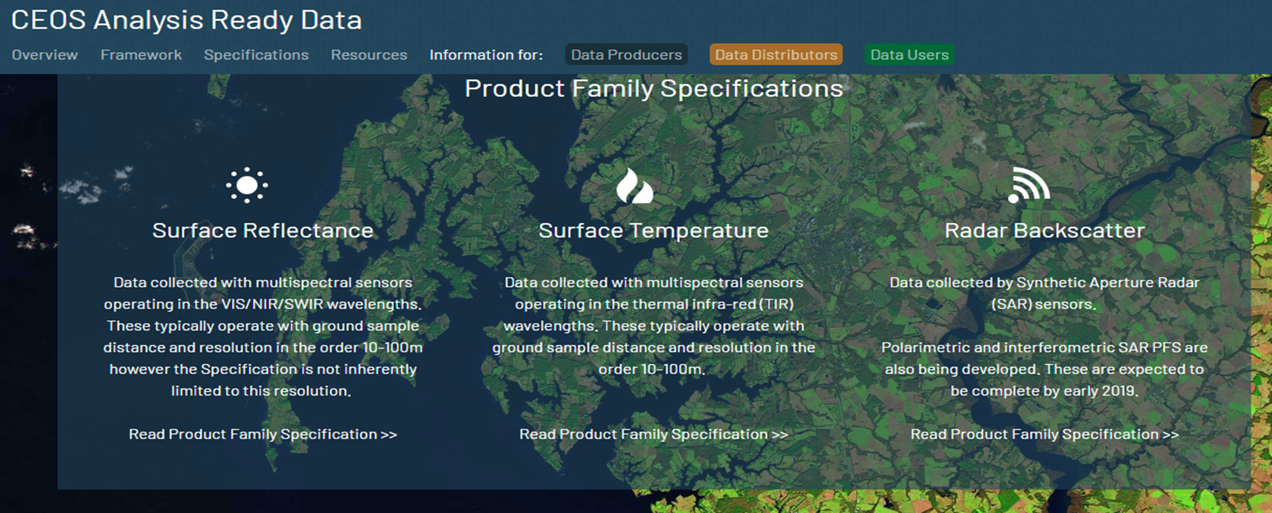
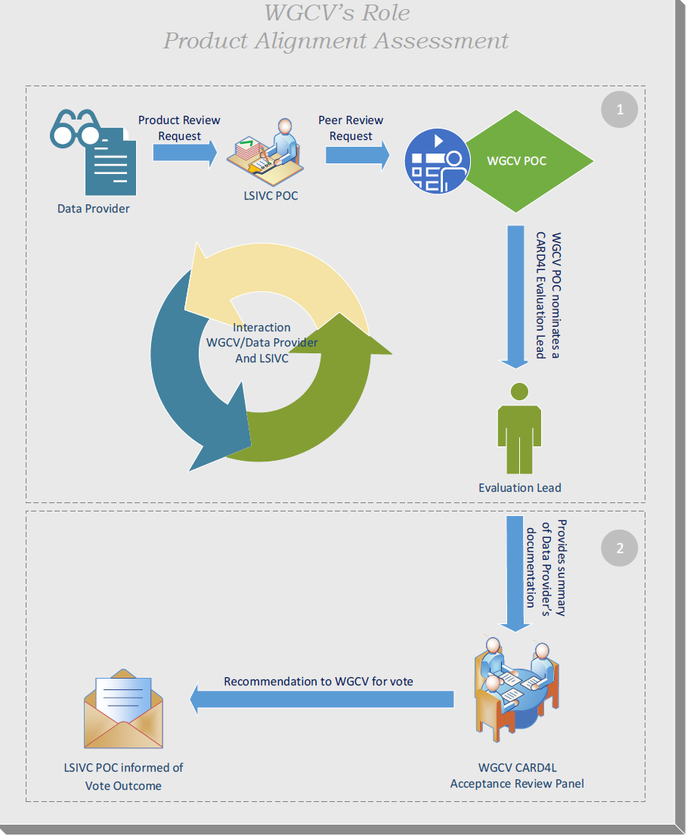
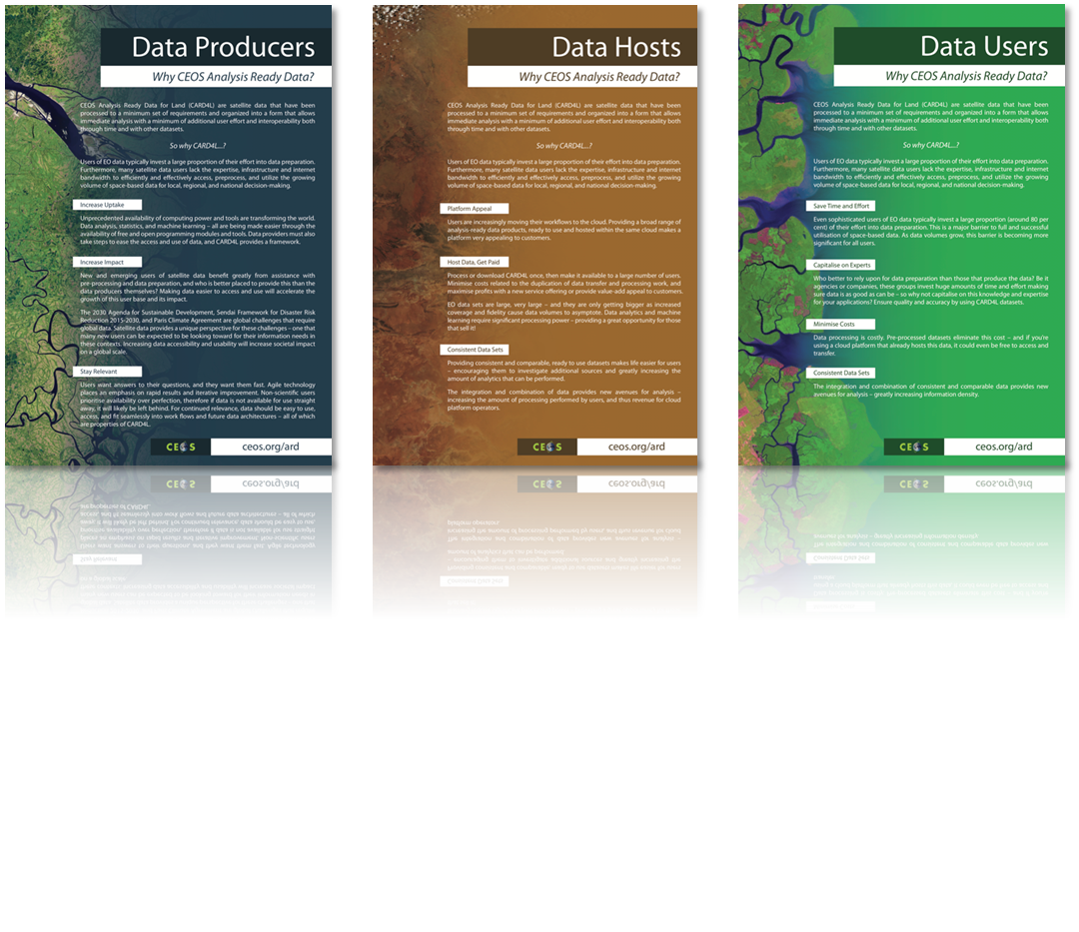
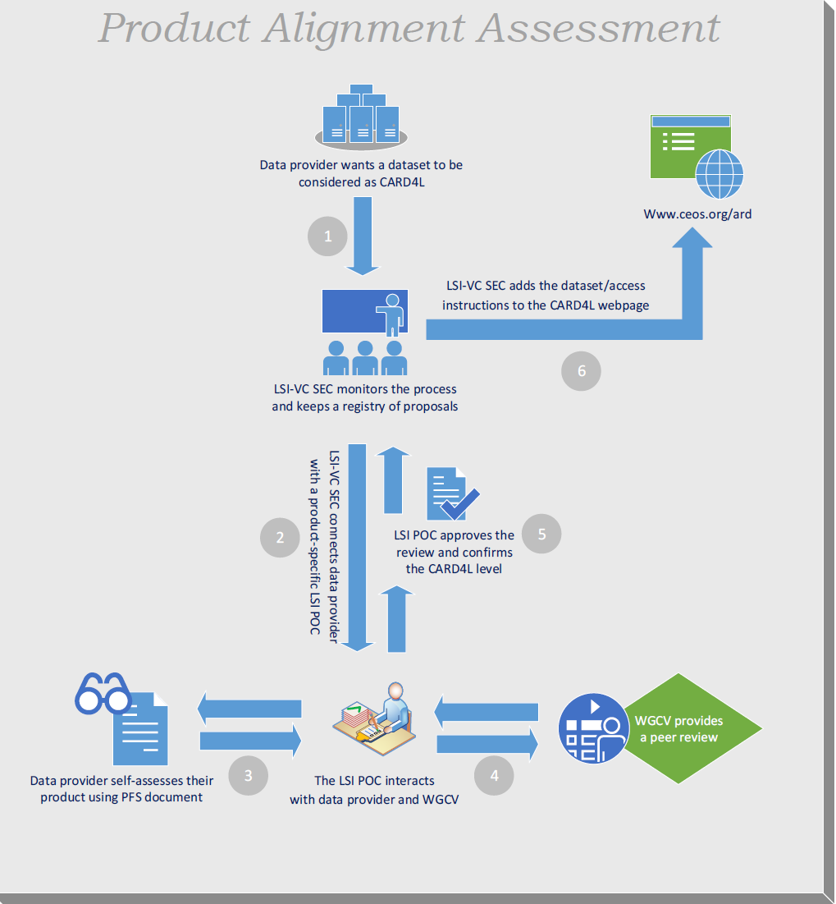
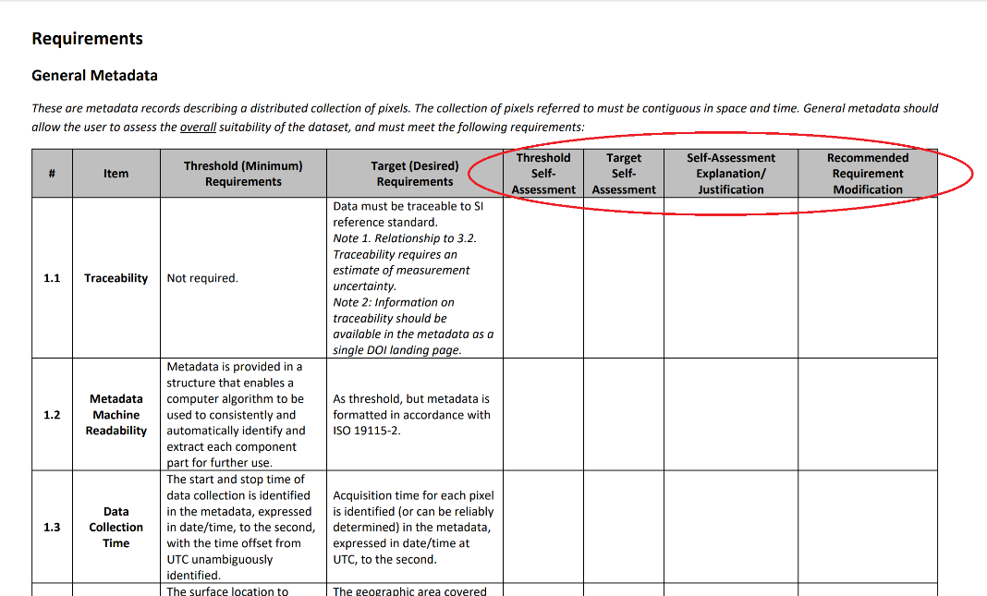
Current Endorsed CARD4L PFS Status
CARD4L Specifications were endorsed in February 2019 – this has been a major step forward!
Surface Reflectance;
Surface Temperature;
Normalised Radar Backscatter, endorsed
Communications materials developed and published on ceos.org/ard
Processes to assess datasets against the specifications agreed and initiated (PAA)
agencies self-assessment, and
independent review process through the WGCV

Slide 4
Current Status – Additional SAR PFSs
Very active CARD4L SAR team – monthly meets lead by Ake Rosenqvist
There are 3 SAR PFSs under development:
Polarimetric Radar (Polarimetric covariance matrix + Polarimetric decomposition)
Differential interferometry
Geocoded SLC
Working on sample products and metadata (Ake/Takeo will give more details)
A working group is being stablished to develop CARD4L PFS for LIDAR products
All SAR PSFs (including the endorsed NRB) will be aligned in terms of terminology, format, etc. to assure consistency
The alignment will to be done in the next review cycle - 2019
Mature drafts are expected to be shared widely by Dec 2019 and tabled for endorsement at LSI-VC9 meeting (Feb 2020)
The CARD4L SAR team is expected to continue until the additional SAR PFS are endorsed

Slide 5
2019 Review Cycle
The endorsed Product Family Specifications are very stable;
PFS improvements in the review cycle will consider:
Comments/inputs from WGCV received early this year
Feedback from ESA heritage mission (self-assessing ERS - backscatter)
Any other relevant feedback received from the expert community
from other agencies self-assessment,
Any updates will be presented at LSI-VC9 (Feb 2020)
Technical expert feedback gathered
Collate feedback and proposed changes
Drafting process submission to CEOS LSI-VC for acceptance
Controlled Process

Slide 6
CARD4L Next Steps
3 further PFS are under development specifically for SAR – 2020 endorsement
A new working group is being stablished to develop CARD4L PFS for LIDAR products
CEOS Agencies are self-assessing their products against the endorsed specifications and adjusting as necessary
CEOS WGCV will undertake peer reviews of these self-assessments, when requested
Following approval, CARD4L datasets will be catalogued for promotion and ease of user access
LSI-VC plans to conduct data supply and user access trials – pushing data to large online storage and analysis hubs to further ease of access and use
Trials with forest monitoring communities have been identified as a priority in the broader CEOS strategy for ARD (2020-2021).
Continue reviewing the PFS documentation and requirements through a controlled process.
Promotion and communication of information on CARD4L products (e.g. conferences, meetings and through the CARD4L webpage).

Slide 7
2019 Upcoming Events
Present CEOS ARD Strategy
Pecora 21/ISESE 38
ARD session & CARD4L abstract
Ministerial Summit / GEO-XVI Plenary
ARD Side Event “Big EO: Big Data”
Event details: Sep 9-12, 2019 – Fairbanks, Alaska
Event details: Oct 6-11, 2019 – Baltimore, Maryland, USA
Event details: Nov 4, 2019 – Canberra, Australia
SIT TW
CEOS Plenary
Present ARD Strategy for endorsement
Event details: Oct 14-16, 2019 – Ha Noi, Viet Nam

Slide 8
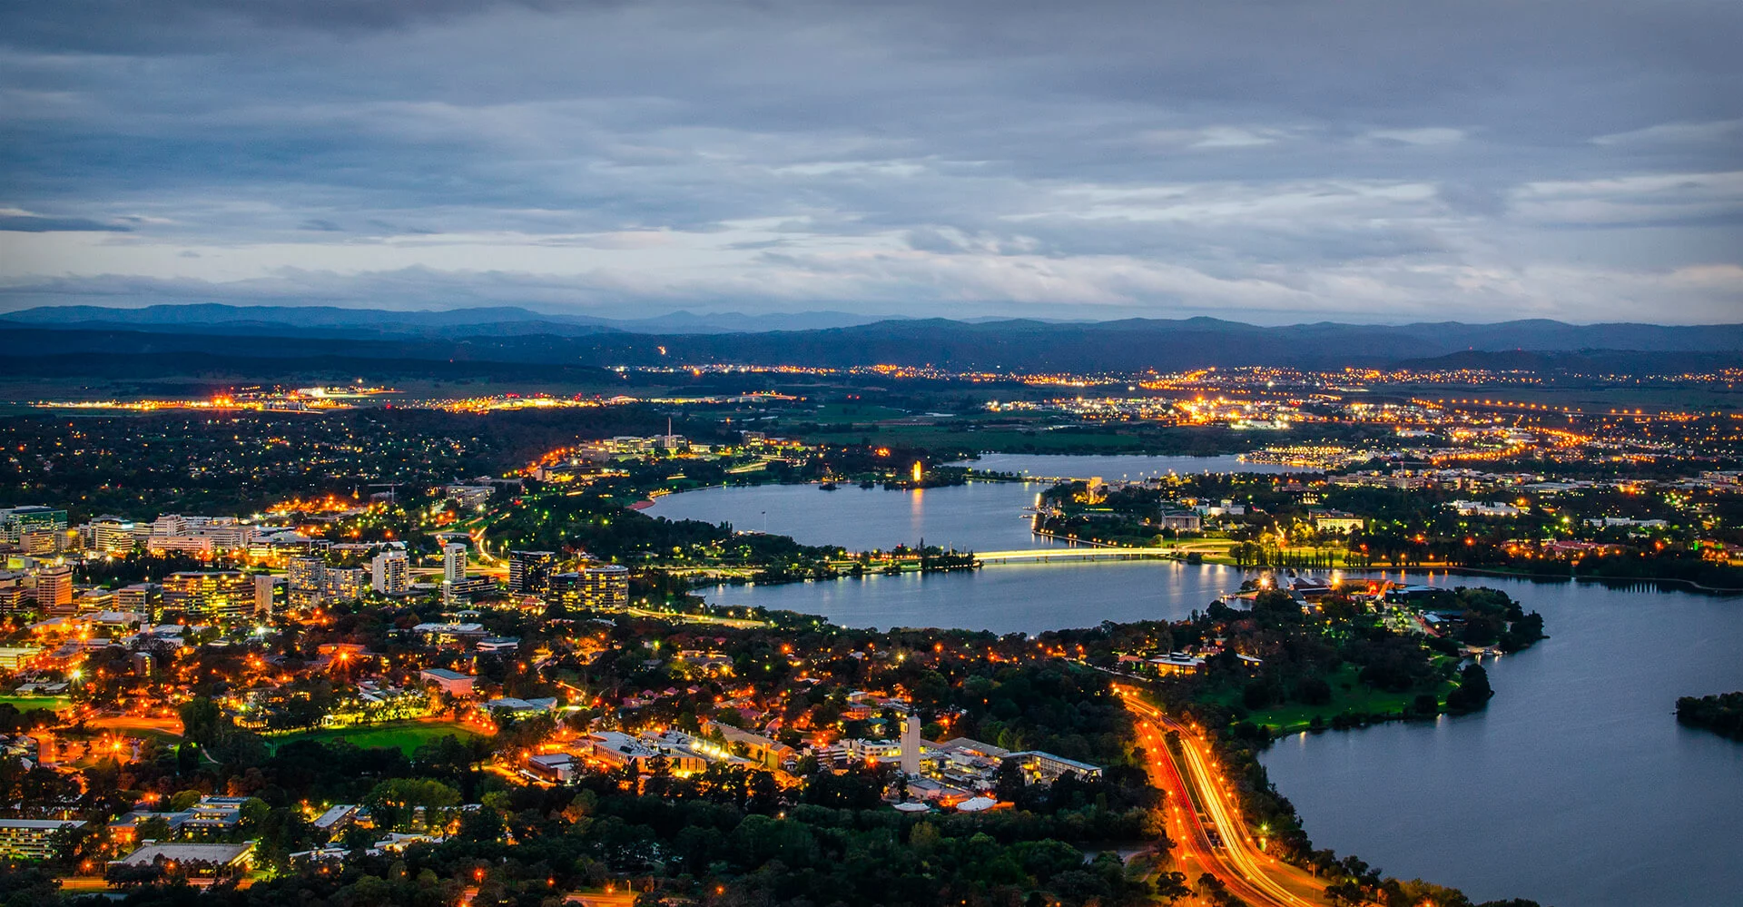
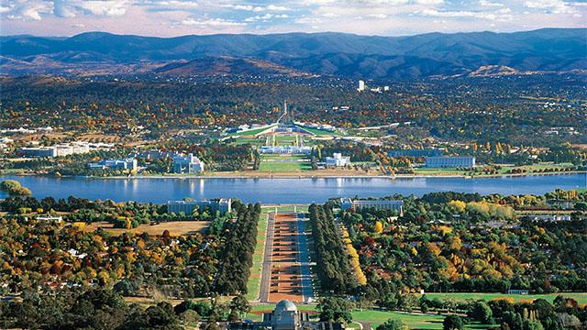
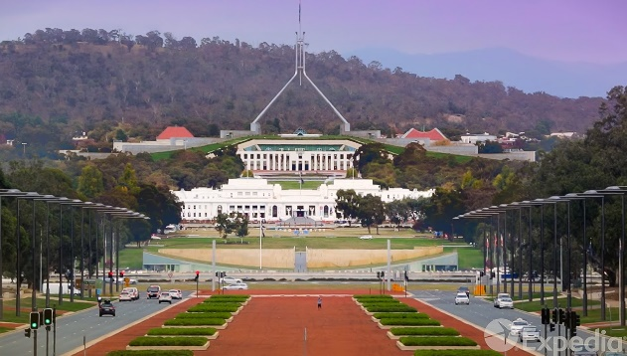
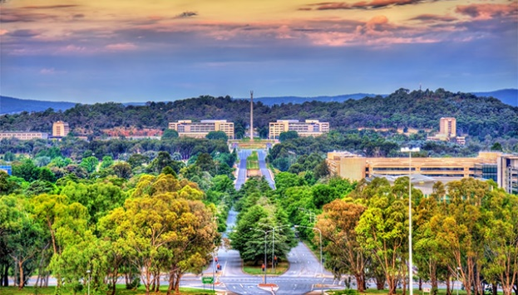
LSI-VC 9 Meeting - Suggested
Host: Geoscience Australia
Location: Canberra, Australia
Dates: March/April 2020

Slide 9
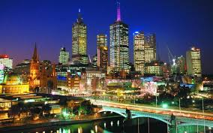
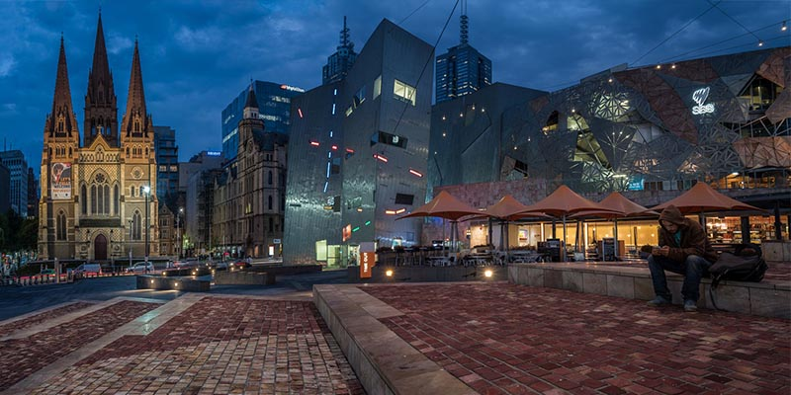
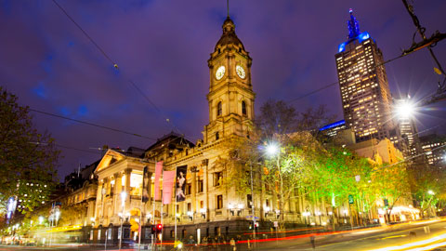
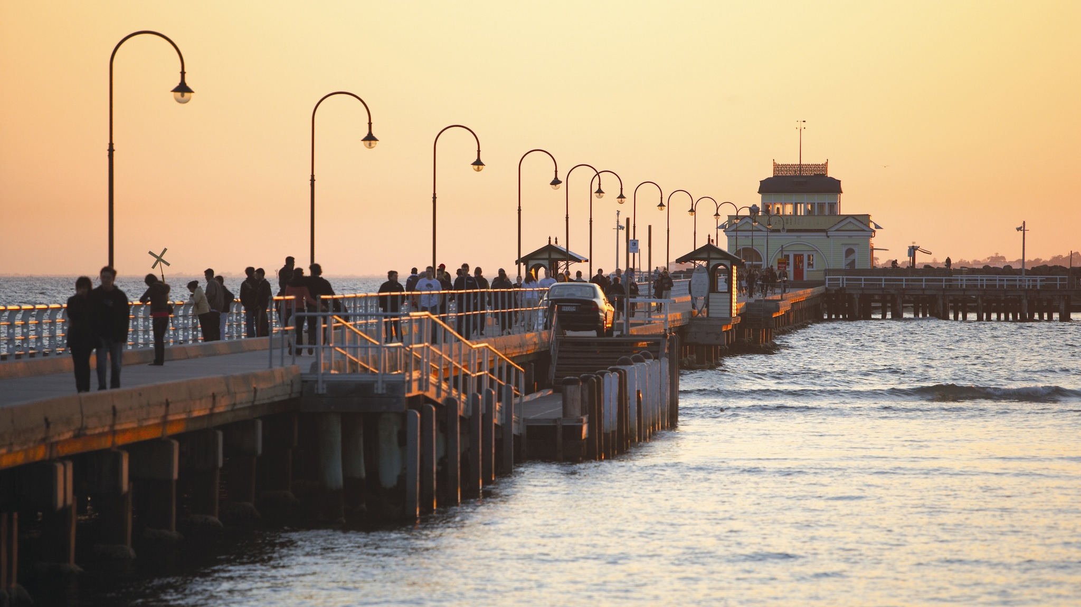
LSI-VC 9 Meeting - Suggested
Host: Geoscience Australia
Location: Melbourne, Australia
Dates: March/April 2020

Slide 10
Thank you!
Interesting facts about Anchorage ☺
English explorer Captain James Cook is credited with first exploring and describing the Anchorage area in 1778.
With a population around 300,000, Anchorage is Alaska’s largest city and home to more than 41 percent of the state’s population. Major industries include government and military, petroleum, and tourism.
Over 150 bird species from around the world migrate to Alaska and hang out in Westchester Lagoon
Anchorage, like all of Alaska, has no native snake population. The only snakes found in the wild are escaped “pets.”
Approximately 250 black bears and 60 grizzly bears live within urban Anchorage and the surrounding area.

