Slide 1

MIM Update
Committee on Earth Observation Satellites
G Dyke
LSI-VC-8
Session 4
Anchorage, Alaska, USA
4-6 September 2019

Slide 2
Summary
MIM Update Survey for 2019 Underway (Matt)
MIM Web App Development Progressed
  Addition of Launch Activity based on COSPAR
  Addition of Data Sets based on OpenSearch
  Addition of Featured Data Sets
Plan to launch updates before CEOS Plenary
MIM API to be iterated
  Based on migration to SQL Server Back End on AWS RDS
  Reworked to mirror website architecture
  October-December

Slide 3
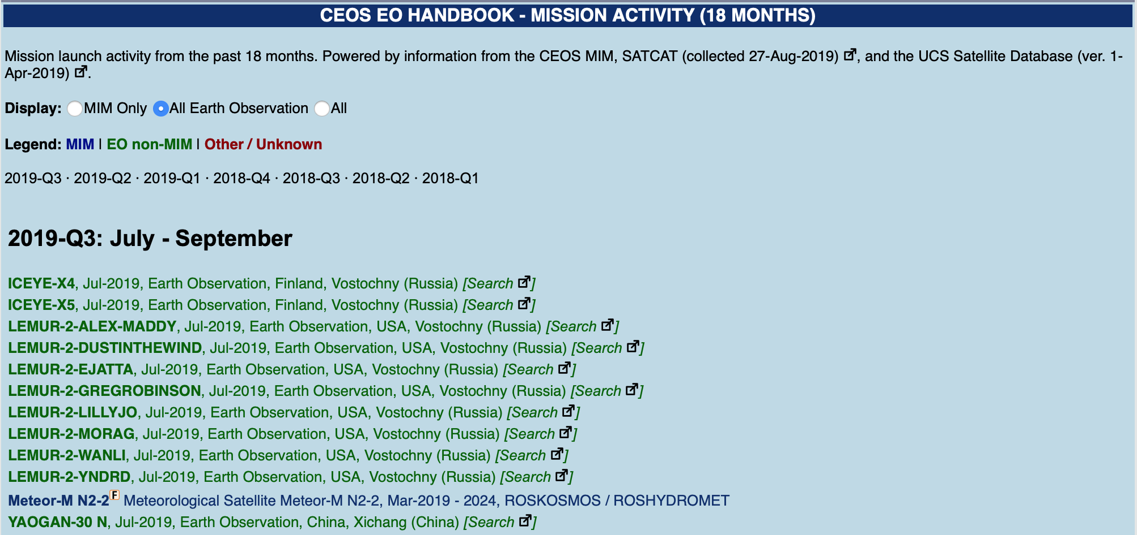
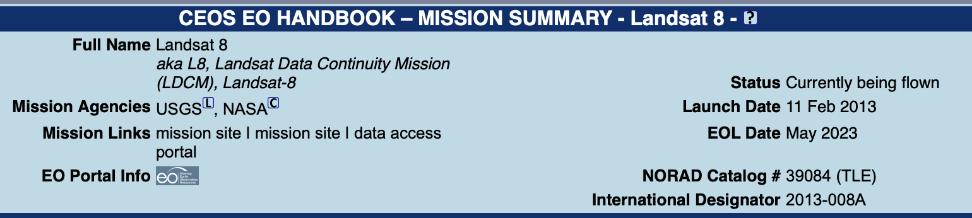
Upstream - Launch Activity

Slide 4
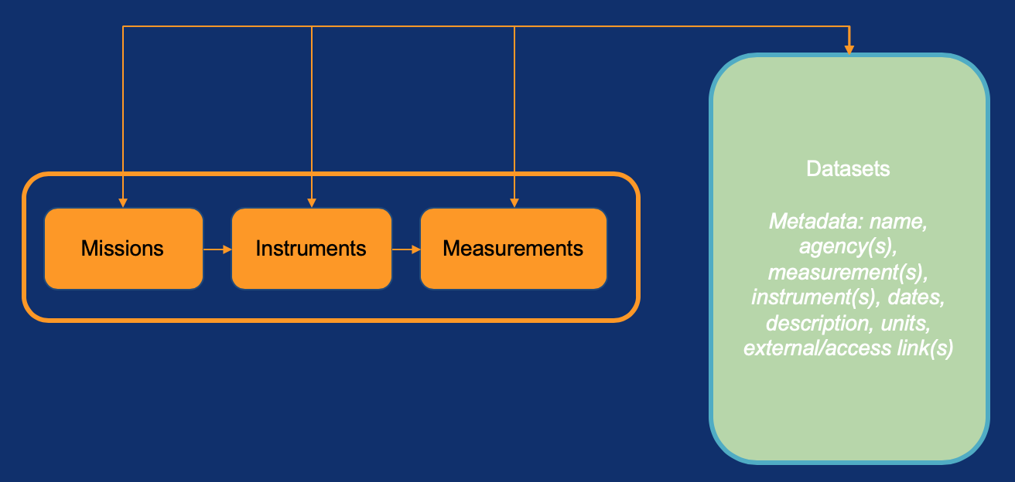
Downstream - Datasets

Slide 5
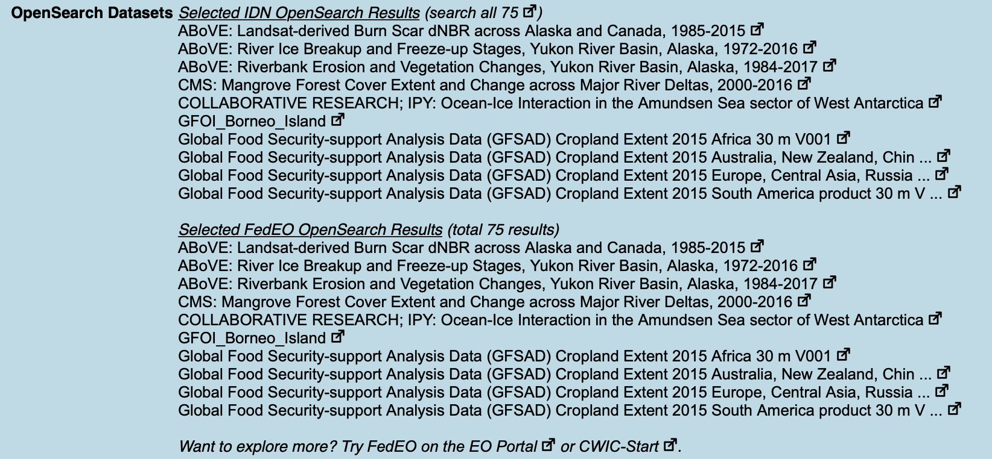
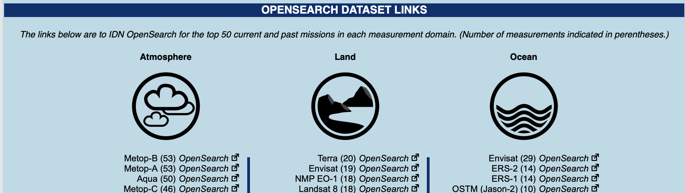
OpenSearch Data

Slide 6
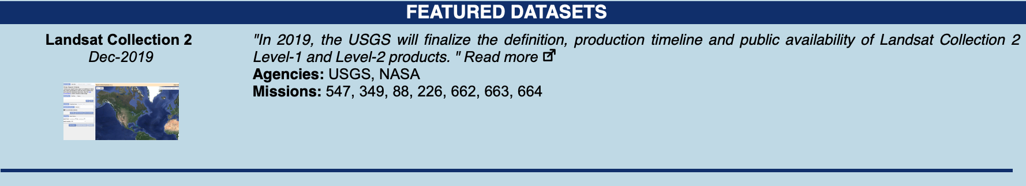
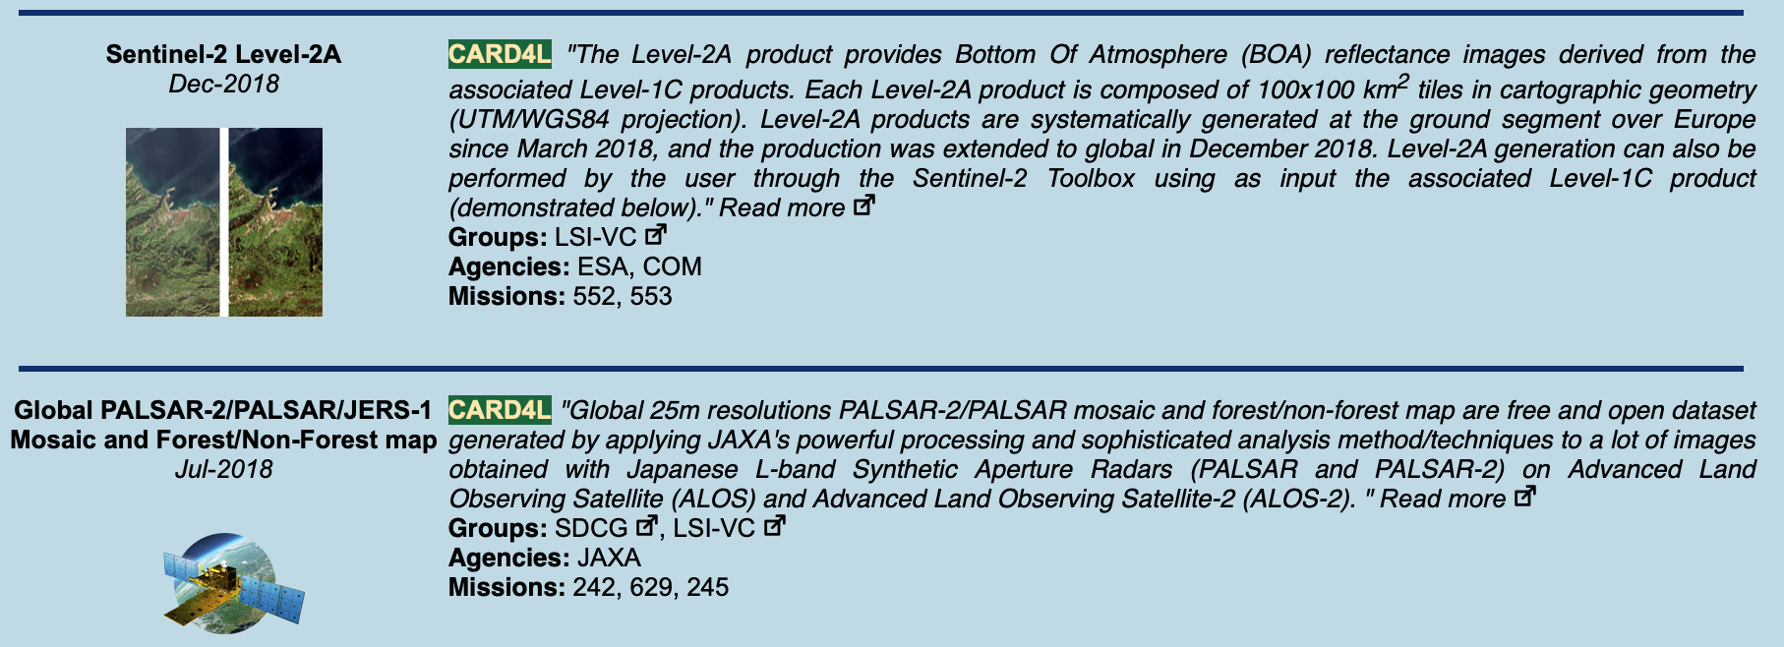

Featured Datasets

Slide 7
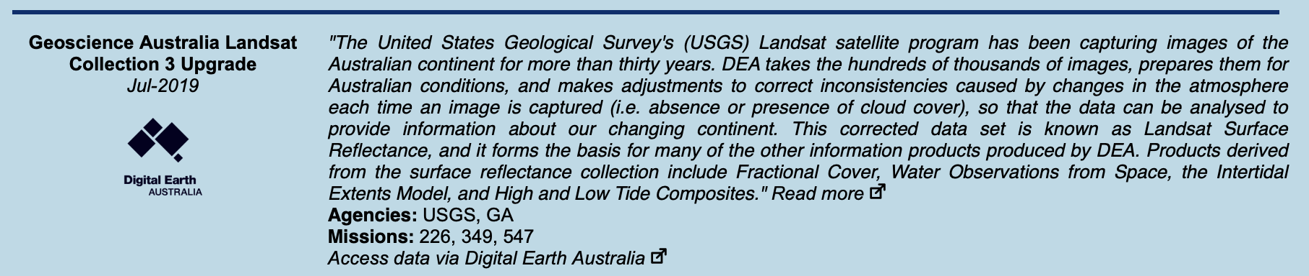
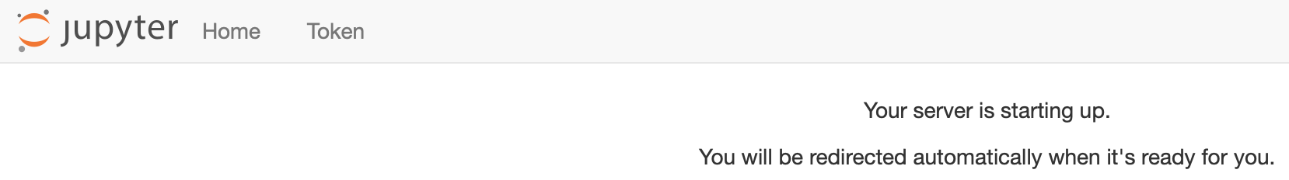
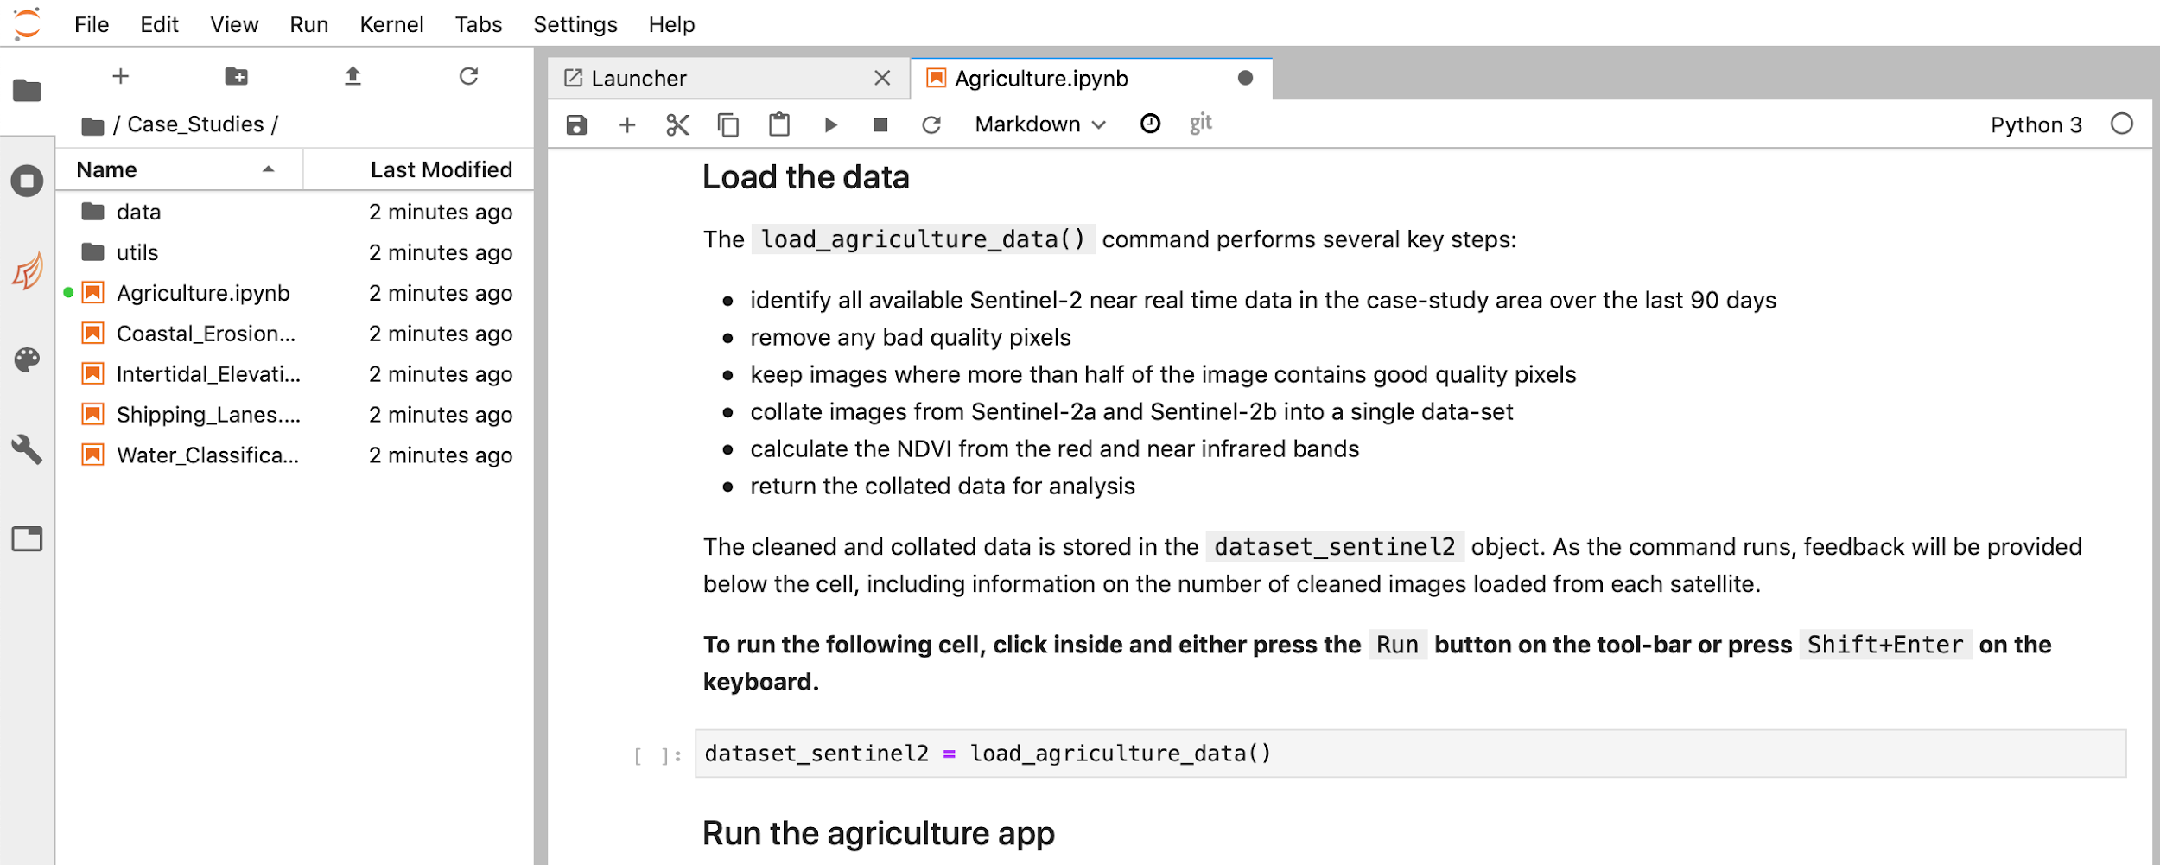

Links to Exploitation Platforms

Slide 8
API
Iterate to leverage addition of new upstream and downstream information
Expand MIM utility for the community with more formats and more information
Update to mirror existing CEOS MIM website structure
  /missions/index
  /mission/<missionID>
  /instruments/index
  /instrument/<instrumentID>
Initial demonstration of utility for gap analysis in 2018 - hope to build on that

Slide 9
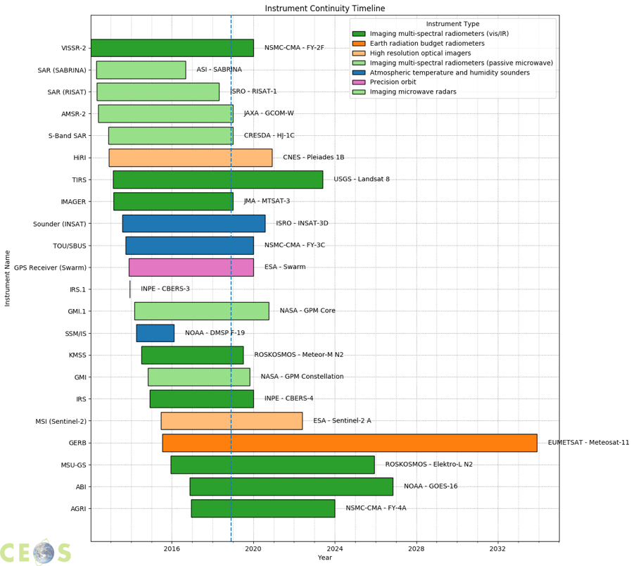
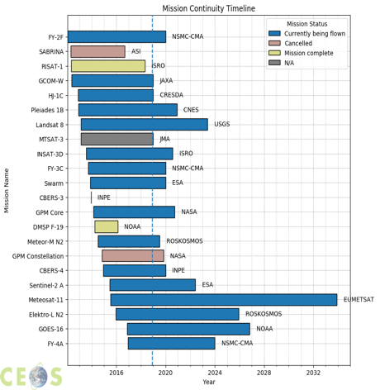
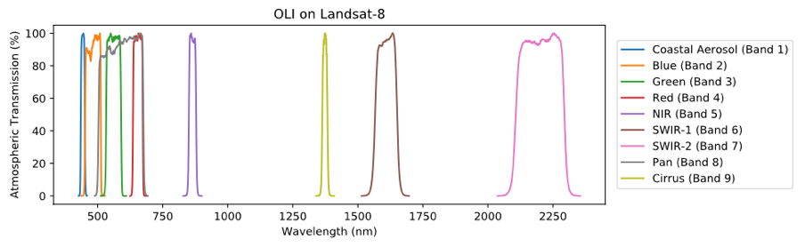
Demo Products

Slide 10
Discussion - Potential Follow-ups
Data
  Featured Datasets - ARD catalog?
  Accessibility - better links to exploitation and/or distributions platforms?
API
  Requirements / Gap Analysis?
  Need more time to iterate underlying API and develop sharable examples
Others?
  ECV Inventory?

