Slide 1
Biomass mission coordination
and data uptake
LSI-VC-8
S Ward, Sep 2019

Slide 2

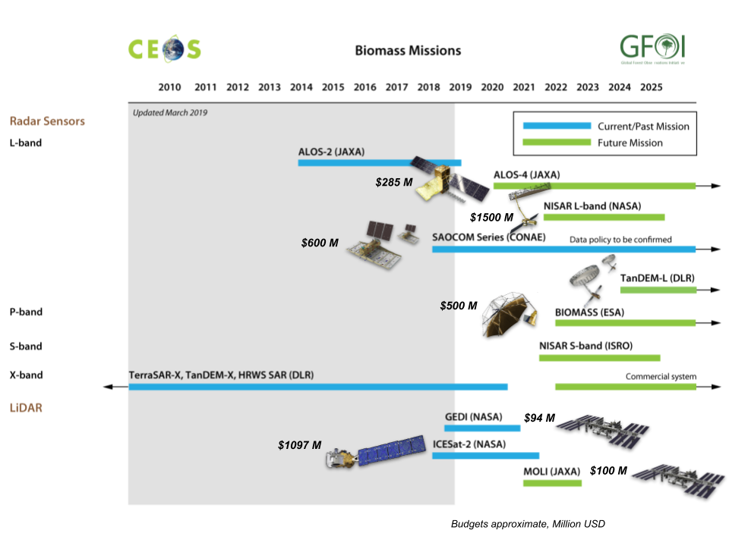
Context
Substantial investment ($4Bn+!) in biomass- related mission launches 2018-2024
Strong interest in biomass from sectors related to carbon emissions and forests
Need to optimise the policy relevance of the space data - through fora such as GFOI and World Bank

Slide 3
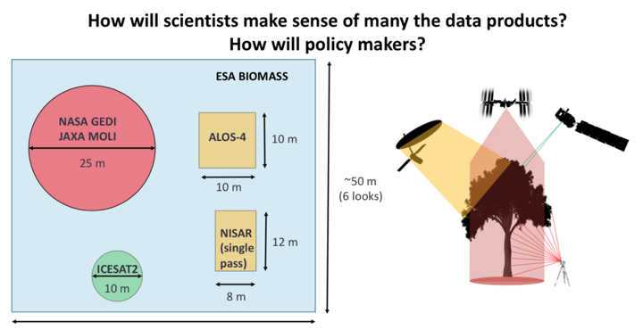
Context

Slide 4
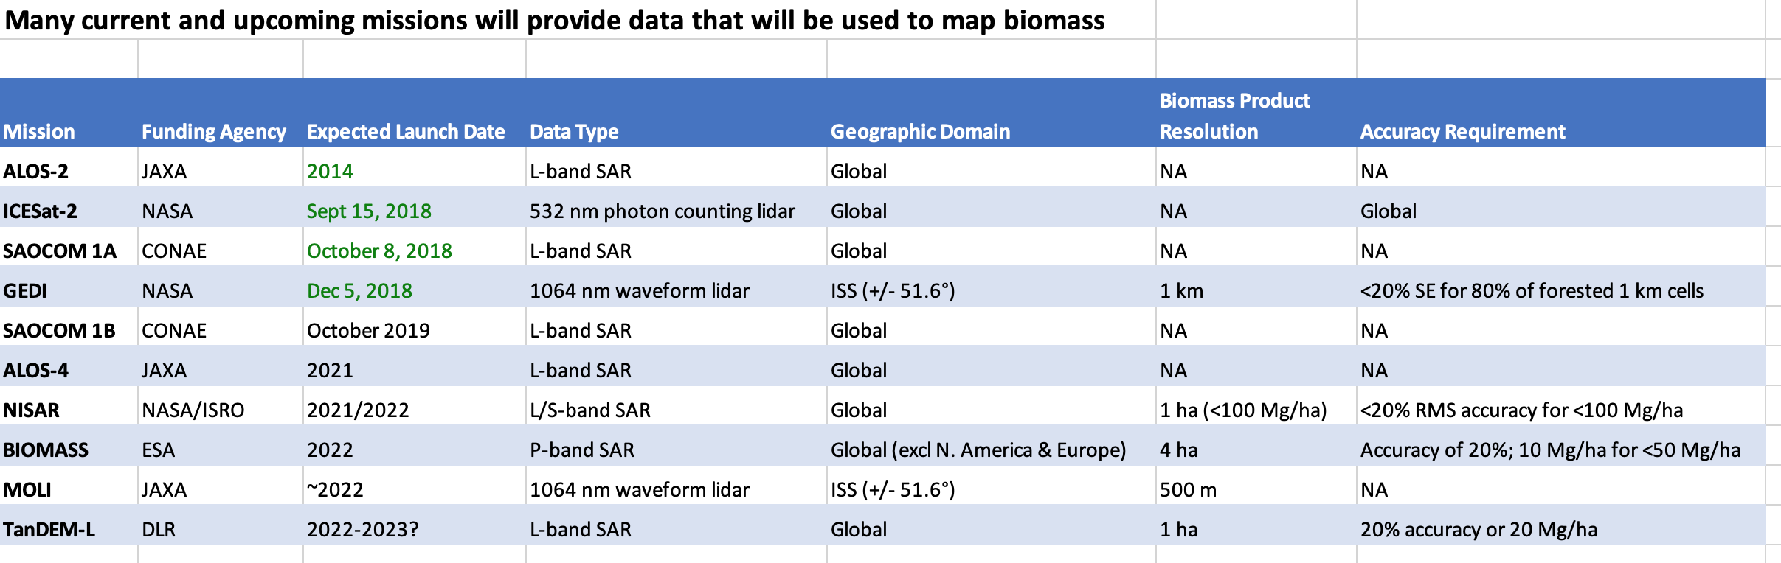
Biomass data

Slide 5
Context
Many international policies requiring biomass information adopted in recent years.
Multilateral agreements & performance-based incentive systems to curb trends in forest loss in tropics
International negotiations related to climate change
Voluntary international processes and their targets related to forests:
  UN Forum on Forests
  Aichi targets under the UN convention on Biological Diversity
  2011 Bonn Challenge to restore 150 million hectares of degraded land by 2020
  2014 New York Declaration
  Land degradation neutrality target UN Convention to Combat Desertification
  UNFCCC NDCs, and the related Sustainable Development Goals (SDGs).
Biomass measurements are of particular significance for policies related to the UNFCCC, because countries must monitor emissions related to gains and loss of biomass, and must report on these regularly

Slide 6
GCOS ECV
T12 is Above Ground Biomass (AGB)
GCOS highlights the further need for actions to:
  Encourage inter-agency collaboration on developing methods to combine biomass estimates from current and upcoming missions (GCOS Action 52)
  Encourage inter-agency collaboration to develop validation methodologies (GCOS action 53)
  Develop a set of validation sites covering the major forest types, particularly in the tropics (GCOS action 54)
  Promote access to well-calibrated and validated regional- and national-scale biomass maps including uncertainty assessment (GCOS action 55)
  Improve access to high-quality forest inventories, especially in the tropics, which can be used for research purposes and Reducing emissions from deforestation and forest degradation plus (REDD+) (GCOS action 56)

Slide 7
Possible joint objectives
Explore how CEOS groups and agencies might work together to accelerate the policy relevance of the new generation of above ground biomass datasets
  gather, synthesize, and communicate user requirements of forest biomass data and space-based AGB data products - that meet user needs, support forest monitoring and wider land use management applications and improve environmental policy to enable countries to help meet international climate and sustainable goals.
  stimulate uptake of biomass data by key stakeholders. integration of biomass products in climate/vegetation models is already progressing (i.e. ESA Biomass CCI: http://cci.esa.int/), but there has been little progress in demonstrating how biomass mapping from space can be integrated in national forest monitoring and national GHG inventories efforts.
  promote collaborative and sustained data provision
  avoid a widening gap between what is evolving in research and from space-based missions, and the diverse demands of users, particularly in terms of the need for operational systems.

Slide 8
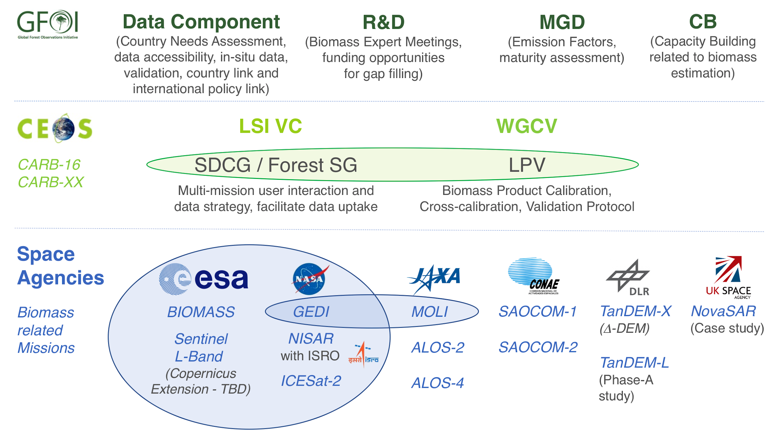
Future Biomass Framework
Notes:
CARB-XX is the new proposed task on “GFOI Data Uptake” or the extension of CARB-04
Cooperation between SDCG and LPV => linked via SDCG to the GFOI Data Component
ESA – NASA bilateral on EO
Cooperation between GEDI and MOLI teams
NovaSAR S-band SAR case study with low duty cycle, hence no global systematic acquisition

Slide 9
Possible joint objectives
Biomass mission coordination implemented through an informal multi-mission group, with close ties to WGCV/LPV but not formally recognised in the CEOS structure
  product and cal-val focus (GCOS requirements)
Would agencies benefit from recognition of the challenges within a CEOS Virtual Constellation framework, and should that be LSI-VC or a standalone VC?
  JAXA, NASA, ESA, DLR, CONAE, ISRO fly the missions
  definitely at the research end of a VC and not operational
  land surface, not strictly imaging
  CARD4Lidar?
  could be embedded within new Forest & Biomass team
  GEOGLAM/Ag will have interest in aspects also
How might we take advantage of the coming SIT term to kick-start any cooperation and establish CEOS Principal attention & support?
Getting traction within LPV/Biomass group… NASA, ESA Principals?

