Slide 1


Joint CEOS/CGMS WGClimate
Jörg Schulz, EUMETSAT
Chair Joint CEOS/CGMS Working Group on Climate
Albrecht von Bargen, DLR
Vice Chair Joint CEOS/CGMS Working Group on Climate
with more slides from David Crisp (NASA)
Notes:
CEOS (the Committee on Earth Observation Satellites): September, 1984 is made up of 55 Agencies from all around the world committed to coordinating their satellite Earth observation programs and sharing data for a more sustainable and prosperous future. These satellite observations are critical for environmental monitoring, meteorology, disaster response, agriculture and many other applications (take a look at these case studies) that can improve life on Earth and save lives.
CEOS organizations currently operate 112 satellites. These satellites and their related systems operate simultaneously and serve both interdisciplinary and international activities; therefore, international discussion and cooperation are critical to their success.
CGMS: 19 September 1972, 16 members + 6 observers, coordinates the meteorological observing system. The main goals of the coordination activities of the Coordination Group for Meteorological Satellites are to support operational weather monitoring and forecasting as well as climate monitoring, in response to requirements formulated by WMO, its programmes and other programmes jointly supported by WMO and other international agencies.

Slide 2
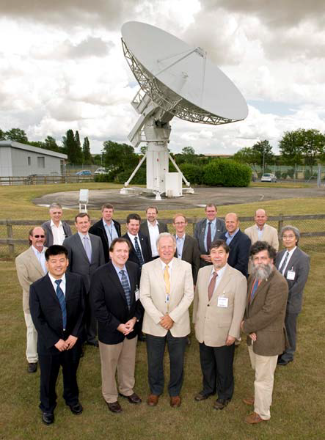
WGClimate: Short History
CEOS Working Group on Climate endorsed at CEOS Plenary in 2010;
The joint development of the high-level architecture for climate monitoring from space led to the formation of the Joint CEOS/CGMS WGClimate endorsed by CEOS and CGMS Plenaries in 2013;
Major Task is: Coordinate and encourage collaborative activities between the world’s major space agencies in the area of climate monitoring.
JWGClimate
Chair: Jörg Schulz (EUMETSAT)
Vice Chair: Albrecht von Bargen (DLR)

Slide 3
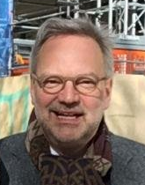

Leadership
Until November 2020
Chair: Jörg Schulz (EUMETSAT)
Vice Chair: Albrecht von Bargen (DLR)
November 2020 – November 2022
Chair: Albrecht von Bargen
Vice Chair: asking for proposals by Agencies
In the alternating chair position the next term is for CGMS. Nevertheless we will issue a call for nomination to CEOS and CGMS after CEOS Plenary.

Slide 4
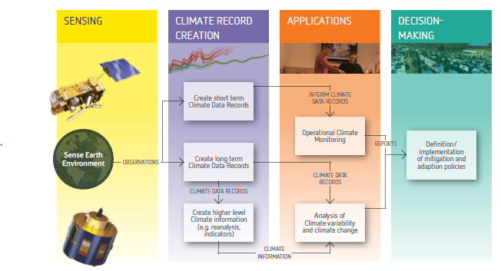
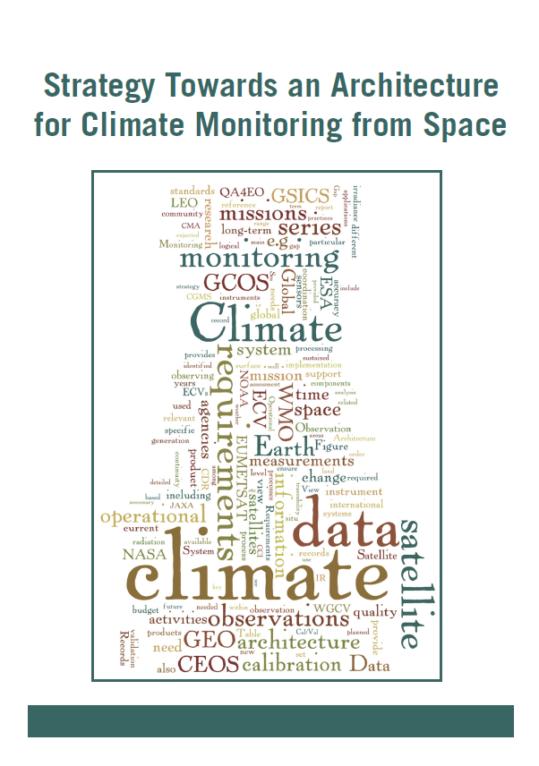
The Architecture for Climate Monitoring from Space
http://ceos.org/document_management/Working_Groups/WGClimate/WGClimate_Strategy-Towards-An-%20Architecture-For-Climate-Monitoring-From-Space_2013.pdf

Slide 5
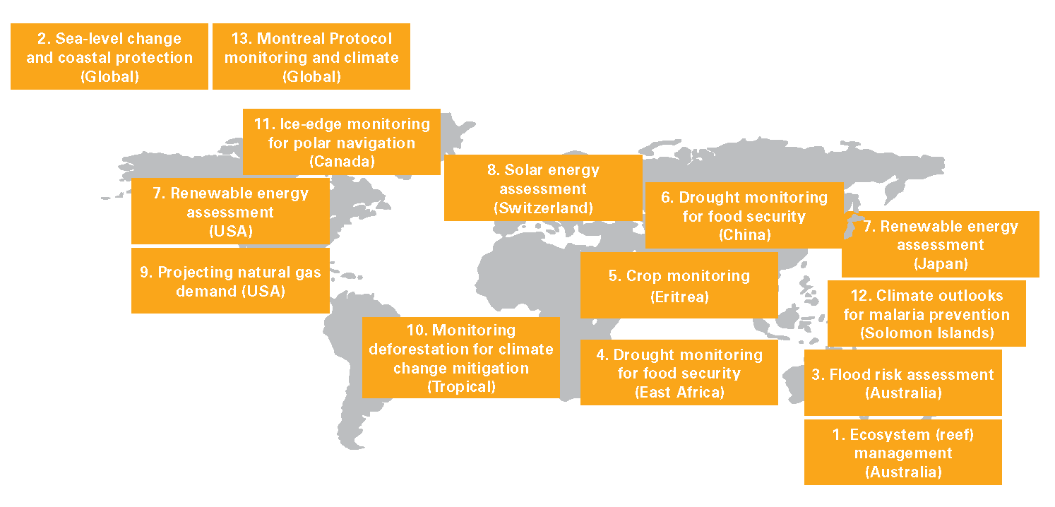
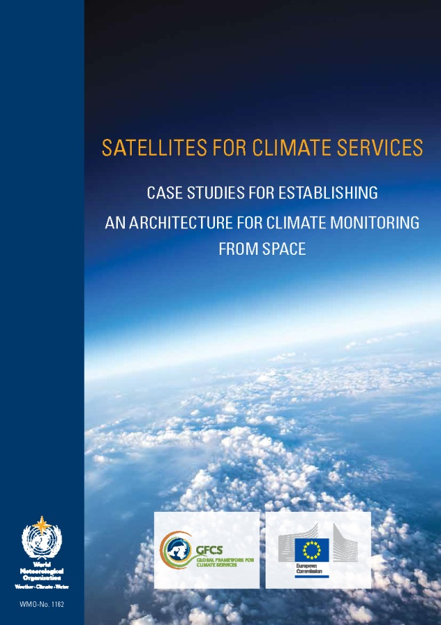



Enhancing use of climate data records
Courtesy of Bojinski et al.; 2015
2015
http://library.wmo.int/pmb_ged/wmo_1162_en.pdf

Slide 6

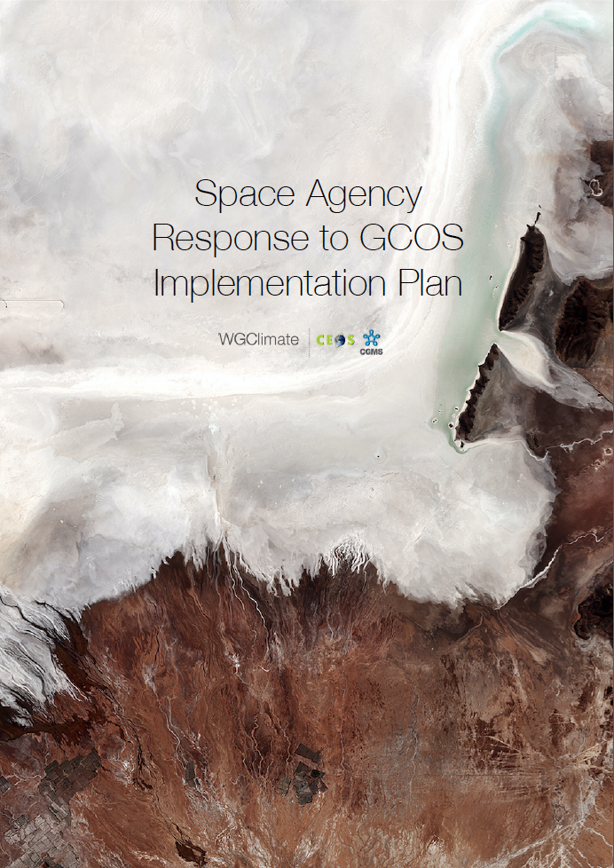
GCOS Implementation Plan &
The Comprehensive Answer
2016
Answer contains status and plans for all actions in GCOS IP relevant for space agencies.
Allows reporting of progress on GCOS needs to UNFCCC.
2017
Notes:
Addresses GCOS Actions with space relevance;
Structure of response is similar to the plan itself;
Contains status and plans for 11 (32) general, 19 (40) atmospheric, 17 (57) oceanic and 48 (72) terrestrial actions;
Allows reporting on progress to GCOS and UNFCCC.

Slide 7
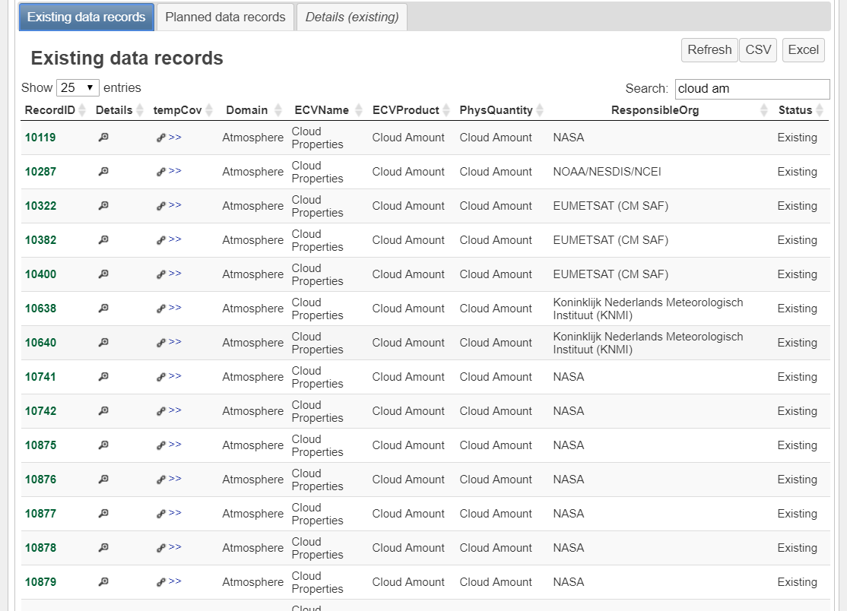
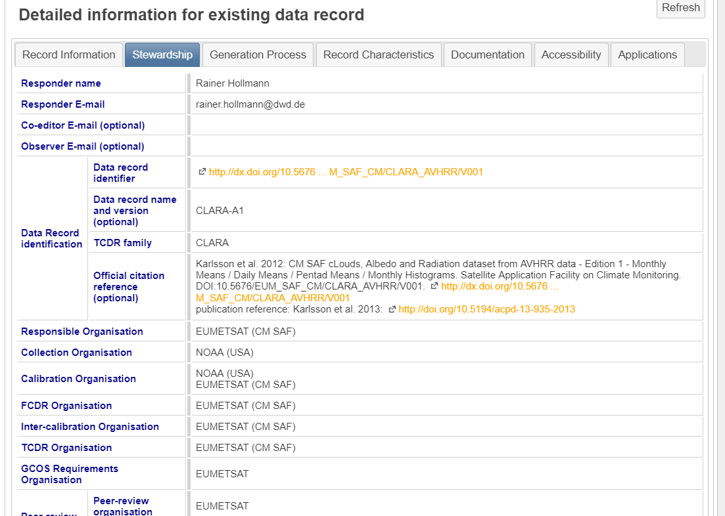
ECV Inventory - Resource for Coordinated Response to GCOS
Action Plan & Creation of conditions to deliver CDRs
ECV Inventory
Gap Analysis & Recommendations
http://climatemonitoring.info/ecvinventory
Notes:
ECV Inventory fully describes current and planned implementation arrangements (ECV Product-by-ECV Product) within the Architecture;
Verified information about almost 1000 (ECV#2) data records including direct access points to the data;
Updated continuously with versions of Inventory (ECV#3 ongoing since Nov 2018) , gap analysis, action plan created annually with approval from CEOS and CGMS;
Recommendations and Coordinated Actions inform space agency planning, improve availability and interoperability of climate data;
Feeds material for all future responses to the GCOS IP.
Users can:
Download the ECV Inventory content for own analysis;
Find direct access points to all CDRs in the Inventory;
Get access to WGClimate gap analysis results and planned actions;
Can access case studies analysing the use of CDRs for applications.

Slide 8
CDR Inventory Contributions
Inventory #3 (Provisional)
Existing: 817
Planned: 481
Total: 1298

Slide 9
Coordinated Action LST CDRs
There is lack of high spatial resolution (100m or better) data records included in the portfolio of future CDRs.
Recommendation #19: The CEOS Land Surface Imaging-Virtual Constellation (LSI-VC) to coordinate on the formulation of future high resolution missions and seamless continuity of sustained Land Surface Temperature CDRs.
VC-LSI | 22 | LSI-VC to formulate future high resolution missions for Land Surface Temperature climate data records aiming at seamless continuity of CDRs. | Discussion with VC-LSI needed. | 31 Dec 2019 | OPEN | Mission Planning, Science, LSI lead needed, needs deadline extension

Slide 10
Coordinated Action LST CDRs
As IR imagers are used for the derivation of LST there is no apparent gap in the availability of such missions, but Table shows that, for most new missions, no plan exists to derive LST climate data records from an individual instrument series or combinations of it.
VC-LSI | 23 | The LSI-VC to assess the usefulness of available data from multiple sensors for the generation of climate data records. Resulting plans at Agencies to generate climate data records shall be registered with the ECV Inventory. | Discussion with VC-LSI needed. | 31 Dec 2019 | OPEN | Science, LSI lead needed, needs deadline extension

Slide 11
Coordinated Action LAI CDRs
For Leaf Area Index (LAI), it was observed that some known data records have not been registered within the ECV Inventory; this omission should be fixed in the next update. The total number of existing and planned data records currently in the ECV inventory is fairly low (two existing and three planned), even though plenty of satellite instruments that have very high relevance for Leaf Area Index are known to exist. Thus, it is recommended that the LAI-VC assess climate user needs for such products that are not currently exploited from existing missions. This should assist future planning for LAI CDRs;
Number of LAI data records has doubled in Inventory #3.
VC-LSI TOPC | 24 | The LSI-VC and GCOS TOPC to assess the climate user community needs for LAI that are not currently exploited from existing missions to enable planning for further Leaf Area Index data records as appropriate. Resulting plans at Agencies to generate climate data records shall be registered with the ECV Inventory. | Discussion with VC-LSI needed. | 31 Dec 2019 | OPEN | Mission sufficiency, Science, LSI lead needed needs deadline extension

Slide 12
Greenhouse Gas Monitoring
CEOS/CGMS provided a white paper describing a constellation architecture for monitoring atmospheric CO2 and CH4 concentrations and their natural and anthropogenic fluxes from space¹ to support climate policy
166-page document, 88 authors representing 47 organizations
Executive Summary (2 pages)
  Overview of objectives and approach for policy makers, CEOS/CGMS Agency leads
Body of report (75 pages)
  Science background and requirements, current and near-term mission heritage and system implementation approach, intended for program scientists and project managers
Technical Appendices (42 pages)
  “Textbook” summarizing state-of-the-art in measurements and models for scientists, engineers, and inventory community
http://ceos.org/document_management/Virtual_Constellations/ACC/Documents/CEOS_AC-VC_GHG_White_Paper_Publication_Draft2_20181111.pdf
Notes:
Atmospheric measurements of CO₂ and CH₄ from ground-, airborne- and space-based sensors could reduce uncertainty in national emission inventory reports by:
providing nations with timely, quantified guidance on progress towards their emission reduction strategies and pledges (NDCs)
identifying additional emission reduction opportunities; and
tracking changes in the natural carbon cycle caused by human activities (deforestation, degradation of ecosystems, fire) and climate change
Atmospheric measurements support conventional, bottom-up inventories by:
Improving the frequency and accuracy of inventory updates for nations not well equipped for producing reliable inventories, and
helping to close the carbon budget by providing measurements over ocean and over land areas with poor data coverage (tropical forests, polar regions)
Complementing Bottom-Up GHG inventories with Top-Down atmospheric inventories
Atmospheric CO₂ and CH₄ measurements provide an integrated constraint on the exchanges of these gases between land, ocean and atmosphere and their trends
Fluxes inferred from atmospheric CO₂ and CH₄ measurements are not as source-specific as those used in bottom-up GHG inventories, but include contributions from sources often omitted or poorly characterized in bottom-up inventories
Combining Ground-, airborne-, and space-based atmospheric measurements
At global scales, CO₂ and CH₄ concentrations are well characterized by precise, ground-based in situ measurements from surface and airborne sensors
Estimates of column-averaged CO₂ and CH₄ dry air mole fractions (XCO₂ and XCH₄, respectively) from space-based measurements can augment the resolution and coverage of the in situ measurements

Slide 13
CEOS/CGMS GHG Roadmap
Coordination mechanism proposed and endorsed by CEOS and CGMS Plenaries
Contributions from multiple CEOS & CGMS entities (WGClimate GHG Task Team, AC-VC, WGCV/ACSG & GSICS)
Addressing Actions on two different time horizons i)Prototype products: 2021 for 2023 Global Stocktake and ii)Pre-operational: 2026 for 2028 Global Stocktake
Roadmap meeting in Tokyo (09/06) draft roadmap by CEOS SIT TW in September 2019 present to CEOS 33rd Plenary (October 2019), and send to CGMS, for written endorsement.
With CGMS Agency
involvement

Slide 14
Value of Integrating the Biomass and GHG monitoring efforts
Space based measurements of land cover and aboveground biomass stocks provide critical constraints on the land carbon cycle and its response to
  human activity (deforestation/reforestation, forest degradation, agriculture and other land use change)
  climate change (drought, floods, heat stress, wildfire, etc.)
Land cover and aboveground biomass measurements alone do not provide useful constraints on the uptake or emissions (fluxes) of CO₂, CH₄ or other greenhouse gases on national scales
However, observable changes in land use or biomass are often associated with dramatic changes in land carbon fluxes
Integrating ongoing efforts to monitor land cover, aboveground biomass and greenhouse gases from space could yield
  new insights into the processes controlling land-atmosphere fluxes
  improved models for predicting their response to climate change.

Slide 15
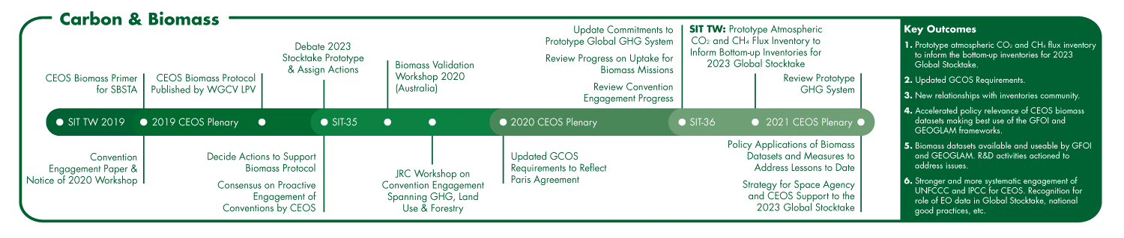
The Carbon & Biomass Initiative
Carbon and GHGs are one of 3 CEOS Chair Priorities for 2020-2021
Supporting the GHG Roadmap process – escalating, elevating, and accelerating progress towards major milestones, including for 2023 Global Stocktake. 2021 prototype flux products.
Reflecting $4Bn+ investment (2018-2024) in Above-Ground Biomass missions and seeking to accelerate the policy relevance of these new data (GFOI, GEOGLAM…)
Encouraging stronger and more systematic engagement by CEOS of convention frameworks – building on IPCC outreach

Slide 16
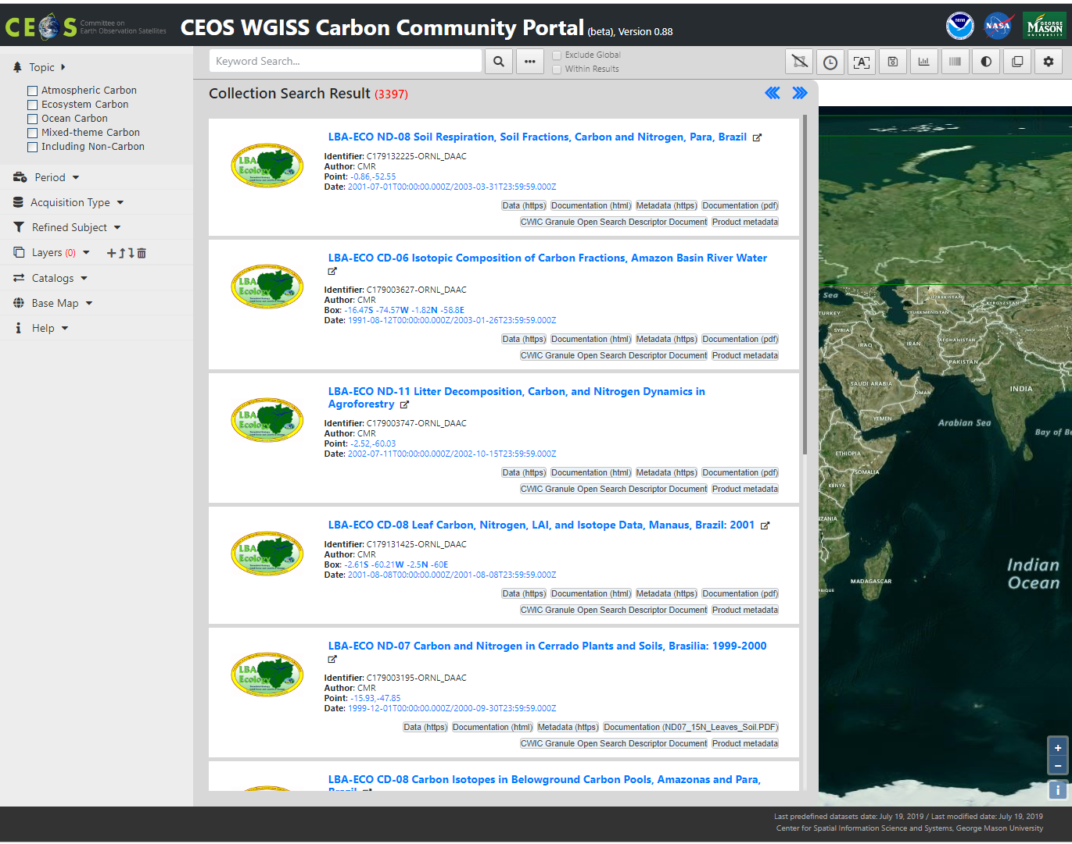
WGISS – Working Group on Information Systems and Services Carbon Community Portal
Goal: To support CEOS Carbon Science Mission by providing easy discovery of and access to carbon-related data resources in CEOS member agencies
The Objectives: 1) enable carbon community to easily find their interested data in the CEOS agency collections brokered by both CWIC and FedEO; 2) allow searching and accessing data within collections using CWIC and FedEO with keywords, spatial and/or temporal constraints; and 3) provide common discovery and access of all CWIC partner holdings targeting at the CEOS Carbon Community
Summary of progresses since WGISS’47 in May 2019:
Refined search support by periods
Improved search support by acquisition types
More data format support for user-uploaded map for searching and customized clipping
Allows searching of Essential Climate Variables (ECV)
Release of fully developed User’s Guide
Updated release of beta version in middle July 2019
Next steps: Release of version 1 in September and tailor it to serve localized and specialized carbon projects
Notes:
Carbon Portal prototype

Slide 17





UNFCCC/GCOS – CEOS/CGMS Relations
COP-21 Paris Agreement: Adaptation (Article 7(c)):
Strengthening scientific knowledge on climate, including research, systematic observation of the climate system and early warning systems, in a manner that informs climate services and supports decision-making.
Reports on Progress
@ SBSTA/COP
Needs and Requirements
Coordinated Response

Slide 18
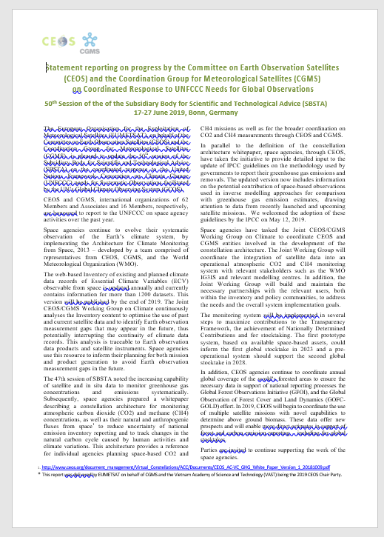
CEOS/CGMS Statement to SBSTA
CEOS/CGMS regularly provide statements to SBSTA demonstrating relevant progress concerning climate observations including GHG;
Progress was echoed in Conclusions of the Systematic Observation chapter, e.g., the ECV Inventory, and the contributions that satellite data can have to reduce uncertainty of national emission inventory reporting and to track changes in the natural carbon cycle caused by human activities and climate variations;
Other items in the statement were:
  update of IPCC guidelines on the methodology used by governments to report their greenhouse gas emissions and removals;
  forest monitoring activities (GFOI and GOFC);
  use of multiple satellite missions with novel capabilities to determine above ground biomass.
Notes:
These data offer new prospects and will enable more direct estimates in support of forest and carbon emission reporting – including for global stocktakes.

