Slide 1
7th Meeting of the CEOS Land Surface Imaging Virtual Constellation (LSI-VC)
Charles Wooldridge
Session 8
Hanoi, Vietnam
14 – 15 February 2019

Slide 2
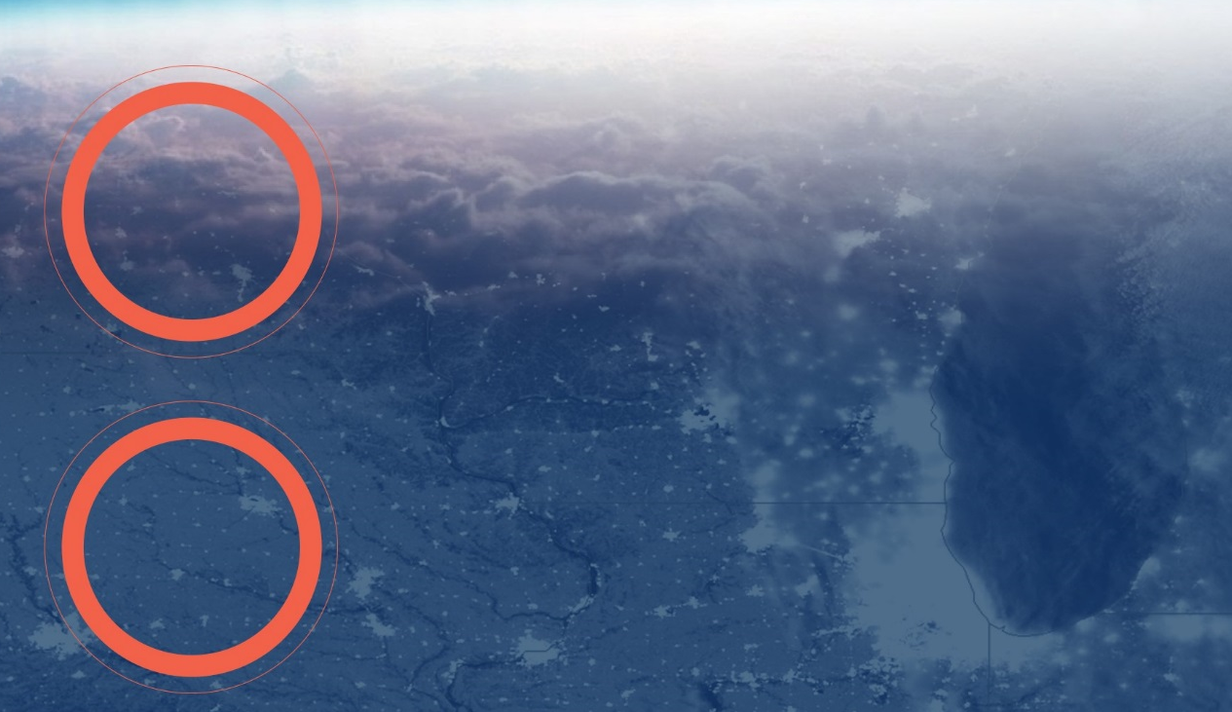
Mission Planning
NESDIS’ mission is provide secure and timely access to global environmental data and information from satellites and other sources to both promote and protect the Nation’s environment, security, economy quality of life.
OUR
MISSION
OUR
VISION
Our vision is to expand understanding of our dynamic planet as the Trusted source of Environmental data.

Slide 3
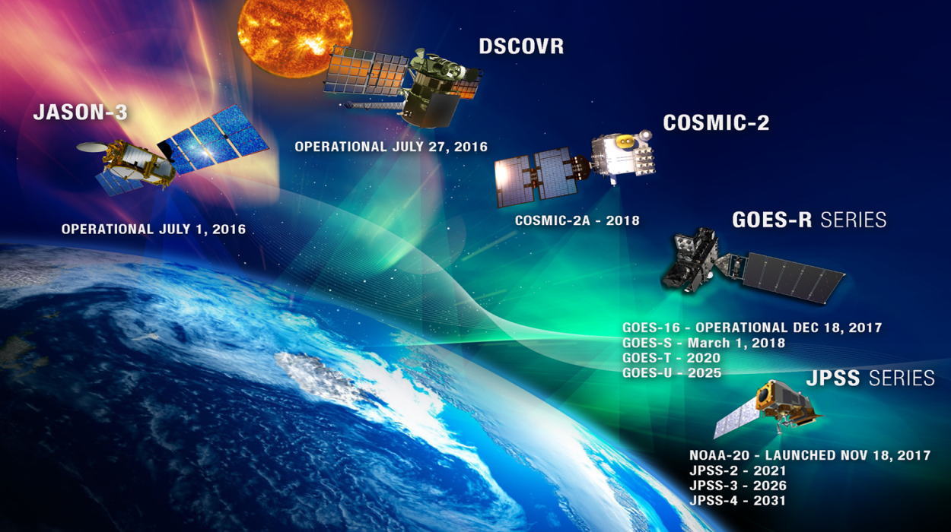
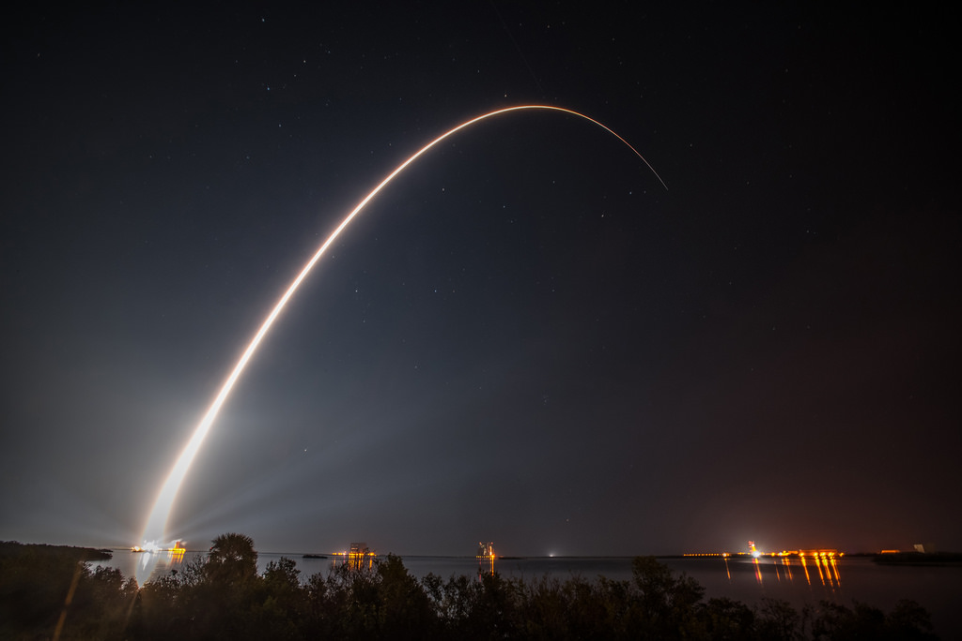
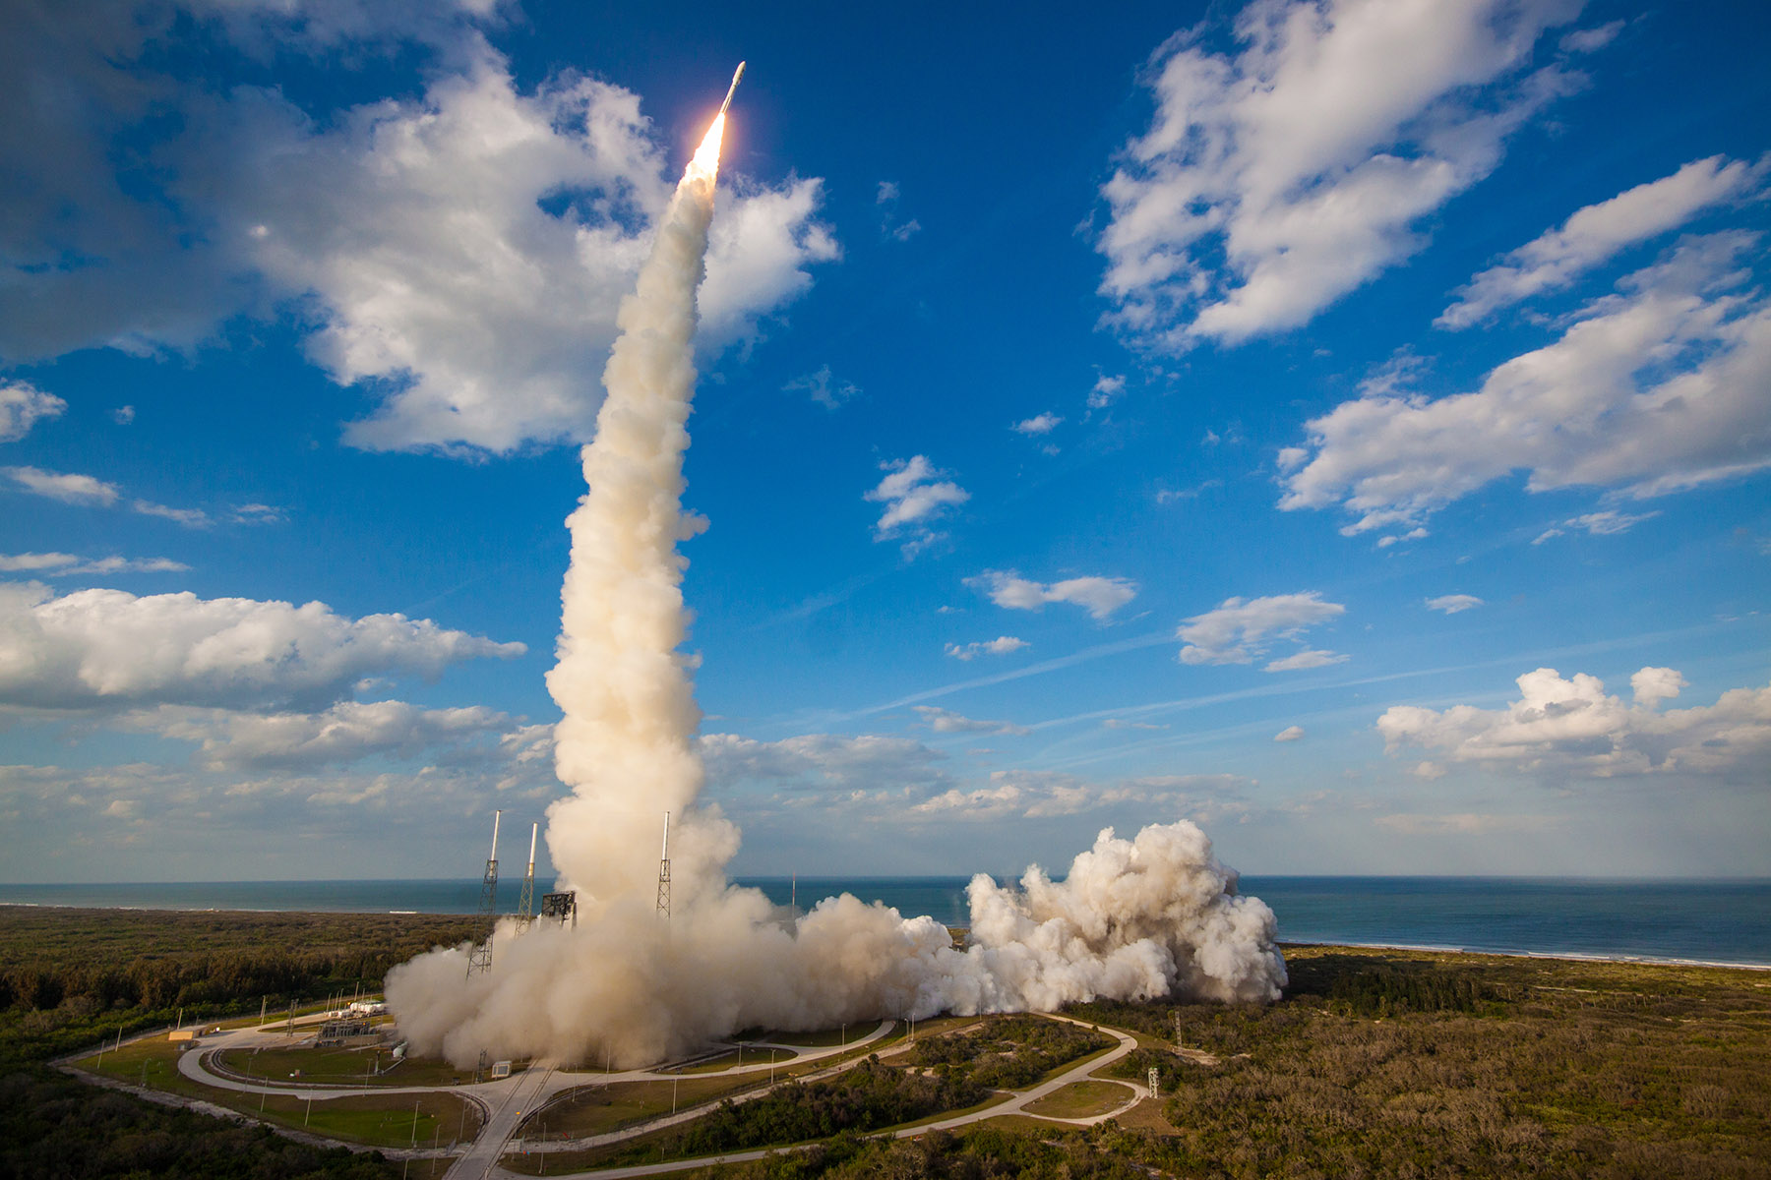

NOAA Recent and
Upcoming Launches
GOES-R Launch Nov 2016
GOES-S Launch Mar 2018
JPSS-1 Launch Nov 2017

Slide 4
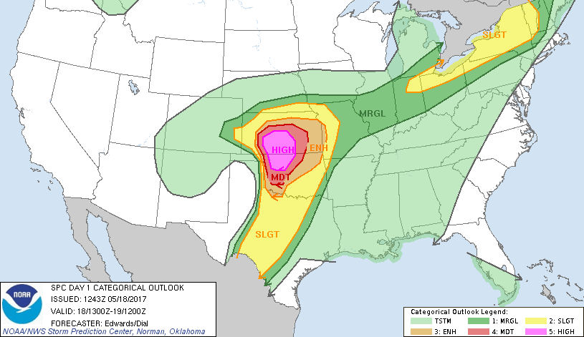
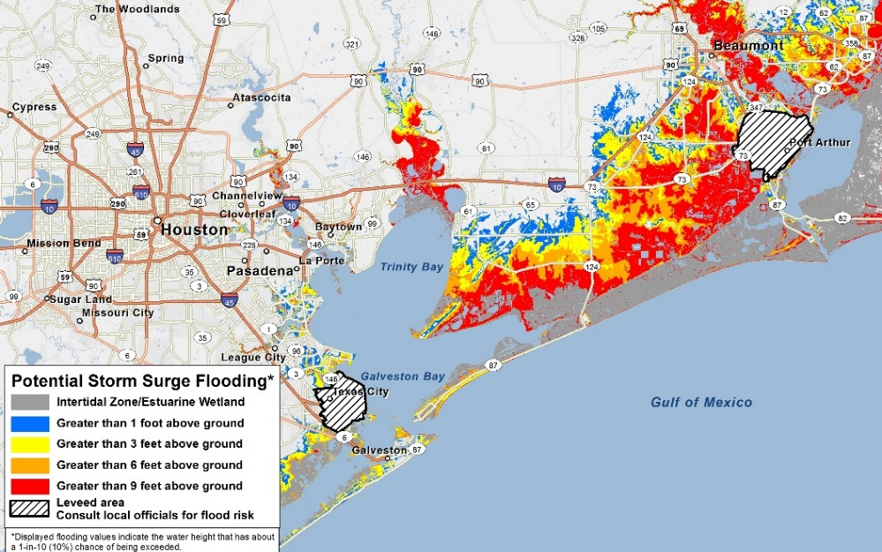
NOAA Satellite Observing Systems
Architecture (NSOSA) Study
  Address NOAA’s systems with a knowledge and inclusion of partner contributions and relationships
  Address NOAA Operational Needs
  Seeks which observation functions should be allocated to which orbit?
  Studies legacy architecture to keep legacy or seek change
  Studies observation functions to find needed improvements
  Examining the space segment architecture decisions for space systems post GOES-R/S/T/U and JPSS-1/2/3/4.

Slide 5
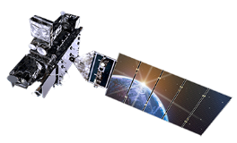
NSOSA developed a large set of designed
and costed alternatives
Alternatives fit within several architectures
  Legacy or expansion
  Radical alternatives
  Hybrids
Either Legacy Expansion or Hybrids were cost-benefit
preferred, depending on the average annual expenditure available
  Legacy Expansion is preferred at narrow budget levels
  Hybrids are preferred over a wide range of budgets
Impacts of Hybrid architecture:
  New capabilities: Mission improvements or deficits
  NWS Operations: Type and number of data feeds, data variety, implied to
  forecaster tools and environments

Slide 6
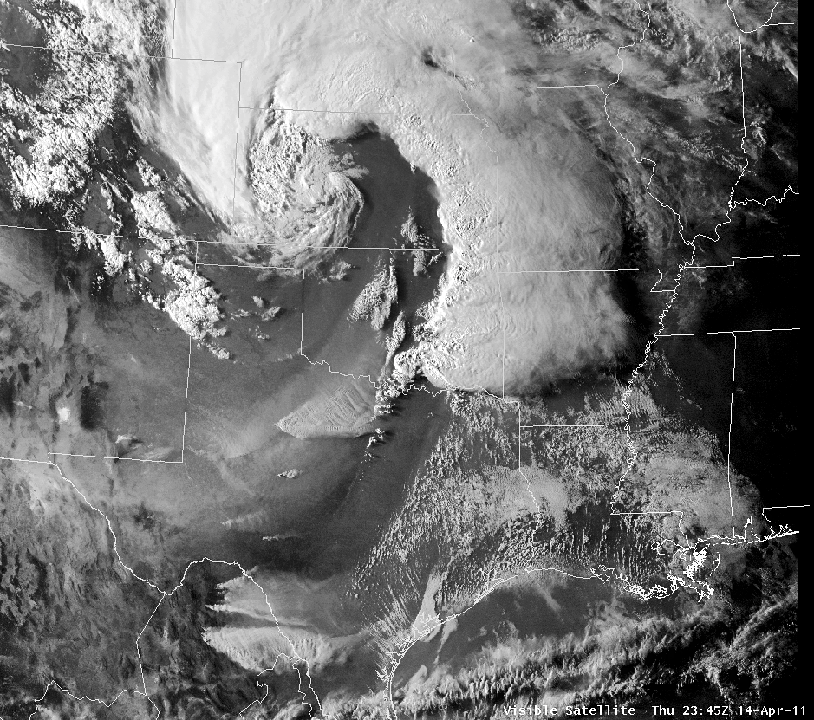
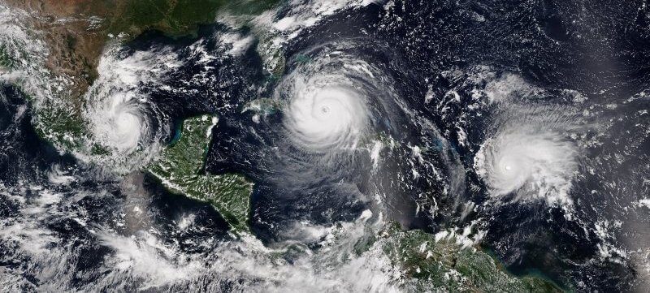
New Capabilities Possible and Under Consideration
LEO
Next generation & additional sounders
Much higher density GNSS-RO
Precipitation & wind measurements
Mixed update/rate/data quality vertical
sounding data set
GEO
Diverse quality imaging from three locations
(east, west, center)
Includes mixture of qualities, taskable update
rates, and spectrum content
Higher quality lightning mapper in center
Tundra
Imaging over North Pole
Auroral imaging
Space Weather
Operational and improved on-Earth-Sun-Axis
solar observation
Off-axis solar observation and situ space
weather

Slide 7

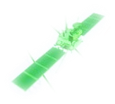
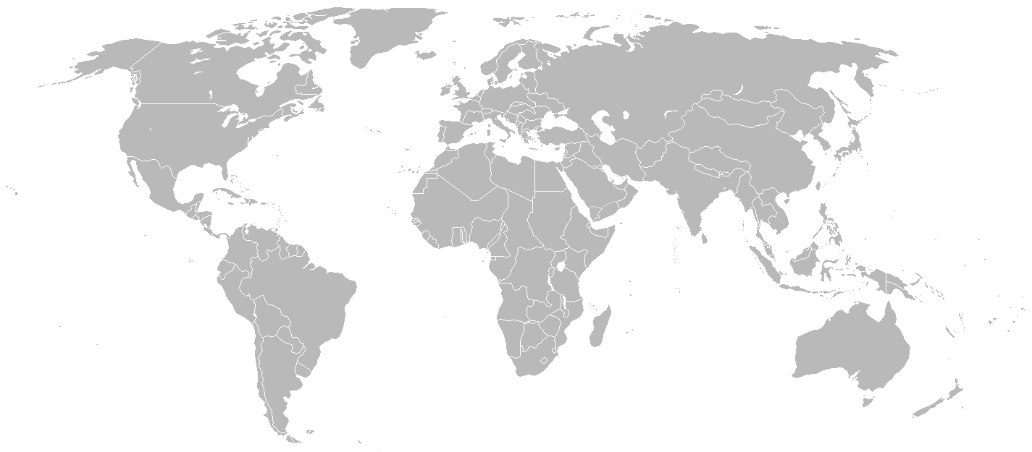


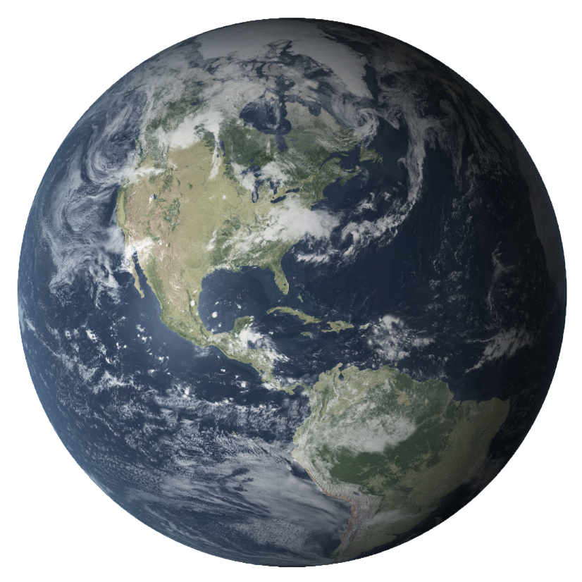

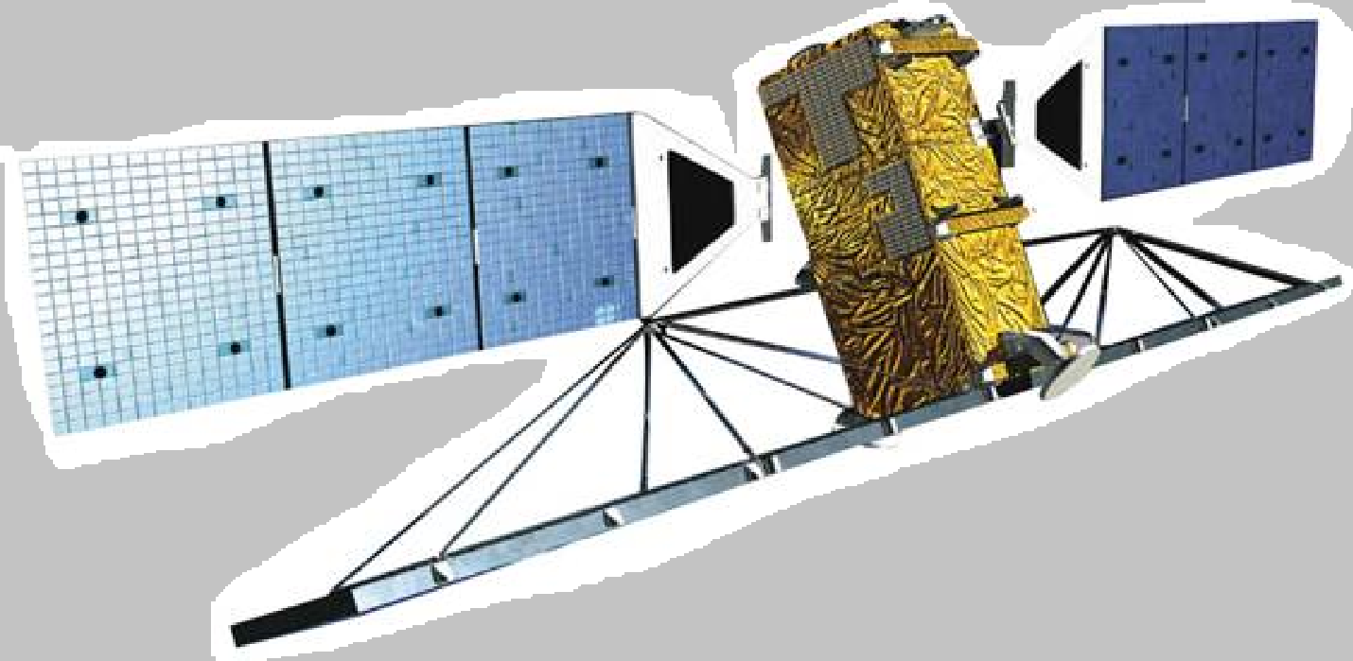

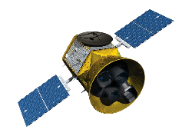
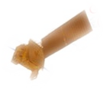
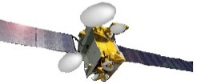
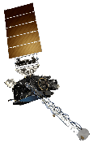

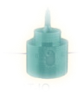
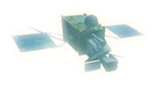

Exemplar Possible Hybrid Architecture
Tundra
GEO is mixed US Gov. satellites & hosted payloads
Partially disaggregated LEO systems
Mixed resolution payloads, update rates
SENTINEL
JASON
Sounder 1330
HIMAWARI
(JAPAN) 140° E
Hosted Imager West
Wind LIDAR
GEO-KOMPSAT
(SOUTH KOREA) 128° E
Hosted Instrument of Opportunity
Radarsat
Exemplar Possible Hybrid Architecture
Sounder 0530
Comprehensive SWX – L1
US Gov Center GEO
“SuperGOES”
Hosted Imager East
EPS-SG-A
EPS-SG-B
MTG-S
(EUMETSAT)
GNSS-RO Data Buys
Communications Service Buys
MTG-I
(EUMETSAT) 0°
Comprehensive SWX – L5
Tundra
Comprehensive space weather

Slide 8
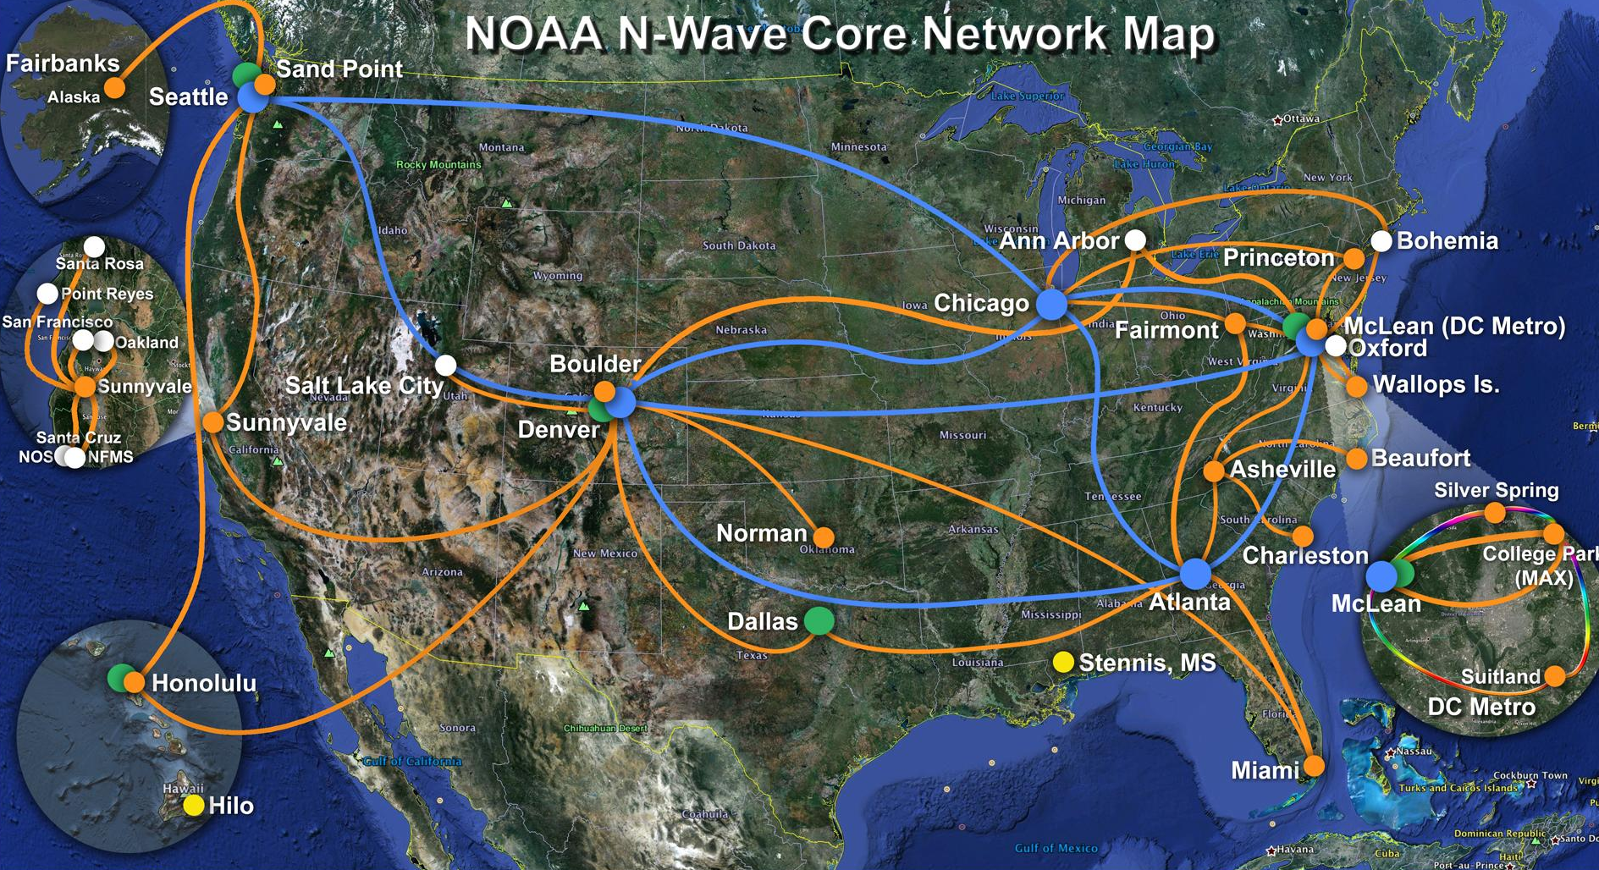
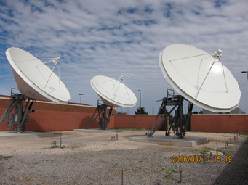
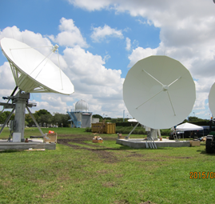
NESDIS Data Processing and Distribution
Satellite-based Services
  GRB (GOES-R series)
  HRD (JPSS)
Terrestrial-based Systems
  Direct Interface to NWS (GOES to AWIPS/SBN)
  Near Real-time Interface for authorized users (PDA)
  Long Term Archive and community access (CLASS)
  Cloud Services
    Big Data Project
    Other Cloud Initiatives
Storm Prediction Center
GRB Receivers
National Hurricane Center
GRB Receivers
Notes:
GOES-R series
GOES Re-Broadcast (GRB) service
High Rate Imagery Transmission (HRIT) & EMWIN service
GEOnetcast Americas (GNC-A) services
Data Collection System & SARSAT (Search & Rescue)
JPSS - High Rate Data (HRD) services

Slide 9
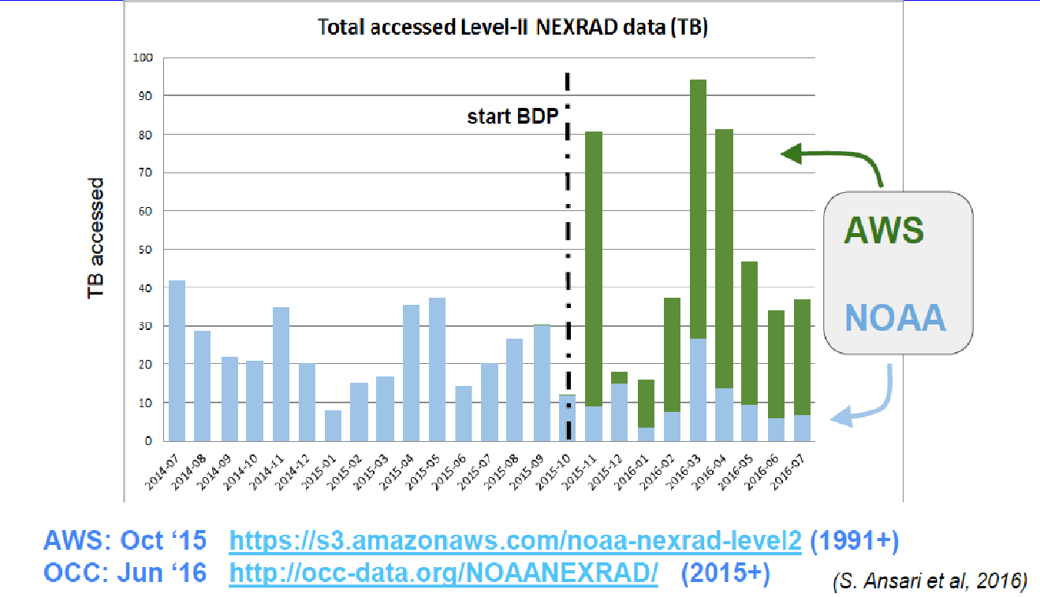
NOAA Big Data CRADA
Notes:
NO generates thousands of datasets as part of its mission to collect information on environments that span from the surface of the sun to the depths of the ocean floor. NOAA’s Big Data Project aims to enhance data discoverability and accessibility, improve efficiency for NOAA and users, as well as spur innovation and economic growth.
The Big Data Project is working with its Cooperative Research & Development Agreement (CRADA) Collaborators to publish NOAA data to their platforms. The Collaborators are providing services to enable data use, including decision support applications.
The BDP began in 2015 as a four-year business experiment to understand if the inherent value in NOAA’s data could be more fully realized if made available in the cloud. For example, one of the first datasets to move to AWS through the BDP was the historical archive of Level-II Next Generation Weather Radar (NEXRAD). By July of 2016, eight months after the data became available on AWS, access to NEXRAD Level-II data was 2.3 times higher than historical monthly rates for the same time period from NCEI, highlighting that providing access to the data in this manner can increase data discoverability and accessibility, maximizing ease of use and reducing the time needed to access and process the data.
The BDP has seen increases in data usage from 2 to 100 times.
NOAA has seen a decrease load on its servers and networks to support data access services
We are wrapping up the experimental phase of the Big Data Project and NOAA is working with our existing – and potentially new - partners to continue hosting additional datasets.

Slide 10
GOAL: Employ efficient, secure, and cost effective compute and storage solutions for aggregating, processing, and disseminating data
Explore use of commercial cloud technology to support future administrative and mission functions
Explore if we can securely and reliably operate cloud-enabled, data source agnostic end-to-end information technology services across NOAA’s lines of business
Evaluate the potential to provide continuity of products and services at expected thresholds with flexibility to execute NOAA’s mission from observational ingest to numerical weather prediction to user data dissemination in a cloud enabled environment
Notes:
Strategic goals for NESDIS Cloud Computing:
Maintain continuity of operations, products, and services
Evaluate the benefits of migrating the end-to-end ground architecture to the cloud based on trade studies, cost-benefit analysis and enterprise risk assessment
Maximize use of cloud-native capabilities
Implement clear governance by defining roles and responsibilities
Define requirements for the cloud architecture to include confidentiality, integrity and availability
Compliant with security, data and acquisition regulations
Collaborate with NOAA OCIO and Line Offices to develop a NOAA cloud utility contract

Slide 11
NESDIS Cloud Migration
Vision: Implement cloud-enabled end-to-end ground service capabilities that are secure, scalable, lifecycle cost effective, and data source agnostic
Experimentation
Migration
Transformation
Initiation & Assess-ment
Proof of Concept
Implemen-tation
Initiation & Assessment
Proof of Concept
Implemen-tation
Cloud Migration
Leverage Cloud
Optimization
NESDIS Cloud Strategy
IPTs
Readiness Assessment
ConOPS
KADP
Build and Evaluate Prototype
Develop implementa-tion and Phasing Plan
Trades
Cloud orchestration
Consolida-tion of activities
Migrate services to cloud
Cloud provisioning
Cloud manage-ment and monitoring
Service, architecture, cost optimization
Evolution of the service-based architecture
Where we are Today
Notes:
Our Vision is to implement cloud-enabled end-to-end ground services capabilities that are secure, scalable, lifecycle cost effective, and data source agnostic.
We’re in phase 1 of a three phased approach:
Experimentation – Gain experience through 4 pilots and engineering prototypes; identify organizational impacts
Planned/Proposed Pilots
Security in the Commercial Cloud: Develop NESDIS Authority to Operate (ATO) methodology to meet security standards in the commercial FedRAMP Moderate cloud by tailoring up security controls
Extension of Common Ingest, Cataloging, and Discoverability to the Cloud: Extend the NESDIS-built common data ingest, cataloging, and discoverability functionality to near-real time ingest and calibration/validation enterprise and demonstrate this capability in the commerical cloud
Native Ingest, Product Generation and Science Development in the Cloud: Demonstrate that commercial cloud computing industry techniciques will work to meet the common functions of all NESDIS systems through development of a single ingest, data processing and distribution capability with cloud-native tools
Distribution Framework: Examine NESDIS common architecture for cloud-based data distribution that limits egress cost from the commercial cloud
2) Migration – Develop implementation and phasing plan and mature the governance and operational processes
3) Transformation – Continuous improvement processes to realize operational efficiencies and cost savings

Slide 12
BACKUP Slides

Slide 13
Product Distribution and Access (PDA)
PDA is an enterprise system for ingesting, producing, and delivering near real-time data to our core, time critical users
PDA includes the following major segments:
  Product Generation - NOAA Data Exploitation (NDE)
  Product Distribution – PDA
  Direct Broadcast - HRIT/EMWIN
  High-speed network and services – Enterprise Infrastructure (EI)
PDA capabilities:
  Peers with high speed wide area network (N-WAVE)
  Scales to meet new growth without major re-work required
  Greater security (secure transfer protocols, baseline monitoring, high performance threat scanning, etc.)
  Configurable production with custom tailoring capability

Slide 14
Allocation of PDA Capacity
PDA was designed with a data volume capacity egress rate of ~40 TB/day (at 25 Gbps).
As of October 2018, ~ 40.24 TB/day has been allocated to approved users. The full system capacity has been allocated.

Slide 15
PDA Data
Distribution Statistics
PDA Statistics for all data (including GOES-16 and JPSS)
Number of User Groups | 78 Active
Total Distributed Data Size* | 10.45 TB/day
Distributed to ‘Pull’ Users (61 Users) | 7.41 TB/day
Distributed to “Push” Users (17 Users) | 3.02 TB/day
Largest Data Consumers – Distributed Data Size
STAR | 2.21 TB/day
CLASS | 1.71 TB/day
DoD | 1.73 TB/day
NWS | 1.0 TB/day
Additional Data Consumers of Interest – Distributed Data Size
To ESPC Shared File System | 732 GB/day
To EUMETSAT | 75 GB/day
*NEW ADDITION - Statistics include data sent to CLASS
Report period covers: 10/1/2018 to 10/22/2018
Source: PDA Ops Environment (NSOF)
Notes:
DoD includes: AF_AFWA, NAVY_NAVO, NAVY_FNMOC,
NWS includes: NCF_SBN, NCEP_IDP, NCEP_EMC, NCEP_WCOSS, NCEP_NHC, NCEP_AWC,
Active Push users: AF_AFWA CLASS_LEGACY_usrgrp CLASS_NDE_usrgrp CLS_AMERICA CLS_FRANCE ESPC_SFS ESPC_VIIRSDIST NAVY_FNMOC NAVY_NAVO NCF_SBN NOAA_CLASS NOAA_NCEI-CO_SPADES NOAA_WOC OSPO_GNC-A OSPO_SARSAT UKMET WEATHER_COMPANY
Active Pull users: ARGENTINA_SMN AUSTRALIA_BOM BARON_WEATHER BIG_DATA BRAZIL_CPTEC CANADA_MC DTN_Weather (SCHNEIDER_ELEC) ESPC_DAPE ESPC_GRAPHICS ESPC_HMS ESPC_IASI ESPC_IMS ESPC_NIC ESPC_NUCAPS ESPC_OKEANOS ESPC_PolarProd ESPC_SAB ESPC_SCATWINDS EUMETSAT GOESR HYDROLOGIC_RC IND_NCMRWF JAPAN_JAXA JAPAN_JMA JPSS_IDPS KOREA_MA MIT_LL NASA_GPM NASA_GSFC NASA_JPL NASA_MSFC NASA_SPORT NCEP_AWC NCEP_EMC NCEP_IDP NCEP_NHC NCEP_WCOSS NOAA_CORAL_REEF_AUSTRALIA NOAA_ESRL NOAA_GLERL NOAA_NCEI-SS NOAA_NSIDC NOAA_NSSL NOAA_STAR NOAA_SWFSC NORTHROP_GRUMMAN OAR_AOML ROFFS_FISHING UCAR_COSMIC UNISYS WORLDWINDS

Slide 16
Data Access
& Distribution Policy
Full policy and data access forms at:
  http://www.ospo.noaa.gov/Organization/About/access.html
Security requirement to document and control all users accessing operational data servers
Significant increases in data volumes necessitate prioritization of users to effectively manage data distribution resources to ensure optimal system performance
Higher priority access will be given to organizations with:
  Mission and statutory authority that supports the requirement for real-time data access
  Signed NESDIS cooperative agreements or other legislative authorities
  A demonstrated timeliness requirement for near real-time satellite data and products to support operational user applications
For non real-time data users, NOAA/NESDIS will offer alternate sources of data access that are internal and external to NESDIS (including CLASS)
At this time, due to PDA system limitations, there is a temporary freeze

Slide 17
Access to PDA
PDA service is dedicated for authorized near real-time users
New user onboarding is currently suspended while the organization assesses time critical user needs and evaluates available capacity on the system
Data access information is available at:
  http://www.ospo.noaa.gov/Organization/About/access.html

