Slide 1
Global Data Flows
LSI-VC-7
S Ward, Feb 2019

Slide 2
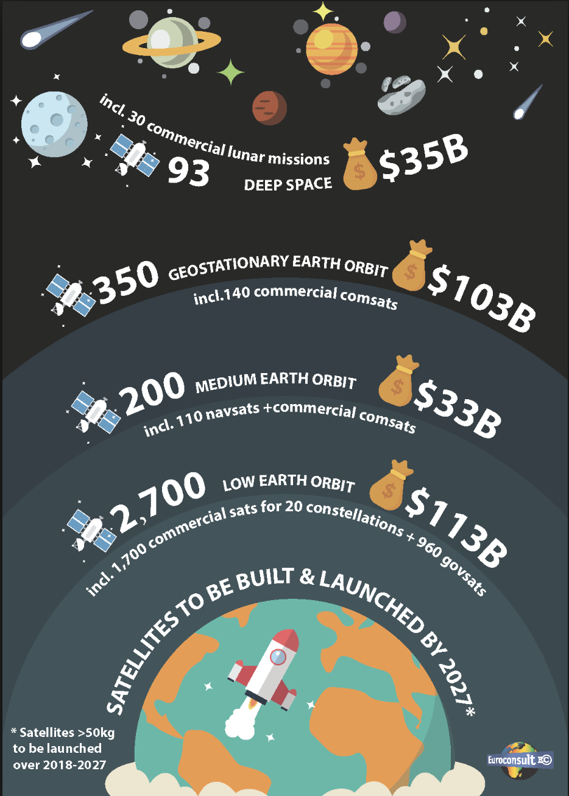
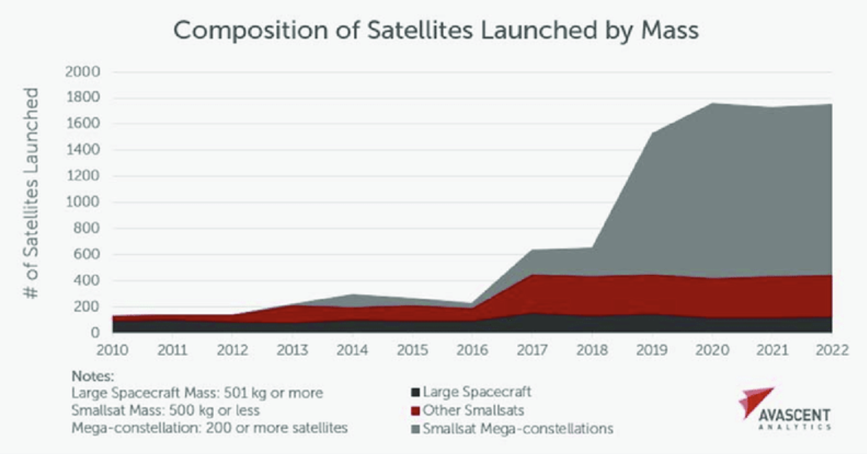
Motivations for public EO programmes
Data standardisation and interoperability is a basic competitiveness measure for public EO programmes - under pressure from explosion in commercial activities
Public EO must demonstrate cost-effectiveness vs Space 2.0
User expectations changed

Slide 3
Context
Space agency standardisation is a solid first step towards the ease of use and interoperability for government EO data.
We need to look forward to ensure that the full benefits of ARD are realised and that CEOS agencies are competitive in terms of ease of access, application and mixing of data.
Industry thought leaders (e.g., Planet) are making good progress towards a ‘post-scene’ world (e.g., COGS on object store like S3; STAC specifications) [harnessing the firehose]
CEOS data needs to ’go with the flow’ for maximum benefits from standards or we are swimming upstream always.

Slide 4
Context
Where are our large data holdings?
In what format?
How are they accessible?
What obstacles do users face in mixing our various CARD4L datasets?

Slide 5
LSI-VC CEOS Work Plan Tasks
ESA has suggested an Open-source library for surface reflectance product generation:
for the generation of CARD4L surface reflectance products;
focus on sen2like/HLS type processing modules;
any agency can contribute to the library, and it could potentially be open to private sector contributions.
Could we have target outputs of:
COGs
STAC catalogue of collections
data output formats and means of access across CARD4L datasets important in support of user simplicity and a post-scene future?

Slide 6
LSI-VC CEOS Work Plan Tasks
LSI agency data are being re-hosted and distributed by the large data aggregators
Should we be proactive in encouraging hosting of CARD4L datasets and work with the aggregators on formats and access?
Ensure that the SIT Chair’s ARD strategy is supportive

