Slide 1
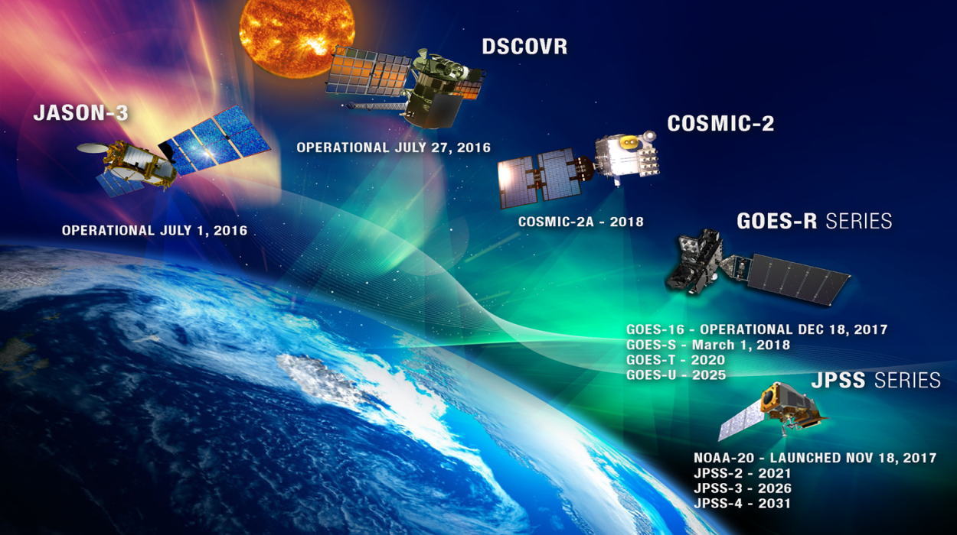
NOAA Recent and
Upcoming Launches
GOES-R Launch Nov 2016
GOES-S Launch Mar 2018
JPSS-1 Launch Nov 2017

Slide 2
Planning for the Future
  Evolving to a more mission-effective, integrated, adaptable and affordable portfolio
  Responding to changing technology, emerging partnerships and evolving observation requirements
  Why start now?
    10-15+ year development timeline for space assets
    Current constellation (GOES-R/S/T/U and JPSS-1/2/3/4) fly-outs 2026-2035
Pre-decisional Deliberative Material

Slide 3
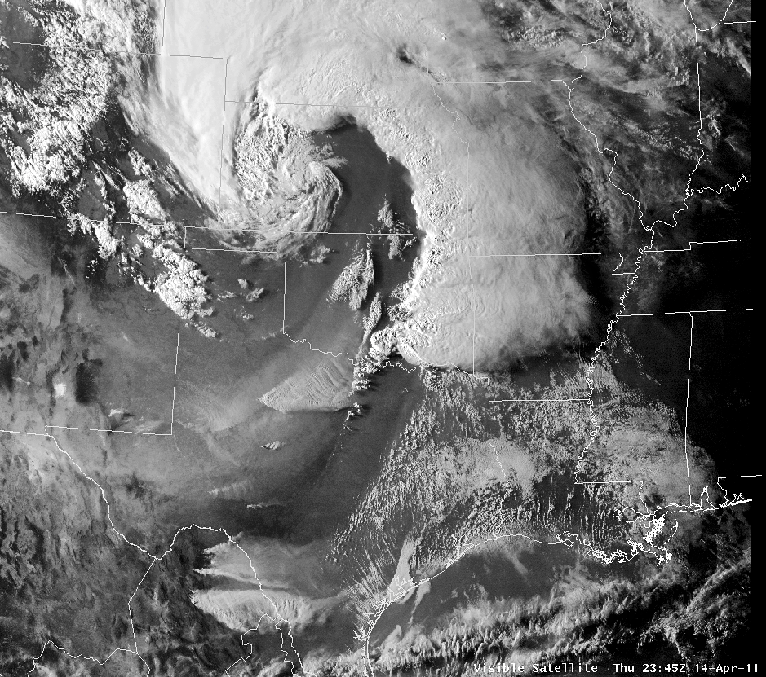
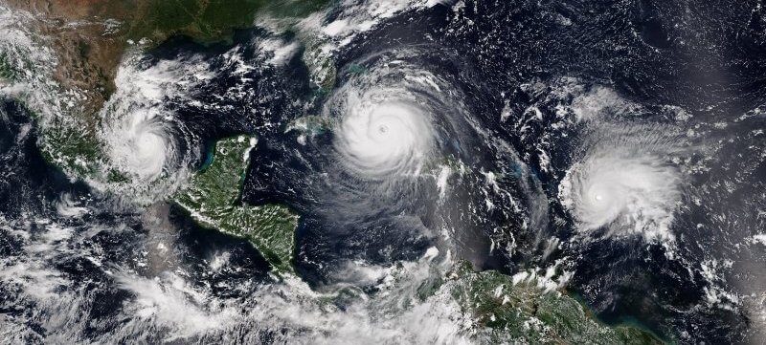
New Capabilities Possible and Under Consideration
LEO
Next generation & additional sounders
Much higher density GNSS-RO
Precipitation & wind measurements
Mixed update/rate/data quality vertical
sounding data set
GEO
Diverse quality imaging from three locations
(east, west, center)
Includes mixture of qualities, taskable update
rates, and spectrum content
Higher quality lightning mapper in center
Tundra
Imaging over North Pole
Auroral imaging
Space Weather
Operational and improved on-Earth-Sun-Axis
solar observation
Off-axis solar observation and situ space
weather

Slide 4
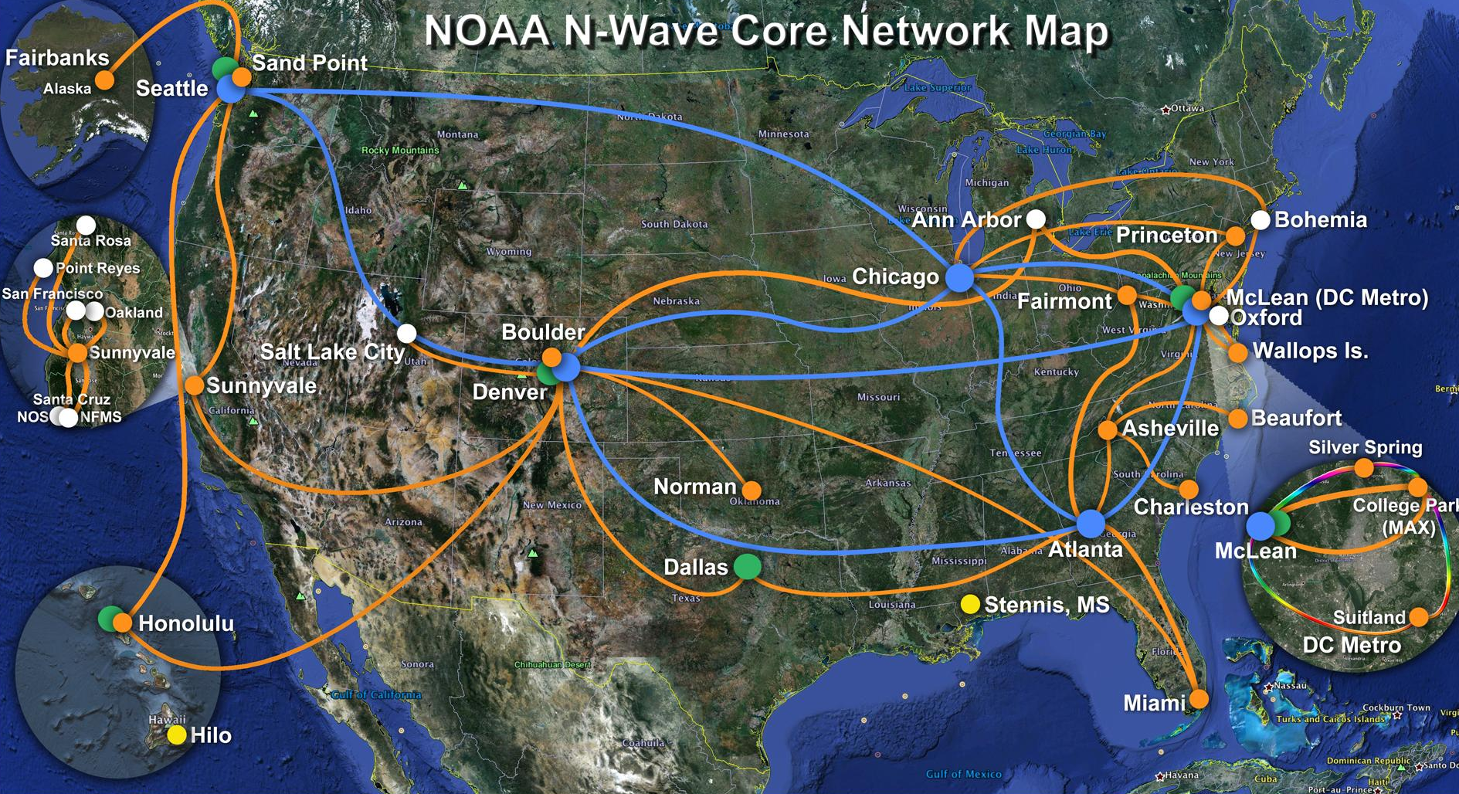
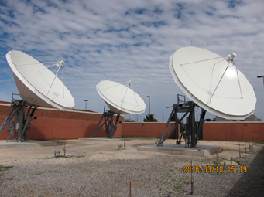
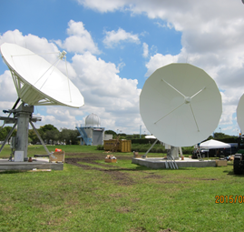
NESDIS Data Processing and Distribution
Satellite-based Services
  GRB (GOES-R series)
  HRD (JPSS)
Terrestrial-based Systems
  Direct Interface to NWS (GOES to AWIPS/SBN)
  Near Real-time Interface for authorized users (PDA)
  Long Term Archive and community access (CLASS)
  Cloud Services
    Big Data Project
    Other Cloud Initiatives
Storm Prediction Center
GRB Receivers
National Hurricane Center
GRB Receivers

Slide 5
NOAA Big Data CRADA

Slide 6
NESDIS Cloud Strategy
Vision: Implement cloud-enabled end-to-end ground service capabilities that are secure, scalable, life-cycle cost effective, and data source agnostic
Strategic goals for NESDIS Cloud Computing:
Continuity of operations, products, and services
Evaluate the benefits of migrating the end-to-end ground architecture to the cloud based on trade studies, cost-benefit analysis and enterprise risk assessment
Maximize use of cloud-native capabilities
Implement clear governance by defining roles and responsibilities
Define requirements for the cloud architecture to include confidentiality, integrity and availability
Compliant with security, data and acquisition regulations
Collaborate with NOAA OCIO and Line Offices to develop a NOAA cloud utility contract

Slide 7
NESDIS Cloud Pilot Projects
Feasibility Areas | Description | Duration
Security in the Commercial Cloud | Develop NESDIS methodology for how security process will function at their current level within the commercial cloud | 8 Months
Cloud Consolidation of Mission Services | Demonstrate the feasibility of consolidating all NESDIS mission services using cloud-enabled tools | 11 Months
Common Data Ingest and on-boarding | Demonstrate that common ingest capability is feasible for all NESDIS business functions through enhanced cloud interoperability | 17 Months
Cloud-Optimized Algorithms and Production | Demonstrate optimized methodology for algorithm deployment and product generation in the cloud and meet current JPSS/GOES performance requirement | 15 Months
Data Access in the Commercial Cloud | Demonstrations of common distribution approaches and data visualization tools to enhance collaboration in the cloud environment | 20 Months*

Slide 8
NESDIS Cloud Migration
Vision: Implement cloud-enabled end-to-end ground service capabilities that are secure, scalable, lifecycle cost effective, and data source agnostic
Experimentation
Migration
Transformation
Initiation & Assess-ment
Proof of Concept
Implemen-tation
Initiation & Assessment
Proof of Concept
Implemen-tation
Cloud Migration
Leverage Cloud
Optimization
NESDIS Cloud Strategy
IPTs
Readiness Assessment
ConOPS
KADP
Build and Evaluate Prototype
Develop implementa-tion and Phasing Plan
Trades
Cloud orchestration
Consolida-tion of activities
Migrate services to cloud
Cloud provisioning
Cloud manage-ment and monitoring
Service, architecture, cost optimization
Evolution of the service-based architecture
Where we are Today

