Slide 1
ESA update
for LSI-VC
Ferran Gascon
LSI-VC-7, VNSC, Hanoi (Vietnam), 14-15 February 2019

Slide 2
Sentinel-1 mission status
Sentinel-1A and Sentinel-1B mission operations → nominal
Sentinel-1 contribution to emergency activations, in particular from the Copernicus Emergency Management Service, continues to be very high, for flood monitoring in particular
A dedicated campaign aiming at demonstrating the monitoring of hurricanes over seas / oceans has been successfully conducted
Sentinel-1 is operated close to its full mission capacity (i.e. difficulty to accommodate additional observations)
A slight increase of the SAR operating time duty cycle constraint has started (outside 3-month eclipse season), mainly allowing to further stabilise the observation scenario
Wind field of Typhoon Mangkhut (11 Sep 2018)
SAR is the only sensor able to characterize extreme winds (greater than 70 m/s) at very high resolution
Copyright: Contains modified Copernicus Sentinel data (2018) / CLS-Ifremer

Slide 3
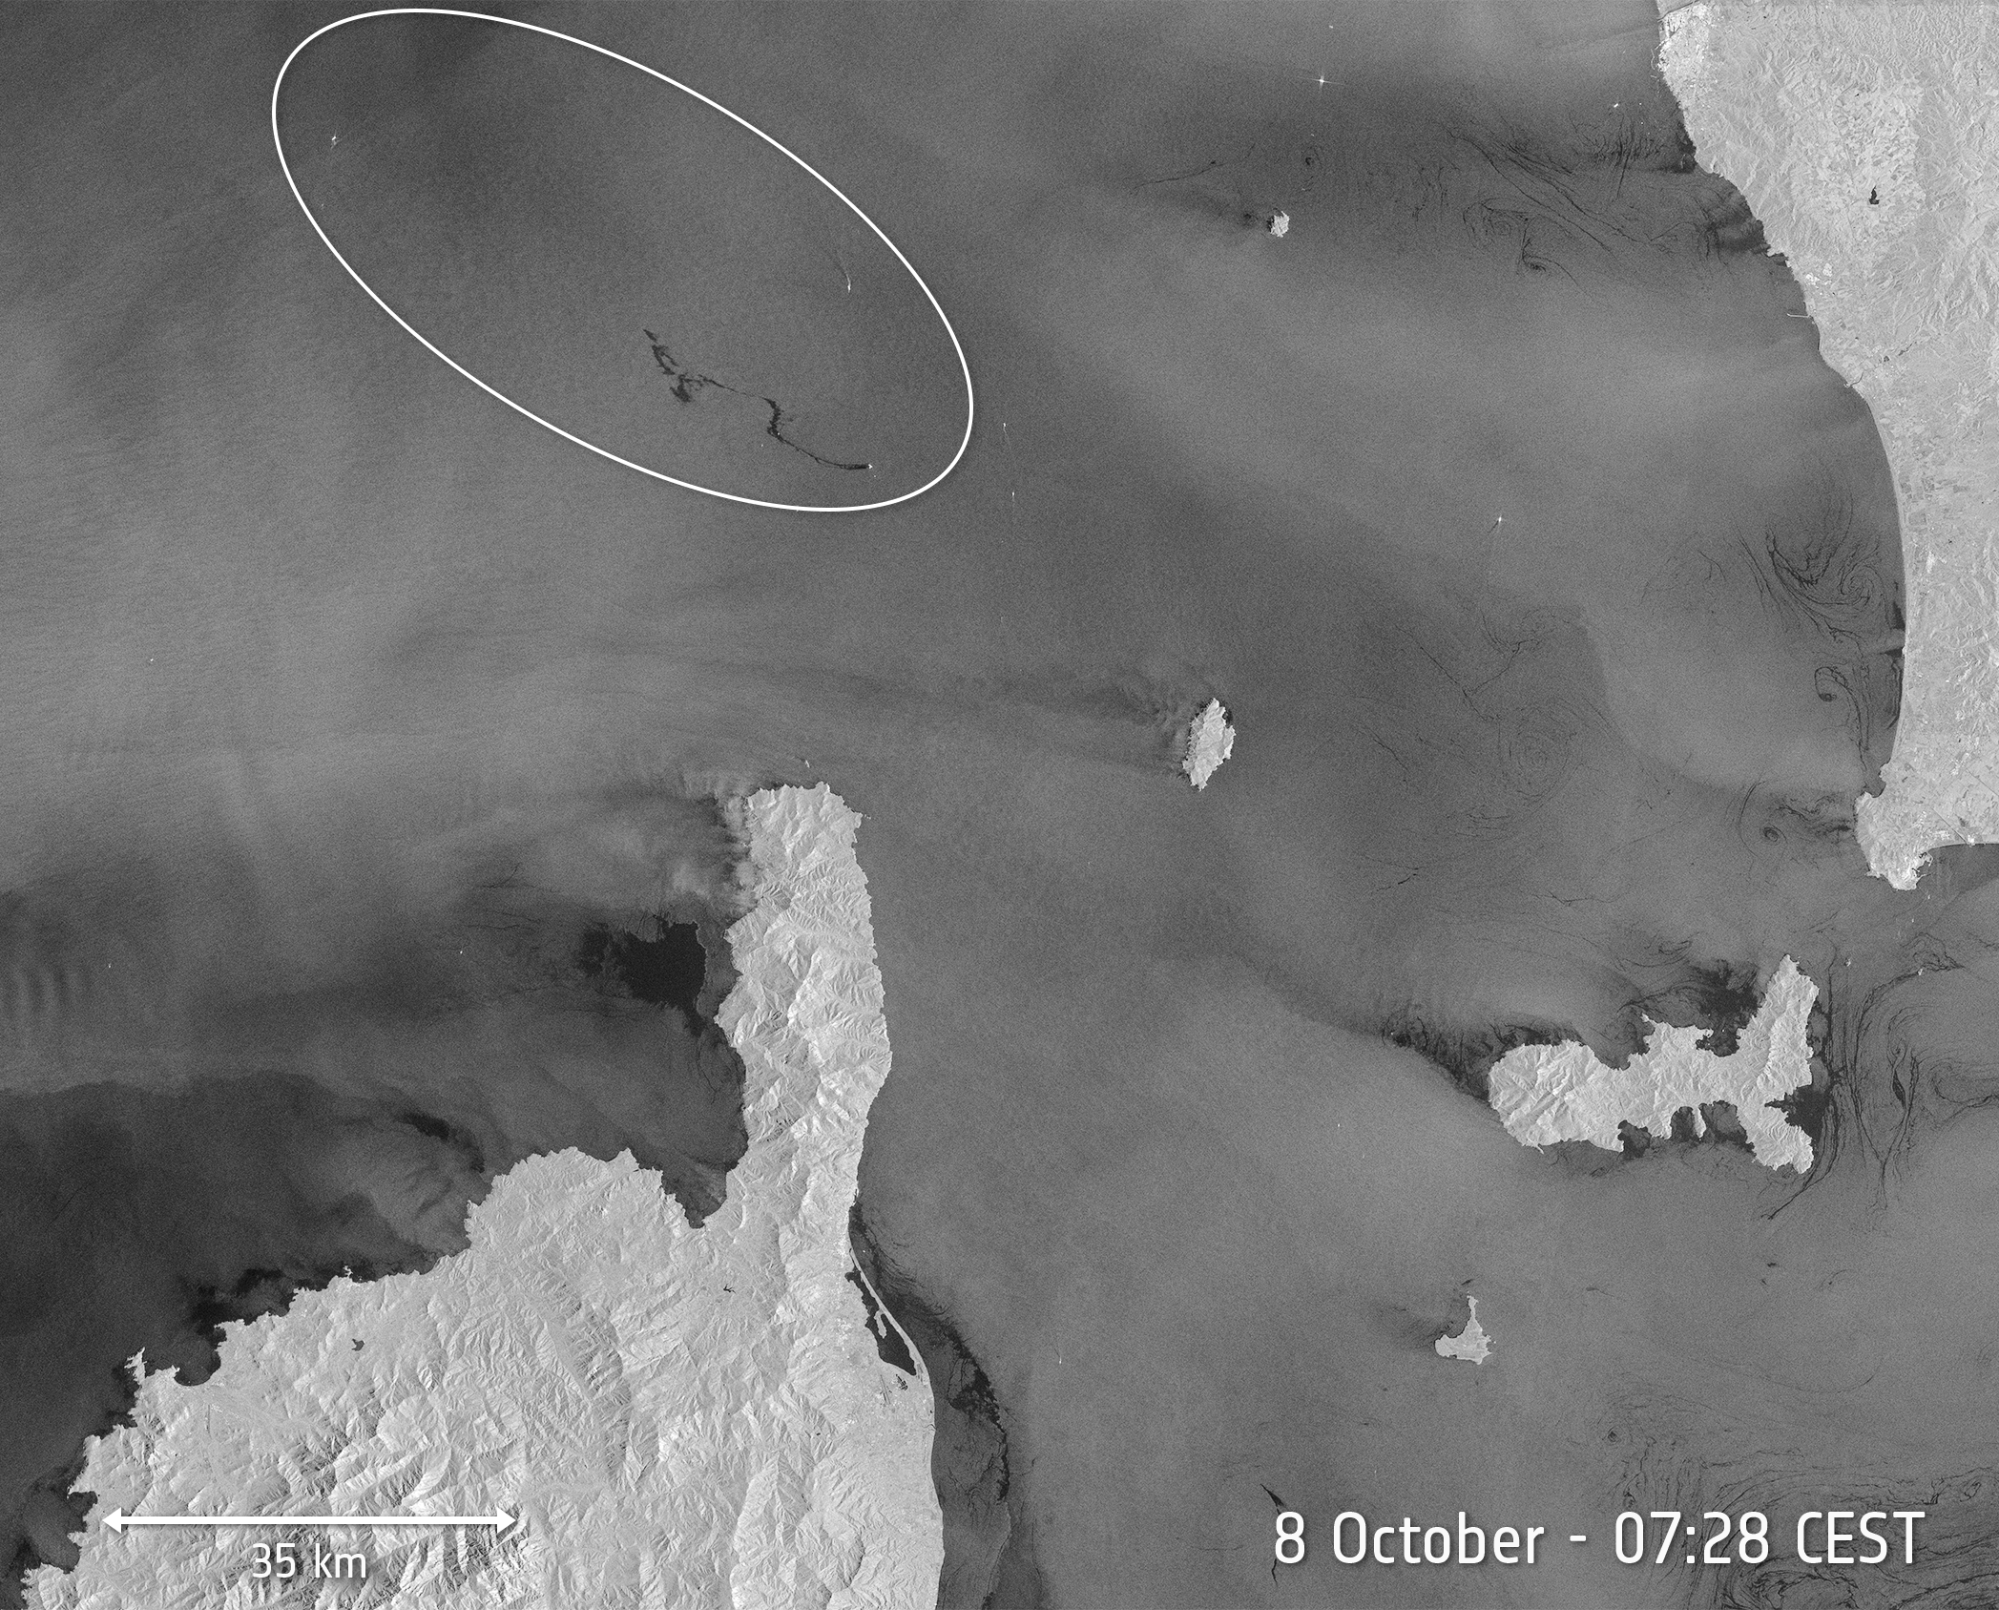
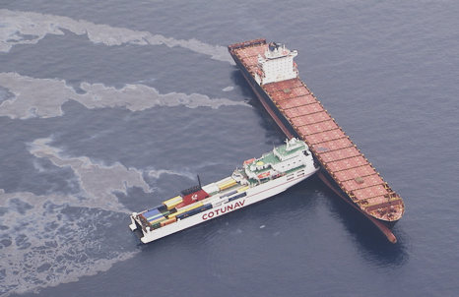
Sentinel-1 mission status
Oil Spill North of Corsica, 8 September 2018
Copyright: Contains modified Copernicus Sentinel data (2018) / processed by ESA

Slide 4
Copernicus Sentinel-2 Mission Status
Nominal Sentinel-2 constellation operations with Sentinel-2A and Sentinel-2B.
Performing global and systematic acquisitions (5-day revisit) since 17 February 2018.
New core product (Level-2A surface reflectance) generated and distributed globally since 13 December 2018 (Europe since 28 March 2018).

Slide 5
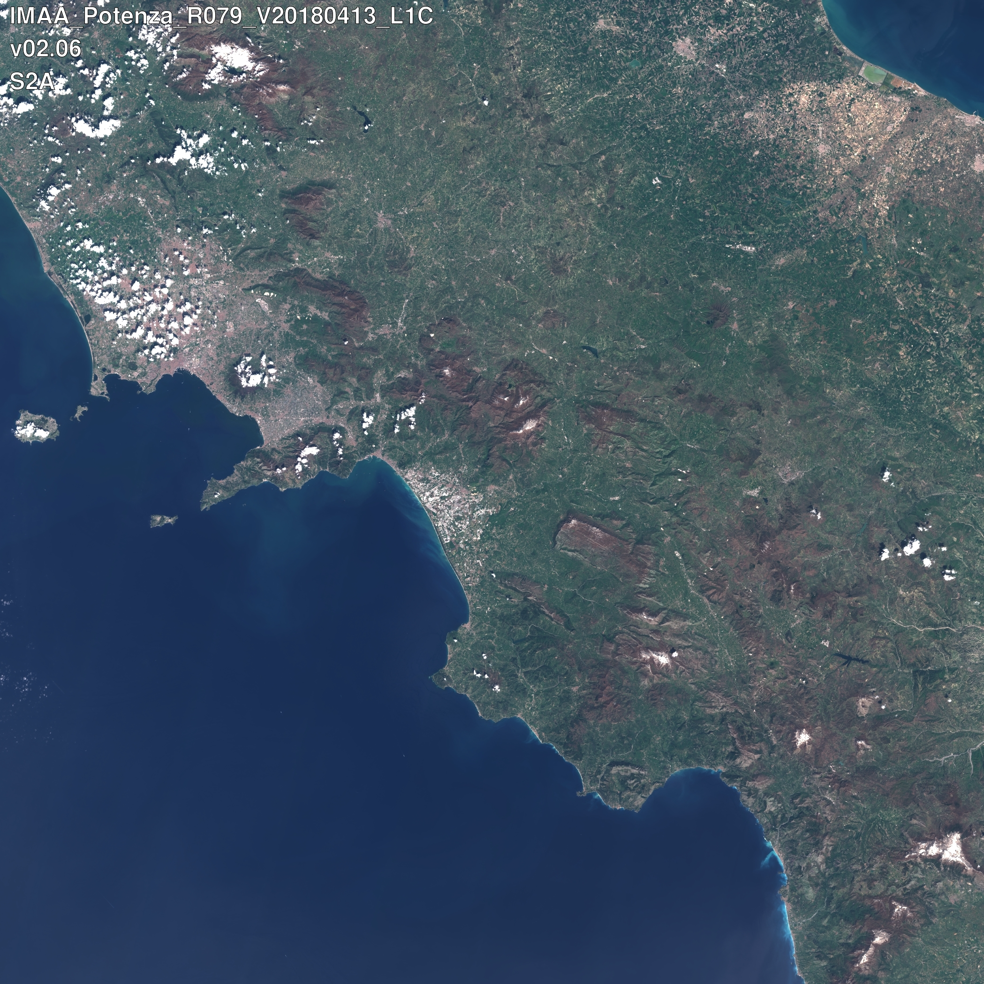
Level-1C

Slide 6
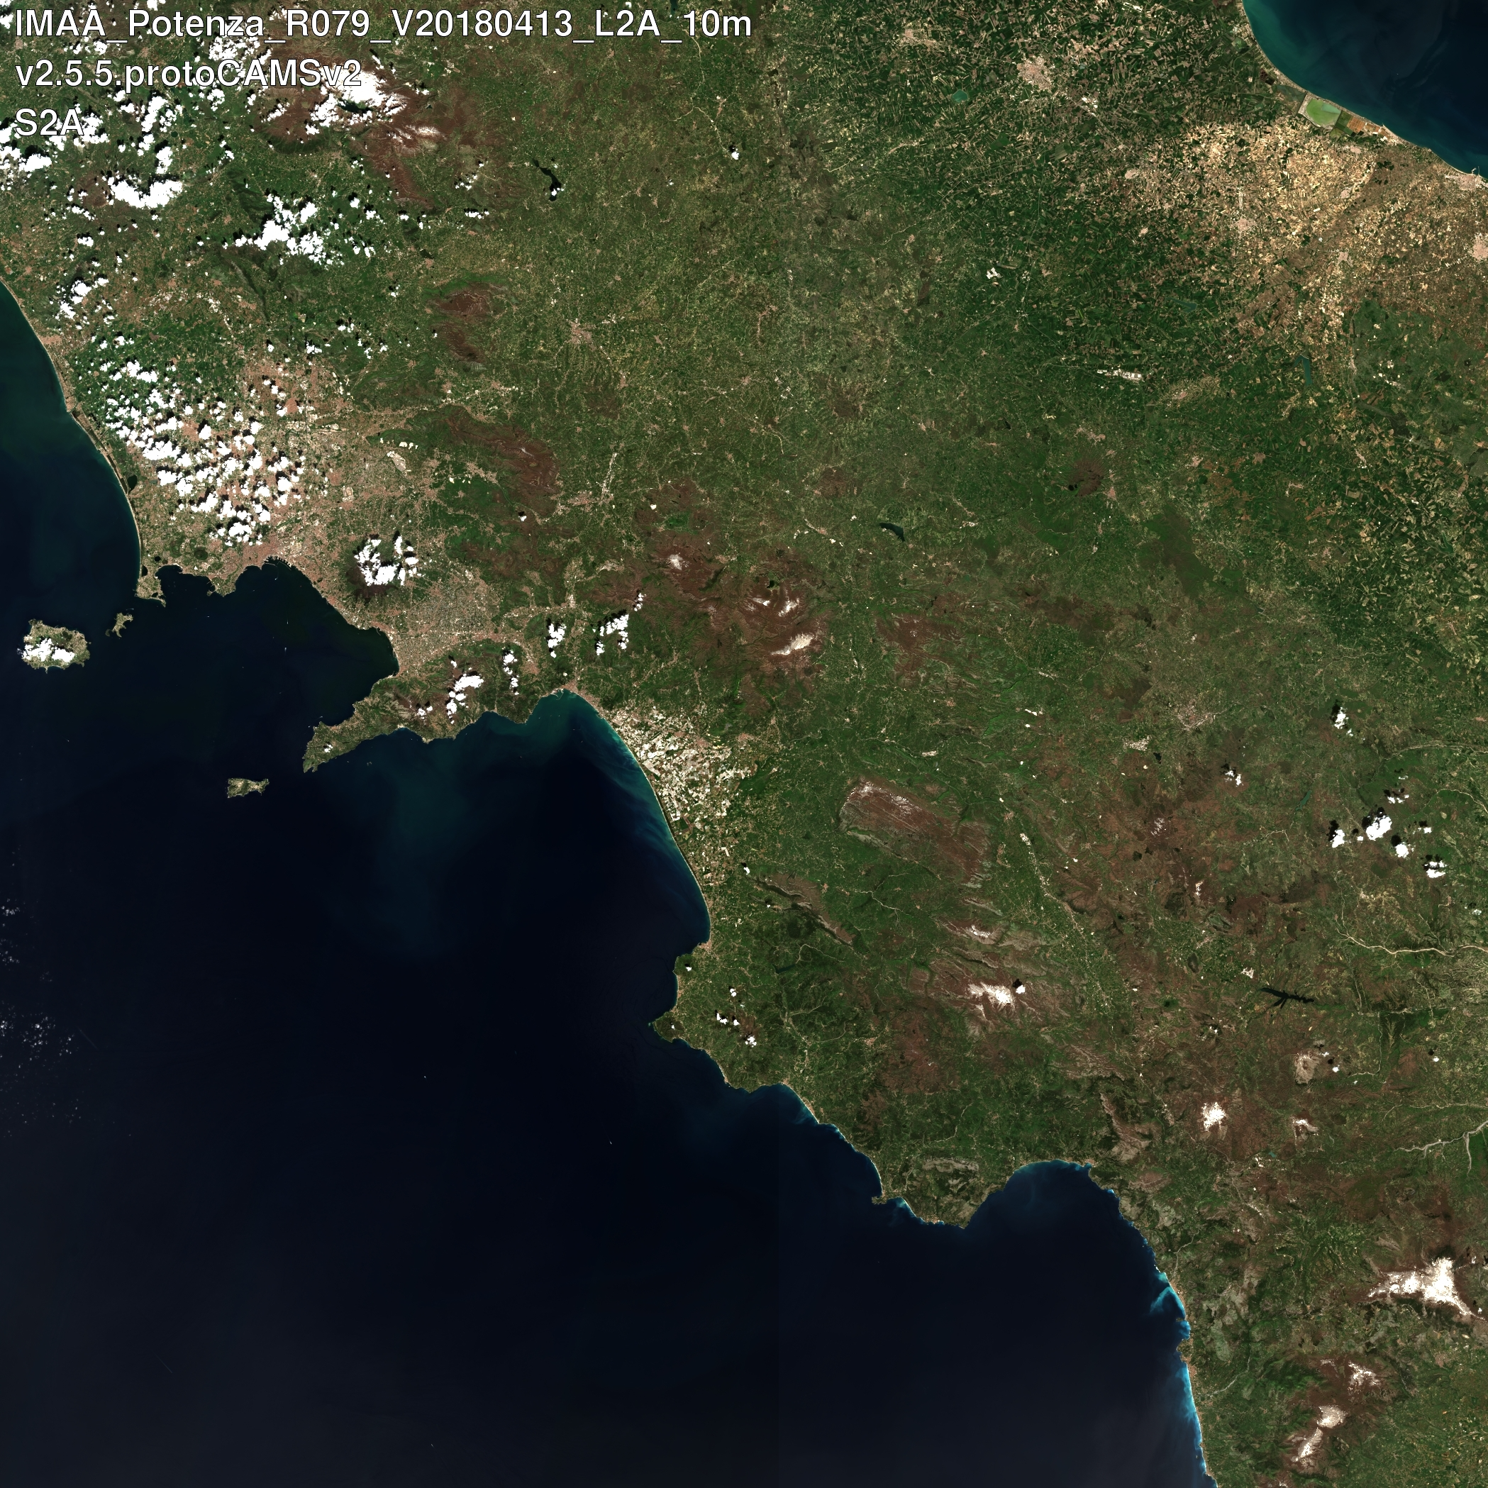
Level-2A

Slide 7
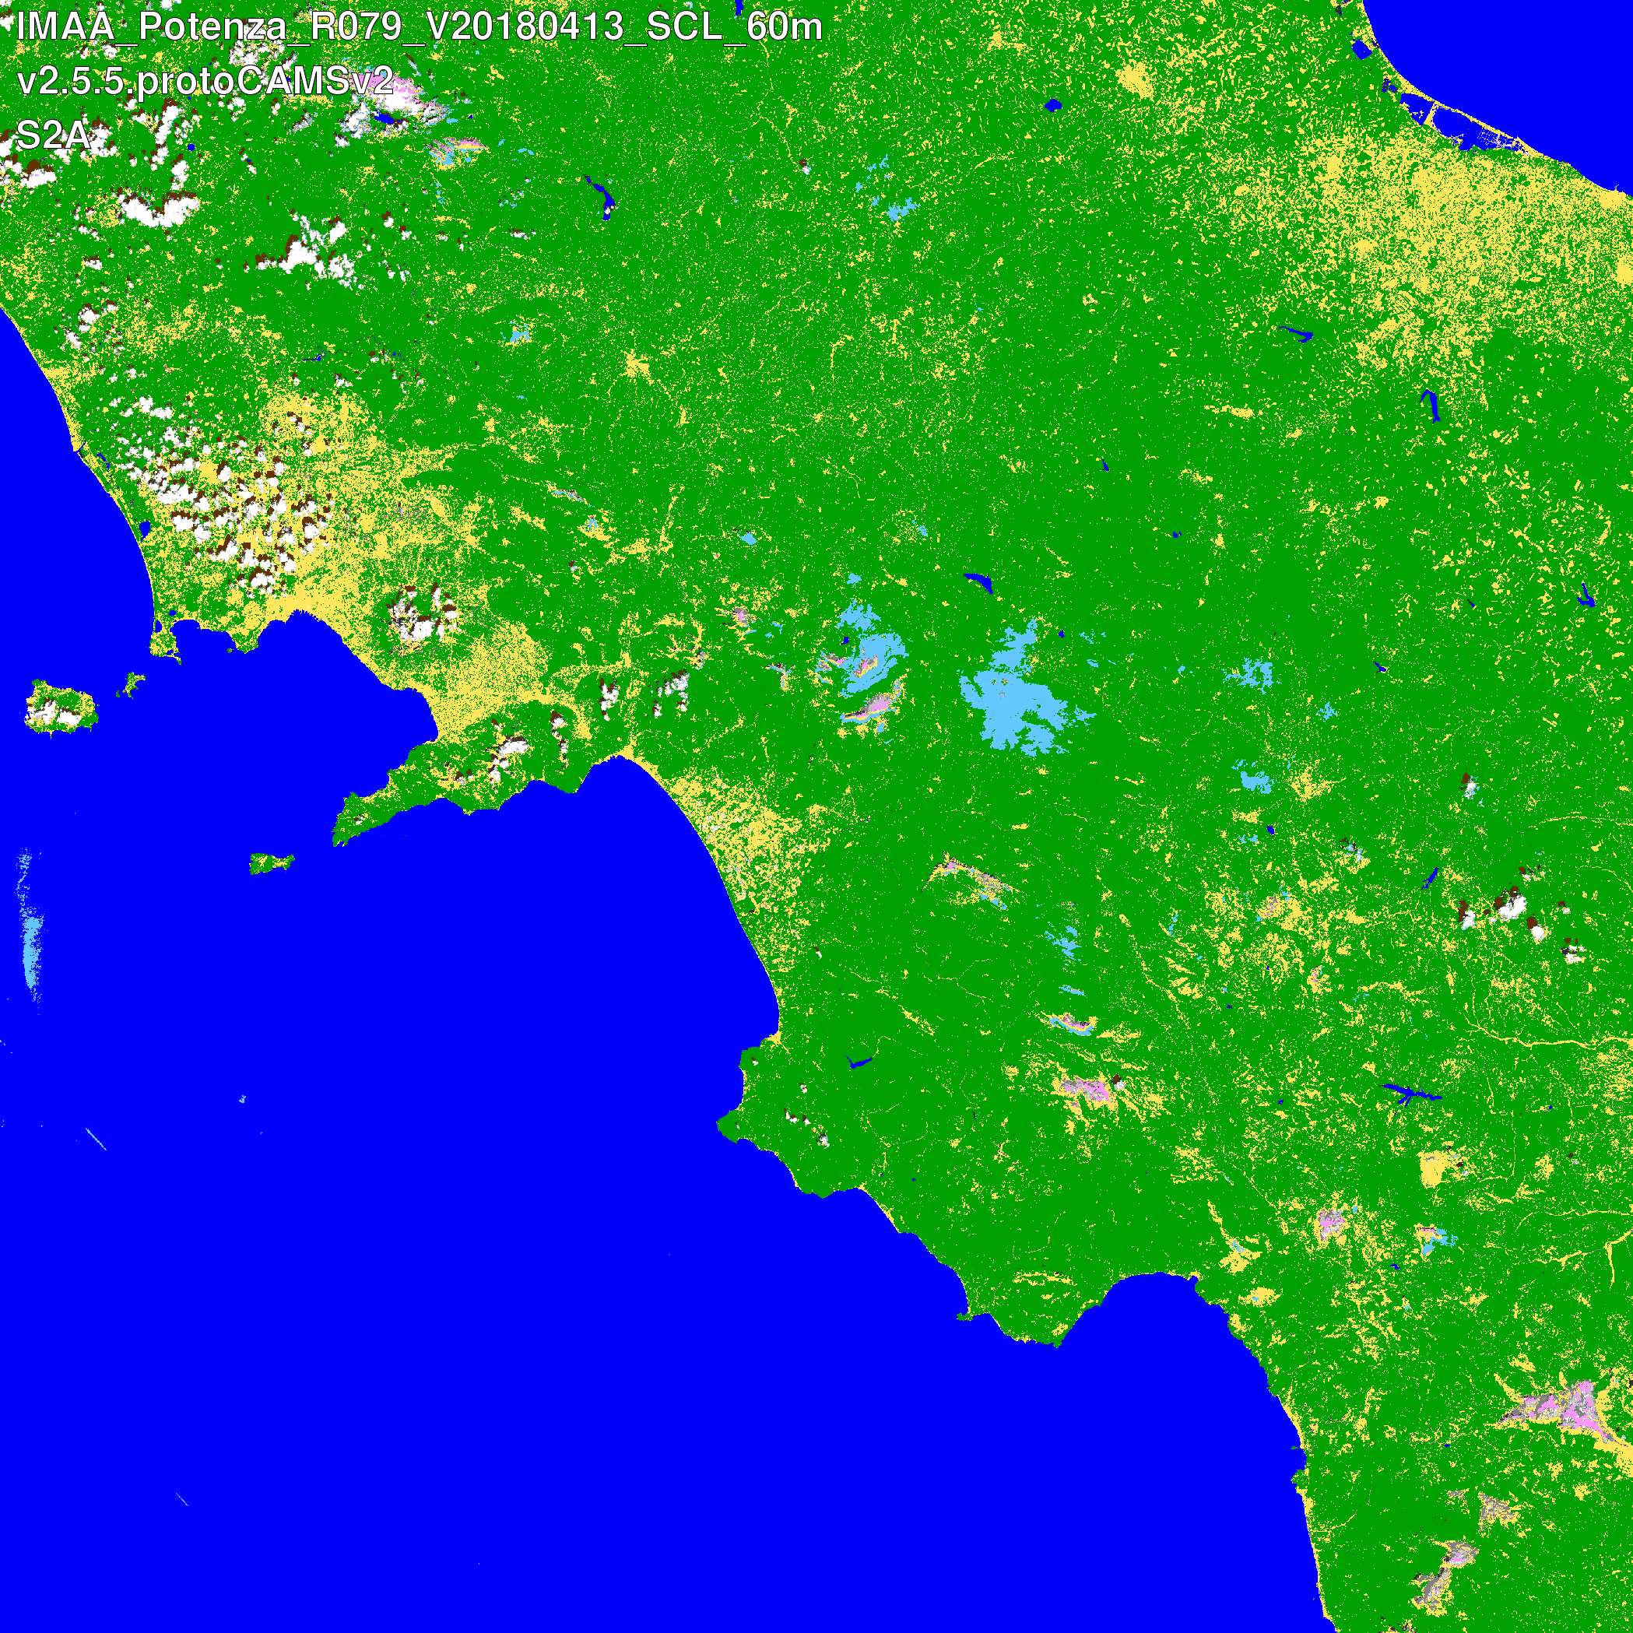
Level-2A

Slide 8
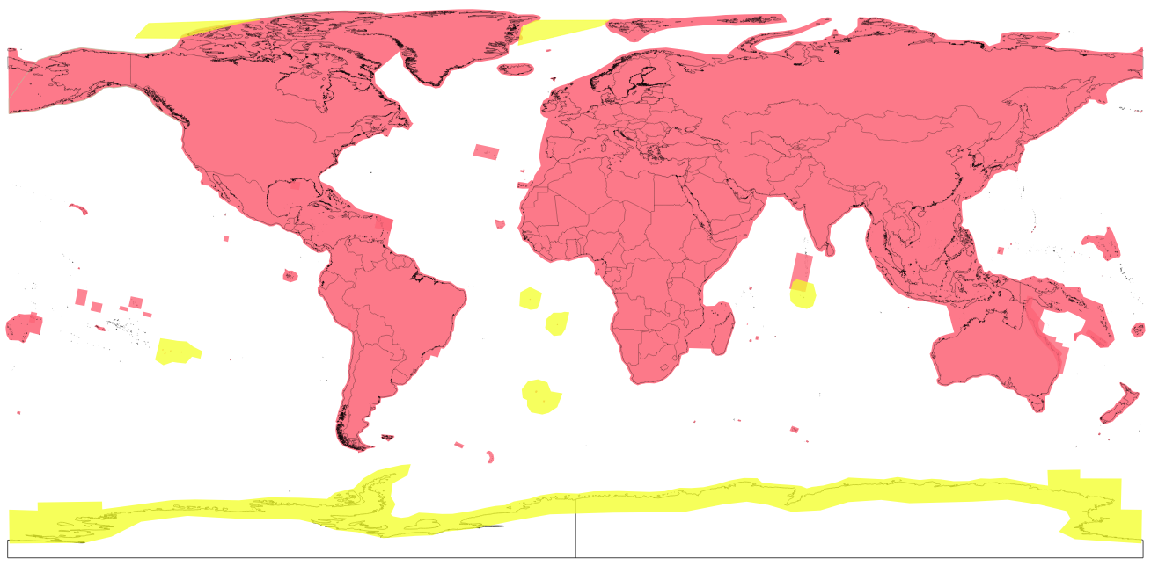
Revisit Time
5-day
10-day

Slide 9
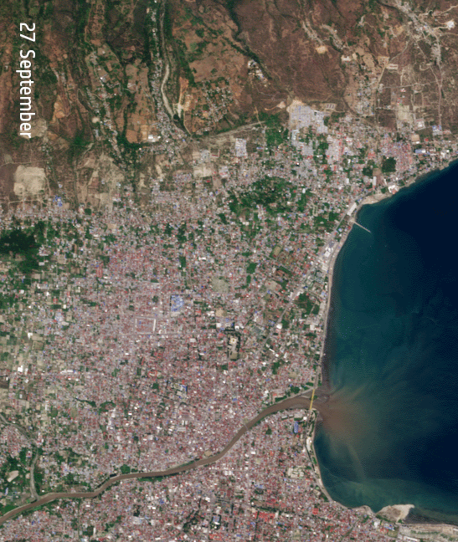
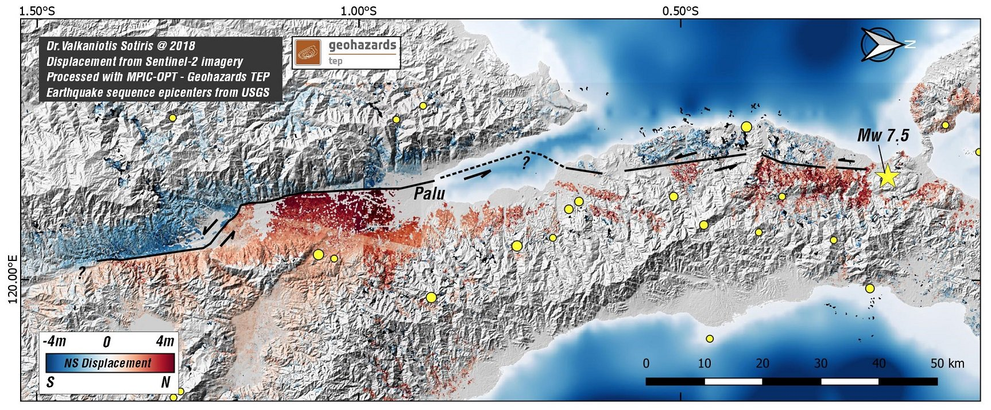
Sentinel-2 mission status
Indonesia Palu earthquake (28 September 2018) :
North – South ground displacement derived from Copernicus Sentinel-2 data
Palu
Copyright: Contains modified Copernicus Sentinel data (2018) / processed by V. Sotiris

Slide 10
S2 Mission Next Steps
2019 Q1: Completion of the conversion of the archive into single-tile format.
2019 Q2: L2A on-demand service open to Copernicus Services.
2019 Q2: Start of the geometry-refined production using Global Reference Image (GRI).
2019 Q2: Usage of improved DEM for L1C and L2A productions.
2019 Q3-Q4: L2A on-demand service to all users.
B11
Band 11

Slide 11
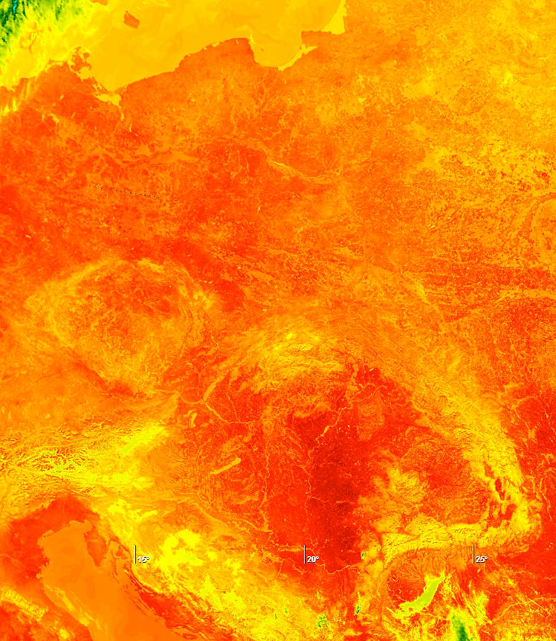
Sentinel-3 mission status
Land Surface Temperature, Central Europe, 13 October 2018
from Infra-Red 12µm channel of SLSTR sensor (1km resolution)
Sentinel-3A mission operations → nominal
New Level 2 synergy products released in October 2018
The definition and implementation of two new core data products, the Aerosol Optical Depth (AOD) and Fire Radiative Power (FRP) is on-going with sample products expected to be available in 2019.
Reprocessing activities are on-going:
For SRAL, a full mission reprocessing (starting from March 2016) has been completed for both the Land and the Marine products. The Land products release is scheduled for Q4 2018.
For SLSTR, Level 1 and 2 data reprocessing started in June 2018 and was completed in September 2018, including an updated cloud masking. The release is planned for Q4 2018.
For OLCI a full mission reprocessing from April 2016 has been carried out and made available to users in September 2018.
Baltic
Adriatic
Copyright: Contains modified Copernicus Sentinel data (2018)

Slide 12
Sentinel-3 mission status
Sentinel-3B
Spacecraft and all instruments in nominal operational mode and functioning well
Tandem phase between S-3B and S3-A for cal/val
S-3B drift phase
S-3B nominal phase (140 deg.)
Launch
25 Apr
Phase E2
17 Oct
28 Nov
2019 Q1
In Orbit Commissioning Review
Routine Operations Readiness Review

Slide 13
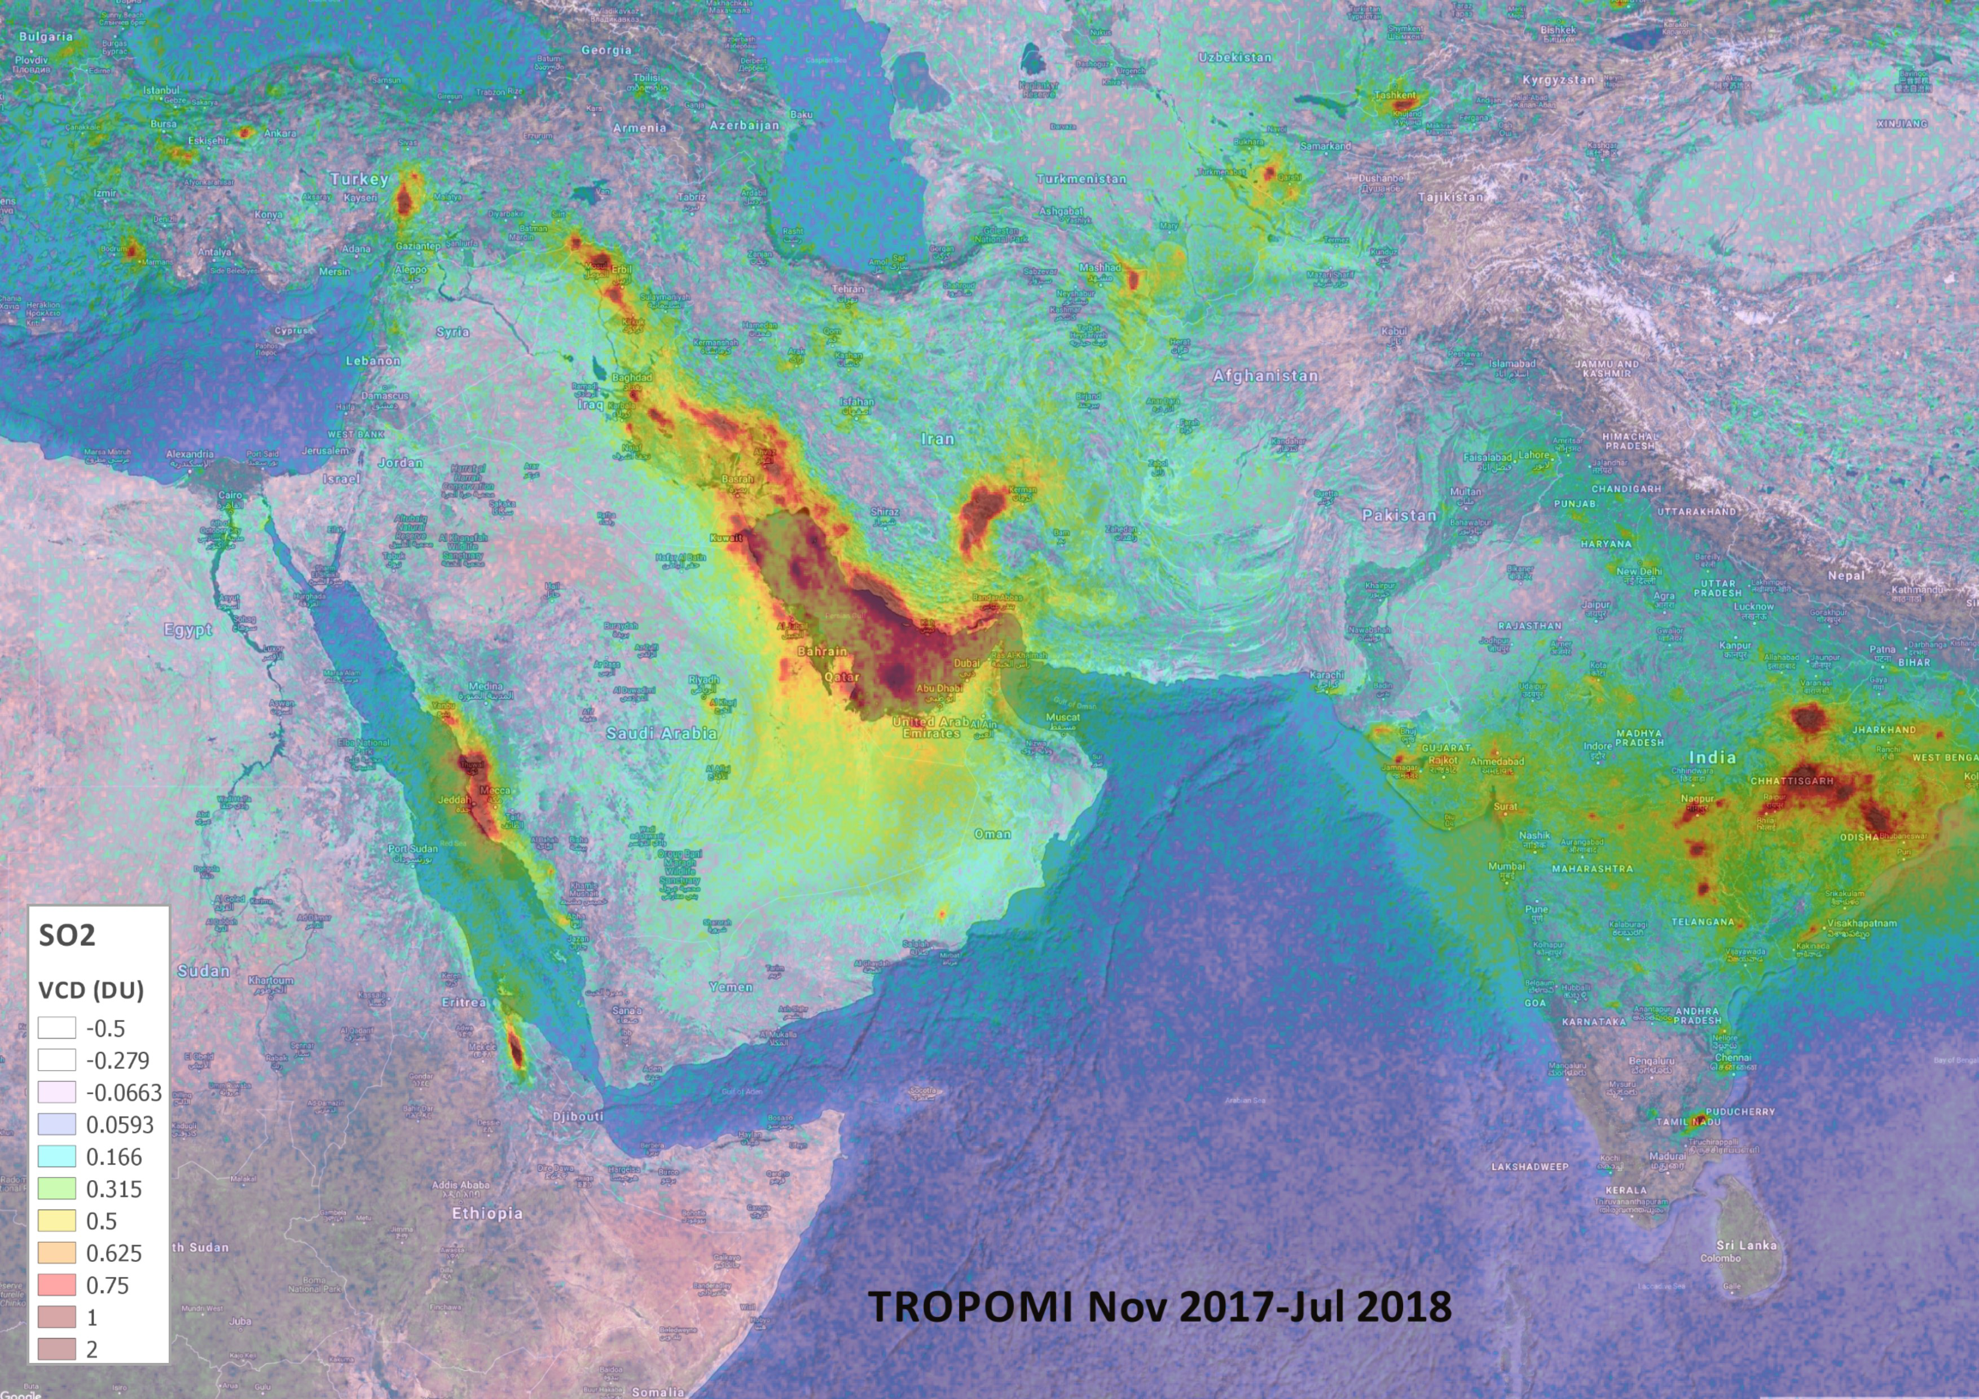
Sentinel-5 Precursor mission status
Sentinel-5 Precursor mission operations → nominal, with on-going ramp-up of data availability to users
First data released in July 2018:
Total Columns of Ozone (O3),
Nitrogen Dioxide (NO2),
Carbon Monoxide (CO),
Cloud & Aerosol information
New data released in October 2018:
Sulfur Dioxide (SO2, in NRT),
Formaldehyde (CH2O, in NRT)
S-5p Sulfur Dioxide (SO2) measurement, November 2017 – July 2018
Sulphur dioxide, which mainly comes from industrial processes and motor vehicle emissions, can result in breathing problems and is a precursor to acid rain
Copyright: Contains modified Copernicus Sentinel data (2018) / processed by BIRA–IASB/DLR

Slide 14
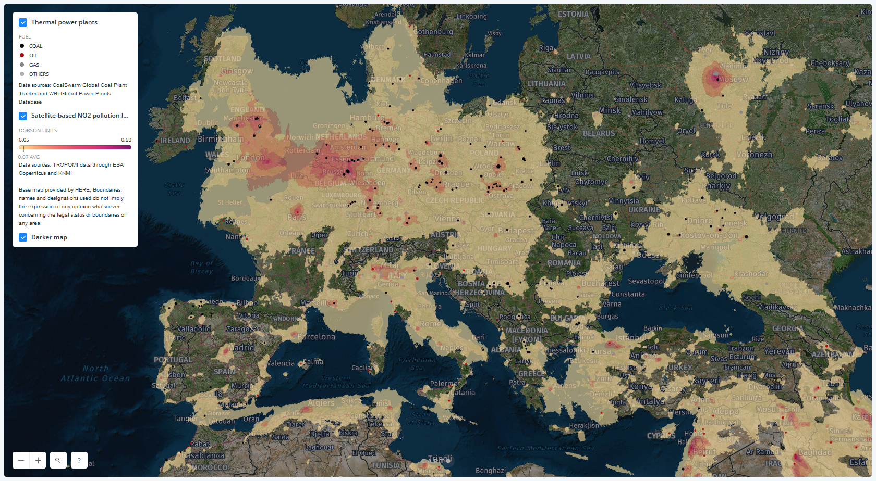
Sentinel-5 Precursor mission status
Nitrogen Dioxide (NO2) hotspots
https://unearthed.greenpeace.org/category/energy
Example of diffusion of information provided by Copernicus Sentinel-5p
Copyright: Contains modified Copernicus Sentinel data (2018) / processed by KNMI and Greenpeace

Slide 15
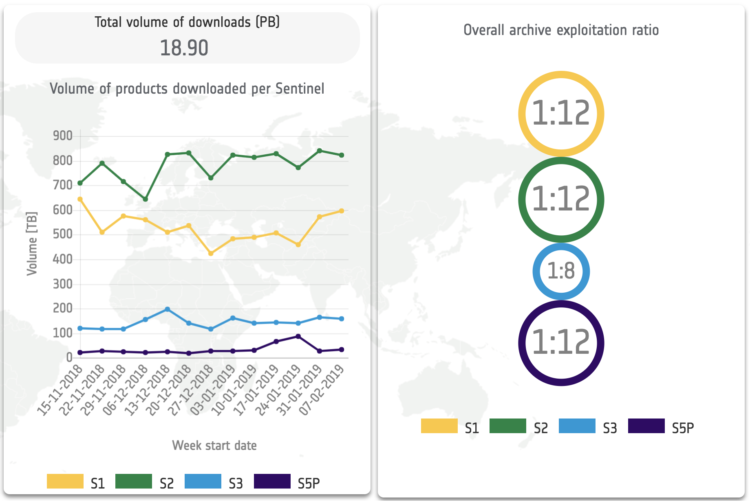
Data Distribution
Private companies re-distributing Sentinel products through free and pay-per-use schemes
Copernicus Data Hubs
International partners mirror sites disseminating towards own national communities
Collaborative mirror sites

Slide 16
Data Distribution

Slide 17
Hanoi, 13/02/2019

Slide 18
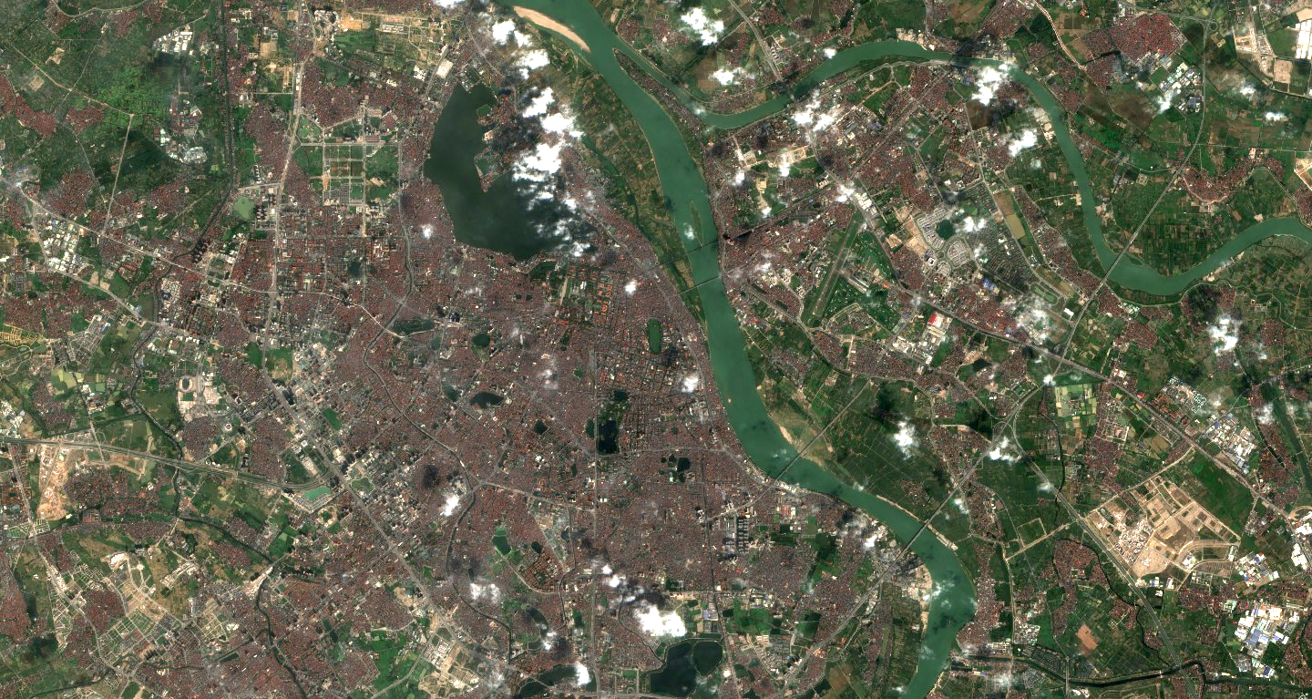
Hanoi, 08/02/2019

