Slide 1
MIM Database API Demonstration
LSI-VC-7
February 2019, Hanoi, Vietnam

Slide 2
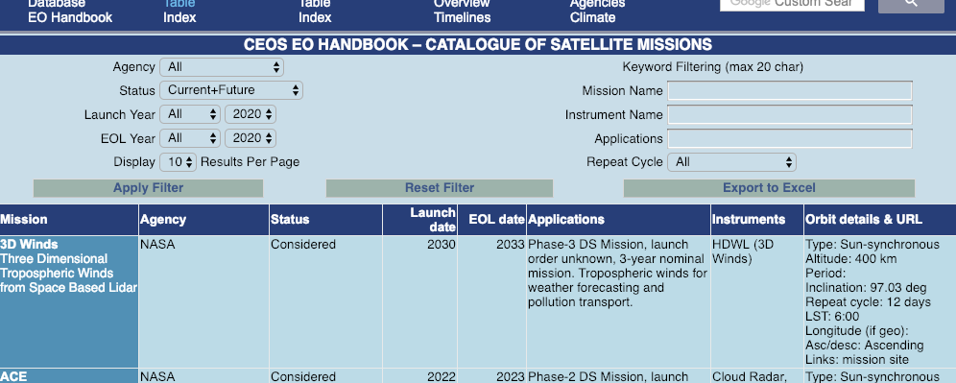
MIM Database Capabilities
CEOS Missions, Instruments and Measurements Database: http://database.eohandbook.com/
Official records of CEOS missions, instruments and measurements
Online and exportable mission and instrument tables
Timelines
MIM-OSCAR comparison tool
Instrument type continuity prototype
Filterable by agency, status, launch and EOL year (5 year selectable), keywords, applications, technical parameters, etc.
For measurement categories, detailed measurement types, or agency; filterable by mission status and dates

Slide 3
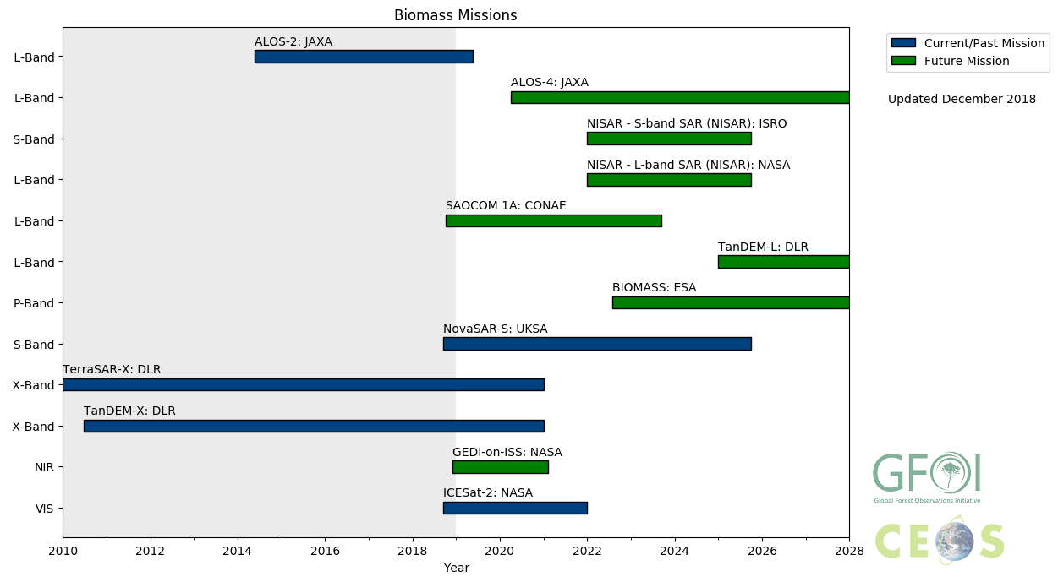
MIM Application Programming Interface (API)
New in 2018!
Further enhances the capability to query and exploit the resources within the MIM Database. A simple, programmable method of accessing the data.
Currently leveraged through Python Notebooks.
Flexible visualisations, tables, etc.
Functionality status:
Mission, instrument and measurement timelines (Gantt)
Missions, instruments and measurements of each type over time (column graph)
Custom timelines (e.g., biomass missions for GFOI)
Instrument waveband response curves (LS8, S-2A/B, more in progress)
Satellite ground tracks and orbit plots
Possible integration with CEOS Visualization Environment tool
OPML format export for tree diagrams

Slide 4
Demonstrations

Slide 5
Next steps and thoughts...
The MIM and SEO teams could support LSI-VC by leveraging these capabilities for land specific queries.
Requirements
What is needed?
What information does CEOS need regarding gaps, and in what format?
Tools
API provides total flexibility, but requires time investment and user expertise
Need test users for API
Gap Analysis Portal
In addition to the API, could pre-cook some useful analyses.
Companion web application for the API?
Online dashboard: gaps.eohandbook.com? – high-level, pre-compiled summary information; automated alerts/summaries; etc.

