Slide 1
CEOS ARD Strategy
LSI-VC-7
S Ward, Feb 2019

Slide 2
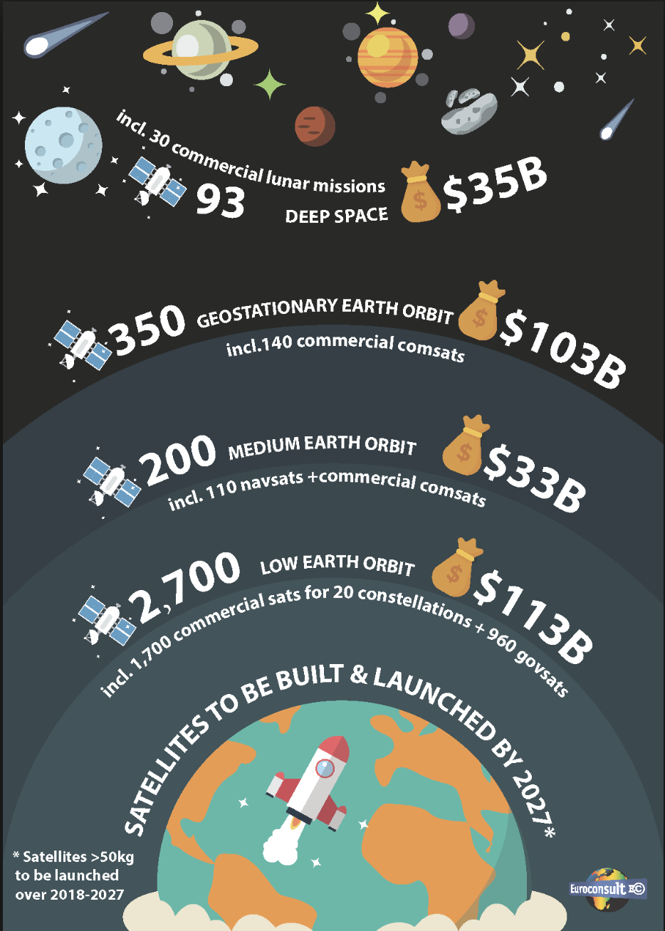
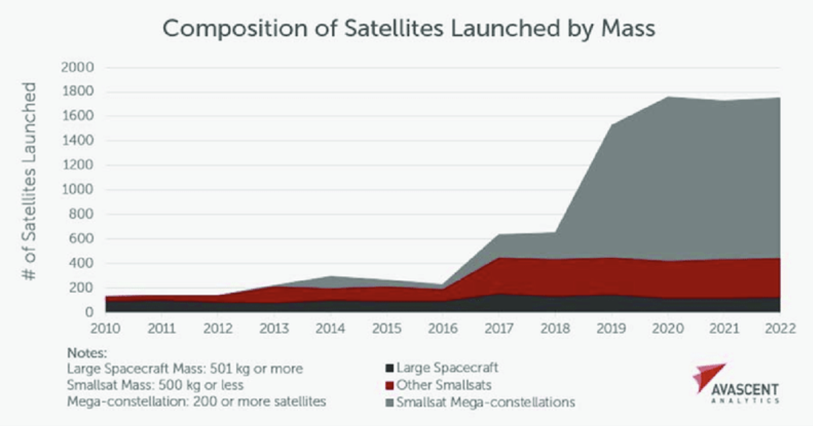
Motivations for public EO programmes
Data standardisation and interoperability is a basic competitiveness measure for public EO programmes - under pressure from explosion in commercial activities
Public EO must demonstrate cost-effectiveness vs Space 2.0
User expectations changed

Slide 3
Trends in EO
‘Disposable’ cameras – lots of them…with poor geometry, radiometry
AI, on-board and on-ground
Machine learning and smart processing to handle huge volumes of data (CARD4ML??)
Large constellations
Analysis-ready data
Bringing users to data (cloud storage and processing, including novel AWS solutions for new entrants)
Still a role for large and long-lived reference platforms
Standardisation and ARD a defence mechanism for space agencies – a necessity to stay relevant and competitive
Pixel ownership needs to become history
Going past scenes into generalised data sets
COGs, STAC catalogues, cloud object stores

Slide 4
CEOS ARD Strategy
Technical Specification work not enough in itself
Processing chain reconfiguration costs money – and data providers need persuading as to the cost-benefit and demand
Data distributors likewise...and also encouraged to adopt CEOS standards
Data users need to see demonstrations for inspiration
We need a considered and prioritised orderly queue given limited capacity
We need advocacy, promotion, and demos to all stakeholders
Early work undertaken to outline a coherent strategy – and action defined to bring a draft to SIT-34 in April
Scope for CEOS priority during 2020-21 SIT Chair Term

Slide 5
CEOS ARD Strategy – Objectives
Ensure continued relevance of public EO programme data and information, leveraging the availability of all relevant CEOS agency missions to meet user needs for information;
Meet the changing expectations of the user base, which is increasingly non-technical and more accustomed to simplicity in geospatial data sourcing, integration and application;
Establish a broad understanding of, and participation in, CEOS efforts to define, produce, and apply ARD in support of societal needs;
Ensure effective engagement of the three key stakeholder groups: EO data providers (both public and private); Big Data hosts and aggregators who stage increasing amounts of CEOS agency free and open data; and data users;
Manage expectations of all stakeholders as to the status and outlook for ARD availability – so that all might plan and invest with confidence in capabilities to best exploit the CEOS agency ARD;
Establish priorities for which products and applications might follow on from the current land-specific PFS;
Ensure appropriate organisational responsibilities across the CEOS structure for the definition and execution of the way forward on ARD.

Slide 6
CARD4ML (Machine Learning)
ML is a ‘buzzy’ area of development right now - still early days
e.g. ESA ‘BrainSat’ e.g., ML on-orbit, EO processing on edge compute
Appears that for a certain class of problems that can be solved using ML and satellite EO, it could be a vital tool in managing the unprecedented and growing volume and velocity of data coming out of the ‘EO firehose’
There are certain classes of problem where more bespoke solutions will likely remain superior (e.g. WoFS)
EO data pre-processing to optimise application to ML should be investigated and considered. i.e. CARD4ML.
Governmental and commercial actors pursuing this for general applications as well as EO applications
Google (incl Earth Engine), AWS, Digital Globe
Preliminary discussions on the topic with Descartes Labs
Initial responses are promising

Slide 7
CARD4ML (Machine Learning)
To date, it appears that the most utility in applying ML to EO data is:
with finer resolution optical data (e.g. Planet, Digital Globe)
in cases where multiple signals exist (e.g. AIS plus Sentinel-1 for ship tracking)
Spatial resolution of Landsat, and even the 10m optical bands on Sentinel-2, may be too coarse for spatially-driven ML applications
highly dependant on feature sizes
application to time series should be investigated
CEOS should be engaged in this area, and consider if and how to support, e.g. via an ARD PFS aimed at ML, e.g. ODC/CEOS Data Cube applications
Action for a small group to study the topic, possibly in consultation with SDCG and GEOGLAM AHWG for thematic inputs, and come back for discussion at the September joint meetings and SIT TW?

Slide 8
CEOS ARD Strategy – Discussion
Suggestions for inclusion in the draft CEOS ARD strategy for SIT-34
Partnerships for CEOS
Priorities for CEOS in promoting uptake
Priorities for the orderly queue
CARD4ML?? (space agency competitiveness measure)
Roles within CEOS

