Slide 1

Session 2: CARD4L Product Family Specification
(09:40:00-10:20)
Committee on Earth Observation Satellites
Geoscience Australia
SLI-VC7 Meeting
Hanoi, Vietnam
14th February 2019

Slide 2
Presentation Outline
PFS overall status
  Mature drafts
  Proposed radar drafts
An overview of the 2018 PFS update process
PFS endorsement
  Backscatter
  Surface Reflectance
  Land Surface Temperature
Lessons learnt
2019 PFSs proposed update plan

Slide 3
Overall PFS Status - Mature PFS drafts
Three mature PFSs:
  Radar Backscatter:
    PFS doc v3.2.2 (link)
  Surface Reflectance:
    PFS doc v3.1.1 (link)
  Land Surface Temperature:
    LST PFS doc V3.3.1 (link)
2018 PFS revision/update completed
  Agencies’ self-assessment feedback
  2018 CEOS Analysis Ready Data survey responses
The documents are for endorsement at the LSI-VC 7 meeting

Slide 4
Overall PFS Status - Additional SAR PFSs
Under development PFSs for Radar products (link)
  Polarimetric covariance matrix – Francois Charbonneau (NRCan/RNCan)
  Polarimetric decomposition – Marco Lavalle/Bruce Chapman (JPL), Takeo Tadono/Ake Rosenquvist (JAXA) and Zheng-Shu Zhou (CSIRO)
  Differential interferometry – Medhavy Thankappan (Geoscience Australia)
  Geocoded SLC – Bruce Chapman (JPL)
SAR Definition Team will be extended for another 6 months (July 2019)
Team will be looking at sample products for each SAR PFSs in the next 6 months
Monthly meetings (next meeting: 27 Feb 2019)
Present mature drafts for endorsement at LSIVC8 meeting (Sep 2019)

Slide 5
2018 PFS update process overview
PFS doc updated/knowledge table shared with agencies leads for review
Additional suggestions added into PFS
LSIVC received the self-assessment feedback
Final draft shared with lsivc for endorsement
Knowledge table created & Teleconferences
1
2
3
4
5

Slide 6
For endorsement by LSI-VC-7
Backscatter PFS
Surface Reflectance PFS
Land Surface Temperature PFS

Slide 7
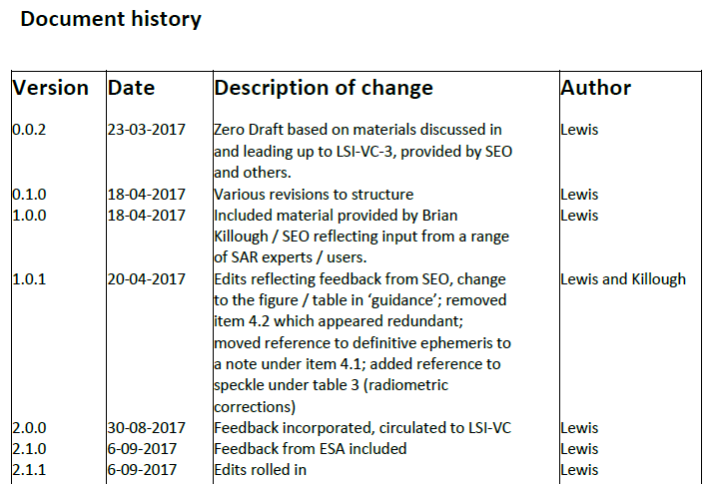
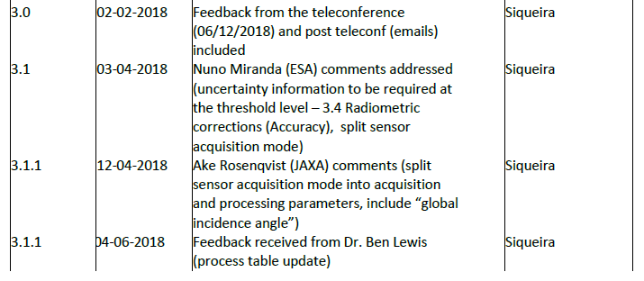
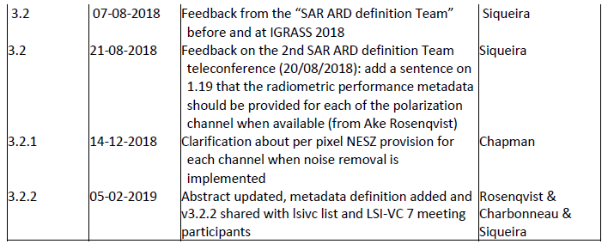
Backscatter PFS update
Comments/suggestions have been addressed:
  During teleconferences - SAR Definition Team
  Follow up actions
PFS doc was distributed to lsivc list and lsivc7 meeting participants (05/02) seeking further input
For endorsement by LSI-VC-7

Slide 8
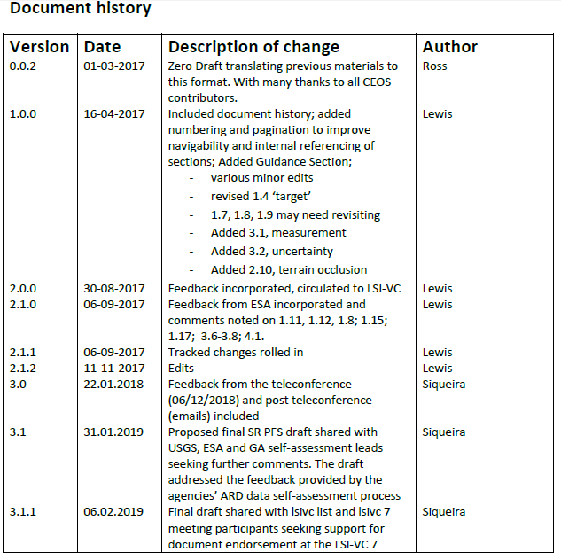
Surface reflectance PFS update
The latest revision included feedback from agency’s pilot self-assessment and user’s survey
There were a number of interactions (e.g. teleconferences and emails)
Feedback/comments were recorded in the “knowledge table”
The final draft of the PFS doc was distributed to lsivc list and lsivc7 meeting participants (06/02) seeking further input
For endorsement by LSI-VC-7

Slide 9
Requirement | Feedback | Comments
1.1 Traceability | Difference between SR and LST in terms of what’s Threshold vs. Target. | Suggestion from ESA during the self-assessment process to move to a threshold level as the traceability is a key metric for product maturity. This is particularly pertinent for climate studies
1.1 Traceability | Similar to the LST version, can we provide a link? | Action required - the link has been removed from document until another link is proposed
1.9 Instrument | Can this be provided on the single DOI landing page? | yes
1.13 Algorithms | Can this be provided on the single DOI landing page? | yes
1.14 Ancillary data | Can this be provided on the single DOI landing page? | yes
2.3 Incomplete testing | For USGS Landsat products, if any ancillary data is missing the processing fails. We implemented this as ‘all or nothing’. We do not anticipate encountering this situation. How would we score this? | open question
2.12 Aerosol optical depth parameters | For the Target, if this is still “to be determined”, are data providers able to take credit for meeting the Target level? If no, then no-one will be able to claim full Target level of compliance with this PFS. Should we just say “Not required” in this version as we continue to further explore the spec? | open question
3.1 Measurement | To remove ambiguity, what is the specific SI reference standard? Can we provide a link? | open question
3.4 Directional Atmospheric Scattering | Note 2: requirement for metadata are better placed in 1.13 and 1.14. – Is this an unresolved comment? | open question
3.5 Water vapour corrections | Same comment as for 3.4 | open question
4.1 Geometric correction | Note 1. The threshold level will not necessarily enable interoperability between data from different sources as the geometric corrections for each of the sources may differ.Therefore, this may be too low a bar to meet the objectives of CARD4L – If this is so, is the requirement sufficient? I don’t think we can leave this type of comment in the PFS. | open question
Surface Reflectance PFS - Specific discussion points

Slide 10
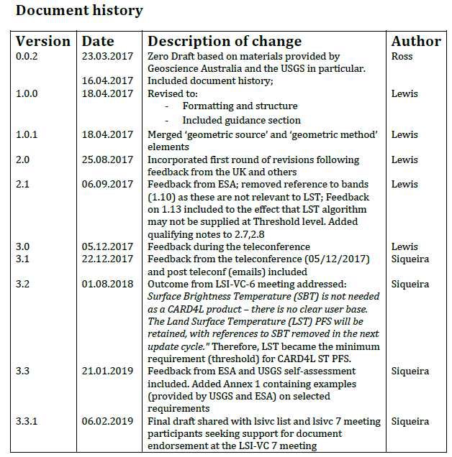
Land Surface Temperature PFS update
The latest revision included feedback from agency’s self-assessment pilot process and user’s survey
There were a number of interactions (e.g. teleconferences and emails)
Feedback/comments were recorded in the “knowledge table”
PFS doc was distributed to lsivc list and lsivc7 meeting participants (06/02) seeking further input
For endorsement by LSI-VC-7

Slide 11
Requirement | Feedback | Comments
1.xx Spectral bands | Do we need a “Spectral bands” parameter? It’s in the SR PFS, and L7, for example, has both 6H and 6L bands | Deleted: suggestion in LST USGS self-assessment doc
1.10 Sensor calibration | The Threshold and Target content here is different than in the SR PFS. Should it be the same? | It is because ‘spectral bands” req has been deleted. In SR the req 1.10 is ‘spectral bands’
1.14 Processing chain provenance | The Threshold level is the Target level in the SR PFS. Should it be the same? | Discussed and agreed at teleconf 17/02 to move req to the threshold level because this req contains crucial information to increase product maturity
1.16 Overall data quality | Should the SR and LST PFS text be the same? | Action to Darren Guent (teleconf 17/02) to reword the req. Participants agreed that the req crucial and needed rewording.
2.7 Illumination and viewing geometry | In the SR PFS, per-pixel is a Target level requirement | Suggestion from ESA to move the req to the threshold level. The threshold req for minimum geometry information is crucial information to the users for numerous applications, and to access algorithm performance with respect to validation and intercomparison
3.2 Corrections for atmosphere and emissivity | While the included Threshold level requirement text may be true, it doesn’t appear to reflect a requirement that must be met. Does this need to be revised? | Action required
3.3 Measurement Uncertainty | The Threshold level is the Target level in the SR PFS. Should it be the same? | Discussed and agreed at 17/02 that the req provides essential information on the product quality, and may be moved to threshold level

Slide 12
2018 lessons learnt
Self-assessment leads have competing priorities with their day-to-day jobs, so teleconferences must be the time to discuss and reach a consensus on what should be included in the documents,
Avoid multiple emails – people do not have time to read them,
Emails should be straight to the point and convene a clear message e.g. what needs to be done, what is expected with clear deadlines,
Emails seeking feedback/comments should not be sent too much time in advance – people forget them ☺
Google drive for document updating and sharing proved to be an efficient way to keep everyone informed and to manage document versions,
Organizing suitable times to have calls turned to be very challenging – suggestion: plan in advance and accept that not everyone will be able to make it!

Slide 13
2019 PFSs review Plan - Jul to Dec 2019
WGCV PFS feedback
ESA Heritage missions self-assessment
Any additional feedback from the community
GA S1 self-assessment
Proposed comments/feedback are expected to be presented at LSIVC8 meeting – Sep 2019

Slide 14
Thank you!

Slide 15
Session 3: CARD4L Product Alignment Assessment
(12:15-12:45)
Committee on Earth Observation Satellites
Geoscience Australia
SLI-VC7 Meeting
Hanoi, Vietnam
14th February 2019

Slide 16
Presentation outline
CARD4L Product Alignment Assessment Process (PAA) review
Pilot self-assessment overview
  Surface Reflectance
  Land Surface Temperature
CARD4L PAA next steps
  Confirm LSIVC POCs for the self-assessment peer review process (nominations)
  Endorse self-assessment package
  Endorse peer review package
Proposed WGCV pilot peer review schedule
Promoting CARD4L in 2019

Slide 17
CARD4L Product Alignment Assessment (PAA) Process

Slide 18
2018 agencies’ pilot self-assessment overview
Four agencies completed self-assessments
  ESA (Land Surface Temperature and Surface Reflectance)
  JAXA (Radar Backscatter)
  GA (Surface Reflectance)
  USGS (Land Surface Temperature and Surface Reflectance)
ESA heritage missions
  Currently self-assessing ERS (backscatter)
  Aim to present results at LSIVC8 meeting
Agencies used similar methodology to self-assess their ARD products
  PFS as the template to add comments and suggestions
Feedback was used to improve PFS documents
Notes:
-

Slide 19
Pilot self-assessments Overview - Surface Reflectance

Slide 20
Pilot self-assessments Overview - Land Surface Temperature

Slide 21
CARD4L PAA next steps
Confirm LSIVC
POCs
Endorse
Peer review package
Endorse
Self-assessment package
Trial peer review
process

Slide 22
CARD4L Self-assessment proposed package
Package/info from LSIVC to Data producers (interested to self-assess their ARD data)
  CARD4L intro - Description (link) & Framework Details (link)
  Self-Assessment Guidelines (i.e., Instructions) (to be developed)
  Detailed Self-Assessment Template (standardized) (link)
  Summary Self-Assessment Template (standardized) (link)
  Directory location for a data provider to upload required information (google drive)
For endorsement by LSI-VC-7

Slide 23
WGCV Peer review proposed package
Package/info from data producer to WGCV/LSIVC (peer-review)
  Completed detailed self-assessment template
    Containing the rationale for claiming compliance for each PFS requirement
  Completed summary self-assessment template
    Containing full or partial compliance at threshold/target levels for PFS sections (geometry, radiometry, general and per-pixel meta metadata )
  Sample imagery data
    Covering geometric and radiometric specifications
  Sample metadata
    Covering the General Metadata and Per-Pixel Metadata specifications
  Contact details for the data producer’s point of contact (POC)
For endorsement by LSI-VC-7

Slide 24
Proposed WGCV pilot peer review schedule
Timeline
Mar19
Apr-May19
Surface Reflectance
Land Surface Temperature
Peer review process
Identify WGCV panel
Radar Backscatter
Identify WGCV panel
Present results at LSIVC8
Identify WGCV panel
Peer review process
Jun-Aug 19
Sep 2019
Peer review process
Jan-Feb20
Feedback into PFS update
Oct-Nov19
Dec19
Feedback into PFS update
Feedback into PFS update
Endorse the process at LSIVC9
Suggestions/Comments??

Slide 25
Promoting CARD4L in 2019
BIDS19
CARD4Lextended abstract
LPS19
ARD session & CARD4L abstract
IGARSS19
ARD session & CARD4L extended abstract
Pecora 21/ISRSE 38
ARD session & CARD4L abstract
Abstract Submission date: February 25, 2019
GFOI Plenary
To be decided/confirmed
GEO Plenary
To be decided/confirmed
Event details: February 19-21, 2019 - Munich, Germany
Event details: April 8-11, 2019 - Maputo, Mozambique
Event details: May 13-17, 2019 - Milan, Italy
Event details: July 28 - August 2, 2019 - Yokohama, Japan
Event details: October 6-11, 2019 - Baltimore, Maryland, USA
Event details: November 4 – 9, 2019 – Canberra, Australia
15 Abstracts
7 abstracts received

Slide 26
Thank you!

