Slide 1

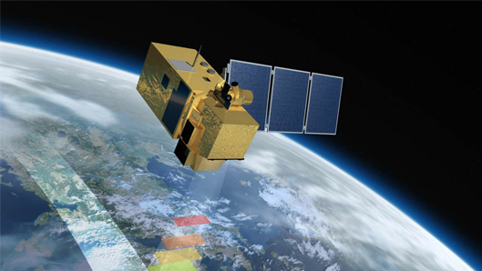
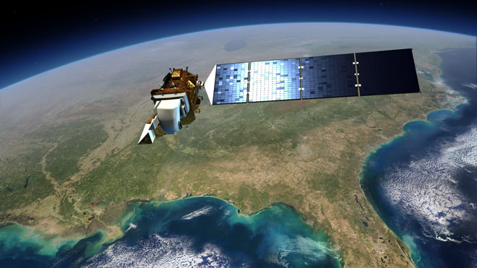
Future US Land Imaging
Jeffrey Masek, NASA GSFC
Update on Harmonized Landsat Sentinel-2 (HLS)
September 6, 2018
Jeffrey Masek¹, Junchang Ju², Jean-Claude Roger², Sergii Skakun², Martin Claverie³, Jennifer Dungan⁴, Chris Justice²
(1) NASA GSFC, (2) Univ. of Maryland, (3) Univ. Catholique de Louvain, (4) NASA ARC
NASA Agency Update – CEOS LSI-VC-2
July 20-22, 2016
Dave Jarrett, NASA HQ
Jeff Masek, NASA GSFC
Presentation contains modified Copernicus Sentinel data (2015-17) processed by ESA

Slide 2
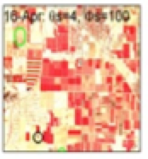
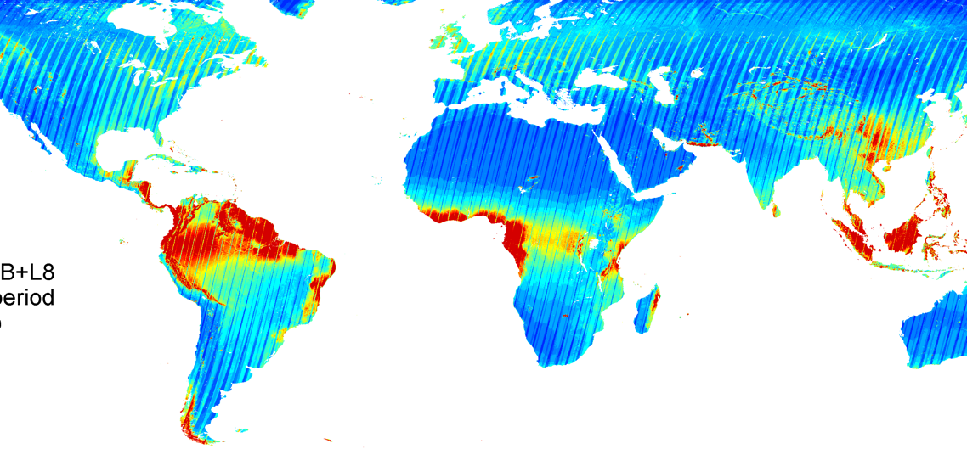
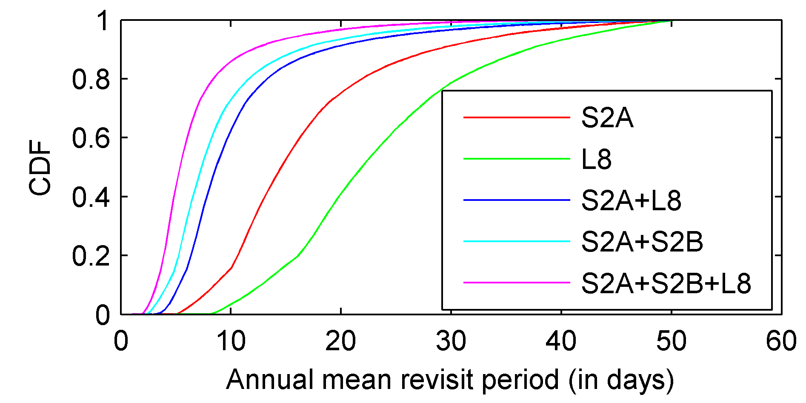
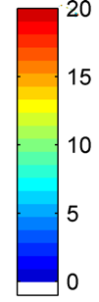
Harmonized Landsat Sentinel-2 (HLS) Project
Merging Sentinel-2 and Landsat data streams can provide 3-4 day global coverage
Goal is “seamless” near-daily 30m surface reflectance record including atmospheric corrections, spectral and BRDF adjustments, regridding
Project initiated in 2012 as collaboration among NASA GSFC, UMD, NASA Ames
Prototype for a multi-sensor Analysis Ready Data product
Potential Revisit using
different Virtual Constellations
S2A+S2B+L8 mean cloud-free revisit period (days)
Cloud free

Slide 3
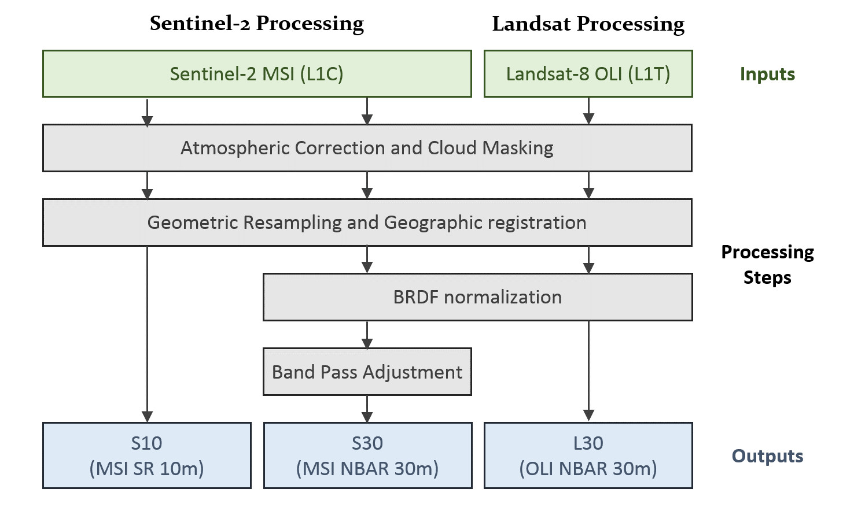
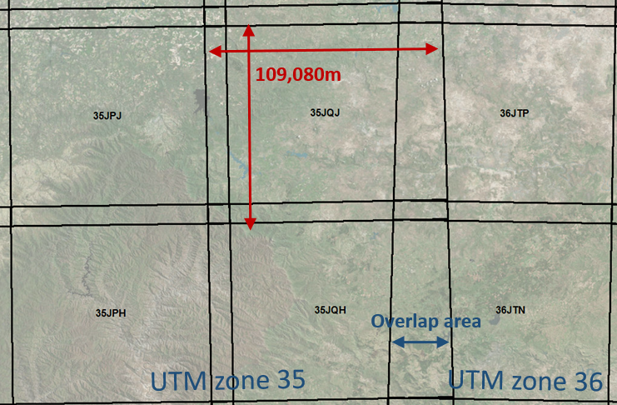
HLS Main specs and Algorithm Flow
All 3 products are aligned on the MGRS S2 Tiles system following UTM zones
S10 (from Sentinel-2)
Spatial: 10m, 20m, 60m
Spectral Bands: All MSI
NBAR: No
S30 (from Sentinel-2)
Spatial: 30m
Spectral Bands: OLI-like + MSI Red Edge
NBAR: Yes
L30 (from Landsat 8)
Spatial: 30m
Spectral Bands: All OLI
NBAR: Yes
Atmospheric Correction | LaSRC/6S approach (image-based aerosol) | Vermote et al. (2016)
BRDF normalization | C-factor technique with the global constant coefficients | Roy et al. (2016)
Spectral bandpass | Linear regression using global training set from EO-1 Hyperion | Claverie et al., (in review)
Cloud/shadow mask | Landsat 8: output from LaSRC; Sentinel-2: Boston University Fmask algorithm | Vermote et al. (2016); Zhu et al. (2015)
Geographic registration | AROP: automated registration and orthorectification package | Gao et al. (2009)

Slide 4
L8/S2 Radiometric Cross-calibration
Since Sentinel-2 launch, NASA, USGS, and ESA teams have compared coincident acquisitions with L8 over pseudo-invariant sites & calibration targets
Accounting for bandpass differences (e.g. using Hyperion spectra), absolute differences between the TOA reflectances are ~2-3%, which is within the uncertainty of the individual systems.
some indication of greater uncertainty for C/A band
see: Barsi, J., Alhammoud, B., Czapla-Myers, J., Gascon, F., Haque, MH., Maewmanee, M., Leigh, L., Markham, B., 2018. Sentinel-2A MSI and Landsat-8 OLI Radiometric Cross Comparison. European Journal of Remote Sensing, in review.

Slide 5
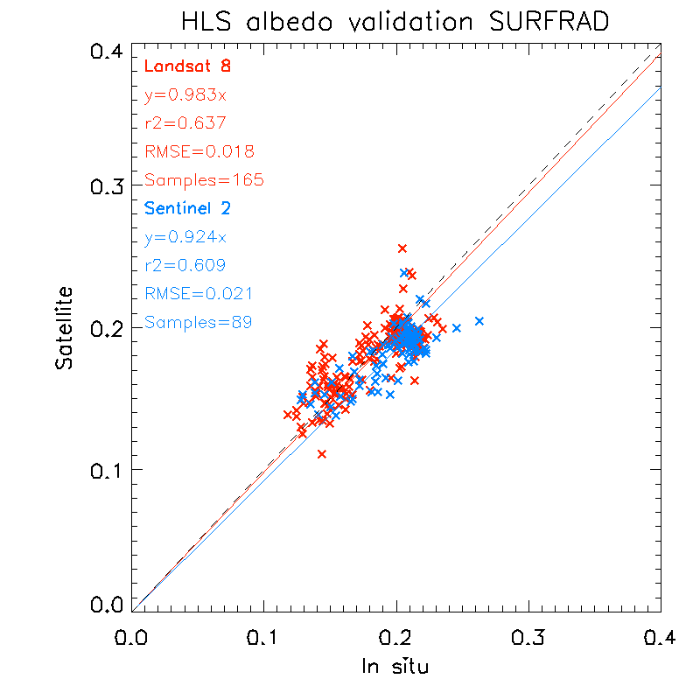
Quality Assurance (QA) & Uncertainty
Product Quality Assurance (QA) - Should the user avoid this particular granule or pixel?
  Per-pixel cloud, shadow, high aerosol bits
  Per-granule comparison with contemporary MODIS NBAR
Product Validation – what is the uncertainty (bias, precision) associated with any given observation compared to the true value?
  “Bottom-up” error budget based on algorithm validation
  Comparison with SURFAD albedometer measurements (B. Franch, UMD)
  Short-term stability of PICS sites
SURFRAD comparison:
RMSE: ~0.02 absolute
(~10% relative)
Short-term variability:
~3-4% relative RMSE

Slide 6
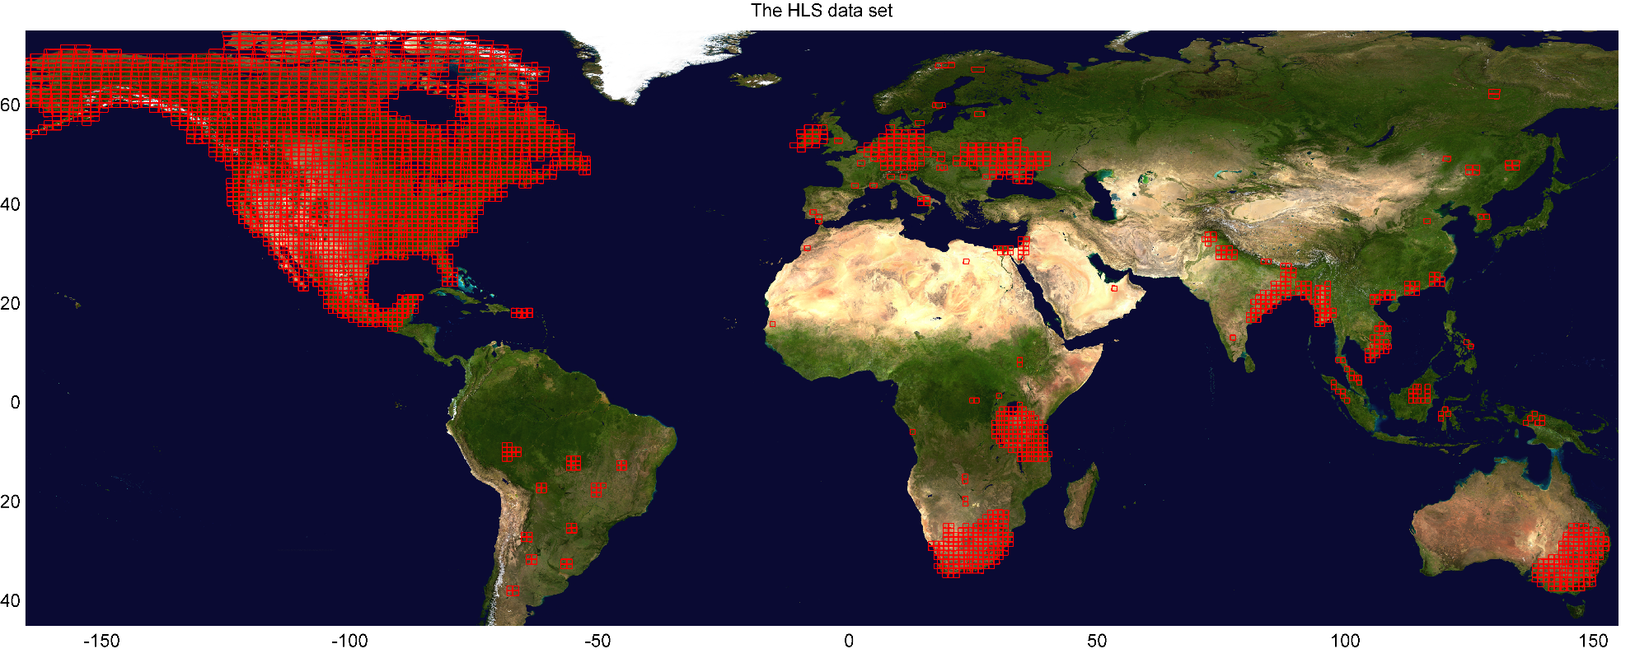
HLS (v1.4) Data Set
Landsat-8 data set: 1,100k products From Mar-2013 to Present (135 TB)
Sentinel-2 data set: 420k products From Jun-2015 to Present (60 + 274 TB)
105 Global Test Sites (3904 MGRS tiles)
>37 million sq. km2 (~25% global land)

Slide 7
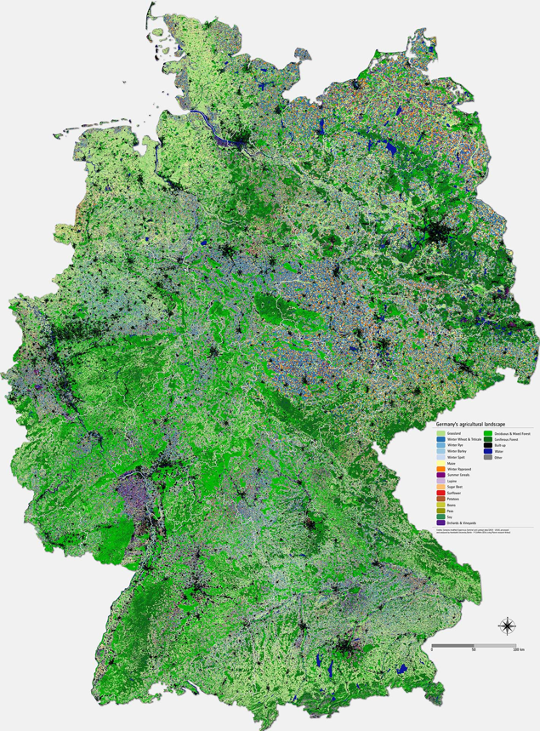
HLS Applications
Test products generated for ~50 user groups around the world
  Prototype satellite-based crop type map for Germany (P. Griffiths/Humboldt U)
  North American vegetation phenology (M. Friedl/Boston U)
  Crop productivity modeling (F. Gao / USDA BARC)
  Australia wetland mapping (M. Broich / U. NSW)
http://www.esa.int/spaceinimages/Images/2017/08/Mapping_Germany_s_agricultural_landscape

Slide 8

HLS Processing Approach
Through Version 1.3 HLS was processed via NASA Ames NEX computing cluster
With Version 1.4, currently migrating to Amazon Web Services (AWS) via NASA Earth Sciences Technology Office (ESTO) AIST Managed Cloud Environment (AMCE)

Slide 9
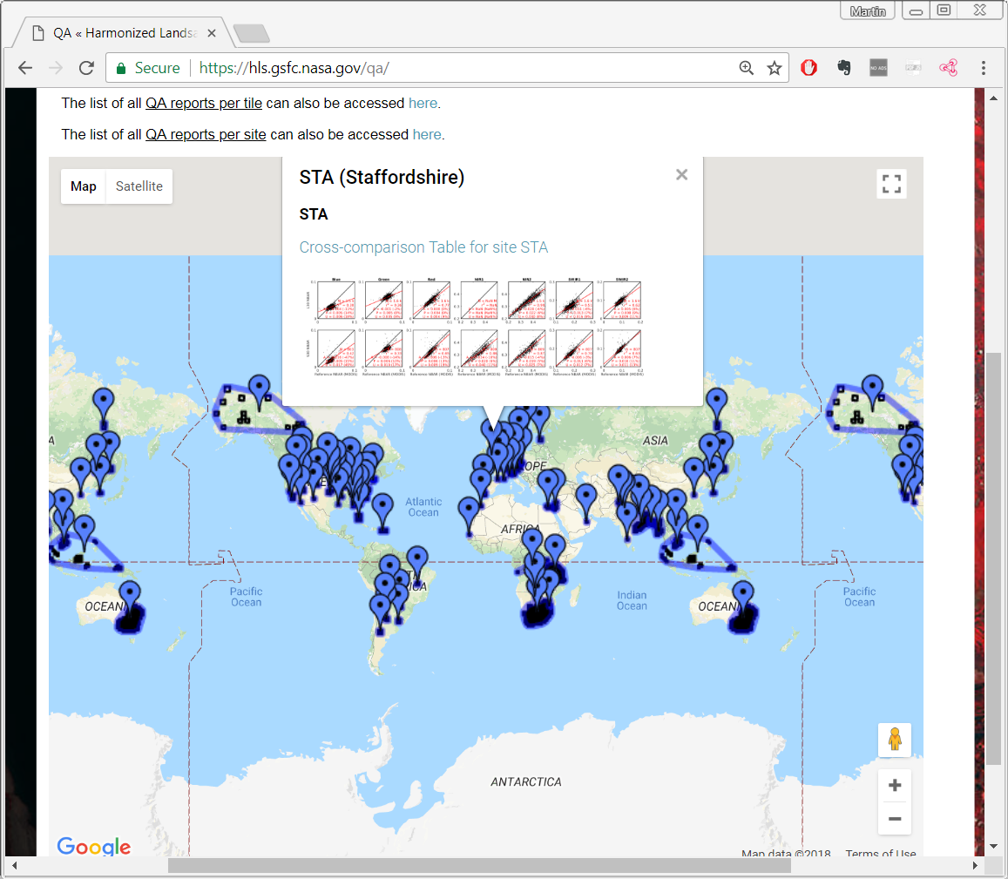
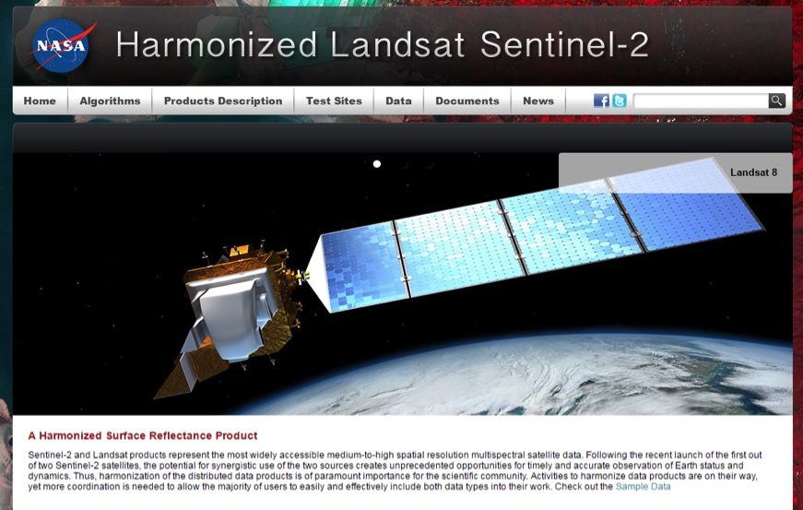
Website and Public Interface
https://hls.gsfc.nasa.gov
Public access
S30, L30 data available (via HTTPS)
QA, Product documentation
Products also available via S3 storage for AWS users

Slide 10
Harmonization Challenges
Landsat/Sentinel-2 cross calibration has not been an issue
  We assume that both sensors record the true signal with zero bias - NASA/USGS and ESA characterization teams working closely together
S2/L8 & S2/S2 geo-registration issues
  Documenting the problem (Storey et al., RSE, 2016)
  HLS uses image-image correlation (AROP) with Sentinel-2 “master” scene
Mixed processing baselines
  Migration of Landsat from L1T to “Collection 1” to ARD
  Early evolution of Sentinel-2 processing baselines & file formats
Cloud and shadow masking
  BU algorithm intercomparison & upgrade (Woodcock)
  CEOS Atmospheric Correction Intercomparison Experiment (ACIX-2)

Slide 11
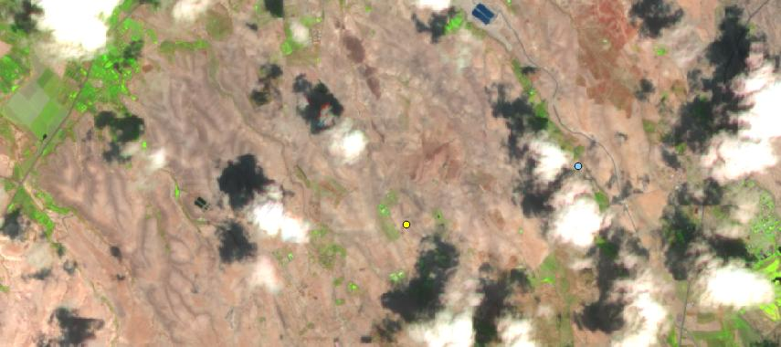
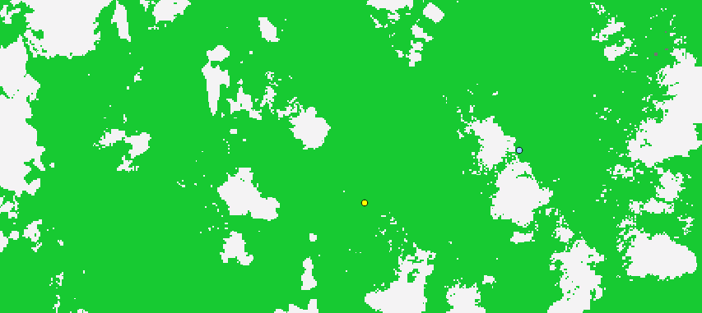

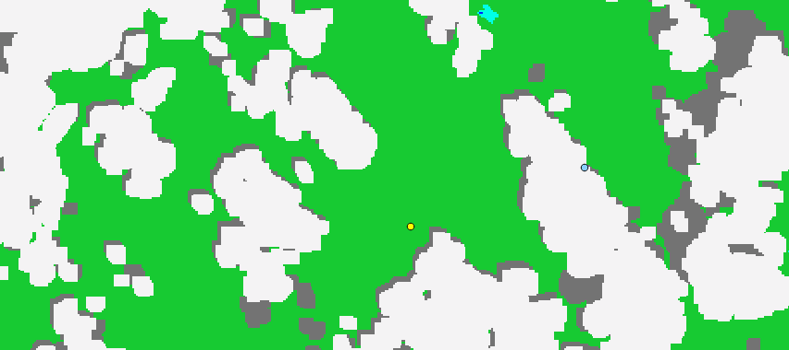

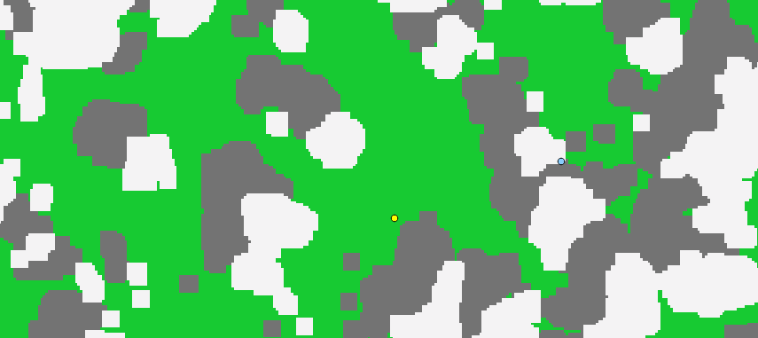
Cloud Mask Evaluation
SEN2COR
LASRC
FMASK
MAJA
TMASK
Clear Cloud shadow Cloud Water
Courtesy of C. Woodcock group (Boston University)

Slide 12
Status and Future Directions
HLS version 1.4 being released this summer – check our web site for availability: https://hls.gsfc.nasa.gov
Support for NASA Multi-Source Land Imaging (MuSLI) team products
  North American Vegetation Phenology (Friedl/BU)
  Sub-Saharan Africa Burned Area (Roy/SDSU)
  High-latitude Albedo Dynamics (Schaaf/U Mass)
Investigating options for global HLS production in 2019-2020

Slide 13
ESA Living Planet 2019
13-17 May 2019
Special Session: Multi-Source Data for Next Generation Land Monitoring
Abstract submissions open Sept 10 – Nov 11, 2018

Slide 14
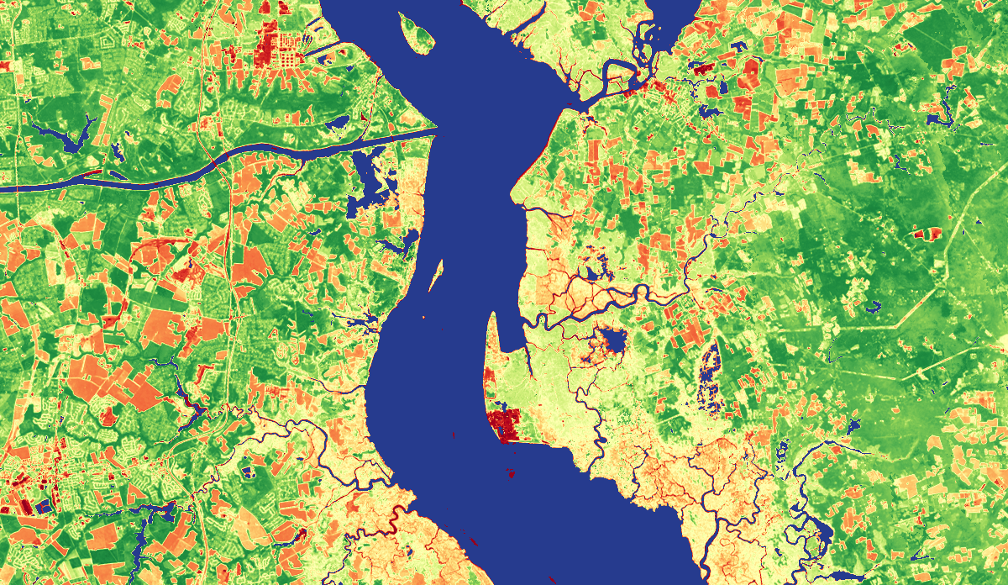
Thank You
Delaware / New Jersey

Slide 15
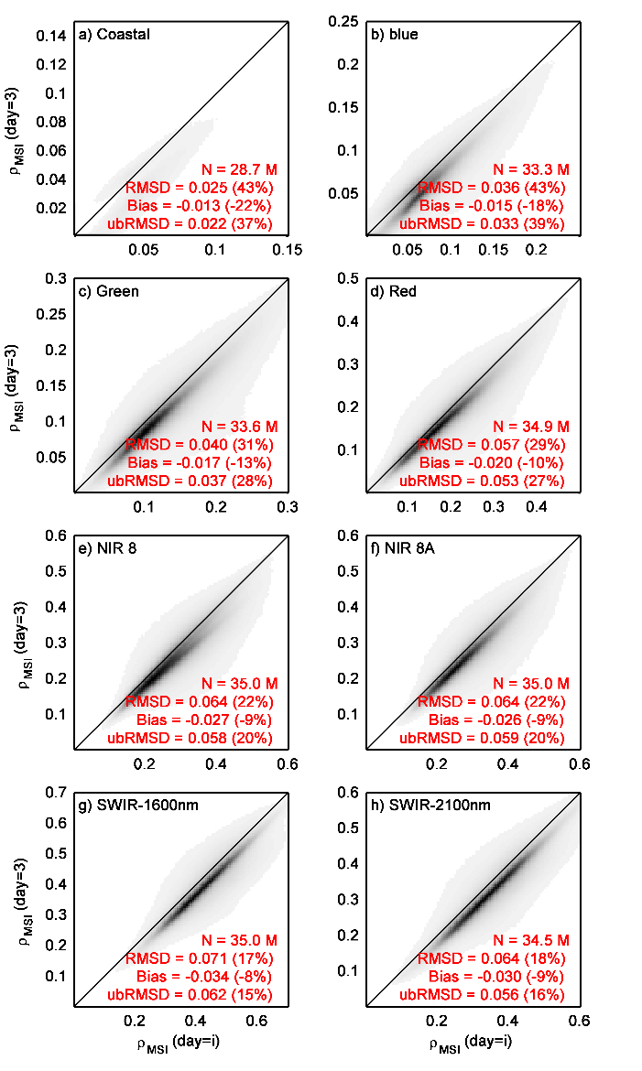
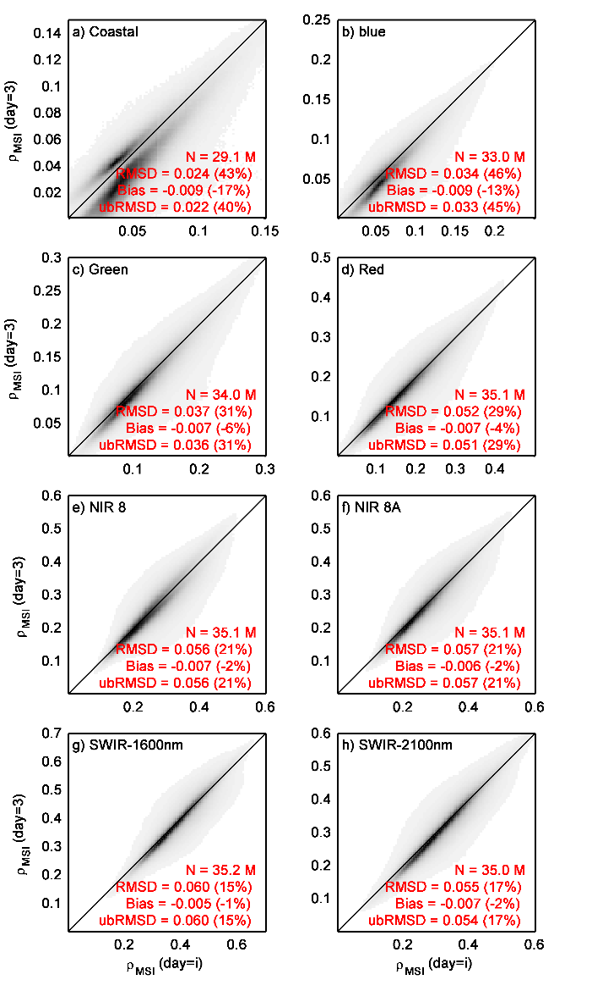
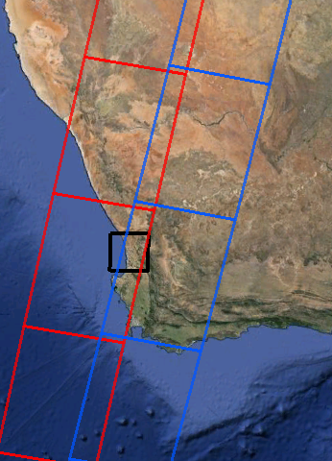
Evaluation of the BRDF adjustment
Without BRDF-adj.
With BRDF-adj.
We evaluated the deviation between edge swath acquisitions of MSI with and without BRDF-adj.
2 MSI swaths
Day_{i}
Overlap
area
Day_{i}+3

Slide 16
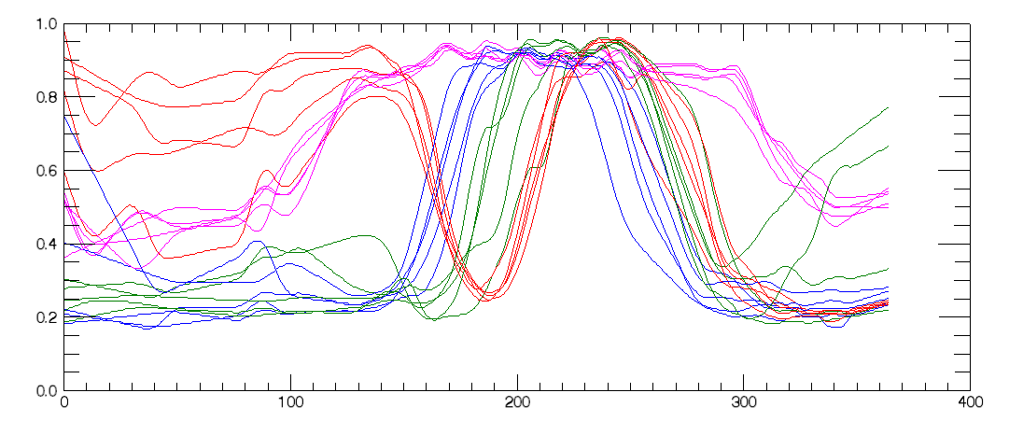
Crop NDVI Phenology
Delaware, USA - crop type examples from USDA Cropland Data Layer (CDL)
HLS data interpolated and smoothed (10-day window)
NDVI
DOY (2016)
Corn
Soybean
Double (Wheat/Soy)
Deciduous Forest

Slide 17
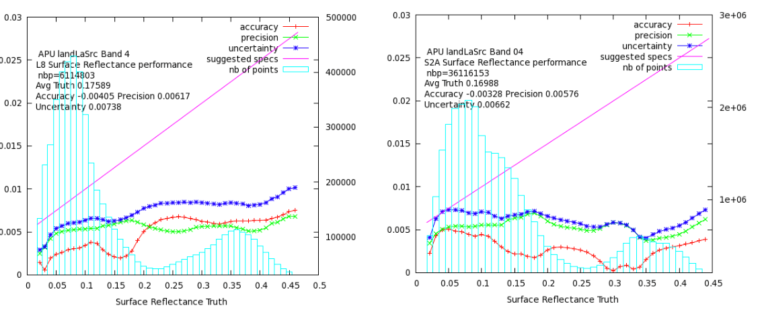
LaSRC Atmospheric Correction
Vermote et al. (2016) - Based on MODIS Collection 6 approach
Uses 6S radiative transfer model to correct for scattering (Rayleigh, Mie) and gaseous absorption
  MODIS water vapor
  NCEP GDAS ozone and surface pressure
  Aerosol optical thickness via fixed red/blue ratio observed in MODIS SR for every land location
Validation by comparison with SR based on Aeronet-measured AOT
L8 version
S2a version
Error
~2-6% relative uncertainty

