Slide 1
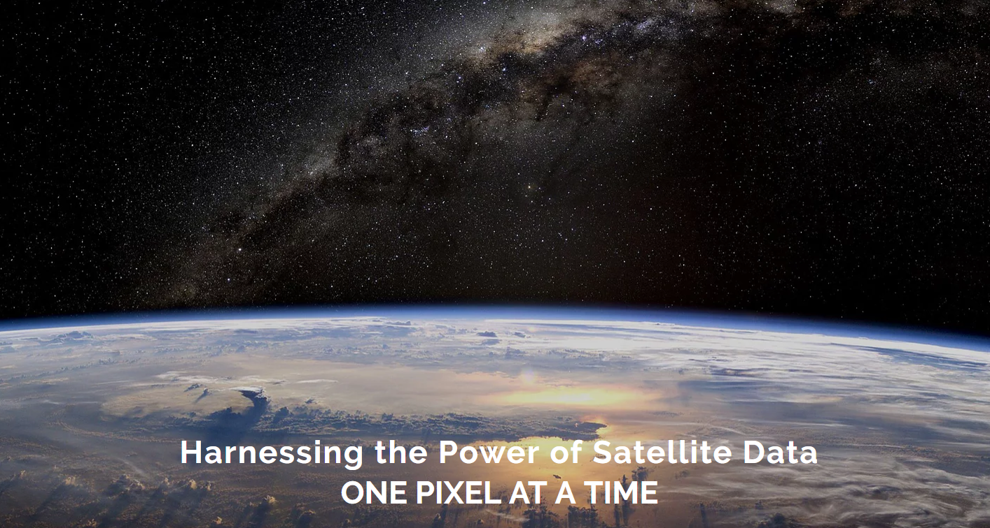
ARD ODC and GFOI Perspectives

Slide 2
Assumptions
LSI-VC is the authority and champion for CEOS ARD efforts
ARD is perhaps the most significant standardisation activity for space agency programmes to remain competitive, meet user expectations, and address FDA challenges and opportunities – including ODC

Slide 3
ODC 2018
Growing community and first CEOS example of FDA pilots
ODC would like to convey – through LSI-VC, to SIT-33 – a request that CEOS and its agencies recognise the importance of ARD standards and production and take measures to resource and expedite the relevant CEOS initiatives
ODC plans a comprehensive stocktake of ARD status, availability and outlook

Slide 4
GFOI
Formal action from 1st joint meeting with LSI-VC to have GEOGLAM and GFOI undertake formal feedback and pilot work to ensure CARD4L fit for purpose for those user communities
SDCG plans to submit a survey to GFOI countries next month in Colombia. Request LSI-VC review of that survey. Also PR materials to inform a short presentation to GFOI countries of ARD (and Data Cube).
Core task proposed for next V of the SDCG 3-year WP. Implies close cooperation with LSI-VC

Slide 5
Thank You

