Slide 1

Discussion on the overall MRI objectives, principles and long-term roadmap
Committee on Earth Observation Satellites
Michael Berger
LSI-VC-5
Session 5
February 2018

Slide 2
MRI Objectives
Providing clear recommendations to space agencies for the implementation of the MRI framework under consideration of widest possible use and the specific mandate of space agencies.
Providing good practices and guidance for user communities in adapting and using multiple sensor products within single data streams including related software tools and reference data sets.

Slide 3
MRI Principles
  Preserving as much as possible information content of single sensors in the system;
  Utilizing instrument/system information and when needed starting with lower level data not available to users;
  Focusing on L2 ARDs (SR, BS, BOA BT) interoperability as a basis for higher level ARDs ensuring data/product consistency;
  Guiding users outlining clearly the usability and limitations of the data sets and providing software APIs, toolboxes and demo material for implementation options with lower level SRL/TRLs.

Slide 4
Resampling
PSF: 1.5 (both sensors)
Resolution factor: 1:3
Resampling: Coarser to higher resolution?
Higher to coarser?
Intermediate or other fusion techniques?

Slide 5
Gridding
Assuming a symmetric MTF
Imaging planes
ds = min
Referenced center pixel L8
Referenced center pixel S2
+
Optimized grid center (1/2 ds)

Slide 6
Optimized Gridding for different Systems
S3
S3
Reality is much more complex as:
non-symmetric MTFs
Topography (slope, aspect)
spatial heterogeneity - different landscape-length scales (e.g. small-scale <-> large scale farming, urban,…)
S1
S1
+
+
S2
S2
S’
S1
+
Optimized central grid points of 2-, 3-, 4- sensor systems with different spatial sampling distances (e.g. S2, L8, S3 and Modis)
S2
S4

Slide 7
Spectral Bands

Slide 8
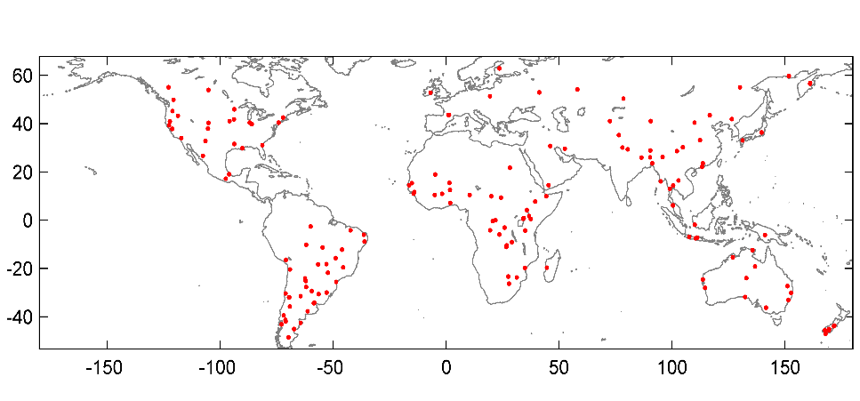
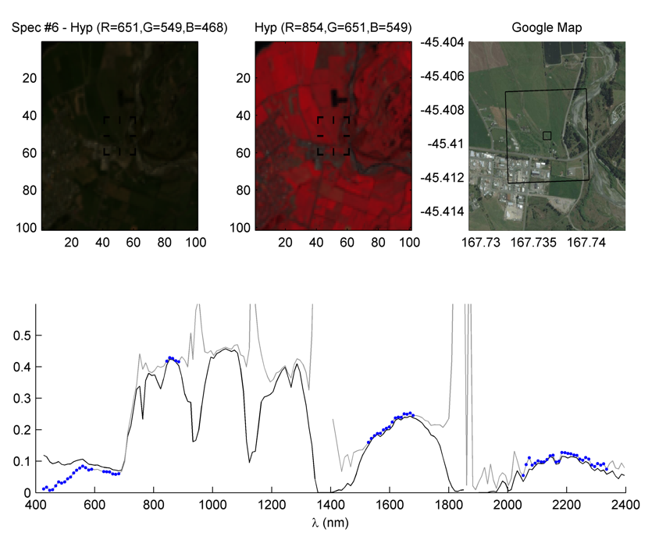
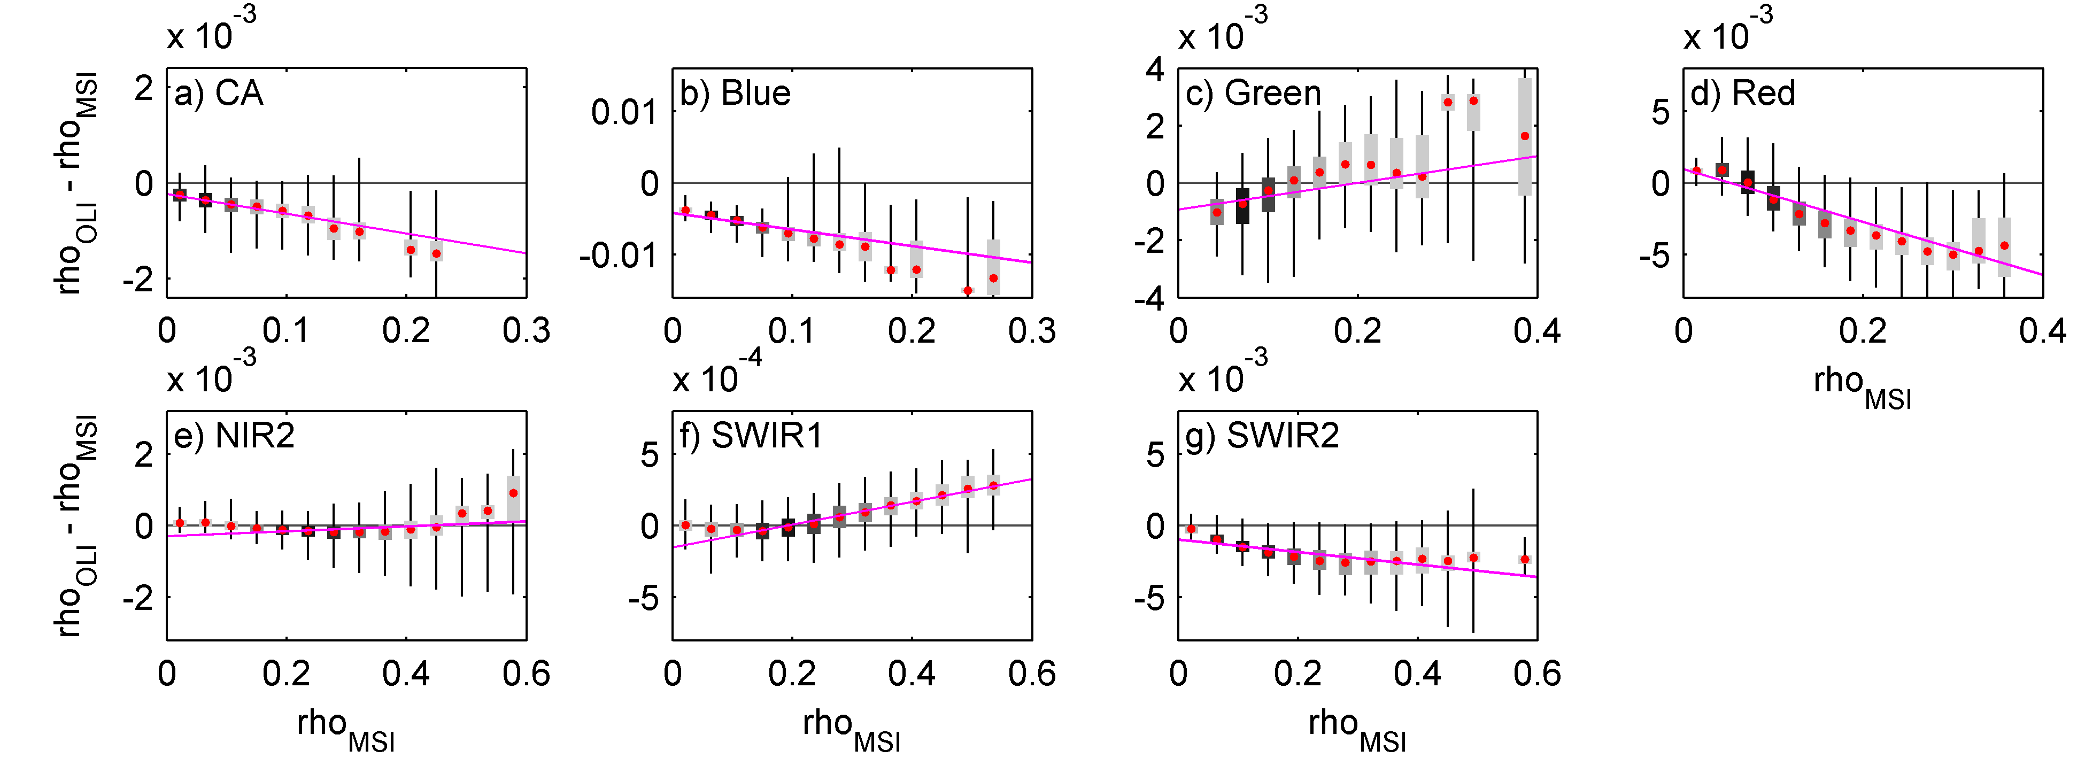

Spectral Band Adjustment used in HLS
158 EO-1 Hyperion scenes
Example of one Hyperion spectra
Extraction of 10,000
Hyperion spectra
-- TOA Reflectance
-- Surface Reflectance (SR)
● SR (OLI/MSI spectral region)
Spectra convolution using
OLI and MSI (S2B) RSR
Linear fits between OLI and MSI SR using Hyperion-derived SR
$ρ_{OLI}=Slope×ρ_{OLI}$ + Offset
HLS Linear fit coefficients
Band Name | Slope | Offset | Residual
CA | 0.996 | -0.00023 | 0.0004
Blue | 0.977 | -0.00411 | 0.0018
Green | 1.005 | -0.00093 | 0.0011
Red | 0.982 | 0.00094 | 0.0015
NIR2 | 1.001 | -0.00029 | 0.0003
SWIR 1 | 1.001 | -0.00015 | 0.0001
SWIR 2 | 0.996 | -0.00097 | 0.0009
Boxplots of the differences between simulated MSI and OLI SR using a 0.02 unit bin. The color of the boxplot reflects the density of the distribution (light grey = low density; black = high density) and the red dots the medians. The magenta lines correspond to the bandpass adjustment fits.
Courtesy: Martin Claverie, Jeff Masek

Slide 9
Issues to be addressed
  Optimized gridding: Need to be analyzed for different systems vis-à-vis impact and cost of an operational implementation.
  Resampling on common grid: Resampling to the coarsest resolution cell in the system may hamper the development and implementation of more sophisticated fusion techniques.
  BRDF correction, Spectral and Temporal Adjustments (accounting for different local solar times): Various approaches exists but their SRL/TRLs need to be assessed. For lower level SRL/TRLs, tools should be provided instead of an operational implementation fostering new developments.
  Common calibration methodologies and standards -> WGCV
  Reference pre-processing methods / data: need to be specified and agreed (e.g. DEMs, common grid,…)

Slide 10
MRI implementation roadmap
Furthering the Framework
Review of current framework with experts, identify missing elements
Furthering the framework under considerations of the agreed principles and expanding it to other sensors (SAR, medium res.)
Elaborating specific recommendations for CEOS approval
Impact Assessment
Review of past and on-going activities
Starting with a test scenario using the current scheme and CARD4L specifications (e.g. related to GEOGLAM, Water and focused on Vietnam?)
Impact assessment of improved scheme including a cost-benefit analysis
Implementation
Defining details on reference data set requirements (e.g. DEMs, reference grid) and fostering their development
Assessment of implementation option (e.g. GSs, toolboxes, data-cube, DIAS incl. SRL/TRLs)
Implementation (dev., testing, verification)

Slide 11
MRI 2018 WP
  Furthering the framework under considerations of the agreed principles and expanding it to other sensors with a focus on moderate resolution SAR.
  Analyzing various past/ongoing implementations (NASA HLS, ESA HLS,…) for MRI framework compliance.
  Initiating detailed assessments of various implementation options (common grid, spectral & temporal adjustments).

