Slide 1

Moderate Resolution Interoperability Recap
Committee on Earth Observation Satellites
Jenn Lacey
LSI-VC-5
Agenda Item #4
February 2018

Slide 2
Moderate Resolution Sensor
Interoperability (MRI) Initiative
Initiative addresses the CEOS strategic objective to encourage complementarity and comparability among the increasing number of Earth observing systems in the moderate resolution class for both optical and SAR sensors and the data received from them.
3 underlying requirements for achieving multi-sensor interoperability
  Provide methodologies to determine the uncertainties for input and combined products
    The goal is to understand the uncertainties at each step of production; for example, by allocating uncertainty to at-sensor products, atmospheric corrections, illumination and view angle corrections, band difference corrections, and classification, as appropriate.
  Determine the acceptable uncertainties for specific applications, as identified by the user community.
  Establish interoperable per-scene and per-pixel metadata for use in data discovery and as analytical filters.
    Metadata can be used to identify available scenes, data quality, and data gaps where clear pixels are not available.

Slide 3
FDA, CARD4L, and MRI Synergy
User feedback is critical for full exploitation of EO data informing current implementations and future directions
Future Data Architectures
CARD4L-compliant data feed FDAs
MRI identifies good practices for implementation of multi-sensor data sets
Moderate Resolution Interoperability
- Addresses how to combine data / scientific methods to maximize interoperability
    CARD4L is the first step
    - MRI provides feedback to CARD4L
CEOS Analysis Ready Data for Land
Product family specifications facilitate uptake of EO data by the user community

Slide 4
Moderate Resolution Sensor
Interoperability (MRI) Initiative
2017 Deliverables
  Framework for moderate (10-100m) resolution interoperability for the creation and use of multi-sensor data streams
  Harmonized Landsat Sentinel-2 (HLS) case study identifies and summarizes lessons learned of the HLS data product
Additional Activities
  Vegetation dynamics monitoring use case study with HLS data explores the relationship between spatial resolution, temporal resolution and vegetation type
  MRI Survey searches for examples of multi-sensor analysis throughout the user community

Slide 5

MRI Framework Document

Slide 6
MRI Framework
An Application-Specific, Conceptual Evaluation Tool
Framework organized into 4 components:
  General Metadata
  Per-pixel Metadata
  Data Measurements
  Geolocation
Within each component are a set of interoperability items for which application-specific Threshold and Target requirements (with uncertainties) are identified
  Threshold = agreed-upon, acceptable minimum value or characteristic
  Target = the goal (ideal characteristic or measure) for which producers and users are striving
Verifications are conducted on each item (actual measurements compared to pre-determined Thresholds/Targets), results documented
Next Steps are proposed to increase product interoperability where gaps exist

Slide 7
HLS Case Study:
MRI Framework Results
Component | Items | Descriptions | Threshold | Target | Verification | Next Steps
General Metadata | Coordinate Reference System | Both products are projected to a UTM/WGS84 map projection. HLS merged products are produced as 30-meter products using the Sentinel-2 tile system. Individual products are available at native resolution prior to resampling Sentinel-2 to 30 meters | Machine readable | TBD | NA | NA
 | Reference grid accuracy | Landsat data are georegistered to the GLS reference database, which contains errors of up to 36m. Sentinel-2 data are systematically corrected. | GLS RMSE 25m Sentinel-2 uses no reference image | Use common reference grid (GRI) | Geolocational accuracy estimated with high resolution images | Sentinel-2 Global Reference Image
 | Geometric accuracy | L30 products have error of <12m (CE90) relative to the GLS reference database. S30 products have absolute geodetic error <10.5m (2s). | L30 <12m (CE90) S30 <10.5m (2s) | 1/3 pixel rule of thumb | Landsat relative to GLS. Sentinel-2 relative to reference images | Sentinel-2 Global Reference Image
 | Spectral bands | The common bands are coastal aerosol, blue, green, red, NIR, SWIR1, and SWIR2. Other bands are available for analysis. | Machine readable | TBD | NA | NA
 | Spectral response curves | The Sentinel-2 MSI band passes are quite similar to those of Landsat-8 OLI, for those bands in common between both instruments. The near-infrared (MSI Band 8a) and shortwave bands in particular are nearly identical. The MSI green band is slightly broader in comparison to OLI, while the red band is shifted ~15nm to the shorter end of the spectrum. | Documented in literature | TBD | NA | NA
 | Radiometric Accuracy | Sentinel-2 MSI has a at-sensor radiometric stability (ie. uniform target over multiple overpasses) requirement of better than 1% (2s) while Landsat 8 OLI has a requirement of better than 0.5% (2s). MSI and OLI agree to within 1.5% with the exception of the coastal aerosol and blue bands. | Minimal within overall error budget |  | Uniform targets | Continued coordinated cross calibration
 | Revisit time & lifetime | Given swath overlap and average cloud cover, a cloud-free HLS observation (either L30 or S30) can be expected every 15-20 days over the humid tropics, and every 5-10 days over mid-latitude agricultural regions. | 10- 20-day Sentinel-2a and 16-day Landsat revisit | Add Sentinel-2b and global 10-day | NA | NA
 | Field of View | The Landsat 8 FOV is 15° and the Sentinel-2 FOV is 21°. View angle differences for some ground targets can differ by up to 18.5° | Documented in literature | TBD | NA | NA
 | Mean Local Time | The average mean local time for Landsat 8 is 10:11 and for Sentinel-2 is 10:30. Minimal impact on radiometry. | Documented in literature | TBD | NA | NA

Slide 8
HLS Case Study:
MRI Framework Results
Component | Items | Descriptions | Threshold | Target | Verification | Next Steps
Per-Pixel Metadata | Clouds | The FMask algorithm is used for both Landsat 8 and Sentinel-2 to detect clouds. The lack of a thermal band on Sentinel-2 increases errors of omission and commission. | Machine readable | TBD | Consistent identifiction of clouds, cloud shadow, land/water and snow & ice | Continued improvementand validation of masks
 | Cloud Shadow | The FMask algorithm is used for both Landsat 8 and Sentinel-2 to detect cloud shadows. Adjacent cloud pixels only estimated for Landsat 8. | Machine readable | TBD
 | Land/water mask | The FMask algorithm is used for both Landsat 8 and Sentinel-2 to detect water. | Machine readable | TBD
 | Snow & Ice masks | The FMask algorithm is used for both Landsat 8 and Sentinel-2 to detect snow and Ice. | Machine readable | TBD
 | DEM | Landsat uses the GLS DEM. Sentinel-2 uses the PlanetDEM | Sensor dependent |  | meet sensor requirements | Open access
 | Terrain Shadow mask | Not used in HLS products | TBD | TBD | TBD | TBD
 | Illumination and Viewing geometry | Solar illumination angles are needed for reflectance calculations. Solar and View angles are needed for BRDF related corrections. View geometry is provided on a per-pixel basis for both Landsat-8 and Sentinel-2 data. | Machine readable | TBD | NA | NA
 | Data Quality | HLS includes Quality Assessment on a per-tile and per-granule basis, by comparison with contemporary MODIS CMG (Climate Modeling Grid) BRDF-adjusted reflectances. QA summaries are available on the HLS web site. | Machine readable | TBD | TBD | TBD
Data Measurements | Measurements | HLS products record surface reflectance or apparent (TOA, blackbody) temperature. Uncertainty of Data Measurement is function of at-sensor estimate plus uncertainty of corrections. Absolute versus temporal consistency. | TBD | TBD | Verify with known calibration sites | Establish sites for calibration and cross-calibration of higher level products
 | Measurement normalization | Reflectance values are normalized to a constant (nadir) view angle and fixed, latitude-dependent solar elevation | Documented in literature | TBD
 | Aerosol, water vapor and Ozone corrections | Aerosol quality flags are set for Landsat 8. Cirrus per-pixel flags are set for both. | Machine Readable | TBD
 | Spectral band difference corrections | Sentinel-2 reflectance values are adjusted to match those derived from equivalent Landsat-8 bandpasses, using a linear-regression model trained on Hyperion hyperspectral data. | Documented in literature | TBD
Geolocation | Geometric Corrections | The HLS product uses image-to-image registration to a best available single reference Sentinel- 2 image for each tile to achieve temporal consistency. | 1/3 pixel | TBD | Image-to-image registration | Relative to common reference database
 | Resampling | Sentinel-2 data are resampled to 30-meters to preserve the radiometric time series at the cost of lower spatial resolution. | Documented in Literature | TBD | Quantify added uncertainty | TBD

Slide 9
HLS Case Study:
Lessons Learned
Not every lesson will be applicable to every project
Radiometric Calibration – Landsat-8 OLI and Sentinel-2 MSI excellent
  HLS did not apply any additional radiometric calibration adjustment to OLI or MSI
Geometric Registration – Two sources of error
  For some locations, L8 ground reference data (GLS2000) is in error by up to 35m
    To be resolved in 2019 timeframe by going to Sentinel-2 GRI
  Early Sentinel-2a imagery (before v2.04, June 2016), processed with an incorrect yaw adjustment – same location from adjacent swaths misregistered by ~30m
    Fixed with v2.04, but early data still need to be reprocessed
  *** For those users requiring image co-registration to better than 30m, it is recommended that products be resampled to a reference using cross-correlation techniques. HLS uses the Automated Registration and Orthorectification Package (AROP) (Gao et al. 2008), which has recently been modified to work with MSI imagery

Slide 10
HLS Case Study:
Lessons Learned
Atmospheric Correction – HLS elected to apply the Landsat Surface Reflectance Code (LaSRC) atmospheric correction algorithm (Vermote et al., 2016) to both Landsat-8 OLI and Sentinel-2 MSI data, with slight modifications to account for spectral bandpass differences
  While it was assumed that using a common correction approach was preferable, HLS did not evaluate the additional uncertainty associated with using two different algorithms (e.g., LaSRC for Landsat-8 and Sen2Cor for Sentinel-2)
Angular and Bandpass Differences – For typical vegetation spectra, the magnitude of reflectance discrepancies arising from bandpass differences between Landsat and Sentinel-2 are considerably smaller than those arising from angular or other effects
  Simple correction adopted by HLS processing (Roy et al., 2016), using fixed coefficients independent of land cover type, removes most of this variance

Slide 11
HLS Case Study:
Lessons Learned
Spatial Resolution – Common spatial resolution of 30m was adopted
  Compromised 10/20m resolution of Sentinel-2 MSI, but coarser resolution reduced variability in time series derived from the joint data set
  Coarse resolution (30m) of HLS products compared to Sentinel-2 MSI native resolution has been the chief complaint by end users about the HLS product suite
Cloud/Shadow Masking – Masking of clouds and shadows is critical to automated time series analysis of optical data
  Single largest source of error when using HLS data for land applications has been errors in the cloud and shadow QA bits
  HLS currently uses the Fmask algorithm developed by Boston University for both Landsat-8 and Sentinel-2
  Lack of a thermal infrared band on Sentinel-2 substantially increases errors of omission and commission in derived cloud masks – significant numbers of HLS MSI observations are cloud contaminated without associated QA flags

Slide 12
HLS Case Study:
Suggested Next Steps
Expanded Bi-lateral and Multi-lateral cross-calibration efforts
Coordinate geolocation reference database
Optimization of spectral band passes for common bands
Intercomparison experiments for atmospheric correction and cloud detection
User driven requirements

Slide 13
MRI Way Forward – 2018
Plan to continue MRI as an LSI-VC activity, focusing on:
  MRI Framework
    Refine the MRI Framework through further case studies
    Provide feedback for CARD4L threshold and target specifications to maximize multi-sensor interoperability
    Broaden MRI Framework beyond at surface reflectance to better support SAR and higher level products
    Broaden MRI Framework to address both higher and lower resolution products
  User Experience
    Survey to discover and document lessons learned and best practices
    Support case studies to address specific interoperability questions
    Community feedback to understand user requirements
    Provide guidance to user community and recommendations to CEOS agencies

Slide 14
Summary
MRI initiative bridges the gap between CEOS data products and the user community for the implementation of consistent and complementary multi-sensor data streams
With the current suite of free and open access data products, the development of long-term (1972 to the present) and dense (2-4 day revisit) time series are possible, if the products are, or can be adapted to be, interoperable
Through the continued evolution of the MRI Framework, higher level data products and SAR data can be more completely integrated
New case studies can continue to build on the compilation of lessons learned and best practices needed by the user community

Slide 15
MRI Team
Co-leads
Team Members
Gene Fosnight | USGS | USGS Chair Team Co-Lead, Landsat, LSI-VC, SDCG
Cindy Ong | CSIRO | WGCV Co-Lead, Imaging Spectroscopy
Richard Moreno | CNES | WGISS Co-Lead, Copernicus
Jeff Masek | NASA | Landsat Sentinel-2 Case Study, LSI-VC
Zoltan Szantoi | JRC | Landsat Sentinel-2 Case Study, LSI-VC
Adam Lewis | GA | LSI-VC, FDA, CARD4L
Paul Briand | CSA | LSI-VC, GEOGLAM, SAR
Yves Crevier | CSA | SDCG, GEOGLAM, SAR
Brian Killough | NASA | SEO, LSI-VC, SDCG, FDA, CARD4L
Debajyoti Dhar | ISRO | Optical/SAR Data Fusion
Takeo Tadono | JAXA | LSI-VC, CARD4L, SAR
Koji Akiyama | RESTEC | LSI-VC
Amanda Regan | EC | User needs for satellite constellations
Nigel Fox | UKSA | WGCV IVOS
Kurt Thome | NASA | WGCV
Andy Mitchell | NASA | WGISS
Kerry Sawyer | NOAA | SIT Vice Chair Team
Kevin Gallo | NOAA | LSI-VC, LPCS Data Integration
Eric Wood | USGS | CEOS Chair Team
15

Slide 16
Background Slides

Slide 17
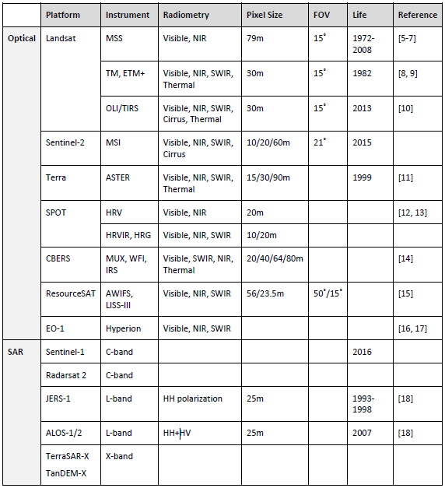
CEOS 10-100 Meter Resolution
Sensor Characteristics

Slide 18
MRI Framework:
General Metadata
Items | Threshold | Target
Coordinate Reference System | Document pixel sizes, origins and map projections in machine readable format. | Document in standardized metadata format. When practical establish common origins and map projections.
Reference grid accuracy | Document absolute accuracy of reference data. Reference grid uncertainty contribution to geometric accuracy should be minimized. | Document relationships among reference databases in operational use. Share reference databases when possible. Adopt common accuracy metric.
Geometric accuracy | Document uncertainty of each individual product and the methodologies used. | Document in standardized metadata format. Total uncertainty when combined with reference grid uncertainty should be on the order of 1/3 pixel. Adopt common accuracy metric.
Spectral bands | Document available bands in machine readable metadata | Document in standardized metadata format. Quantify benefits provided by additional bands.
Spectral response curves | Document spectral response curves in public literature | Document spectral response curves in machine readable, standardized metadata and in CEOS MIM database
Radiometric Accuracy | Document biases and uncertainty in public literature. | Document total error budget and temporal consistency for product families in metadata.
Revisit time & lifetime | Document revisit time and active lifetime in public literature. Interoperability goal to achieve 7-day cloud free revisit time. | Identify critical time periods and regions. Encourage access to historical archives. Extend interoperable time series globally to the beginning of the Landsat MSS period (1972) or earlier.
Field of View | Document Field of View. High level products need to account for different viewing geometries | Quantify radiometric uncertainty associated with off-nadir viewing angles.
Mean Local Time | Document Mean Solar Time. High level products need to account for different solar geometries. | Quantify uncertainty associated with different solar geometries between missions and through the life of the mission

Slide 19
MRI Framework:
Per-Pixel Metadata
Items | Threshold | Target
Clouds | Document cloud definition and methodology, including treatment of cirrus clouds and cloud edges. Document potential confusion with other classes, such as sand, snow and ice. | Verify and validate cloud masks. Include opacity and probability estimates. Investigate new bands needed to optimize estimates. Quantify confusion with other classes. Adopt common methodology and standards for use on multiple sensors.
Cloud Shadow | Document cloud shadow methodologies. Document potential confusion with other dark objects such as water and terrain shadow. | Verify and validate cloud shadow masks. Quantify confusion with other dark objects. Adopt common methodology and standards for use on multiple sensors.
Land/water mask | Document land/water methodology. | Verify and validate methodologies within context of their use in radiometric corrections. Adopt common methodology and standards for use on multiple sensors.
Snow & Ice masks | Document Snow & Ice detection methodology. | Verified and validated snow & Ice detection methodologies. Adopt common methodology and standards for use on multiple sensors.
DEM | The required accuracy of the DEM is dependent upon the corrections implemented, swath width and pixel size. | Share DEMs when possible both among operational agencies and with users. Requirements are highly variable.
Terrain Shadow mask | Terrain shadow masks are needed to estimate radiometric contamination associated with shadows. Known confusion such as with water and cloud shadow needs to be quantified. | Terrain shadows are particularly important for mountainous areas, wide swaths and for SAR sensors. Adopt common methodology and standards for use on multiple sensors.
Illumination and Viewing geometry | Solar angles are needed for reflectance calculations. View angles are needed for BRDF related corrections including terrain illumination corrections | Per pixel versus scene center solar angle corrections. View angle corrections.
Data Quality | No data, saturated, contaminated, terrain occlusion pixels need to be identified. | Establish standardized QA mask for different product levels. Adopt common methodology and standards for use on multiple sensors.

Slide 20
MRI Framework:
Data Measurements
Items | Threshold | Target
Measurements | Documented absolutely calibrated measurement units with or without corrections below. Validated and verified at-sensor data measurements | Validated and verified Surface reflectance data
Measurement normalisation | Normalise measurements to nadir viewing and temporally constant by spatially varying by latitude solar angle. Use consistent methodology to create multi-sensor data stream | Investigate more complete, but practical BRDF models, which will require prior knowledge of the Earth surface.
Aerosol, water vapor and Ozone corrections | Document atmospheric model corrections. Use consistent methodology to create multi-sensor data stream. | Validate and verify atmospheric models and compare results. If convergence on single model is not possible, document and accommodate differences.
SBAF compensation | Initial estimate is a linear fit between equivalent spectral bands using hyperspectral spectra. | Spectral Band Adjustment Factors (SBAF) need to compensate for different spectral response curves and are surface type dependent.

Slide 21
MRI Framework:
Geolocation
Items | Threshold | Target
Geometric Correction | Image data are precision corrected to a reference data set. | Minimize misregistration through orthorectification and precision registration to a common reference data set. Document methods & uncertainties/error throughout processing chain
Resampling | The number and type of spatial resampling will impact the radiometric signal | Minimize the number of resampling operations. Quantify impact of upsampling or downsampling on time series analysis for different applications. Document resampling type/method applied.

Slide 22
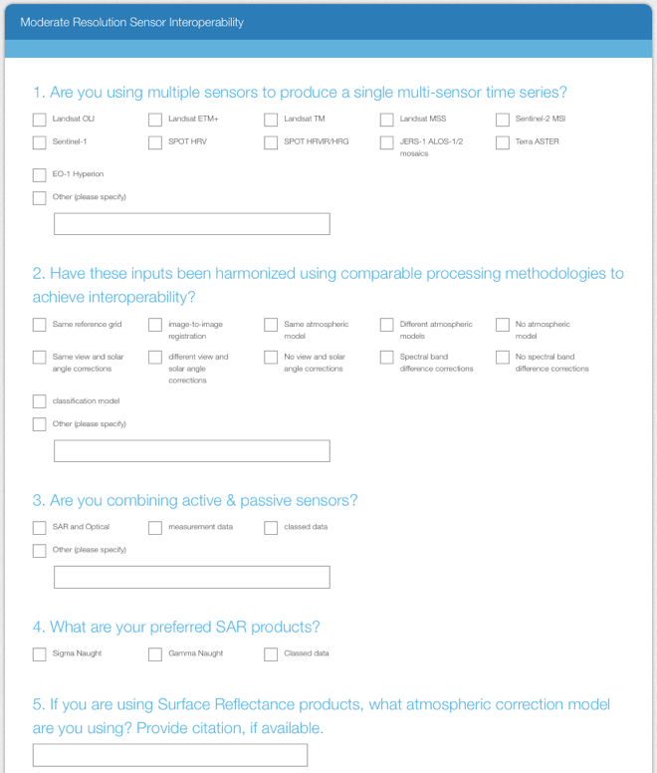
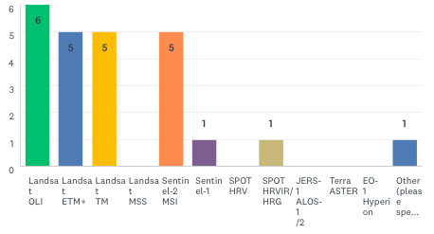
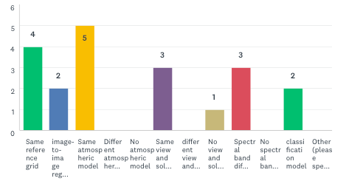
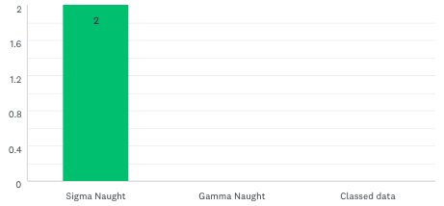
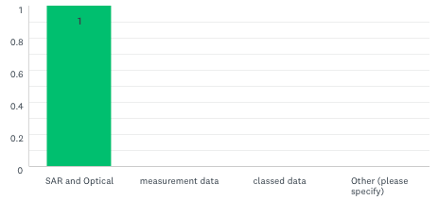
MRI Survey
MRI Survey provides the user community an opportunity to contribute lessons learned and best practices. The survey is preliminary and tested within the team.
Q1
Q2
Q3
Q4
Q5: 4 responses

Slide 23
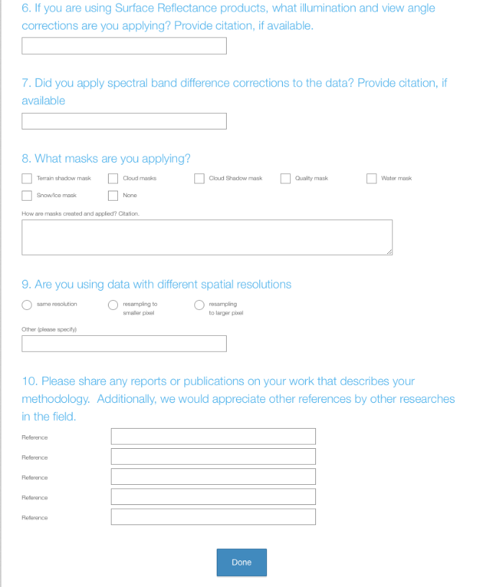
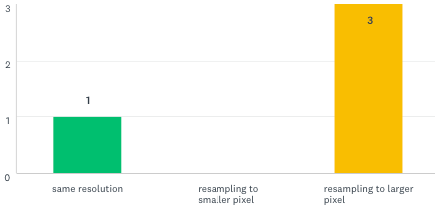
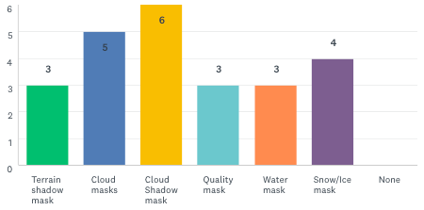
MRI Survey
Seeks to discover users exploring the use of multi-sensor data stream.
What methodologies are used to achieve interoperability?
What are the uncertainty requirements?
Q6: 4 responses
Q7: 4 responses
Q8
Q9
Q10: 1 response

Slide 24
HLS Case Study:
MRI Framework Results

Slide 25
HLS Case Study:
MRI Framework Results

