Slide 1

CEOS Workplan
FDA actions
Committee on Earth Observation Satellites
Steven Hosford
LSI-VC-5
Agenda Item #3.1
February 2018

Slide 2
Summary
CEOS Workplan
  Context
  Update cycle
Actions on Future Data Architectures
  Overview
  Framing the discussion on FDA
CARD4L FDA vs LSI actions?

Slide 3
CEOS Work Plan purpose
The 3 year CEOS Work Plan is one of CEOS’s 4 Governing documents
It records the near-term actions of all the CEOS entities in their work to achieve the goals outlined in the CEOS Strategic Guidance document
The actions captured in the WP shall be consistent with these goals and in consideration of the capacity and resources of CEOS Agencies
The actions shall be defined in agreement between the CEOS entities (actionees) and CEOS leadership (principals)
Actions considered for termination if they are
  No longer aligned with strategic goals
  No longer benefit stakeholders
  No longer feasible or affordable
Actions are considered for termination at the appropriate CEOS meeting

Slide 4
CEOS Work Plan purpose
Focus on objectives and deliverables associated with timescales and assigned responsibilities
Updated annually by the CEO under the guidance of the CEOS Chair
In consultation with:
the CEOS SIT Chair
CEOS Secretariat
CEOS Working Groups
Virtual Constellations
Ad Hoc Teams
CEOS membership at large
CEOS’s external stakeholders
Provide sound and shared basis for measuring our progress in a multiannual perspective
Shall be consistent with and mutually supporting of other CEOS guiding documents

Slide 5
CEOS Work Plan timeline
CEOS Work Plan is one of CEOS’s governing documents
Based on a 3 year period
Update annually
1st request for updates
Deadline for updates
1st draft of work plan
Finalised work plan
July
June
August
May
April
September
March
October
November
February
December
January

Slide 6
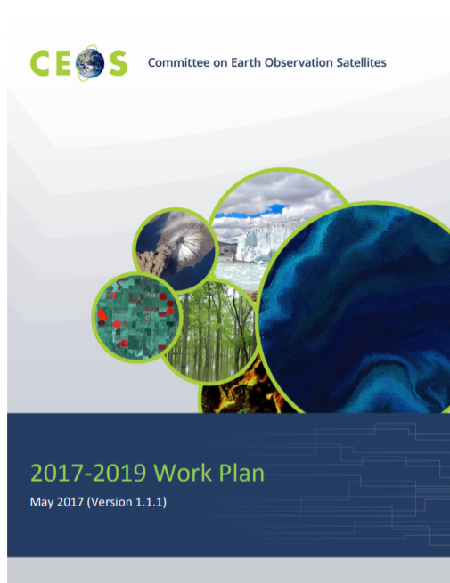
CEOS Work Plan timeline
CEOS Work Plan is one of CEOS’s governing documents
Based on a 3 year period
Update annually
1st request for updates
Deadline for updates
1st draft of work plan
Finalised work plan
July
June
August
May
CEOS Work plan is generally agreed by “virtual endorsement” during the first quarter
April
September
March
October
November
February
December
January

Slide 7
CEOS 2017-2019 Work Plan
Eighty-seven (87) Objectives/Deliverables for 2017-2019
Main outcomes are described for the following thematic areas:
  Climate Monitoring, Research, and Services
  Carbon Observations, Including Forested Regions
  Observations for Agriculture
  Observations for Disasters
  Observations for Water
  Future Data Architectures
  Capacity Building
  Data Access, Availability and Quality
  Advancement of the CEOS Virtual Constellations
  Support to Other Key Stakeholder Initiatives
  Outreach to Key Stakeholders
  Organizational Issues

Slide 8
Actions on Future Data Architectures

Slide 9
Actions on
Future Data Architectures
Committee on Earth Observation Satellites

Slide 10
FDA Themes and Outcomes
(plenary slide)
CEOS Analysis Ready Data (ARD)
  Develop and provision CARD4L-compliant optical and/or SAR products
  Examine ARD for ocean and atmosphere domains
Interoperable Free and Open Tools
  Continue supporting the CEOS Data Cube (CDC) initiative
  Demonstrate new technologies through ongoing support of ‘pilot projects’ and consideration of alternate candidate architectures
Data, Processing, and Architecture Interface Standards
  Develop standards for pixel-level data discovery, access, and common analytical processing requests (e.g., cloud free mosaics of ARD) exploiting EO satellite data among various CEOS exploitation platforms
Analytical Processing Capabilities
  Prototype portable web-based analytical processing APIs/Web Services that work across CEOS exploitation platforms in full computing environments for time series and other analysis
User Metrics
  Develop a data use metrics framework through which agencies can contribute to how EO data is being used, rather than just downloaded data quantities

Slide 11
CEOS Work Plan 2018-2020 Proposed FDA actions
Context - framing the discussion on FDAs
FDA-x: Establish a common description of Future Data Architecture functional blocks and identify interfaces and interoperability approaches
FDA-5: Promote awareness of FDAs
FDA-x: Inventory and characterise existing FDAs operated by both public and private entities including the standards and approaches they use (e.g. Data Cubes, Exploitation Platforms, Copernicus DIAS, etc).
CARD4L
FDA-7: Product Specifications in accordance with the CARD4L Framework
FDA-X: TBD

Slide 12
CEOS Work Plan 2018-2020 Proposed FDA actions
Interoperable Free and Open Tools
FDA-x: Finalise inventory of Software and Tools available or used at CEOS agencies for EO purposes focusing on Open Source but remaining as broad and inclusive as possible and implement a mechanism for discovery and access.
Data, Processing, and Architecture Interface Standards
FDA-x: Organise several sessions/workshops to share lessons learned and outcomes from FDA systems and platform pilots and Interoperability Projects.
FDA-x: Review and update CEOS WGISS Best Practices to address data via user-defined polygons.
FDA-x: Inventory current EO space data products formats at CEOS agencies and develop recommendations on the way forward to facilitate interoperability

Slide 13
CEOS Work Plan 2018-2020 Proposed FDA actions
Analytical Processing Capabilities
FDA-x: Develop a White Paper on Single Sign-On (SSO) authentication.
User Metrics
FDA-x: Develop a User Metrics Best Practice.

Slide 14
CEOS Work Plan 2018-2020 Proposed FDA actions
FDA-x: Establish a common description of Future Data Architecture functional blocks and identify interfaces and interoperability approaches

Slide 15
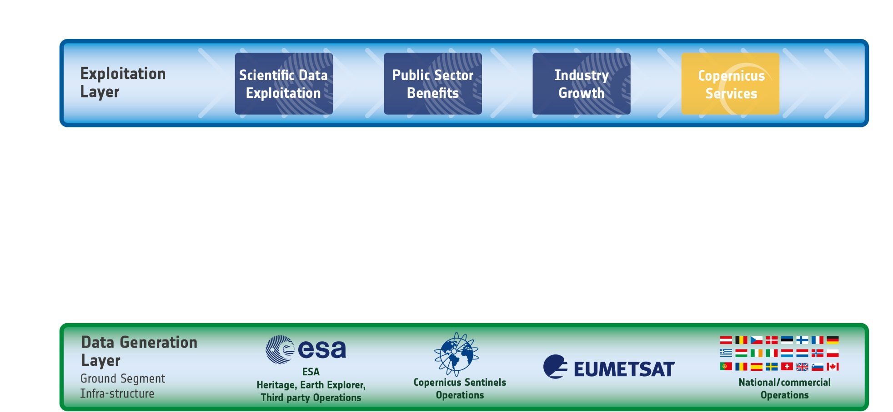










Future Data Architecture functional blocks
The EO Ecosystem: the past
… Mission Ground Segments make data available for download
… Users process the data on their own infrastructures

Slide 16
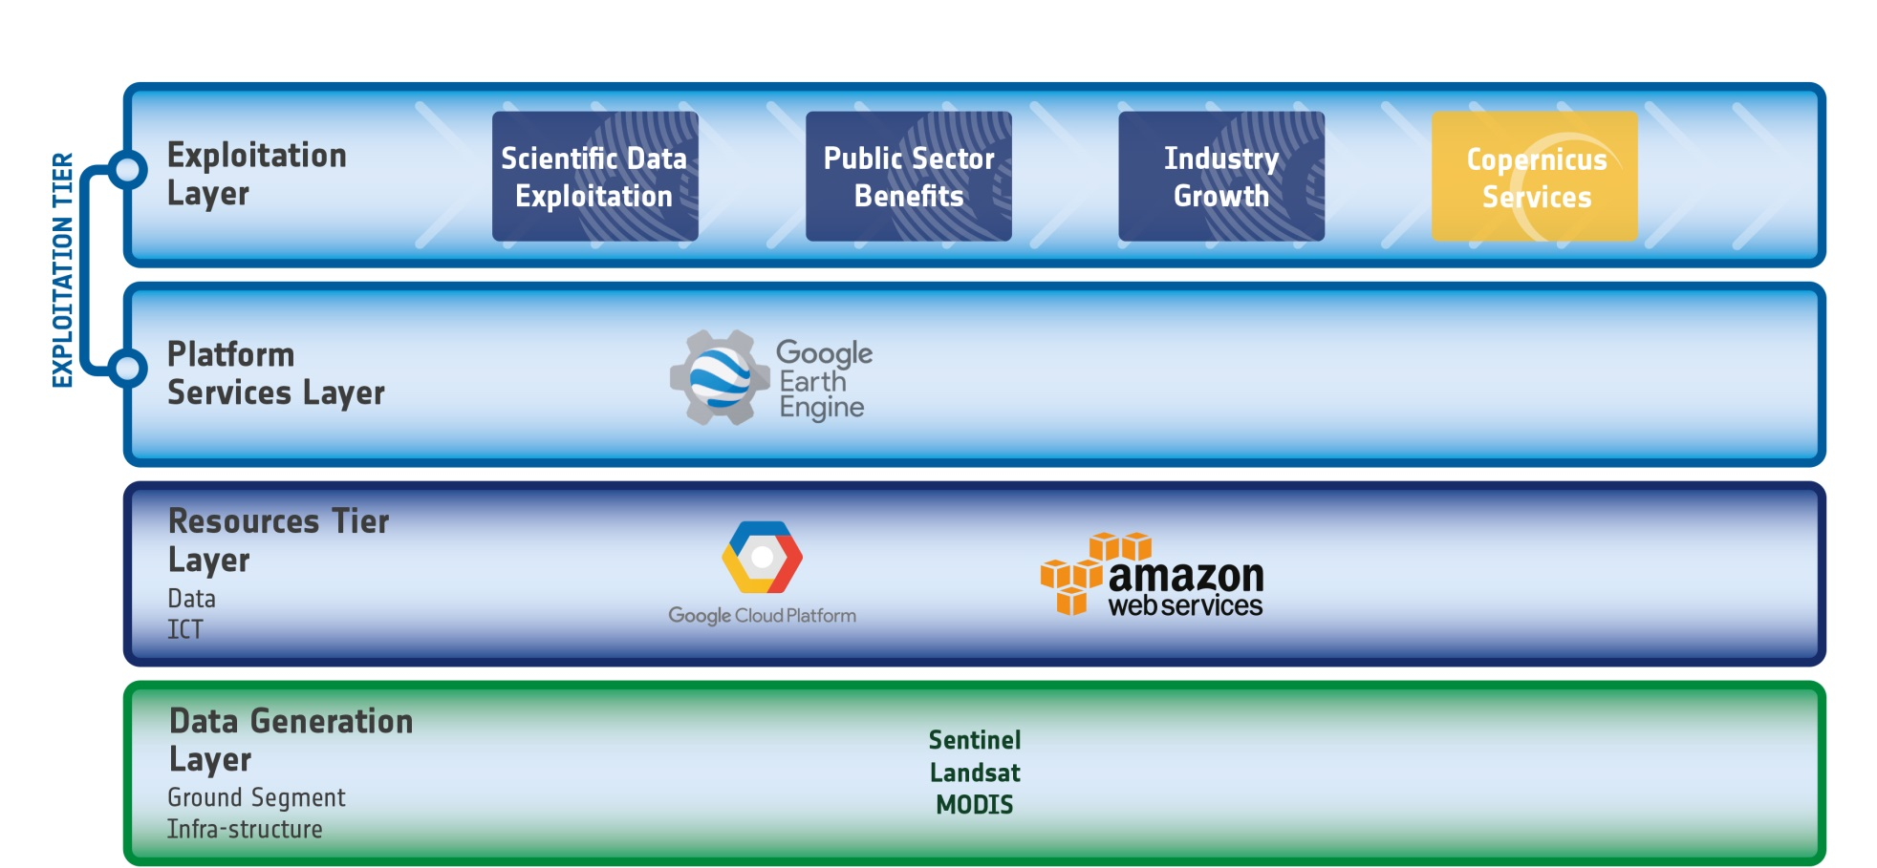
Future Data Architecture functional blocks
The EO Ecosystem: IT industry starts investing
… Google and Amazon start hosting US public missions and later Sentinel Data
with Google providing a first cross-mission analysis environment

Slide 17
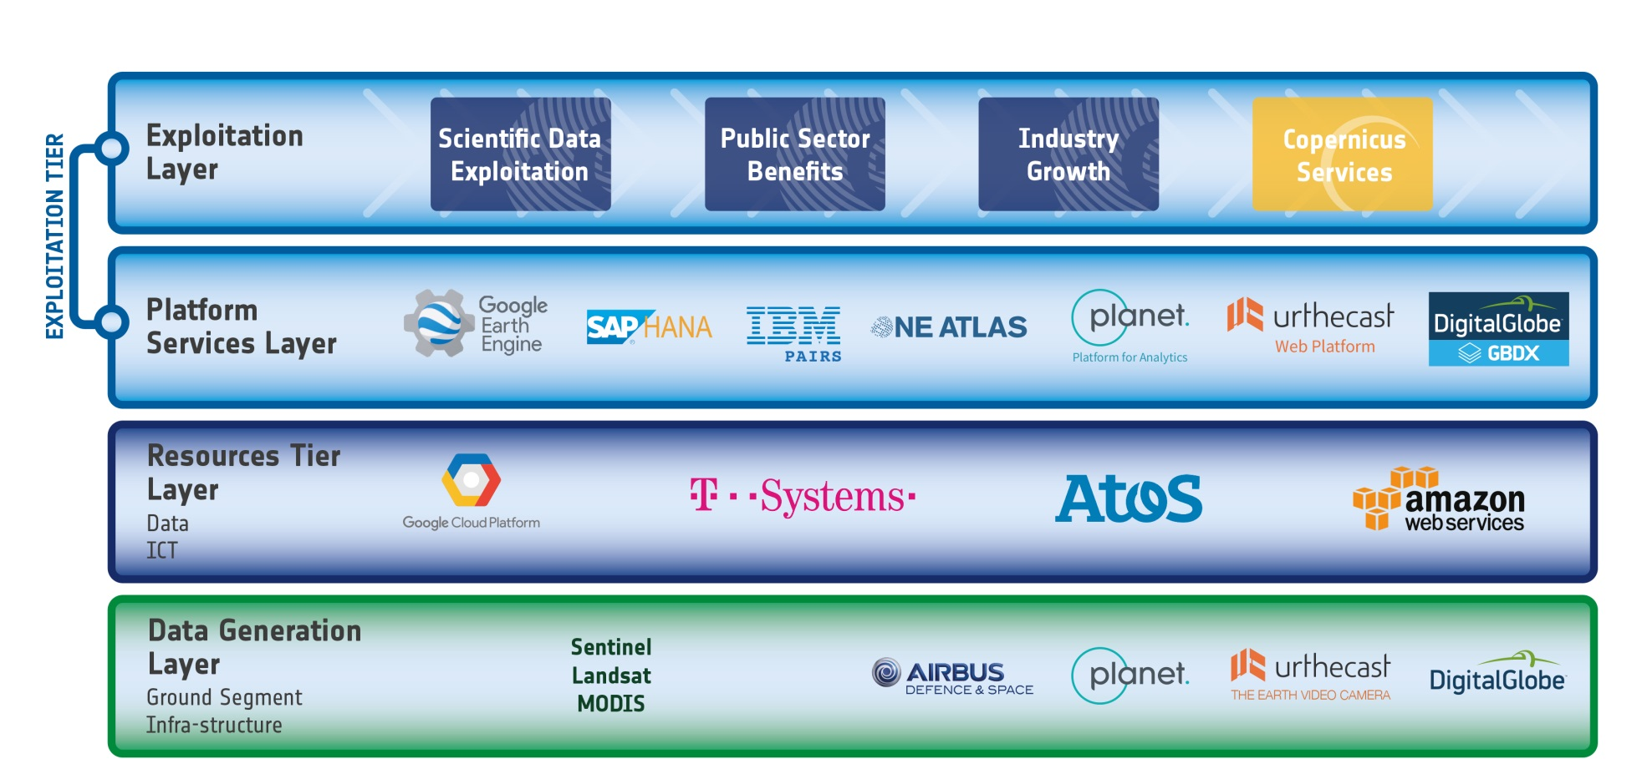



Future Data Architecture functional blocks
The EO Ecosystem: Established EO sector reacts …
… and start using the new capabilities, with principally US and European actors addressing the EO market offering new Data Analytics capabilities

Slide 18
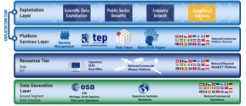

Future Data Architecture functional blocks
ICT/Data Resources Layer
This layer includes the data hosting infrastructures, i.e. the resources to enable scientific, public or commercial value-adding on the data.
Advantages:
Large quantities of data hosted in one place – available for processing
Mutualise storage, avoiding strain on local storage and transfer bandwidth
Data
Processing power
ICT/Data Resources Layer
Data Generation Layer
Data Generation Layer
This layer includes the “traditional” Mission Ground Segment that delivers quality assured and traceable Mission data products. It also includes EO data management activities.

Slide 19
Future Data Architecture functional blocks
Exploitation Layer
This is the knowledge layer including the domain and application specific knowledge and experience that value-adders use to define the processing chains and algorithms required to extract actable information.
Exploitation Layer
Platform Services
Platform Services Layer
This layer includes higher-level data analytics platform services such as Thematic Platforms, Data Cube, Open Earth Engine. These EO specific and domain specific data manipulation environments provide tools to prototype information extraction processing chains and can then deploy them operationally against the data holdings in the lower tiers

