Slide 1
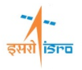
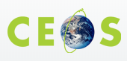
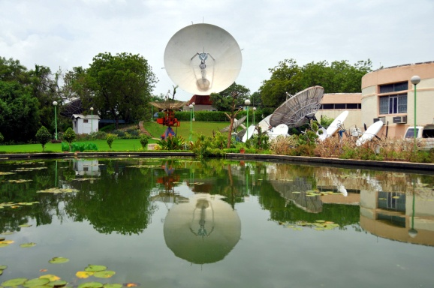
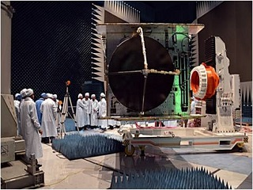
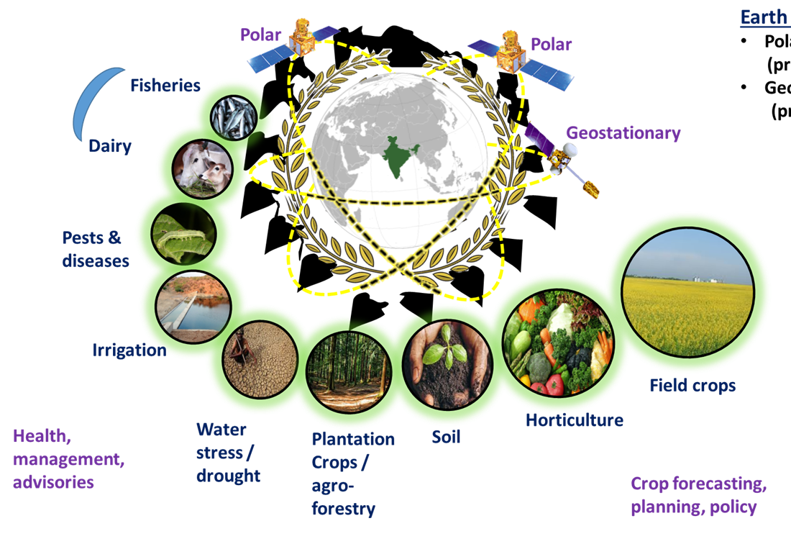
LSI – VC 5th meeting during 21 -23 Feb., 2018 in Tokyo, Japan
Land Products and Applications by ISRO
Bimal K. Bhattacharya
Head, Agriculture and Land Ecosystem Division (AED)
Biological and Planetary Sciences and Applications Group (BPSG)
Earth and Planetary Sciences and Applications Area (EPSA)
Space Applications Centre, ISRO, Ahmedabad 380015, Gujarat, India
Ahmedabad Earth Station
Satellite Payload Development
Payload definition and development, application research
Remote Sensing
Communication
Navigation
Other centres
NRSC, Hyderabad
Data reception, dissemination
Airborne survey, disaster
Geospatial applications
IIRS, Dehradun
Training & Academic outreach

Slide 2
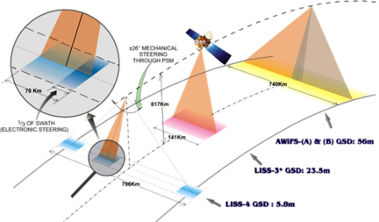
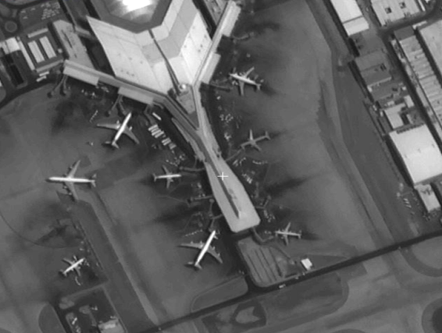
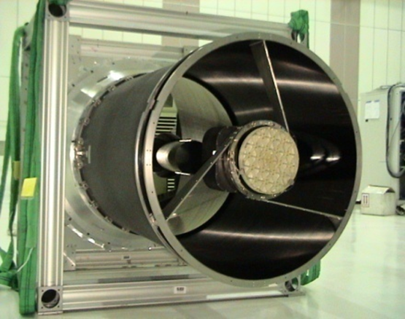
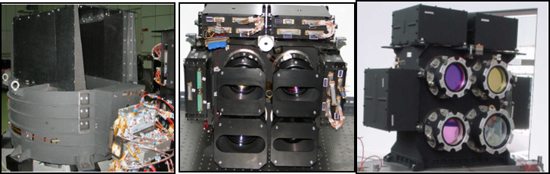
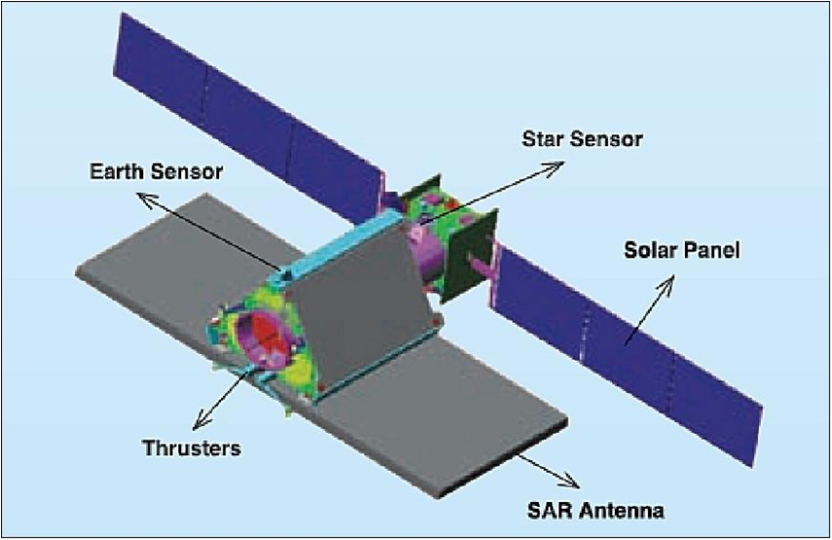
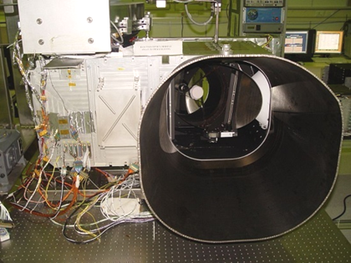
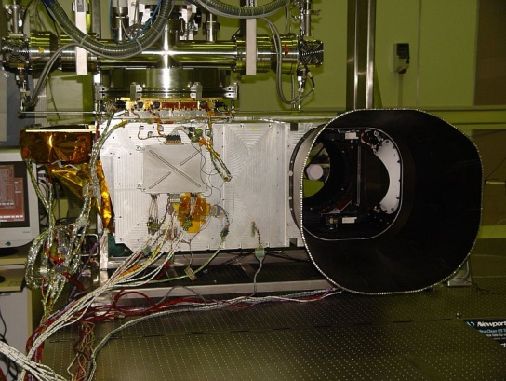
Electro-Optical (EO) and Microwave payloads for Earth Observations
Land resources
Cartography
Resourcesat series
Three tier imaging
Cartosat series
Sub meter resolution
Synthetic Aperture Radar (SAR)
Meteorology
RISAT-1 C-band
7 channel Imager
19 channel sounder
INSAT-3D series

Slide 3
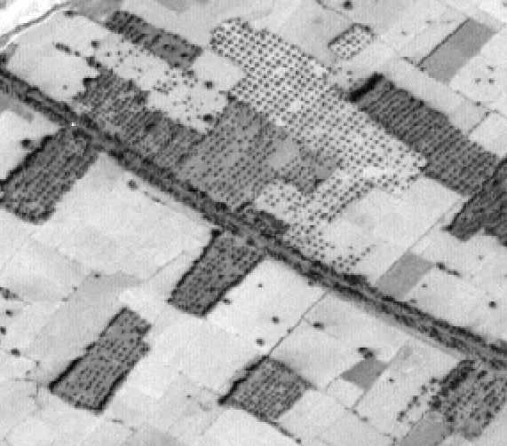
Examples of Three-tier Observations from Resourcesat satellites
False Color Composites from multi-spectral bands
(Green, Red, Near-infrared)
Advanced Wide Field Sensor
AWiFS: 56m (5 day)
Linear Imaging Self-scanner
LISS-III: 24m (24 day)
Cartosat - 1
LISS-IV: 5.8 m

Slide 4
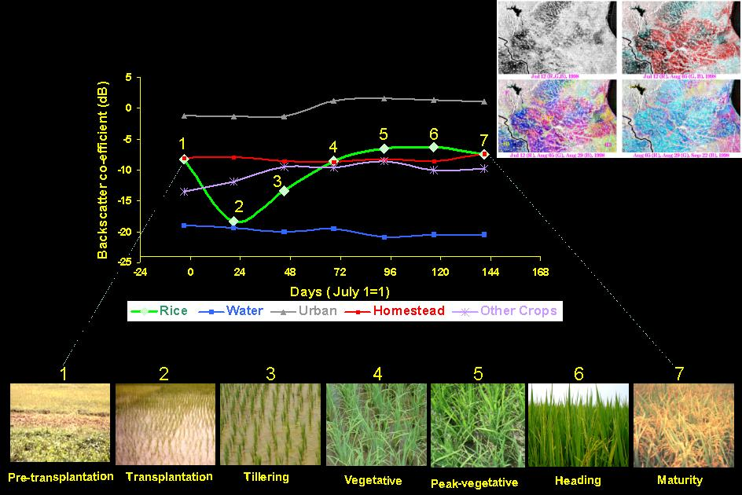
Backscatter signature of Synthetic Aperture Radar

Slide 5
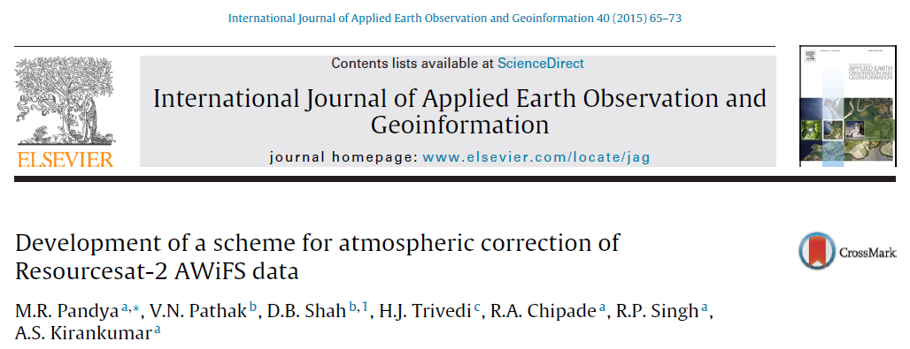
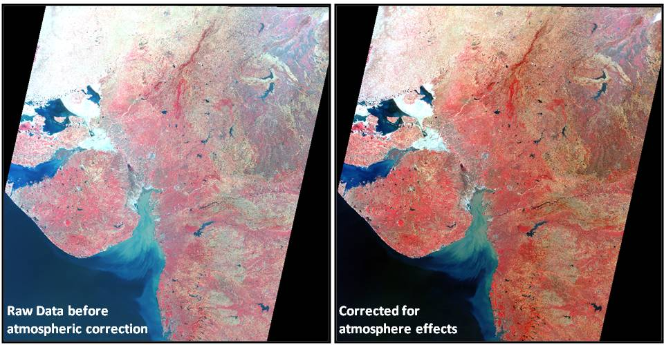
Scheme for Atmospheric Correction of Resourcesat-2 AWiFS data (SACRS2)

Slide 6
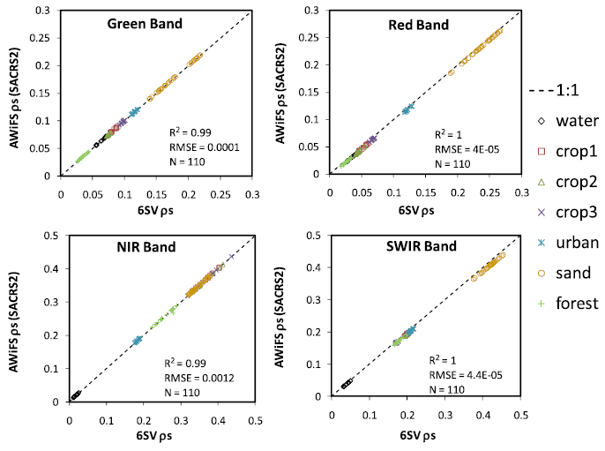
Validation of SACRS2-derived reflectance with 6S-derived and in-situ reflectance
Validation of SACRS2 reflectance with the in-situ measurements
over Bareja, Kutchh, Hoshangabad sites.
Comparison of surface reflectances (ρs) in four spectral bands derived using the SACRS2 scheme and 6SV model for the RS2 AWiFS data over various land covers.

Slide 7
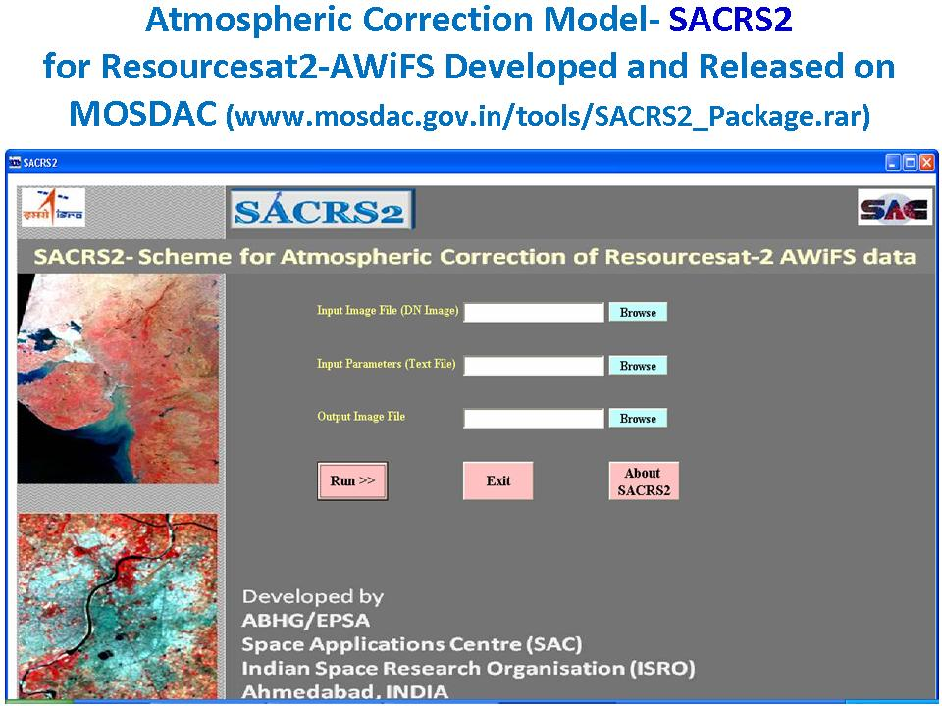
Software package developed: SACRS2-AWiFS

Slide 8
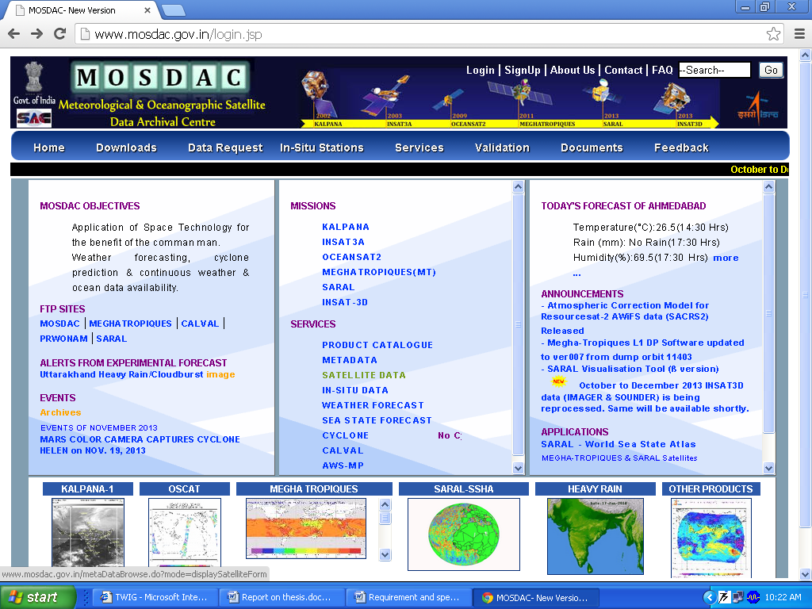
SACRS2 Model Released on MOSDAC site
SACRS2 software released on MOSDAC site

Slide 9
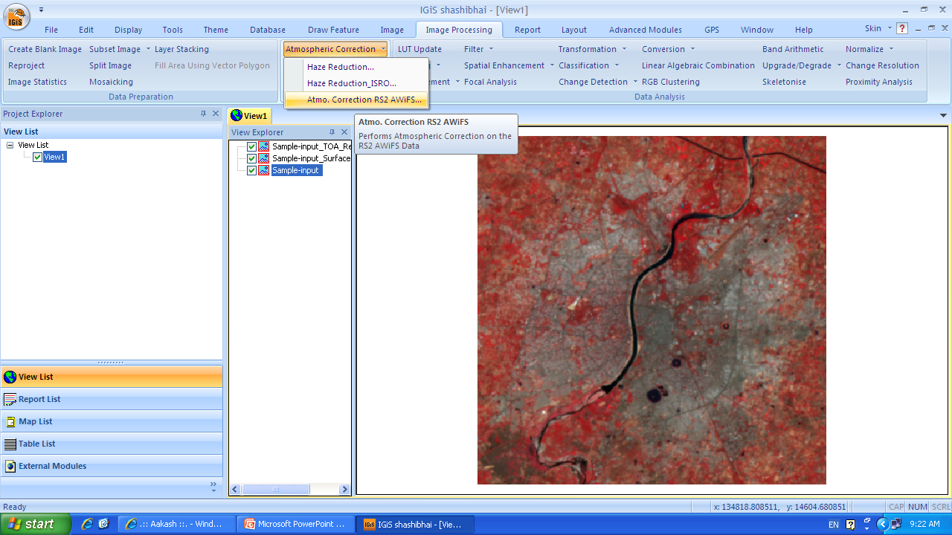
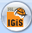
SACRS2 module included in IGIS V2 software

Slide 10
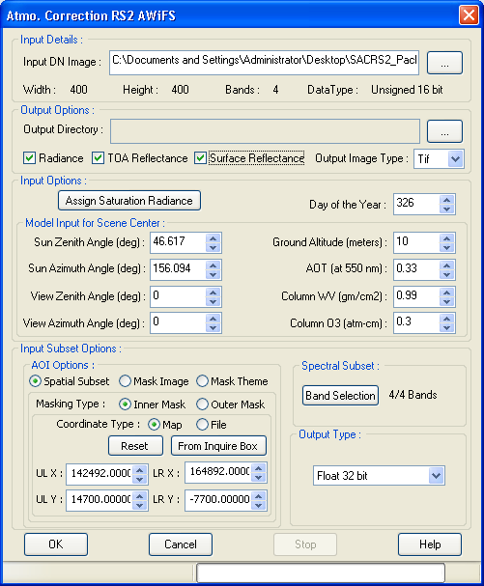
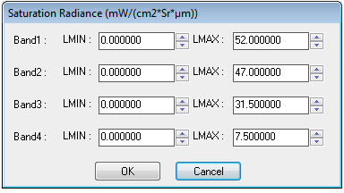
Model takes raw Digital Number file of RS2-AWiFS as input and provides radiance, TOA reflectance and Surface Reflectance as outputs based upon atmospheric and viewing geometry parameters
SACRS2 module included in IGIS V2

Slide 11
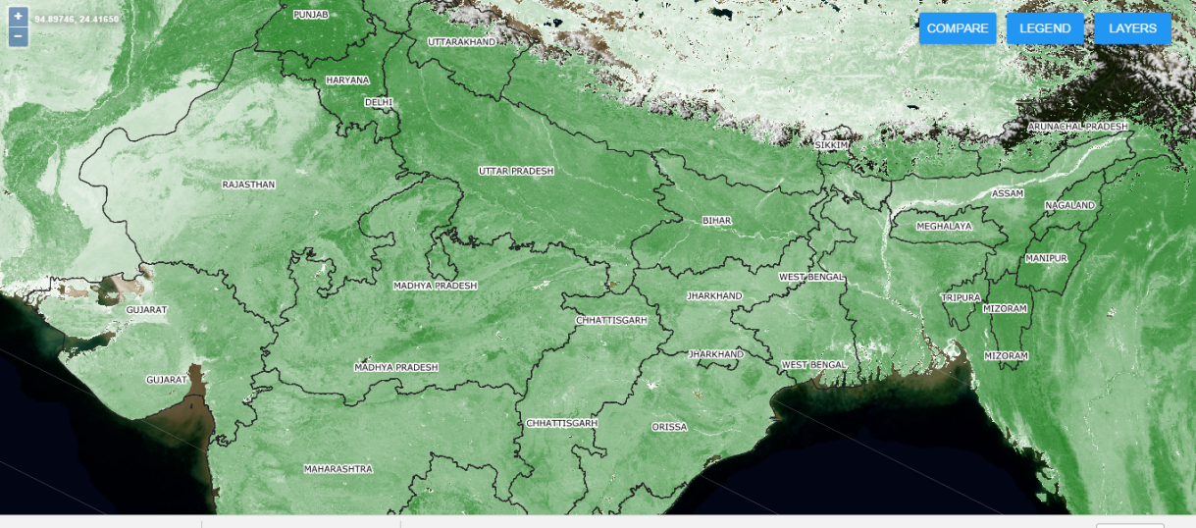
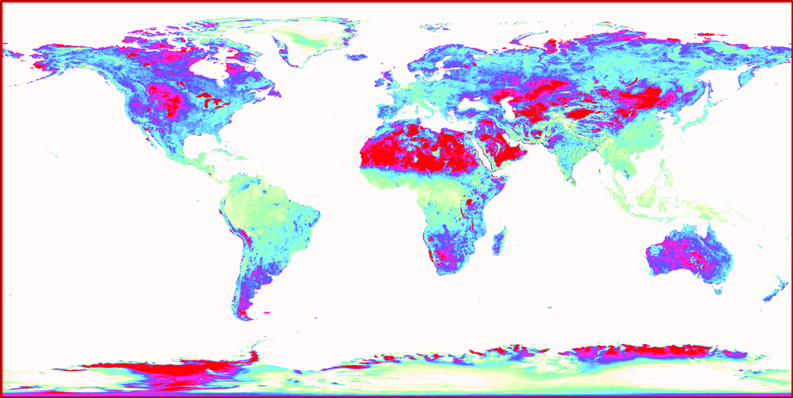
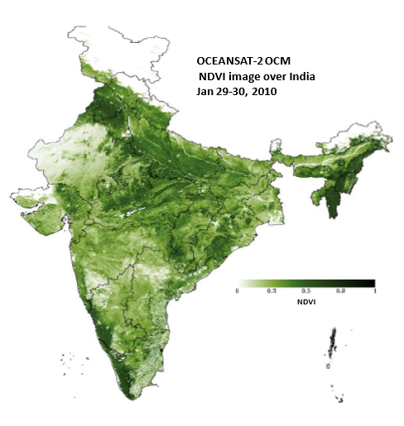
Some Ocean monitoring sensors useful for Land studies
Oceansat-2 Ocean Color Monitor
Ku band scatterometer back scattering coefficient (sigma-0) in Vertical polarization data from SCATSAT1 over the globe
NDVI product from
Oceansat-2 Ocean Color Monitor during January
Ocean monitoring satellites have global coverage
It has 1-2 day repeativity, but have moderate to coarser resolution
Useful for quick assessment and modelling

Slide 12
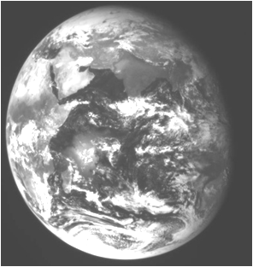
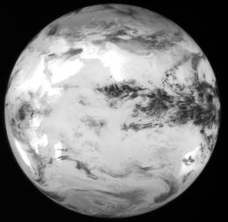
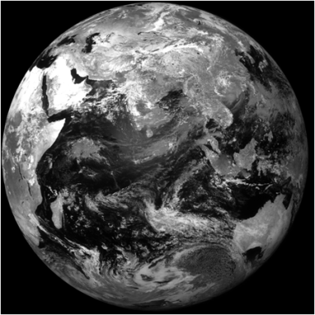
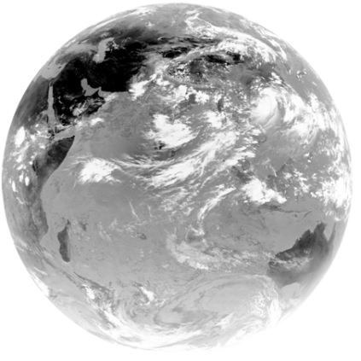
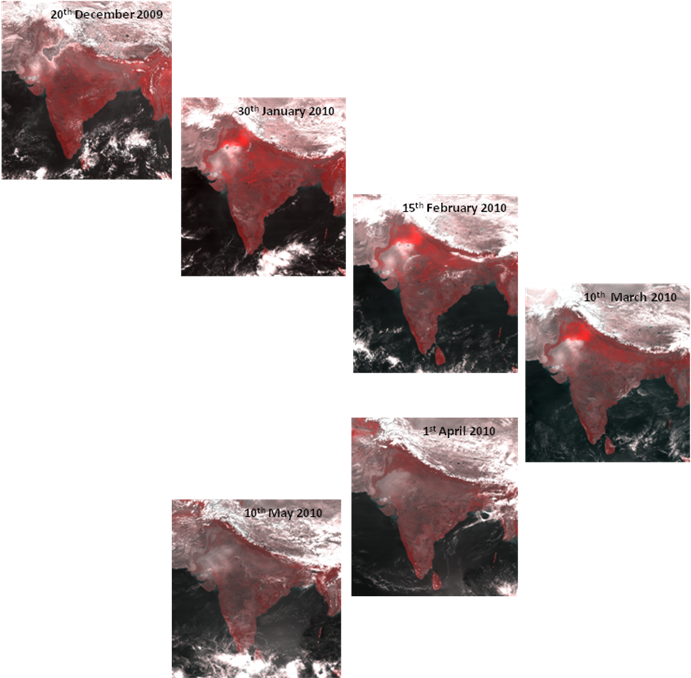
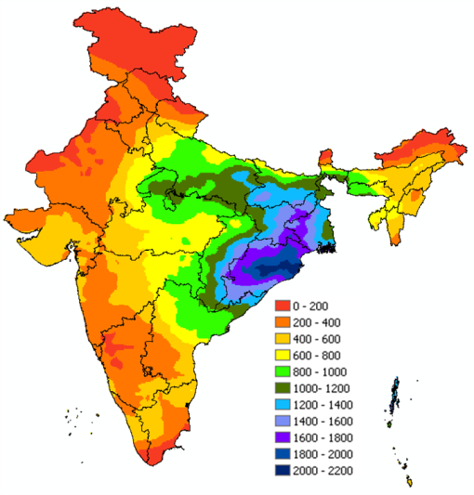
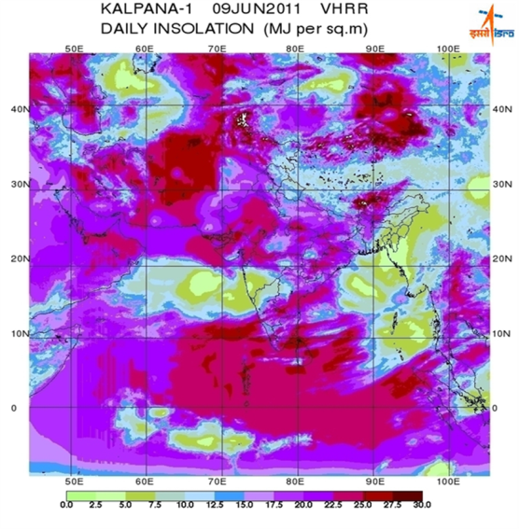
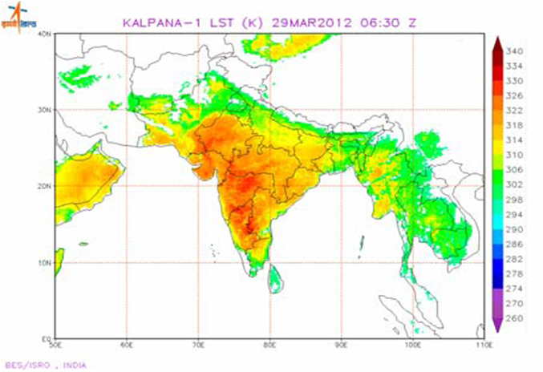
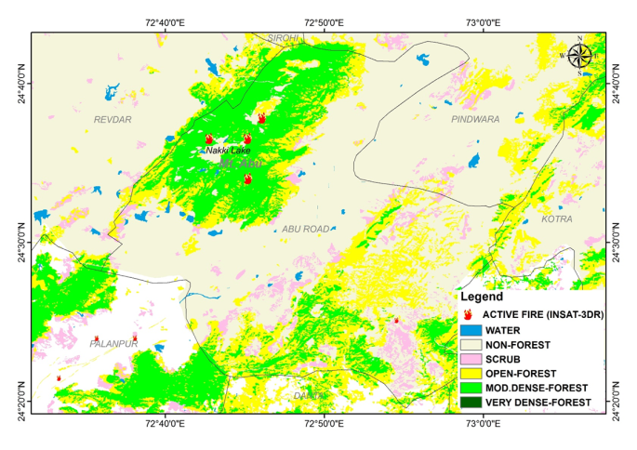
Operational Weather products from Meteorological satellites (INSAT)
Coarser (8 km)
4 km
Finer (1 km)
Radiometer (Kalpana - 1)
Multi-spectral
(CCD : INSAT 3A)
Imager (INSAT 3D)
Meteorology
Vegetation & snow
Optical band
Thermal band
SWIR band
MIR band
Geophysical / biophysical products (Rainfall, LST, insolation, forest fire)
at MOSDAC (www.mosdac.gov.in) from Kalpana-1, INSAT 3A, INSAT 3D & 3DR
Forest Fire
Rainfall
Daily Solar radiation
Land surface temperature (LST)

Slide 13
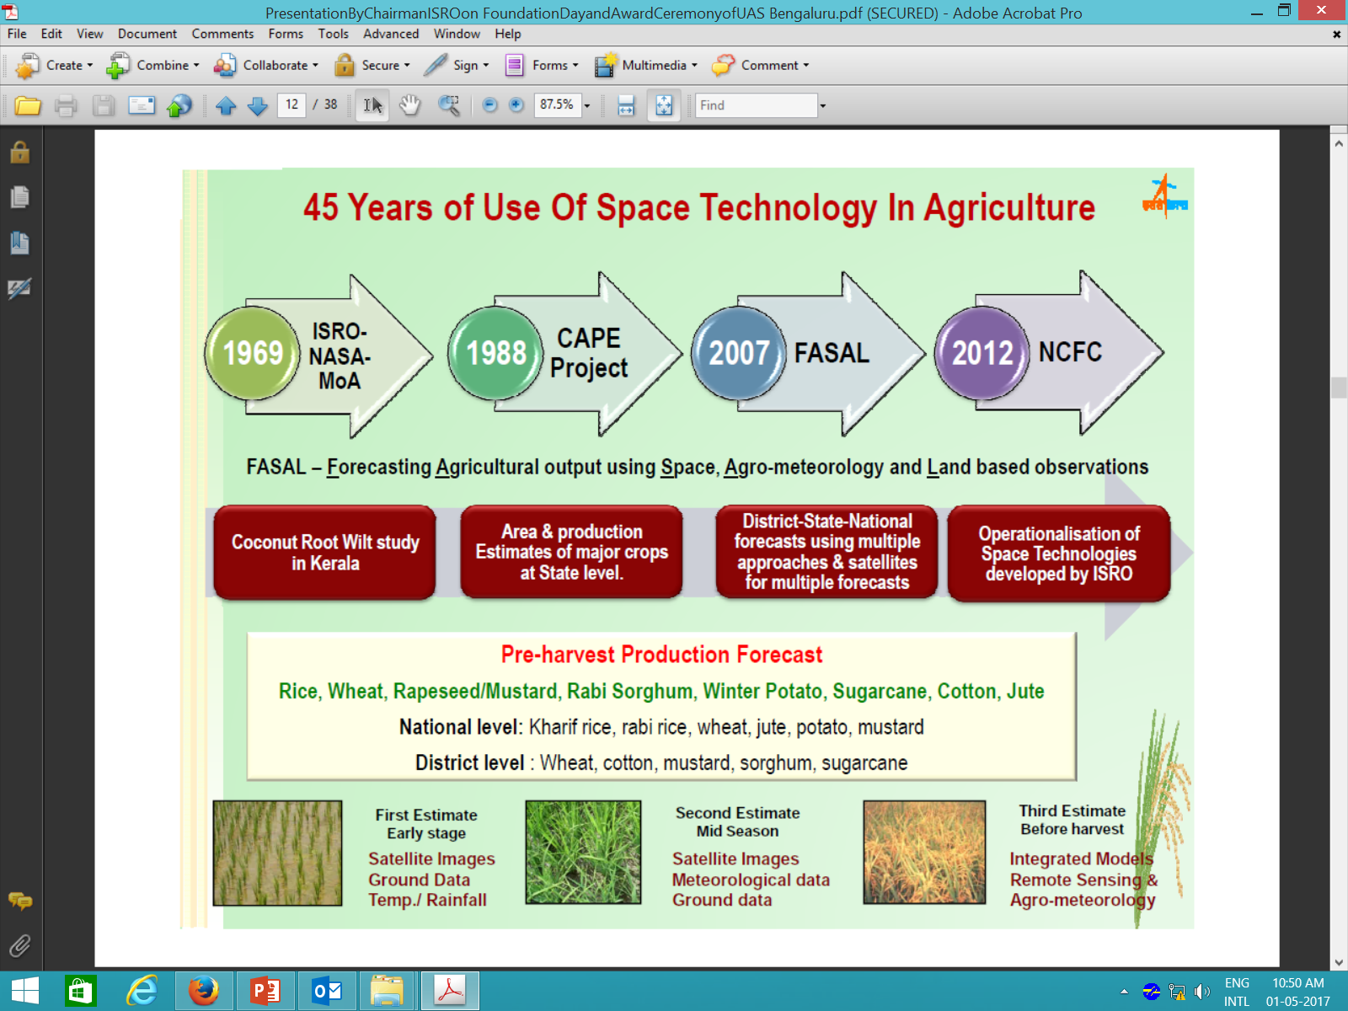

Slide 14
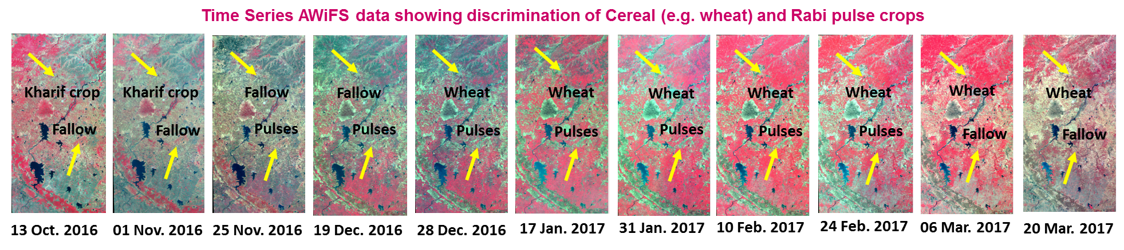
Examples of crop inventory

Slide 15
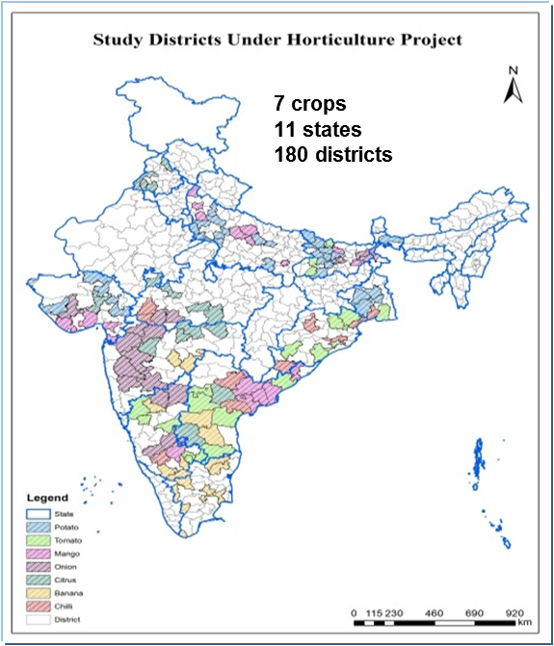
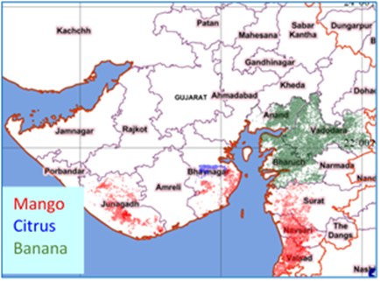
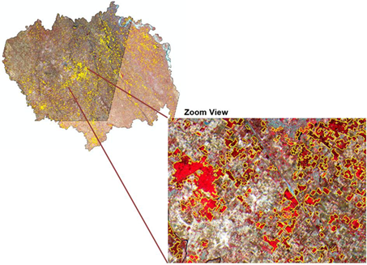
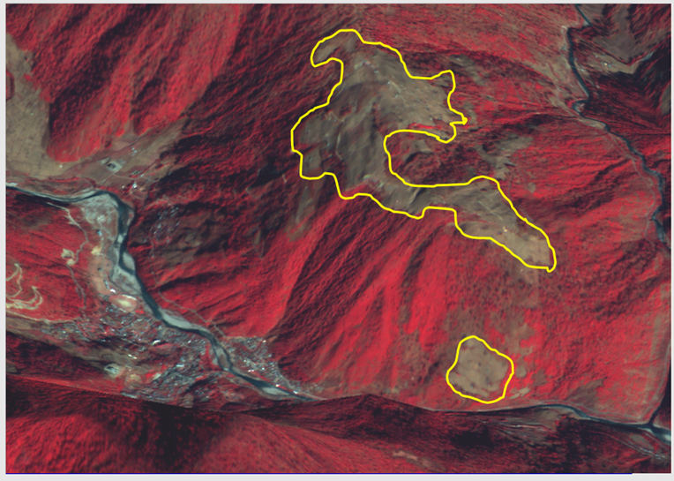
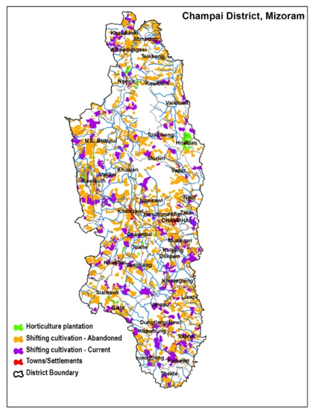
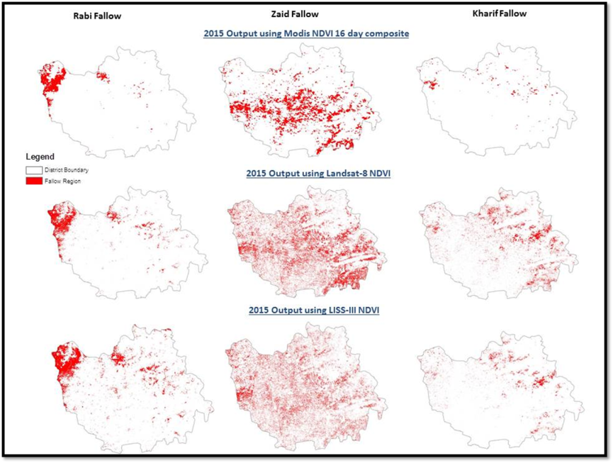
Horticultural crop inventory and Geo-spatial Applications
Primarily with LISS-III & LISS-IV
Geospatial support for site suitability in zoom land of north-east
Agricultural fallow and prospect of horticultual intensification
Bhiwani District,
Haryana

Slide 16
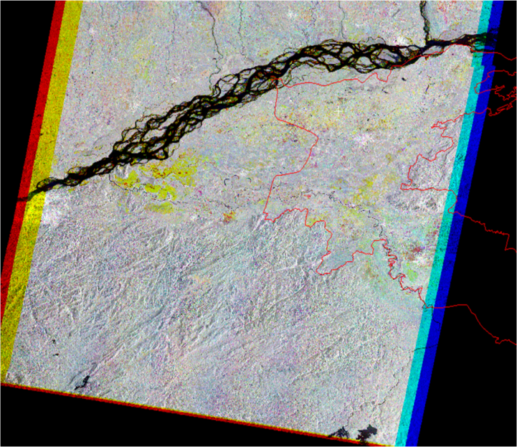
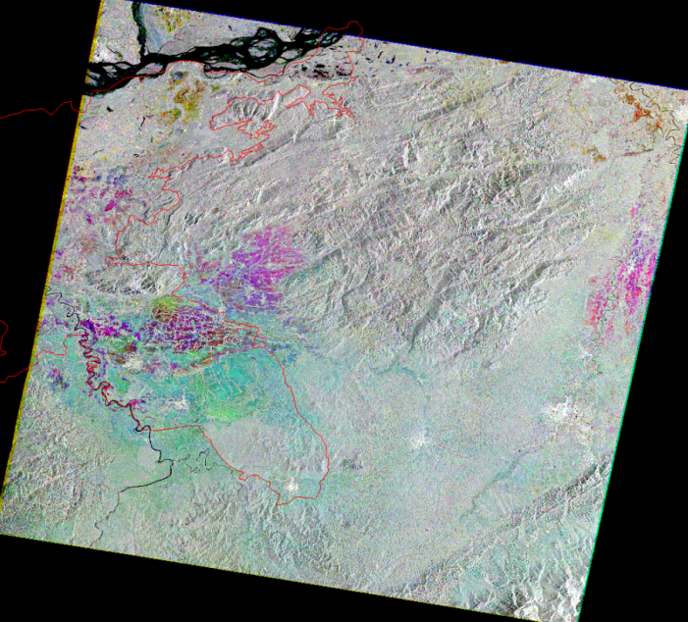
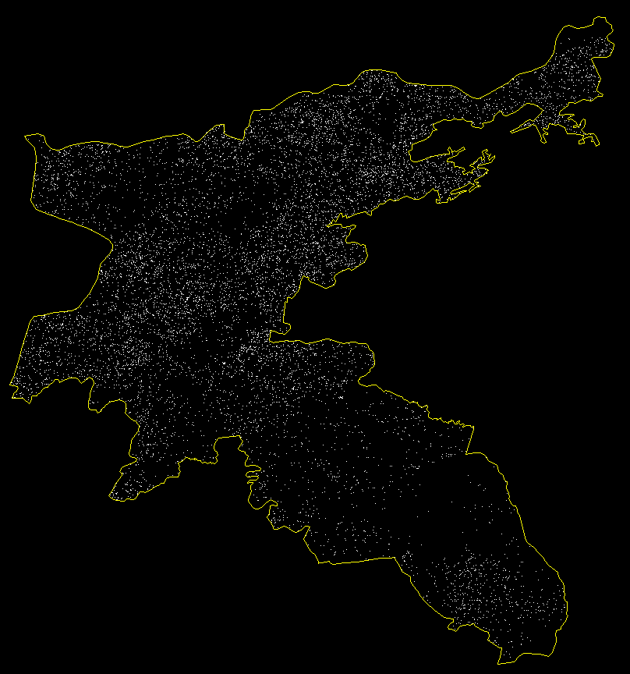
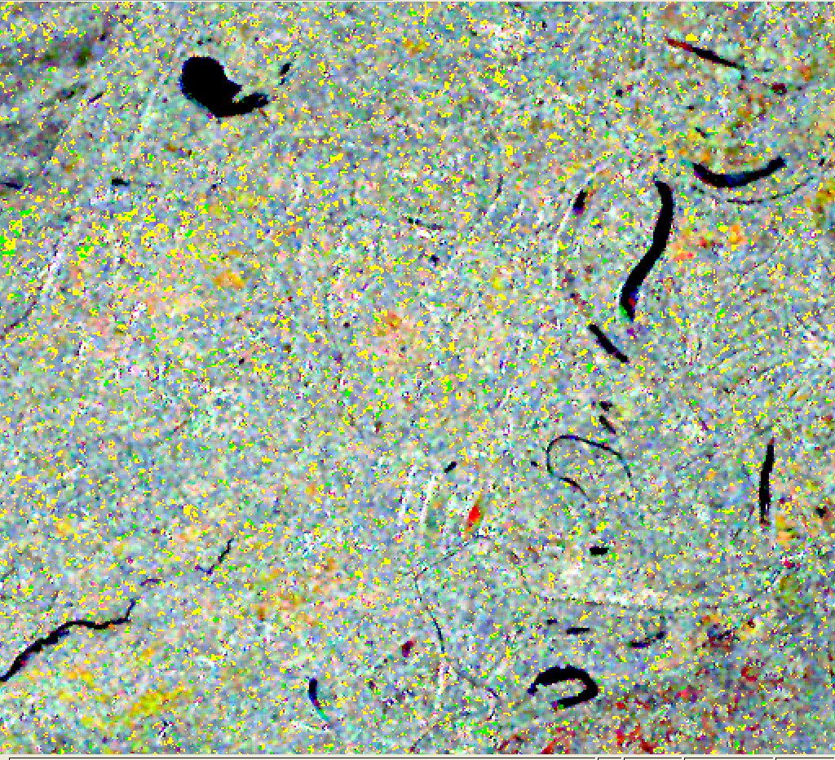
Jute growing areas from RISAT-1 Synthetic Aperture Radar data
Three-date FCC of
9 May, 3 June, 28 June 2016
of MRS RISAT-1
Three-date FCC of
27 April, 22 May,16 June, 2016
of MRS RISAT-1
Jute growing areas in Nagaon district, Assam

Slide 17
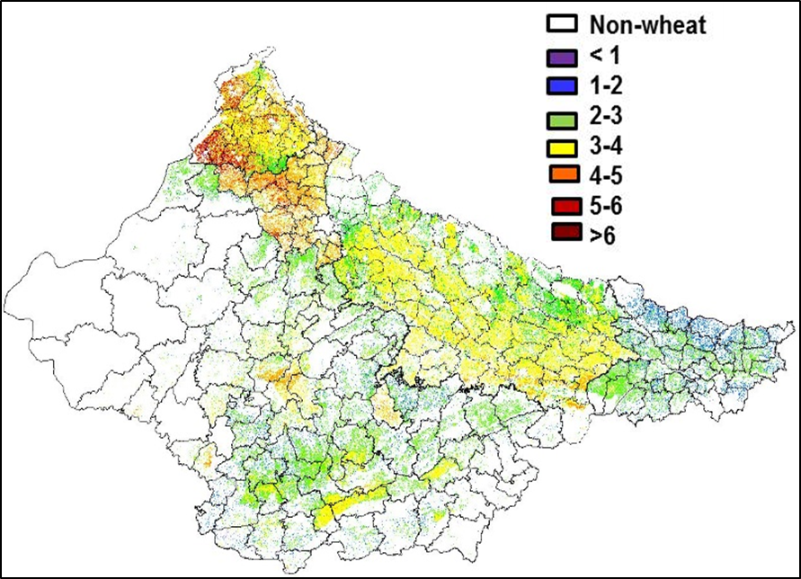
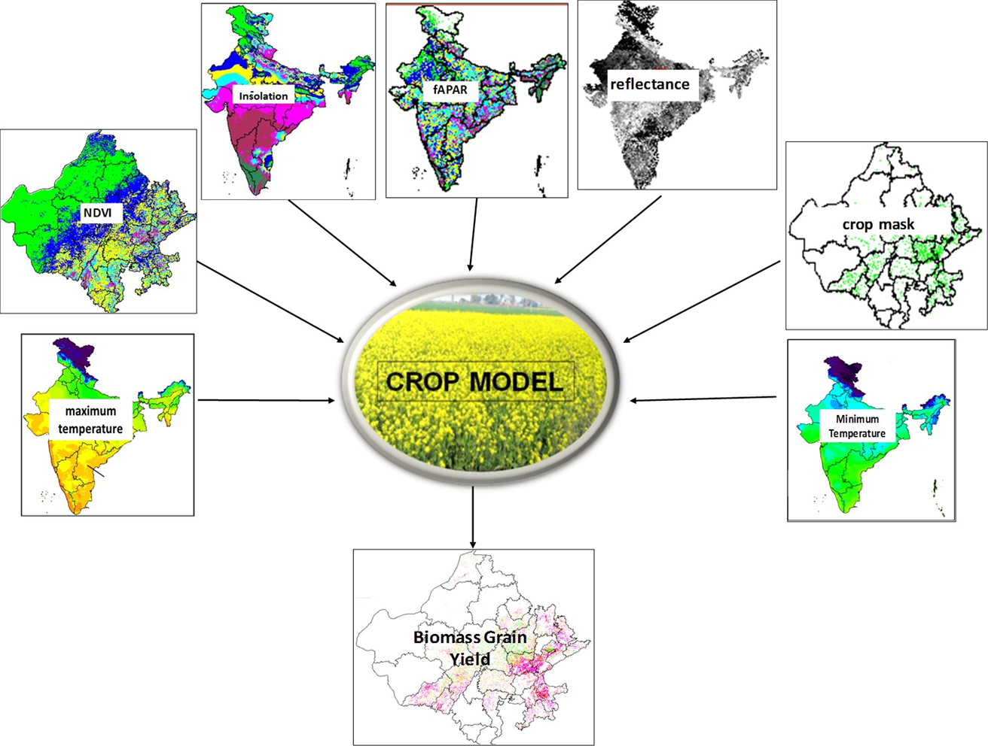
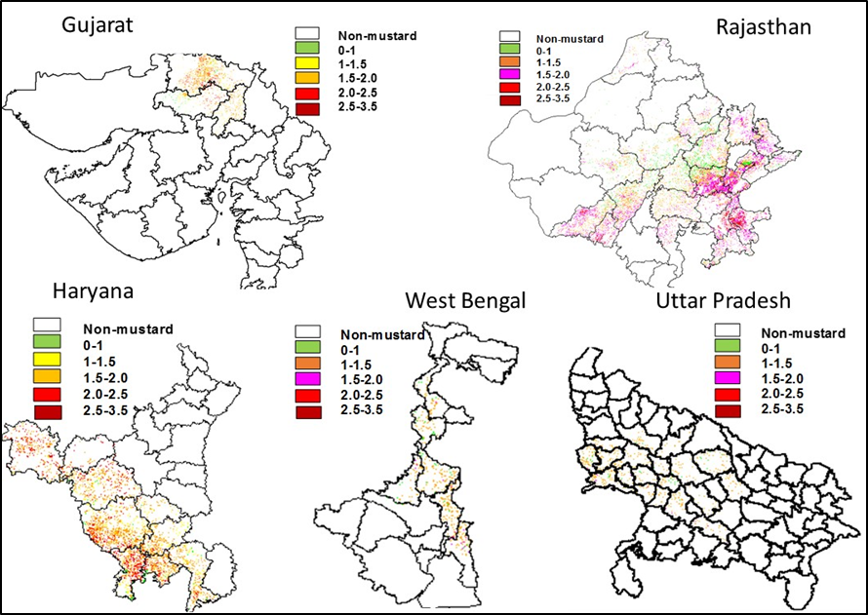
Crop yield modelling using LEO-GEO satellite data
Modelling framework
Wheat yield (tha⁻¹)
Mustard yield (tha⁻¹)

Slide 18








Satellite-based Value-added Agro-met Products for farmers advisories
Sowing suitability based on crop vigour and surface soil moisture
4th Week, June
3rd Week, July
1st Week, July
4th Week, July
2nd Week, July
Kharif Sowing Suitability from
Space based observations

Slide 19


Forest dynamics and carbon sequestration
East coast delta of India
Alpine tree-line shift

Slide 20




Climate and Agro-ecosystem Interaction : Process Studies through Fluxes
NEE of CO₂

Slide 21

High-resolution ET modelling using thermal remote sensing and surface energy balance
Using Landsat 8 data

Slide 22







ISRO – JPL AVIRIS-NG Airborne Hyperspectral Campaign over India : Phase – I results
Airborne hyperspectral campaign with AVIRIS-NG instrument was carried out over 57 sites in India during December 2015 – March 2016 (Phase – I) covering seven science themes : Agriculture & ecosystem, Geology, Urban, Coastal –Ocean, River and Inland Water, Snow & Glacier, Atmosphere
Both airborne L1 and L2, ground-truth data have been archived in VEDAS and being disseminated to Indian researchers. Hands-on training has also been provided to academia.

Slide 23




Future ISRO EO missions
OCEANSAT-3/ 3A/3B Global missions with 13 channel OCM, Ku-band Scatterometer, Hyperspectral sesnor are also in pipeline

Slide 24

International and Global missions during 2021 - 2023
Indo – French : ISRO-CNES thermal infrared mission
TRISHNA : Thermal InfRed Imaging Satellite for High-resolution Natural resource Assessment
Five-channel VNIR suite 3-day revisit, 60m spatial resolution
Single-channel SWIR
Four-channel thermal Infrared
Major science objective : Terrestrial Ecosystem Stress and Water use

Slide 25



Towards Global Initiatives
Kharif rice:Bangladesh using C band SAR data
Queries
How ISRO can revive the role in Geo-GLAM ?
How framework of Analysis-Ready-Data (ARD) can be implemented with Resourcesat series and other future sensors ?
How ISRO can become part of GFOI ?
2009
SAR FCC (July, Aug, Sep 2010)
2010
Rabi crops: Pakistan using multi date AWiFS data

