Slide 1

Multi-Mission Coverage Analysis
A COVE coverage analysis supporting the need and potential for satellite data interoperability
LSI-VC Meeting
February 21, 2018 (12:30)
Tokyo, Japan
Brian Killough
CEOS Systems Engineering Office
NASA Langley Research Center

Slide 2
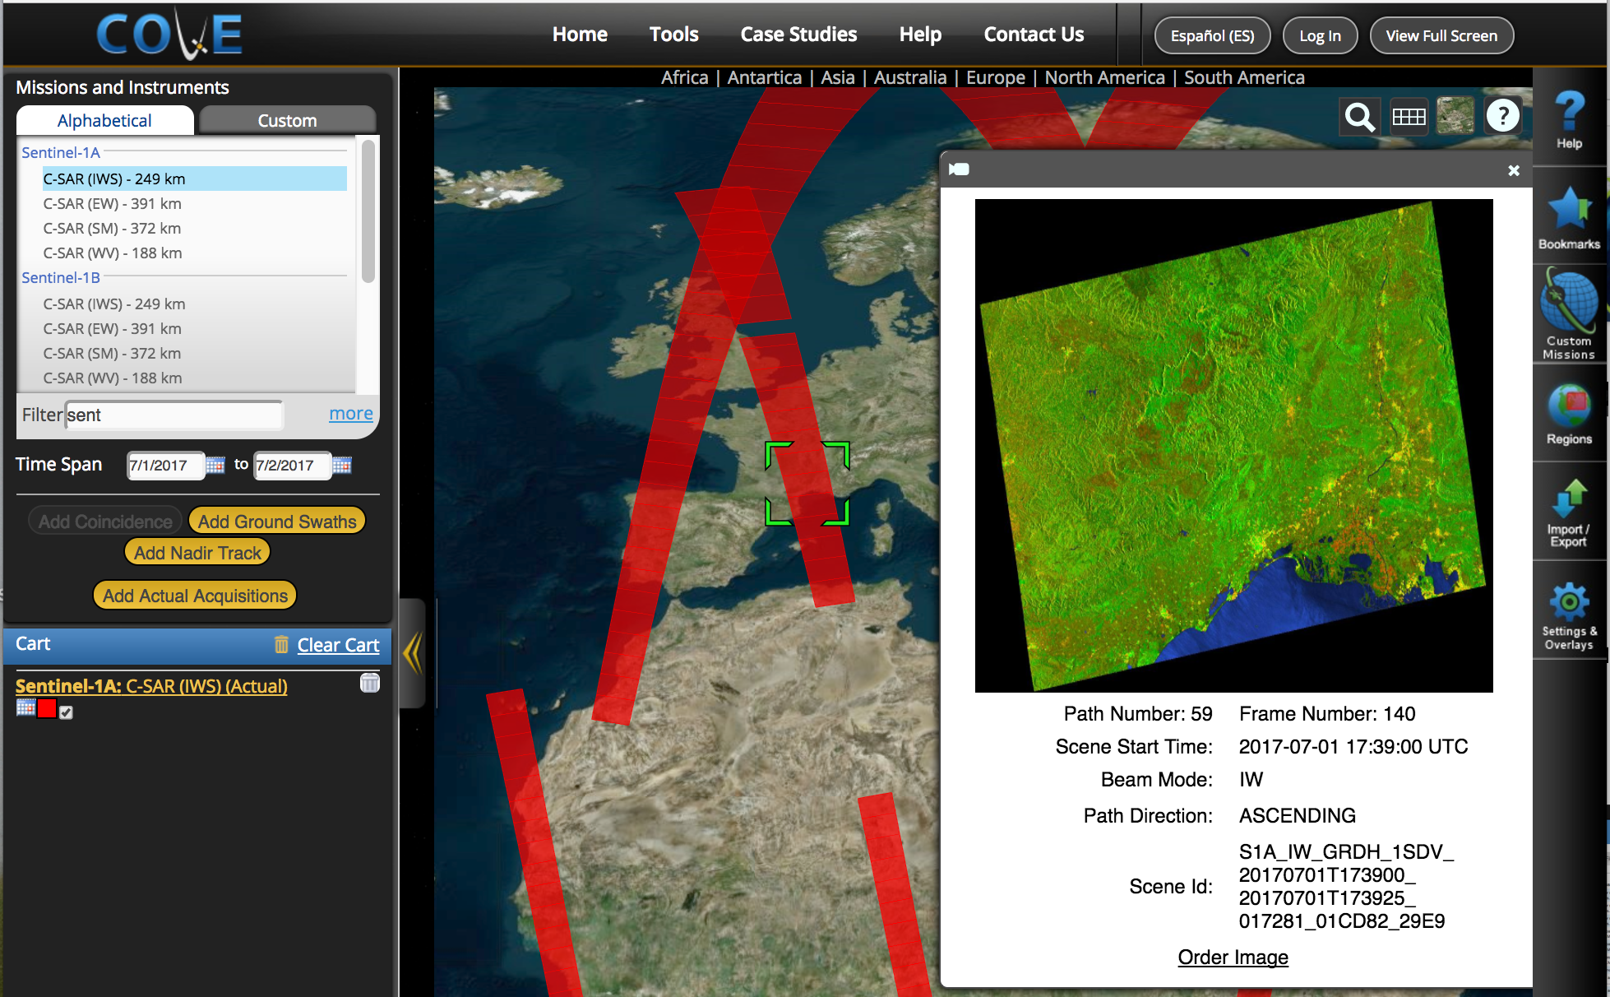
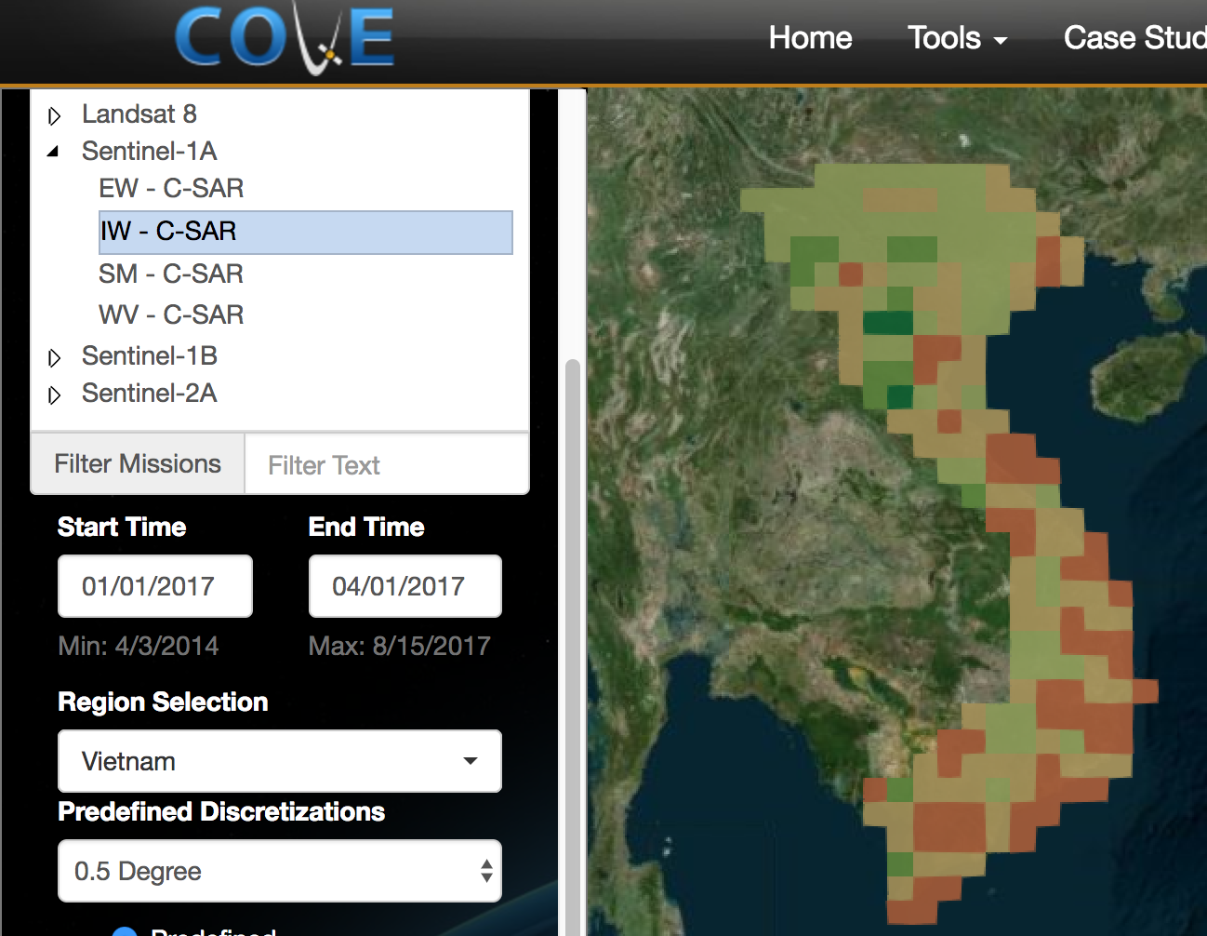
COVE Tool Updates
The CEOS Visualization Environment (COVE) is a browser-based suite of tools for searching, analyzing, and visualizing actual and potential satellite sensor coverage.
COVE is FREE and OPEN for anyone to use!
There is a large international user base with 4000+ users in 2017.
COVE includes 131 missions and is linked to several mission archives to get metadata and browse images for past acquired data: Landsat, SPOT, Pleaides, Radarsat-2, ALOS-1, TerraSAR-X, Sentinel-1, Sentinel-2, CBERS-4 and ResourceSAT-2.
Coverage Analyzer and Data Browser:
New tools for coverage assessments and scene data to support data ordering.
www.ceos-cove.org

Slide 3
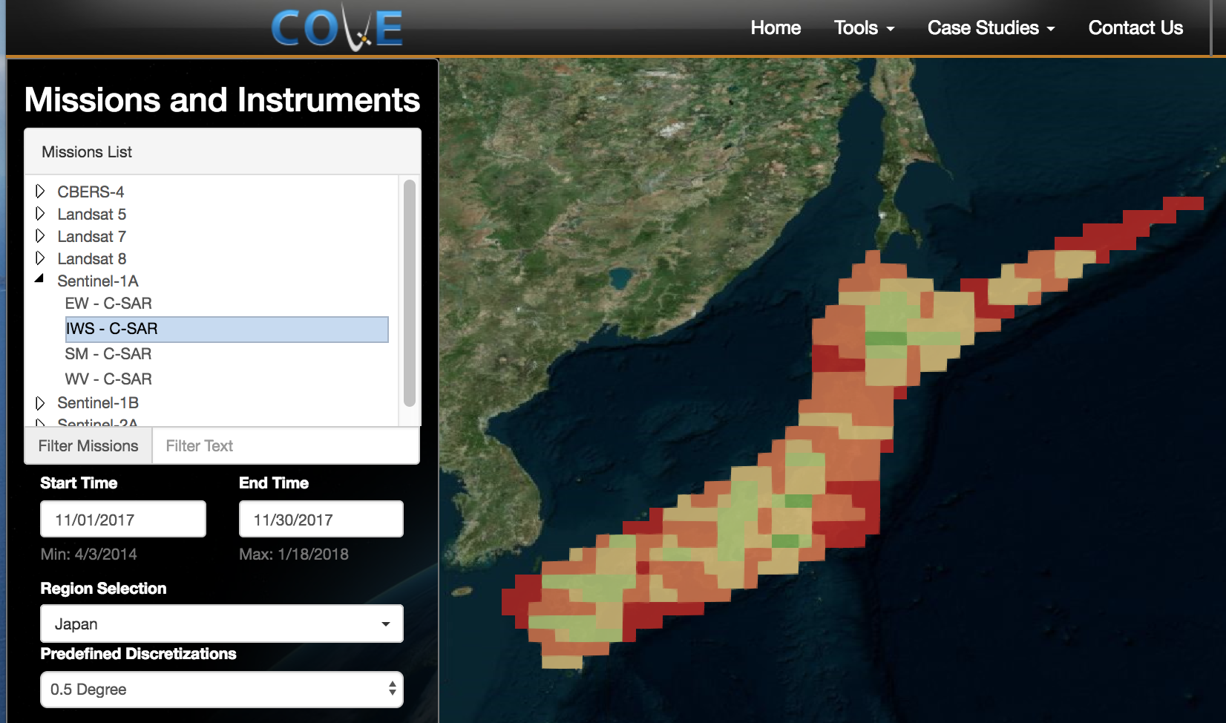
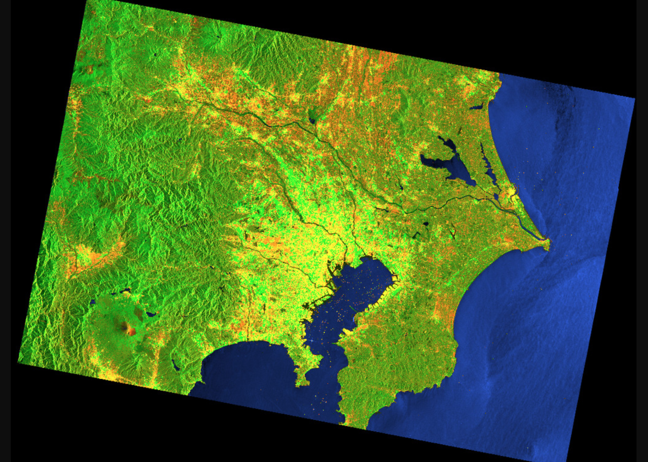
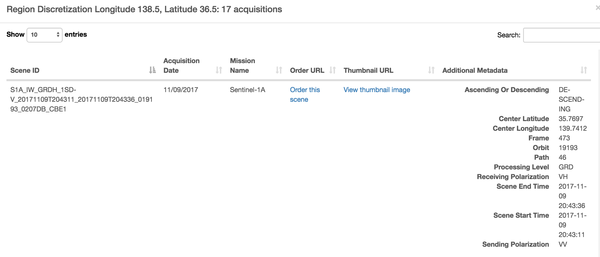
Coverage Analyzer
Support for CBERS-4, Landsat 5/7/8, Sentinel-1A/1B, and Sentinel-2A.
Output using discretizations for Landsat WRS, Sentinel-2 tiles, and various Lat-Lon degrees (0.10, 0.25, 0.5, 1.0).
Example Case:
Japan, Nov 2017
Sentinel-1A, IWS Mode
- Table Output with scene information
- View Browse image
- Link to ordering

Slide 4
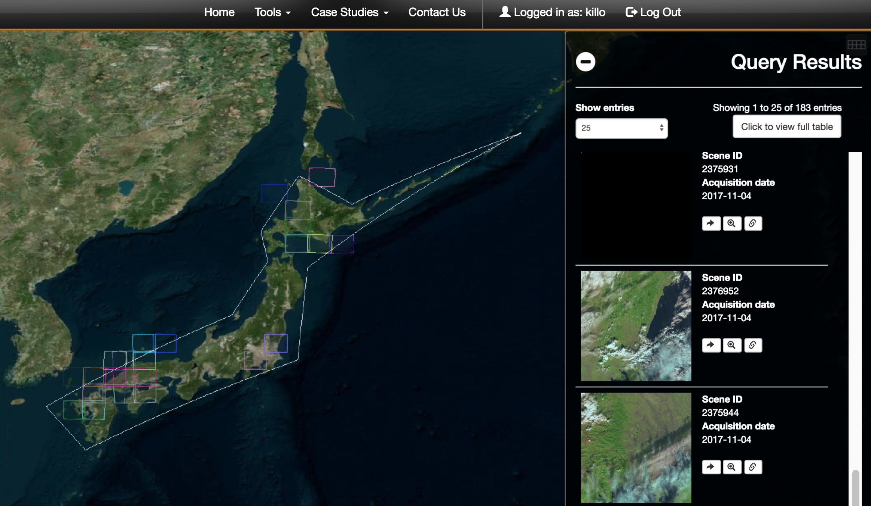
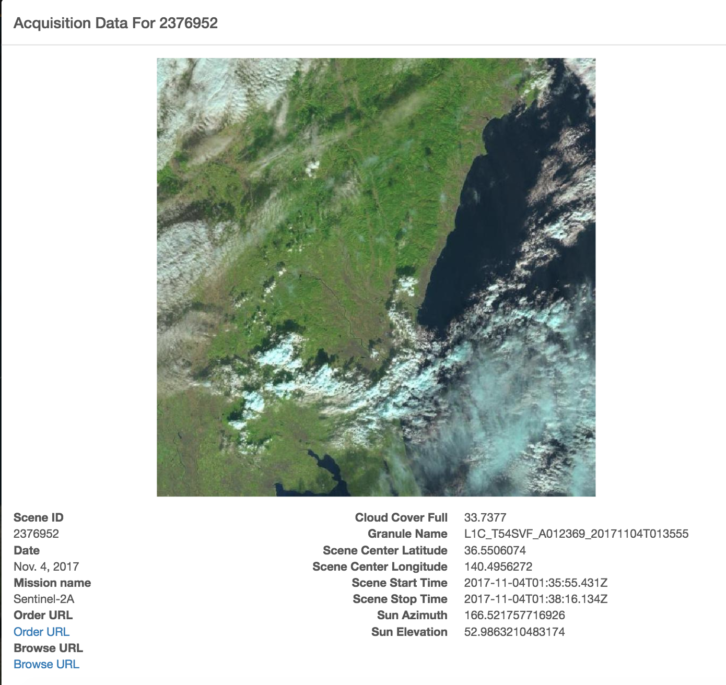
Data Browser
Support for CBERS-4, Landsat 5/7/8, Sentinel-1A/1B, and Sentinel-2A ... similar to Coverage Analyzer
Filtering for cloud cover threshold (optical missions)
Example Case:
Japan, Nov 2017
Sentinel-2A, <50% cloudy
- Table Output with scene information and browse images
- Links to view the acquisition details, zoom into footprint on the map, and order the scene

Slide 5
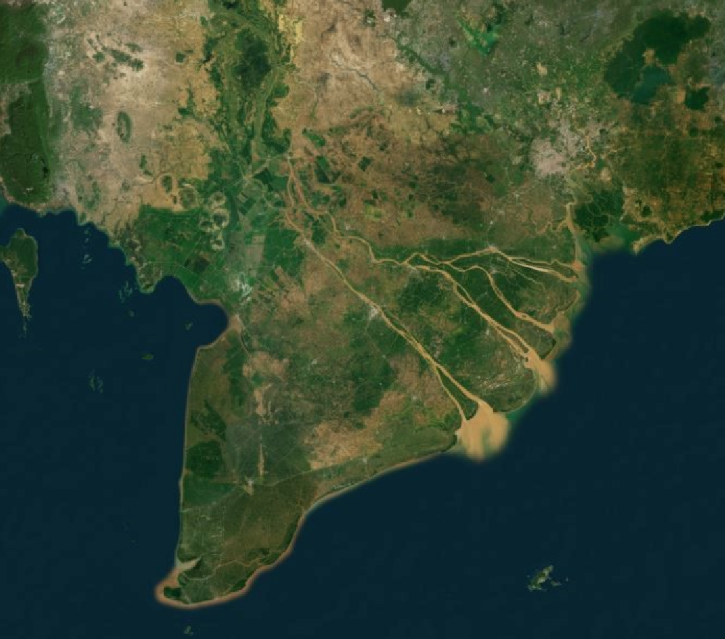
Vietnam Mekong Basin
A Data Interoperability Coverage Analysis Case
The Vietnam Mekong Basin is an area of high interest for water and rice crop applications.
Cloud-free satellite data is critical to developing relevant application products.

Slide 6
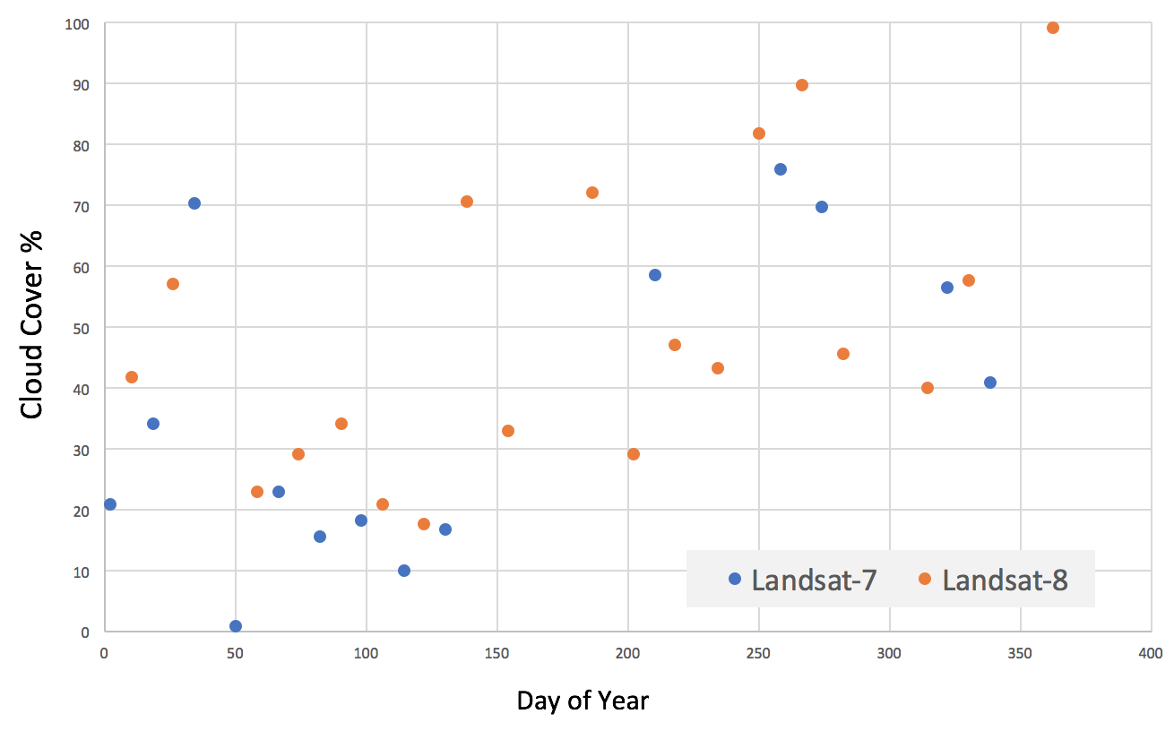
Landsat Coverage over the Vietnam Mekong Basin - 2016
Landsat-7 Gap = 80 days!

Slide 7
Landsat Coverage over the Vietnam Mekong Basin - 2016
Less Cloudy: Days 50-150
More Cloudy: Days 200-350

Slide 8
Landsat Summary
Year 2016 coverage over the Vietnam Mekong Basin (using COVE tool)
Southern Vietnam is cloudy and optical data is limited
The maximum views per year is ~22 per mission, or 44 total
The time gap between successive views can be large ... 16 to 208 days.

Slide 9
Multiple Missions
There is a great benefit to combining data from multiple missions, so data interoperatbility and validation testing is critical to achieving these benefits
Theoretical limit for any given year and mission combination
* There were 3 times per year when all 3 missions were coincident (Landsat/S1/S2)
NOTE: Unique + Coincident = Total possible visits per year

Slide 10
Other Considerations
What should we consider when trying to use data from multiple missions?
Many regions of the world are very cloudy, and optical data will be severely limited in those areas. In the Vietnam example, any one location can be viewed ~50% of the time (due to clouds), so optical data opportunities are cut in half!
Coincident views are EXCELLENT opportunities for interoperability and validation testing of multiple missions. There are more opportunities than you would think, but we still need to remember clouds are an issue.
Most of the multiple mission combinations yield viewing gaps of 0 to 5 days with an average of 2 to 3 days. Clouds can still be an issue, but if we learn how to use radar for more applications, the viewing frequency will improve.
CONCLUSION: Data Interoperability is very important!

Slide 11
Interoperability Example
There are basically 2 approaches for interoperable data use ... merge two datasets into one, or use them separately to produce the same application product. Each case requires the data to be spatially aligned and “analysis-ready”
16 day revisit
10 day revisit
8 day revisit
12 day revisit
Landsat 8
Sentinel 2A
Landsat 7/8
Sentinel- 1A
HLS M30
5 day revisit
Merge Data
Data
Cube
Align
Pixels
Data
Cube
Revisit
2 to 8 days
(average 4.8)
WOFS
Water Detection
WOFS
Water Detection
WASARD
Water Detection
Water Extent Product
Water Extent Product

