Slide 1
Potential European SR ARD
Committee on Earth Observation Satellites
Steven Hosford
LSI-VC-5
Agenda Item #??
February 2018

Slide 2
Context
Ramp-up of European contribution to FDA and CARD4L under COM’s “Data” priority (“b”)
Potential European Surface Reflectance ARD producers “Consultation/Information meeting” held on 23/01 + 26/01
Consultation/Information Meeting objectives:
Share information on the current version of the ARD specification
Identify potential ARD producers in Europe and discuss their plans for production of SR ARD products (S2 and other)
Slide set subsequently shared and validated by European partners

Slide 3
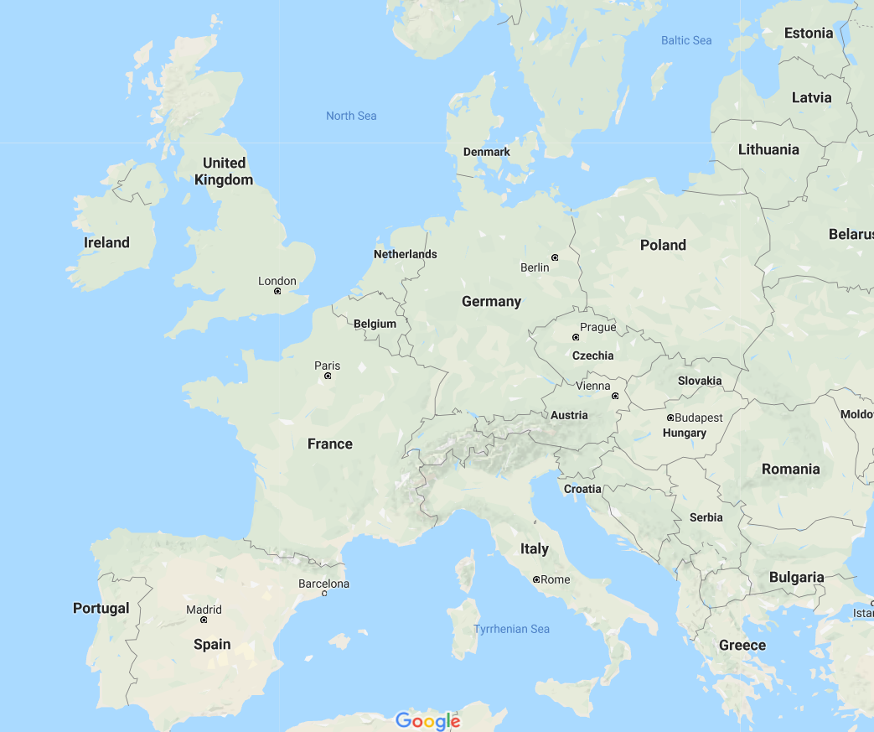
Potential European SR ARD producers
CNES. Olivier Hagolle
DLR. Tobias Storch and Stefan Auer
ESA. Ferran Gascon
UKSA/Catapult. Daniel Wicks and Gwawr Jones
VITO. Ruben Van De Kerchove

Slide 4
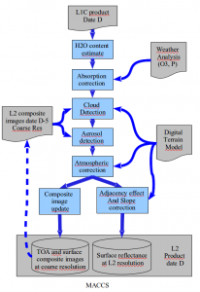
Status at CNES
Theia land data centre has been producing and distributing Surface Reflectance products since 2015
Characteristics:
Atmospheric corrections: MAJA
Geometric references: ESA L1C
Sentinel-2 products covering 7M km2 since Dec 2015
(see geographical extent on next slide)
Landsat SR products over France and overseas territories
Quasi real-time production for Sentinel-2
Possibility to extend geographical extent, but TBC
Matched to threshold PFS
ISSUE NON SPECIFIC TO CNES
Registration accuracy of 0.5 pixel (currently too ambitious for S2 @ 10m?)

Slide 5
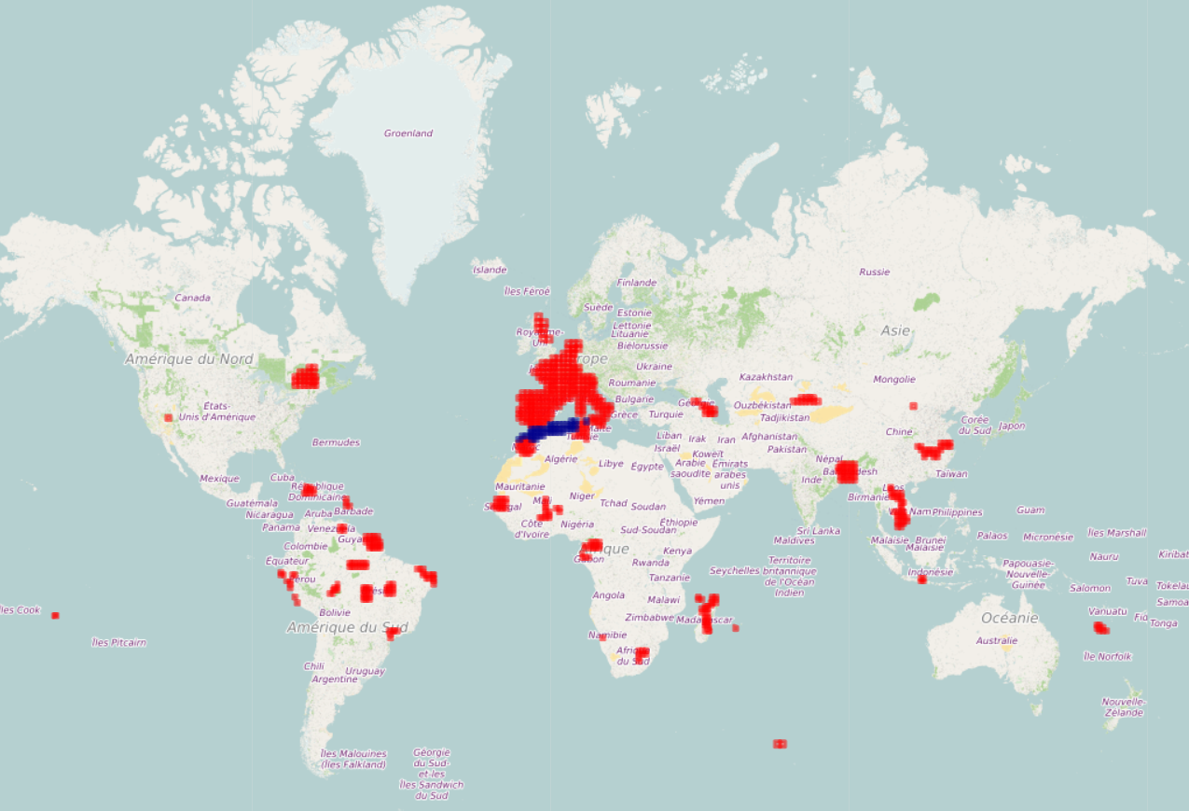
CNES S2 Surface Reflectance products
Currently being produced
Coming soon

Slide 6
Status at DLR – S2
S2 MAJA production
DLR has a implemented MAJA code on DLR processing environment.
The objective is to produce L2a over Germany
Production and distribution planned, but not yet operational
Hosting planned on CODE-DE (scheduled to become available in May)
Collectively with CNES western Europe will be covered with a MAJA L2a product
S2 Sen2Cor production
On-demand S2 Sen2Cor production possible on CODE-DE
www.code-de.org

Slide 7
Status at DLR - EnMAP
EnMAP (hyperspectral mission to be launched late 2020)
Mission operating on “Principal Investigator” approach
Definition of Enmap ground segment underway
Interest in aligning with CARD4L product specifications
Different atmospheric correction over land and water: Land ATCOR, Water EOMap code
Mostly within PFS threshold for EnMAP
Comments on PFS:
Possibility of hyperspectral not mentioned
Not compatible with 2.3 – Incomplete testing
PFS target distinguishes between cloud and terrain shadow (not done in EnMAP Ground segment)

Slide 8
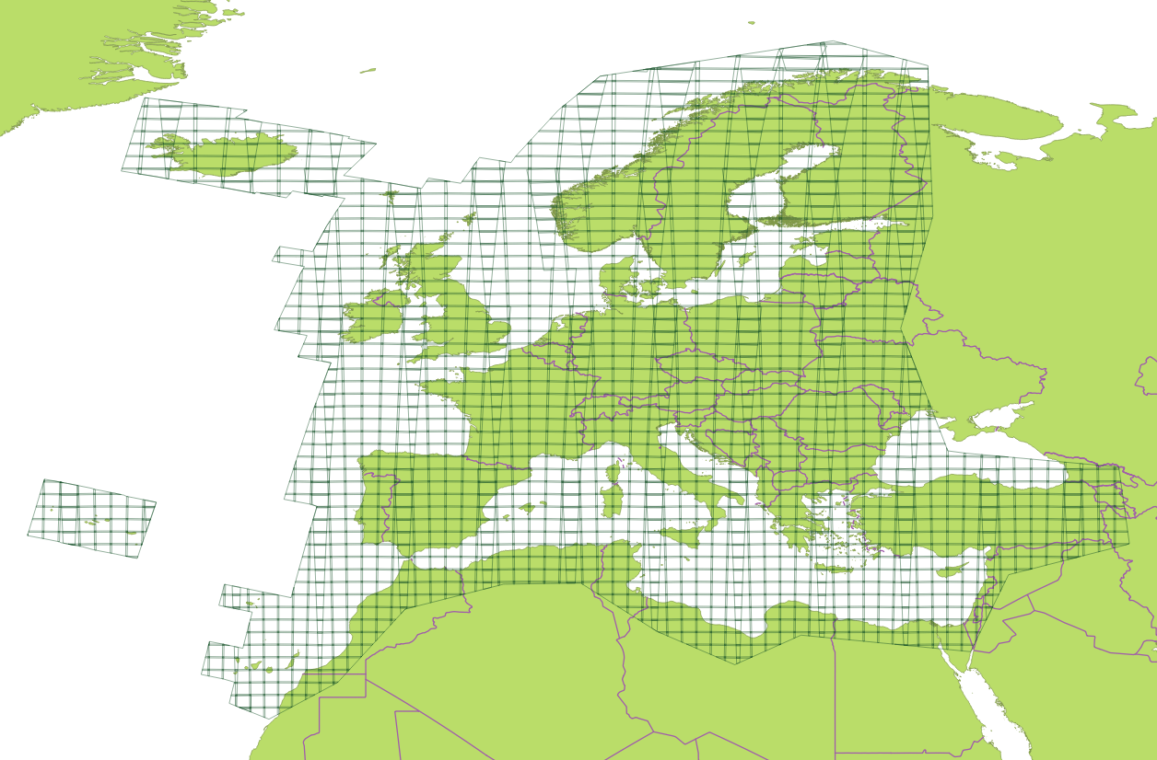
Status at ESA - L2A Production
L2A Operational Production
Phase-A (from March 2018): systematic generation of L2A over Europe.
Phase-B (from July 2018): systematic global generation of L2A;
Phase-C (up to mid-2019): on-demand L2A processing from L1C archive.
L2A Pilot Production
Systematic production over EEA areas started since May 2017.
Sentinel-2B Level-2A production started January 2018.

Slide 9
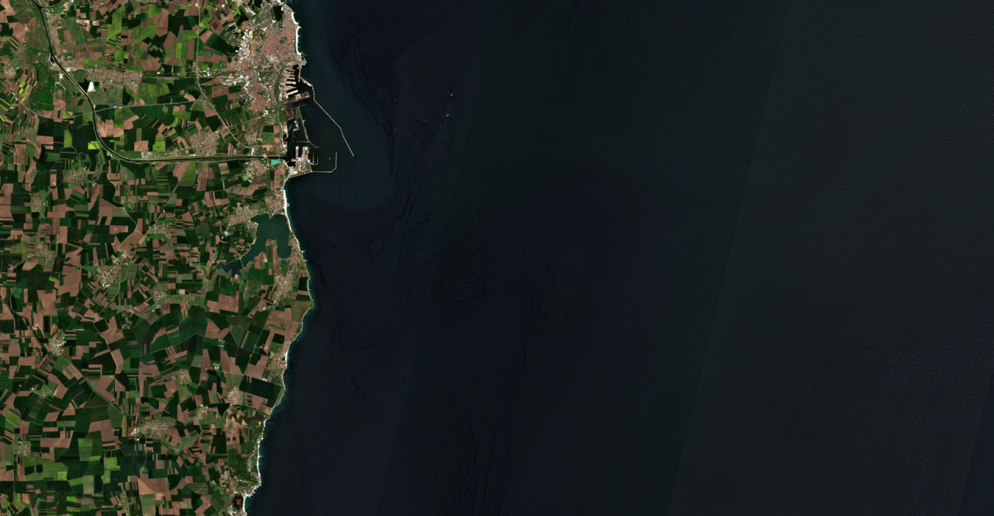
Status at ESA ESA - New Sen2Cor 2.5
New version of Sen2Cor released (v2.5) supporting Sentinel-2B
Several Bugs fixed.
Full compatibility to PSD 14.3
Backward PSD compatibility assured.
Improvement of Ozone selection.
Improvement of AOT retrieval
Improvement of Cloud Screening and Scene Classification over coastal/inland/muddy waters, urban areas/bright surfaces.

Slide 10
Status in UK
Systematic generation of S2 Surface Reflectance products for the UK explored in a project led by Satellite Applications Catapult (Defra and UKSA funded)
Characteristics
Atmospheric and geometric correction carried out with ARCSI building on Landsat ARD production for Wales.
Systematic processing of all UK S2 coverage up until June 2017 (available through UK collaborative ground segment - https://geobrowser.satapps.org/).
UK S2 L2a products currently available as an open dataset through JNCC.
Some other ad-hoc and project-related areas have been processed (Malaysia, UK Overseas territories, select small island Pacific nations) – Systematic processing will continue to be carried out in these geographies for data including S1, S2, L8 & SPOT.
Interest in participating in algorithm inter-comparison exercises (e.g. ACIX).
Planned validation activities as a collaboration between National Physical Laboratory, Satellite Applications Catapult & JNCC.
Coastal tailored ARD product being developed and tested by Plymouth Marine Laboratory, focused on Plymouth and Baltic regions.
Significant work on S1 ARD being conducted by both Catapult & JNCC.

Slide 11
Status in UK – Defra EO Alpha Project
Objective is to create a working facility to centrally produce, to an agreed standard, ARD for Sentinel 1 and Sentinel 2 data
Prototype only – systematic production of ARD is future aim
Processing chain for S2 ARD same as established in SA Catapult led project (using ARCSI), and S2 ARD produced dataset will be moved to facility.
Data accessible for use in GI desktop tools as well as via API, for public sector organisations across the UK.
Data accessible to the academic community via NCEO and STFC’s CEDA.
Also aims to provide a working space with access to algorithms (R, python, SNAP etc.) for methods development and projects in the cloud next to the data.

Slide 12
Status at VITO
Several S2 derived products available covering Belgium in Terrascope
Systematic production of L2a
Sen2Cor for masking
ICOR for water and land atmospheric correction
Specific geometric correction
Several L3 (or L2b) products
fPAR, LAI, Canopy chlorophyll content and canopy water content, fCover
Some ad-hoc areas covered also. Data can be found at:
www.terrascope.be
Data is hosted on a Mission Exploitation Platform environment enabling access to processing algorithms (Python, R, SNAP) linked to a scalable Hadoop Spark cluster.
Data access through VMs or Jupyter notebooks
Plans to enlarge processed area to cover Europe and Africa (TBC).

Slide 13
Status at VITO
Several S2 derived products available covering Belgium in Terrascope (contd)
Water products systematically produced for several sites over Europe (both coastal and inland)
Acolite or iCor for atmospheric correction
Landsat data used to generate water products also, but these are not available through terrascope

Slide 14
Status at VITO
Sensor | Product | Processing chain | Current production . | Anticipated production/improvements
Proba-V | S1 TOC (100, 300, 1km); S5 TOC (100m); S10 TOC (300m; 1km) + NDVI | Proba-V | Collection 1; global coverage (56°S - 83°N, daily systematic production www.vito_eodata.be | Collection 2 expected 2019-2020: improved atcor, improved cloudmask, brdf corrected
Sentinel-2 | L2A (TOC), FAPAR, FCOVER, NDVI, LAI, (CCC, CWC) | Terrascope: Sen2cor + iCOR + Biopar | Belgium (systematic) + various other tiles (ad-hoc): www.terrascope.be + https://proba-v-mep.esa.int/sentinel-web-services | Europe + Africa systematic/on-demand (TBD) + DCS4COP sites
 | RRs, AOT, SPM, T, Chl, Kd | Highroc/DSC4COP: Idepix + Acolite/iCOR + water products | 15+ coastal and inland water sites in Europe http://www.highroc.eu/ | iCor improvements, new products (biopars, water, synthesis, depends on user)
Landsat | RRs, AOT, SPM, T, Chl, Kd | Highroc/DSC4COP: Idepix + Acolite/iCOR + water products | 15+ coastal and inland water sites in Europe | TBD

