Slide 1
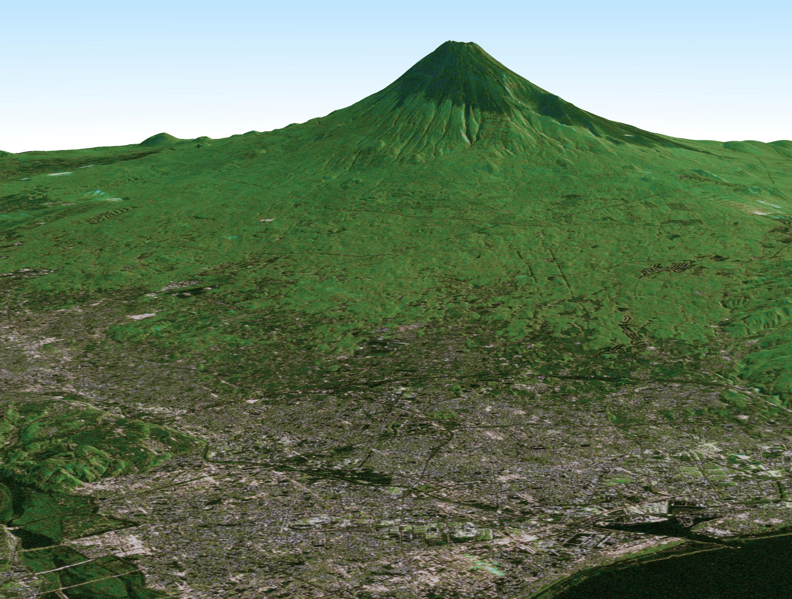
CEOS LSI-VC-5, Tokyo Japan
JAXA Updates on LSI-VC
21-23 February, 2018
Takeo Tadono
Earth Observation Research Center (EORC)
Japan Aerospace Exploration Agency (JAXA)

Slide 2
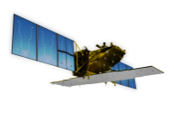
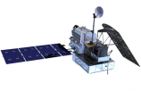
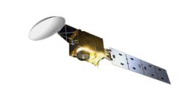
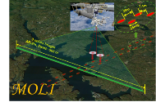
JAXA Satellite Lineup
As of Sep 2017
Targets (JFY) |  | 2014 | 2015 | 2016 | 2017 | 2018 | 2019 | 2020 | 2021 | 2022 | 2023 | 2024
Disasters & Resources
Climate Change & Water Cycle Water Cycle
Climate Change
GHGs
Technology Demonstration
Communications
[Land and disaster monitoring]
ALOS-2 / PALSAR-2
Advanced SAR (ALOS-4)
Advanced Optical (ALOS-3)
[1997〜2015]
TRMM / PR
[Precipitation 3D structure]
GPM / DPR
[2012〜]
[Wind, SST , water vapor, precipitation,]
GCOM-W / AMSR2
AMSR2’s successor sensor
[Vegetation, aerosol, cloud, SST, ocean color]
GCOM-C / SGLI
[Cloud and aerosol 3D structure]
EarthCARE / CPR
[2009〜]
[CO_{2,} CH₄]
[CO_{2,} CH₄, CO]
GOSAT /FTS, CAI
GOSAT-2
GOSAT-3
SLATS
(Super Low Attitude Test Satellite)
MOLI
(Vegetation LiDAR onboard ISS)
[2008〜]
(Wideband InterNetworking engineering test
and Demonstration Satellite)
WINDS
ETS-9 (Engineering Test Satellite No.9)
Japanese Data Relay System (JDRS)
Mission status:
On orbit
Extended Life Period
Development
Study

Slide 3
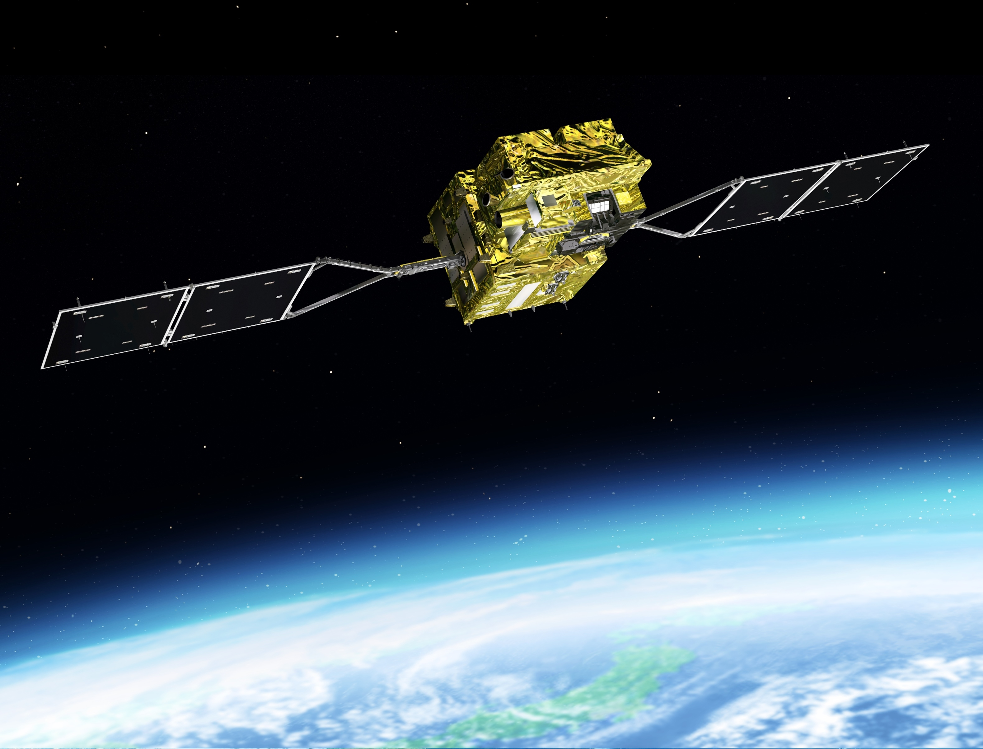
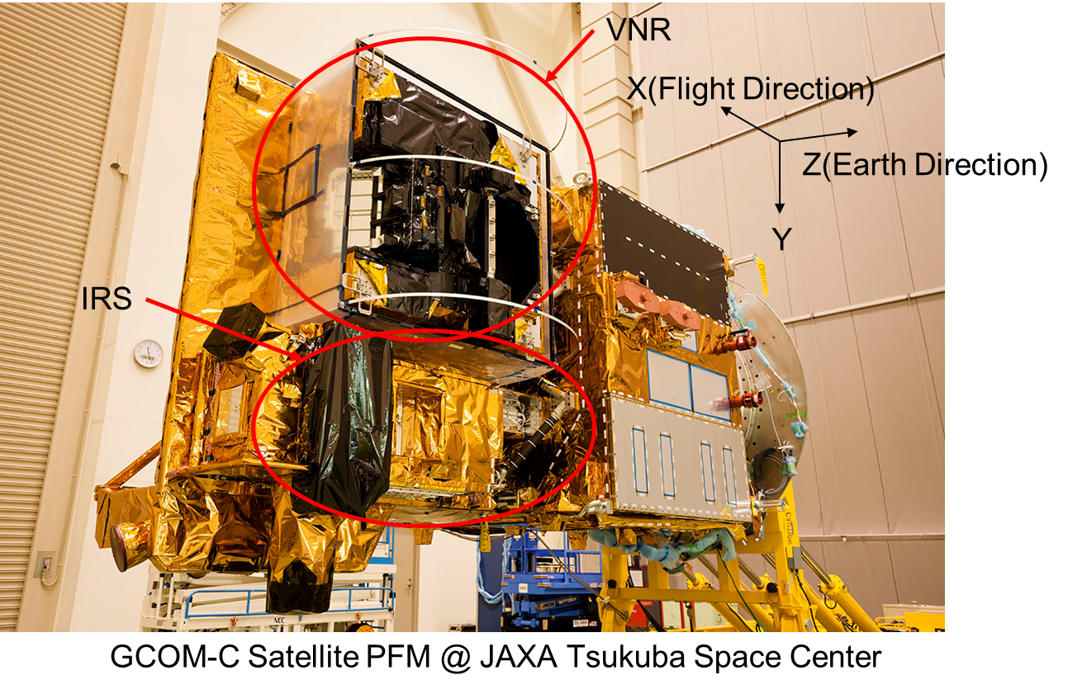
Global Change Observation Mission-Climate (GCOM-C)
shortwave & thermal InfraRed (T) Scanner (IRS)
Polarization (along-track slant) radiometer (P)
Visible & Near infrared push-broom Radiometer (VNR)
GCOM-C SGLI characteristics
Orbit | Sun-synchronous (descending local time: 10:30), Altitude: 798km, Inclination: 98.6deg
Launch Date | Dec. 23, 2017
Mission Life | 5 years
Scan | Push-broom electric scan (VNR: VN & P) Wisk-broom mechanical scan (IRS: SW & T)
Scan width | 1150km cross track (VNR: VN & P) 1400km cross track (IRS: SW & T)
Spatial resolution | 250m (land and coastal areas), 500m, 1km
Polarization | 3 polarization angles for POL
Along track tilt | Nadir for VN, SW and TIR, & +/-45 deg for P

Slide 4
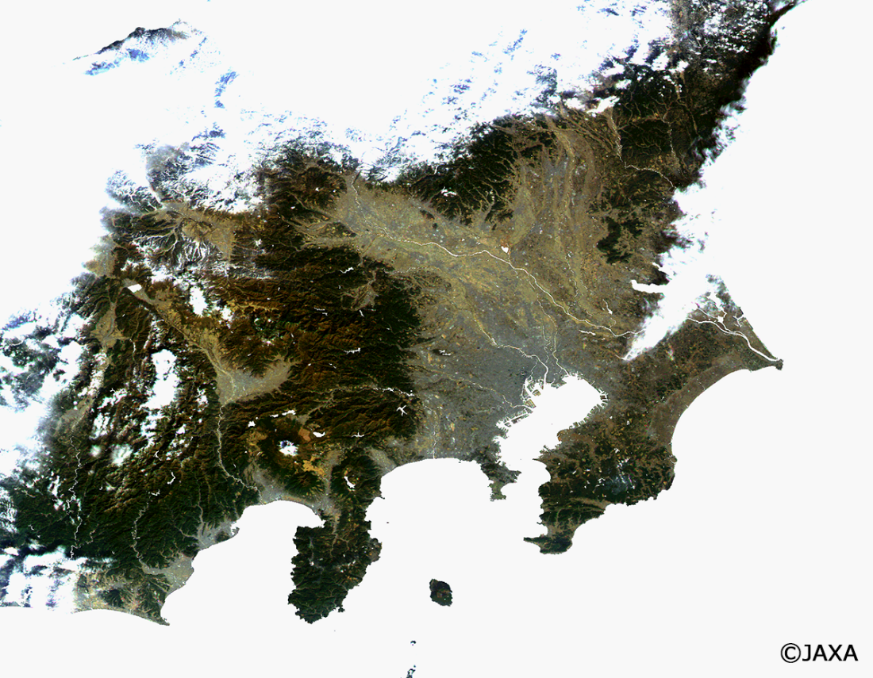
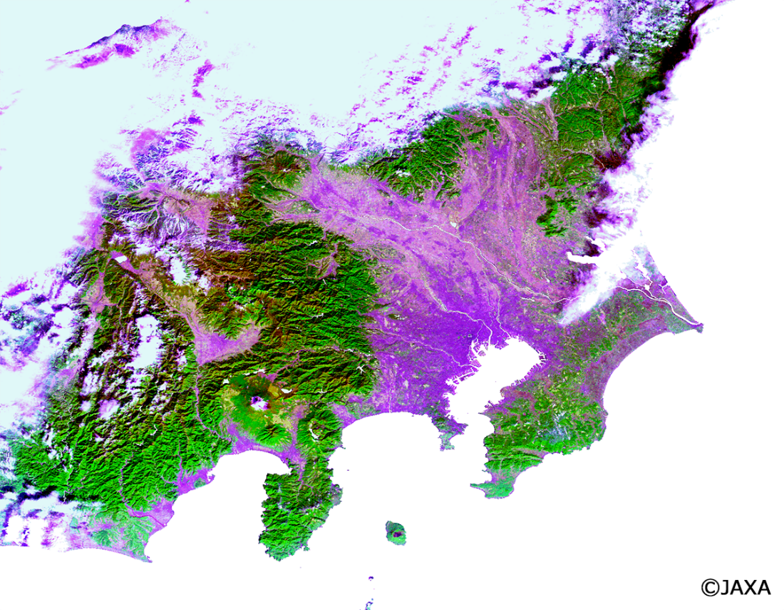
Global Change Observation Mission-Climate (GCOM-C)
図は、気候変動観測衛星「しきさい」搭載のSGLIが2018年1月6日午前10時30分頃（日本時間）に関東上空で取得した250m分解能の観測画像で、左に人間の肉眼での見た目に近い色で合成したトゥルーカラー画像*、右に近赤外域の波長を使用して合成したナチュラルカラー画像**です。静岡県や関東山地東側に広がる常緑針葉樹はトゥルーカラーでは暗く写り落葉性樹木との区別がはっきりしませんが、植生に感度が高い近赤外域を用いるナチュラルカラーでは鮮やかな緑色で表されています。一方、房総半島等に点在するゴルフ場は、芝生が色褪せる時期のため、緑色ではなく薄黄色の斑点状に見えています。
*：赤，緑，青にSGLIのVN8, VN5, VN3の各チャンネル反射率を割り当てたRGB合成画像
**：赤，緑，青にSGLIのVN8, VN11, VN3の各チャンネル反射率を割り当てたRGB合成画像

Slide 5
Open & Free Plan on JAXA’s EO Satellite Data
Satellite / Sensor |  | In the past | In near future
MOS, JERS-1, ADEOS, ADEOS-2, AMSR-E, TRMM |  | ○ | ○
GOSAT |  | ○ | ○
GCOM-W, GCOM-C |  | ○ | ○
GPM |  | ○ | ○
ALOS (2006-2011) | AVNIR-2 ORI (10m) | ー | ○
 | PALSAR (10m) | ー | ○
 | PRISM DSM (30m) | ○ | ○
 | Forest/Non-Forest Map (25m) | ○ | ○
ALOS-2 (2014-) | ScanSAR (100m) | ー | ○
 | Stripmap (10m) | ー | ー

Slide 6
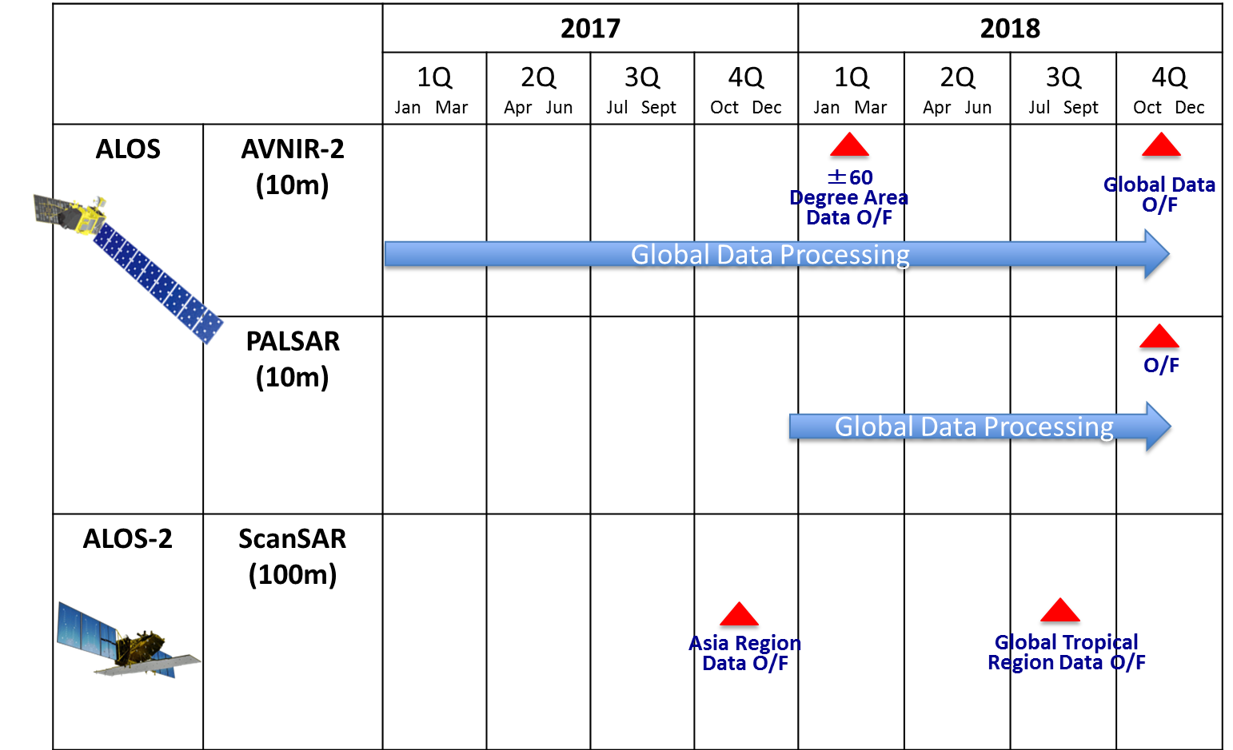
Open & Free Plan on ALOS Series Data
Start from Japan

Slide 7
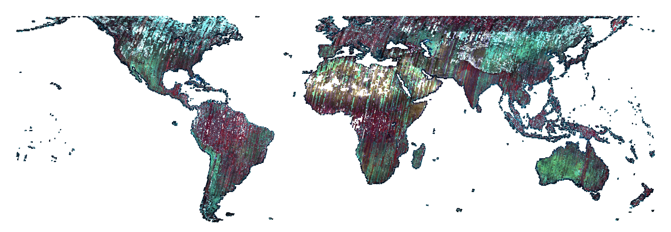
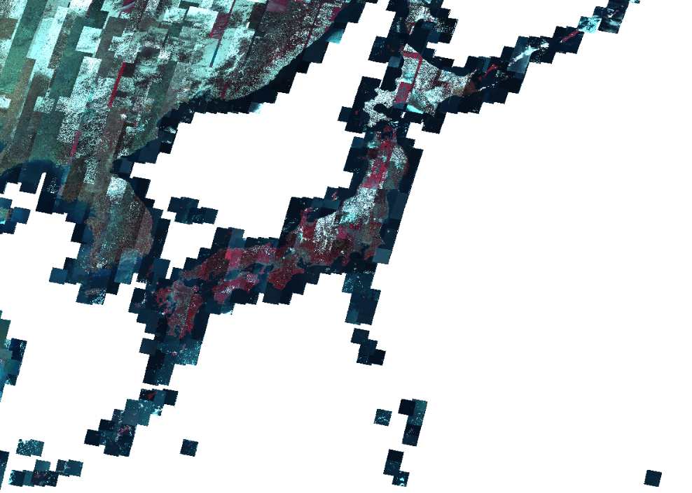
ALOS AVNIR-2 ORI Dataset
AVNIR-2 Ortho Rectified Image (ORI)
- Automatic processing using PRISM DSM and ORI.
- Areas within 60 deg. latitude had priority.
- Global areas will be done in 2018.
- < 30 % clouds / scene is processed.
- Scene-based product in total 0.8 mil. scenes.
- Acquired date: 2006 to 2011.
This will be complemented Landsat-7.
- These does not apply atmospheric correction.
Any suggestions?

Slide 8
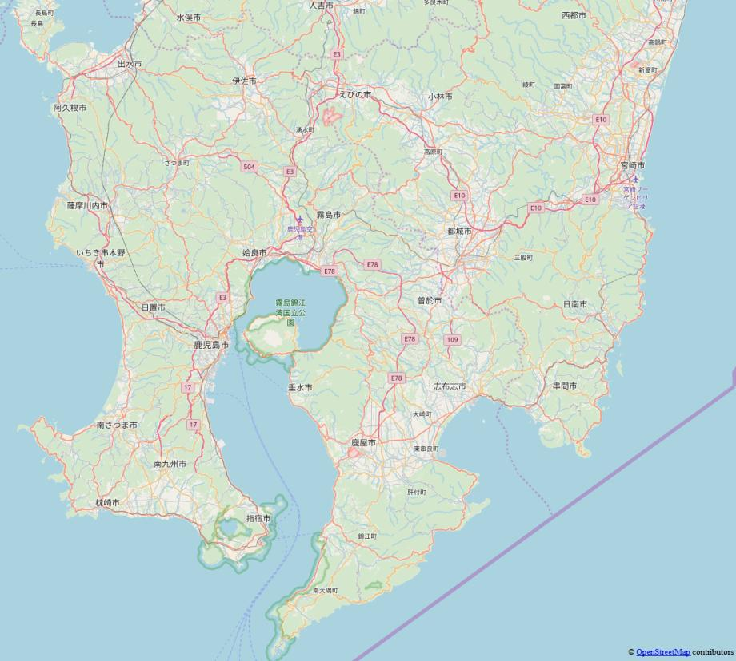
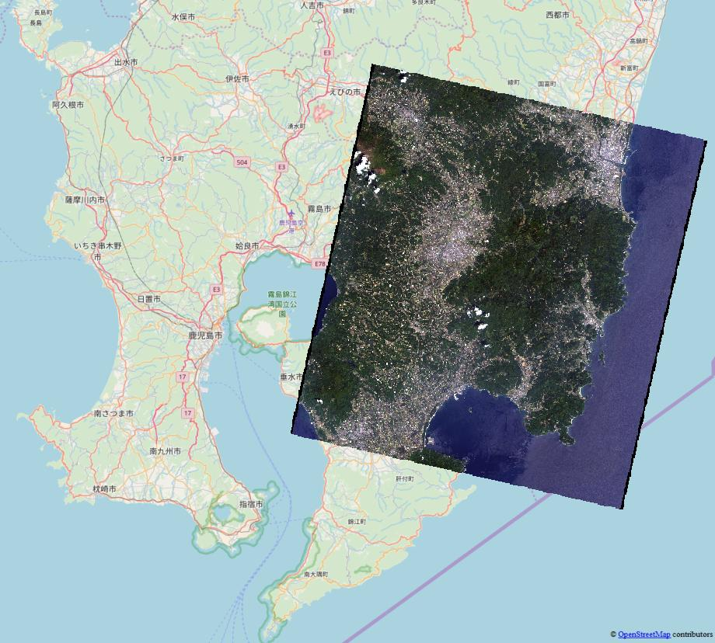
ALOS AVNIR-2 ORI Dataset
Example of utilization
ALOS/AVNIR-2
- 2009/04/29
- 2010/11/02

Slide 9
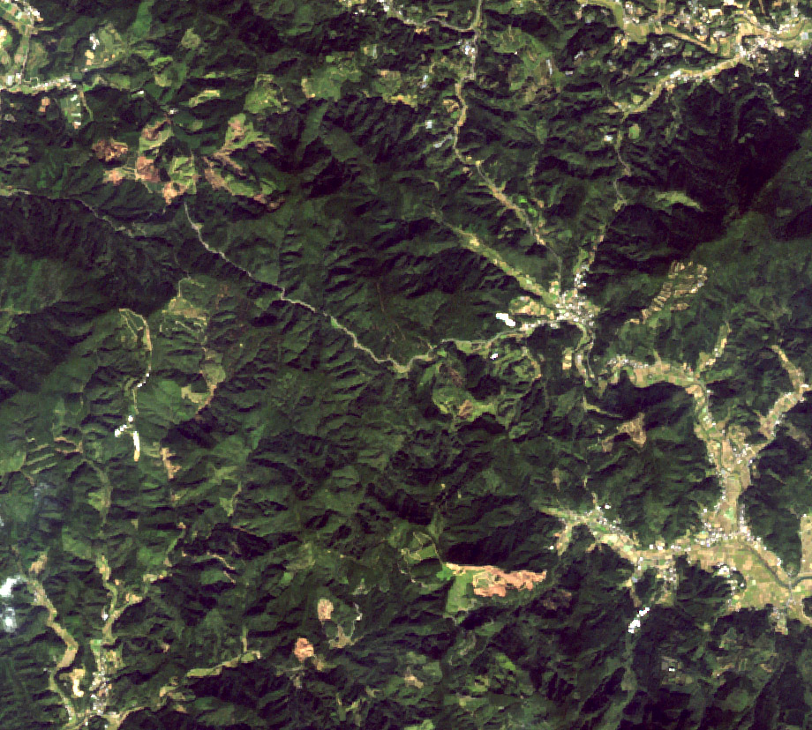
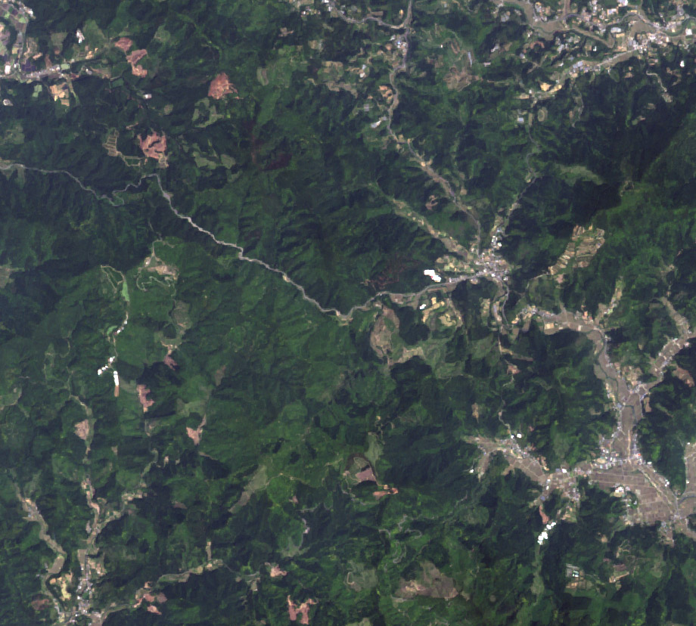
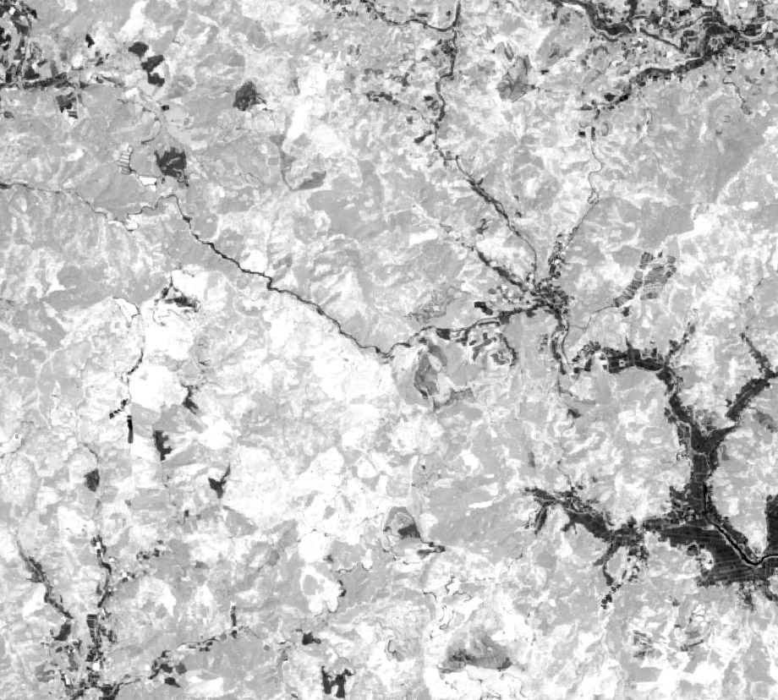
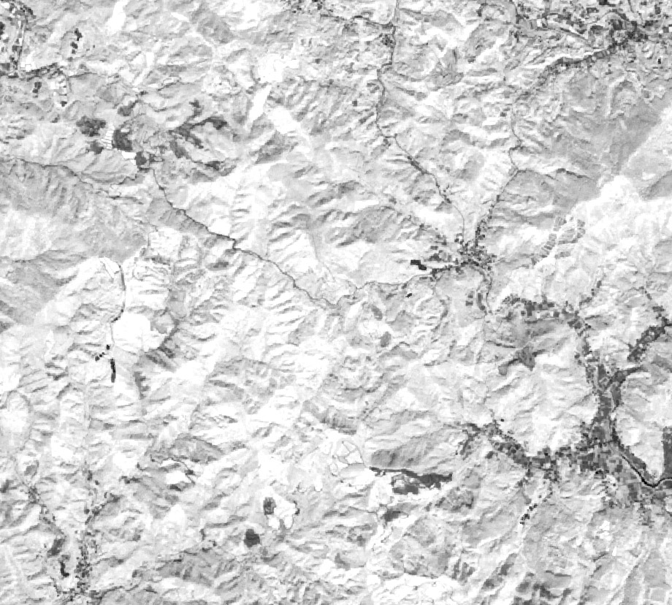
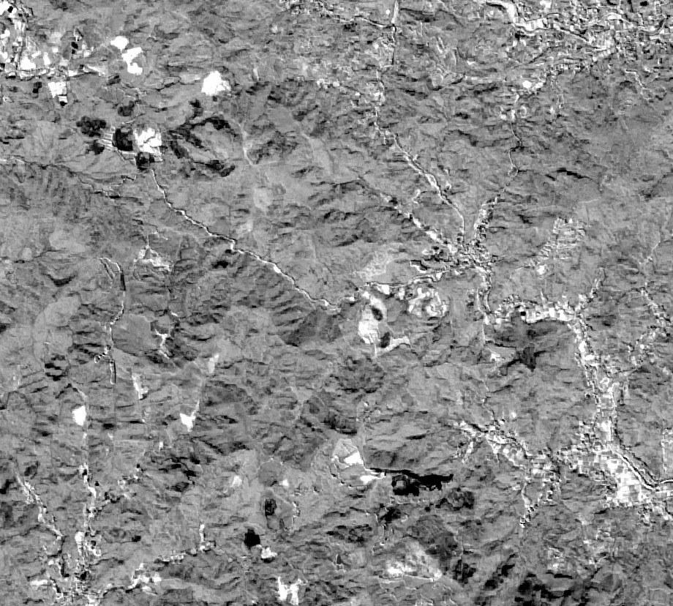
ALOS AVNIR-2 ORI Dataset
2010年観測画像
2009年観測画像
2009年植生指標画像
2010年植生指標画像
植生指標変化画像
2009年観測画像
AVINIR-2画像の変化
森林伐採の検出

Slide 10
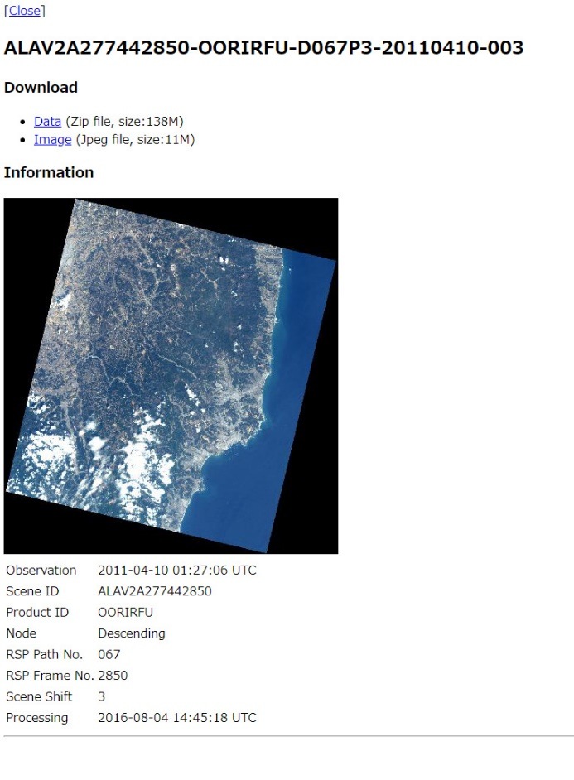
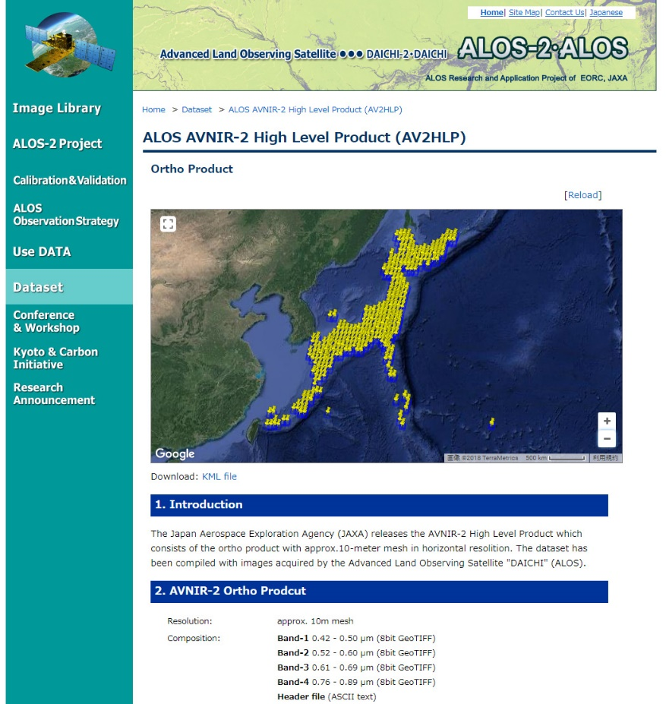
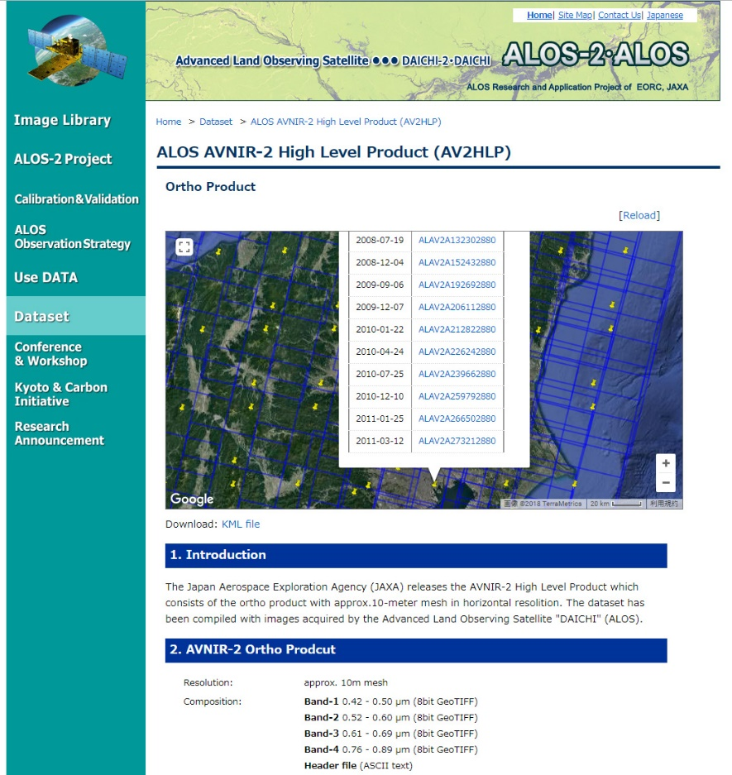
ALOS AVNIR-2 ORI Dataset
Download site on JAXA EORC web (Under developing)

Slide 11
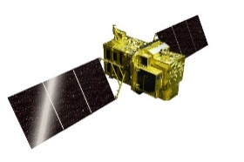
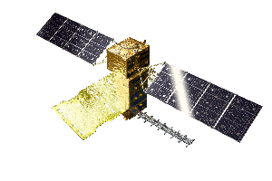
ALOS F/O Missions
Continuous observations successor “Daichi” (ALOS) from 2006 to 2011
Contribute to ensure the safety and security of citizens, i.e. disasters monitoring and management, land deformation monitoring, national developing management, foods and natural resources, environmental issues in global etc. as common issues.
Contribute to industrial development based on Earth observation data i.e. National Spatial Data infrastructure (NSDI) and new applications.
JFY2014 | 2015 | 2016 | 2017 | 2018 | 2019 | 2020 | 2021
May 24
ALOS-2 (L-SAR)
Launch
Initial C/O
Initial Cal-Val
Product release
Mission operation (5 years)
Post-mission operation
ALOS-3
(Optical)
Development
Mission operation (7 years)
ALOS-4
(L-SAR)
Development

Slide 12
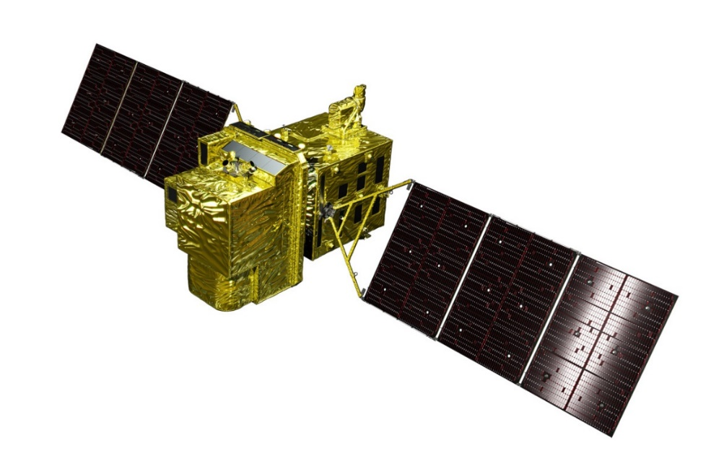
ALOS-3 Overview
Items |  | Specifications
Orbit | Type | Sun-synchronous sub-recurrent
 | Altitude | 669 km at the equator
 | Local Sun Time | 10:30 am +/- 15 minutes at the descending node
 | Revisit | 35 days (Sub-cycle 3 days)
Instruments |  | - Wide-swath and high-resolution optical imager (WISH, as a tentative) - Dual-frequencies Infrared sensor (hosted payload)
Ground Sampling Distance (GSD) |  | - Panchromatic band of WISH (Pa): 0.8 m - Multispectral band of WISH (Mu): 3.2 m (6 bands)
Quantization |  | 11 bit / pixel
Swath width |  | 70 km at nadir
Mission data rate |  | Approx. 4 Gbps (after onboard data compression: 1/4 (Pa) and 1/3 (Mu))
Mission data downlink |  | - Direct Transmission: Ka and X-band - via. the Optical Data Relay Satellite
Mass |  | Approx. 3 tons at launch
Size |  | 5 m×16 m×3.5 m on orbit
Duty |  | 10 mins / recurrent
Design life time |  | Over 7 years
Wide-swath and high-resolution optical imager (WISH)
In-orbit configuration

Slide 13
Wide-Swath and High-Resolution Optical Imager
Observation channel band allocations among optical satellites (visible to near-infrared).
Wavelength | 400 nm |  |  |  |  |  |  |  |  |  | 500 nm |  |  |  |  |  |  |  |  |  | 600 nm |  |  |  |  |  |  |  |  |  | 700 nm |  |  |  |  |  |  |  |  |  | 800 nm |  |  |  |  |  |  |  |  |  | 900 nm
 | 0 | 1 | 2 | 3 | 4 | 5 | 6 | 7 | 8 | 9 | 0 | 1 | 2 | 3 | 4 | 5 | 6 | 7 | 8 | 9 | 0 | 1 | 2 | 3 | 4 | 5 | 6 | 7 | 8 | 9 | 0 | 1 | 2 | 3 | 4 | 5 | 6 | 7 | 8 | 9 | 0 | 1 | 2 | 3 | 4 | 5 | 6 | 7 | 8 | 9 | 0 | 1 | 2 | 3 | 4 | 5 | 6 | 7 | 8 | 9
Advanced Optical Satellite
Blue
Green
Red
Near-IR
Coastal
RedEdge
ALOS PRISM AVNIR-2
Blue
Green
Red
Near-IR
WorldView -2, 3
Blue
Green
Red
Near-IR1
Coastal
Yellow
RedEdge
Near-IR2

Slide 14
ALOS-4 Overview
Y
Launch | JFY 2020 by H-3 launch vehicle as planned
Orbit | Same orbit as ALOS-2 Sun-synchronous sub-recurrent orbit Altitude: 628 km Inclination angle: 97.9 degree Local sun time at descending: 12:00 ± 15 min. Revisit time: 14 day (15-3/14 rev/day)
Lifetime | 7 years
Satellite Mass | Approx. 3 tons
Downlink | 3.6 Gbps/1.8 Gbps (Ka-band)
Mission Instruments | PALSAR-3 (Phased Array type L-band Synthetic Aperture Radar-3) SPAISE3 (SPace based AIS Experiment 3)
Prime contractor | Mitsubishi Electric Corporation
X
Z
Solar array paddle
PALSAR-3
antenna
Ka-band DT antenna
SPAISE3
antenna

Slide 15
Characteristics of PALSAR-3 onboard ALOS-4
Expanding swath width without decreasing the resolution and image quality of PALSAR-2 by using the Digital Beam Forming (DBF).
To guarantee the continuity of ALOS-2 applications, PALSAR-3 would inherit the major function and performance (NESZ, S/A, etc.) of PALSAR-2
 | ALOS-4 | ALOS-2
Stripmap (res. 3/6/10 m) | 100-200 km | 30-70 km
ScanSAR (res. 25m*) | 700 km | 350-490 km
Spotlight (res. 1 x 3 m) | 35km×35km | 25km×25km
Input: 6 ch. in range
Output: max. 4 beams
*single look
Swath width 100-200 km

Slide 16
Summary
ALOS-2 and GCOM-C operations are very well.
JAXA’s ARD production and release status reported:
ALOS AVNIR-2 ORI are partially ready to release, and will be in JFY 2018 for globally.
ALOS-2 PALSAR-2 ARD (mosaic) in 2017 will release soon
ALOS-3 and ALOS-4 are developing as schedule, and will be launched in JFY 2020.
ALOS-3 has capabilities high-resolution (0.8 m in pan.), wide-swath (70 km) and body-pointing within 60 deg.
ALOS-4 will be taken with the same orbit as ALOS-2, and approx. four times bigger swath that enable four times frequent observation as well as InSAR analysis.

